Slide 1

KPC GROUP
Integrated Healthcare &
Education Ecosystem
Four transformative projects for West Bengal
Amader Bari
Oncology
Multispeciality
KPC University
Senior living
Hospital
Hospital
Science & research
WHY THIS, WHY NOW — West Bengal faces stacked gaps; this ecosystem closes them without State capex
~1.22 L
High
300m+
₹0
new cancer cases / yr
cardiac & trauma mortality
Indians 60+ by 2050
State capital asked
Submitted for the kind consideration of the Government of West Bengal · 2026

Slide 2
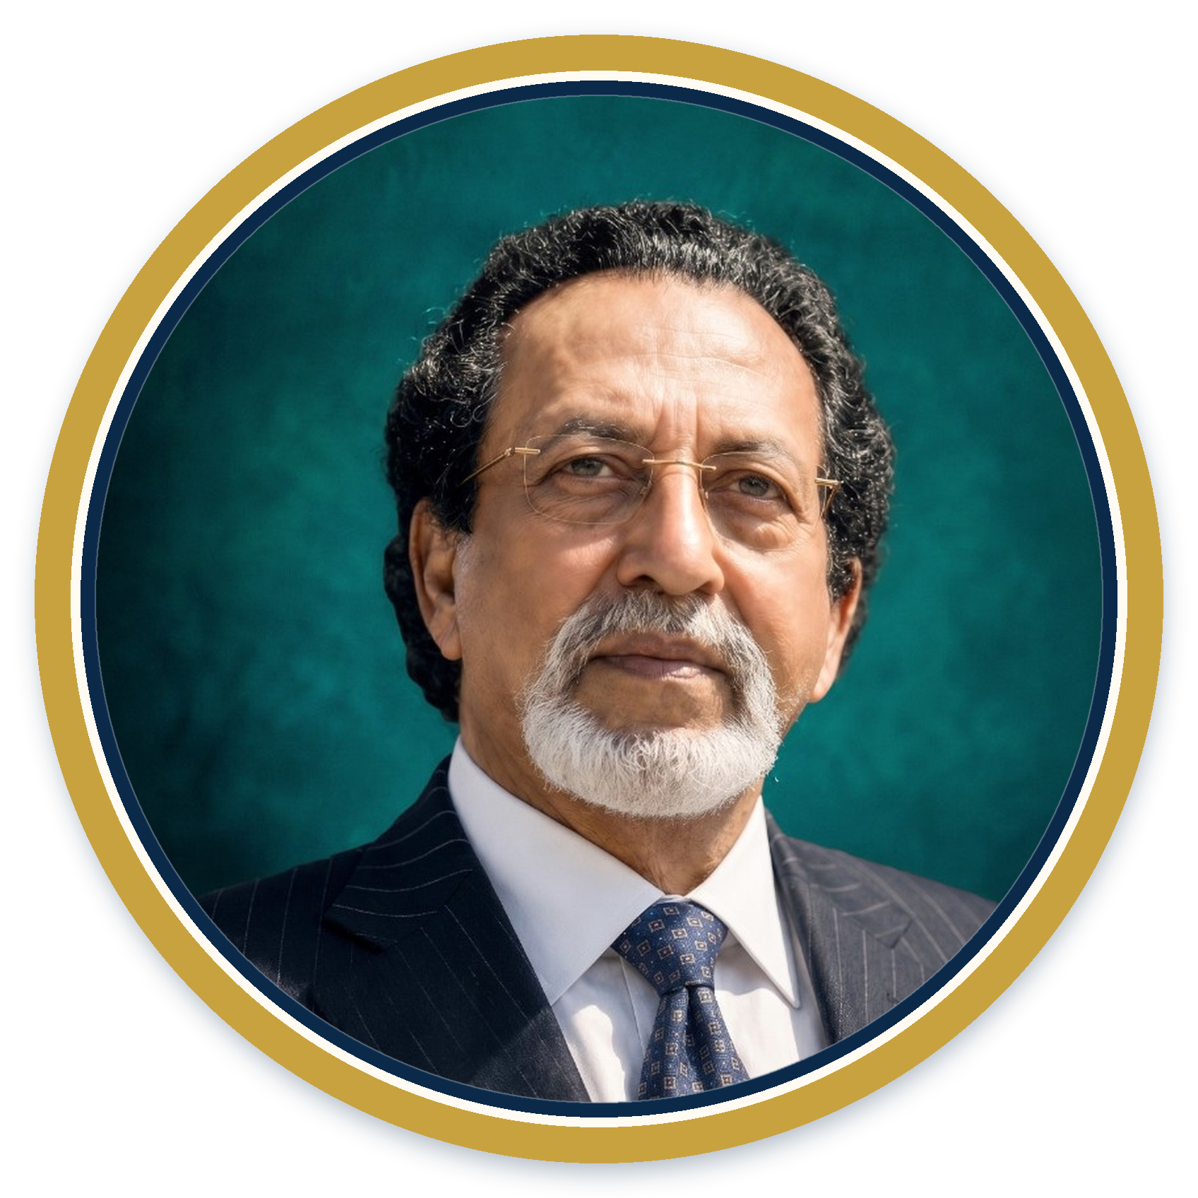
The Visionary Founder
Dr. Kali Pradip Chaudhuri
Board Certified
American Board of Orthopaedic Surgery
MD, FACS, FAAOS, FICS
Founder & Chairman
KPC Group of Companies
Southern California, USA
Fellowships
AAOS · ACS · International College of Surgeons
Orthopaedic Surgeon · Entrepreneur · Philanthropist
Academic Role
Born into a zamindar family in Sylhet. MBBS, Calcutta National Medical College. Further training across Malaysia, England, Canada and the United States. Board-certified orthopaedic surgeon who built a global healthcare and diversified group from first principles.
Faculty, Loma Linda University Medical School
Leadership
Chairman of Surgery & Orthopaedics, California hospitals
Recognition
AAPI Lifetime Achievement Award
KPC Group · Integrated Development Proposal · Confidential
2 / 18

Slide 3
A Global Journey of Impact
EARLY YEARS
1982+
1994
From Sylhet to the world
Orthopaedic practice in USA
Founding of KPC Group
MC College, Sylhet. MBBS, Calcutta National Medical College. Practice in Malaysia, UK, Canada, USA.
Southern California clinician and surgeon. Leadership at Hemet Valley and Menifee Valley Medical Centers.
Scalable healthcare systems; diversification into real estate, pharma, education, energy, IT.
2000S
2003–08
TODAY
Hospital acquisitions & scale
Return to Bengal
Continuing commitment
California network including Hemet & Menifee ($172M). Hundreds of thousands of patients served.
West Bengal’s first private medical college at Jadavpur under PPP — K.S. Ray TB campus.
University, oncology, multispeciality and Amader Bari on 15+ years of delivery.
KPC Group · Integrated Development Proposal · Confidential
3 / 18

Slide 4
KPC Medical College & Hospital – West Bengal’s First Private Medical College
2006–08
48.03 acres
1,050+
150+
Established (first private)
Jadavpur campus
Hospital beds
MBBS seats (annual)
Integrated campus institutions
KPC Medical College
Shova Rani Nursing College
MBBS + MD/MS in 16 disciplines · NMC recognised · Affiliated to WBUHS
B.Sc Nursing · INC recognised
Sadhana Memorial School of Nursing
Paramedical Institute
GNM courses
State Medical Faculty approved diploma programmes
Health Care Management Institute
Open & Distance Learning
BHA, BPT, BMLT, B.Sc CCT, PG Hospital Admin
PG Nutrition & Dietetics (IGNOU collaboration)
KPC Group · Integrated Development Proposal · Confidential
4 / 18

Slide 5
FROM A PIONEERING PPP COLLEGE TO A FULL HEALTHCARE–EDUCATION ECOSYSTEM
Development Legacy in West Bengal
01
02
03
First private medical college
48.03-acre urban campus
1,050+ bed hospital
2006–08 PPP on the historic K.S. Ray TB Hospital campus, Jadavpur.
Public-health land transformed into a working medical education and tertiary-care campus.
OTs, ICUs, NICU, radiology, blood bank and emergency — capacity still expanding.
04
05
06
Manpower for the State
Social commitment
Next wave of projects
Doctors, nurses, paramedics and administrators serving government and private facilities.
Foundation-backed access; scheme and subsidised patients are core to the mandate.
Oncology, multispeciality, University (B+G+6) and Amader Bari rest on 15+ years of trust.
KPC Group · Integrated Development Proposal · Confidential
5 / 18

Slide 6
A Unified Vision for West Bengal
Four interlinked projects address the continuum of care, education and social well-being — from childhood to the second innings of life.
Rising disease burden
Demographic shift
Manpower deficit
▸ ~1.22 lakh annual cancer cases in WB
▸ 300+ million Indians 60+ by 2050
▸ Acute shortage of doctors & nurses
▸ High cardiac mortality rates
▸ Nuclear families and migration
▸ Need for regionally rooted talent
▸ Trauma & paediatric critical-care gaps
▸ Shortage of dignified senior living
▸ Research & training capacity required
KPC Group · Integrated Development Proposal · Confidential
6 / 18

Slide 7
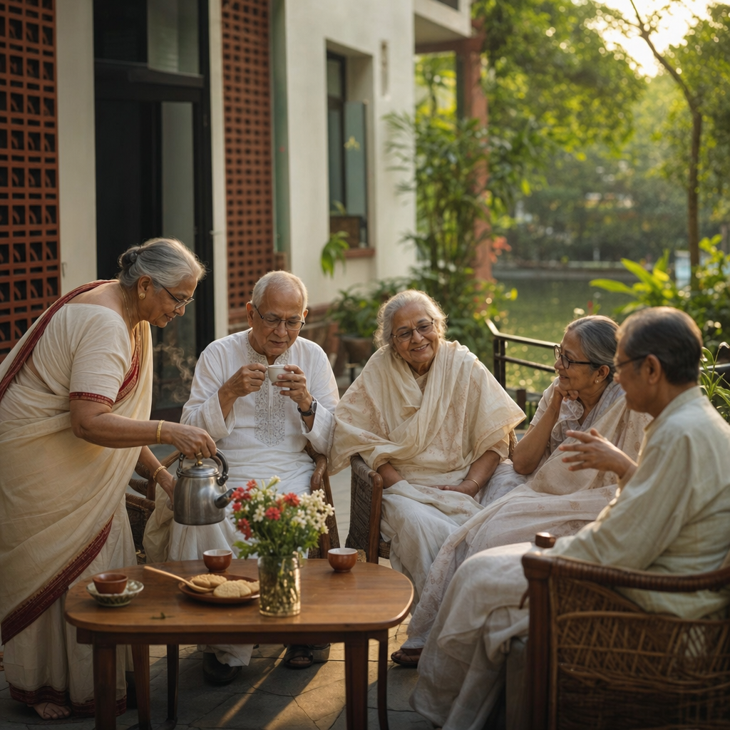
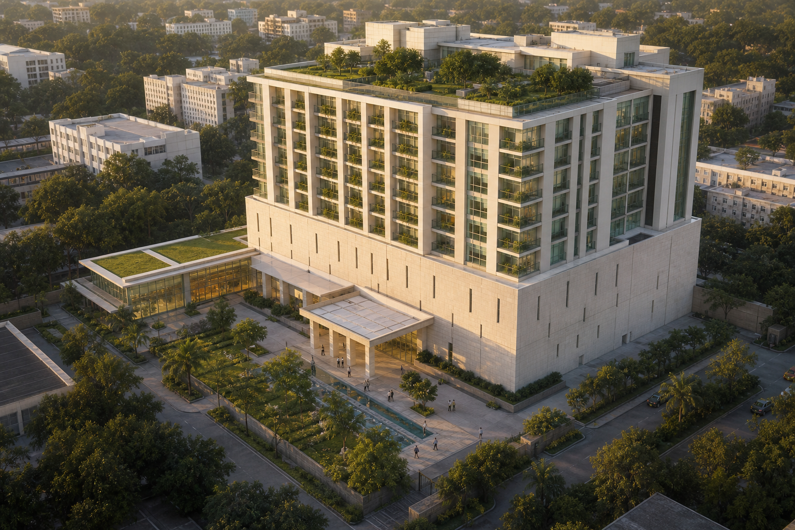
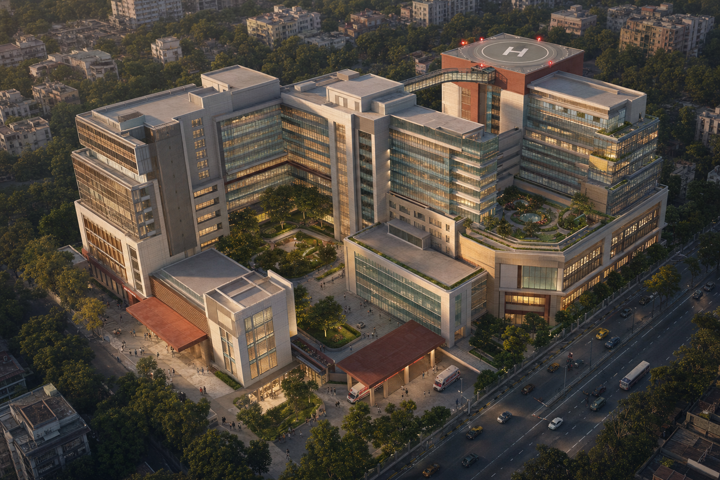
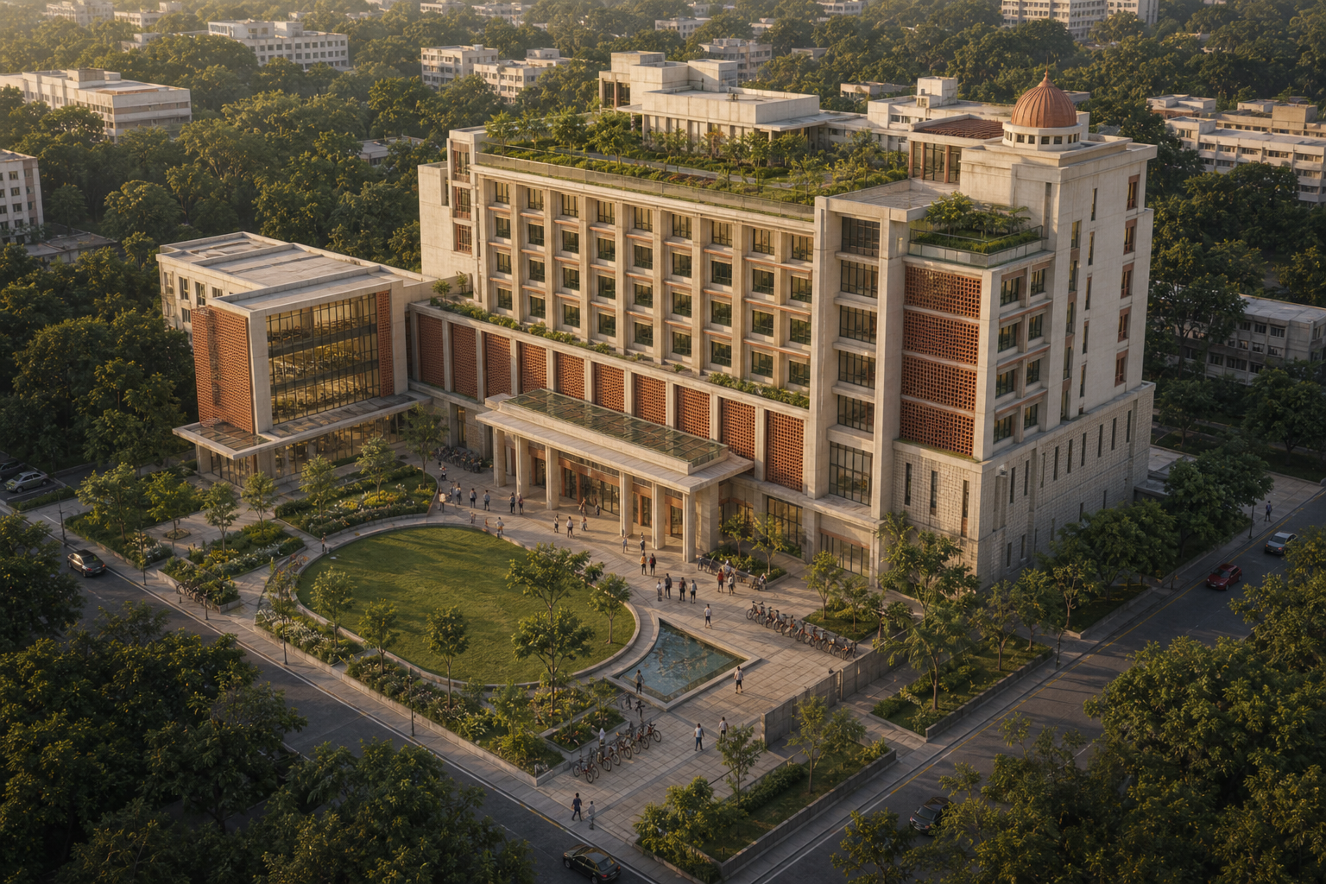
The Four Pillars
Amader Bari
220–250 residents · ₹108–122 Cr
Senior Living Campus
Jadavpur · B+G+7
Oncology Hospital
270 beds · Robotics & plasma
World-Class Cancer Care
Jadavpur · B+G+7
Multispeciality Hospital
490 beds · ₹350–550 Cr
Tertiary Care Focus
Kolkata · Helipad enabled
KPC University
₹200 Cr · Fully self-funded
Science, Education & Research
Jadavpur · B+G+6
KPC Group · Integrated Development Proposal · Confidential
7 / 18

Slide 8
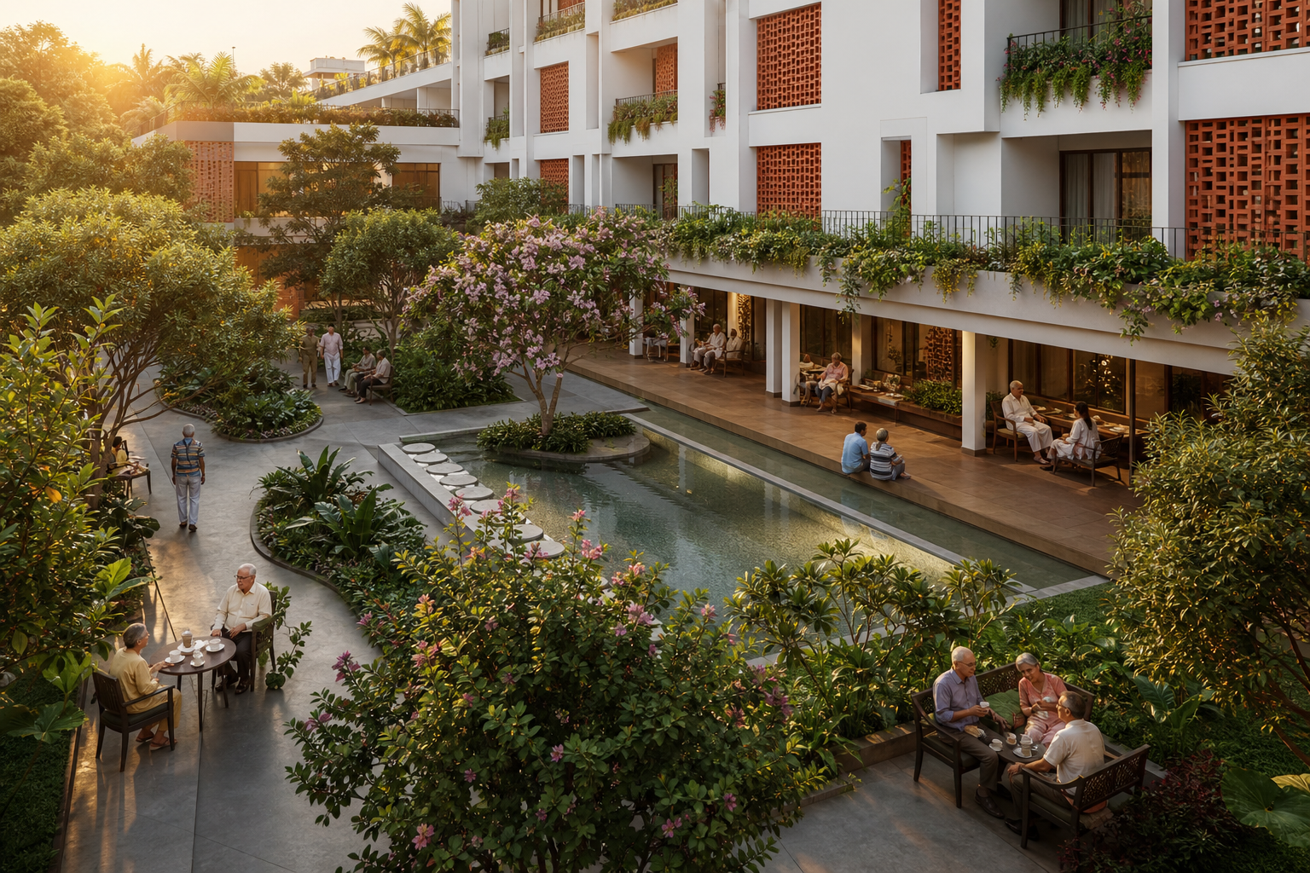
Amader Bari · Contemporary Bengali Senior Living
220–250
B+G+7
15%
₹108–122 Cr
Residents
Homely campus
Subsidised / free
Project cost
1 Independent living
Housekeeping, meals, activities, emergency response
2 Assisted living
Direct operation by the Foundation. Ultra-low density campus. Cultural rootedness: adda, festivals, Bengali cuisine — a home, not an institution.
Personal care, medication, mobility support
3 High-dependency
Full nursing, specialised diets, continuous monitoring
KPC Group · Integrated Development Proposal · Confidential
8 / 18

Slide 9
World-Class Oncology Hospital · 270 Beds
270
B+G+7
Robotic
Plasma
Dedicated oncology beds
Modern configuration
Surgery & precision care
Therapy & apheresis
Surgical oncology (robotic)
Radiation oncology (Linac / IMRT / SBRT)
Medical oncology & immunotherapy
Haemato-oncology & BMT
Plasma therapy & apheresis
Molecular diagnostics & NGS
Palliative & psycho-oncology
Rehabilitation & survivorship
KPC Group · Integrated Development Proposal · Confidential
9 / 18

Slide 10
Multispeciality Tertiary Hospital · 490 Beds
150
101
Cardiac sciences
Paediatrics
60
60
Orthopaedics
Emergency & trauma + helipad
Helipad-enabled trauma and cardiac air evacuation. Indicative cost ₹350–550 Cr, excluding land. 30–42 months from financial close.
100
19
Day-care / one-day
Flex / omnipotent
KPC Group · Integrated Development Proposal · Confidential
10 / 18

Slide 11
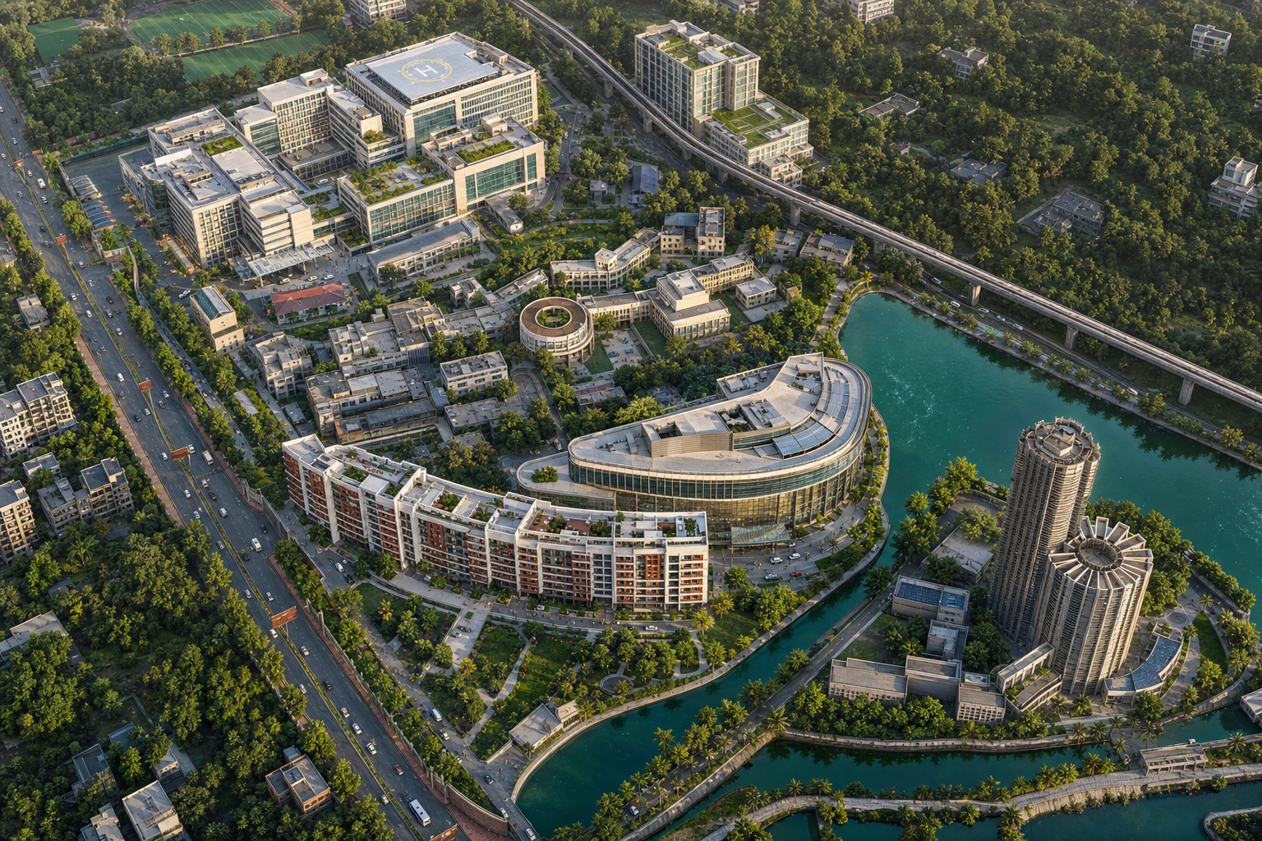
KPC University of Science Education & Research
B+G+6
₹200 Cr
2,800+
15+ yrs
Proposed academic block
Project cost 100% internal
Annual learner pipeline (Y5)
Proven operating track record
Proposed schools & programmes (allied, management & research focus)
Paramedical Sciences
Health Care Management
B.Sc MLT · Critical Care Tech · Biotech · Optometry · BPT · ASLP
BHA · MHA · MPH · Hospital Administration
Allied Health Sciences
Open & Distance Learning
M.Sc · MPT · Nutrition · Bioinformatics · Physiology
IGNOU programmes · Interdisciplinary Ph.D
Zero fiscal burden. Sponsoring-body cash ₹95.93 Cr (FY23). Approval sought under WB Private University Guidelines 2012 — not a land-area KPI slide.
Skill & Research Centres
Centres of Excellence
Emerging Medical Technology · Rural Health Delivery
R&D · Knowledge Sharing · Innovation Hub
KPC Group · Integrated Development Proposal · Confidential
11 / 18

Slide 12
Combined Investment Snapshot
₹660 – 870+ Cr indicative total
Private / foundation capital · University 100% internal · zero State capex
Amader Bari
₹108–122 Cr
Foundation corpus + loans + CSR
Oncology Hospital
Significant capex
KPC Group standalone facility
Multispeciality Hospital
₹350–550 Cr
Excluding land value
KPC University
₹200 Cr
100% internal · B+G+6 academic block
KPC Group · Integrated Development Proposal · Confidential
12 / 18

Slide 13
Manpower Generation & Employment Impact
~900
Paramedical UG (Y5)
Oncology
1,200–1,500 staff
~700
Health management & allied
Multispeciality
2,000–2,500 staff
800+
PG / research / Ph.D
Amader Bari
300–400 caregivers
~400
Skill & certificate
University
400–600 faculty & admin
2,800+
Total annual pipeline
Construction peak
2,500+ temporary jobs
KPC Group · Integrated Development Proposal · Confidential
13 / 18

Slide 14
Benefits to the Government of West Bengal
Capacity without fiscal burden
Decongestion of public hospitals
Skilled manpower for the State
760+ hospital beds + 250 senior-living beds from private / foundation capital. University fully self-financed.
Absorbs tertiary cardiac, trauma, paediatric, oncology and orthopaedic referrals.
Paramedics, managers and allied professionals trained to national standards and retained in-region.
Social mandate & equity
Emergency resilience
Knowledge hub East & North-East
15% subsidised elderly beds; scheme patients; University fee concessions.
Helipad trauma & cardiac air-evacuation complements State highway ambulance systems.
Cancer care, allied education and geriatric living keep patients and talent in Bengal.
KPC Group · Integrated Development Proposal · Confidential
14 / 18

Slide 15
Massive Growth for Society
A full life-cycle continuum of care & opportunity
Childhood & youth
Working age
Cancer care
Second innings
Paediatric care · allied health education · skill development
Cardiac & trauma · orthopaedics · employment generation
Prevention to palliative · plasma & robotics
Dignified senior living · cultural rootedness · age-in-place
Lives saved · Disability reduced · Families supported · Dignity restored · Talent retained in Bengal
KPC Group · Integrated Development Proposal · Confidential
15 / 18

Slide 16
Synergies Across the Ecosystem
01 Clinical–academic integration
02 Shared campus advantage
03 Continuum for families
University students train with the Medical College and the new hospitals; research feeds protocols.
Jadavpur KPC ecosystem — diagnostics, expertise, logistics, governance.
Paediatric care → adult tertiary → cancer → senior living in one trusted group.
04 Talent pipeline
05 Cross-subsidy & sustainability
06 Brand & trust multiplier
Allied graduates feed hospitals and Amader Bari — lower attrition, higher quality.
Paid services support subsidised elderly care and scheme patients.
15+ years of PPP medical-college operation underwrites every new initiative.
KPC Group · Integrated Development Proposal · Confidential
16 / 18

Slide 17
Request for Government Support
01
In-principle endorsement
Accept the four interlinked projects as one contribution to State health and education goals.
02
Facilitation of clearances
Time-bound statutory, environmental, AERB, fire and building sanctions.
03
Site & policy guidance
Final site for the multispeciality hospital; PPP frames consistent with past KPC models.
04
University recognition path
KPC University under the 2012 Private University Guidelines — B+G+6 academic block.
05
Partnership dialogue
Detailed DPRs, equipment planning, long-term collaboration with departments.
KPC Group · Integrated Development Proposal · Confidential
17 / 18

Slide 18
Together for a Healthier,
Skilled & Compassionate Bengal
Four projects. One ecosystem. Built on 15+ years of proven delivery by Dr. Kali Pradip Chaudhuri and the KPC Group in West Bengal.
KPC Group · Kali Pradip Chaudhuri Foundation
1F, Raja S.C. Mullick Road, Jadavpur, Kolkata – 700032
Submitted for the kind consideration of the Government of West Bengal · 2026

