Slide 1
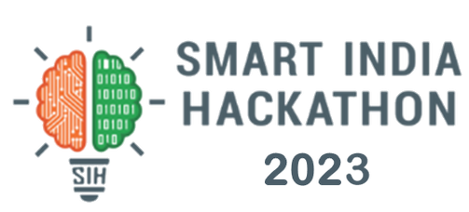

Basic Details of the Team and Problem Statement
Ministry/Organization Name : Ministry of Mines
PS Code : SIH1339
Problem Statement Title : Automation of drill core rock sample lithology logging
Team Name : NeuroTech
Team Leader Name : Sayan Mandal
Institute Code (AISHE) : U-0796
Institute Name : Indian Institute of Information Technology, Kalyani
Theme Name : Transportation & Logistics

Slide 2
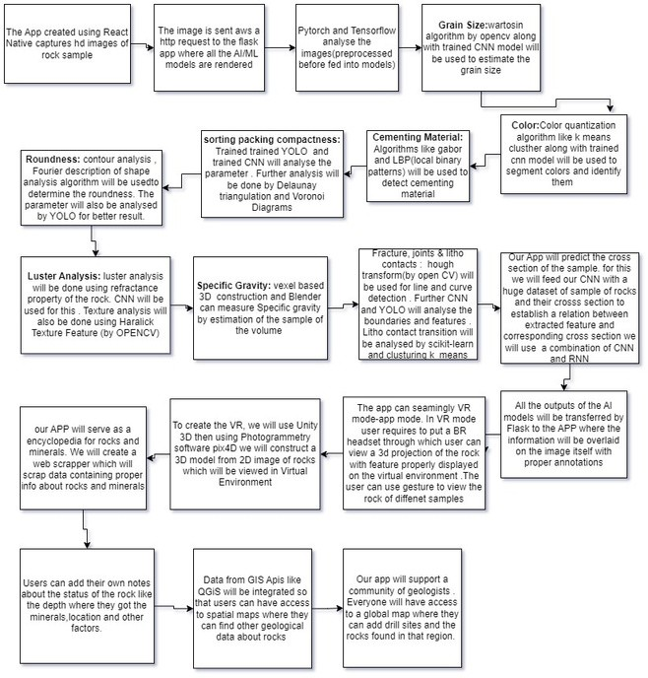
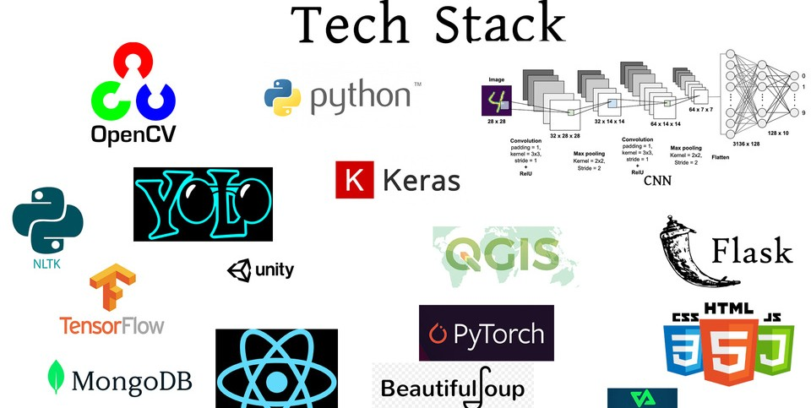
Idea/Approach Details:
Flowchart
GeoVisionPro revolutionizes geological exploration at drill rock sites. With powerful AI-driven technology, it automates the rock detection process, saving time and enhancing accuracy. Geologists can easily scan, analyze, and identify rock samples using advanced algorithms. The Global Geological Map allows users to share drill locations and rock findings, fostering collaboration and data integrity through blockchain technology. It's the ultimate tool for geologists to streamline their work and connect with a global community of rock enthusiasts.
Features of GeoVisionPro :
Core Sample Analysis: Our app offers comprehensive core sample analysis by utilizing computer vision techniques. It identifies and classifies rock types, recognizes geological discontinuities such as fractures and faults, and assesses characteristics like grain size, color, sorting, packing, compactness, roundness, luster, and specific gravity. Users can access real-time analysis results, providing immediate insights into core samples' properties.
Virtual 3D Projection: The app provides a unique virtual reality experience by creating 3D projections of rock samples. These projections allow users to explore and interact with rocks in a virtual environment, making it easier to visualize and understand their features, including fractures, joints, and more. This feature enhances geological research and education.
Virtual Drill Library: We've incorporated a virtual drill library containing a vast repository of information about rocks, deposits, and research papers from around the world. Geologists can access a wealth of data to support their research and studies, enhancing their knowledge and understanding of geological phenomena.
Global Geological Map: The app includes a global geological map that serves as a hub for geologists to connect and collaborate. Users can share their geological findings and locate them on the map. This feature fosters knowledge exchange and contributes to a comprehensive geological database, benefiting researchers and enthusiasts worldwide.
Web Scraping Integration: To populate the virtual drill library, we've integrated web scraping capabilities. The app collects data from reputable geological sources like Mindat and integrates this information into the library, ensuring that users have access to the latest geological data and research.
GIS Integration: Geographic Information System (GIS) APIs enhance the app's geospatial capabilities. Users can view geological findings on an interactive map, making it easier to interpret data in the context of their geographical location. The GIS API also supports location-based services, geocoding, routing, and geospatial analysis.
Natural Language Processing (NLP): NLP technologies are employed to retrieve relevant data from the virtual drill library and GIS when users scan a rock. This ensures that users receive valuable information and insights about the geological findings they encounter, enhancing their research and understanding.
Blockchain Data Provenance: We implement blockchain technology to create an immutable ledger of geological data. This ledger records the history of data changes, allowing users to trace the origin and modifications of geological information. This enhances data security and transparency.
Predictive Cross-Section: The app offers predictive modeling to visualize cross-sections of rocks. When a rock is scanned, the app generates and displays images of cross-sections, enabling users to explore the internal structure and features of rocks without the need for physical sampling.
Community: Within our app, geologists can join a thriving community of like-minded professionals and enthusiasts. This community serves as a hub for knowledge exchange, collaboration, and networking. Geologists can share their findings, insights, and experiences with peers from around the world.
Global Geological Map: The heart of our app is the Global Geological Map, a dynamic tool that displays drill locations from around the world. Users can add their own drill locations and the rock samples extracted from those sites. Here's how it works:
Worldwide Drill Locations: The map showcases drill sites from various corners of the globe. Users can explore these locations to see where geological research and exploration are actively taking place.
User Contributions: Geologists and rock enthusiasts can add their own drill locations to the map. When they extract a rock sample, they can geotag the location, making it visible to the global geological community.
Virtual Rock Repository: For each drill location, users can upload information about the rock samples they've collected. This includes details about the type of rock, its properties, and any unique findings.
CNN

Slide 3
Idea/Approach Details:
Use Cases:
Automated Core Sample Analysis: Geologists conducting fieldwork can quickly analyze core samples using the app's computer vision techniques. By scanning the samples, they receive instant and accurate information about rock types, grain size, color, and other properties, aiding in real-time lithological analysis.
Educational Virtual Reality Experience: Students and researchers can use the Virtual 3D Projection feature to explore virtual rock samples. They can interact with different rock types, inspect fractures and joints, and understand lithological characteristics in a visually engaging manner, enhancing their geological education.
Research Database Access: Researchers working on lithological studies can access the Virtual Drill Library, which contains a vast repository of research papers and rock information. They can gather data on specific lithological formations, aiding in in-depth analysis and comparative studies.
Collaborative Data Sharing: Geologists working on similar lithological formations in different parts of the world can share their findings on the Global Geological Map. By adding drill locations and rock samples to the map, they create a collaborative platform for comparing lithological data globally, promoting knowledge exchange.
Enhanced Field Surveys with GIS Integration: During field surveys, geologists can use the GIS Integration feature to overlay geological findings on interactive maps. This helps them visualize lithological variations in the context of geographical locations, assisting in comprehensive geological mapping and exploration.
Efficient Literature Review with NLP: Researchers conducting literature reviews on specific lithological topics can utilize NLP technologies to retrieve relevant research papers and publications from the Virtual Drill Library. This accelerates the research process, ensuring access to the latest studies and findings related to specific lithological characteristics.
Blockchain-Verified Lithological Data: Geologists collecting lithological data can store their findings on the app's blockchain ledger. The blockchain data provenance ensures the integrity and authenticity of the data, making it reliable for future reference and research, thereby enhancing the credibility of lithological studies.
Predictive Lithological Modeling: Geologists interested in understanding subsurface lithological structures can use the Predictive Cross-Section feature. By scanning surface rocks, the app generates cross-sectional images, aiding in predictive modeling of subsurface lithological formations without the need for invasive drilling, saving time and resources.
Community-driven Lithological Knowledge Exchange: Geologists interested in a specific lithological area can join the community within the app. They can share their lithological findings, discuss unique lithological features, and collaborate on research projects, fostering a vibrant community dedicated to advancing lithological knowledge and understanding.
Dependencies / Show stopper:
Data Accuracy and Quality: Inaccurate or unreliable geological data could lead to erroneous analysis and misinformed decisions, undermining the credibility of the app.
Security Concerns: Given the sensitive nature of geological data, ensuring robust security measures to protect user information and prevent unauthorized access or data breaches is paramount.
Legal and Ethical Compliance: Adhering to legal regulations regarding data usage, copyright issues related to research papers, and ethical considerations in geological research is crucial to avoid legal complications.
User Adoption: If the app's interface is not user-friendly or lacks intuitive design, it might deter users from adopting the app, hindering its widespread use and impact.
Technical Glitches: Unexpected technical issues, bugs, or system failures could disrupt the app's functionality, leading to a poor user experience and loss of user trust.
Data Privacy: Ensuring user privacy and obtaining necessary consents for data collection and usage is vital to comply with data protection laws and maintain user trust.

Slide 4

Team Members
Team Leader Name : Sayan Mandal
Branch : B.Tech Stream : ECE Year : 2nd
Team Member 1 Name : Abhrasnata Ray
Branch : B.Tech Stream : ECE Year : 2nd
Team Member 2 Name : Sreeja Mondal
Branch: B. Tech Stream : ECE Year : 2nd
Team Member 3 Name : Soumyadeep Sen
Branch : B. Tech Stream: CSE Year : 2nd
Team Member 4 Name : Sayan Sarkar
Branch : B. Tech Stream: CSE Year : 2nd
Team Member 5 Name : Debraj Bose
Branch : B. Tech Stream: CSE Year : 2nd
Team Mentor 1 Name: Chandrim Bannerjee
Category : Industry
Expertise : Artificial Intelligence and Machine Learning, Generative AI , Smart City Advisor and Smart Grid Advisor.
Domain Experience (in years): 27 years
Team Mentor 2 Name: Manas Kumar Das
Category : Industry Expertise : IT Industry, CEO of Exabyte Infotech PVT.LTD.
Domain Experience (in years): 32 years

