Slide 1

Relaxi Taxi
Driver Onboarding – Proof of concept
Presenter: Sayan Nag

Slide 2
Agenda
Scope
Goals
Assumptions
Flow Diagram
Service Definitions
Architecture
Scalability & Availability
Security
DEMO

Slide 3
Scope
You are part of a team, building a ride management application like Uber. You are responsible for the driver onboarding module. As part of this module, you are required to build an interface that will allow a driver to sign-up as a driver partner. The driver onboarding module should:
a) Allow a driver to sign-up and enter their profile information
b) Trigger onboarding processes like document collection, background verification, shipping of tracking device, etc.,
c) Allow a driver to mark when they are ready to take a ride

Slide 4
Goals
Enable new drivers to onboard our platform with ease.
Easy document upload and verification process.
Auto triggering of verification process.
Automated shipping transition.
Stage wise status intimation through notifications.
Two factor authentication.
Security of stored PII information.
Secured communication between interface and backend services.
Scalability to handle higher workloads.

Slide 5
Assumptions
Driver is using a mobile app or web interface, and has minimal knowledge on portal operations – 1. Like checking mails or mobile SMS for OTP.
2. Taking photos and finding them on the device for upload.
Deployment Infrastructure
1. Container orchestration through cloud hosted Kubernetes cluster. 2. Multi availability zone deployment of K8s. 3. Access to object stores, SQL databases and messaging queues.

Slide 6
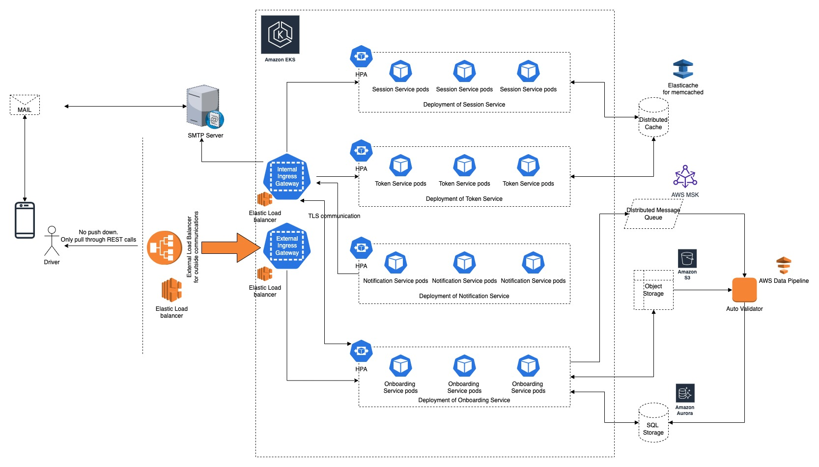
Architecture

Slide 7
Service Definitions
Token Service Generates and validates JWT token and OTP
Session Service
User session management through timed session expiry
Notification Service
Send notifications to external emails through hosted SMTP server
Onboarding Service
Interface between external device and cloud deployment. Inter service communication with above mentioned services. Business logic implementation.

Slide 8
API Endpoints
Token Service /internal/token/create /internal/token/validate /internal/auth/create/ /internal/auth/validate/<email>/<otp>
Session Service /internal/session/create /internal/session/validate
Notification Service
/internal/notification/send/email/<email>/<otp>
Onboarding Service /register/init/{email}
/register/init/{email}
/register/login
/register/driver/demographics/information
/register/driver/demographics/address
/driver/document/information
/driver/document/upload/{driverDocumentId}/{type}
/vehicle/document/information
/vehicle/document/information /vehicle/document/upload/{vehicleDocumentId}/{type}
/admin/device/{driverdocumentId}/{vehicleDocumentID}
/admin/shipment/{deviceId}
/admin/shipment/activate/device/{deviceId}
/activate/driver/{driverId}

Slide 9
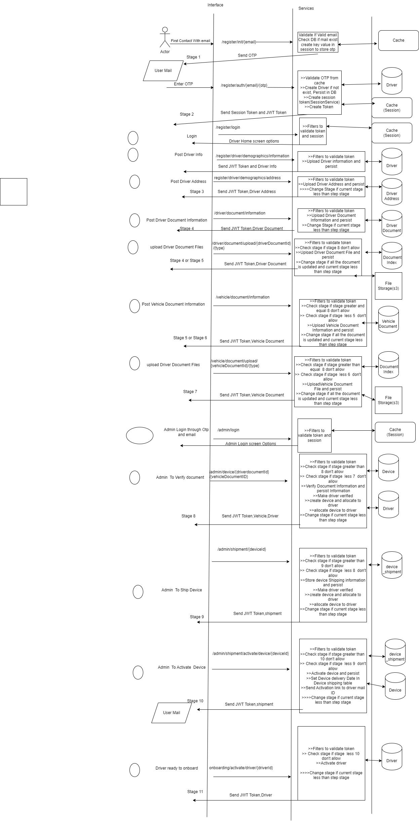
Flow Diagram

Slide 10
Scalability & Availability
Multi zonal deployment of Kubernetes cluster to avoid service disruption due to data center outages. Example AWS EKS.
Geo redundant object store for higher availability. Example, AWS S3.
MySQL deployment with cross region backup and recovery. Example AWS Aurora.
Distributed cache backed by redundant storage. AWS Elasticache.
Auto scalable load balancers to handle fluctuating volume of incoming traffic. Example AWS ELB.
Variable HPA parameters for scale up or down to match request load.
Adequate node availability for K8s to support variable HPA triggers.

Slide 11
Security
External request source validation CORS and JWT token validation.
User Session Management through session expiry.
Two factor authentication through passwords and OTPs.
Separation of application gateways to limit traffic to particular application deployments.
SSL encrypted TLS communication between pods for internal service communication.
Encryption of mysql database.
SSL enabled communication of cache and queue.
Object store encryption through AES 256 cipher to secure PII information.

Slide 12
Let’s jump into the DEMO

