Slide 1
Restaurant App Architecture

Slide 2
Restaurant App High Level
BACK-END
Restaurant DB Service
(Mongo)
Authentication DB Service
(Mongo)
Authentication Module
Service Mesh + API Gateway
(Istio)
Clients
Food Module
(node + ex)
Message Queue
(Rabbit MQ)
Restaurant Module (Front-End)
Order Module
(node + ex)
Billing Module
(node + ex)
Role Base User Module
(node + ex)
Table Module
(node + ex)
Monitoring
(Grafana)
Telemetry (Prometheus)

Slide 3
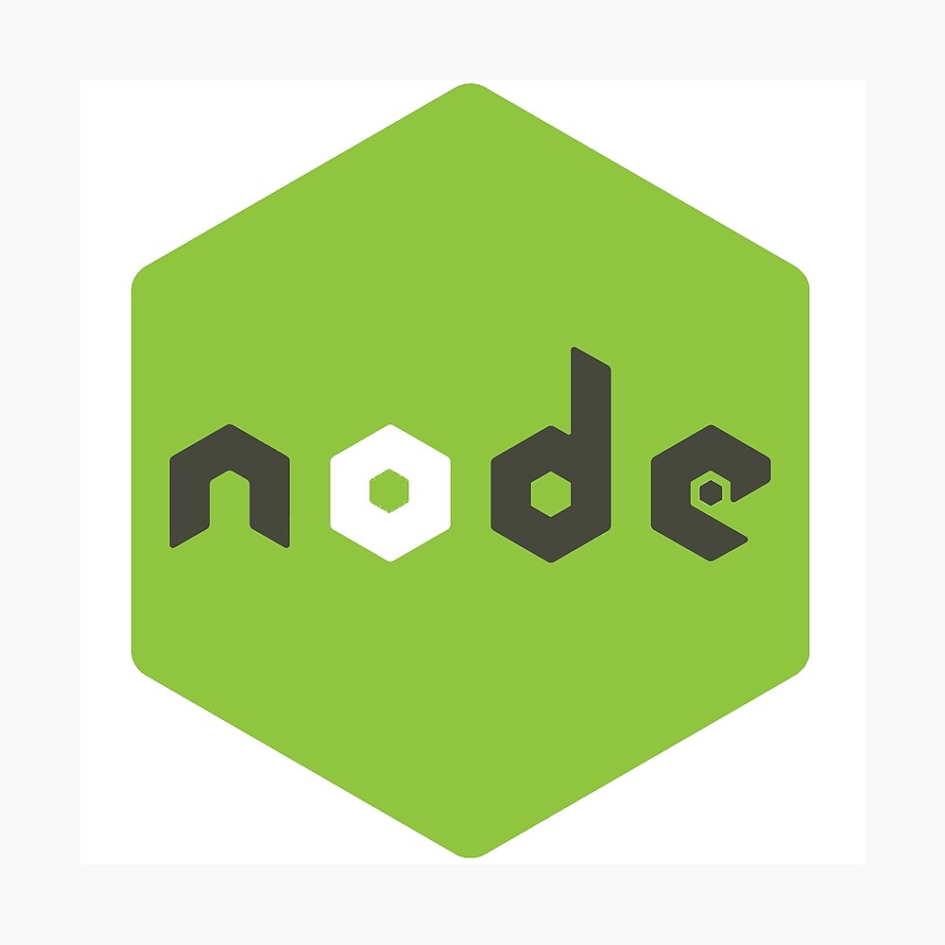
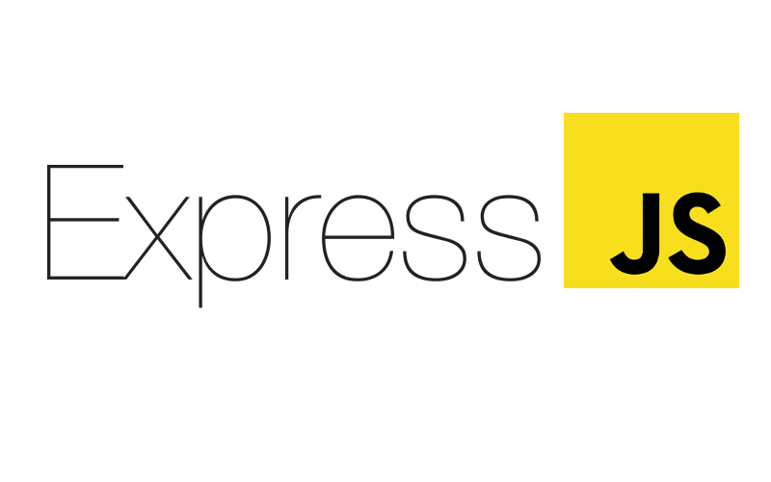











Tech Stack

Slide 4

Restaurant App Communication Architecture
Authentication DB Service
(Mongo)
Authentication Module
Role Base User Module
(node + ex)
Restaurant DB Service
(Mongo)
Order Module
(node + ex)
Restaurant Module (Front-End)
Table Module
(node + ex)
Billing Module
(node + ex)
Food Module
(node + ex)
Message Queue
(Rabbit MQ)

Slide 5
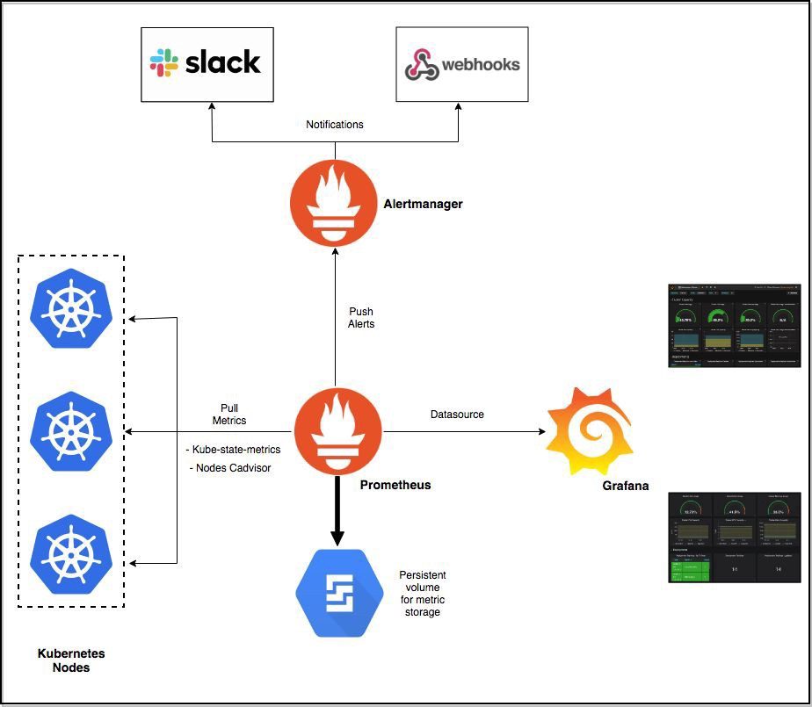
Monitoring Architecture

