Slide 1
Nostradamus
A Framework to predict performance of ML models in Production

Slide 2
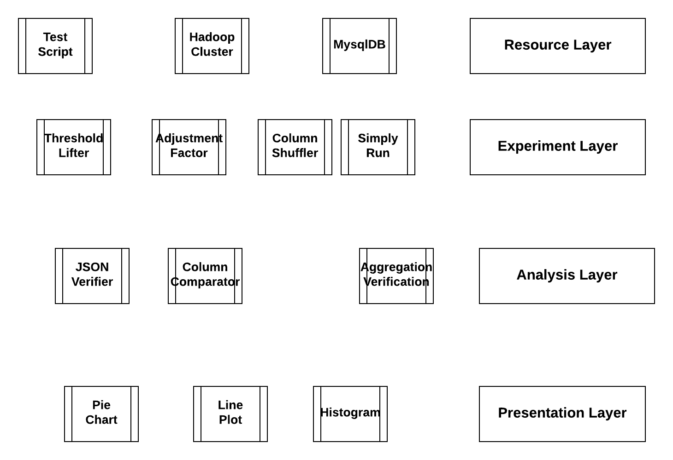
ML-QA Automation Framework

Slide 3
ML-QA Research Problem
Let X is a model that has a KPI (Key Performance Indicator) K, will run on an infinite data set S. In S the value of K is K_{S} . We need to define a sampling function F, and a, b, c, d which map the S into a subset A such that, if the value of K in A is K_{A} and a < K_{A} < b, then we will have two finite number c, d such that c < K_{S} < d
We have to do random sampling. Sample collection should be unbiased and independent. It should have all cordial elements of important features in ad price. If we collect data from different dates for a particular publisher, days should be selected from different week, month and year.

Slide 4
Experiment –Sample of Mean
Experiment:
Calculate prediction of site revenue of a user go out prediction algorithm for 100 days data.
Analysis:
Mean revenue is X_{mean} and standard deviation is S_{std.} We can claim we are 95% confident that for this algorithm for that publisher revenue will be in range of X_{mean} +/- .196 * S_{std. ;} we are 99% confident that for this algorithm site revenue will be in range of X_{mean} +/- .3 * S_{std}
For example if for site A we have average revenue USD 30,000 and standard deviation USD 1,000 then we can we will be 95% confident that range will be between USD 29804 and USD 30196.
We can do the same thing for other algorithm and compare the ranges. We can do the same for other KPI also.

Slide 5
Experiment –Difference of Mean
For 100 days data we run A and B algorithm. For N1 days one version run without any exception and for N2 days other version run without any exception
Average revenue of algorithm A is X_{A} and standard deviation is S_{B} , Similarly for algorithm B the average revenue is X_{B} and standard deviation is S_{B} .
We define
z score = (X_{A} - X_{B} ) /sqrt(S²_{B} /N2 + S²_{A} /N1)
If Z > 1.96 then
We have 95% confidence that algorithm A is a better algorithm than B
If Z > 2.58 then
We have 99% confidence that algorithm A is a better algorithm than B
If Z < -1.96 then
We have 95% confidence that B is a better algorithm than A
If Z < -2.58 then
We have 99% confidence that B is a better algorithm than A
This experiment can be used to compare any two algorithm calculating other KPI.

Slide 6
Experiment – Difference of proportion
For 100 days data we run two different versions of user go out prediction . For N1 days version one run without any exception and for N2 days version two run without any exception.
Average error rate of version one is X₁, Similarly for other version the average error rate is X₂
We define
z score = (X₁ – X₂ ) /sqrt(X₁*(1 – X₁ ) /N1 + X₂*(1 – X₂ ) /N2)
If Z > 1.96 then
We have 95% confidence that version two is a better algorithm than version one
If Z > 2.58 then
We have 99% confidence that version two is a better algorithm than version one
If Z < -1.96 then
We have 95% confidence that version one is a better algorithm than version two
If Z < -2.58 then
We have 99% confidence that version one is a better algorithm than version two
This experiment can be used to compare any two classification algorithm

Slide 7
Experiment – Analysis of Variance
There are four models to predict the user go off. For each of those we have 100 days predicted revenue. Analysis of variance will verify the Null Hypothesis that all models are same.
It can be used for feature importance also. To verify the country is an important feature or not we will take 100 days revenue of four country US, UK, IN and SA and test the null hypothesis all countries are same.

Slide 8
Questions??..

