Slide 1
FLIP ROBO
FLIGHT PRICE PREDICTOR

Slide 2
PROBLEM STATEMENT
BUILDING A MACHINE LEARNING MODEL TO PREDICT THE FLIGHT PRICES USING THE GIVEN INDEPENDENT VARIABLES.

Slide 3
EDA STEPS AND VISUALIZATIONS
Checking various parameters like number of unique values in each column.
No null values present.
Finding out trends in data.
Finding out price fluctuations with varius independent variables.
Removing companies which has very less data present.

Slide 4
DATASETS USED FOR TRAINING PURPOSE
Dataset was obtained from makemytrip.com by web scraping using selenium.

Slide 5
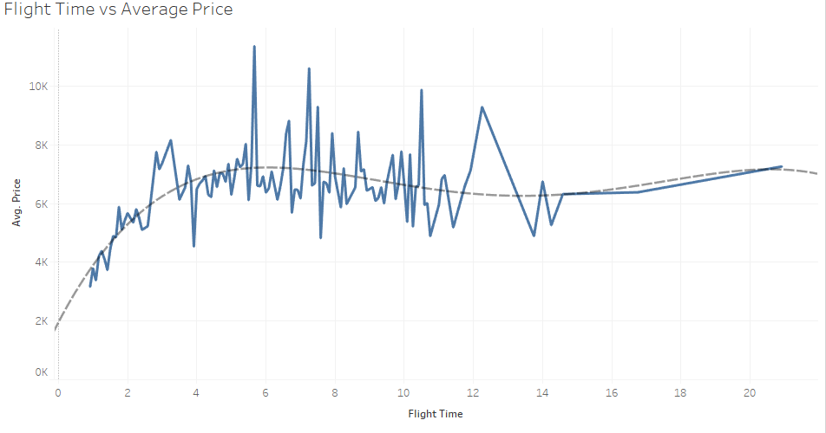
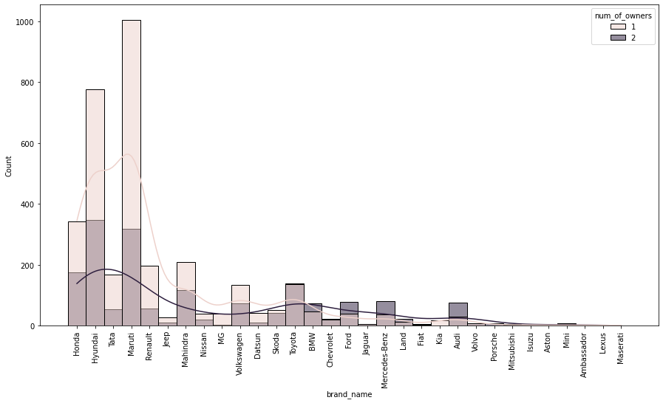
SOME VISUALIZATIONS

Slide 6
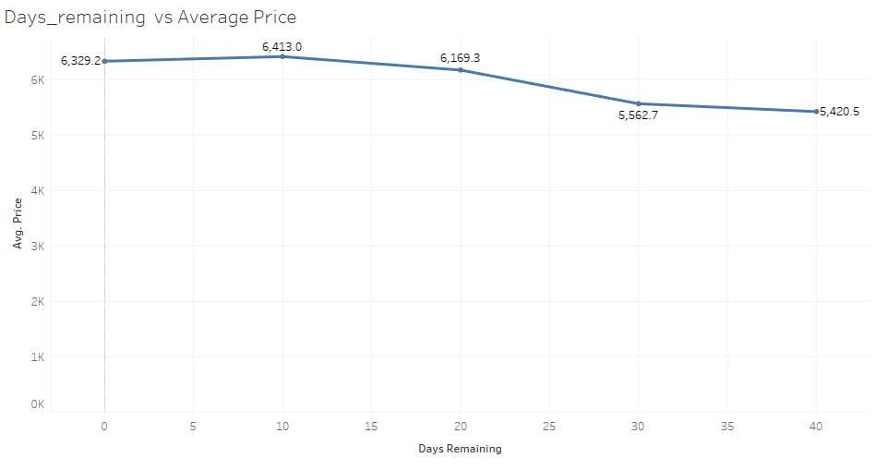

Slide 7
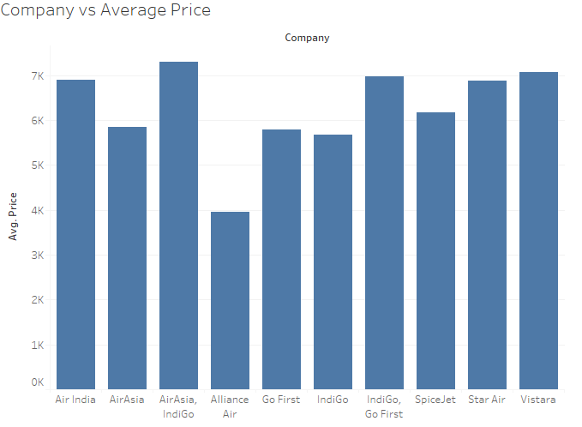

Slide 8
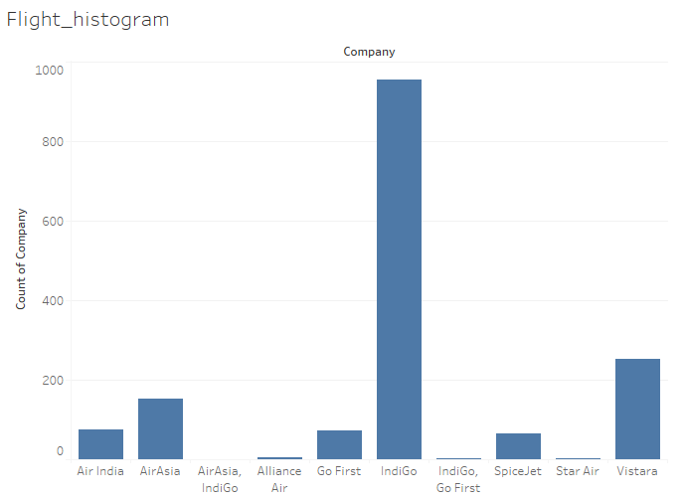

Slide 9
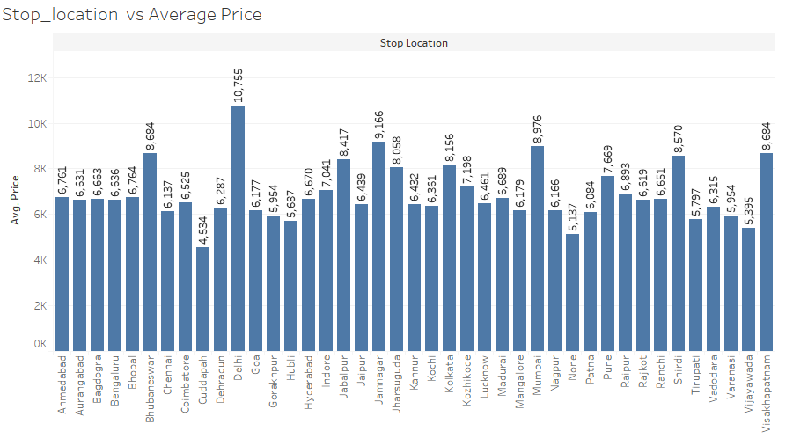

Slide 10
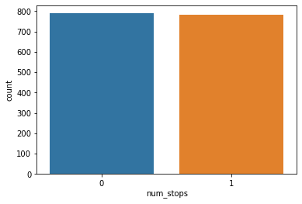
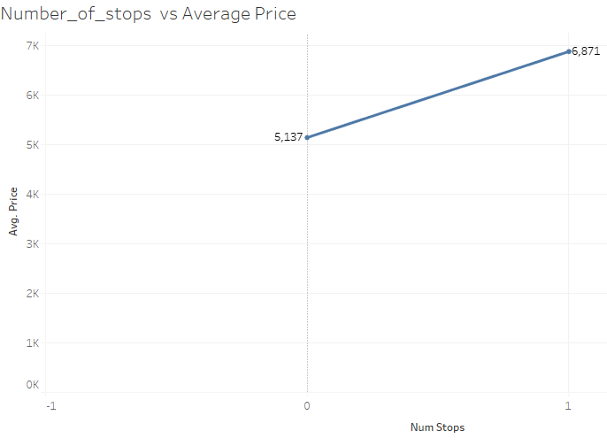
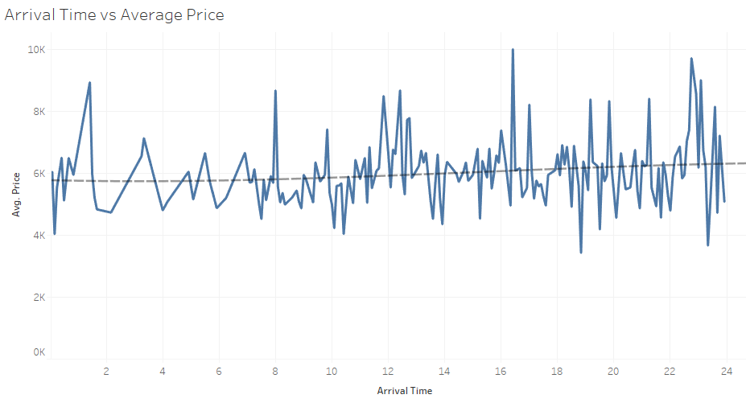
SOME MORE VISUALIZATIONS

Slide 11
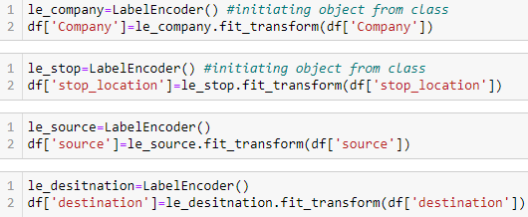
PRE-PROCESSING LABEL ENCODING
Label encoding was done on all the columns containing categorical data.

Slide 12
PRE PROCESSING POWER TRANSFORMER
Power Transformer was applied on columns having skewness more than 0.65 or less than
-0.65.
Also different algorithms were tested with and without applying power transformer on various columns to obtain better accuracy.

Slide 13
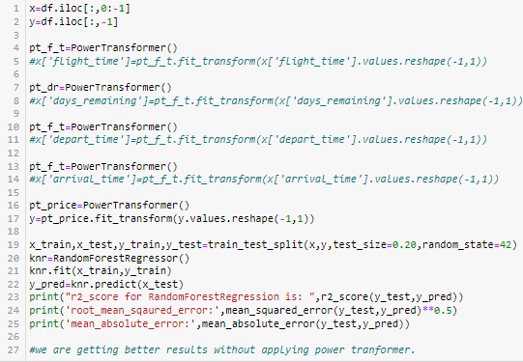

Slide 14
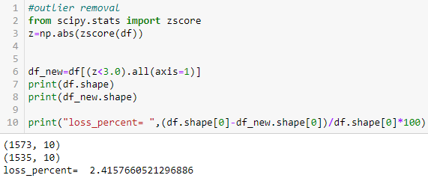
OUTLIER REMOVAL

Slide 15
MODEL TRAINING
Tests were performed on various algorithms like LinearRegression, RandomForestRegressor, KNNRegressor, GradientBoostingRegressor.
The Highest r2_scores obtained from different models are as shown below.
Model | Highest r2_score
KNN Regressor | 0.673424365671921
RandomForest Regressor | 0.8744016047633423
GradientBoosting Regressor | 0.8307491846654054

Slide 16
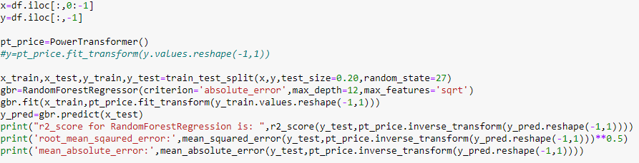
FINAL MODEL
Since RandomForestRegressor gave the best results, we are finalising and saving the model.

Slide 17
CONCLUSION
All the columns had low correlation with the target. They gave bad results with LinearRegression like algorithms but gave good results with algorithms like random forest regressor,gradient boosting regressor.
Better results could have been obtained with more number of columns.

Slide 18
Thank you

