Slide 1

WIPRO NGA Program – Python
Capstone Project Presentation –4th and 5th Sept
Project Title Here – Library Management System
Presented by – Sayan Sarkar
www.rpsconsulting.in

Slide 2
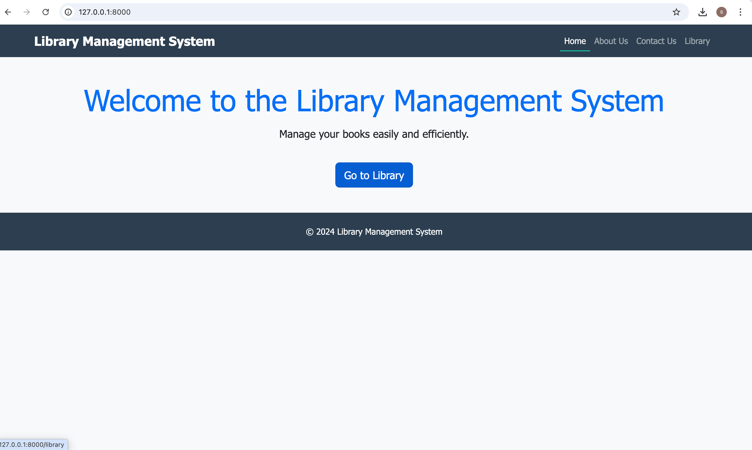

Library Management System
Built with Flask & Fast API, using SQLite3
Welcome to our Library Management System project. This project aims to create a web-based application for managing books in a library.
2025 - RPS Consulting all rights reserved

Slide 3
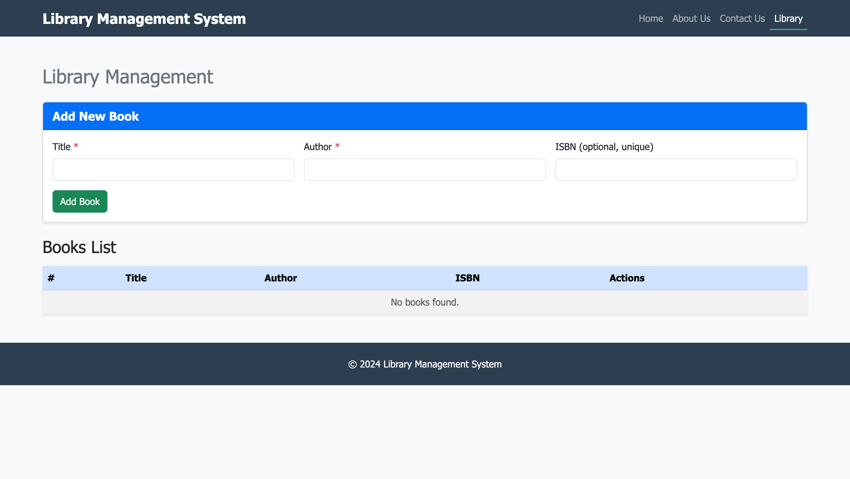
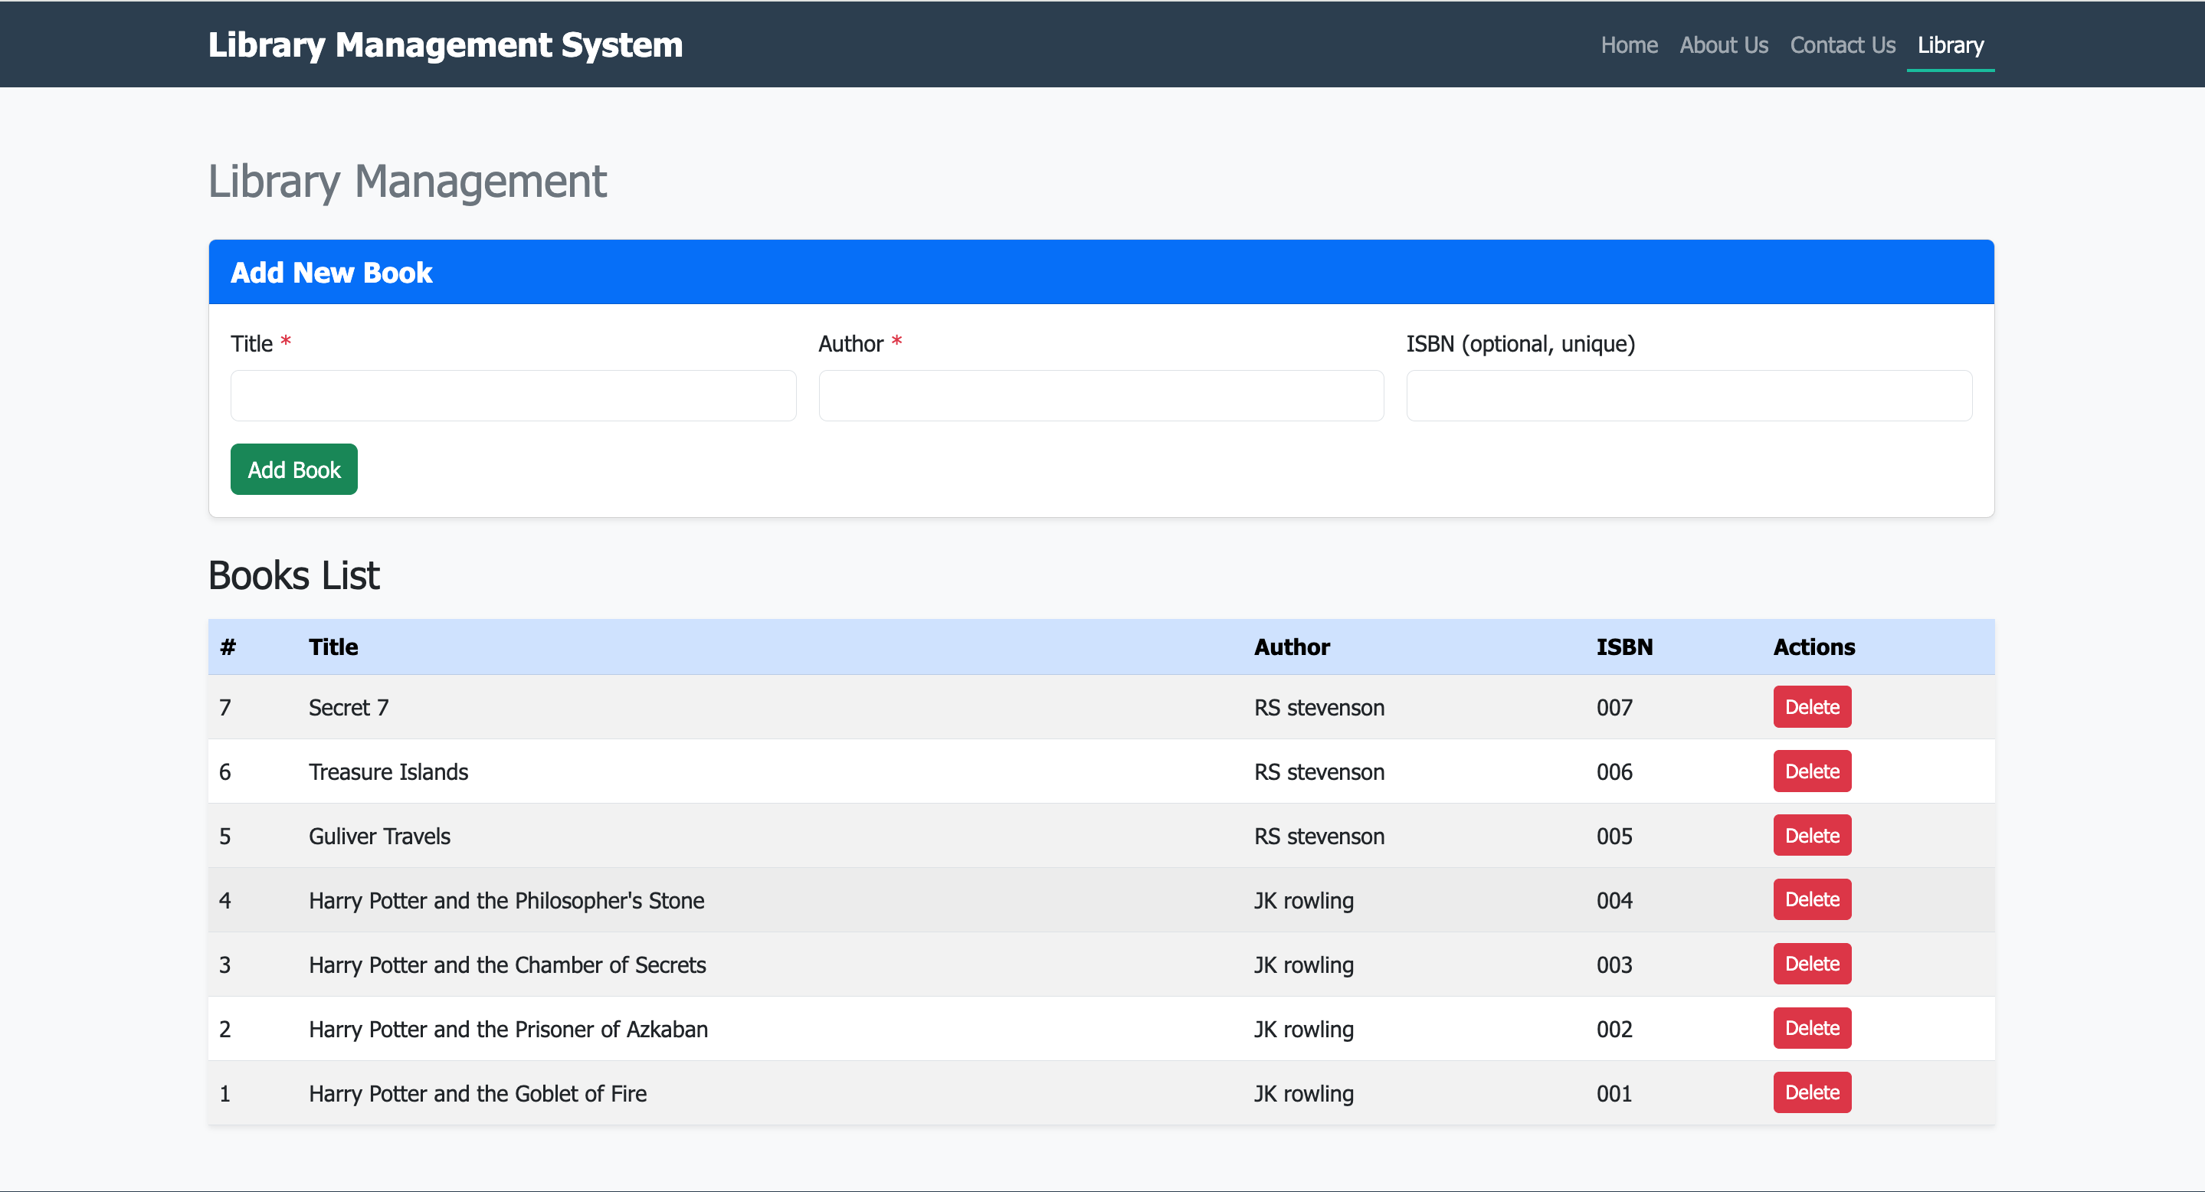
Project Overview
Web-based Library Management System
Features:
Add New Books
Display All Books in Table
Tech Stack:
Backend: Flask & Fast API
Database: SQLite3
Frontend: HTML + CSS
2025 - RPS Consulting all rights reserved

Slide 4
Using Flask
Simple & beginner-friendly
Good for small-scale projects
Traditional synchronous request handling
Well-documented & widely used
2025 - RPS Consulting all rights reserved

Slide 5
Using Fast API
Modern & high-performance
Built-in async support (faster I/O operations)
Auto API docs with Swagger & Re Doc
Suitable for scalable applications
2025 - RPS Consulting all rights reserved

Slide 6
Using Fast API
Modern & high-performance
Built-in async support (faster I/O operations)
Auto API docs with Swagger & Re Doc
Suitable for scalable applications
2025 - RPS Consulting all rights reserved

Slide 7
Performance Comparison: Flask vs Fast API
Fast API: Faster, async, scalable
Flask: Slower, but simpler for beginners
Both work well with SQLite3
2025 - RPS Consulting all rights reserved

Slide 8
Conclusion
Both frameworks can implement the project
Flask: easy for rapid prototyping
Fast API: better long-term for performance
2025 - RPS Consulting all rights reserved

