Slide 1
Introduction to Computer Vision
Presented By:
Rounak Koner
Sayan Majumder
Sohan Chakma

Slide 2
Our agenda
Introduction to Computer Vision
How Computer Vision Works
Application of Computer Vision
Challenges in Computer Vision

Slide 3
What is computer vision ?

Slide 4
What is computer vision ?
Computer vision, a type of artificial intelligence that enables computers to interpret and analyze the visual world.
Enable machines to learn and understand digital data like images and videos.
It applies machine learning models to identify and classify objects in digital images and videos.

Slide 5
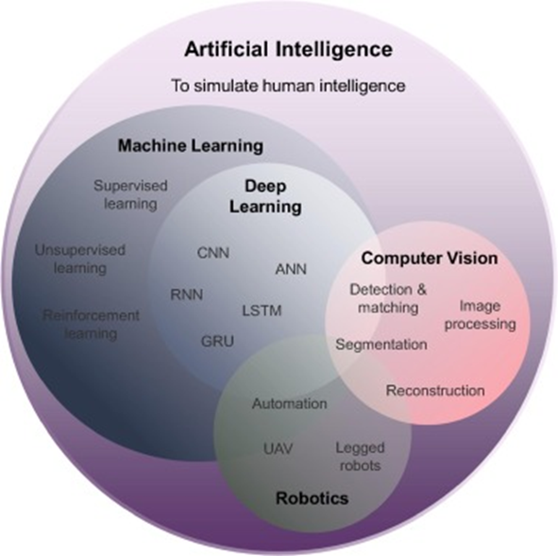

Slide 6
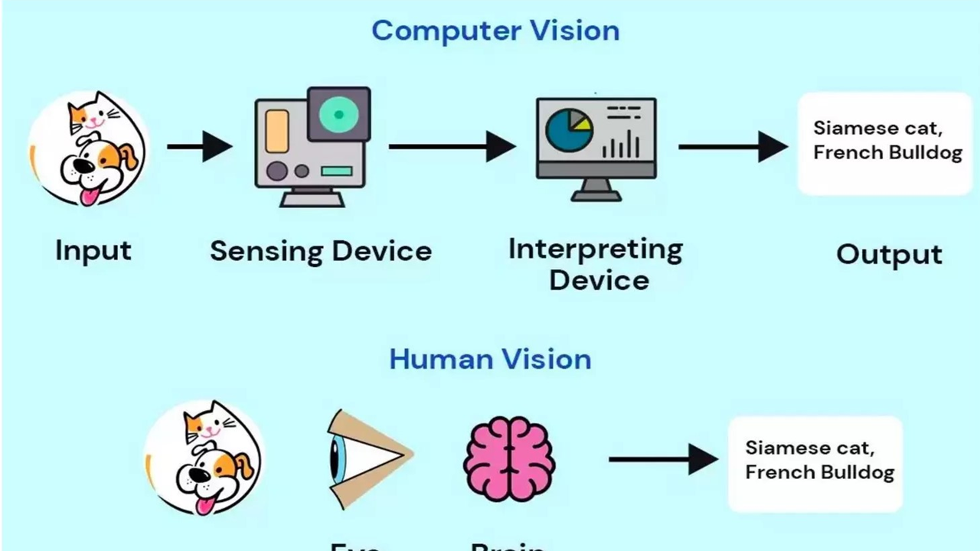

Slide 7
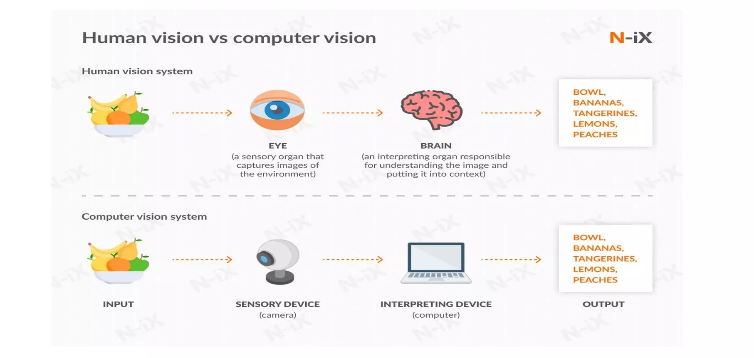

Slide 8
How computer vision works ?

Slide 9
Computer Vision works in three basic step :
Acquiring an image
Processing the image
Understanding the image

Slide 10
LET’S TALK IN MORE DETAIL ABOUT THE FUNCTOINALITY OF computer vision ?
Computer Vision technology tends to mimic the way the human brain works.
One of the popular hypothesis states that our brain rely on patterns to decode individual objects . This concept is used to create computer vision systems.
Computer Vision algorithms that we use today are based on pattern recognition.
We train computers on a massive amount of visual data - computers process images , label objects on them , and find pattern in those objects.

Slide 11
For example , if we send a million images of flowers , the computer will analyze them , identify patterns that are similar to all flowers and, at the end of this process , will create a model “flower”.
As a result, the computer will be able to accurately detect weather a particular image is a flower every time we send them a picture.

Slide 12
Applications of computer vision

Slide 13
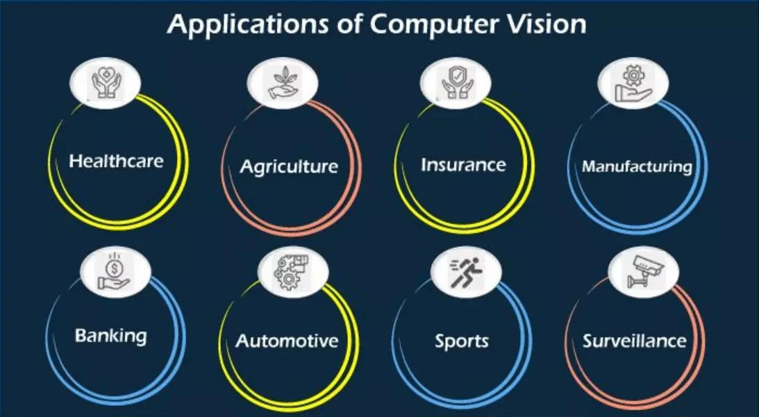
Applications of computer vision
Computer Vision is one of the areas in machine learning where core concepts are already being integrated into major products that we use everyday like :
In Self-Driving Cars
In Facial Recognition
In Augmented Reality and Mixed Reality
In Healthcare

Slide 14
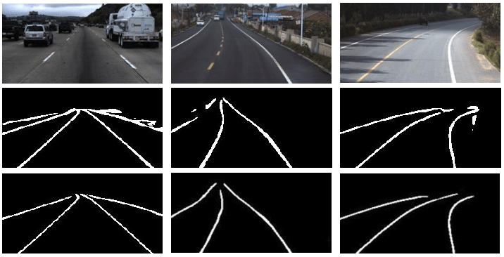
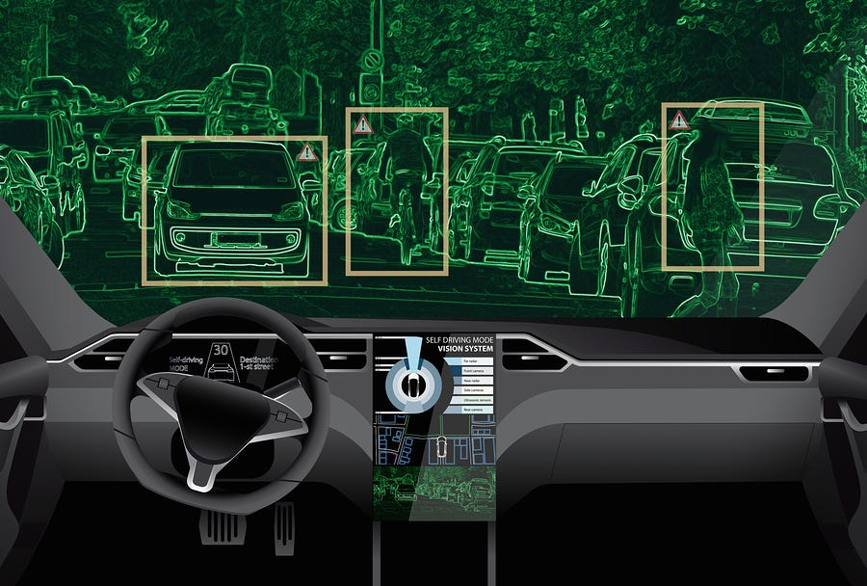
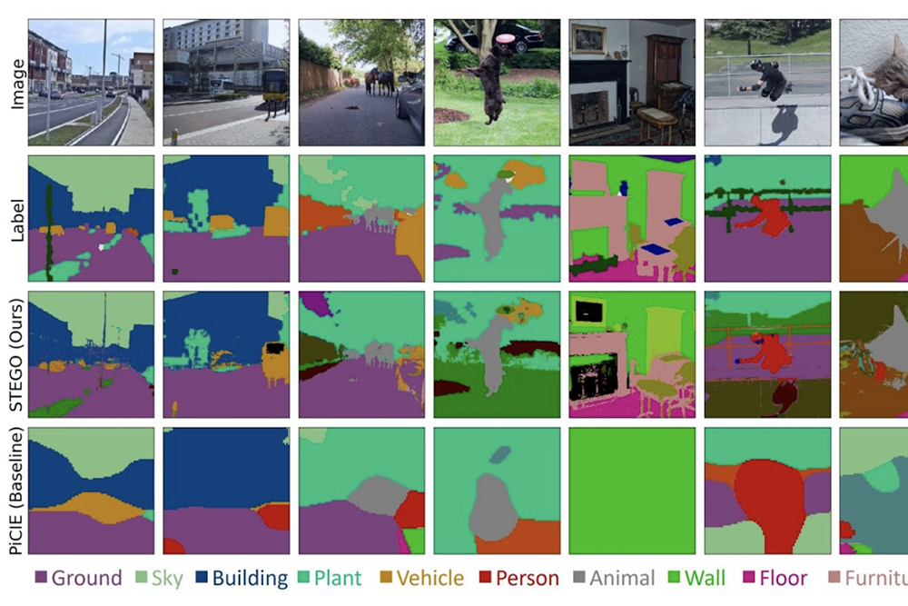
Computer vision in self driving cars
Perception and Environment Understanding: Cameras process data to detect objects like pedestrians, signs, and lanes, crucial for safe navigation.
Object Detection and Tracking: Identify and monitor objects to predict movements, ensuring safe driving decisions and obstacle avoidance.
Semantic Understanding and Scene Interpretation: Analyze surroundings, segmenting images and recognizing complex scenarios for informed navigation decisions.

Slide 15

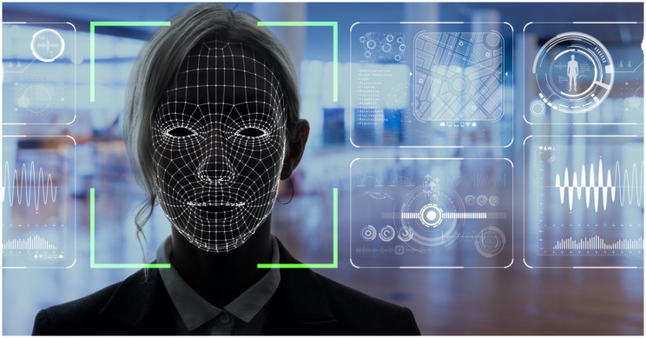
Computer vision in self FACIAL RECOGNITION
Facial Feature Detection: Identify facial landmarks like eyes and nose for accurate recognition and emotion analysis.
Biometric Authentication: Verify identity using unique facial characteristics, enhancing security in access control systems.
Privacy Concerns: Address ethical issues surrounding data protection and consent in facial recognition technology deployment.

Slide 16
Computer vision Augmented Reality and Mixed Reality
Enhanced User Experience: Computer vision enhances AR/MR by verlaying digital content onto the real world, creating immersive user interactions.
Object Recognition and Tracking: Computer vision identifies and tracks real-world objects, allowing AR/MR applications to interact intelligently with the environment.
Spatial Mapping and Localization: Computer vision maps physical surroundings, enabling accurate localization of virtual objects and precise alignment in AR/MR experiences.

Slide 17
Computer vision in Healthcare
Medical Imaging Analysis : Computer vision algorithms analyze medical images (X-rays, MRIs, CT scans) to assist in diagnosis and treatment planning.
Disease Detection and Diagnosis : Computer vision aids in detecting anomalies and diagnosing diseases from medical images, improving accuracy and efficiency.
Surgical Assistance and Navigation : Computer vision guides surgeons during procedures, providing real-time feedback and enhancing precision and safety.

Slide 18
Challenges of computer vision

Slide 19
Challenges of computer vision
Helping computers to see turns out to be very hard.
It is difficult to build a machine that has a vision similar to human beings.
Because we are not entirely sure how human vision works in the first place.
There are five major challenges that business managers can face while implementing computer vision in their business –
Inadequate hardware
Poor data quality
Weak planning for model development
Time shortage
Proper knowledge of the domain

Slide 20
Thank you

