Slide 1
EXPLAINABLE ARTIFICIAL INTELLIGENCE: INTERPRETING NAMED ENTITY RECOGNITION USING POST-HOC TECHNIQUES
MASTER OF SCIENCE IN MACHINE LEARNING AND ARTIFICIAL INTELLIGENCE
Liverpool John Moores University (LJMU)
Sayan Banerjee
Student ID: 922994
August 2020

Slide 2
Background
Named Entity Recognition
Natural Language Processing (NLP) is a field in Artificial Intelligence (AI) for interpretation of natural language data.
Named entity recognition (NER) is a NLP task for Information Extraction (IE).
Statistical NER algorithms are transparent by design.
Latest state of the art Deep Neural Network architectures for NER prediction is not interpretable.
NER is a sequence prediction problem where each word in a sentence are marked whether that is part of an entity or otherwise.
AI Explainability
Intrinsic vs post-hoc
Result of explanation
Feature summary
Model-specific vs model-agnostic
Local vs global
Model internals
Data points
Local surrogate interpretable model
AI explainability
Deep learning’s complex architecture and huge parameter space makes it black-box (not transparent by design)
The understanding of the ML model is necessary for practical use and further enhancement.
removing unnecessary biases induced by training data.
increasing trustworthiness and therefore chances of adoption
Interpretability of ML model helps in
There exists various types of AI expandability as shown in figure. -
Intrinsic AI explainability is not applicable for black box - deep neural network models.
Focus of the study is post-hoc, model agnostic and local explanation using local surrogate interpretable models
Local explanation is
Interpretation of predictions on a single or small set of observations
Post-hoc and model agnostic for majority of cases
Approximation of the complex model using interpretable function
Sufficiently covered in recent research on AI explainability

Slide 3
Problem statement
Why explanation required for NER
NER is a common but non-trivial task in retrieving information from documents.
Statistical modelling of NER needs extensive human effort to create rich linguistic features.
Deep learning based models replaces these steps as end to end system.
Role for explanation in NER task is to demonstrate how these feature engineering steps are captured inside deep learning model
Often NER is part of larger system that expects accuracy and interpretability in NER prediction.
Lack of them can make the outcome of NER unusable
A motivating example where explanation of reasonably accurate (with respect to validation data) NER model needs explanation.
Annotation of data by a small group of people has higher chances of induced bias in training and validation data set.
The same bias will be transmitted in training of the NER model
Validation of the model on similarly biased data will not be able to detect the issue.
Previous work in NER explanation
AI explainability in NLP is focused towards text classification.
Current explainability methods lack focus on how explanations could be made more useful for human use.
No consensus on evaluation of explanation generated form explainability methods.
Only a couple of studies experimented AI explainability on NER and only one used model agnostic local interpretability

Slide 4
Literature review
From literature review, three focus areas that lacks exploration
Comparison of all reviewed post-hoc explainability techniques in below table. The two methods that are implemented as part of this study in highlighted in yellow.
Making explanations understandable to layman users
Characteristics that human would expect in AI explanation (Miller, 2019). -
should be short
Evaluation methodology for explanation
No consensus amongst on evaluation methodology for generated explanations
Ambiguity in identifying suitable quantitative metrics for measuring performance of explanations.
Explanation to have qualitative characteristics like accuracy, comprehensibility and time efficiency (Doshi-Velez and Kim, 2017; Carvalho et al., 2019; Molnar, 2019)
Explanations should highlight model biases and shortcomings (Alvarez-Melis and Jaakkola, 2017; Gilpin et al., 2019)
should answer ‘why’ question contrastively
should highlight abnormalities if present
should be understood in little time.
Choice of explainability method for NER task
Only one study on NER explanation with model agnostic local explainability (Villarroya, 2018).
Use of Local Interpretable Model-Agnostic Explanations (LIME) that uses locally interpretable model on perturbed data set for generating explanation (Ribeiro et al., 2016)
Primary disadvantage of LIME - dependency on heuristically weighting perturbed dataset (Molnar, 2019)
Recommendation for the study - experimenting Kernel SHAP (Lundberg and Lee, 2017)
Explainability technique | Model specific / agnostic | Local / Global | Explanation method | Based on result of explanation
Saliency scores | Model specific | Local | Visual explanation | Data points
Deconvnet | Model specific | Local | Feature relevance | Data points
Grad-CAM | Model specific | Local | Visual explanation | Data points
Guided Backprop | Model specific | Local | Feature relevance | Data points
LRP | Model specific | Local & Gloal | Feature relevance | Data points
Integrated Gradients | Model specific | Local | Feature relevance | Data points
DeepLIFT | Model specific | Local | Feature relevance | Data points
LIME | Model agnostic | Local | Local explanations | Feature summary on local surrogate interpretable model
Anchors | Model agnostic | Local | Local Explanations | Data points
Shapley Values | Model agnostic | Local & Global | Local explanation | Feature summary
SHAP | Model agnostic | Local & Global | Local explanation | Feature summary on local surrogate interpretable model

Slide 5
Aim and objectives
The main aim for this study is to generate explanations using Kernel SHAP for Named Entity Recognition (NER) predictions from state-of-the-art NER model.
To generate explanations for NER prediction using Kernel SHAP
The primary goal of this research is to generate explanations for NER predictions that are easy to understand for layman users
To evaluate explanation generated from Kernel SHAP based on the attributes of a good explanation as perceived by human.
To validate whether explanations can provide insights on shortcomings of the NER model that can drive improvement
Objectives of the study
Exploration of post-hoc explainability methods for NER
Making explanations human acceptable
Qualitative and quantitative evaluation of explanations
Research gaps from literature review

Slide 6
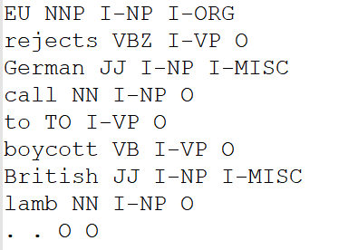
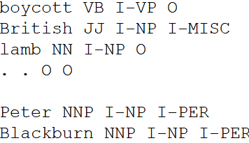
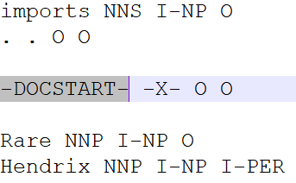
Methodology – high-level overview and data description
Activities in high-level
Data set -
CoNLL 2003 English named entity dataset
Contain one training and two testing datasets
Pre-process CoNLL 2003 NER data
Test set – A
Training set
Test set – B
Train Bi-LSTM-CRF
Validate NER model against test set A
Identify entities to generate explanation
Word Separation
Sentence Separation
Document Separation
Identify test subsample for explanation generation
Data Set | Number of Documents | Number of sentences | Number of words
Training | 946 | 14987 | 203621
Test-a | 216 | 3466 | 51362
Test-b | 231 | 3864 | 46435
Generate Explanations using LIME
Generate Explanations using Kernel SHAP
Visualize Explanations from LIME
Visualize Explanations from Kernel SHAP
Number of words, sentences and documents in the data sets
Tags / Data set | Training | Test-a | Test-b
O | 87243 | 20121 | 21261
B-PER | 4483 | 1008 | 1001
I-PER | 2998 | 675 | 688
B-LOC | 4789 | 1180 | 1149
I-LOC | 590 | 156 | 170
B-ORG | 4484 | 839 | 1184
I-ORG | 2168 | 356 | 470
B-MISC | 1716 | 460 | 396
Compare explanations for model improvement insights
Number of B and I tags in the data sets – B tag indicating number of entities
Compare explanations for general interpretability
Improve NER model based on insights
Conclude research
Validate NER model against test set B

Slide 7
Methodology – NER model building and evaluation
Data Processing and transformation steps in details
Read dataset
Data pre-processing
Linguistic features– These features are fed directly to CRF layer in BI-LSTM-CRF architecture (Huang et al., 2015)
Spelling related features – Features related to morphology of the word for each word and surrounding words
Context related features – POS tag and phrase tag for each word and surrounding words
Add sentence index
Add Document index
Treat missing values
Data transformations
Convert NER tag from IOB to IOB2 format
Architecture for BI-LSTM-CRF architecture -
Input - accepts the word index for 25 words in a sentence
Embedding - converts each word to a 300-dimension vector similar to GloVe embedding vectors used to initialize the weights.
BI-LSTM - bidirectional LSTM layer to capture contextual features.
Fully connected - fully connected / dense layer.
Auxiliary Input - spelling and context related features
Concatenation – concatenation of output of dense layer and the auxiliary input
CRF - final output layer outputs probability scores for 9
Convert chunk tag from IOB to IOB2 format
Filter sentences based on maximum number of words in sentence
Word index assignment
Create spelling features from words
Filtering word embedding for words with word index
Create context features from words
Treat missing features
Pad shorter sentences to maintain same sentence length
NER model evaluation -
Sequence F1 score - harmonic mean of recall and precision
The entity is accurately predicted when both entity tag (e.g. LOC, MISC etc. based on B tag and I tags), and start and end position of the tag in the sentence (e.g. position 0 to 2 in the sentence) are correct
One-hot encoding for string features
Standardization for numeric features
Concatenate
Main input to DNN embedding layer
Auxiliary input to DNN CRF layer

Slide 8
Methodology – Explanation generation
LIME-NER (improvised LIME from (Villarroya, 2018)) and Kernel SHAP for explanation generation from NER prediction
None of these methods are designed to generation of explanation for NER task.
Study would like to generate explanation for each entity instead of each word inside entity.
NER model prediction with probabilities for each B and I tag
LIME-NER
Kernel SHAP
Data
preparation
Word level probability to entity level probability - O, PER, ORG, LOC, and MISC.
Convert to entity level prediction probabilities
Select appropriate subset for explanation
Explanation instance selection for entity = MISC or LOC, probability threshold = 0.95 (mostly)
Pre-process – sentence to input matrix compatible to NER model.
Prediction –NER prediction for words of interest
Post-process – word level probability to entity level probability
Flatten input - sentences to NER model input matrix to single row for each sentence
Feature enrichment – words, spelling and context features
Generate
explanation
Create wrapper around NER predict function
Pre-process –transform flat feature list to NER model input
Prediction and Post-process – same as LIME
Replacing words with dummy words randomly
Assign weight based on similarity with original observation
Weighted interpretable model
Explain using feature summary
Coalitions based on all possible feature values
Assign weights based on number of coalitions present
Weighted liner model
Model coefficients are the Shapley Values used for explanation
Generate explanation
Visualize explanation
Feature weights/ importance
Words highlighted in text
Force plot
Multioutput decision plot

Slide 9
Methodology – Explanation evaluation
Qualitative Evaluation - evaluate the explanations based on the characteristics of a good explanation for human user
Quantitative Evaluation - Area over the perturbation curve (AOPC) with most relevant first (MoRF) and least relevant first (LeRF) perturbation methods (Villarroya, 2018).
Accuracy
Ability to answer contrastive ‘why’ question
Explanation of instances with close competing probability scores
Time efficiency
Number of cognitive chunks required for explanation
Weighted average for the chunks based on complexity
Comprehensibility
Identity & Stability – similarity of features in explaining same entity in multiple instances -
Separability – dissimilarity of features in explaining different entities in different instances.
MoRF –
Arrange words in the sentence in descending order of relevance score from explanation of ground truth entity class
Remove most relevant word from sentences iteratively.
NER prediction probability score for ground-truth entity class in each iteration
LeRF –
Arrange words in the sentence in ascending order of relevance score from explanation of ground truth entity class
Remove least relevant word from sentences iteratively.
NER prediction probability score for ground-truth entity class in each iteration
- Both methods will be applied on LIME-NER and Kernel SHAP individually.
- NER prediction probability score for ground-truth class will be averaged in each iteration of word removal.
 | AOPC+MoRF | AOPC+LeRF
Accurate prediction | Higher initial steepness = order of features in explanation supports accurate prediction | Higher initial steepness = less redundancy in features used for explanation
Inaccurate Prediction | Higher initial steepness = most influencing features in explanation supports true class prediction | Higher initial steepness = least important features in explaining ground truth entity having higher influence in accurate prediction

Slide 10
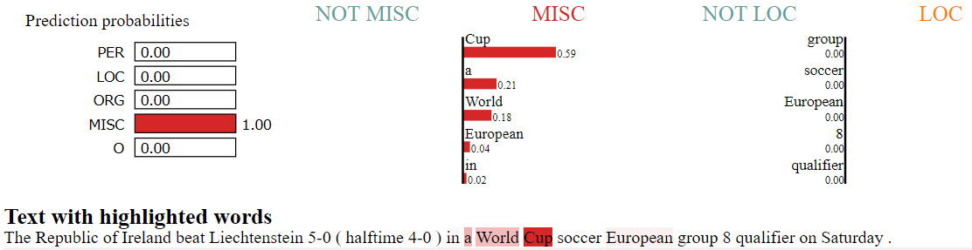
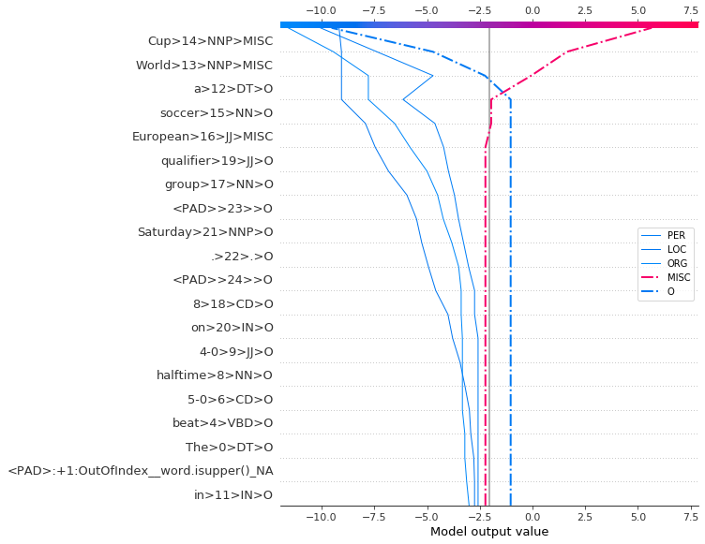
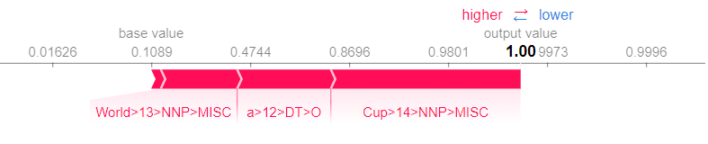
Results – NER model performance and interpretation of explanations
NER model performance – Sequence F1 score for each entity on test-a dataset
Entity | Sequence F1 score
LOC | 0.89
PER | 0.78
ORG | 0.78
MISC | 0.76
Macro average | 0.82
The macro average of sequence F1 score suggests that model is reasonably accurate
focus of study is to perform local explanation for
best performing entity – LOC
worst performing entity - MISC
Sentence - ‘The Republic of Ireland beat Liechtenstein 5-0 ( halftime 4-0 ) in a World Cup soccer European group 8 qualifier on Saturday .’
Explain – ‘World Cup’ being predicted as ‘MISC’ (Accurate prediction)
LIME-NER explanation -
Prediction probability for MISC entity is 1.
The word ‘Cup’ has the highest importance
The word ‘World’ next highest positive influence followed by the words ‘a’ and ‘European’
Kernel SHAP – multioutput decision plot
No influence from features below ‘European’
‘European - first positive influence on ‘MISC’
‘scorer’ – no influence on ‘MISC’ or ‘O’
‘O’ tag in absence of words ‘Cup’, ‘a’, ‘World’
Kernel SHAP – force plot
Prediction probability for MISC entity is 1.
words ‘Cup’, ‘a’, ‘World, ‘European’
No word having negative influence

Slide 11
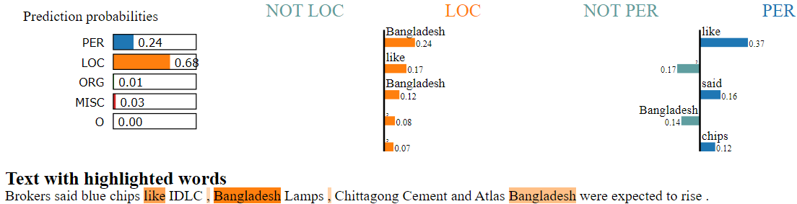
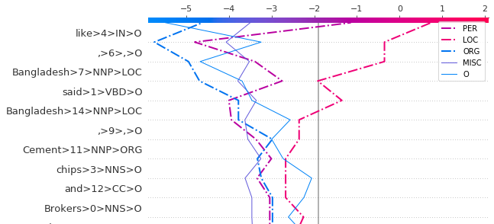
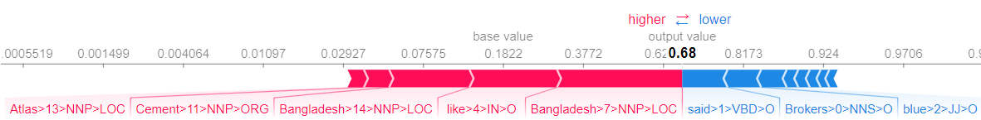
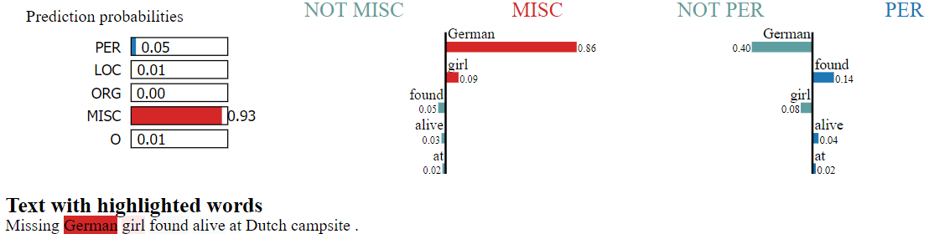
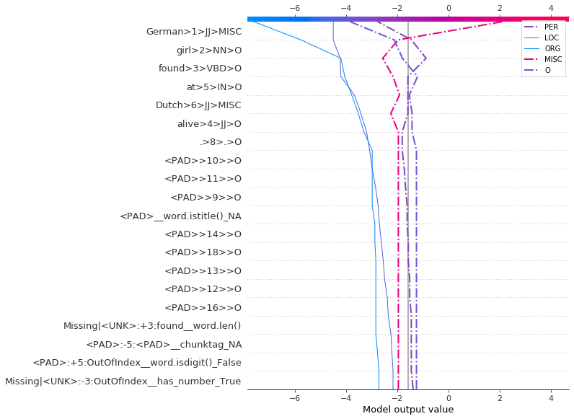
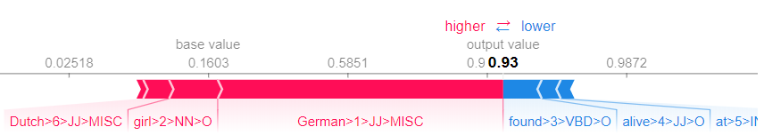
Results – comparison of explanations for unknown entity words
Sentence - ‘Brokers said blue chips like IDLC , Bangladesh Lamps , Chittagong Cement and Atlas Bangladesh were expected to rise .’ Explain – ‘IDLC’ being predicted as ‘LOC’ (Ground truth entity – ‘ORG’)
LIME-NER explanation -
‘Bangladesh’ and ‘like’ – surrounding word of entity word ‘IDLC’ having highest positive influence
2nd highest prediction probability is for ‘PER’ entity and not ‘ORG’
Kernel SHAP – multioutput decision plot
‘like’ has positivize influence for ‘ORG’ tag
it has similar influence for ‘LOC’ tag
Kernel SHAP – force plot
‘Bangladesh’ and ‘like’ – surrounding word of entity word ‘IDLC’ having highest positive influence
Sentence - ‘Missing German girl found alive at Dutch campsite .’ Explain – ‘Missing’ being predicted as ‘MISC’ (Ground truth entity – ‘O’)
LIME-NER explanation and Kernel SHAP Force plot
Same words having influence in ‘MISC’ prediction.
The order of influence is also the same
Kernel SHAP – multioutput decision plot
‘German’ - most positive influence on ‘MISC’ prediction is also predicted as ‘MISC’.
Absence of ‘German’ would have predicted ‘PER’ entity for the word ‘Missing’

Slide 12
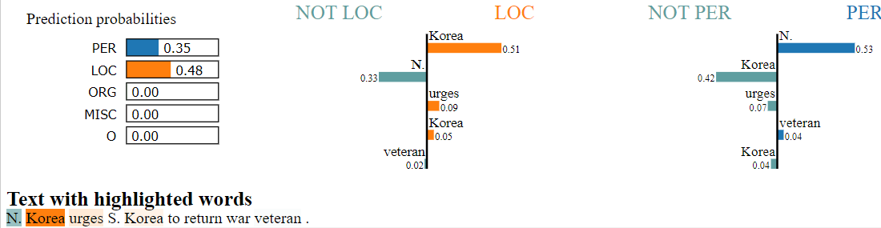
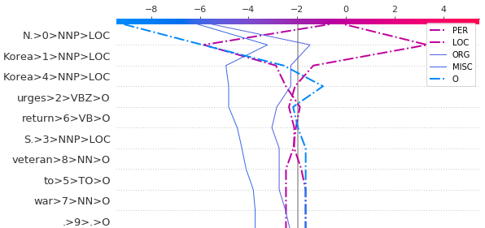
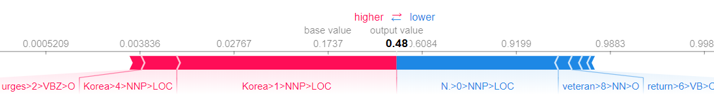
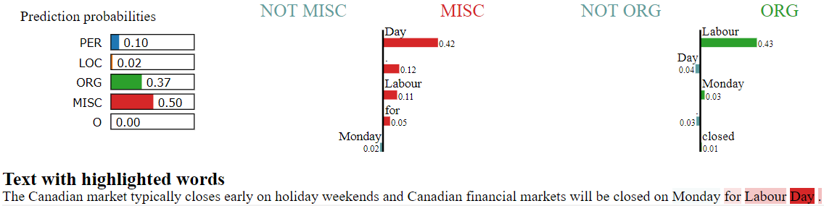
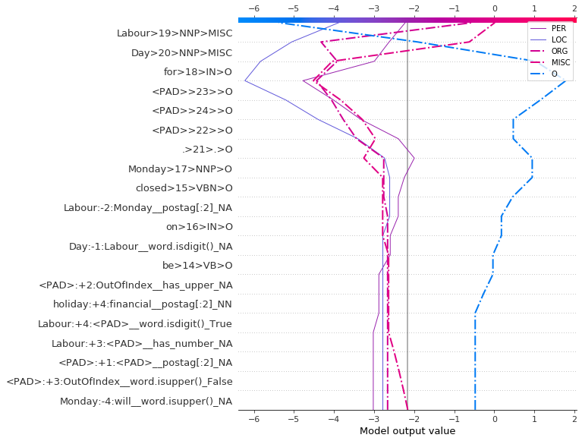
Results – Accuracy and time efficiency
Sentence - ‘N. Korea urges S. Korea to return war veteran .’ Explain – ‘N. Korea’ being predicted as ‘LOC’ (competing entity – ‘PER’)
LIME-NER and Kernel SHAP explanation
‘Korea’ has most positive influence and ‘N.’ has most negative influence in ‘LOC’ prediction.
The influences are exactly in opposite direction for ‘PER’ entity prediction
Sentence - ‘The Canadian market typically closes early on holiday weekends and Canadian financial markets will be closed on Monday for Labour Day .’ Explain – ‘Labour Day’ being predicted as ‘MISC’ (competing entity – ‘ORG’)
LIME-NER and Kernel SHAP explanation - word ‘Day’ that is the second word in the entity words has
positive influence in ‘MISC’ prediction
negative influence in ‘ORG’ prediction.
Time efficiency
Kernel SHAP predictions are more time efficient for LOC entity prediction explanation
Entity: LOC | Accurate | Inaccurate
LIME-NER | -9.25 | -9.71
Kernel SHAP | -3.88 | -2.43
Kernel SHAP predictions are more time efficient for MISC entity prediction explanations
The first word in entity words, ‘Labour’
has more positive influence in predicting ‘ORG’
less positive influence in predicting ‘MISC’.
Entity: MISC | Accurate | Inaccurate
LIME-NER | -8.17 | -10
Kernel SHAP | -4.5 | -7.7

Slide 13
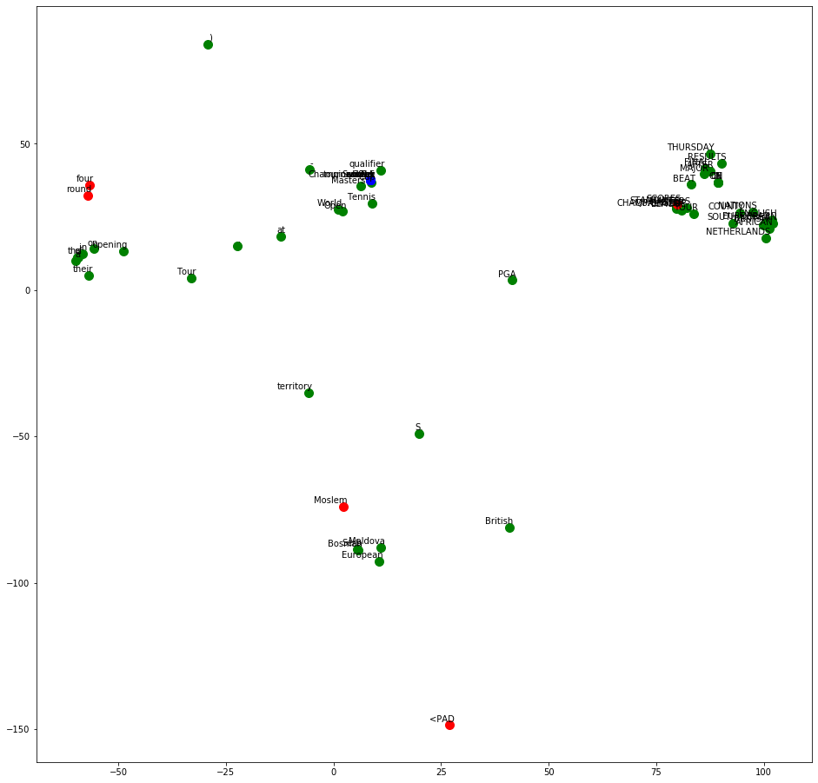
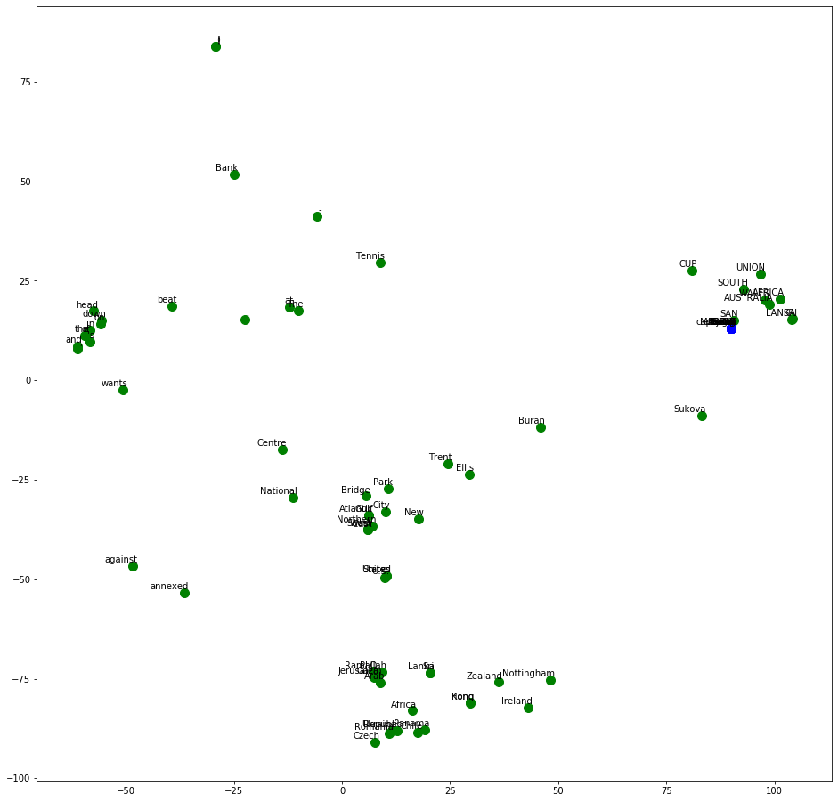
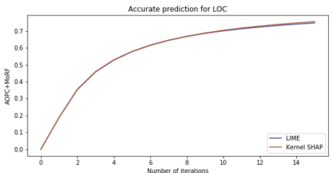
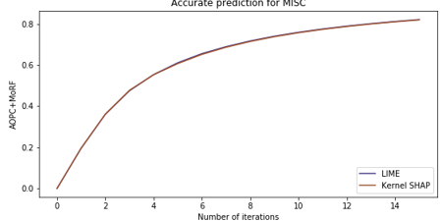
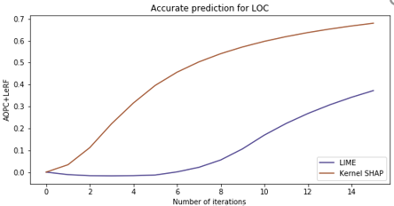
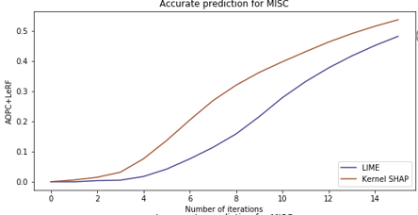
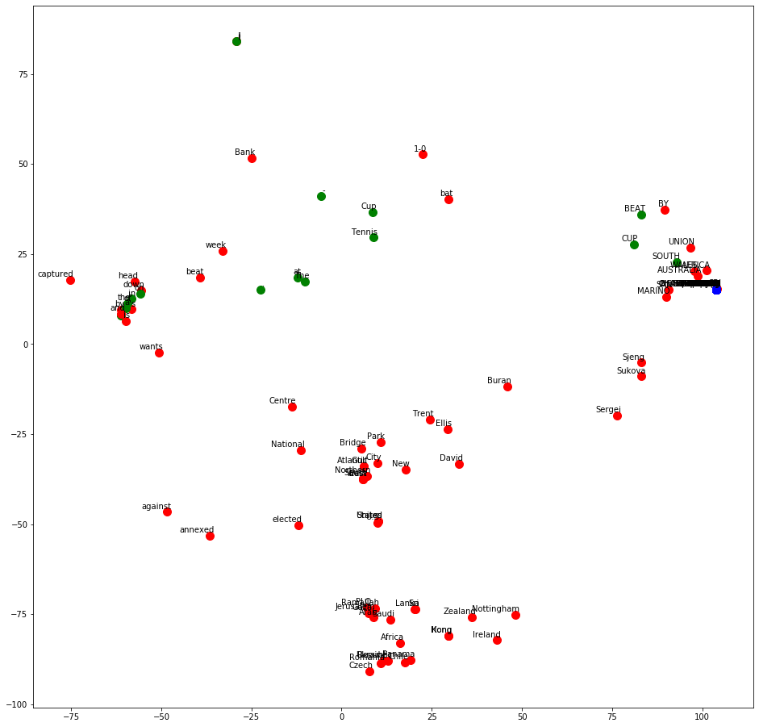
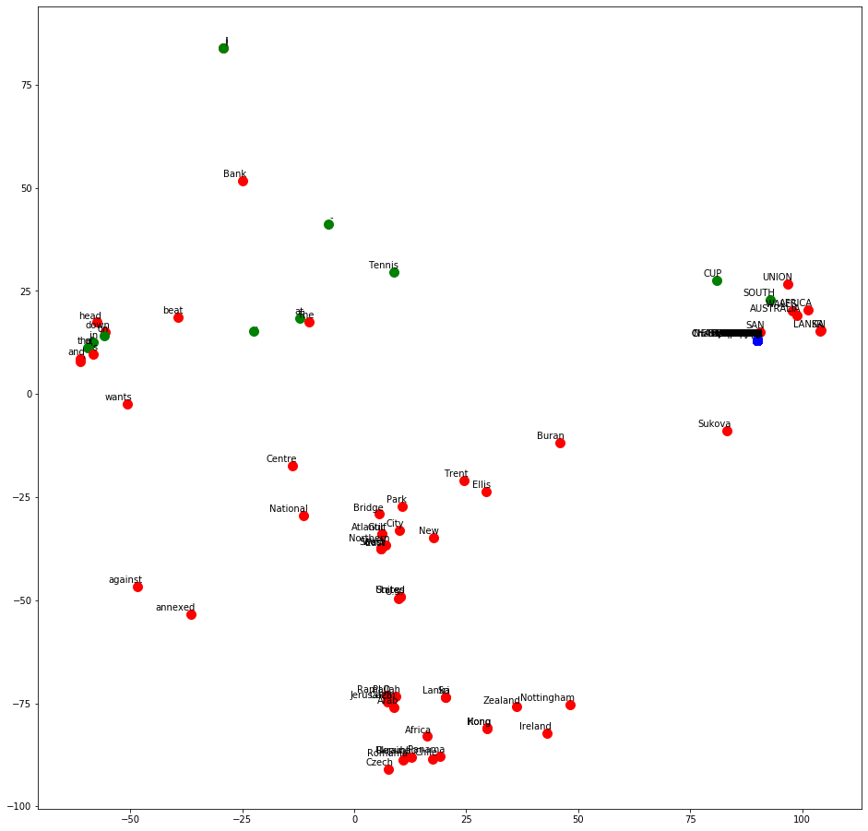
Results – Comprehensibility and AOPC
Comprehensibility comparison – t-SNE transformed words
AOPC comparison – Perturbation using MoRF and LeRF methods
MISC prediction
LOC prediction
Red – Kernel SHAP
Blue – LIME-NER
Green – Both
AOPC + MoRF for accurate prediction – Same steepness for both LIME-NER and Kernel SHAP.
Equal capability in capturing most influential features for accurate predictions
LIME-NER and Kernel SHAP performs at par with respect to identity and stability.
Kernel SHAP performs marginally better in separability compared to LIME-NER.
Kernel SHAP used less number of common words in explanation of two different entities
LIME-NER
Red – LOC
Blue – MISC
Green – Both
Kernel SHAP
AOPC + LeRF for accurate prediction – lesser steepness of LIME-NER. LIME-NER explanation has redundant features.

Slide 14
Results – NER model improvements
Model improvement insights -
Very few of spelling and context related features are ever used in explanations from Kernel SHAP
LIME-NER explanations are abstracted at word level, so this insight was not available from LIME-NER
NER model modified in two steps and performance of modified NER models are evaluated using sequence F1 score on both test-a and test-b data sets.
1st Modification
Model architecture is unchanged
Number of spelling and context related features are reduced
No context word is used for spelling and context related features
2nd Modification
spelling and context related features are completely discarded
Auxiliary input and Concatenation layers are dropped
These updates to the architecture changed the input dimension and trainable parameters for the CRF later drastically
CRF layer | Initial NER model | NER model after 1st modification | NER model after 2nd modification
Input dimension | batch size x 25 x 2764 | batch size x 25 x 789 | batch size x 25 x 50
Trainable parameters | 24984 | 7209 | 558
Output dimension | batch size x 25 x 9 | batch size x 25 x 9 | batch size x 25 x 9
No changes in sequence F1 score for both test-a and test-b datasets
Same performance achieved using less complex models
Prediction time reduced to less than a half
Entity | Sequence F1 score
 | Initial NER model |  | NER model with spelling and context related features for single word |  | NER model without spelling and context related features
 | Test-b | Test-a | Test-b | Test-a | Test-b | Test-a
LOC | 0.84 | 0.89 | 0.84 | 0.89 | 0.85 | 0.90
PER | 0.73 | 0.78 | 0.74 | 0.81 | 0.74 | 0.82
ORG | 0.75 | 0.78 | 0.74 | 0.79 | 0.76 | 0.77
MISC | 0.60 | 0.76 | 0.60 | 0.75 | 0.58 | 0.77
Macro average | 0.76 | 0.82 | 0.76 | 0.82 | 0.76 | 0.83
 | Prediction from initial NER model | Prediction after 1st modification | Prediction after 2nd modification
Number of sentences predicted | 5389 | 5389 | 5389
Total time taken | 24 seconds | 15 seconds | 10 seconds
Average time of prediction for each sentence | 4.5 milliseconds | 2.8 milliseconds | 1.9 milliseconds

Slide 15
Conclusion
Research Questions
Is Kernel SHAP an effective method to explain Named Entity Recognition model built using BI-LSTM-CRF architecture?
Are the explanations generated using Kernel SHAP for Named Entity Recognition model easy to understand for layman users?
Can the explanations generated using Kernel SHAP for Named Entity Recognition model provide insights related to shortcomings of the model?
Implementation of Kernel SHAP for NER explanation
Evaluation of explanation using qualitative metrics focused on human acceptance of explanations
Maintained same sequence F1 score amongst initial and modified NER models.
Analysis of influence for both word and non-word features
Kernel SHAP performed better with respect to time efficiency and separability clause of comprehensibility
Quantitative metrics highlighted more efficient choice of features for explanation by Kernel SHAP
Kernel SHAP explanations provide insight that spelling and context related features are mostly redundant
Allows post-hoc feature enrichment for visualizing explanations
Kernel SHAP explanation highlighted high dependency on entity words and words in the immediate surrounding that are present in pre-trained GloVe embedding
Model complexity and therefore prediction time reduced drastically in modified models
Contribution to knowledge
Extensive literature review on application of AI explainability on NLP
Global explanation using Kernel SHAP
Design of Kernel SHAP implementation for NER
Formulation of time efficiency metric
Future recommendations
Design of rich visualization for explanation of text content, specifically NER

