Slide 1
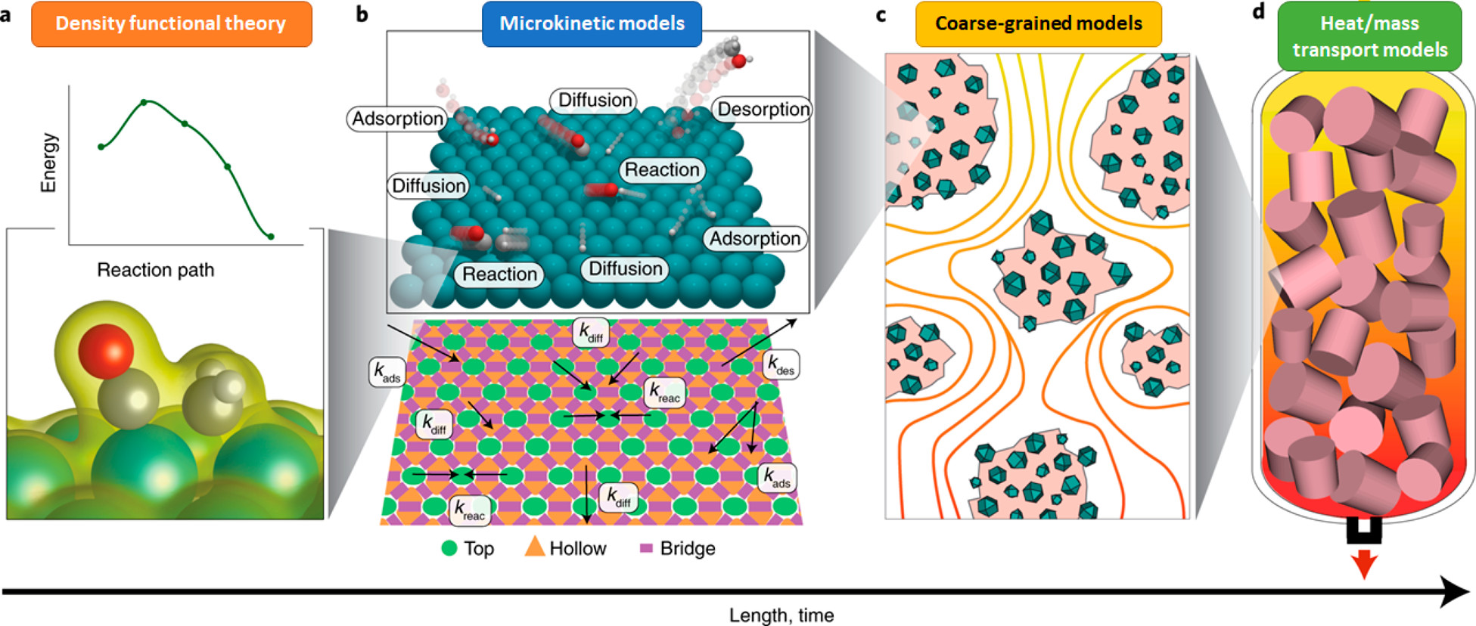
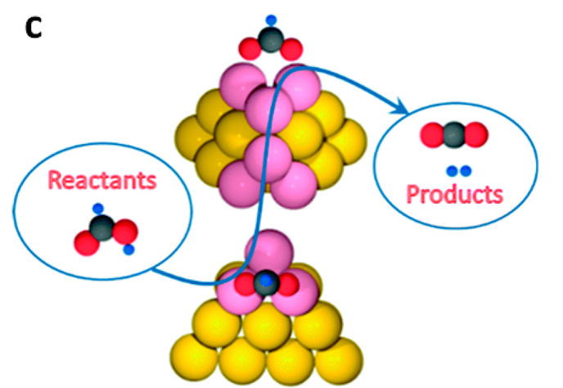
Electronic Structure Theory
Lecture: Motivation
Sayan Bhowmik
School of Chemical & Biomolecular Engineering
College of Engineering
Georgia Institute of Technology

Slide 2
Bottom-up catalyst discovery
Electronic Structure
(a) DFT: energetics of elementary steps
(b) MKM: intrinsic activity of catalyst
(c) Coarse graining: microstructure effects of catalyst
(d) Transport model: macroscopic heat and mass flow
Bruix, A. et al. Nat Catal 2, 659–670 (2019).

Slide 3
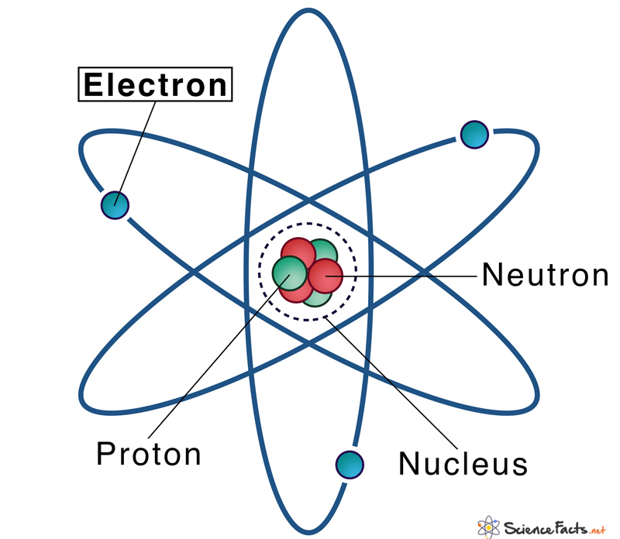
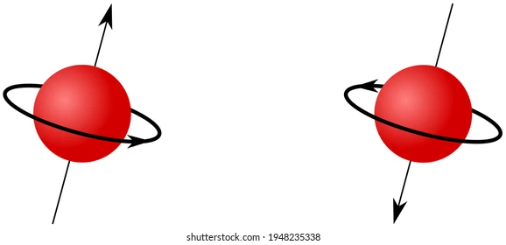
Electron & its Quirks!
Lecture 2
Sayan Bhowmik
School of Chemical & Biomolecular Engineering
College of Engineering
Georgia Institute of Technology

Slide 4
Contents
We will understand what wave-particle duality is.
We will look at wave-particle duality of electrons.
Consequences of wave-particle duality:
  De-Broglie relationship
  Heisenberg uncertainty principle

Slide 5


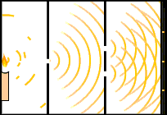
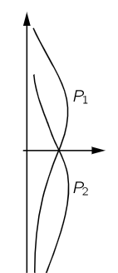
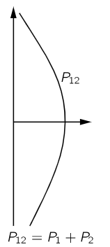

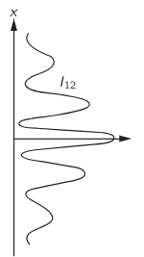
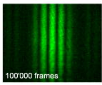



Wave-particle duality
Particle Nature
Wave Nature
Thomas Young (1801)
1
2
Light band
2 slits, 3 bands
counterintuitive
1
Light band
Possible only if light bends – waves!!
2
Light band
Physics 2000 – CU Boulder
Wikimedia Commons
Distribution if 2 is closed
Distribution if 2 is closed
Distribution if both are open
$$I_{1}∝A_{1}^{2}$$
Distribution if both are open
Distribution if 1 is closed
Distribution if 1 is closed
$$I_{2}∝A_{2}^{2}$$
$$I_{12}∝{\left|A_{1}+A_{2}\right|}^{2}$$
Feynman’s lectures on physics, T. L. Dimitrova and A. Weis, Am. J. Phys. 76 2, February 2008

Slide 6
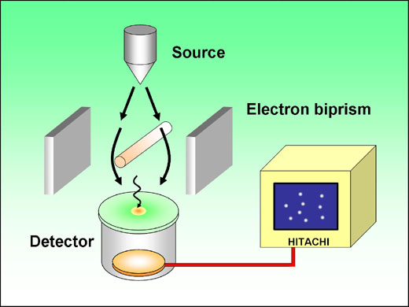
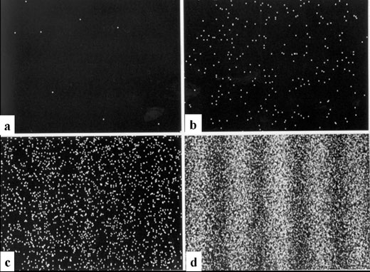
Wave-particle duality - electrons
Seemingly random
8 electrons
270 electrons
Interference fringes
A. Tonomura et al. , Am. J. Phys. 57 2, February 1989
Electrons have both particle and wave nature!
Waves associated with particles are called “matter waves”
2000 electrons
160000 electrons

Slide 7
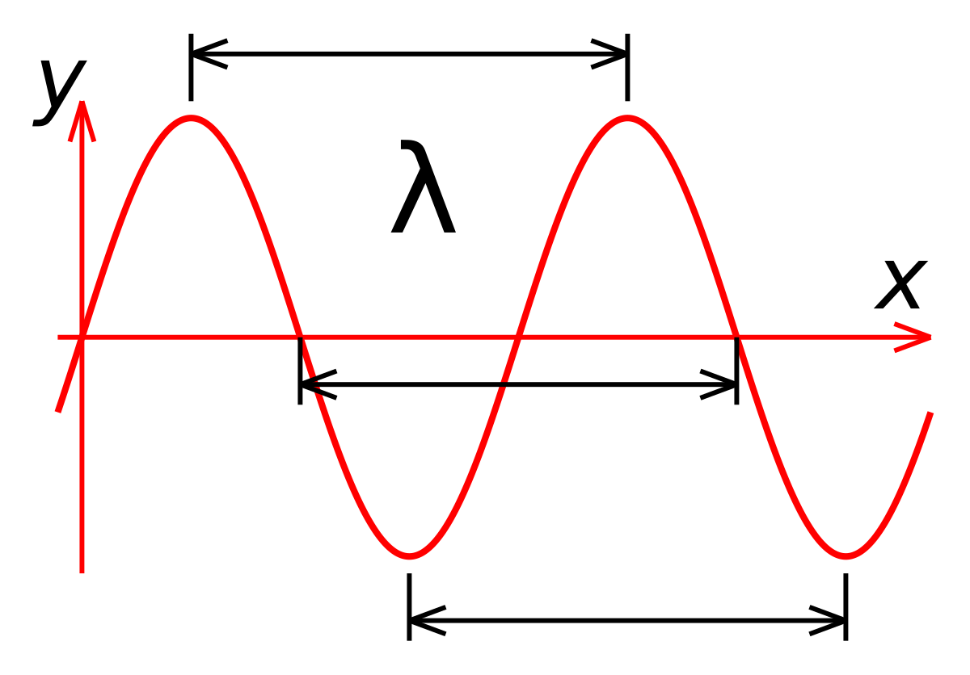
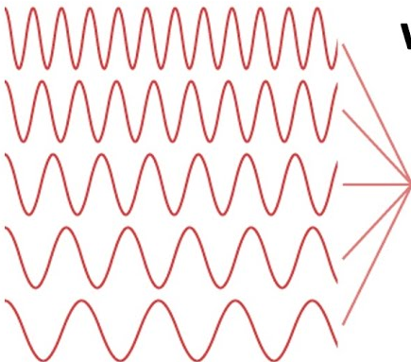
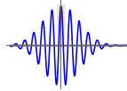
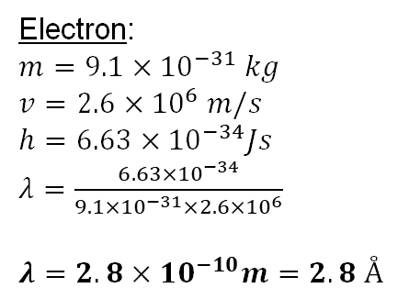

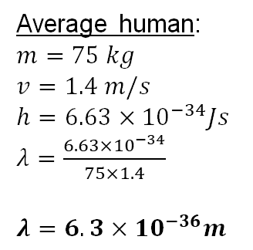

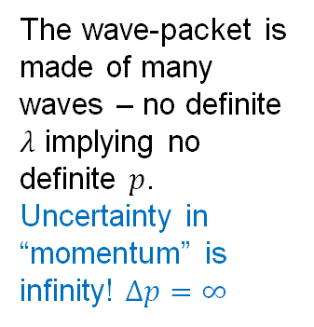
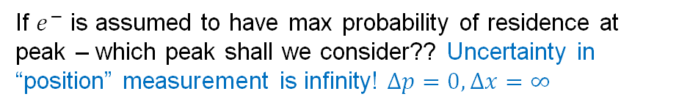



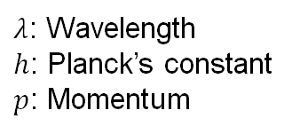

De Broglie Relationship & Heisenberg Uncertainty
Consequence of wave particle duality:
Every particle having momentum has a wavelength
Every wave has a momentum associated
If $p$ is known, then by De Broglie’s relationship $λ$ is known
$$×$$
$$×$$
$$×$$
For matter waves:
$$λ=h/p$$
$λ$: Wavelength
$h$: Planck’s constant
$p$: Momentum
If $e^{−}$ is assumed to have max probability of residence at peak – which peak shall we consider?? Uncertainty in “position” measurement is infinity! $Δp=0,Δx=∞$
Average human:
$m=75 kg$
$v=1.4 m/s$
$h=6.63×{10}^{−34}Js$
$λ=\frac{6.63×{10}^{−34}}{75×1.4}$
$λ=6.3×{10}^{−36}m$
Wave-packet
The wave-packet is made of many waves – no definite $λ$ implying no definite $p$. Uncertainty in “momentum” is infinity! $Δp=∞$
Electron:
$m=9.1×{10}^{−31} kg$
$v=2.6×{10}^{6} m/s$
$h=6.63×{10}^{−34}Js$
$λ=\frac{6.63×{10}^{−34}}{9.1×{10}^{−31}×2.6×{10}^{6}}$
$λ=2.8×{10}^{−10}m=2.8 Å$
$$e^{−}$$
Superposition of waves
$$L$$
$$Δx=0$$
$$ΔxΔp≥\frac{h}{4π}$$

Slide 8
Summary
We understood how wave-nature and particle-nature can be distinguished experimentally.
We learnt that electrons could have both wave or particle nature.
We learnt that every matter has waves associated with it – De Broglie’s hypothesis
We learnt that position and momentum cannot be measured simultaneously for quantum systems – Heisenberg Uncertainty

Slide 9
Electron & its Quirks!
Lecture 3
Sayan Bhowmik
School of Chemical & Biomolecular Engineering
College of Engineering
Georgia Institute of Technology

Slide 10
Contents
We will understand what free electron motion is.
We will look at waves in confinement – standing waves.
Consequences of electrons in confinement:
  Time-dependent Schrodinger Equation
  Time-independent Schrodinger Equation (Stationary States)
Ground state – A special Stationary State

Slide 11
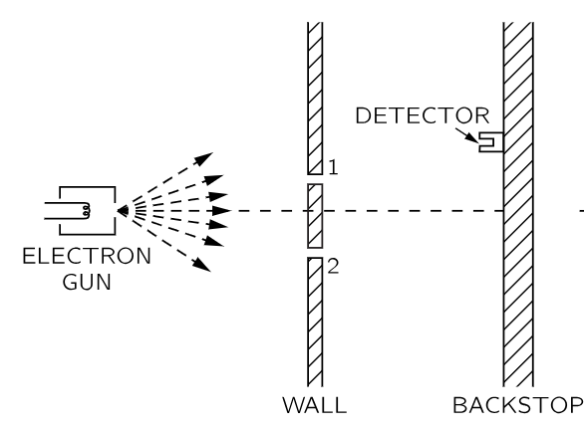

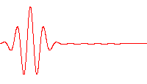
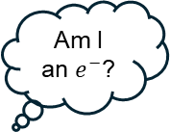

Free electron without confinement
Electron double slit expt.
N slits expt.
N slits expt. – e⁻ can take any path
Each path has associated probabilities
Feynman’s Path Integral Method
Am I an $e^{−}$?
Drunkard’s walk-
Diffusion process
$$i\frac{∂ψ}{∂t}=−\frac{1}{2}∇^{2}ψ$$
N slits, N walls expt. – more combination of paths!
Infinite slits and walls expt. – free space!
Infinite paths – similar to Markov chains!
1 D diffusion of free e⁻
Feynman’s lectures on physics

Slide 12

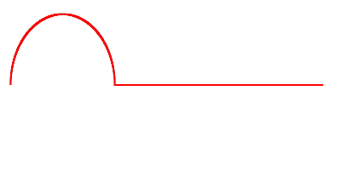
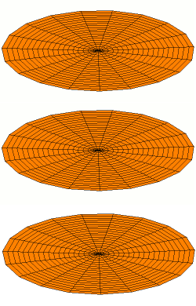
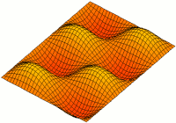
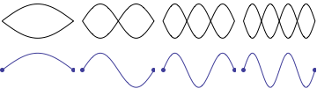
Waves in confinement – Standing Waves
Wikimedia Commons
Wikimedia Commons
Wikimedia Commons
One end fixed
Both ends fixed
Special vibrations when both ends fixed:
The wave shape does NOT change in shape with time.
The oscillation becomes 0 at some points other than ends - nodes
Standing Waves
Standing Waves: 2D membranes
https://www.acs.psu.edu/drussell/Demos/StandingWaves/StandingWaves.html

Slide 13
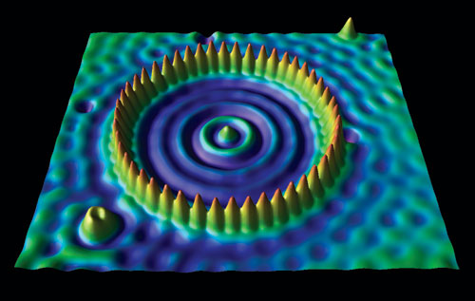
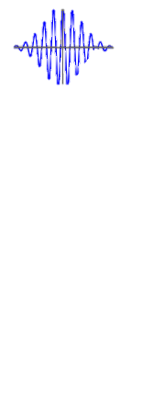
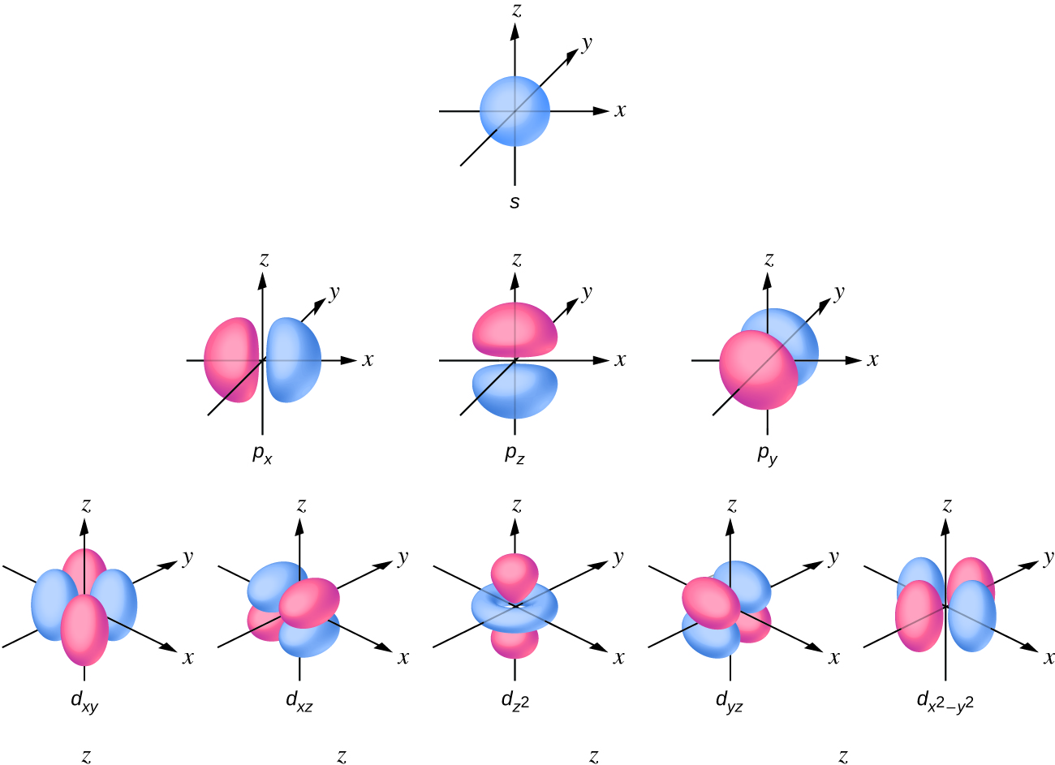




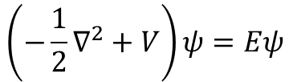
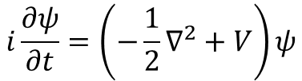
Electrons in confinement – Stationary States
nodes
$$e^{−}$$
Cu (111) surface e⁻
Fe atoms
Wikimedia Commons
Wave associated with an e⁻ can have a state where the wave forms standing waves – stationary states
Solutions to TISE ($ψ$) for H:
Don Eigler, IBM – STM experiments
Time dependent Schrodinger Equation:
Only occupied state
e⁻ revolves around nucleus due to an attractive potential
e⁻ is therefore bound/confined around nucleus
Can form 3D standing waves or stationary states – atomic orbitals
$$H^{+}$$
$$i\frac{∂ψ}{∂t}=\left(−\frac{1}{2}∇^{2}+V\right)ψ$$
$$e^{−}$$
Time independent Schrodinger Equation:
$$\left(−\frac{1}{2}∇^{2}+V\right)ψ=Eψ$$

Slide 14


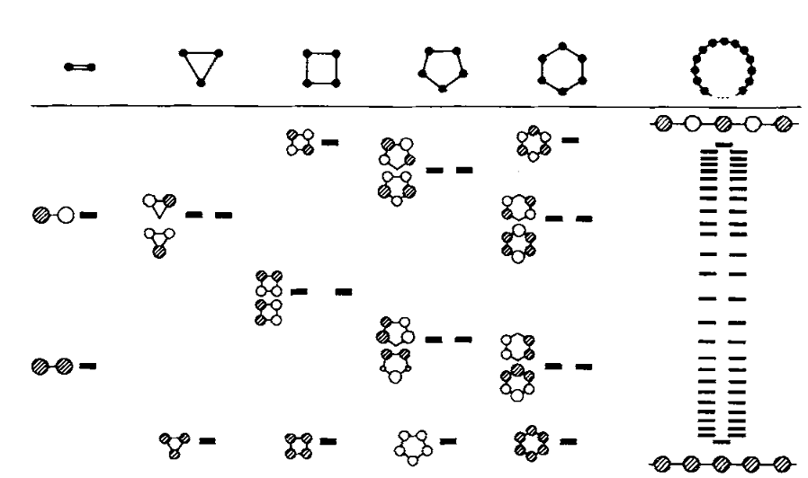




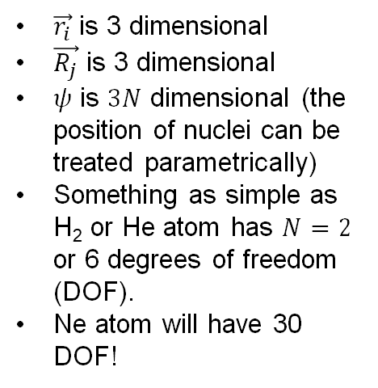
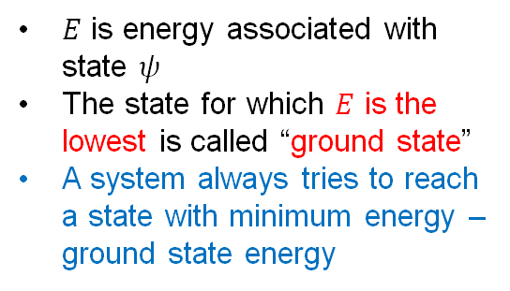

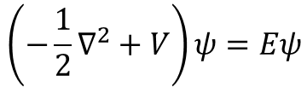

Ground State – Special Stationary State
Time independent Schrodinger Equation (TISE):
How do we model systems having > 1 electron or nucleus (compounds)?
$$\left(−\frac{1}{2}∇^{2}+V\right)ψ=Eψ$$
Hydrogen “molecules”
$\vec{r_{i}}$ is 3 dimensional
$\vec{R_{j}}$ is 3 dimensional
$ψ$ is $3N$ dimensional (the position of nuclei can be treated parametrically)
Something as simple as H₂ or He atom has $N=2$ or 6 degrees of freedom (DOF).
Ne atom will have 30 DOF!
$E$ is energy associated with state $ψ$
The state for which $E$ is the lowest is called “ground state”
A system always tries to reach a state with minimum energy – ground state energy
Aim: To find ground state solution
Solve the TISE but solution only exists for Hydrogen – 1 electron
There are 117 other elements and millions of compounds all having > 1 electron!
$$ψ=ψ\left(\vec{r_{1}},\vec{r_{2}},⋯,\vec{r_{N}},\vec{R_{1}},\vec{R_{2}},⋯,\vec{R_{M}}\right)$$
$N$ electrons, $M$ nuclei
There must be a cheaper way to solve things!
Roald Hoffmann, Angew,. Chem. Int. Ed. Engl. 26 (1987) 846-878

Slide 15
Summary
We understood how free electron motion can be characterised as a random walk.
We learnt about waves in confinement and standing waves
We learnt about electrons in confinement and stationary states
We learnt that stationary states are obtained from solutions of Time independent Schrodinger Equation
We learnt that solving the Schrodinger Equation is seemingly impossible!

