Slide 1
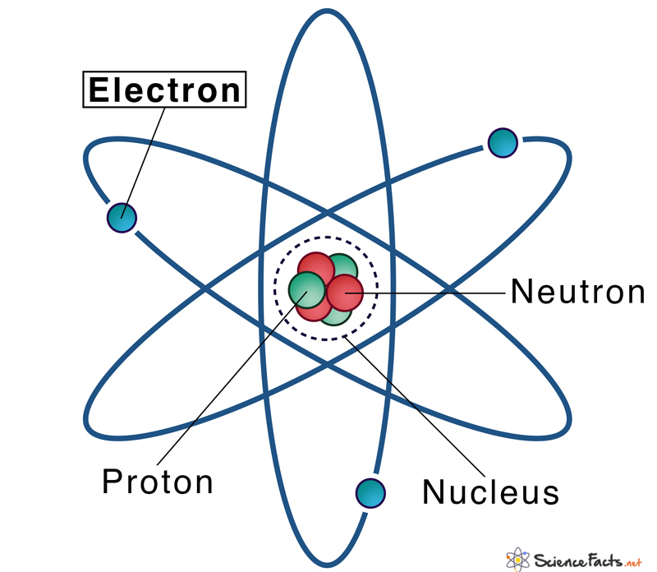
Electronic Structure Theory
Lecture 4: Many Body Problem
Sayan Bhowmik
School of Chemical & Biomolecular Engineering
College of Engineering
Georgia Institute of Technology

Slide 2
Contents
We will understand what atomic units are.
We will look at Hamiltonian of electronic problem.
Born Oppenheimer approximation – decoupling the electronic motion from the nucleus.

Slide 3
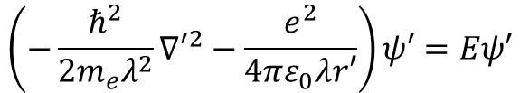


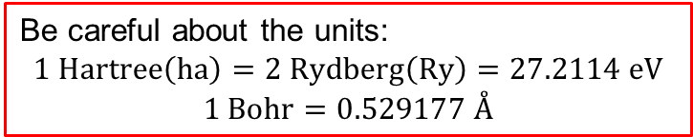

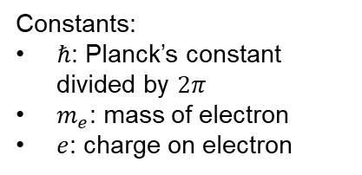
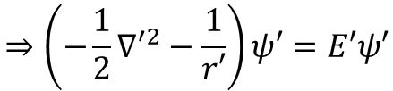
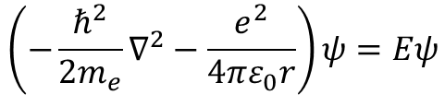
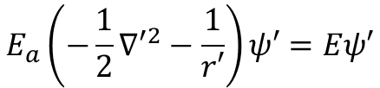
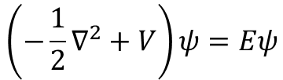
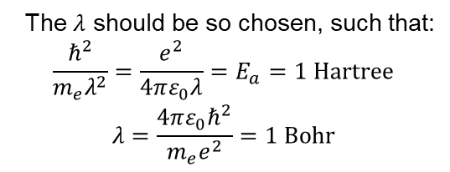
Atomic Units
In SI unit:
$$H^{+}$$
$$\left(−\frac{1}{2}∇^{2}+V\right)ψ=Eψ$$
$$\left(−\frac{ℏ^{2}}{2m_{e}}∇^{2}−\frac{e^{2}}{4πε_{0}r}\right)ψ=Eψ$$
Constants:
$ℏ$: Planck’s constant divided by $2π$
$m_{e}$: mass of electron
$e$: charge on electron
$$e^{−}$$
Written in atomic units
Non-dimensional form:
$$x,y,z→λx^{′},λy^{′},λz′$$
The $λ$ should be so chosen, such that:
$$\frac{ℏ^{2}}{m_{e}λ^{2}}=\frac{e^{2}}{4πε_{0}λ}=E_{a}=1 Hartree$$
$$λ=\frac{4πε_{0}ℏ^{2}}{m_{e}e^{2}}=1 Bohr$$
$$\left(−\frac{ℏ^{2}}{2m_{e}λ^{2}}{∇′}^{2}−\frac{e^{2}}{4πε_{0}λr′}\right)ψ′=Eψ′$$
$$E_{a}\left(−\frac{1}{2}{∇′}^{2}−\frac{1}{r′}\right)ψ′=Eψ′$$
Be careful about the units:
$$1 Hartree\left(ha\right)=2 Rydberg\left(Ry\right)=27.2114 eV$$
$$1 Bohr=0.529177 Å$$
In Hartree units
$$⇒\left(−\frac{1}{2}{∇′}^{2}−\frac{1}{r′}\right)ψ′=E′ψ′$$
In Bohr units
Attila Szabo and Neil S. Ostlund, Modern Quantum Chemistry – Introduction to Advanced Electronic Structure Theory, Dover Publications

Slide 4
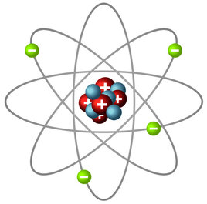




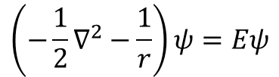


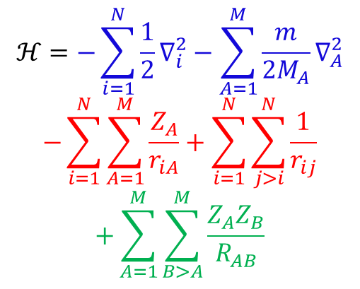
Many Body Electronic Structure Problem
One nucleus
One electron:
$$\left(−\frac{1}{2}∇^{2}−\frac{1}{r}\right)ψ=Eψ$$
$$H^{+}$$
Nuclear attraction
energy
$$e^{−}$$
Repulsion energy
Many nuclei, many electrons:
$$ψ=ψ\left(\vec{r_{1}},\vec{r_{2}},⋯,\vec{r_{N}},\vec{R_{1}},\vec{R_{2}},⋯,\vec{R_{M}}\right)$$
$N$ electrons, $M$ nuclei
Nuclear repulsion
Kinetic energy of $e^{−}$
$$ℋψ=Eψ$$
$$ℋ=−\sum_{i=1}^{N}{\frac{1}{2}∇_{i}^{2}}−\sum_{A=1}^{M}{\frac{m}{2M_{A}}∇_{A}^{2}}$$
$$−\sum_{i=1}^{N}{\sum_{A=1}^{M}{\frac{Z_{A}}{r_{iA}}}}+\sum_{i=1}^{N}{\sum_{j>i}^{N}{\frac{1}{r_{ij}}}}$$
$$+\sum_{A=1}^{M}{\sum_{B>A}^{M}{\frac{Z_{A}Z_{B}}{R_{AB}}}}$$
Kinetic Energy
Kinetic energy of nuclei
Potential Energy
Attila Szabo and Neil S. Ostlund, Modern Quantum Chemistry – Introduction to Advanced Electronic Structure Theory, Dover Publications

Slide 5
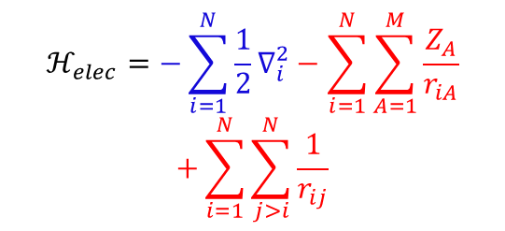
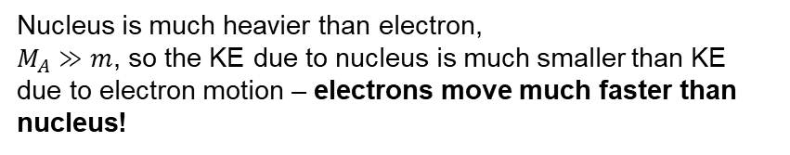
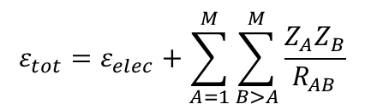
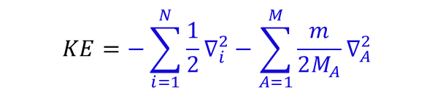

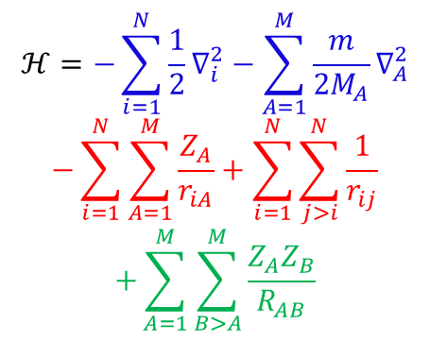



Born Oppenheimer Approximation
$$KE=−\sum_{i=1}^{N}{\frac{1}{2}∇_{i}^{2}}−\sum_{A=1}^{M}{\frac{m}{2M_{A}}∇_{A}^{2}}$$
Kinetic Energy
Nuclear attraction
energy
Due to nucleus
Repulsion energy
Nucleus is much heavier than electron,
$M_{A}≫m$, so the KE due to nucleus is much smaller than KE due to electron motion – electrons move much faster than nucleus!
Nuclear repulsion
0
$$ℋ=−\sum_{i=1}^{N}{\frac{1}{2}∇_{i}^{2}}−\sum_{A=1}^{M}{\frac{m}{2M_{A}}∇_{A}^{2}}$$
$$−\sum_{i=1}^{N}{\sum_{A=1}^{M}{\frac{Z_{A}}{r_{iA}}}}+\sum_{i=1}^{N}{\sum_{j>i}^{N}{\frac{1}{r_{ij}}}}$$
$$+\sum_{A=1}^{M}{\sum_{B>A}^{M}{\frac{Z_{A}Z_{B}}{R_{AB}}}}$$
$$ℋ_{elec}=−\sum_{i=1}^{N}{\frac{1}{2}∇_{i}^{2}}−\sum_{i=1}^{N}{\sum_{A=1}^{M}{\frac{Z_{A}}{r_{iA}}}}$$
$$+\sum_{i=1}^{N}{\sum_{j>i}^{N}{\frac{1}{r_{ij}}}}$$
Kinetic energy of $e^{−}$
Kinetic energy of nuclei
$$ℋ_{elec}ψ_{elec}=ε_{elec}ψ_{elec}$$
$$ψ_{elec}=ψ_{elec}\left(\left\{r_{i}\right\},\left\{R_{A}\right\}\right);$$
$$ε_{elec}=ε_{elec}\left(\left\{R_{A}\right\}\right)$$
const.
$$ε_{tot}=ε_{elec}+\sum_{A=1}^{M}{\sum_{B>A}^{M}{\frac{Z_{A}Z_{B}}{R_{AB}}}}$$
Explicit in $\left\{r_{i}\right\}$, parametric in $\left\{R_{A}\right\}$
Attila Szabo and Neil S. Ostlund, Modern Quantum Chemistry – Introduction to Advanced Electronic Structure Theory, Dover Publications

Slide 6
Summary
We understood what atomic units are.
We learnt about many body electronic structure problem.
We learnt about the Born Oppenheimer approximation
  Solving for only the “electron” interaction suffices
  The nuclear positions can be dealt with parametrically

Slide 7
Electronic Structure Theory
Lecture 5: Orbitals
Sayan Bhowmik
School of Chemical & Biomolecular Engineering
College of Engineering
Georgia Institute of Technology

Slide 8
Contents
Born Oppenheimer approximation – consequences.
We will understand what antisymmetry of orbitals means.
We will look at spin and spatial orbitals.

Slide 9

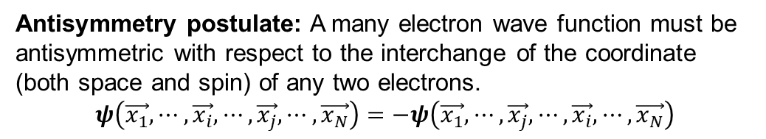
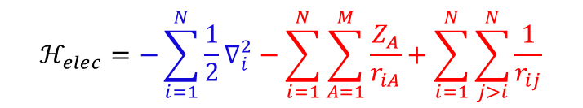
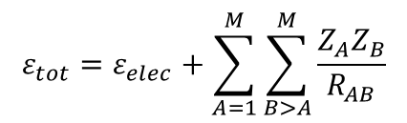
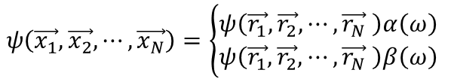






Born Oppenheimer Approximation
$$ℋ_{elec}=−\sum_{i=1}^{N}{\frac{1}{2}∇_{i}^{2}}−\sum_{i=1}^{N}{\sum_{A=1}^{M}{\frac{Z_{A}}{r_{iA}}}}+\sum_{i=1}^{N}{\sum_{j>i}^{N}{\frac{1}{r_{ij}}}}$$
$$ψ=ψ\left(\vec{r_{1}},\vec{r_{2}},⋯,\vec{r_{N}},\vec{R_{1}},\vec{R_{2}},⋯,\vec{R_{M}}\right)$$
$$ψ=ψ\left(\vec{r_{1}},\vec{r_{2}},⋯,\vec{r_{N}} \right)$$
$N$ electrons, $M$ nuclei
Combined coordinates: $x=\left\{r,ω\right\}$
$$ℋ_{elec}ψ_{elec}=ε_{elec}ψ_{elec}$$
Spatial coordinates of electron
spin variable
$$ψ_{elec}=ψ_{elec}\left(\left\{r_{i}\right\},\left\{R_{A}\right\}\right);$$
$$ε_{elec}=ε_{elec}\left(\left\{R_{A}\right\}\right)$$
$$ψ\left(\vec{x_{1}},\vec{x_{2}},⋯,\vec{x_{N}}\right)=\left\{\begin{aligned}ψ\left(\vec{r_{1}},\vec{r_{2}},⋯,\vec{r_{N}} \right)α\left(ω\right) \\ ψ\left(\vec{r_{1}},\vec{r_{2}},⋯,\vec{r_{N}} \right)β\left(ω\right) \end{aligned}\right.$$
Up-spin
Down-spin
Explicit in $\left\{r_{i}\right\}$, parametric in $\left\{R_{A}\right\}$
spatial part
$$ε_{tot}=ε_{elec}+\sum_{A=1}^{M}{\sum_{B>A}^{M}{\frac{Z_{A}Z_{B}}{R_{AB}}}}$$
Pauli’s exclusion principle
Antisymmetry postulate: A many electron wave function must be antisymmetric with respect to the interchange of the coordinate (both space and spin) of any two electrons.
$$ψ\left(\vec{x_{1}},⋯,\vec{x_{i}},⋯,\vec{x_{j}},⋯,\vec{x_{N}}\right)=−ψ\left(\vec{x_{1}},⋯,\vec{x_{j}},⋯,\vec{x_{i}},⋯,\vec{x_{N}}\right)$$
Attila Szabo and Neil S. Ostlund, Modern Quantum Chemistry – Introduction to Advanced Electronic Structure Theory, Dover Publications

Slide 10
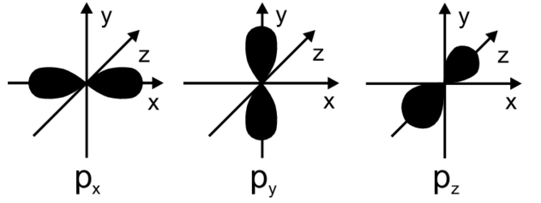
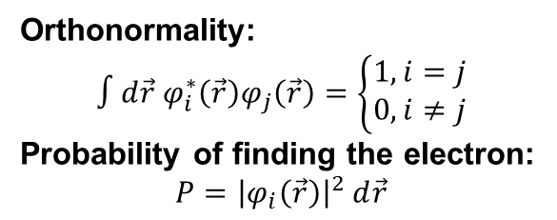
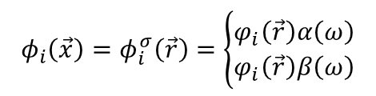
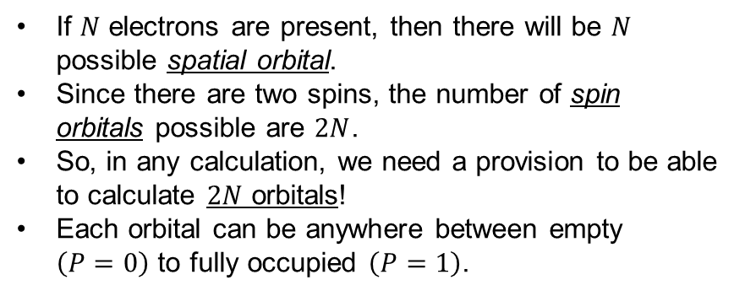
Orbitals
Definition: A wave function for a single particle (an electron). A spatial orbital is a function of the position vector $\vec{r}$ and describes the spatial distribution of an electron.
Orthonormality:
$$∫d\vec{r}{ φ}_{i}^{∗}\left(\vec{r}\right)φ_{j}\left(\vec{r}\right)=\left\{\begin{aligned}1, i=j \\ 0, i≠j\end{aligned}\right.$$
Probability of finding the electron:
$$P={\left|φ_{i}\left(\vec{r}\right)\right|}^{2} d\vec{r}$$
If $N$ electrons are present, then there will be $N$ possible spatial orbital.
Since there are two spins, the number of spin orbitals possible are $2N$.
So, in any calculation, we need a provision to be able to calculate $2N$ orbitals!
Each orbital can be anywhere between empty $\left(P=0\right)$ to fully occupied $\left(P=1\right)$.
Spin orbitals for each electron:
$${φ_{i}\left(\vec{x}\right)=φ}_{i}^{σ}\left(\vec{r}\right)=\left\{\begin{aligned}φ_{i}\left(\vec{r}\right)α\left(ω\right) \\ φ_{i}\left(\vec{r}\right)β\left(ω\right)\end{aligned}\right.$$
Orthonormal orbitals
Attila Szabo and Neil S. Ostlund, Modern Quantum Chemistry – Introduction to Advanced Electronic Structure Theory, Dover Publications

Slide 11
Summary
We understood how the electronic problem can be decoupled from the nuclear motion.
We learnt about antisymmetric postulate
We learnt about orbitals and their involvement in the solution of the problem.

Slide 12
Electronic Structure Theory
Lecture 6: Slater determinants and Electron Density
Sayan Bhowmik
School of Chemical & Biomolecular Engineering
College of Engineering
Georgia Institute of Technology

Slide 13
Contents
Slater determinants – from orbitals to complete wavefunction.
We will understand how to get to electron density from the individual orbitals.

Slide 14
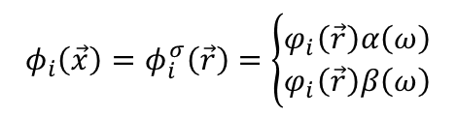

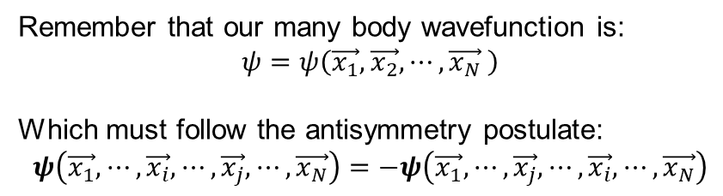

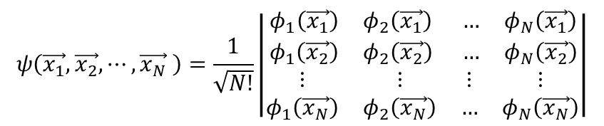
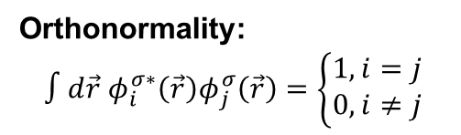
Slater determinants
Remember that our many body wavefunction is:
$$ψ=ψ\left(\vec{x_{1}},\vec{x_{2}},⋯,\vec{x_{N}} \right)$$
Which must follow the antisymmetry postulate:
$$ψ\left(\vec{x_{1}},⋯,\vec{x_{i}},⋯,\vec{x_{j}},⋯,\vec{x_{N}}\right)=−ψ\left(\vec{x_{1}},⋯,\vec{x_{j}},⋯,\vec{x_{i}},⋯,\vec{x_{N}}\right)$$
$$ψ\left(\vec{x_{1}},\vec{x_{2}},⋯,\vec{x_{N}} \right)=\frac{1}{\sqrt{N!}}\left|\begin{matrix}\begin{matrix}φ_{1}\left(\vec{x_{1}}\right) & φ_{2}\left(\vec{x_{1}}\right) \\ φ_{1}\left(\vec{x_{2}}\right) & φ_{2}\left(\vec{x_{2}}\right)\end{matrix} & \begin{matrix}… & φ_{N}\left(\vec{x_{1}}\right) \\ … & φ_{N}\left(\vec{x_{2}}\right)\end{matrix} \\ \begin{matrix}⋮ & ⋮ \\ φ_{1}\left(\vec{x_{N}}\right) & φ_{2}\left(\vec{x_{N}}\right)\end{matrix} & \begin{matrix}⋮ & ⋮ \\ … & φ_{N}\left(\vec{x_{N}}\right)\end{matrix}\end{matrix}\right|$$
Spin orbitals for each electron:
$${φ_{i}\left(\vec{x}\right)=φ}_{i}^{σ}\left(\vec{r}\right)=\left\{\begin{aligned}φ_{i}\left(\vec{r}\right)α\left(ω\right) \\ φ_{i}\left(\vec{r}\right)β\left(ω\right)\end{aligned}\right.$$
Antisymmetry satisfied – switch two rows
Indistinguishable electrons – all N electrons are associated with each of the orbitals
Mapping of orbitals to complete wavefunction
Orthonormality:
$$∫d\vec{r}{ φ}_{i}^{σ∗}\left(\vec{r}\right)φ_{j}^{σ}\left(\vec{r}\right)=\left\{\begin{aligned}1, i=j \\ 0, i≠j\end{aligned}\right.$$
$$ℋ_{elec}ψ_{elec}=ε_{elec}ψ_{elec}$$
How do we form $ℋ_{elec}$?
One electron is indistinguishable from the other
Attila Szabo and Neil S. Ostlund, Modern Quantum Chemistry – Introduction to Advanced Electronic Structure Theory, Dover Publications

Slide 15


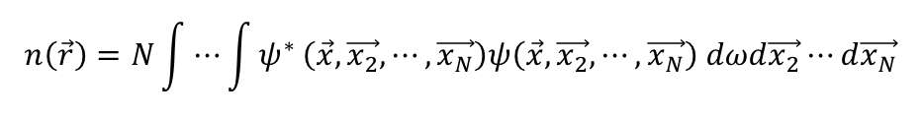
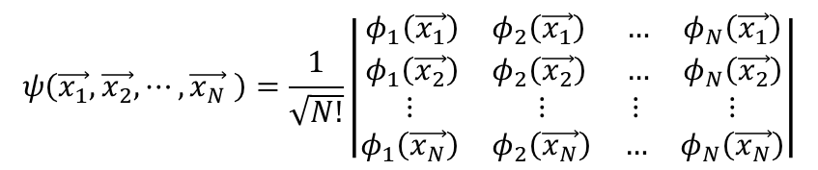

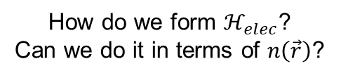
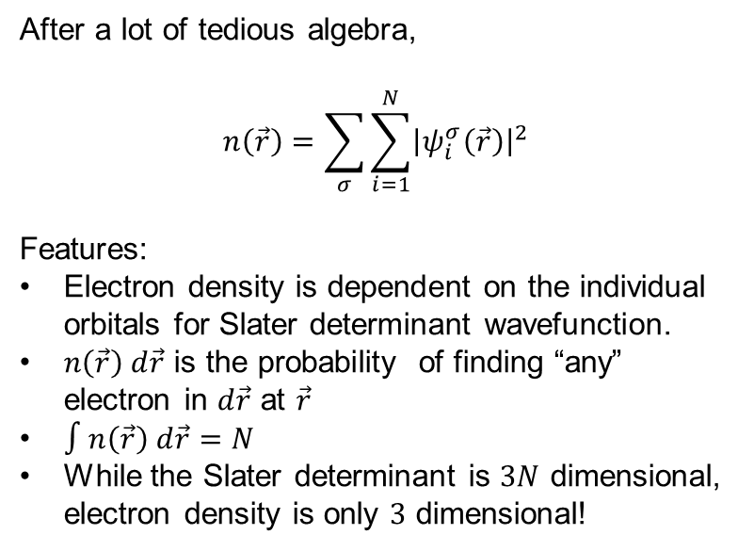
Electron density
After a lot of tedious algebra,
$$n\left(\vec{r}\right)=\sum_{σ}{\sum_{i=1}^{N}{{\left|ψ_{i}^{σ}\left(\vec{r}\right)\right|}^{2}}}$$
Features:
Electron density is dependent on the individual orbitals for Slater determinant wavefunction.
$n\left(\vec{r}\right) d\vec{r}$ is the probability of finding “any” electron in $d\vec{r}$ at $\vec{r}$
$∫n\left(\vec{r}\right) d\vec{r}=N$
While the Slater determinant is $3N$ dimensional, electron density is only $3$ dimensional!
$$ψ\left(\vec{x_{1}},\vec{x_{2}},⋯,\vec{x_{N}} \right)=\frac{1}{\sqrt{N!}}\left|\begin{matrix}\begin{matrix}φ_{1}\left(\vec{x_{1}}\right) & φ_{2}\left(\vec{x_{1}}\right) \\ φ_{1}\left(\vec{x_{2}}\right) & φ_{2}\left(\vec{x_{2}}\right)\end{matrix} & \begin{matrix}… & φ_{N}\left(\vec{x_{1}}\right) \\ … & φ_{N}\left(\vec{x_{2}}\right)\end{matrix} \\ \begin{matrix}⋮ & ⋮ \\ φ_{1}\left(\vec{x_{N}}\right) & φ_{2}\left(\vec{x_{N}}\right)\end{matrix} & \begin{matrix}⋮ & ⋮ \\ … & φ_{N}\left(\vec{x_{N}}\right)\end{matrix}\end{matrix}\right|$$
$$n\left(\vec{r}\right)=N\int{⋯\int{ψ^{∗}}}\left(\vec{x},\vec{x_{2}},⋯,\vec{x_{N}}\right)ψ\left(\vec{x},\vec{x_{2}},⋯,\vec{x_{N}}\right) dωd\vec{x_{2}}⋯d\vec{x_{N}}$$
Electron density
$$ℋ_{elec}ψ_{elec}=ε_{elec}ψ_{elec}$$
How do we form $ℋ_{elec}$?
Can we do it in terms of $n\left(\vec{r}\right)$?
Attila Szabo and Neil S. Ostlund, Modern Quantum Chemistry – Introduction to Advanced Electronic Structure Theory, Dover Publications

