Slide 1
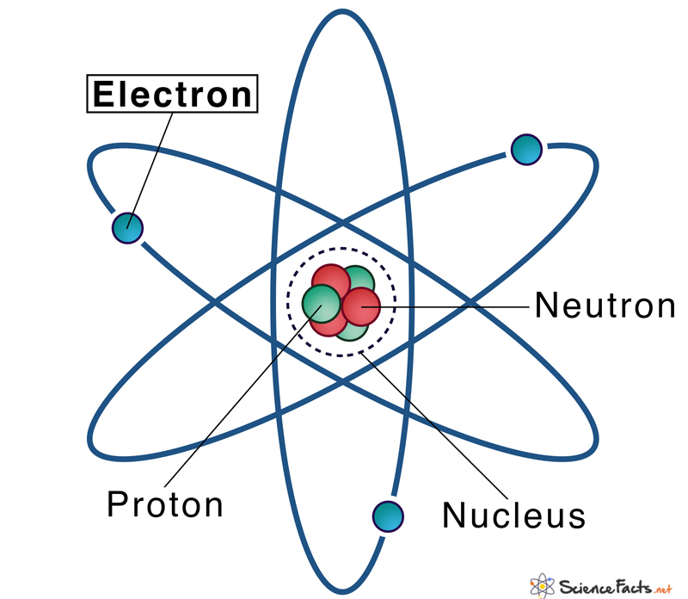
Electronic Structure Theory
Lecture 7: Hohenberg & Kohn Theorems
Sayan Bhowmik
School of Chemical & Biomolecular Engineering
College of Engineering
Georgia Institute of Technology

Slide 2
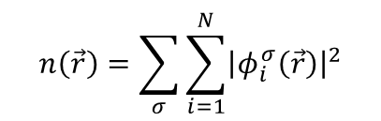

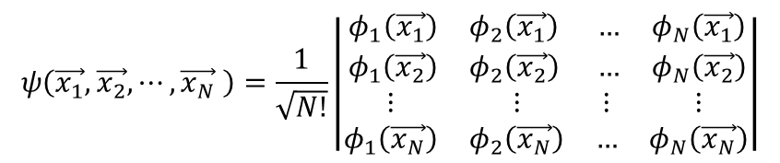
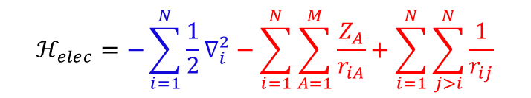
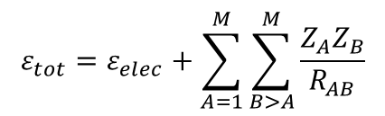


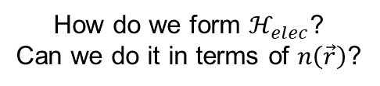
Recap
$$ℋ_{elec}=−\sum_{i=1}^{N}{\frac{1}{2}∇_{i}^{2}}−\sum_{i=1}^{N}{\sum_{A=1}^{M}{\frac{Z_{A}}{r_{iA}}}}+\sum_{i=1}^{N}{\sum_{j>i}^{N}{\frac{1}{r_{ij}}}}$$
Orbitals: A wave function for a single particle (an electron).
$$ψ\left(\vec{x_{1}},\vec{x_{2}},⋯,\vec{x_{N}} \right)=\frac{1}{\sqrt{N!}}\left|\begin{matrix}\begin{matrix}φ_{1}\left(\vec{x_{1}}\right) & φ_{2}\left(\vec{x_{1}}\right) \\ φ_{1}\left(\vec{x_{2}}\right) & φ_{2}\left(\vec{x_{2}}\right)\end{matrix} & \begin{matrix}… & φ_{N}\left(\vec{x_{1}}\right) \\ … & φ_{N}\left(\vec{x_{2}}\right)\end{matrix} \\ \begin{matrix}⋮ & ⋮ \\ φ_{1}\left(\vec{x_{N}}\right) & φ_{2}\left(\vec{x_{N}}\right)\end{matrix} & \begin{matrix}⋮ & ⋮ \\ … & φ_{N}\left(\vec{x_{N}}\right)\end{matrix}\end{matrix}\right|$$
$$ℋ_{elec}ψ_{elec}=ε_{elec}ψ_{elec}$$
$$ψ_{elec}=ψ_{elec}\left(\left\{r_{i}\right\},\left\{R_{A}\right\}\right);$$
$$ε_{elec}=ε_{elec}\left(\left\{R_{A}\right\}\right)$$
$$n\left(\vec{r}\right)=\sum_{σ}{\sum_{i=1}^{N}{{\left|φ_{i}^{σ}\left(\vec{r}\right)\right|}^{2}}}$$
Electron Density:
Explicit in $\left\{r_{i}\right\}$, parametric in $\left\{R_{A}\right\}$
$$ε_{tot}=ε_{elec}+\sum_{A=1}^{M}{\sum_{B>A}^{M}{\frac{Z_{A}Z_{B}}{R_{AB}}}}$$
How do we form $ℋ_{elec}$?
Can we do it in terms of $n\left(\vec{r}\right)$?

Slide 3
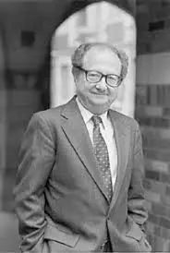
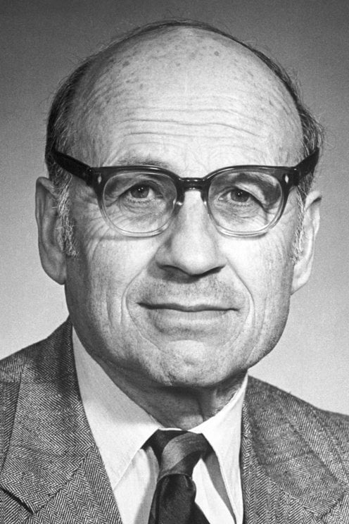

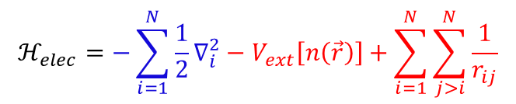



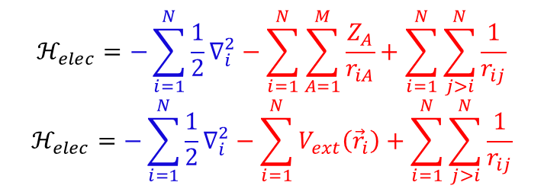
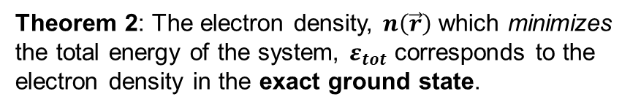

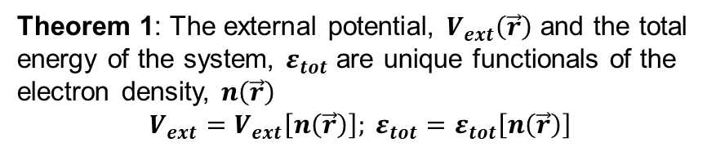

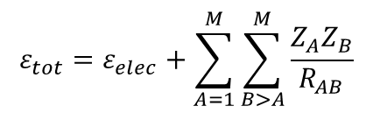

Hohenberg & Kohn Theorems
$$ℋ_{elec}ψ_{elec}=ε_{elec}ψ_{elec}$$
$$ε_{tot}=ε_{elec}+\sum_{A=1}^{M}{\sum_{B>A}^{M}{\frac{Z_{A}Z_{B}}{R_{AB}}}}$$
Pierre Hohenberg
Walter Kohn
$$ℋ_{elec}=−\sum_{i=1}^{N}{\frac{1}{2}∇_{i}^{2}}−\sum_{i=1}^{N}{\sum_{A=1}^{M}{\frac{Z_{A}}{r_{iA}}}}+\sum_{i=1}^{N}{\sum_{j>i}^{N}{\frac{1}{r_{ij}}}}$$
$$ℋ_{elec}=−\sum_{i=1}^{N}{\frac{1}{2}∇_{i}^{2}}−\sum_{i=1}^{N}{V_{ext}\left({\vec{r}}_{i}\right)}+\sum_{i=1}^{N}{\sum_{j>i}^{N}{\frac{1}{r_{ij}}}}$$
$$ℝ$$
$$f$$
$$ℝ$$
$$f\left(ℝ \right)$$
$$F$$
$$ℝ$$
One body term
Two body term
Functions
Functionals
Theorem 1: The external potential, $V_{ext}\left(\vec{r}\right)$ and the total energy of the system, $ε_{tot}$ are unique functionals of the electron density, $n\left(\vec{r}\right)$
$$V_{ext}=V_{ext}\left[n\left(\vec{r}\right)\right]; ε_{tot}=ε_{tot}\left[n\left(\vec{r}\right)\right]$$
$$ℋ_{elec}=−\sum_{i=1}^{N}{\frac{1}{2}∇_{i}^{2}}−V_{ext}\left[n\left(\vec{r}\right)\right]+\sum_{i=1}^{N}{\sum_{j>i}^{N}{\frac{1}{r_{ij}}}}$$
Theorem 2: The electron density, $n\left(\vec{r}\right)$ which minimizes the total energy of the system, $ε_{tot}$ corresponds to the electron density in the exact ground state.
One body term
Two body term
Martin, R. M., Electronic structure: Basic theory and applications, Cambridge University Press, 2004

Slide 4
Electronic Structure Theory
Lecture 8: Hamiltonian approximations
Sayan Bhowmik
School of Chemical & Biomolecular Engineering
College of Engineering
Georgia Institute of Technology

Slide 5
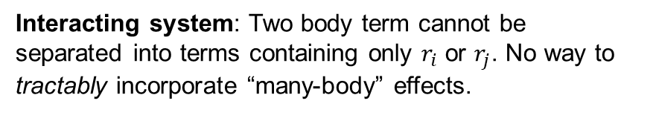
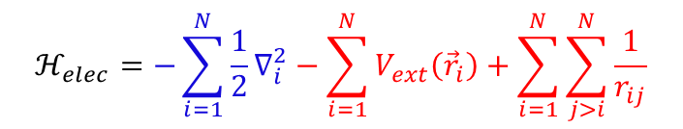
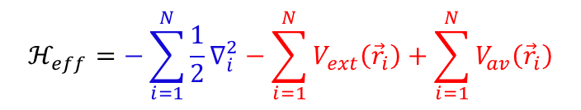
Interacting and non-interacting electrons
$$ℋ_{elec}=−\sum_{i=1}^{N}{\frac{1}{2}∇_{i}^{2}}−\sum_{i=1}^{N}{V_{ext}\left({\vec{r}}_{i}\right)}+\sum_{i=1}^{N}{\sum_{j>i}^{N}{\frac{1}{r_{ij}}}}$$
Interacting system: Two body term cannot be separated into terms containing only $r_{i}$ or $r_{j}$. No way to tractably incorporate “many-body” effects.
One body term
Two body term
Non – interacting system: Replace the two-body term with some “average” one-body term describing the “many-body” interactions.
We now have an effective Hamiltonian mimicking the electronic Hamiltonian.
Easier to handle (and tractably solve)!
$$ℋ_{eff}=−\sum_{i=1}^{N}{\frac{1}{2}∇_{i}^{2}}−\sum_{i=1}^{N}{V_{ext}\left({\vec{r}}_{i}\right)}+\sum_{i=1}^{N}{V_{av}\left({\vec{r}}_{i}\right)}$$
One body term
Two body term – changed to one body term
Martin, R. M., Electronic structure: Basic theory and applications, Cambridge University Press, 2004

Slide 6
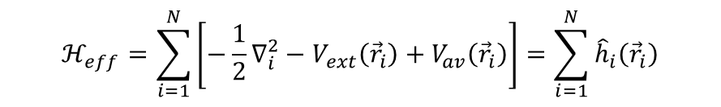
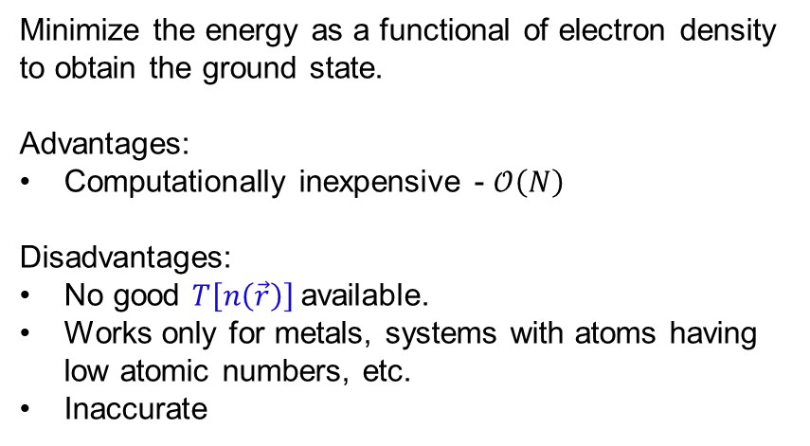
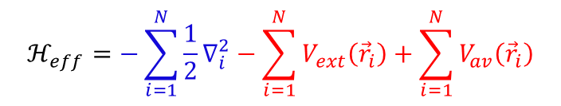
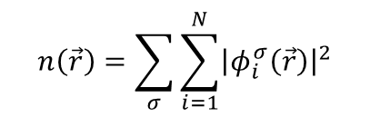
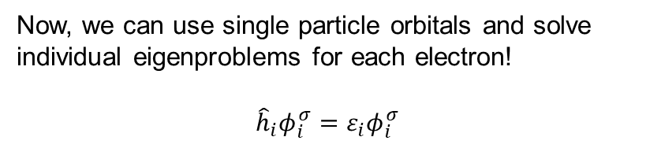
Effective Hamiltonian
$$ℋ_{eff}=−\sum_{i=1}^{N}{\frac{1}{2}∇_{i}^{2}}−\sum_{i=1}^{N}{V_{ext}\left({\vec{r}}_{i}\right)}+\sum_{i=1}^{N}{V_{av}\left({\vec{r}}_{i}\right)}$$
$$n\left(\vec{r}\right)=\sum_{σ}{\sum_{i=1}^{N}{{\left|φ_{i}^{σ}\left(\vec{r}\right)\right|}^{2}}}$$
Electron Density:
One body term
$$ℋ_{eff}=T\left[n\left(\vec{r}\right)\right]−V_{ext}\left[n\left(\vec{r}\right)\right]+V_{av}\left[n\left(\vec{r}\right)\right]$$
$$ℋ_{eff}=\sum_{i=1}^{N}{\left[−\frac{1}{2}∇_{i}^{2}−V_{ext}\left({\vec{r}}_{i}\right)+V_{av}\left({\vec{r}}_{i}\right)\right]}=\sum_{i=1}^{N}{{\hat{h}}_{i}\left({\vec{r}}_{i}\right)}$$
Orbital free density functional theory (OFDFT)
Minimize the energy as a functional of electron density to obtain the ground state.
Advantages:
Computationally inexpensive - $𝒪\left(N\right)$
Disadvantages:
No good $T\left[n\left(\vec{r}\right)\right]$available.
Works only for metals, systems with atoms having low atomic numbers, etc.
Inaccurate
Effective Hamiltonian becomes a sum of one-electron Hamiltonians
Now, we can use single particle orbitals and solve individual eigenproblems for each electron!
$${\hat{h}}_{i}φ_{i}^{σ}=ε_{i}φ_{i}^{σ}$$
This still entails solving an eigenproblem for N eigenvalues and eigenvectors.
Martin, R. M., Electronic structure: Basic theory and applications, Cambridge University Press, 2004

Slide 7
Electronic Structure Theory
Lecture 9: Kohn-Sham Density Functional Theory
Sayan Bhowmik
School of Chemical & Biomolecular Engineering
College of Engineering
Georgia Institute of Technology

Slide 8

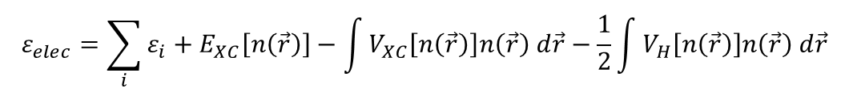


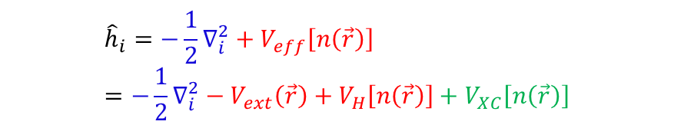

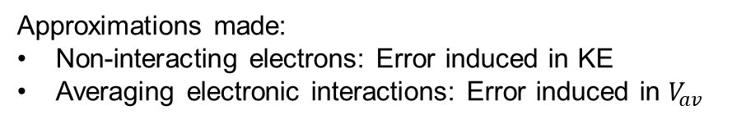
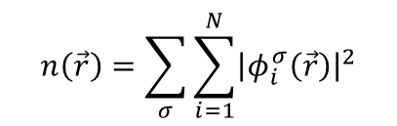

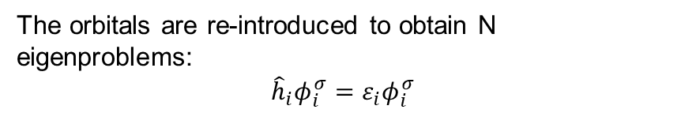
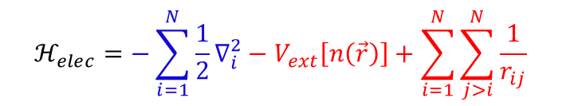
Density Functional Theory
$$ℋ_{eff}=T\left[n\left(\vec{r}\right)\right]−V_{ext}\left[n\left(\vec{r}\right)\right]+V_{av}\left[n\left(\vec{r}\right)\right]$$
The orbitals are re-introduced to obtain N eigenproblems:
$${\hat{h}}_{i}φ_{i}^{σ}=ε_{i}φ_{i}^{σ}$$
OFDFT
Guess $n\left(\vec{r}\right)$ input
Self-consistency loop, $n\left(\vec{r}\right)=F\left[n\left(\vec{r}\right)\right]$
$${\hat{h}}_{i}=−\frac{1}{2}∇_{i}^{2}+V_{eff}\left[n\left(\vec{r}\right)\right]$$
$${\hat{h}}_{i}=−\frac{1}{2}∇_{i}^{2}+V_{eff}\left[n\left(\vec{r}\right)\right]$$
$$n\left(\vec{r}\right)=\sum_{σ}{\sum_{i=1}^{N}{{\left|φ_{i}^{σ}\left(\vec{r}\right)\right|}^{2}}}$$
Kohn Sham DFT
Effective potential:
$$ℋ_{elec}=−\sum_{i=1}^{N}{\frac{1}{2}∇_{i}^{2}}−V_{ext}\left[n\left(\vec{r}\right)\right]+\sum_{i=1}^{N}{\sum_{j>i}^{N}{\frac{1}{r_{ij}}}}$$
Approximations made:
Non-interacting electrons: Error induced in KE
Averaging electronic interactions: Error induced in $V_{av}$
$${\hat{h}}_{i}=−\frac{1}{2}∇_{i}^{2}+V_{eff}\left[n\left(\vec{r}\right)\right]=−\frac{1}{2}∇_{i}^{2}−V_{ext}\left(\vec{r}\right)+V_{H}\left[n\left(\vec{r}\right)\right]+V_{XC}\left[n\left(\vec{r}\right)\right]$$
$${\hat{h}}_{i}=−\frac{1}{2}∇_{i}^{2}−V_{ext}\left[n\left(\vec{r}\right)\right]+V_{av}\left[n\left(\vec{r}\right)\right]$$
Corrects for the approximations made
$$ε_{elec}=\sum_{i}{ε_{i}}+E_{XC}\left[n\left(\vec{r}\right)\right]−\int{V_{XC}\left[n\left(\vec{r}\right)\right]n\left(\vec{r}\right) d\vec{r}}−\frac{1}{2}\int{V_{H}\left[n\left(\vec{r}\right)\right]n\left(\vec{r}\right) d\vec{r}}$$
Martin, R. M., Electronic structure: Basic theory and applications, Cambridge University Press, 2004

Slide 9
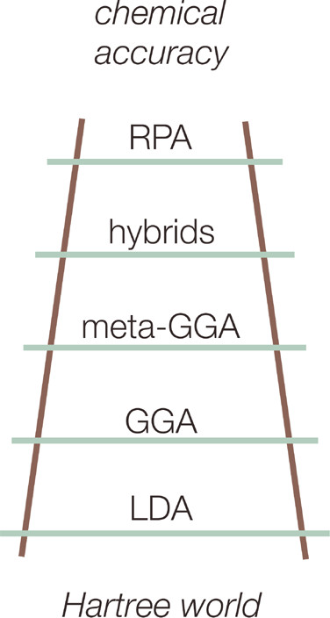




Exchange Correlation Functionals
Only source of approximation in the theory
The exact form is still unknown and is an active area of research even after ~6 decades of research
Even a small improvement made can massively impact the accuracy of DFT calculations
The various levels of approximations are quantified as the different rungs of Jacob’s Ladder
Many body theory
Non-local approximation
$$n\left(\vec{r}\right), ∇n\left(\vec{r}\right),∇^{2}n\left(\vec{r}\right),φ_{i}$$
Accuracy increases (usually),
Cost increases
$$n\left(\vec{r}\right), ∇n\left(\vec{r}\right),∇^{2}n\left(\vec{r}\right)$$
Semi-local approximation
$$n\left(\vec{r}\right), ∇n\left(\vec{r}\right)$$
Local approximation
$$n\left(\vec{r}\right)$$
Martin, R. M., Electronic structure: Basic theory and applications, Cambridge University Press, 2004

Slide 10
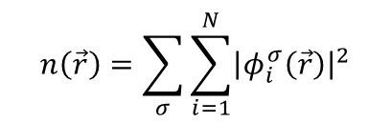
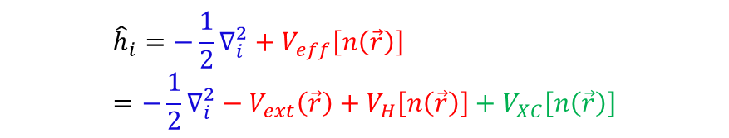
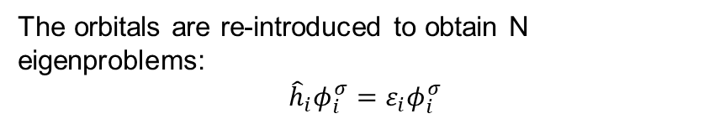



Summary
The orbitals are re-introduced to obtain N eigenproblems:
$${\hat{h}}_{i}φ_{i}^{σ}=ε_{i}φ_{i}^{σ}$$
Guess $n\left(\vec{r}\right)$ input
Self-consistency loop, $n\left(\vec{r}\right)=F\left[n\left(\vec{r}\right)\right]$
$${\hat{h}}_{i}=−\frac{1}{2}∇_{i}^{2}+V_{eff}\left[n\left(\vec{r}\right)\right]$$
$$n\left(\vec{r}\right)=\sum_{σ}{\sum_{i=1}^{N}{{\left|φ_{i}^{σ}\left(\vec{r}\right)\right|}^{2}}}$$
$${\hat{h}}_{i}=−\frac{1}{2}∇_{i}^{2}+V_{eff}\left[n\left(\vec{r}\right)\right]=−\frac{1}{2}∇_{i}^{2}−V_{ext}\left(\vec{r}\right)+V_{H}\left[n\left(\vec{r}\right)\right]+V_{XC}\left[n\left(\vec{r}\right)\right]$$
Martin, R. M., Electronic structure: Basic theory and applications, Cambridge University Press, 2004

