Slide 1
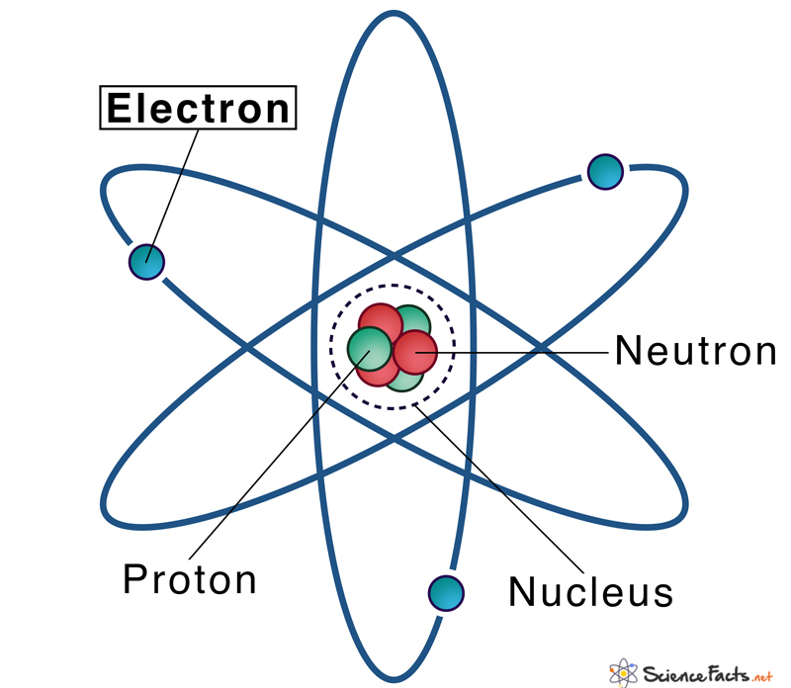
Electronic Structure Theory
Lecture 10: DFT for Molecules
Sayan Bhowmik
School of Chemical & Biomolecular Engineering
College of Engineering
Georgia Institute of Technology

Slide 2
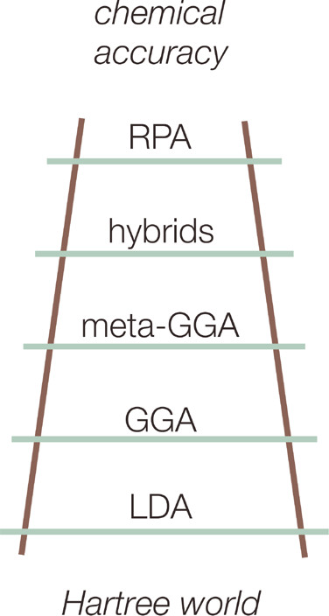
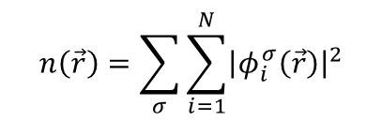
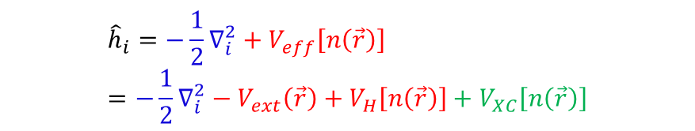






Recap
The orbitals are re-introduced to obtain N eigenproblems:
$${\hat{h}}_{i}φ_{i}^{σ}=ε_{i}φ_{i}^{σ}$$
Guess $n\left(\vec{r}\right)$ input
Self-consistency loop, $n\left(\vec{r}\right)=F\left[n\left(\vec{r}\right)\right]$
$${\hat{h}}_{i}=−\frac{1}{2}∇_{i}^{2}+V_{eff}\left[n\left(\vec{r}\right)\right]$$
$$n\left(\vec{r}\right)=\sum_{σ}{\sum_{i=1}^{N}{{\left|φ_{i}^{σ}\left(\vec{r}\right)\right|}^{2}}}$$
$$ℋ_{elec}ψ_{elec}=ε_{elec}ψ_{elec}$$
Explicit in $\left\{r_{i}\right\}$, parametric in $\left\{R_{A}\right\}$
$${\hat{h}}_{i}=−\frac{1}{2}∇_{i}^{2}+V_{eff}\left[n\left(\vec{r}\right)\right]=−\frac{1}{2}∇_{i}^{2}−V_{ext}\left(\vec{r}\right)+V_{H}\left[n\left(\vec{r}\right)\right]+V_{XC}\left[n\left(\vec{r}\right)\right]$$
Martin, R. M., Electronic structure: Basic theory and applications, Cambridge University Press, 2004

Slide 3

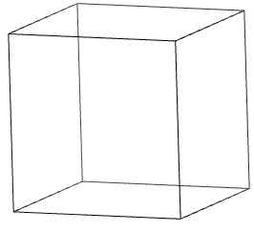

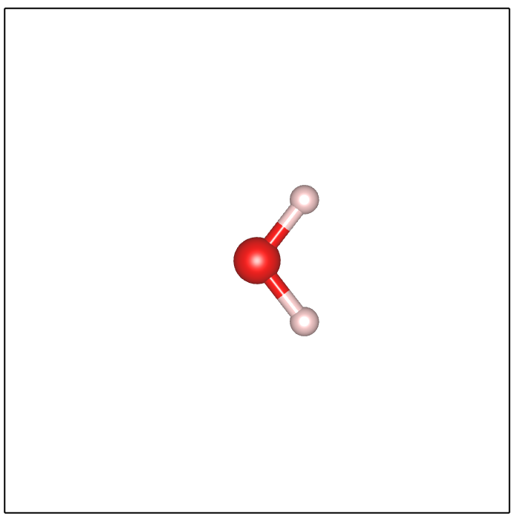
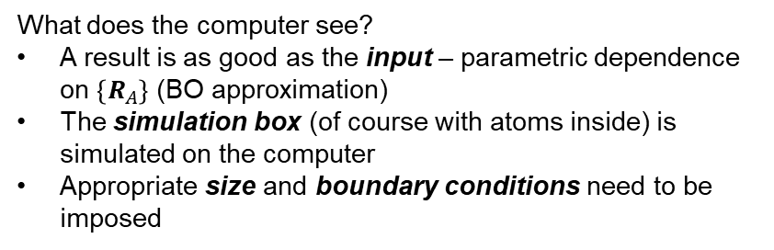
DFT for molecules
Boundary
conditions
CO
Simulation box
What does the computer see?
A result is as good as the input – parametric dependence on $\left\{R_{A}\right\}$ (BO approximation)
The simulation box (of course with atoms inside) is simulated on the computer
Appropriate size and boundary conditions need to be imposed
O₂
H₂O

Slide 4
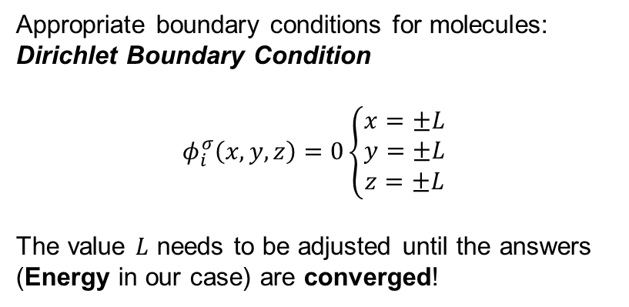
DFT for molecules
Boundary
conditions
Appropriate boundary conditions for molecules:
Dirichlet Boundary Condition
$$φ_{i}^{σ}\left(x,y,z\right)=0\left\{\begin{aligned}x=±L \\ y=±L \\ z=±L\end{aligned}\right.$$
The value $L$ needs to be adjusted until the answers (Energy in our case) are converged!
Simulation box
H₂O

Slide 5
Electronic Structure Theory
Lecture 11: DFT for Periodic Solids
Sayan Bhowmik
School of Chemical & Biomolecular Engineering
College of Engineering
Georgia Institute of Technology

Slide 6
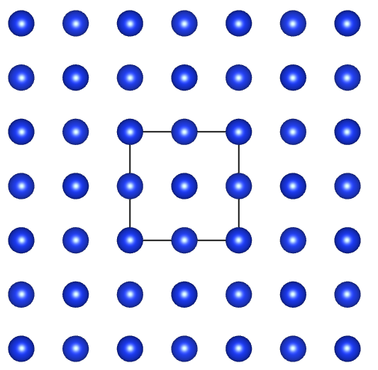
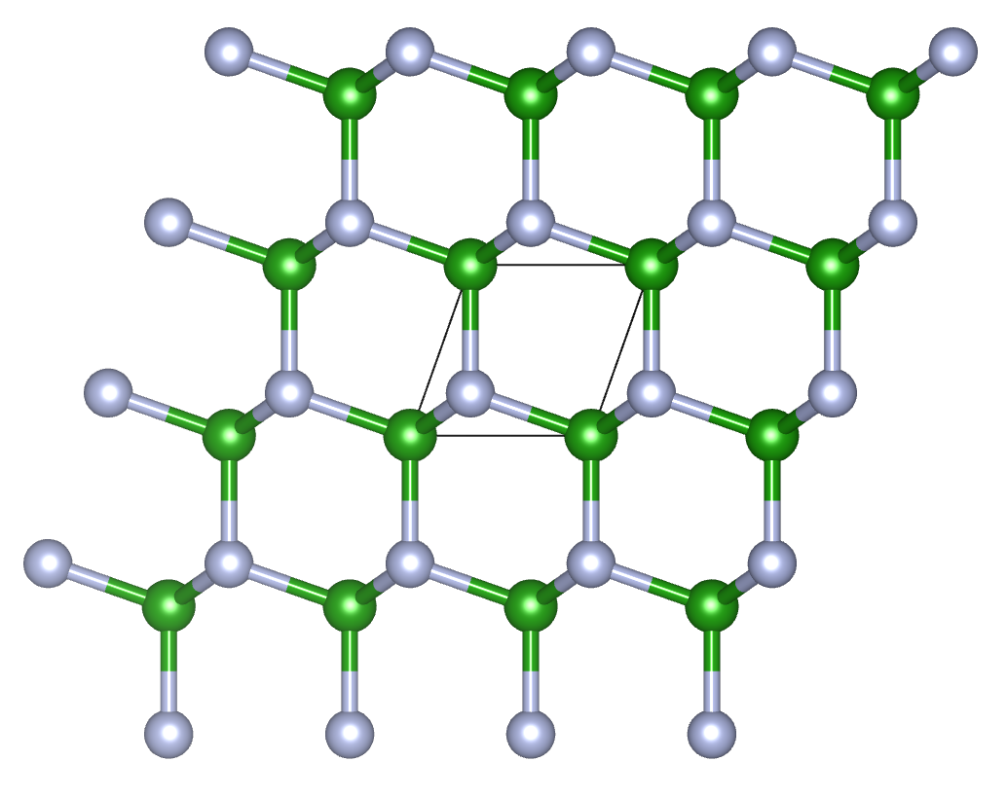








DFT for periodic solids
$$⋯⋯$$
FCC Si
Boundary
conditions
$$⋯⋯$$
$$⋯⋯$$
Infinite domain
Simulation box
$$⋯⋯$$
Hexagonal BN
$$⋯⋯$$
What does the computer see?
A result is as good as the input – parametric dependence on $\left\{R_{A}\right\}$ (BO approximation)
The simulation box (of course with atoms inside) is simulated on the computer
Appropriate size and boundary conditions need to be imposed
Finite simulation box
$$⋯⋯$$
$$⋯⋯$$
$$⋯⋯$$

Slide 7
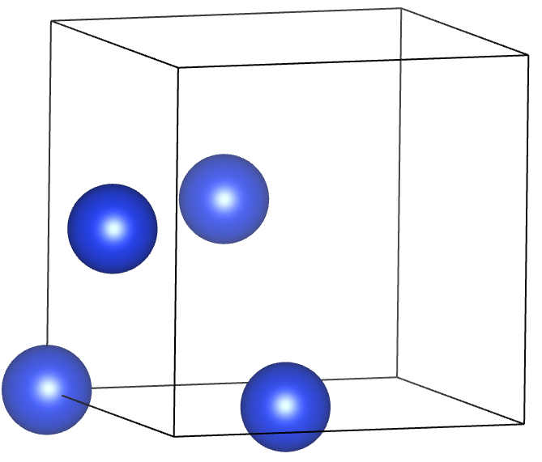
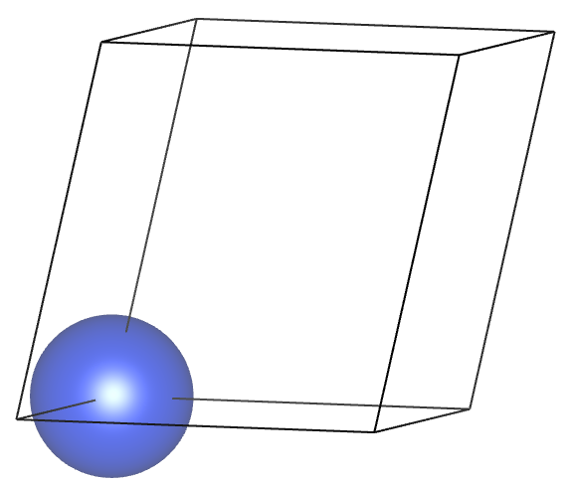
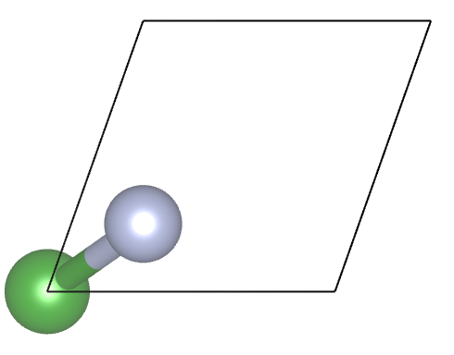








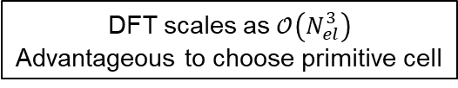

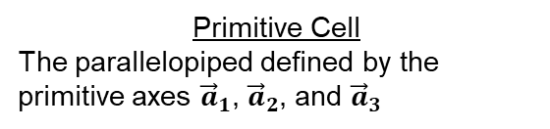
Periodic solids
Unit Cell
Smallest repeating unit that has the full rotational and translational symmetry of the crystals
Primitive Cell
The parallelopiped defined by the primitive axes ${\vec{a}}_{1}$, ${\vec{a}}_{2}$, and ${\vec{a}}_{3}$
Atom Basis
The number of atoms at each lattice point in the cell
FCC Si
FCC Si
FCC Si
$$L$$
$$L$$
$${\vec{a}}_{3}$$
1 atom per lattice point
$${\vec{a}}_{1}$$
$${\vec{a}}_{3}$$
$${\vec{a}}_{1}$$
$${\vec{a}}_{2}$$
$$L$$
$${\vec{a}}_{2}$$
Simple Cubic Lattice
All sides equal
Angle between sides are 90
FCC type: 4 lattice points
Unit cell containing only 1 lattice point
Hexagonal BN
DFT scales as $𝒪\left(N_{el}^{3}\right)$
Advantageous to choose primitive cell
2 atoms per lattice point
Wigner-Seitz construction: A way to form primitive cell using lattice points.
Kittel, C., Introduction to Solid State Physics, Wiley, 2019

Slide 8
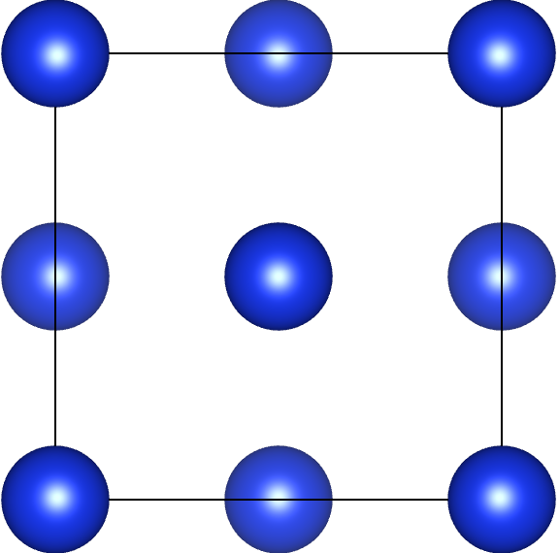
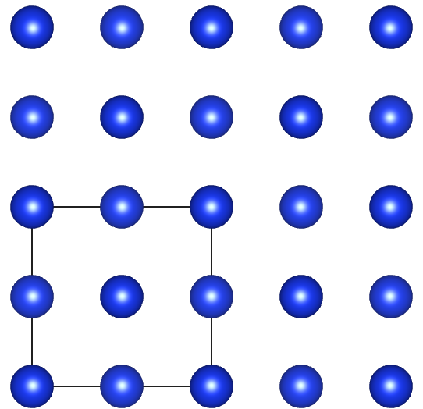
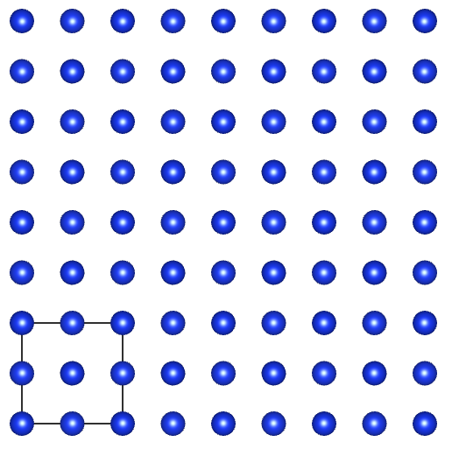
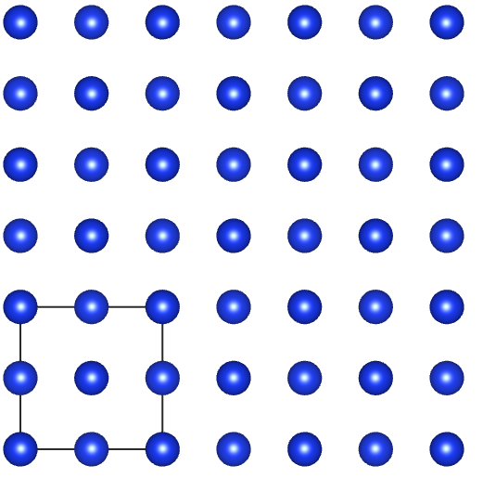
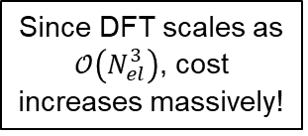



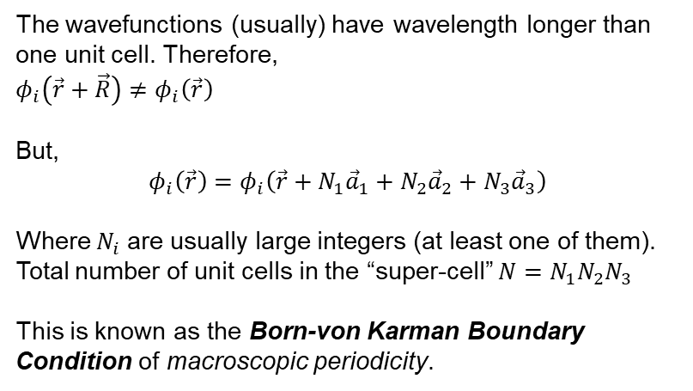



Born-von Karman Boundary Conditions
$$⋯⋯$$
$$⋯⋯$$
Increase $N_{i}$
$$\vec{R}$$
Periodic Potential:
$$V\left(\vec{r}+\vec{R}\right)=V\left(\vec{r}\right)$$
The wavefunctions (usually) have wavelength longer than one unit cell. Therefore,
$φ_{i}\left(\vec{r}+\vec{R}\right)≠φ_{i}\left(\vec{r}\right)$
But,
$$φ_{i}\left(\vec{r}\right)=φ_{i}\left(\vec{r}+N_{1}{\vec{a}}_{1}+N_{2}{\vec{a}}_{2}+N_{3}{\vec{a}}_{3}\right)$$
Where $N_{i}$ are usually large integers (at least one of them). Total number of unit cells in the “super-cell” $N=N_{1}N_{2}N_{3}$
This is known as the Born-von Karman Boundary Condition of macroscopic periodicity.
Till convergence in energy
Since DFT scales as $𝒪\left(N_{el}^{3}\right)$, cost increases massively!
Increase $N_{i}$
Increase $N_{i}$
Increase $N_{i}$
Ashcroft, N. W. and Mermin, N. D., Solid State Physics, Hartcourt College Publishers, 1976

Slide 9
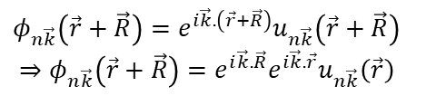

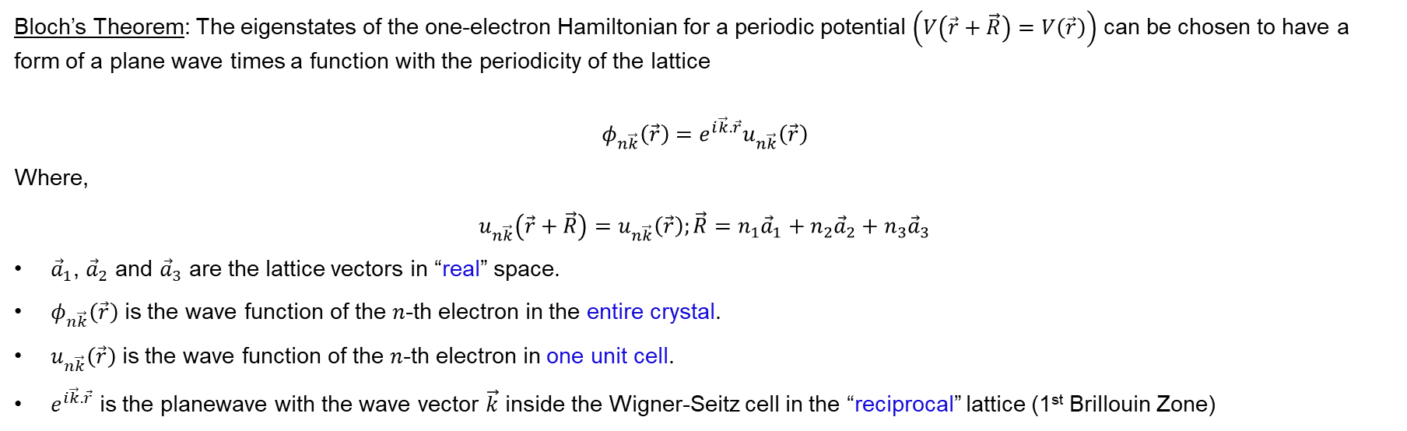
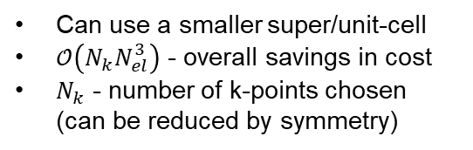


Bloch Periodic Boundary Conditions
Bloch’s Theorem: The eigenstates of the one-electron Hamiltonian for a periodic potential $\left(V\left(\vec{r}+\vec{R}\right)=V\left(\vec{r}\right)\right)$ can be chosen to have a form of a plane wave times a function with the periodicity of the lattice
$$φ_{n\vec{k}}\left(\vec{r}\right)=e^{i\vec{k}.\vec{r}}u_{n\vec{k}}\left(\vec{r}\right)$$
Where,
$$u_{n\vec{k}}\left(\vec{r}+\vec{R}\right)=u_{n\vec{k}}\left(\vec{r}\right);\vec{R}=n_{1}{\vec{a}}_{1}+n_{2}{\vec{a}}_{2}+n_{3}{\vec{a}}_{3}$$
${\vec{a}}_{1}$, ${\vec{a}}_{2}$ and ${\vec{a}}_{3}$ are the lattice vectors in “real” space.
$φ_{n\vec{k}}\left(\vec{r}\right)$ is the wave function of the $n$-th electron in the entire crystal.
$u_{n\vec{k}}\left(\vec{r}\right)$ is the wave function of the $n$-th electron in one unit cell.
$e^{i\vec{k}.\vec{r}}$ is the planewave with the wave vector $\vec{k}$ inside the Wigner-Seitz cell in the “reciprocal” lattice (1st Brillouin Zone)
$$φ_{n\vec{k}}\left(\vec{r}+\vec{R}\right)=e^{i\vec{k}.\left(\vec{r}+\vec{R}\right)}u_{n\vec{k}}\left(\vec{r}+\vec{R}\right)$$
$$⇒φ_{n\vec{k}}\left(\vec{r}+\vec{R}\right)=e^{i\vec{k}.\vec{R}}e^{i\vec{k}.\vec{r}}u_{n\vec{k}}\left(\vec{r}\right)$$
$$φ_{n\vec{k}}\left(\vec{r}+\vec{R}\right)=e^{i\vec{k}.\vec{R}}φ_{n\vec{k}}\left(\vec{r}\right)$$
$$φ_{n}\left(\vec{r}\right)=φ_{n}\left(\vec{r}+N_{1}{\vec{a}}_{1}+N_{2}{\vec{a}}_{2}+N_{3}{\vec{a}}_{3}\right)$$
Bloch Periodic Boundary Condition
Born von-Karman Boundary Condition
Can use a smaller super/unit-cell
$𝒪\left(N_{k}N_{el}^{3}\right)$ - overall savings in cost
$N_{k}$ - number of k-points chosen (can be reduced by symmetry)
Larger super-cells
$𝒪\left(N_{el}^{3}\right)$ - higher computational cost
Ashcroft, N. W. and Mermin, N. D., Solid State Physics, Hartcourt College Publishers, 1976

Slide 10
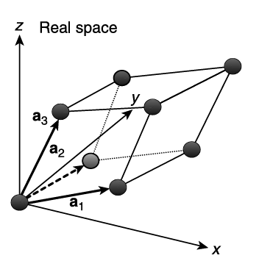
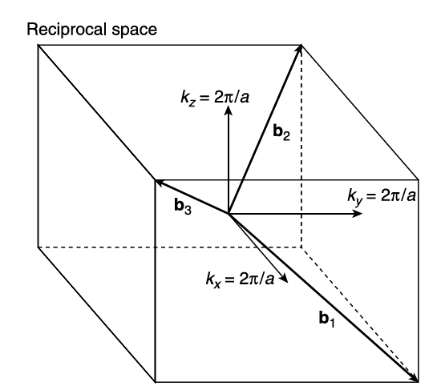
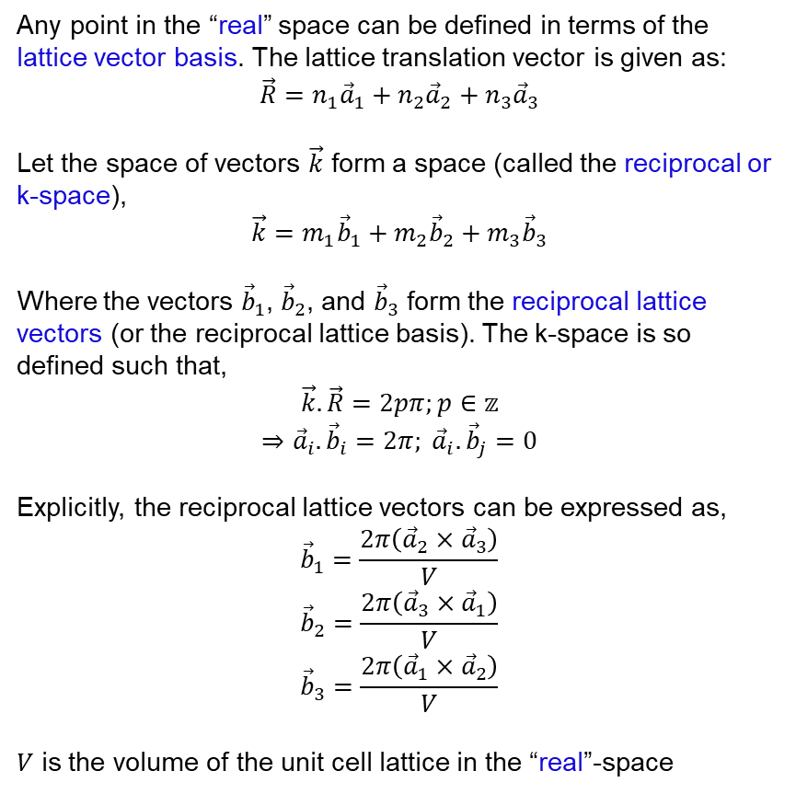
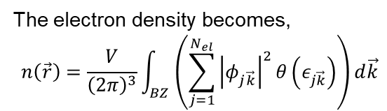

Reciprocal space (k-space)
Any point in the “real” space can be defined in terms of the lattice vector basis. The lattice translation vector is given as:
$$\vec{R}=n_{1}{\vec{a}}_{1}+n_{2}{\vec{a}}_{2}+n_{3}{\vec{a}}_{3}$$
Let the space of vectors $\vec{k}$ form a space (called the reciprocal or k-space),
$$\vec{k}=m_{1}{\vec{b}}_{1}+m_{2}{\vec{b}}_{2}+m_{3}{\vec{b}}_{3}$$
Where the vectors ${\vec{b}}_{1}$, ${\vec{b}}_{2}$, and ${\vec{b}}_{3}$ form the reciprocal lattice vectors (or the reciprocal lattice basis). The k-space is so defined such that,
$$\vec{k}.\vec{R}=2pπ;p∈𝕫$$
$$⇒{\vec{a}}_{i}.{\vec{b}}_{i}=2π; {\vec{a}}_{i}.{\vec{b}}_{j}=0$$
Explicitly, the reciprocal lattice vectors can be expressed as,
$${\vec{b}}_{1}=\frac{2π\left({\vec{a}}_{2}×{\vec{a}}_{3}\right)}{V}$$
$${\vec{b}}_{2}=\frac{2π\left({\vec{a}}_{3}×{\vec{a}}_{1}\right)}{V}$$
$${\vec{b}}_{3}=\frac{2π\left({\vec{a}}_{1}×{\vec{a}}_{2}\right)}{V}$$
$V$ is the volume of the unit cell lattice in the “real”-space
The volume of the Brillouin Zone is
$$V_{BZ}=\frac{{\left(2π\right)}^{3}}{V}$$
The electron density becomes,
$$n\left(\vec{r}\right)=\frac{V}{{\left(2π\right)}^{3}}\int_{BZ}{\left(\sum_{j=1}^{N_{el}}{{\left|φ_{j\vec{k}}\right|}^{2}θ\left(ε_{j\vec{k}}\right)}\right)d\vec{k}}$$
Occupation of j-th orbital at k-th wave-vector
Sholl, D. S. and Steckel, J. A., Density functional theory: A practical introduction, Wiley, 2009

Slide 11
Electronic Structure Theory
Lecture 12: Basis
Sayan Bhowmik
School of Chemical & Biomolecular Engineering
College of Engineering
Georgia Institute of Technology

Slide 12
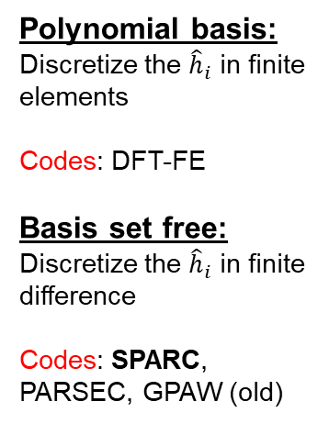

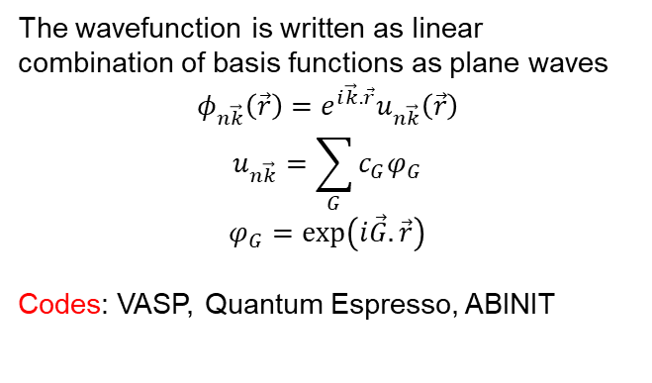

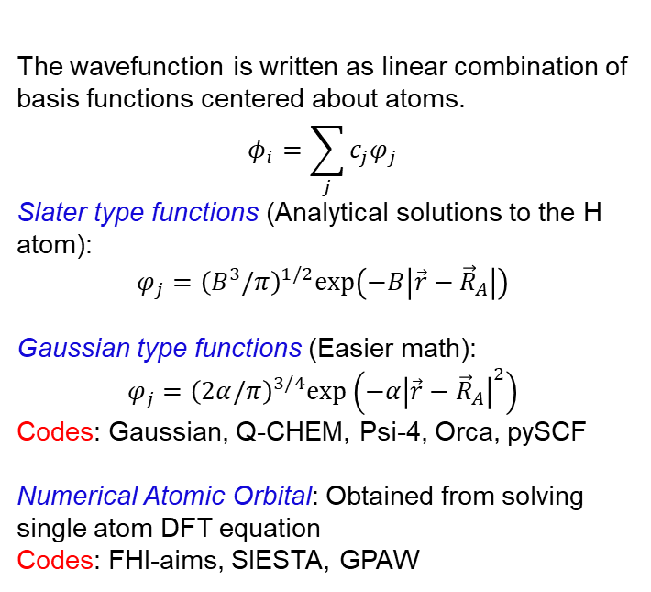


Basis sets
DFT Equations
Molecules
Periodic Solids
$${\hat{h}}_{i}=−\frac{1}{2}∇_{i}^{2}+V_{eff}\left[n\left(\vec{r}\right)\right]$$
Dirichlet Boundary Condition
$$φ_{i}\left(x,y,z\right)=0\left\{\begin{aligned}x=±L \\ y=±L \\ z=±L\end{aligned}\right.$$
Bloch Periodic Boundary Condition
$${\hat{h}}_{i}φ_{i}^{σ}=ε_{i}φ_{i}^{σ}$$
$$φ_{n\vec{k}}\left(\vec{r}+\vec{R}\right)=e^{i\vec{k}.\vec{R}}φ_{n\vec{k}}\left(\vec{r}\right)$$
Basis:
The wavefunction is written as linear combination of basis functions centered about atoms.
$$φ_{i}=\sum_{j}{c_{j}φ_{j}}$$
Slater type functions (Analytical solutions to the H atom):
$$φ_{j}={\left(B^{3}/π\right)}^{1/2}exp⁡\left(−B\left|\vec{r}−{\vec{R}}_{A}\right|\right)$$
Gaussian type functions (Easier math):
$$φ_{j}={\left(2α/π\right)}^{3/4}exp⁡\left(−α{\left|\vec{r}−{\vec{R}}_{A}\right|}^{2}\right)$$
Codes: Gaussian, Q-CHEM, Psi-4, Orca, pySCF
Numerical Atomic Orbital: Obtained from solving single atom DFT equation
Codes: FHI-aims, SIESTA, GPAW
The wavefunction is written as linear combination of basis functions as plane waves
$$φ_{n\vec{k}}\left(\vec{r}\right)=e^{i\vec{k}.\vec{r}}u_{n\vec{k}}\left(\vec{r}\right)$$
$$u_{n\vec{k}}=\sum_{G}{c_{G}φ_{G}}$$
$$φ_{G}=exp⁡\left(i\vec{G}.\vec{r}\right)$$
Codes: VASP, Quantum Espresso, ABINIT
Polynomial basis:
Discretize the ${\hat{h}}_{i}$ in finite elements
Codes: DFT-FE
Basis set free:
Discretize the ${\hat{h}}_{i}$ in finite difference
Codes: SPARC, PARSEC, GPAW (old)

Slide 13
Electronic Structure Theory
Lecture 13: Pseudopotentials
Sayan Bhowmik
School of Chemical & Biomolecular Engineering
College of Engineering
Georgia Institute of Technology

Slide 14
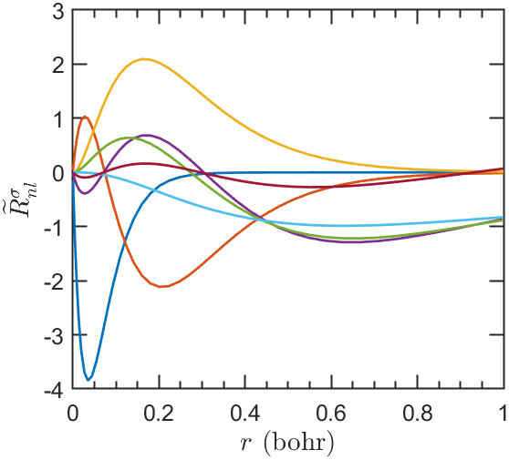
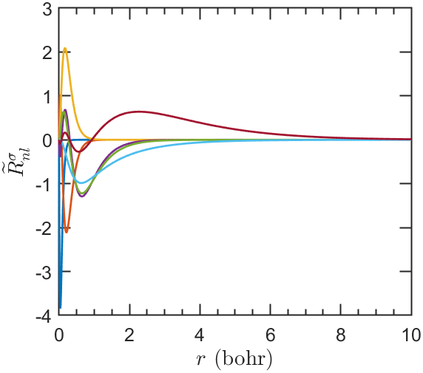

Need for a pseudopotential
Ni
All electron calculations
$$𝒪\left(N_{el}^{3}\right)$$
Ni
Wavefunctions are extremely oscillatory near the nuclei – higher resolution is needed to accurately resolve
Core electrons do not participate in chemical bonding
Valence electrons are more important to model
Can we replace the real potential due to nucleus + core electrons by a “pseudo” potential such that outside a core region, the “pseudo” potential matches the real potential?
Martin, R. M., Electronic Structure Theory: Basic Theory and Practical Methods, Cambridge University Press, 2020

Slide 15
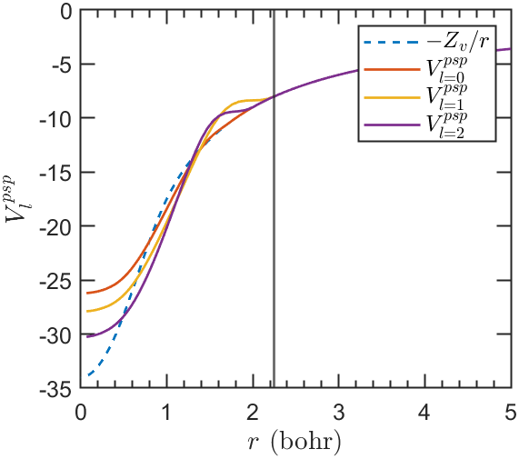




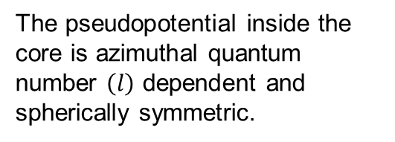






Ionic pseudopotentials
$$28 e^{−}$$
1$8 e^{−}$
$$28 p^{+}$$
$$10 e^{−}$$
$$28 p^{+}$$
$$V_{ext}=−\frac{18}{r}$$
$$V_{ext}=−\frac{28}{r}$$
$$r_{cut}$$
Large $r_{cut}$:Soft
Small $r_{cut}$: Hard
The pseudopotential inside the core is azimuthal quantum number $\left(l\right)$ dependent and spherically symmetric.
$$V_{ext}=−\frac{18}{r}$$
Other approaches: Projector Augmented Waves (PAW) where the plane waves are augmented with extra functions near the nucleus
$$r_{cut}$$
Martin, R. M., Electronic Structure Theory: Basic Theory and Practical Methods, Cambridge University Press, 2020

Slide 16
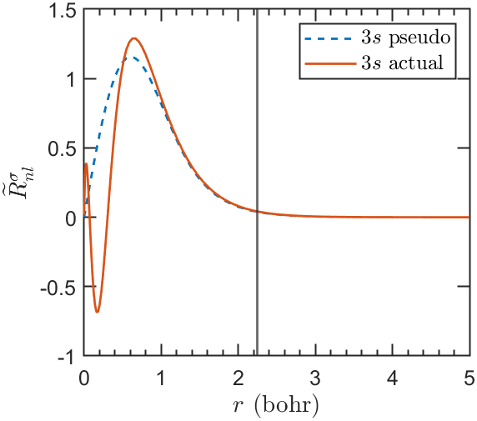
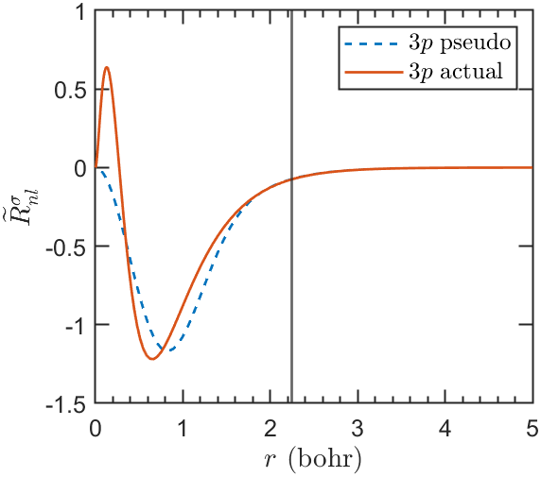
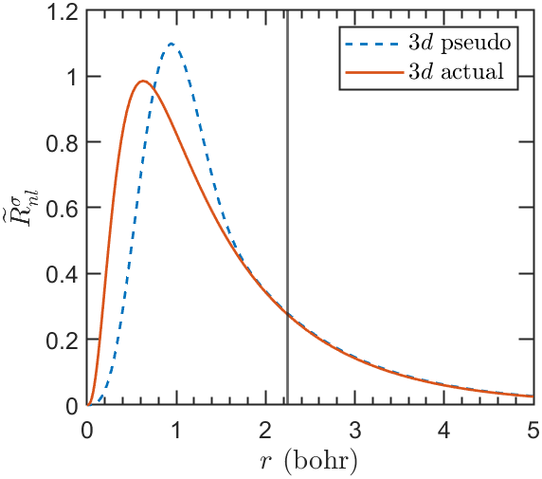
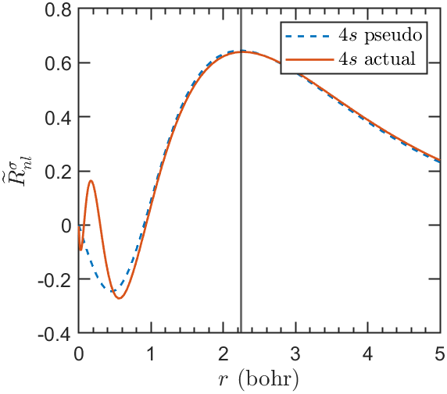


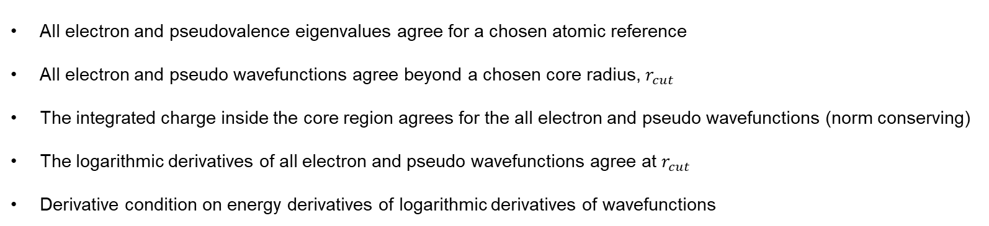


Norm-Conserved Ionic pseudopotentials
$$r_{cut}$$
$$r_{cut}$$
$$r_{cut}$$
$$r_{cut}$$
All electron and pseudovalence eigenvalues agree for a chosen atomic reference
All electron and pseudo wavefunctions agree beyond a chosen core radius, $r_{cut}$
The integrated charge inside the core region agrees for the all electron and pseudo wavefunctions (norm conserving)
The logarithmic derivatives of all electron and pseudo wavefunctions agree at $r_{cut}$
Derivative condition on energy derivatives of logarithmic derivatives of wavefunctions
Martin, R. M., Electronic Structure Theory: Basic Theory and Practical Methods, Cambridge University Press, 2020

Slide 17
Electronic Structure Theory
Lecture 14: Accuracy and Beyond
Sayan Bhowmik
School of Chemical & Biomolecular Engineering
College of Engineering
Georgia Institute of Technology

Slide 18
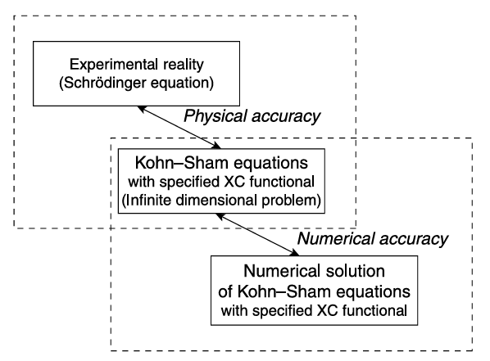
Physical vs Numerical Accuracy
Physical accuracy: How precise the predictions of a DFT calculations are when some property is calculated relative to the property measured from the best possible experiment.
Numerical accuracy: Is the solution to the mathematical Kohn-Sham problem a well converged one?
As users, we are more concerned with Numerical accuracy, but we should not neglect Physical accuracy.
Sholl, D. S. and Steckel, J. A., Density functional theory: A practical introduction, Wiley, 2009

Slide 19
Numerical Accuracy
Results depend on initial atomic positions (BO approximation)
If “spin” is important for system, then it needs to be “switched on” for the calculation – sometimes switching on spin makes the system energy lower than one would obtain for switching it off (O₂ being a case).
The boundary conditions should be appropriately set – Dirichlet for molecules/atoms, Bloch periodic for periodic solids:
  Atomic orbital basis – Natural for molecules/atoms but can be used for solids.
  Plane wave basis – Natural for periodic solids but can be used for molecules/atoms. Only Bloch periodic BC possible – need a larger box for molecules. More vacuum induces instabilities and convergence difficulties
  Real space methods – Boundary conditions can be set appropriately (choice) leading to smaller box sizes required for convergence.
The numerical “knobs” must be tuned to achieve convergence
  Energy cutoff (ECUT) / Mesh: ECUT is a parameter for plane wave codes where one needs to keep increasing it until convergence is achieved in energies. Similarly, mesh is a parameter for real space codes where one needs to keep reducing the spacing until convergence is achieved.
  k-points: One can specify the number of k-points in each reciprocal space direction. One needs to keep increasing it (following the general rule of thumb that a small dimension in real space corresponds to a large dimension in reciprocal space requiring more k-points in that direction) until convergence
  Pseudopotentials: Many codes (like QE/ABINIT/SPARC) allow a choice of PAW, Norm Conserved PSP, Ultrasoft PSP. User needs to choose depending on the target application and accuracy desired. Some psp might give easier convergence.
  Convergence tolerance on Energy: The self-consistency cycle needs to be stopped. Many codes apply convergence criteria on Energy, some apply it on norm of density. When criteria is on Energy, a stricter tolerance (like 1e-5 eV or 1e-6 ha) is needed compared to when on density (sometimes 1e-4 is also enough).
  Convergence tolerance on Force: Important for structural relaxations. At the energy minima, force on the atoms is 0. Tolerance can be set to (0.05 or 0.01 or 0.005 eV/Å, 1e-3 or 1e-4 ha/Bohr) depending on the application
  Optimizers: Conjugate Gradient (CG), Broyden-Fletcher-Goldfarb-Shanno (BFGS or L-BFGS) choices
Sholl, D. S. and Steckel, J. A., Density functional theory: A practical introduction, Wiley, 2009

Slide 20
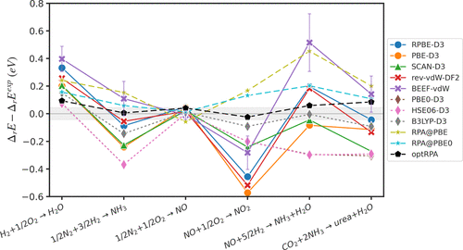
Physical Accuracy
DFT can yield very accurate predictions for some property while grossly mis-predicting other properties for the same material
How accurate do we want our predictions to be for scientific conclusions? Can we get the trends correct from DFT predictions?
How accurately does your simulation mimic real conditions?
A “zoo” of XC exists! Typical accuracy of XC functionals are 1~2 eV when compared to experiments.
Need to choose a XC leading to best accuracy for some “test” calculation with the particular system elements/molecules. Often available in literature (benchmark calculations).
Additional corrections – like Dispersion, Hubbard correction to yield more accuracy depending on systems.
Sholl, D. S. and Steckel, J. A., Density functional theory: A practical introduction, Wiley, 2009
Kim, H., Yu, N.-K., Tian, N., and Medford, A. J., J. Phys. Chem. C 2024 128 (27), 11159-11175

Slide 21
Systematic vs Discrete convergence
Systematic convergence
Discrete convergence
Increase ECUT/Mesh – Energy converges (to machine precision theoretically)
Plane waves and real space methods provide systematic convergence – but the #DOFs are larger
Atomic basis are unable to provide systematic convergence – but the #DOFs are smaller
Increase k-points – Energy converges (to machine precision theoretically)
Theory hierarchy – Usually the physical accuracy goes as: Hartree-Fock < DFT < Perturbative approaches (MP2) < Coupled Cluster (CCSD(T)) < Full Configuration Interaction (CI)
XC functional – Usually the Jacob’s ladder is a good point of reference
Initial guess – The densities are guessed using the pseudopotential core densities, the wavefunction guess is a random vector. A “good” guess would improve convergence
Eigen-solvers – There are choices over eigen-solvers which might provide better stability or better convergence.

