Slide 1
ChBE 3200: Transport Phenomena
(Fall 2023)
Lecture 8: Macroscopic Energy Balance
Sayan Bhowmik,
Graduate Teaching Assistant.
09-08-2023

Slide 2
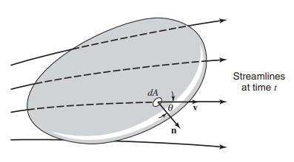
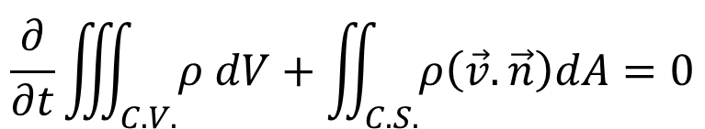
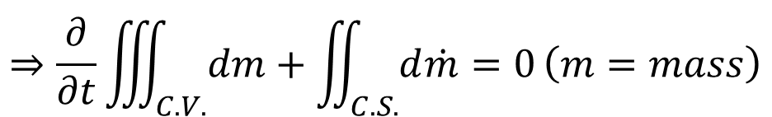
Conservation of Mass: Continuity
$$\left\{\begin{aligned}Rate of mass \\ efflux from C.V.\end{aligned}\right\}−\left\{\begin{aligned}Rate of mass \\ flow into C.V.\end{aligned}\right\}+\left\{\begin{aligned}Rate of accumulation \\ of mass in C.V.\end{aligned}\right\}=0$$
$$\frac{∂}{∂t}\iiint_{C.V.}{ρ dV}+\iint_{C.S.}{ρ\left(\vec{v}.\vec{n}\right)dA=0}$$
$$⇒\frac{∂}{∂t}\iiint_{C.V.}{dm}+\iint_{C.S.}{d\dot{m}=0}\left(m=mass\right)$$
Continuity
Momentum Theorem
Energy Equation
Image: Welty, Rorrer, Foster, Fundamentals of Momentum, Heat and Mass Transfer

Slide 3
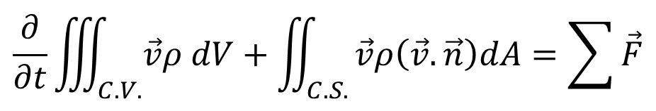
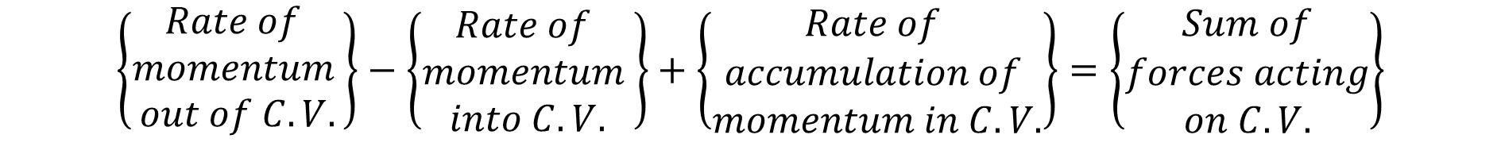
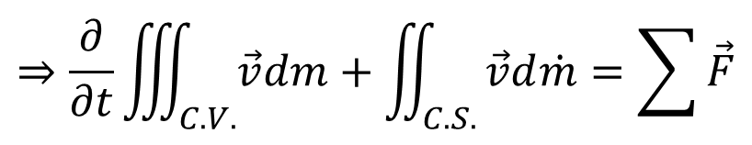
Conservation of Momentum: Newton’s 2nd Law
$$\left\{\begin{aligned}Rate of \\ momentum \\ out of C.V.\end{aligned}\right\}−\left\{\begin{aligned}Rate of \\ momentum \\ into C.V.\end{aligned}\right\}+\left\{\begin{aligned}Rate of \\ accumulation of \\ momentum in C.V.\end{aligned}\right\}=\left\{\begin{aligned}Sum of \\ forces acting \\ on C.V.\end{aligned}\right\}$$
$$\frac{∂}{∂t}\iiint_{C.V.}{\vec{v}ρ dV}+\iint_{C.S.}{\vec{v}ρ\left(\vec{v}.\vec{n}\right)dA=\sum{\vec{F}}}$$
$$⇒\frac{∂}{∂t}\iiint_{C.V.}{\vec{v}dm}+\iint_{C.S.}{\vec{v}d\dot{m}=\sum{\vec{F}}}$$
Continuity
Momentum Theorem
Energy Equation
Image: Welty, Rorrer, Foster, Fundamentals of Momentum, Heat and Mass Transfer

Slide 4
Agenda
Continuity
Momentum Theorem
Energy Equation
Conservation of Energy: First Law of Thermodynamics
First Law of Thermodynamics
Macroscopic Energy Balance Equation
Specific Total Energy

Slide 5
First Law of Thermodynamics
Statement: If a system is carried through a cycle, the total heat added to the system is proportional to the work done by the system on its surroundings.

Slide 6
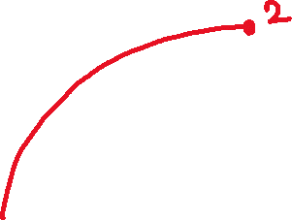


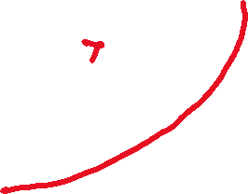
First Law of Thermodynamics
Statement: If a system is carried through a cycle, the total heat added to the system is proportional to the work done by the system on its surroundings.
P
V

Slide 7

First Law of Thermodynamics
Statement: If a system is carried through a cycle, the total heat added to the system is proportional to the work done by the system on its surroundings.
P
V

Slide 8

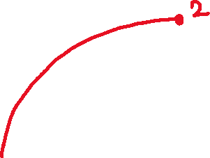





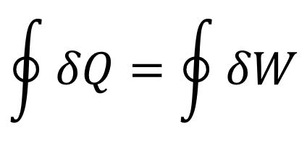
First Law of Thermodynamics
Statement: If a system is carried through a cycle, the total heat added to the system is proportional to the work done by the system on its surroundings.
$$\oint{δQ=\oint{δW}}$$
P
V

Slide 9


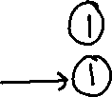
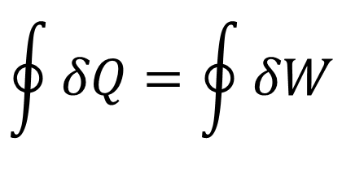











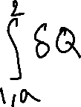








First Law of Thermodynamics
Statement: If a system is carried through a cycle, the total heat added to the system is proportional to the work done by the system on its surroundings.
P
V
$$\oint{δQ=\oint{δW}}$$

Slide 10

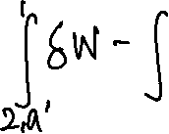




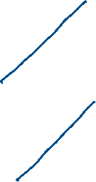






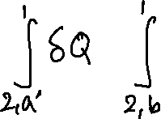









First Law of Thermodynamics
Statement: If a system is carried through a cycle, the total heat added to the system is proportional to the work done by the system on its surroundings.
P
V
$$\oint{δQ=\oint{δW}}$$

Slide 11







First Law of Thermodynamics
Statement: If a system is carried through a cycle, the total heat added to the system is proportional to the work done by the system on its surroundings.
P
V
$$\oint{δQ=\oint{δW}}$$

Slide 12


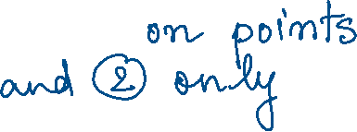










First Law of Thermodynamics
Statement: If a system is carried through a cycle, the total heat added to the system is proportional to the work done by the system on its surroundings.
P
V
$$\oint{δQ=\oint{δW}}$$

Slide 13




















First Law of Thermodynamics
Alternatively: The mathematical form can be re-written in terms of Total Energy of system, E.

Slide 14



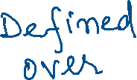









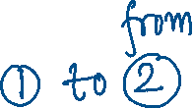


First Law of Thermodynamics
Alternatively: The mathematical form can be re-written in terms of Total Energy of system, E.
P
V

Slide 15
















First Law of Thermodynamics
Can we get back the original statement ?
P
V

Slide 16
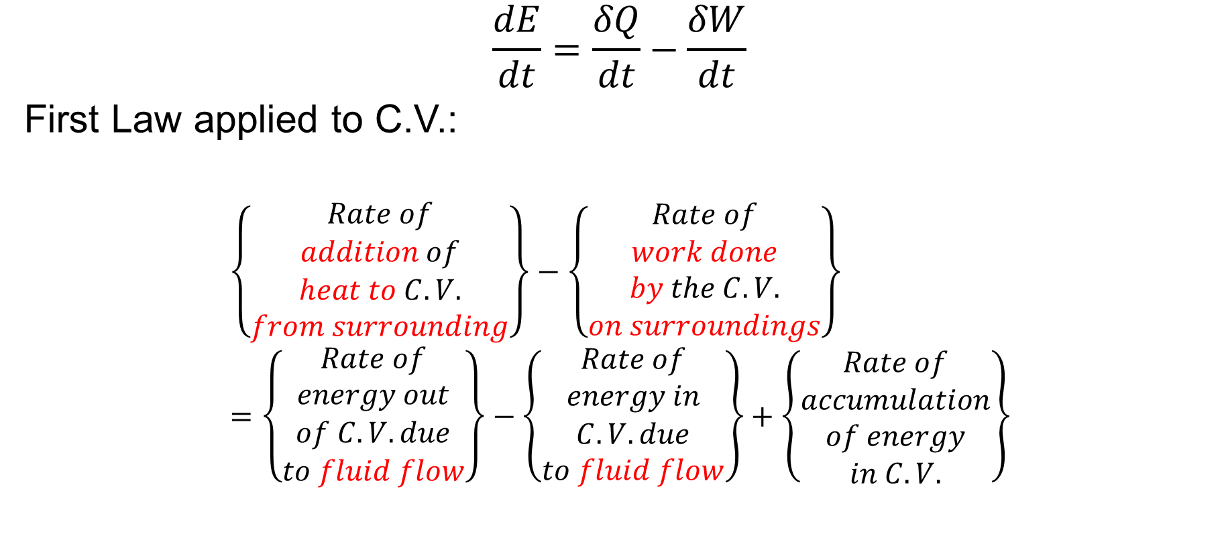
First Law of Thermodynamics: Unsteady State
$$\frac{dE}{dt}=\frac{δQ}{dt}−\frac{δW}{dt}$$
First Law applied to C.V.:
$$\left\{\begin{aligned}Rate of \\ addition of \\ heat to C.V. \\ from surrounding\end{aligned}\right\}−\left\{\begin{aligned}Rate of \\ work done \\ by the C.V. \\ on surroundings\end{aligned}\right\}=\left\{\begin{aligned}Rate of \\ energy out \\ of C.V. due \\ to fluid flow\end{aligned}\right\}−\left\{\begin{aligned}Rate of \\ energy in \\ C.V. due \\ to fluid flow\end{aligned}\right\}+\left\{\begin{aligned}Rate of \\ accumulation \\ of energy \\ in C.V.\end{aligned}\right\}$$

Slide 17
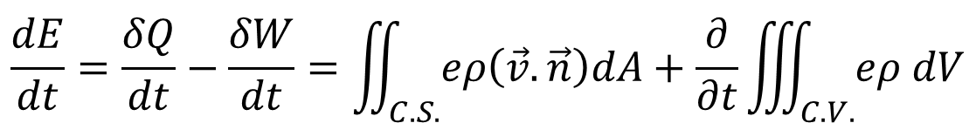
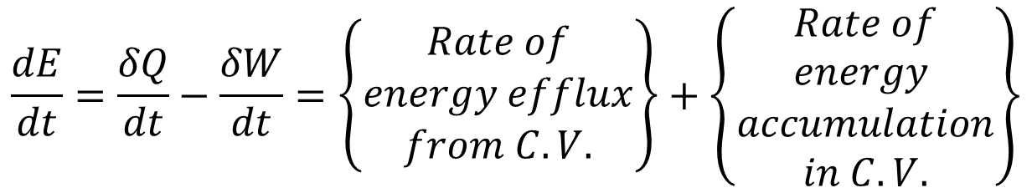
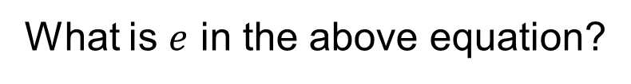
First Law: Applied to Control Volume
$$\frac{dE}{dt}=\frac{δQ}{dt}−\frac{δW}{dt}=\left\{\begin{aligned}Rate of \\ energy efflux \\ from C.V.\end{aligned}\right\}+\left\{\begin{aligned}Rate of \\ energy \\ accumulation \\ in C.V.\end{aligned}\right\}$$
$$\frac{dE}{dt}=\frac{δQ}{dt}−\frac{δW}{dt}=\iint_{C.S.}{eρ\left(\vec{v}.\vec{n}\right)dA}+\frac{∂}{∂t}\iiint_{C.V.}{eρ dV}$$
Conservation of Energy Equation
What is $e$ in the above equation?

Slide 18



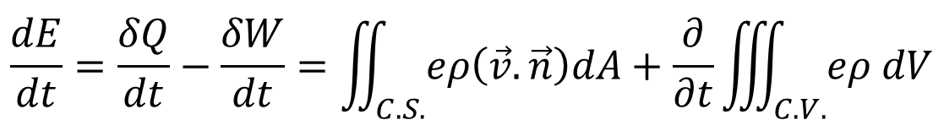










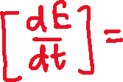
Specific Total Energy
$$\frac{dE}{dt}=\frac{δQ}{dt}−\frac{δW}{dt}=\iint_{C.S.}{eρ\left(\vec{v}.\vec{n}\right)dA}+\frac{∂}{∂t}\iiint_{C.V.}{eρ dV}$$
Specific Total Energy, $e$: Total Energy per unit mass

Slide 19

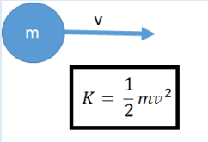
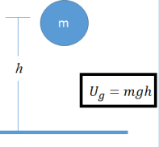
Specific Total Energy
Macroscopic Energy
Microscopic Energy
Internal Energy
Kinetic Energy
Potential Energy

Slide 20
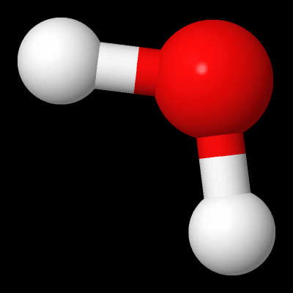
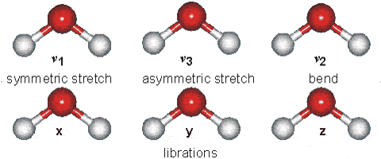
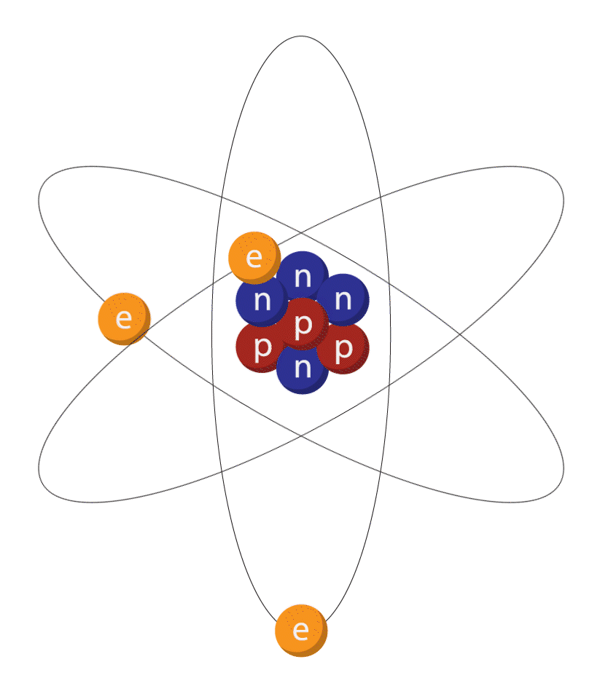
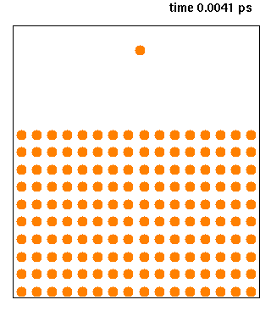
Specific Total Energy
Microscopic Energy
Molecular Vibration
Source: https://www.acamedia.info/sciences/J_G/envrad/microwaves/index.htm
Molecular Translation
Molecular Rotation
Source: Wikimedia
Electron Spin
&
Nuclear Energy
Source: Wikimedia
Intermolecular
Attraction
Source: Wikipedia

Slide 21
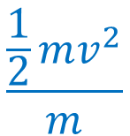
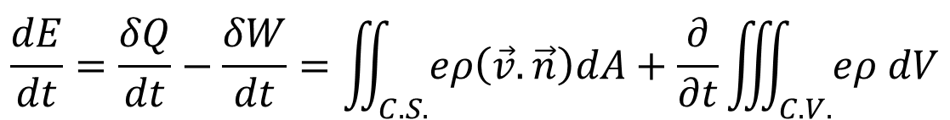
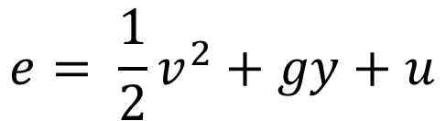
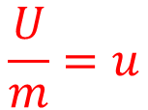
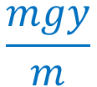
Specific Total Energy
$e=$ kinetic energy/mass + potential energy/mass + internal energy/mass
$$\frac{\frac{1}{2}mv^{2}}{m}$$
$$\frac{mgy}{m}$$
$$\frac{U}{m}=u$$
$$e= \frac{1}{2}v^{2}+gy+u$$
$$\frac{dE}{dt}=\frac{δQ}{dt}−\frac{δW}{dt}=\iint_{C.S.}{eρ\left(\vec{v}.\vec{n}\right)dA}+\frac{∂}{∂t}\iiint_{C.V.}{eρ dV}$$
R.H.S. terms explained
Conservation of Energy Equation

Slide 22
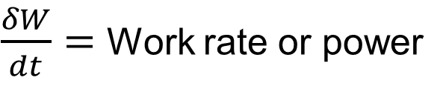
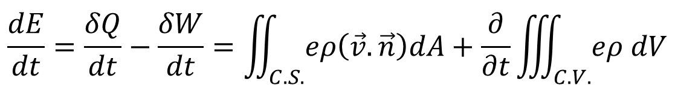
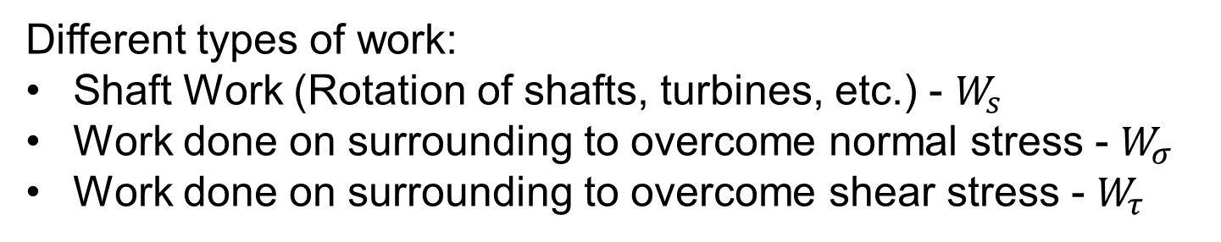
Preview: Next Class
$$\frac{dE}{dt}=\frac{δQ}{dt}−\frac{δW}{dt}=\iint_{C.S.}{eρ\left(\vec{v}.\vec{n}\right)dA}+\frac{∂}{∂t}\iiint_{C.V.}{eρ dV}$$
Conservation of Energy Equation
$\frac{δW}{dt}=$ Work rate or power
Different types of work:
Shaft Work (Rotation of shafts, turbines, etc.) - $W_{s}$
Work done on surrounding to overcome normal stress - $W_{σ}$
Work done on surrounding to overcome shear stress - $W_{τ}$

Slide 23
Thank You!

