Slide 1
ChBE 3200: Transport Phenomena
(Fall 2023)
Lecture 9: Macroscopic Energy Balance & Bernoulli Principle
Sayan Bhowmik,
Graduate Teaching Assistant.
09-11-2023

Slide 2
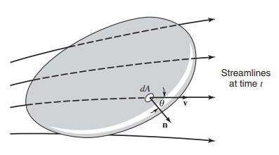
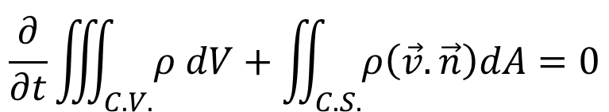
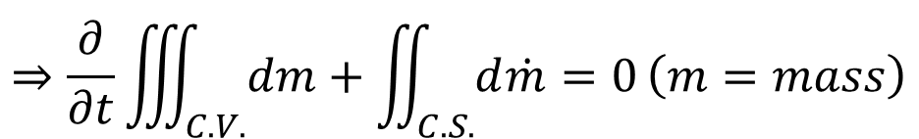
Conservation of Mass: Continuity
$$\left\{\begin{aligned}Rate of mass \\ efflux from C.V.\end{aligned}\right\}−\left\{\begin{aligned}Rate of mass \\ flow into C.V.\end{aligned}\right\}+\left\{\begin{aligned}Rate of accumulation \\ of mass in C.V.\end{aligned}\right\}=0$$
$$\frac{∂}{∂t}\iiint_{C.V.}{ρ dV}+\iint_{C.S.}{ρ\left(\vec{v}.\vec{n}\right)dA=0}$$
$$⇒\frac{∂}{∂t}\iiint_{C.V.}{dm}+\iint_{C.S.}{d\dot{m}=0}\left(m=mass\right)$$
Continuity
Momentum Theorem
Energy Equation
Image: Welty, Rorrer, Foster, Fundamentals of Momentum, Heat and Mass Transfer

Slide 3
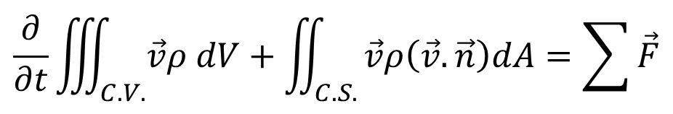
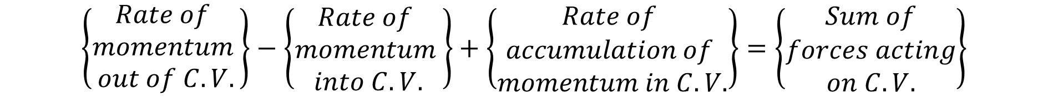
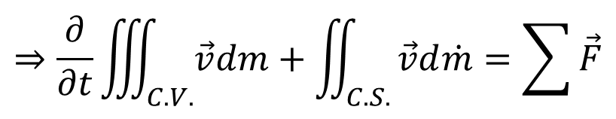
Conservation of Momentum: Newton’s 2nd Law
$$\left\{\begin{aligned}Rate of \\ momentum \\ out of C.V.\end{aligned}\right\}−\left\{\begin{aligned}Rate of \\ momentum \\ into C.V.\end{aligned}\right\}+\left\{\begin{aligned}Rate of \\ accumulation of \\ momentum in C.V.\end{aligned}\right\}=\left\{\begin{aligned}Sum of \\ forces acting \\ on C.V.\end{aligned}\right\}$$
$$\frac{∂}{∂t}\iiint_{C.V.}{\vec{v}ρ dV}+\iint_{C.S.}{\vec{v}ρ\left(\vec{v}.\vec{n}\right)dA=\sum{\vec{F}}}$$
$$⇒\frac{∂}{∂t}\iiint_{C.V.}{\vec{v}dm}+\iint_{C.S.}{\vec{v}d\dot{m}=\sum{\vec{F}}}$$
Continuity
Momentum Theorem
Energy Equation
Image: Welty, Rorrer, Foster, Fundamentals of Momentum, Heat and Mass Transfer

Slide 4
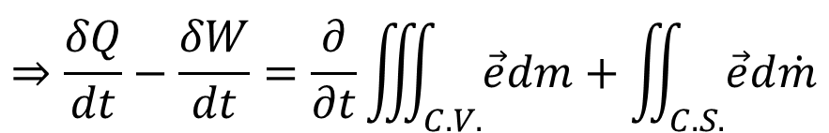
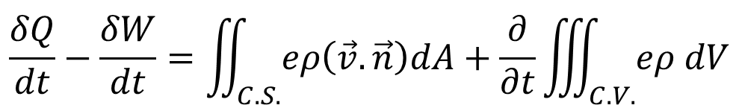
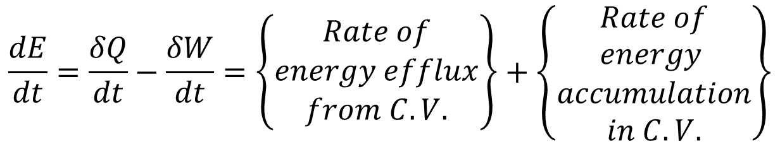
Conservation of Energy: First Law of Thermo.
$$\frac{dE}{dt}=\frac{δQ}{dt}−\frac{δW}{dt}=\left\{\begin{aligned}Rate of \\ energy efflux \\ from C.V.\end{aligned}\right\}+\left\{\begin{aligned}Rate of \\ energy \\ accumulation \\ in C.V.\end{aligned}\right\}$$
$$\frac{δQ}{dt}−\frac{δW}{dt}=\iint_{C.S.}{eρ\left(\vec{v}.\vec{n}\right)dA}+\frac{∂}{∂t}\iiint_{C.V.}{eρ dV}$$
$$⇒\frac{δQ}{dt}−\frac{δW}{dt}=\frac{∂}{∂t}\iiint_{C.V.}{\vec{e}dm}+\iint_{C.S.}{\vec{e}d\dot{m}}$$
Continuity
Momentum Theorem
Energy Equation
Image: Welty, Rorrer, Foster, Fundamentals of Momentum, Heat and Mass Transfer

Slide 5
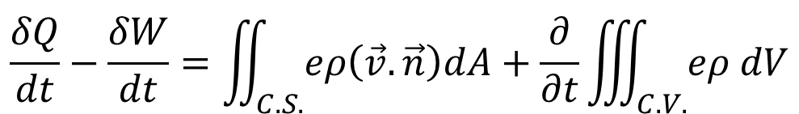
Agenda
$$\frac{δQ}{dt}−\frac{δW}{dt}=\iint_{C.S.}{eρ\left(\vec{v}.\vec{n}\right)dA}+\frac{∂}{∂t}\iiint_{C.V.}{eρ dV}$$
Conservation of Energy: First Law of Thermodynamics
Types of Work – Shaft and Shear
A Special Case: Bernoulli’s Principle

Slide 6
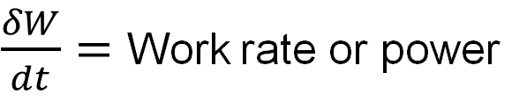
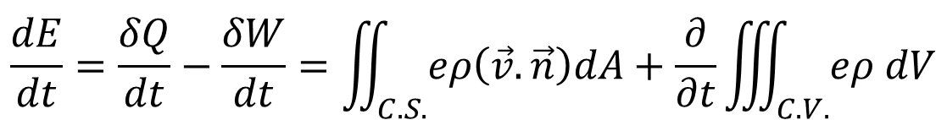
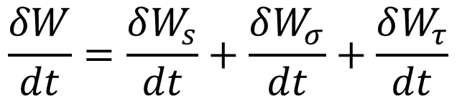
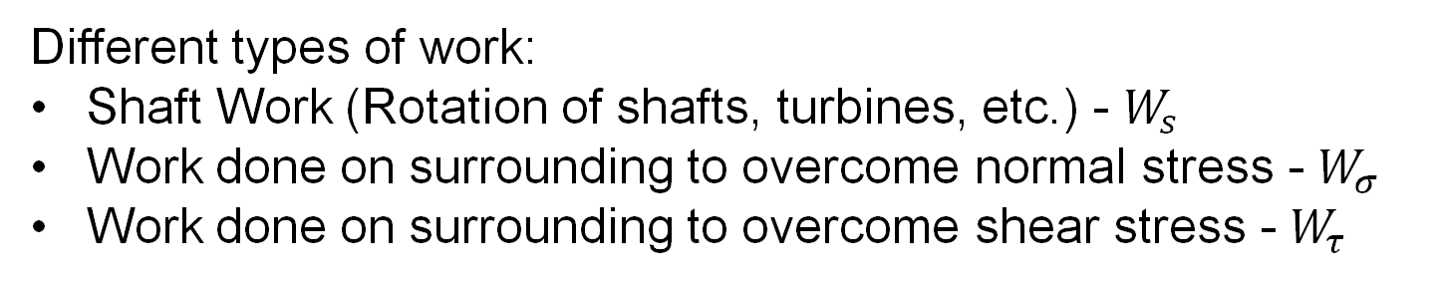
Types of Work
$$\frac{dE}{dt}=\frac{δQ}{dt}−\frac{δW}{dt}=\iint_{C.S.}{eρ\left(\vec{v}.\vec{n}\right)dA}+\frac{∂}{∂t}\iiint_{C.V.}{eρ dV}$$
Conservation of Energy Equation
$\frac{δW}{dt}=$ Work rate or power
Different types of work:
Shaft Work (Rotation of shafts, turbines, etc.) - $W_{s}$
Work done on surrounding to overcome normal stress - $W_{σ}$
Work done on surrounding to overcome shear stress - $W_{τ}$
$$\frac{δW}{dt}=\frac{δW_{s}}{dt}+\frac{δW_{σ}}{dt}+\frac{δW_{τ}}{dt}$$

Slide 7













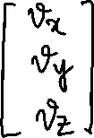




























Notations: Vectors and Tensors
Vectors
Tensors

Slide 8
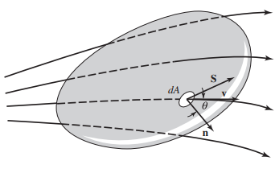
























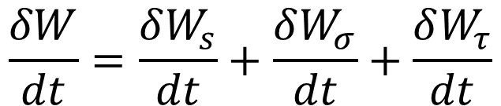





Work done to overcome fluid-stress
$$\frac{δW}{dt}=\frac{δW_{s}}{dt}+\frac{δW_{σ}}{dt}+\frac{δW_{τ}}{dt}$$
Work done to overcome fluid-stress
Image: Welty, Rorrer, Foster, Fundamentals of Momentum, Heat and Mass Transfer

Slide 9
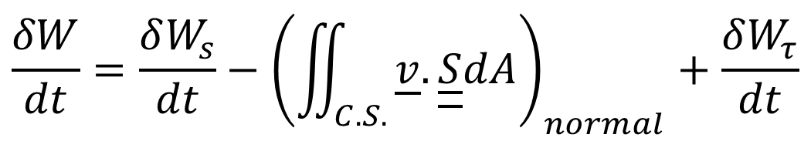
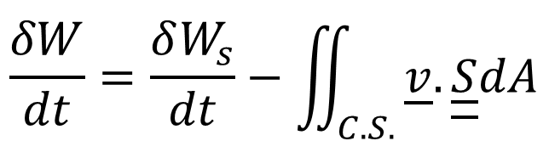
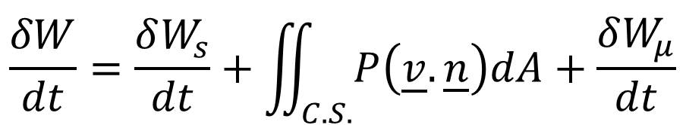

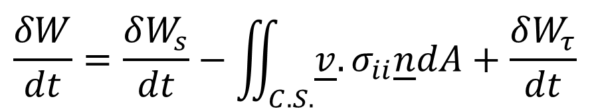
Work done to overcome fluid-stress
$$\frac{δW}{dt}=\frac{δW_{s}}{dt}−\iint_{C.S.}{\underline{v}.\underline{\underline{S}}dA}$$
$$\frac{δW}{dt}=\frac{δW_{s}}{dt}−{\left(\iint_{C.S.}{\underline{v}.\underline{\underline{S}}dA}\right)}_{normal}+\frac{δW_{τ}}{dt}$$
$$\frac{δW}{dt}=\frac{δW_{s}}{dt}−\iint_{C.S.}{\underline{v}. σ_{ii}\underline{n}dA}+\frac{δW_{τ}}{dt}$$
$$σ_{ii}=−P,τ=τ\left(μ,\underline{v}\right)$$
$$\frac{δW}{dt}=\frac{δW_{s}}{dt}+\iint_{C.S.}{P\left(\underline{v}. \underline{n}\right)dA}+\frac{δW_{μ}}{dt}$$

Slide 10
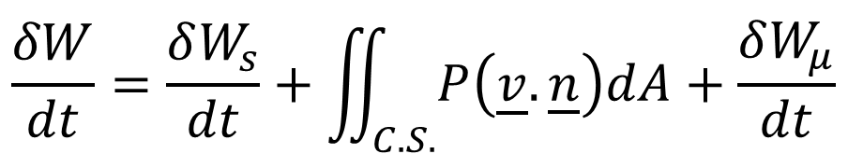
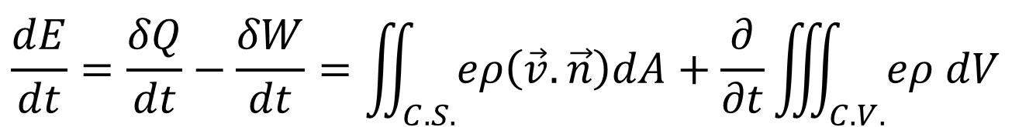
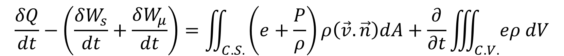
Conservation of Energy
$$\frac{dE}{dt}=\frac{δQ}{dt}−\frac{δW}{dt}=\iint_{C.S.}{eρ\left(\vec{v}.\vec{n}\right)dA}+\frac{∂}{∂t}\iiint_{C.V.}{eρ dV}$$
$$\frac{δW}{dt}=\frac{δW_{s}}{dt}+\iint_{C.S.}{P\left(\underline{v}. \underline{n}\right)dA}+\frac{δW_{μ}}{dt}$$
$$\frac{δQ}{dt}−\left(\frac{δW_{s}}{dt}+\iint_{C.S.}{P\left(\underline{v}. \underline{n}\right)dA}+\frac{δW_{μ}}{dt}\right)=\iint_{C.S.}{eρ\left(\vec{v}.\vec{n}\right)dA}+\frac{∂}{∂t}\iiint_{C.V.}{eρ dV}$$
$$\frac{δQ}{dt}−\left(\frac{δW_{s}}{dt}+\frac{δW_{μ}}{dt}\right)=\iint_{C.S.}{\left(e+\frac{P}{ρ}\right)ρ\left(\vec{v}.\vec{n}\right)dA}+\frac{∂}{∂t}\iiint_{C.V.}{eρ dV}$$
Conservation of Energy Equation

Slide 11














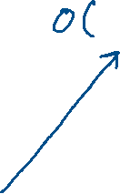





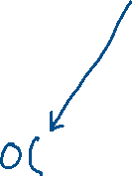

Bernoulli Principle: A Special Case
Assumptions:
Flow is incompressible and steady
Inviscid flow (Viscosity=0, friction=0)
Isothermal, Heat added to system =0
$$\frac{δQ}{dt}−\left(\frac{δW_{s}}{dt}+\frac{δW_{μ}}{dt}\right)=\iint_{C.S.}{\left(e+\frac{P}{ρ}\right)ρ\left(\vec{v}.\vec{n}\right)dA}+\frac{∂}{∂t}\iiint_{C.V.}{eρ dV}$$

Slide 12
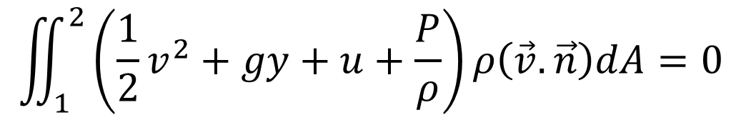
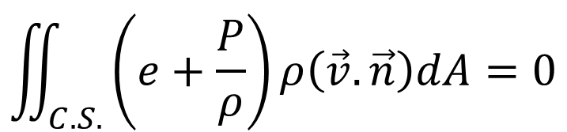
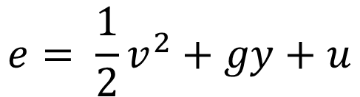
Bernoulli Principle: A Special Case
$$\iint_{C.S.}{\left(e+\frac{P}{ρ}\right)ρ\left(\vec{v}.\vec{n}\right)dA}=0$$
$$e= \frac{1}{2}v^{2}+gy+u$$
$$\iint_{1}^{2}{\left(\frac{1}{2}v^{2}+gy+u+\frac{P}{ρ}\right)ρ\left(\vec{v}.\vec{n}\right)dA}=0$$
$$\left(\frac{1}{2}{v_{2}}^{2}+gy_{2}+u_{2}+\frac{P_{2}}{ρ_{2}}\right)ρ_{2}v_{2}A_{2}−\left(\frac{1}{2}{v_{1}}^{2}+gy_{1}+u_{1}+\frac{P_{1}}{ρ_{1}}\right)ρ_{1}v_{1}A_{1}=0$$

Slide 13
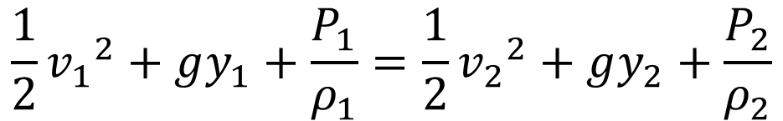
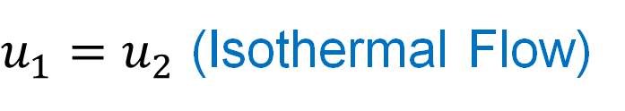
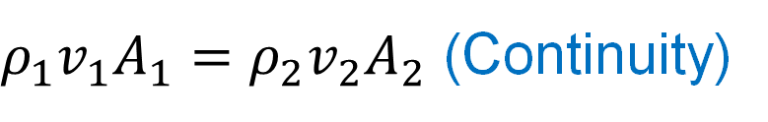
Bernoulli Principle: A Special Case
$$\left(\frac{1}{2}{v_{2}}^{2}+gy_{2}+u_{2}+\frac{P_{2}}{ρ_{2}}\right)ρ_{2}v_{2}A_{2}−\left(\frac{1}{2}{v_{1}}^{2}+gy_{1}+u_{1}+\frac{P_{1}}{ρ_{1}}\right)ρ_{1}v_{1}A_{1}=0$$
$ρ_{1}v_{1}A_{1}=ρ_{2}v_{2}A_{2}$ (Continuity)
$u_{1}=u_{2}$ (Isothermal Flow)
$$\frac{1}{2}{v_{1}}^{2}+gy_{1}+\frac{P_{1}}{ρ_{1}}=\frac{1}{2}{v_{2}}^{2}+gy_{2}+\frac{P_{2}}{ρ_{2}}$$
Bernoulli’s Equation

Slide 14
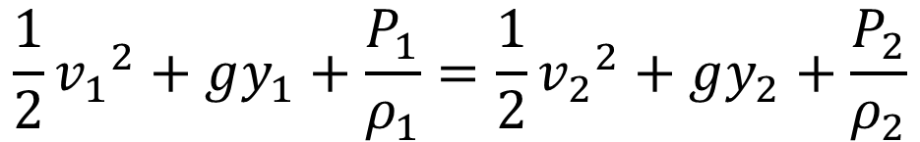
Bernoulli Principle: A Special Case
Assumptions:
Flow is incompressible and steady
Inviscid flow (Viscosity=0, friction=0)
Isothermal, Heat added to system =0
Bernoulli Principle:
For a steady, incompressible, inviscid, isothermal flow without any heat transfer, the total mechanical energy is conserved.
$$\frac{1}{2}{v_{1}}^{2}+gy_{1}+\frac{P_{1}}{ρ_{1}}=\frac{1}{2}{v_{2}}^{2}+gy_{2}+\frac{P_{2}}{ρ_{2}}$$
Bernoulli’s Equation
Caveat: In general, mechanical + internal energy is conserved!

Slide 15
Thank You!

