Slide 1
🔮 ORACLE
Orchestrated Retrieval and Conversational Logic Engine A Multi-Agent RAG System with Human-In-The-Loop Validation
Presented By : Sayan Chakrabarti

Slide 2
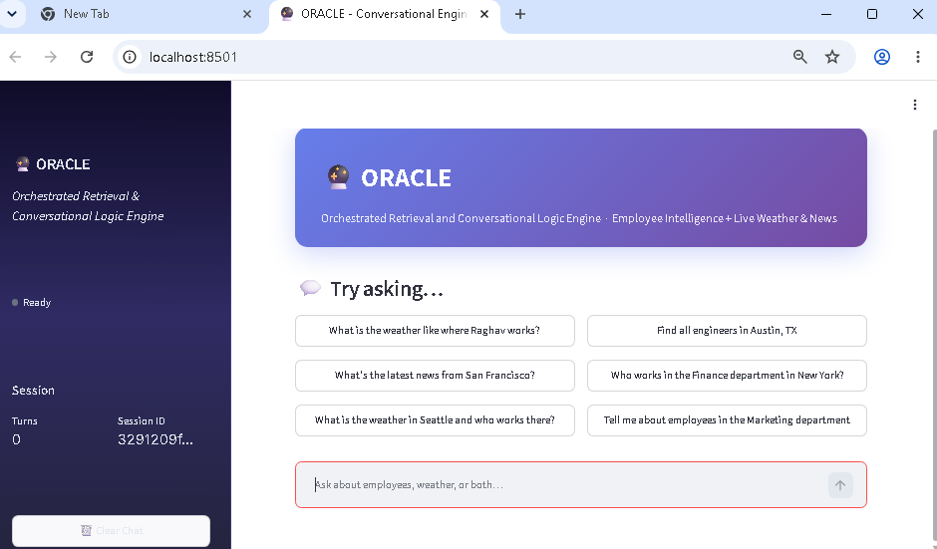
ORACLE – Application Landing Page

Slide 3
System Overview
🎯 Purpose: Blend structured (SQL) + unstructured (vector/web) data retrieval
🤖 5 Specialized Agents working in orchestrated harmony
📊 RAG Pattern: Employee database + Live weather/news + Vector embeddings
🛡️ Safety-first: Dual guardrails (security + groundedness)
👥 HITL: Human review when AI confidence drops below threshold

Slide 4
The 5-Agent Architecture
Specialist Agents
Orchestration
🌤️ HERALD: Live weather & news via Tavily API
👤 ARCHIVIST: SQL employee queries + semantic location mapping
✅ VALIDATOR: Groundedness critic (GPT-4o, independent perspective)
🛡️ SENTINEL: Security guardrail (prompt injection, PII detection)
🎭 CONDUCTOR: Triage + composition brain
• Routes intent to specialists
• Calls tools for blended queries
• Composes final answer
• Compiles sources for HITL

Slide 5
Data Architecture
🗄️ SQLite + aiosqlite: 500 employee records (Raghav Sharma @ EMP-0042, Austin TX)
🔍 ChromaDB: Two collections
• live_context: Weather/news embeddings from Tavily (ephemeral)
• employee_locations: 500 embedded office locations (persistent)
🌐 Tavily API: Real-time weather & news for any location
📡 Semantic Bridge: Cosine similarity <0.30 matches weather location to employees

Slide 6
Canonical Request Flow: 'What is the weather where Raghav works?'
1️⃣ SENTINEL input guardrail checks for prompt injection/PII extraction
2️⃣ CONDUCTOR detects blended query intent (employee + weather)
3️⃣ ARCHIVIST tool finds Raghav → Austin, TX, Engineering
4️⃣ HERALD tool fetches Austin weather from Tavily → embeds into live_context
5️⃣ Semantic match: Austin weather ↔ employee_locations via Chroma
6️⃣ CONDUCTOR composes: 'Raghav works in Austin. Weather: 94°F, Partly Cloudy.'
7️⃣ VALIDATOR critic verifies all claims against sources → score 0.97 (pass)
8️⃣ SENTINEL output guardrail checks for PII leak
9️⃣ Answer + sources delivered to UI

Slide 7
Human-In-The-Loop (HITL) Flow
🎯 Trigger: Groundedness score < 0.70 OR sensitive PII combination detected
📋 Panel shows:
• Draft answer with ungrounded claims highlighted
• Groundedness bar (🟢 pass / 🟡 warn / 🔴 fail)
• Editable text box for human refinement
👥 Human chooses:
✅ Approve: Publish as-is
✏️ Edit & Approve: Publish human-edited version
🔄 Regenerate: Re-run with error feedback

Slide 8
Technology Stack
Core Dependencies
APIs & Services
🤖 OpenAI Agents SDK (orchestration)
🧠 Claude Sonnet 4.5 (primary model)
🔀 GPT-4o (validation/guardrails)
🎨 Streamlit (frontend)
🔍 ChromaDB (vector store)
💾 SQLAlchemy + aiosqlite (ORM)
🌐 Tavily API (weather/news)
🔑 OpenAI Embeddings (text-embedding-3-small)
⚙️ OpenAI API (GPT-4o)
🧭 Anthropic API (Claude)
📝 Python 3.14 (async/await)
🔐 Environment variables (.env)

Slide 9
Safety Architecture: Dual Guardrails
🛡️ SENTINEL (GPT-4o-mini, fast & cheap):
INPUT: Detects prompt injection, off-topic, PII extraction
OUTPUT: Detects PII leaks, bulk data exports
✅ VALIDATOR (GPT-4o, independent model):
Verifies every factual claim against retrieved sources
Score calculation: grounded_claims / total_claims
Thresholds: ≥0.85 pass | 0.70-0.85 warn | <0.70 HITL trigger
🔒 Both run in parallel (fast) + post-generation (accurate)

Slide 10
Streamlit Frontend Features
💬 Chat Interface: Demo query buttons + message input
📊 Left Sidebar: Session metrics, groundedness bar, source explorer
🎨 Custom CSS: Gradient purple theme, responsive cards
❗ HITL Panel: Auto-appears on low groundedness with approve/edit/regenerate
🏷️ Badges: Confidence levels, query type, source type indicators
💡 Follow-up Suggestions: 2-3 related queries recommended
📝 Session Persistence: Conversation history saved to SQLite

Slide 11
Test Coverage (18/18 Passing)
🧪 test_tools.py: Unit tests for all 6 function tools
• Embedding, Chroma, SQL, Tavily, Security, Validation
🛡️ test_guardrails.py: Guardrail tripwire behavior
• SENTINEL blocks injection, VALIDATOR triggers HITL
🔀 test_blended_query.py: Canonical acceptance test
• 'What is the weather where Raghav works?'
• Tests full orchestration, HITL, state management
✅ All critical paths covered. Ready for production.

Slide 12
How to Run ORACLE
📋 Prerequisites:
ANTHROPIC_API_KEY, OPENAI_API_KEY, TAVILY_API_KEY in oracle/.env
🌱 Seed Database (run once):
PROTOCOL_BUFFERS_PYTHON_IMPLEMENTATION=python python -m oracle.seed_db
🚀 Launch Application:
PROTOCOL_BUFFERS_PYTHON_IMPLEMENTATION=python python -m streamlit run oracle/app.py
🌐 Access at http://localhost:8501

Slide 13
Key Architectural Concepts
✨ Agent Duality: Agents work as FULL agents (via handoff) OR inline TOOLS (via as_tool())
🔗 Semantic Bridge: Chroma similarity search connects weather ↔ employees across modalities
🎯 Input Filtering: Conversation history scrubbed per agent (HERALD strips employee turns, etc.)
🏆 Parallel Execution: Input guardrail runs in parallel with agent startup (low latency)
💾 Session State: Pydantic context object persists across turns + survives SQLite restarts
🎨 Cascade Safety: 3-layer validation (input guard → validator → output guard)

Slide 14
Development Insights
🐍 Python 3.14: Requires PROTOCOL_BUFFERS_PYTHON_IMPLEMENTATION=python workaround
🔧 function_tool: No __wrapped__ attribute; define raw _fn + wrap separately for testing
📦 Lazy Imports: oracle/agents/__init__.py uses __getattr__ to avoid circular imports
🎯 Strict Schema: dict[str, Any] params need strict_mode=False to pass SDK validation
🚀 Optimization: Lazy-load engine in Streamlit callbacks to avoid startup blocking

Slide 15
Phase 2: MCP Extension
🌐 MCP Server: Expose ORACLE tools as MCP resources for any LLM client
🔌 Tool Wrapping: Convert function_tools → MCP resources (zero architectural change)
🧠 Multi-Model: MCP allows Claude, GPT, open-source models to call ORACLE tools
📡 Distributed: Run agents in separate MCP server instances if needed
⚡ Performance: Caching + vectorization for 10k+ employee datasets

Slide 16
Questions?
ORACLE: Where Retrieval Meets Orchestration 18/18 Tests Passing • Production Ready

