Slide 1
Loan Eligibility Prediction
Using Logistic Regression
~
Sayan Biswas
Swarnavo Sarkar
Bishal Adhikary
Subhakshan Chakraborty
2nd September , 2024

Slide 2
Problem Identification
Primary Goal | To build a model that predicts loan eligibility of a customer using Machine Learning techniques.
Business Needs | Banks & other financial institutions need to assess the risk of lending to customers, to reduce defaulting cases.
Customer Needs | Predicting loan eligibility helps in effective risk management by identifying high-risk applicants & helping them make informed lending decisions.
Outcome | The trained model can be used to automate a part of the loan approval process, leading to quicker decision making & reduced risk of financial frauds.

Slide 3
Dataset
Dataset Source | The dataset is sourced from -> geeksforgeeks.org
Features | Dataset Shape: 13 columns & 598 rows Datatype : float (5), int (1), object (7)
Categorical Variables | There are total 7 categorical data: Loan_ID, Gender, Married, Education, Self_Employed, Property_Area, Loan_Status.
Target Variable | Loan_Status: The goal of the prediction model is to predict this Loan_Status based on the other features in the dataset. ​
Dataset Split | Training Set : 60% Testing Set : 40%

Slide 4
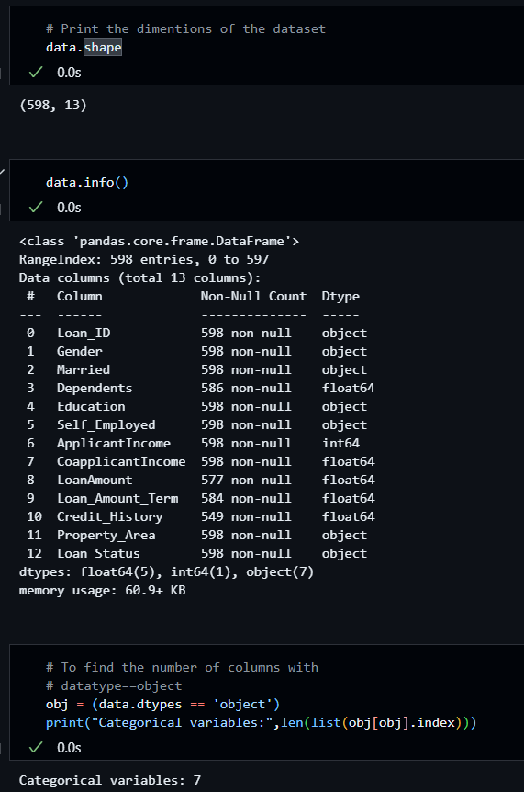
Dataset Analysis
The shape of dataset is : (598, 13)
Dataset.info() shows
no. of data,
datatypes,
size of data, etc.
The CATEGORICAL COLUMNS can be identified using their datatypes, which is usually ‘object’.

Slide 5
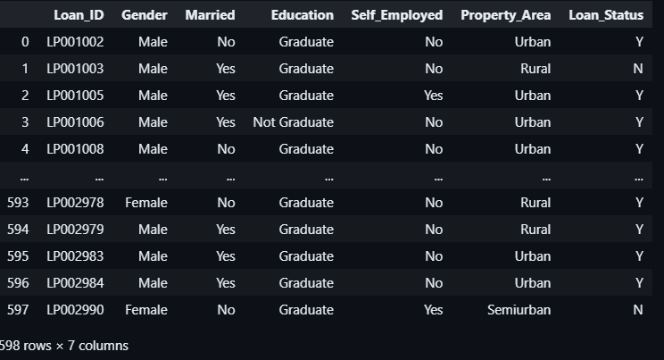
Dataset Analysis
Categorical Data Columns

Slide 6
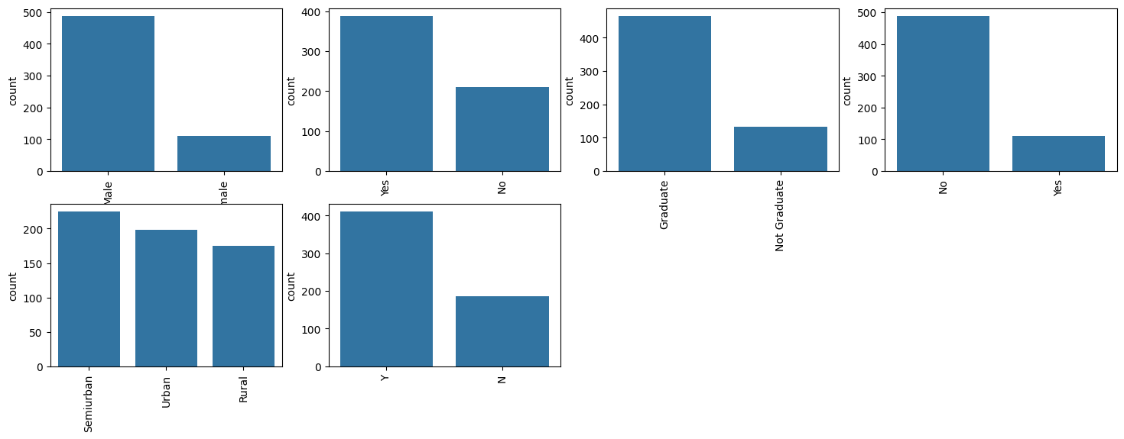
Dataset Analysis
Visualizing Categorical Data Columns

Slide 7
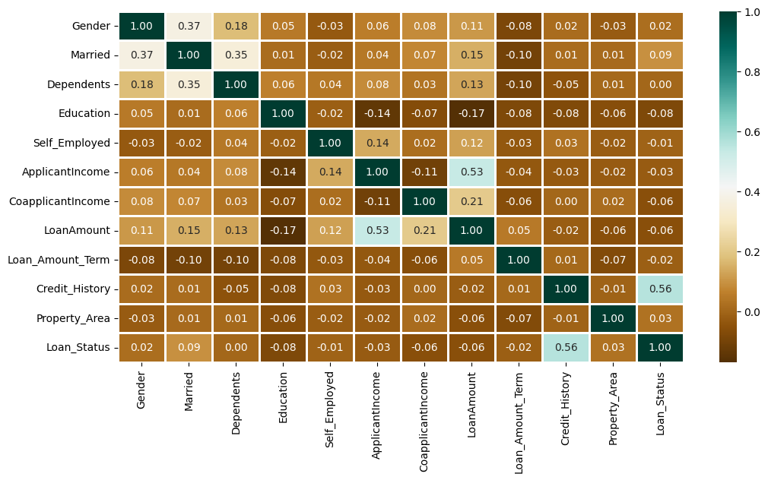
Dataset Analysis
Visualizing Data Correlation Heatmap
0 --> No Correlation
+1 --> Positive Correlation
-1 --> Negative Correlation

Slide 8
Libraries Used
Library | Pseudonym
import pandas | as pd
import numpy | as np
import matplotlib.pyplot | as plt
import seaborn | as sns
Library | Module
from sklearn | import preprocessing
from sklearn.model_selection | import train_test_split
from sklearn | import metrics
from sklearn.metrics | import confusion_matrix
from sklearn | import roc_curve, auc

Slide 9
Libraries Used
Classification Models Used
Library | Module
from sklearn.linear_model | import LogisticRegression
from sklearn.svm | import SVC
from sklearn.ensemble | import RandomForestClassifier
from sklearn.neighbors | import KNeighborsClassifier

Slide 10
About the Libraries Used
1. pandas (`pd`):
Purpose : Pandas is a powerful library for data manipulation and analysis. It provides data structures like Dataframes and Series, which are designed to handle and analyse structured data efficiently.
Common Uses : Data loading, data cleaning, data transformation, and data exploration.
2. NumPy (`np`):
Purpose : NumPy is the fundamental package for scientific computing with Python. It provides support for large, multi-dimensional arrays and matrices, along with a large collection of high-level mathematical functions to operate on these arrays.
Common Uses : Array operations, statistical calculations, linear algebra, and as a backend for other libraries like pandas.
3. Matplotlib (`plt`) :
Purpose : Matplotlib is a plotting library for the Python programming language and its numerical mathematics extension NumPy. It provides an object-oriented API for embedding plots into applications.
Common Uses : Creating static, interactive, and animated visualizations in Python.
4. Seaborn (`sns`) :
Purpose: Seaborn is a Python data visualization library based on matplotlib. It provides a high-level interface for drawing attractive and informative statistical graphics.
Common Uses : Building complex visualizations like heat maps, time series, violin plots, and more with simpler code.

Slide 11
About the Libraries Used
Modules from Scikit-learn Library:
preprocessing: This module provides various utilities for scaling, transforming, and normalizing data. Preprocessing is essential for preparing raw data for machine learning models, ensuring that the data is in a suitable format and scale.
metrics: This module provides tools to evaluate the performance of machine learning models. It includes various metrics for classification, regression, and clustering.
roc_curve and auc: These functions are used to calculate the Receiver Operating Characteristic (ROC) curve and the Area Under the Curve (AUC) for evaluating the performance of classification models, particularly their ability to distinguish between different classes.
confusion_matrix: This function computes the confusion matrix to evaluate the accuracy of a classification model by comparing predicted and actual class labels.
train_test_split: This function is used to split a dataset into training and testing subsets. It helps to evaluate the performance of a machine learning model by training on one portion of the data and testing on another, ensuring that the model is not overfitted to the training data.

Slide 12
About the Libraries Used
Machine Learning Models for Classification:
LogisticRegression: This is a linear model used for binary classification tasks. It predicts the probability of a binary outcome using a logistic function.
KNeighborsClassifier: This classifier implements the k-nearest neighbors algorithm, which classifies data points based on the classes of their nearest neighbors in the feature space.
RandomForestClassifier: This is an ensemble learning method based on decision trees. It builds multiple decision trees during training and outputs the mode of their predictions for classification tasks. It is known for its robustness and high accuracy.
SVC (Support Vector Classifier): SVC is a type of Support Vector Machine (SVM) used for classification tasks. It attempts to find the hyperplane that best separates classes in the feature space, often used in complex classification problems.

Slide 13
Solution Flow Diagram
Feature
Selection
Data Collection
Data Preprocessing
Model Building
Testing Accuracy
Prediction
ML model used

Slide 14
Machine Learning Models

Slide 15
Support Vector Classifier(SVC)
Support Vector Classifier (SVC) is a supervised machine learning algorithm used for classification tasks. It is part of the support vector machine (SVM) family and aims to find the optimal hyperplane that separates data points of different classes with the maximum margin. Here are its key features:
Hyperplane and Margin: SVC finds the hyperplane that best separates the classes in the feature space with the largest margin, defined as the distance between the hyperplane and the nearest data points from each class, known as support vectors.
Support Vectors: These are the data points that lie closest to the hyperplane and are critical in defining the position and orientation of the hyperplane.
Kernel Trick: SVC can handle non-linearly separable data using kernel functions (e.g., linear, polynomial, radial basis function (RBF), and sigmoid) to transform the data into a higher-dimensional space where a linear separation is possible.
Regularization Parameter ©: Controls the trade-off between maximizing the margin and minimizing classification error. A smaller value of C allows more misclassification for a wider margin, while a larger value aims for a narrower margin with fewer errors.
Robustness to Overfitting: SVC is effective in high-dimensional spaces and is robust against overfitting, especially when the number of dimensions exceeds the number of samples.
Versatility and Applications: SVC is versatile and effective for both binary and multi-class classification problems. It is widely used in fields such as image recognition, bioinformatics, and text categorization.
SVC is powerful for complex, high-dimensional datasets where clear separation boundaries exist, and its kernel functions make it adaptable to various classification challenges.

Slide 16
K - Neighbors Classifier
The K-Neighbors Classifier (KNN) is a simple, non-parametric, and instance-based learning algorithm used for classification tasks. It classifies data points based on the majority class among its k nearest neighbors in the feature space.
Below are its key features:
Instance-Based Learning: KNN does not learn a model but makes predictions based on the training data directly, using the entire dataset during the prediction phase.
Distance Metrics: It typically uses Euclidean distance to find the nearest neighbors, but other distance metrics like Manhattan or Minkowski can also be used depending on the nature of the data.
Parameter k: The number of neighbors, kkk, is a crucial hyperparameter. A smaller kkk makes the model more sensitive to noise, while a larger kkk makes it more generalized. Commonly, kkk is set to an odd number to avoid ties.
Majority Voting: For classification, KNN assigns the class label that is most frequent among the k nearest neighbors.
Scalability: KNN can be computationally expensive with large datasets since it requires distance calculations for all training samples during prediction.
No Training Phase: It has no explicit training phase, making it straightforward and easy to implement.
Versatility: It works well with multi-class classification problems and can also be adapted for regression tasks.
Applications include recommendation systems, anomaly detection, and pattern recognition, where KNN’s simplicity and interpretability are advantageous.

Slide 17
Random Forest Classifier
The RandomForestClassifier is an ensemble learning method used for classification tasks. It operates by constructing a multitude of decision trees during training and outputting the mode of their predictions (classification) for each input. It is a popular model in machine learning due to its high accuracy, robustness to overfitting, and ability to handle large datasets with high dimensionality.
Key Features:
Ensemble Method: Random forests combine the predictions of multiple decision trees, which reduces the risk of overfitting compared to using a single decision tree.
Majority Voting: For classification tasks, the RandomForestClassifier aggregates the results of individual trees using majority voting to make the final prediction.
Feature Importance: It provides a measure of feature importance, indicating how much each feature contributes to the model’s predictions.
Handling Missing Values: Random forests can handle missing data well by utilizing median/mode imputation and also by using surrogates for splits.
Key Parameters:
n_estimators: The number of trees in the forest.
max_depth: The maximum depth of each tree, which controls how complex the individual trees can be.
max_features: The number of features to consider when looking for the best split.
criterion: The function used to measure the quality of a split.
Applications:
Finance: Risk assessment and fraud detection.
Medicine: Disease prediction and patient classification.
Marketing: Customer segmentation and behavior prediction.
The RandomForestClassifier is a powerful tool in the machine learning toolkit, suitable for a wide range of classification problems due to its flexibility, ease of use, and high performance.

Slide 18
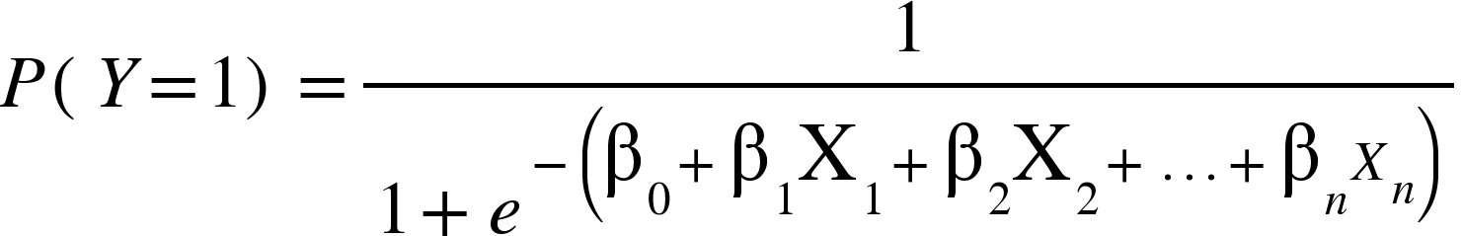
Logistic Regression
Logistic regression is a statistical method used for binary classification problems, where the goal is to predict the probability of a binary outcome (e.g., success/failure, yes/no, 0/1) based on one or more predictor variables. Unlike linear regression, logistic regression uses the logistic function (sigmoid function) to model the relationship between the independent variables and the dependent variable, ensuring that the output is bounded between 0 and 1.
Key Points:
Logistic Function: The core of logistic regression is the logistic function:
Interpretation: The coefficients ((beta)) represent the change in the log odds of the outcome for a one-unit change in the predictor variable.
Loss Function: It uses the log-loss (cross-entropy) as the loss function, which penalizes incorrect classifications more heavily as the confidence in the prediction increases.
Assumptions: Logistic regression assumes that the predictors are linearly related to the log odds of the outcome and that observations are independent.
Applications: Commonly used in various fields such as medicine (predicting the presence or absence of a disease), marketing (customer conversion prediction), and finance (credit scoring).
Logistic regression is straightforward to implement and interpret, making it a popular choice for binary classification tasks, especially when the relationship between the dependent and independent variables is approximately linear on the logit scale.

Slide 19
Testing The Accuracy of the Models

Slide 20
What is Accuracy Score?
The Accuracy Score is a metric used to evaluate the performance of a classification model by measuring the proportion of correctly classified instances out of the total instances.
Key Points:
Formula:
Range: The accuracy score ranges from 0 to 1, where 1 indicates perfect accuracy (all predictions are correct) and 0 indicates no correct predictions.
Use: It is straightforward and easy to interpret, making it useful for evaluating models where class distribution is balanced.
Limitations: Accuracy can be misleading in imbalanced datasets, where a model might achieve high accuracy by simply predicting the majority class. In such cases, other metrics like precision, recall, or F1 Score might provide more insight.
The Accuracy Score provides a general measure of model performance but may not fully capture the model’s effectiveness in cases where class distribution is skewed.
Accuracy = | Number of Correct Predictions
 | Total Number of Predictions

Slide 21
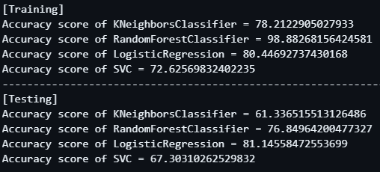
Accuracy Score

Slide 22
What is F1 Score?
The F1 Score is a metric that combines precision and recall to evaluate a classification model, especially in cases with imbalanced data.
Precision: The ratio of true positives to all positive predictions made by the model.
Precision = (TP)/(TP + FP)
Recall: The ratio of true positives to all actual positives.
Recall = (TP)/(TP+FN)
F1 Score: The harmonic mean of precision and recall, calculated as: F1 Score = (2 x Precision x Recall) / (Precision + Recall)
Range: From 0 to 1, where 1 indicates perfect precision and recall.
Use: Useful when you need to balance precision and recall, particularly with imbalanced datasets.

Slide 23
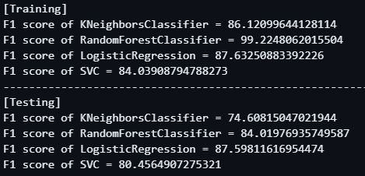
F1 Score

Slide 24
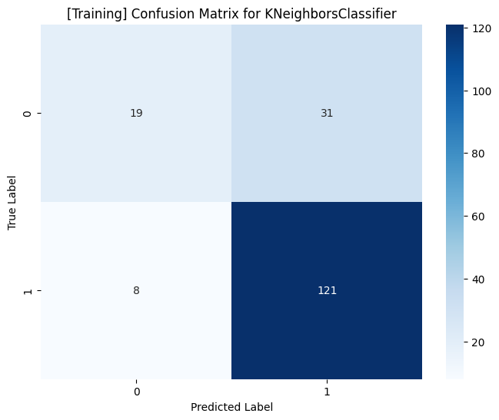
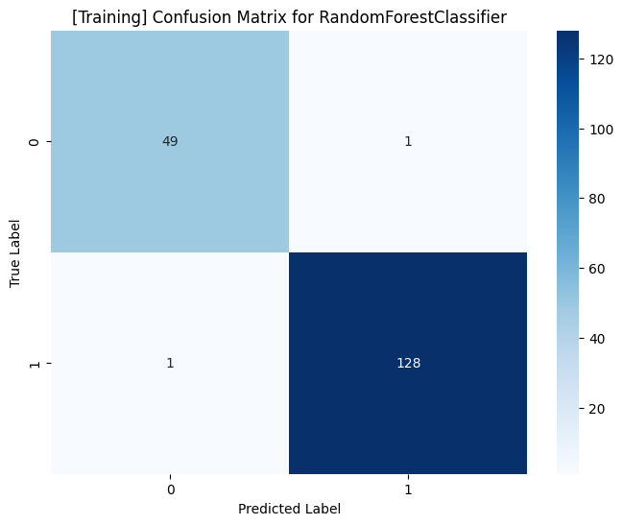

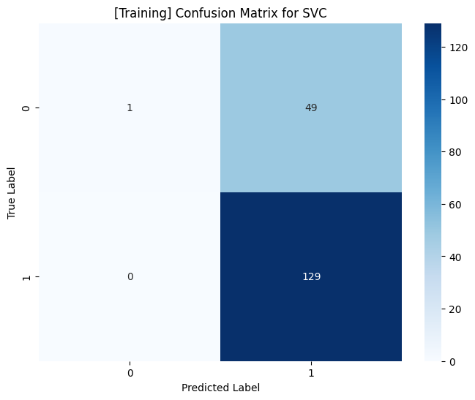
Confusion Matrix [Training]

Slide 25
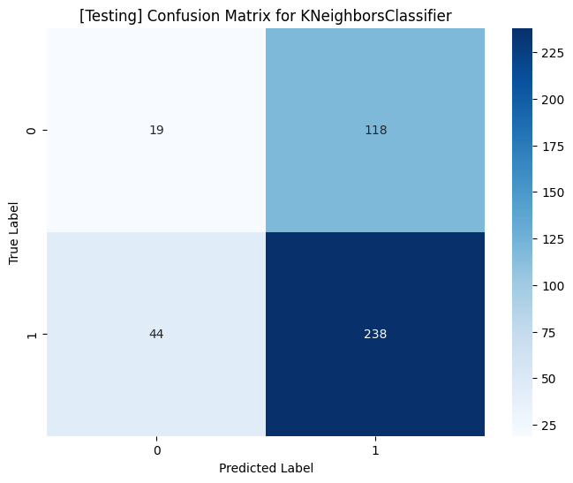
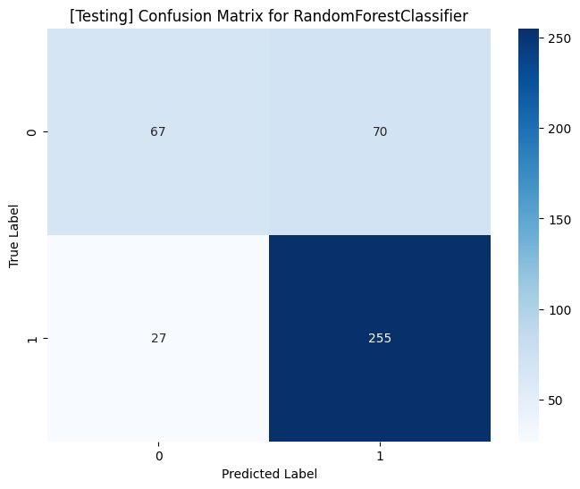
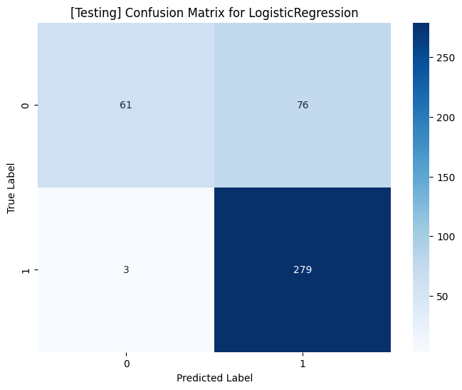
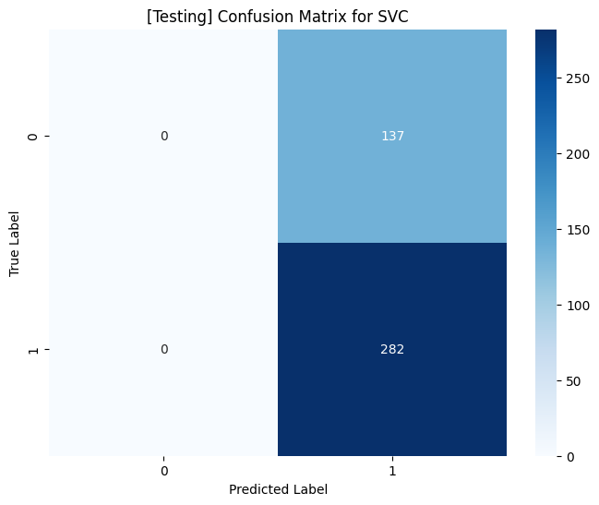
Confusion Matrix [Testing]

Slide 26
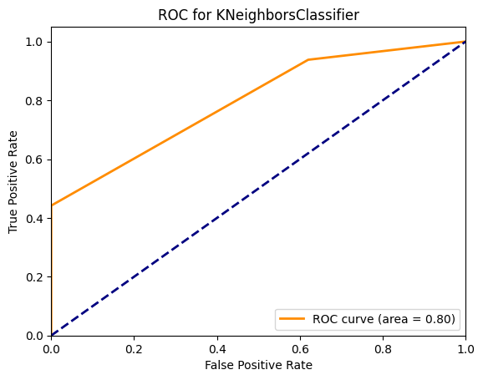
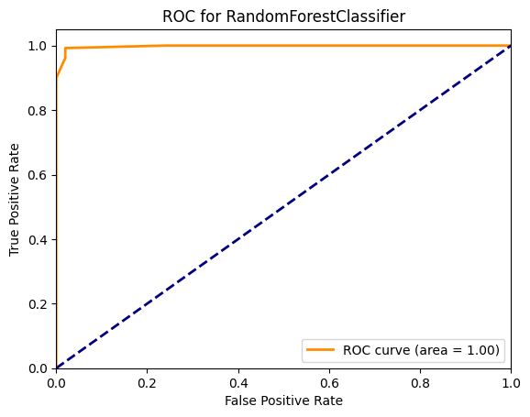
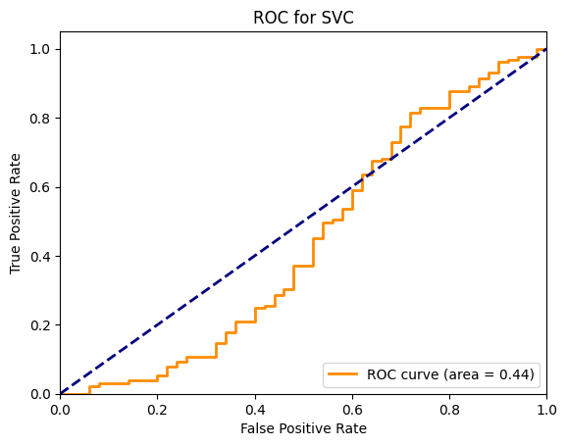
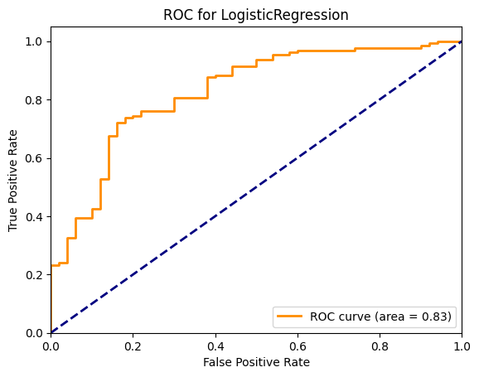
ROC Curve [Training]

Slide 27
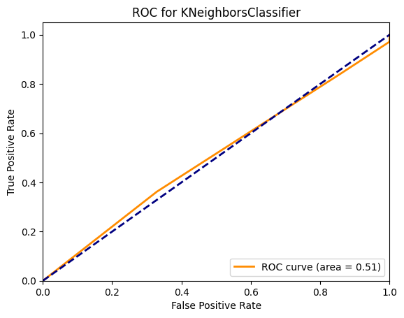
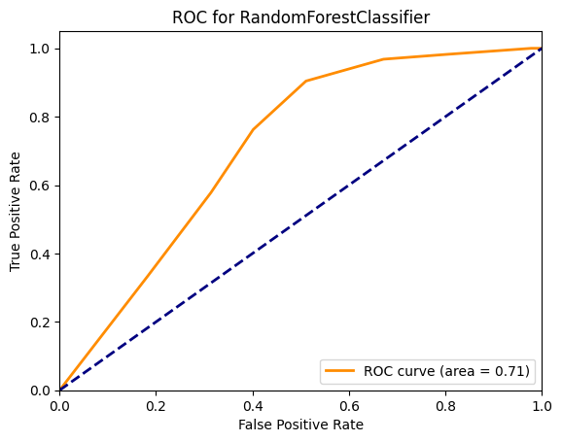
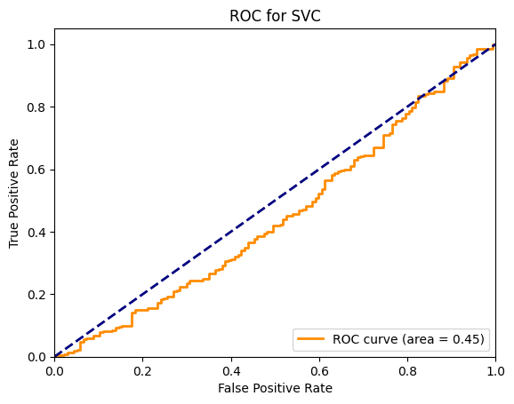
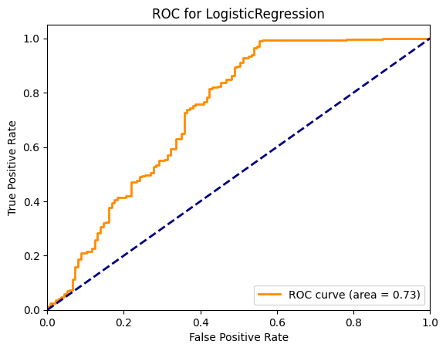
ROC Curve [Testing]

Slide 28
Scope of Improvements
Scope of Improvements in Loan Approval Prediction 1. Random Forest:
Improvements:
Tune hyperparameters (e.g., number of trees, max depth) to optimize performance.
Experiment with different bootstrap methods and feature subsets.
2. K-Nearest Neighbors (KNN):
Improvements:
Optimize the number of neighbors (k) to balance bias and variance.
Experiment with different distance metrics (e.g., Euclidean, Manhattan).
Implement feature scaling for better performance.
3. Logistic Regression:
Improvements:
Feature engineering and selection to improve model accuracy.
Tune regularization parameters (e.g., C) to prevent overfitting.
Consider polynomial features for capturing nonlinear relationships.
4. Support Vector Classifier (SVC):
Improvements:
Optimize hyperparameters (e.g., C, kernel type, gamma) for better separation.
Experiment with different kernels (e.g., RBF, polynomial) based on data characteristics.
Use feature scaling for improved model performance.

Slide 29
Conclusion
In conclusion, machine learning algorithms offer powerful tools for enhancing the accuracy and efficiency of loan eligibility prediction. By leveraging models such as Random Forest, K-Nearest Neighbors (KNN), Logistic Regression, and Support Vector Classifier (SVC), financial institutions can significantly improve their decision-making processes.
Key Takeaways:
Random Forest provides robust performance with high-dimensional data and offers insights through feature importance, which can be optimized further with hyperparameter tuning.
K-Nearest Neighbors (KNN), with its simplicity, can be refined by adjusting the number of neighbors and distance metrics, while feature scaling can enhance its accuracy.
Logistic Regression delivers clear probabilistic outcomes and can benefit from improved feature engineering and tuning of regularization parameters to avoid overfitting.
Support Vector Classifier (SVC) excels in complex and high-dimensional spaces, with performance improvements achievable through kernel selection and hyperparameter optimization.
Future Directions:
Data Quality: Ensure the use of high-quality, relevant data to train models effectively.
Model Evaluation: Continuously evaluate and compare model performance using various metrics to identify the best-performing algorithm.
Integration: Consider integrating these models into a cohesive decision-support system for loan eligibility to provide comprehensive and reliable predictions.
Implementing these machine learning techniques thoughtfully can lead to more accurate predictions, improved risk assessment, and ultimately better decision-making in loan approvals.

Slide 30
THANK YOU

