Slide 1

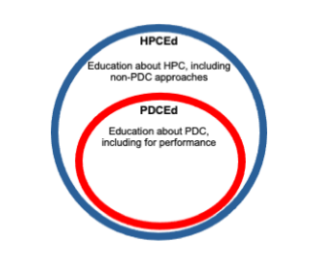
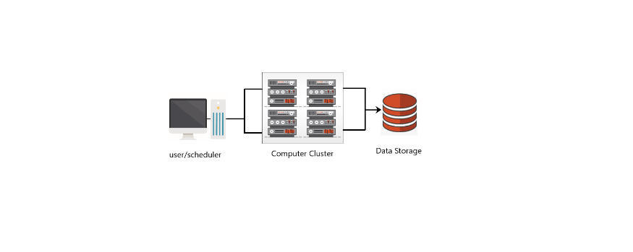
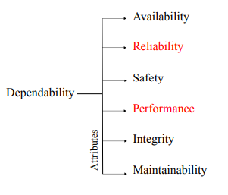

High-Performance Computing: A Survey
¹Sanandita Bera , ²Manasija Bhattacharya
Haldia Institute of Technology, Information Technology
ABSTRACT
PDCEd before HPCEd
RF_{PE} = (2) [7]
the RF_{PE} is calculated as the ratio of the time to solution of the original application to the time to solution of a version enhanced using a resilience solution X, assuming that both terms are measured for identical fault rates.
Resilience Factor Yield (RY) provides a measure of effective resilience.
RY = ^{n}√ (RF_{T1}RF_{T2} ...RF_{Tn}) (3) [7]
For a set of solutions S={S1, S2, S3 ... S_{N} } that each provides fault resilience for an application, the RY_{PE} provides a measure of their combined impact on the performance characteristics.
CONCLUSION
a) HPC in the field of computer science emphasizes the making of cluster computers, supercomputers, and parallel algorithms [1].
b) Parallel computing is not accessible to everyone because of the high cost of supercomputers.
c) In HPC architecture, servers must be networked together in a cluster.
d) The clusters technique is used in numerous areas, such as scientific calculations, weather forecasting, bioinformatics, signal processing, petroleum exploration, and so on [1].
Keywords: Cluster computers, parallel algorithms, supercomputers
a) In this paper, we discussed how HPC offers numerous benefits to industries that processes huge quantities of data.
b) Scientists and researchers need more time, training, and capital to understand and utilize these tools and technology.
c) HPC allows scientists and researchers to work on problems much faster than they would without this technology.
d) Domain knowledge is an important part of HPC education so that students can gain experience on how to use HPC to solve real-world problems.
e) No cloud provider fits all user requirements. Each one has its value in the market.
f) In the information technology field, there are no clear predictions regarding what would happen in the next few years.
Figure 1: Claim: Effective HPCEd covers all of PDCEd [11]
a) Figure 2 illustrates the relationship between HPCEd and PDCEd. It recognises that students must at least learn PDC to learn HPC, as some elements of HPC go beyond PDC.
b) HPCEd demands are in addition to those of PDCEd, so it is imperative that HPCEd prepares to meet the contemporary needs of computer science and engineering students.
ADVANTAGES
HPC allows scientists and researchers to work on these problems faster and collect the results more efficiently.
The main advantages of HPC are speed, cost, fault tolerance and total cost of ownership.
Speed: High performance means fast calculations. The speed of an HPC depends on its configuration.
Fault tolerance: If a part of the system fails, the entire HPC system will not fail. It ensures that the computations continue uninterrupted.
Cost: HPC is cheaper than supercomputing because it utilizes fewer clusters.
Total cost of ownership(TCO): Total cost also includes on-site power, cooling, and maintenance of the HPC.
Cloud provider present TCO as a benefit because customers only pay for the amount of resources they use.
INTRODUCTION
a) HPC offers an excellent medium to accelerate the computational requirements of scientific and engineering applications.
b) In last 50 years, despite rapid fluctuations in dealers, architectures and technologies the evolution of performance is still a steady and continuous process.
c) The main goal of HPC is to process numbers, rather than sort data. HPC is built on superior performance, enabling businesses to do more for less.
d) The collection of clusters provides high-performance computing and independent computers work simultaneously to solve a problem.
e) The situation is changing expeditiously with several systems available for performing grid-based computing.
f) HPC is presently running everywhere due to its potential to solve extensive computational problems within equitable time and cost parameters.
j) HPC is now being used more intensively by researchers in artificial intelligence, data science, biological sciences, cloud computing.
ARCHITECTURE
REFERENCES
In HPC architecture, multiple servers are networked together in a cluster that has a better performance than a single computer.
Organizations have a choice of different ways to design HPC systems. Three HPC designs are used:
a) Parallel Computing
b) Cluster Computing
c) Grid and Distributed Computing
A HPC architecture comprises of several servers networked together, also called an HPC cluster. To enhance computing power all components the cluster coordinates with each other. To capture the output, the cluster is networked to the data storage while software programs and algorithms are run simultaneously on the servers. The storage component needs to take in data and transfer it to the servers as quickly as it is processed.
Challenges in Implementing HPC architecture:
a) The long-term cost of managing HPC infrastructure is a major challenge.
b) A HPC environment isn’t of much value if we don’t get awesome performance.
c) If one component of the architecture fails, then the performance of the entire HPC solutions falters.
[1] Simons, Joshua E.; Buell, Jeffrey, “Virtualizing high-performance computing”, Vol. Iss. 4, December 2010
[2] Jack Dongarra, et al., “HIGH PERFORMANCE COMPUTING TODAY”, (2000)
[3] Scott Lathrop; Thomas Murphy, “High-Performance Computing Education”, 10, 5, 9–11, September 2008,
[4] “Critical Analysis of High-Performance Computing (HPC)”, International Journal of Computer Science and Information Security (IJCSIS), Vol. 16, No. 9, September 2018
[5] N DeBardeleben, et al., “High-End Computing Resilience: Analysis of issues facing the HEC community and path-forward for research and development”, December 2009
[6] P. Cholda; J. Tapolcai; T. Cinkler; K. Wajda; A. Jajszczyk, “Quality of resilience as a network reliability characterization tool”, IEEE Network 23, 2, 11–19, March 2009
[7] “Towards New Metrics for High-Performance Computing Resilience”, FTXS ’17, June 2017
[8] John McCarthy; Patrick J Hayes, “Some philosophical problems from the standpoint of artificial intelligence”, In Readings in artificial intelligence. 431–450.
[9] Gangman Yi; Vincenzo Loia, “High-performance computing systems and applications for AI”, The Journal of Supercomputing 75, 8, 4248–4251, 2019
[10] Kumar, Dileep et. al. “Design and Implementation of High-Performance Computing (HPC) Cluster.” Academic Journal of Management Sciences, January 2018.
[11] “High Performance Computing Education: Current Challenges and Future Directions” TiCSE-WGR ’20, June 17–18, 2020
[12] C. A. Thraskias et al., "Survey of Photonic and Plasmonic Interconnect Technologies for Intra-Datacenter and High-Performance Computing Communications," in IEEE Communications Surveys & Tutorials, vol. 20, no. 4, pp. 2758-2783
[13] Yuping Fan. “Job Scheduling in High-Performance Computing”. 2021. Chapter in Horizons in Computer Science Research, Volume 18
[14] Critical Analysis of High-Performance Computing (HPC) International Journal of Computer Science and Information Security (IJCSIS), Vol. 16, No. 9, September 2018
[15] Thomas Sterling, Matthew Anderson, and Maciej Brodowicz. 2017. A Survey: Runtime Software Systems for High Performance Computing. Supercomput. Front. Innov.: Int. J. 4, 1 (March 2017), 48-68
More references are mentioned in the paper
Figure 2: HPC architecture representation
DISADVANTAGES
The use of an HPC environment has certain disadvantages.
A) It is difficult for one person on a single computer terminal to track and monitor everything that is happening in an HPC environment.
B) Code developed for one HPC cluster may not be portable to other HPC clusters.
C) It is a challenge to convince sponsors to make long term investment in large teams behind developing tools.
There are also significant costs associated with HPC, including:
Initial equipment costs: Equipment is very expensive and will become outdated within a few years.
Continual upgrading costs: due to continuous development of HPC technologies, frequent system upgrade is required.
Operational and management costs: The cooling and power required to keep HPC clusters running are also very expensive.
.
Literature Review
Virtualizing High-Performance Computing | Presents challenges in virtualization of HPC including performance-related issue discussion. Outlined preliminary measurement efforts and also discussed future work needed to gain more understanding of the performance landscape for virtualized HPC [1].
Job Scheduling in High-Performance Computing | Reviews challenges faced by HPC job scheduling and scheduling methods adopted by schedulers to overcome these challenges. The proposed intelligent scheduling framework monitors the abnormal behaviours and performance of an HPC system and improve system and job performance dynamically [13].
Critical Analysis of High-Performance Computing | Paper compares two types of clusters to check overall performance in execution time. Experimented with clusters having almost same configuration. Two different parallel programs executed on clusters for pi and quick sort to analyse the cluster. It was observed that small size problems Dell cluster performed better against HP cluster while large size problems HP cluster won the game [14] .
Towards New Metrics for High-Performance Computing Resilience | Documents ways to quantify resilience that considers reliability and performance characteristics of the solutions from the perspective of HPC applications. The proposed metrics for quantifying resilience advocates outcome-based approach to quantify resilience in terms of performance and reliability of fault events on HPC applications [7].
Survey of Photonic and Plasmonic Interconnect Technologies for Intra-Datacenter and HPC Communication | Based on the latest literature data this paper compares conventional electrical, photonic and plasmonic short distance interconnect technologies in terms of bandwidth density and energy efficiency. The comparison showed that both photonic and plasmonic technologies can be used for energy-efficient interconnects that could meet future prospects [12].
Resilience of HPC applications
HPC systems are subject to an ever-increasing number of failures, errors, and breakdowns.
Resilience of an HPC application relates to the effectiveness of error handling.
FUTURE WORK
With graphic-intensive applications requiring fast processing, HPC is quickly becoming a necessity rather than an option. The scope of HPC applications will be further expanded in the future.
Thanks to advances in technology, faster microprocessors will be available every year and inexpensive HPC systems with few processors will deliver performance that previously could only be achieved by expensive vector computers or MPP systems.
New applications will emerge, not only in science and engineering, but also in commerce, in fields such as information retrieval, decision support, financial analysis, or data mining.
Future HPC architectures will have more powerful compute nodes, use more cores and accelerators, and use new cloud-based memory and I/O technologies to handle more intensive workloads and scale.
What is needed is a stable set of tools that work on all relevant platforms, provide code developers with the tools they need to debug code and optimize its performance and provide users the tools they need to configure the problem, run the code and analyse the responses.
The next generation of HPC will also include convergence with quantum computers, radically transforming the way we perceive the value of computing.
Figure 3: Dependability Attribute Tree [11]
Dependability refers to a property of a system that indicates whether the system is operating properly. The systems ability to avoid service failures decides how much a system is dependable.
Resilience Metrics - The metrics that provide a measure of the resilience of an application, independent of the type and severity of fault events.
Resilience Factor(RF) provides a measure of the impact of events in terms of performance and reliability outcomes.
RF_{PE} = (1) [7]
The RF_{PE} is calculated as the ratio of the time to solution in the absence of fault events to the time to solution in the presence of fault events.

