Slide 1
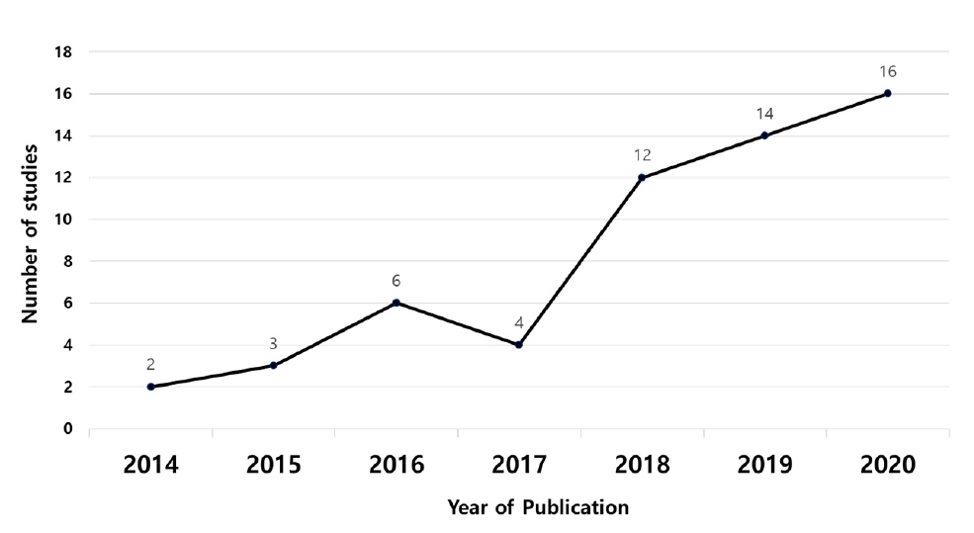
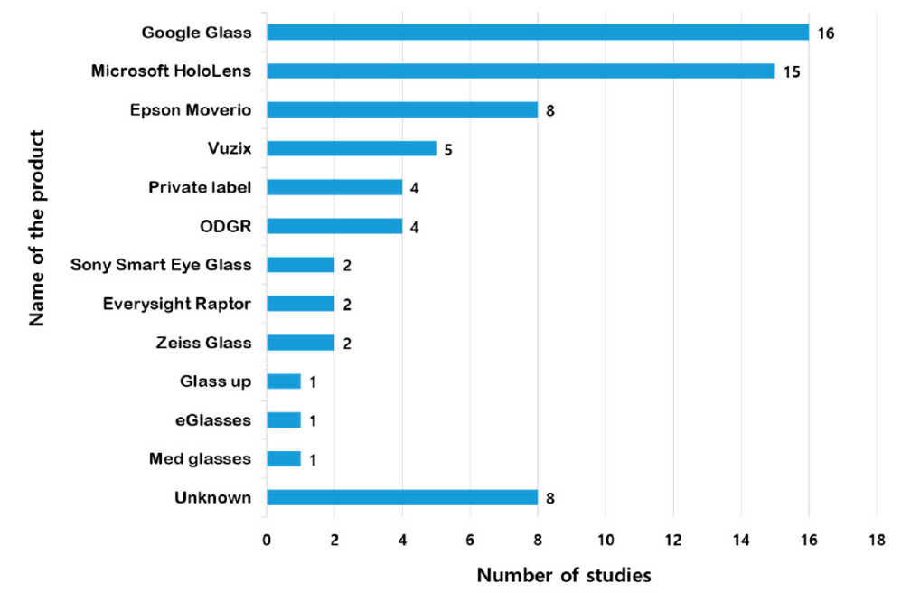
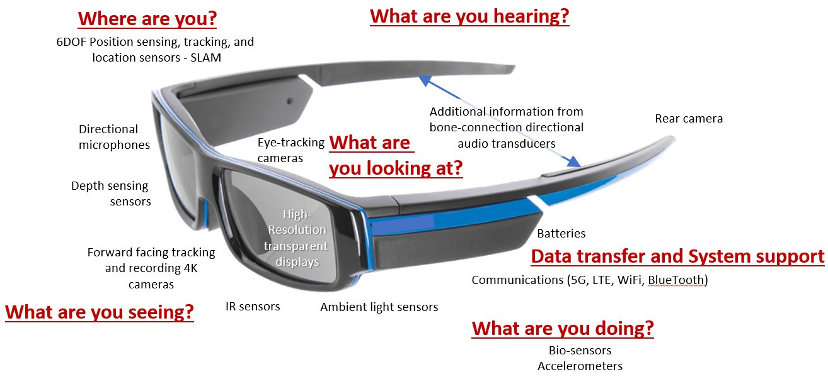
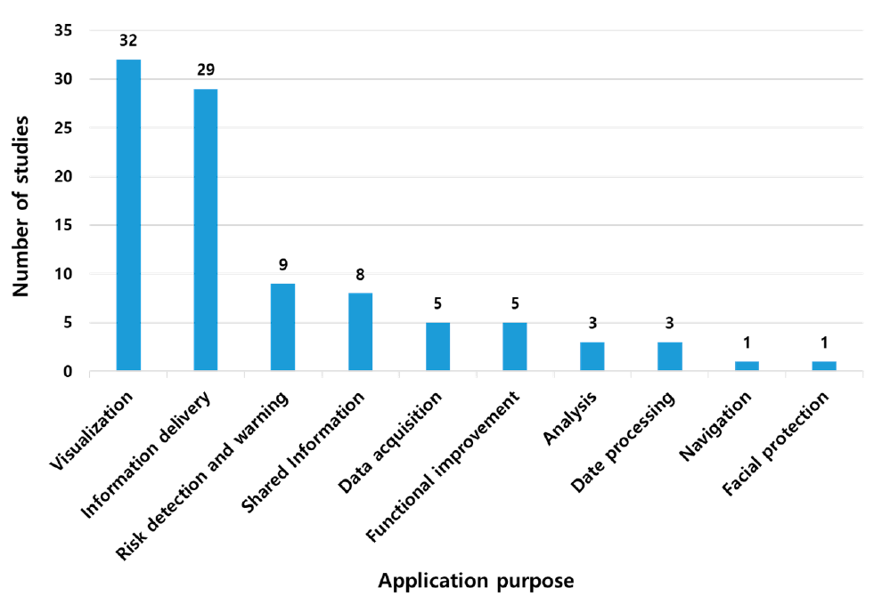
A Survey Report on Smart Glasses
¹Nitish Kumar Maurya, ¹Sayan De, ¹Shilanjan Ghosh, ²Manasija Bhattacharya
^{1,2}Haldia Institute of Technology, Information Technology, West Bengal, India
ABSTRACT
METHODOLOGY
DISCUSSION
CONCLUSION
a) Smart glasses are wearable computing devices that look like regular eyeglasses but have a built-in display and computer processing capabilities.
b) Smart glasses are being used in various fields, including agriculture, healthcare, accessibility, and entertainment.
c) The adoption of smart glasses is increasing rapidly, with over 1.5 million new users per year. [1]
d) Smart glasses provide real-time data and instructions, reducing the need for manual input and increasing the speed and accuracy of tasks.
e) Smart glasses have challenges such as battery life, input methods, wireless communication issues, device weight, and data privacy concerns.
Keywords: smart glass, computer processing capabilities, fields, sensors.
a) An app-based Mine Field Worker Support (MFWS) system developed for use by workers with a handheld PXRF analyzer. [1]
b) A remote study was performed to evaluate the effectiveness of smart glasses would be in the field of accessibility, specifically for blind people. Two different camera form factors were evaluated; a laptop camera, and a camera embedded in smart glasses. [2]
c) An MPV Model using color and motion was developed to display visual cues in the peripheral vision of the user. It was implemented within a navigation application. The researchers were able to isolate both the impact of peripheral vision and use of smartglasses, by comparing the MPV model with standard applications. [3]
d) A comprehensive literature review was performed to provide an overview of applications of HMD and smart glasses in surgery. The study aimed to explore whether VR and AR could enhance student learning, engagement and performance. [4]
e) A prototype application, built on the Android platform, was used in the UNESCO World Heritage site in the city of Malacca, to study the effectiveness of smart glasses in the field of tourism. It aimed to provide visitors with an immersive and information-rich experience as the heritage site. [5]
A number of survey related to smart glasses have already been conducted in the past, and the impacts of the technology in various fields, were recorded.
Fig. 2: The number of articles published each year between January 2014 and October 2020. [6]
a) This study analyzed the number of research papers published on smart glasses from January 2014 to October 2020 to determine research trends.
b) The number of papers related to smart glasses had been increasing since 2014 but declined in 2017 due to the release of Google Glass. However, the number of published papers has skyrocketed since then and has been steadily increasing up to 2020.
c) Out of 57 papers, 43 were published after 2017. The study found that 74% of the papers were published during the last 3 years.
Fig 3: Frequency of use based on model of smart glasses. [6]
a) The smart glasses used in the research were categorized to understand the most used products among multiple smart glass products.
b) As for the smart glasses used in the research, Google Glass was used the most, in 16 studies, followed by Microsoft HoloLens in 15 studies.
c) Epson’s Movie series was used in eight studies, making it the third most popular among the commercialized products. Beyond commercially available smart glasses, there were four cases in which we made our own smart glasses to suit the research purpose.
Fig. 4: Number of studies based on research purpose. [6]
a) Smart glasses were found to be used in various fields, although the purpose of their application may be different.
b) Smart glasses play the most visual role, so the research aims to convey other information to the user’s line of sight. Therefore, 32 studies were performed to convey the information obtained from smart glasses and then to visualize such information.
c) In addition, nine studies were aimed at notifying users of dangers using acquired data and eight studies were aimed at sharing information.
a) In this paper, we explored the ways in which smart glasses are influencing workflow and productivity in various fields, thus proving itself to be a very useful and versatile piece of technology.
b) Since it is a new & emerging technology, the user base is currently increasing at a rate of over 1.5 million per year and the number of users is expected to increase even more in the upcoming years. [7]
c) However, nothing is perfect in this world. Everything has it’s own set of pros and cons, so do smart glasses. Hence, we studied their impact on the workspace, like how it is helping blind people come from dark to light.
d) Recently conducted surveys have proved it’s usefulness and efficiency in various real life scenario. In addition, it’s also saving the users a lot of time and resources, and making their lives easier.
e) Extensive research & groundwork is being done to resolve it’s current limitations.
INTRODUCTION
Smart glasses are wearable computing devices that look like regular eyeglasses but have a built-in display and computer processing capabilities.
a) Smart glasses provide real-time feedback to users, which makes them useful `for applications such as healthcare, field work, and training.
b) Smart glasses are equipped with sensors, such as accelerometers and gyroscopes, that enable tracking of head and eye movements, responding to user input, and object recognition. [2]
c) Smart glasses provide an immersive augmented reality (AR) or virtual reality (VR) experience for gaming, entertainment, and educational purposes. [3]
d) Nowadays, tourism is the fastest-growing sectors in the world, and this technology is used by tourists to overcome the language barriers and gather more information about particular places, like their culture, ideology, history, etc.
e) Smart glass is an emerging technology, and ongoing research and development efforts are being conducted to address it’s limitations and further enhance their capabilities.
FUTURE SCOPE
These are some potential areas where smart glasses could have a significant impact.
a) Healthcare: Smart glasses can be used for remote medical consultations, telemedicine, and real-time monitoring of patients. They can aid in surgical procedures, provide hands-free access to medical records, and facilitate training for medical professionals.
b) Accessibility and Inclusion: Smart glasses can assist individuals with visual impairments, hearing impairments, and other disabilities, providing real-time information, navigation, and communication support.
c) Education and Training: Smart glasses can be used for remote learning, virtual classrooms, and interactive training in various fields, such as vocational training, technical skills development, and professional development.
d) Field Service and Maintenance: Smart glasses can be used for remote assistance and guidance in field service and maintenance tasks, reducing downtime, and improving efficiency.
ADVANTAGES
a) Smart glasses increase work efficiency by freeing up both the hands of the worker. [1]
b) It can collect raw data using it’s sensors, which can then be analysed and represented in the form of charts and graphs.
c) The data processing can be outsourced through a real-time database cloud, since the smart glasses is connected to the Internet.
d) The smart glass can identify objects in front of it and provide audio & visual cues about them. [2]
e) Smart glasses do not need any muscle activation for holding, which results in less physical demand for the user.
f) They are helpful in overcome language barriers, by providing language translation services. [5]
FEATURES
REFERENCES
DISADVANTAGES
[1] Kim, D.; Choi, Y. Application of Smart Glasses for Field Workers Performing Soil Contamination Surveys with Portable Equipment. Sustainability 2022, 14, 12370.
https://doi.org/10.3390/su141912370
[2] Kyungjun Lee, Jonggi Hong, Ebrima Jarjue, Ernest Essuah Mensah, and Hernisa Kacorri. 2022. From the Lab to People’s Home: Lessons from Accessing Blind Participants’ Interactions via Smart Glasses in Remote Studies. In 19th Web for All Conference (W4A’22), April 25–26, 2022, Lyon, France. ACM, New York, NY, USA, 11 pages.
https://doi.org/10.1145/3493612.3520448
[3] Isha Chaturvedi, Farshid Hassani Bijarbooneh, Tristan Braud, and Pan Hui. 2019. Peripheral Vision: A New Killer App for Smart Glasses. In 24th International Conference on Intelligent User Interfaces (IUI ’19), March 17–20, 2019, Marina del Ray, CA, USA. ACM, New York, NY, USA, 14 pages.
https://doi.org/10.1145/3301275.3302263
[4] Fabien Lareyre, Arindam Chaudhuri, Cédric Adam, Marion Carrier, Claude Mialhe, and Juliette Raffort. 2021. Applications of head-mounted displays and smart glasses in vascular surgery. Department of Vascular Surgery, Hospital of Antibes-Juan-les-Pins, France.
[5] Waqas Khalid Obeidy1, Haslina Arshad1, and Jiung Yao Huang. TouristicAR: A Smart Glass Augmented Reality Application for UNESCO World Heritage Sites in Malaysia. Center for Artificial Intelligence Technology, Faculty of Information Science and Technology, Universiti Kebangsaan Malaysia.
waqas@siswa.ukm.edu.my
[6] Applications of Smart Glasses in Applied Sciences: A Systematic Review.
[7] Laricchia, F. U.S. workforce: smart glasses users 2016-2025. 2022, 14, 02.
[8] Emily Drake. Smart-glasses. 2019, 04.
https://blog.siggraph.org/2019/04/seeing-things-that-arent-there-how-augmented-reality-will-change-our-lives.html/smart-glasses/
a) Battery life is a major concern, since the smart glasses have a lot of sensors, and there’s very little space to accommodate a long-lasting battery in that limited space.
b) Voice control is primarily used as an input method, but it is not feasable in noisy environments. Keyboard input is another option, but it’s not always practical to input data in that manner which the workers are working in their fields.
c) The visual cues given by the smart glasses may not be useful for colour blind people. [3]
d) Comfort of use, especially when the user is required to wear it for long hours, can still be improved. [4]
e) Data privacy is a major concern since the data is transmitted over wireless networks, which can be prone to man-in-the-middle attacks.
f) Latency spikes when using the Internet, can make real-time communication difficult.
g) Troubleshooting of hardware/software issues can be difficult, especially if it’s used by physically or mentally disabled people.
h) Since it is a new technology for the workers, they need to get themselves familiar with the functionality of smart glasses. So, in the initial days, they may feel like their work is getting delayed.
Fig 1: Smart Glass [8]
Listed below are the main features of smart glasses:
a) Display: Smart glasses typically have a small screen, which is positioned in front of the wearer's eye, which is used to display information as well as provide an immersive experience. It can be either transparent or opaque.
b) Sensors: Smart glasses are equipped with multiple sensors such as accelerometers, gyroscopes, and magnetometers. These sensors track the wearer's head and eye movements, which helps the smart glass respond to gestures or voice commands, and provide features like object & face recognition and environmental monitoring.
c) Camera: Smart glasses have built-in cameras, thus enabling features such as image recognition or video conferencing.
d) Microphone: Smart glasses are equipped with microphones, which the user can use to provide input.
e) Wireless Connectivity: Smart glasses use wireless connectivity, like Bluetooth, Wi-Fi, or 5G, to transmit/receive data to/from other devices such as smartphones or computers. Thus, functions like data analysis, app usage, and remote collaboration can be performed externally, thus reducing the amount of on-board processing power required.

