Slide 1
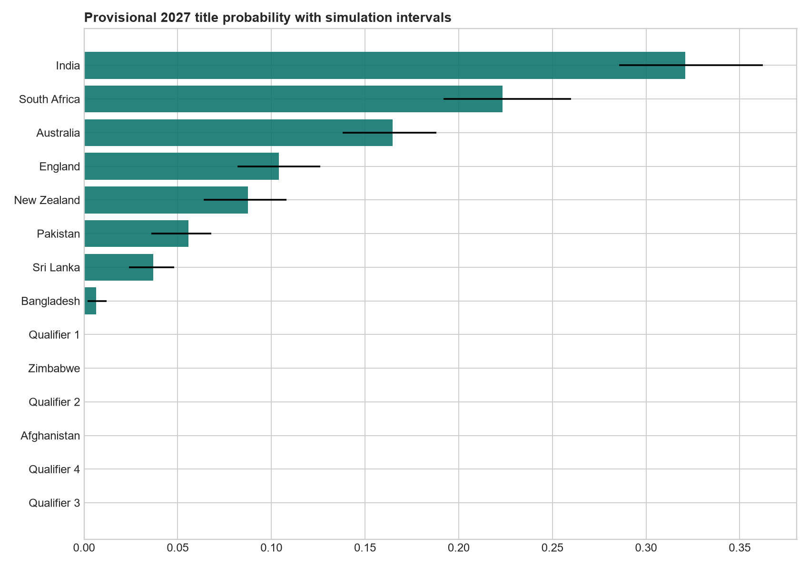
ICC Men's ODI World Cup 2027
Prediction project
A leakage-controlled model comparison and provisional tournament scenario analysis
Provisional scenario-based estimates—not an official tournament forecast.
Data through 2 November 2026
Source: supplied project data and final model outputs

Slide 2
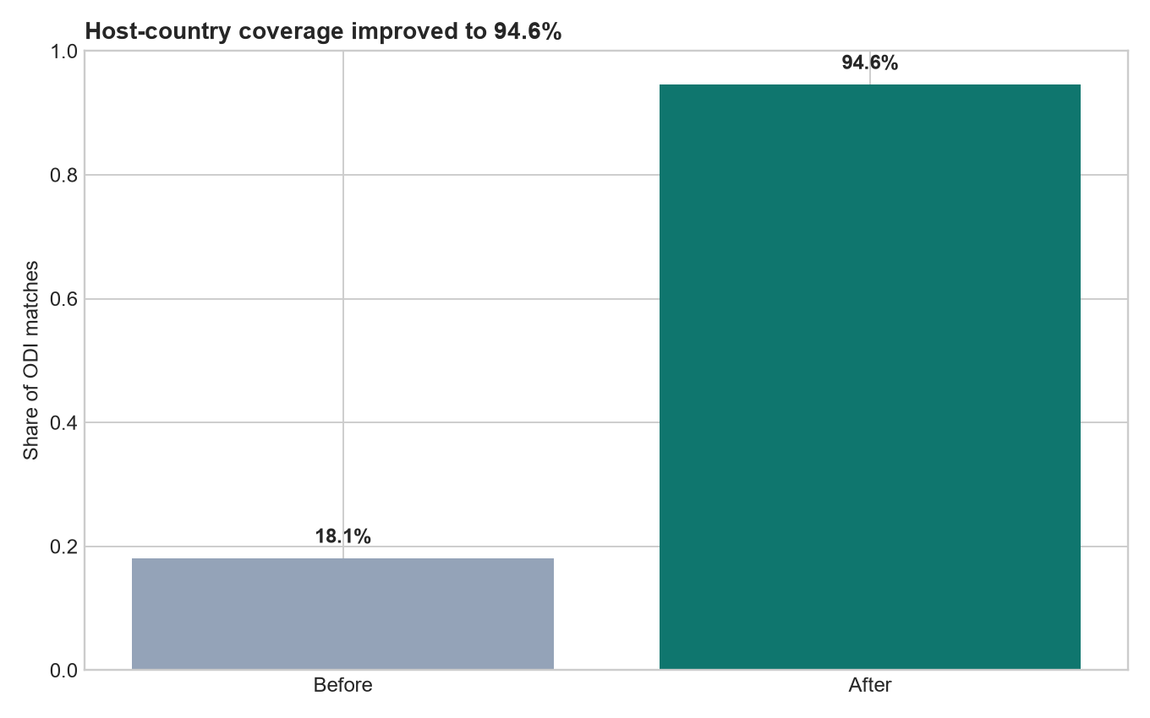
Data sources and coverage
02
2,617
502
1,000
946
match-level men's ODIs
World Cup matches since 1975
recent team records
host-country team rows
The match source begins in 2002 and does not cover every ODI. The model retains ties and no-results in cleaned data but excludes them from binary fitting.
The final test contains 374 decisive matches from 9 July 2023 to 2 November 2026.
Source: supplied project data and final model outputs

Slide 3
Data cleaning and venue normalization
03
Cleaning decisions
• Team and venue aliases standardized
• Dates parsed and invalid values audited
• One training row retained per match ID
• Team-centric recent rows excluded from training
• Unresolved venue countries left blank
The expanded mapping experiment did not justify replacing the preserved CatBoost model.
Coverage improved from 473 to 2,475 matches. 142 matches remain unresolved.
Source: supplied venue, city, country and event-name fields; unresolved locations were not guessed

Slide 4
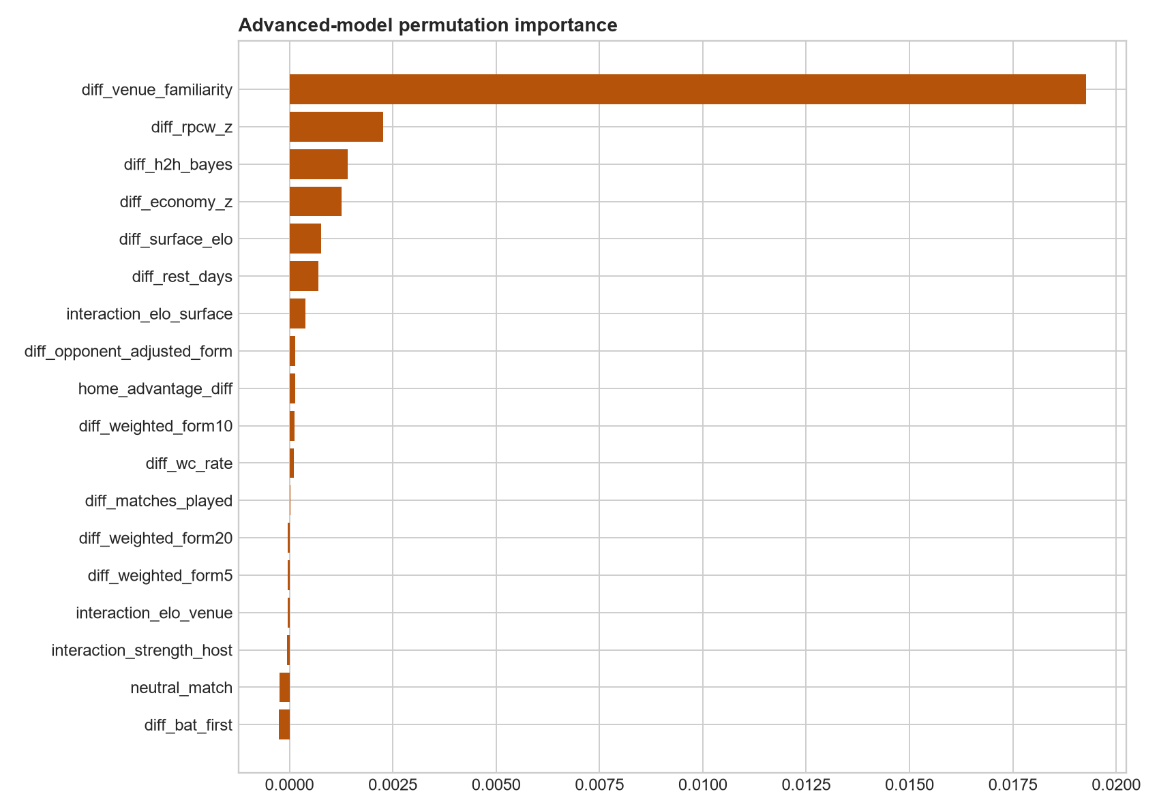
Feature engineering
04
Team strength
Recent performance
Scoring efficiency
Context
Dynamic Elo, surface Elo, host-country Elo and opponent-adjusted form
Weighted form over 5, 10, 20 and 50 matches, recent opponent strength and rest days
Era-adjusted runs per wicket, run rate, economy and net run-rate proxy
Home, away, neutral, venue familiarity, head-to-head and World Cup experience
Source: supplied project data and final model outputs

Slide 5
Leakage prevention and chronological testing
05
TRAIN
VALIDATION
FINAL TEST
Through 11 Aug 2019
Through 7 Jul 2023
9 Jul 2023 to 2 Nov 2026
Expanding windows tune models inside the training period. Validation selects calibration. The pipeline opens the final test only after those choices are fixed.
Rolling features capture team state before the current match. Served probabilities are invariant to team order.
Source: supplied project data and final model outputs

Slide 6
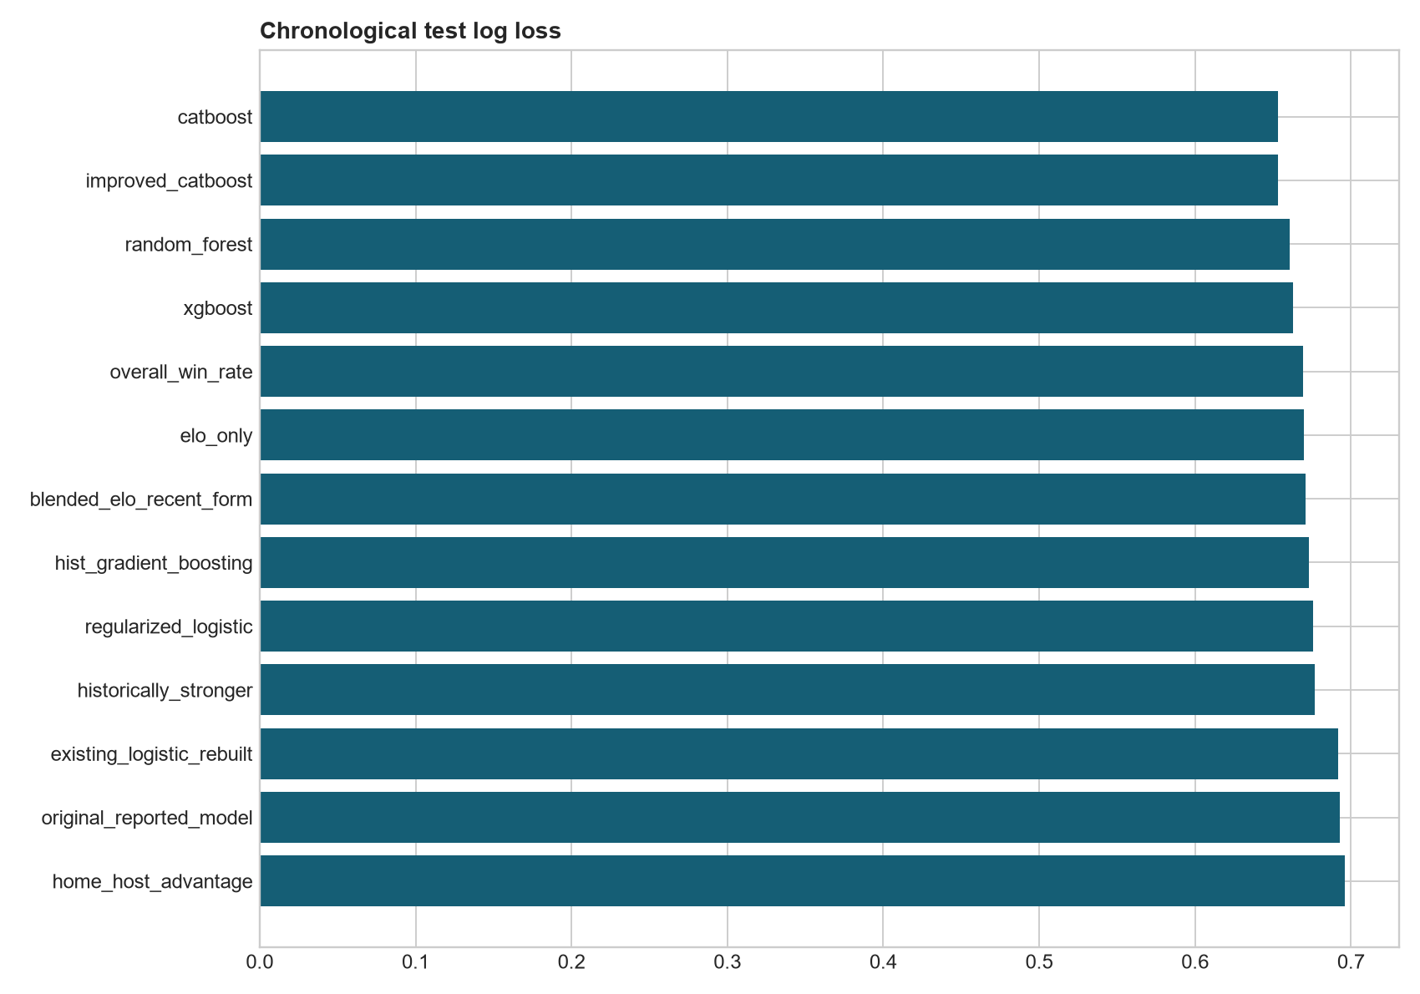
Model comparison
06
CatBoost recorded the lowest final-test log loss
0.6534
CatBoost log loss
0.6697
Elo-only log loss
Lower log loss indicates better probabilistic predictions.
Source: supplied project data and final model outputs

Slide 7
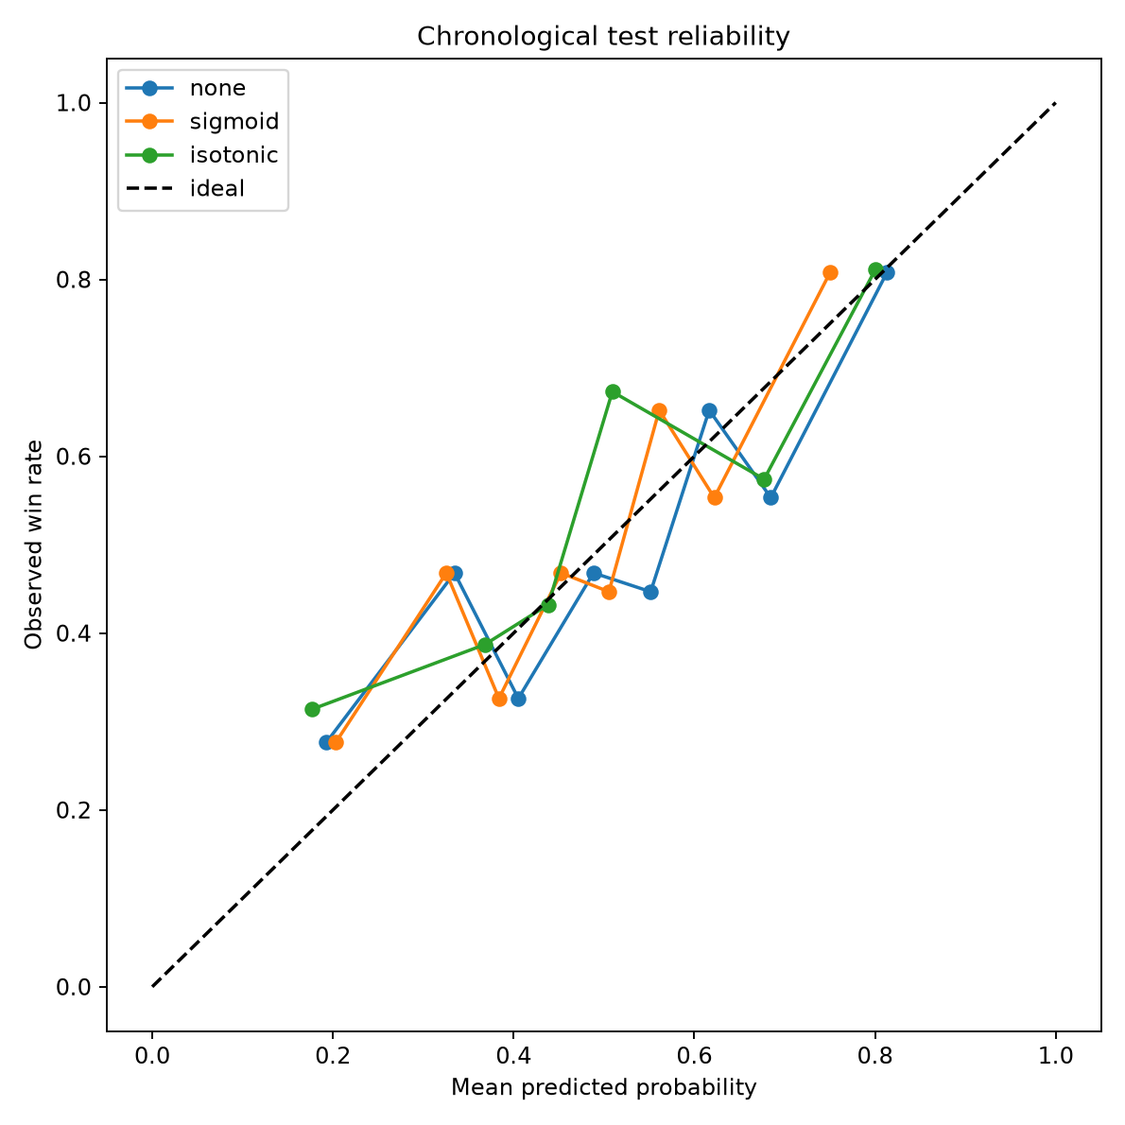
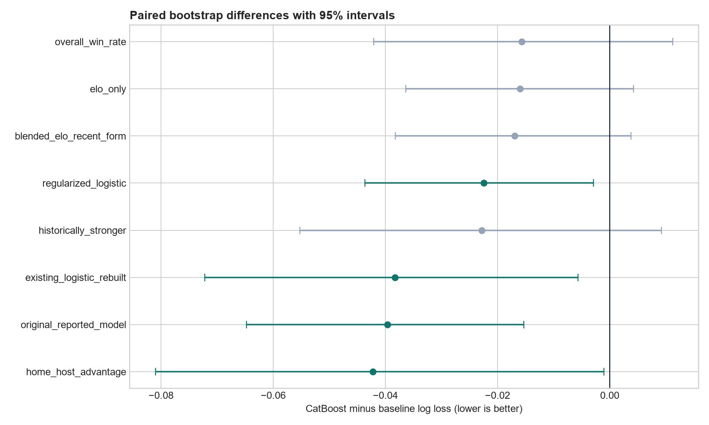
Final model performance
07
61.50%
0.6608
0.6534
0.2310
Accuracy
ROC-AUC
Log loss
Brier score
Source: supplied project data and final model outputs

Slide 8
Prediction explanations
08
Every test-match output includes
• Winner and both team probabilities
• Elo and recent-form differences
• Host and venue context
• Three largest SHAP contributions
• Plain-language model explanation
SHAP values describe model behavior. They do not prove that a feature caused a result.
Source: supplied project data and final model outputs

Slide 9
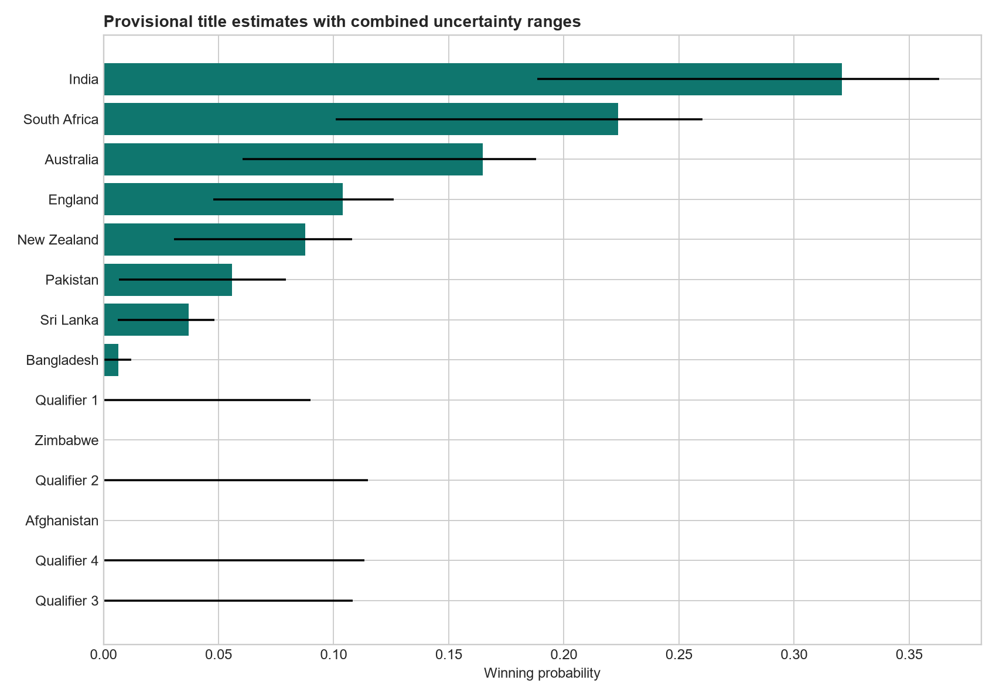
Provisional tournament probabilities
09
India currently has the highest provisional estimated winning probability
32.1%
Central winning estimate
Combined scenario range
18.8% to 36.3%
Provisional scenario-based estimates—not an official tournament forecast.
Source: supplied project data and final model outputs

Slide 10
Prediction uncertainty and limitations
10
Uncertainty sources
Material limitations
Sampling variation from retraining on bootstrap samples
Model variation in match probabilities
Monte Carlo tournament variation
Qualifier-strength and schedule scenarios
Four qualifiers remain unknown
Official fixtures and venues are unavailable
Current squads and injuries are unavailable
Surface labels approximate scoring conditions
Historical ODI coverage is incomplete
Reported outer ranges are scenario ranges, not formal confidence intervals.
Source: supplied project data and final model outputs

Slide 11
Future improvements and rerun process
11
Highest-value additional data
Rerun inputs
Complete historical ODI coverage
Verified venue countries and pitch types
Player and squad availability
Injuries and weather
Official 2027 fixtures
Final 14 teams
Official groups or fixtures
Confirmed venues
Current squads
The pipeline exposes venue mappings, model artifacts, prediction outputs and simulation scenarios as reusable files.
Source: supplied project data and final model outputs

Slide 12
Final conclusion
CWC 2027 prediction project
The preserved CatBoost model improves probability quality over the original project while retaining the same chronological final test.
Its advantage is statistically clear against the original and rebuilt logistic models. The evidence does not establish superiority over every strong simple baseline.
India currently has the highest provisional estimated winning probability. Qualifiers, squads and the official schedule remain incomplete.
Source: supplied project data and final model outputs

