Slide 1
online_retail_II.csv
Run #13 · 10 Aug 2026, 09:11 · narrative: llm

Slide 2
Data quality context
- The active baseline for this source is still PROVISIONAL (established automatically on first ingest, not yet confirmed by a human). The findings below describe how this run compares to that unconfirmed baseline.
Validation events recorded: 0
Still awaiting a human decision: 0
Fixes applied automatically: 0
Fixes reverted after post-condition checks: 0

Slide 3
Narrative
Price correlates with Quantity, showing a coefficient of -0.4. In customer segmentation analysis, the champions segment is associated with a value share of 0.598823, while the loyal segment is associated with a value share of 0.161834. Additionally, repeat behaviour is associated with a repeat rate of 0.975429. In market basket analysis, the item PINK REGENCY TEACUP AND SAUCER is associated with GREEN REGENCY TEACUP AND SAUCER with a lift of 22.025862.
Notes:
Grounded claims behind this report (5):
claim-0: Price correlates with Quantity. [cites correlation-9]
claim-1: The champions segment is associated with a value share of 0.598823. [cites rfm-segment_profile-5]
claim-2: The loyal segment is associated with a value share of 0.161834. [cites rfm-segment_profile-6]
claim-3: PINK REGENCY TEACUP AND SAUCER is associated with GREEN REGENCY TEACUP AND SAUCER with a lift of 22.025862. [cites market_basket-association_rule-15]
claim-4: Repeat behaviour is associated with a repeat rate of 0.975429. [cites retention_churn-repeat_behaviour-65]

Slide 4
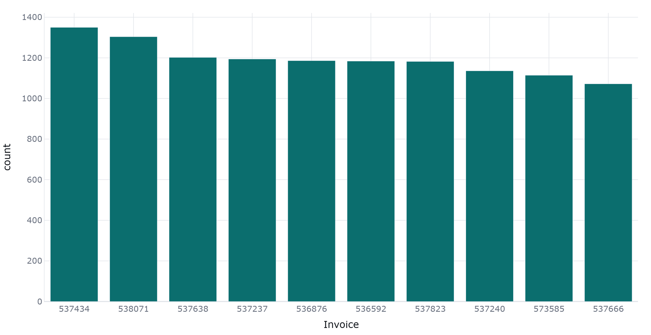
Invoice - category frequencies

Slide 5
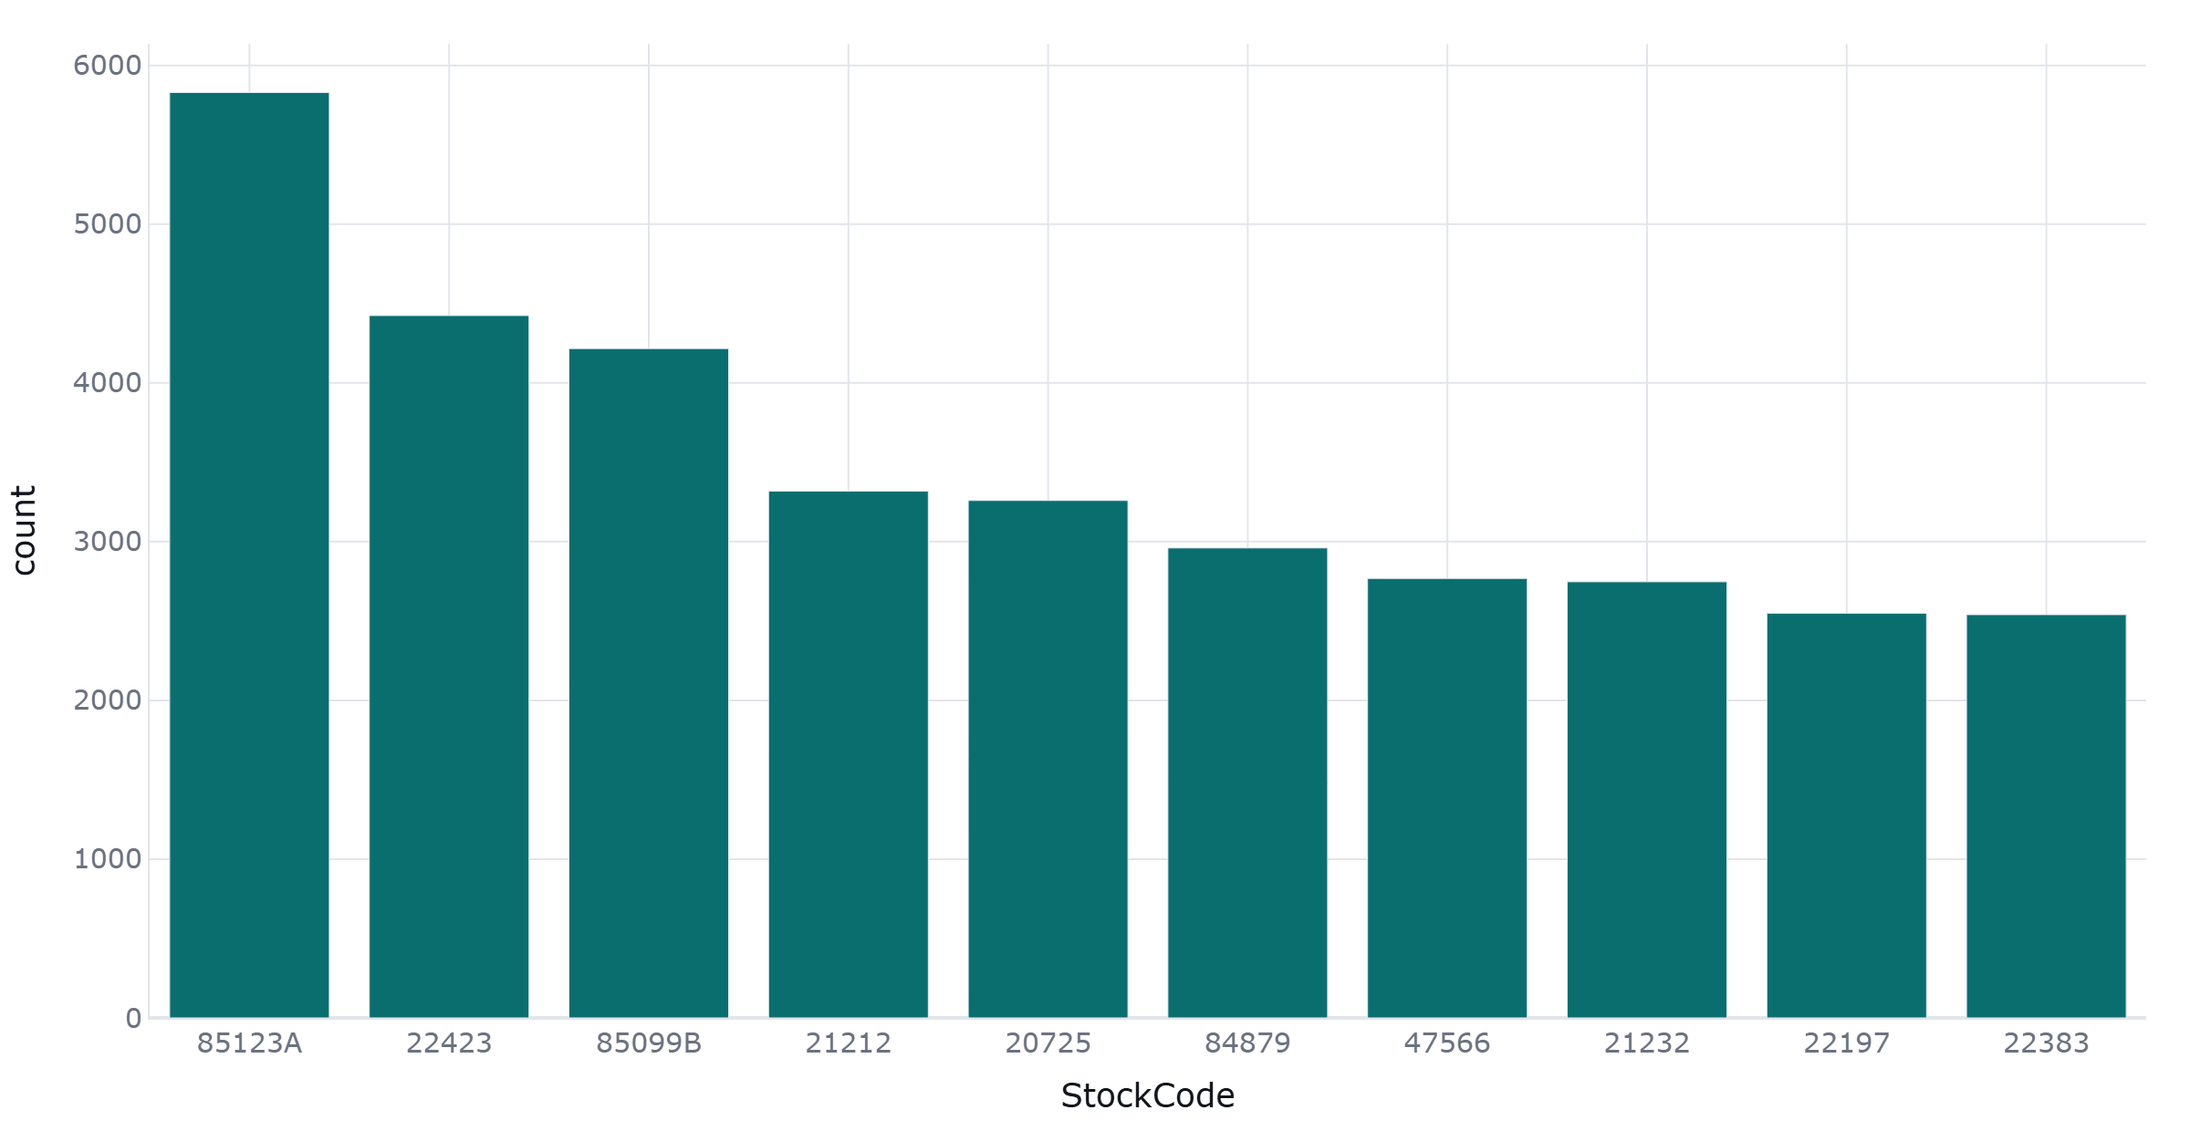
StockCode - category frequencies

Slide 6
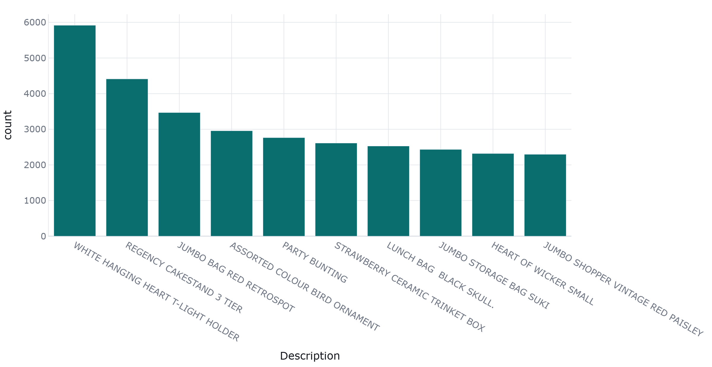
Description - category frequencies

Slide 7
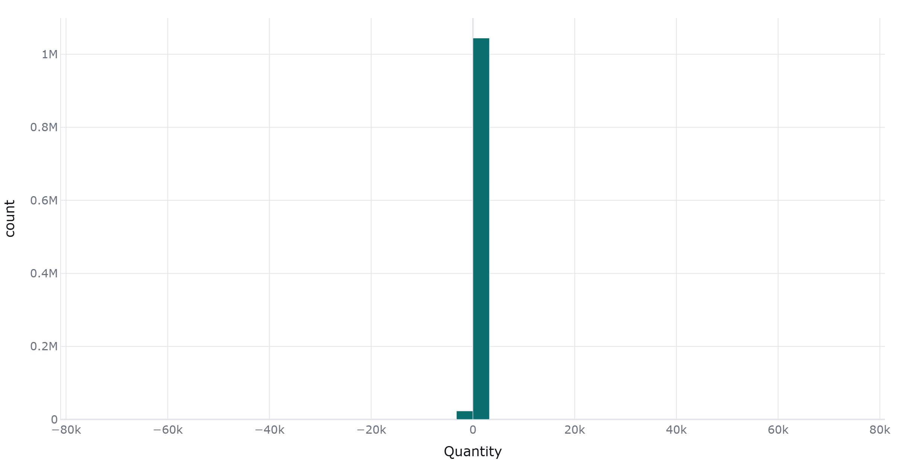
Quantity - distribution

Slide 8
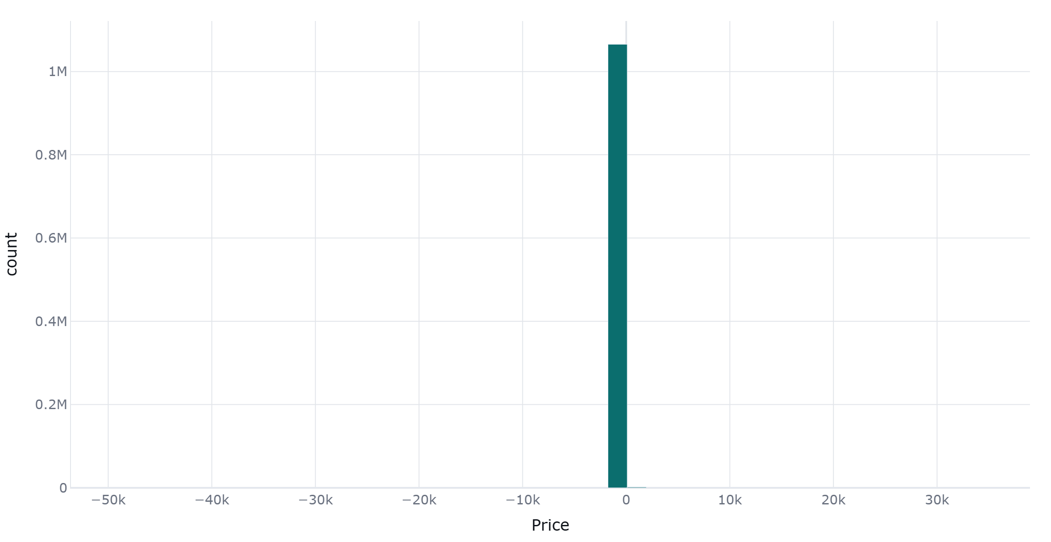
Price - distribution

Slide 9
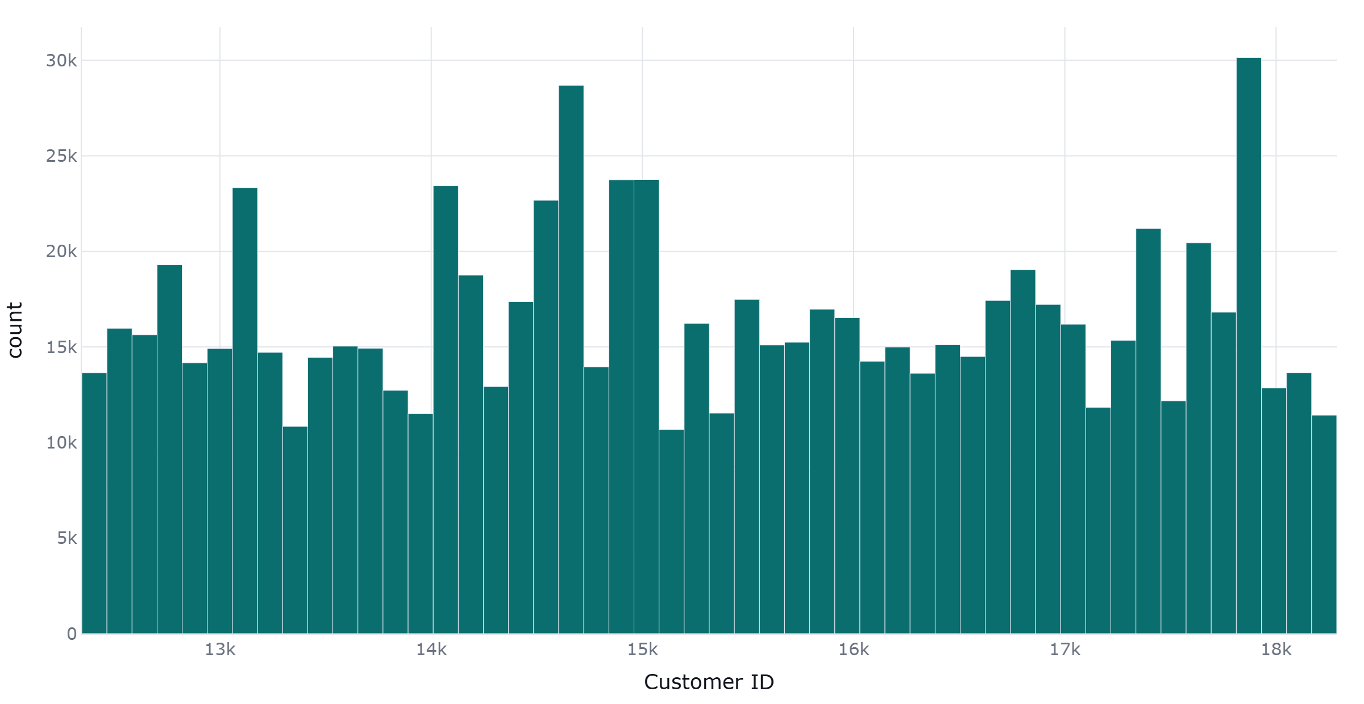
Customer ID - distribution

Slide 10
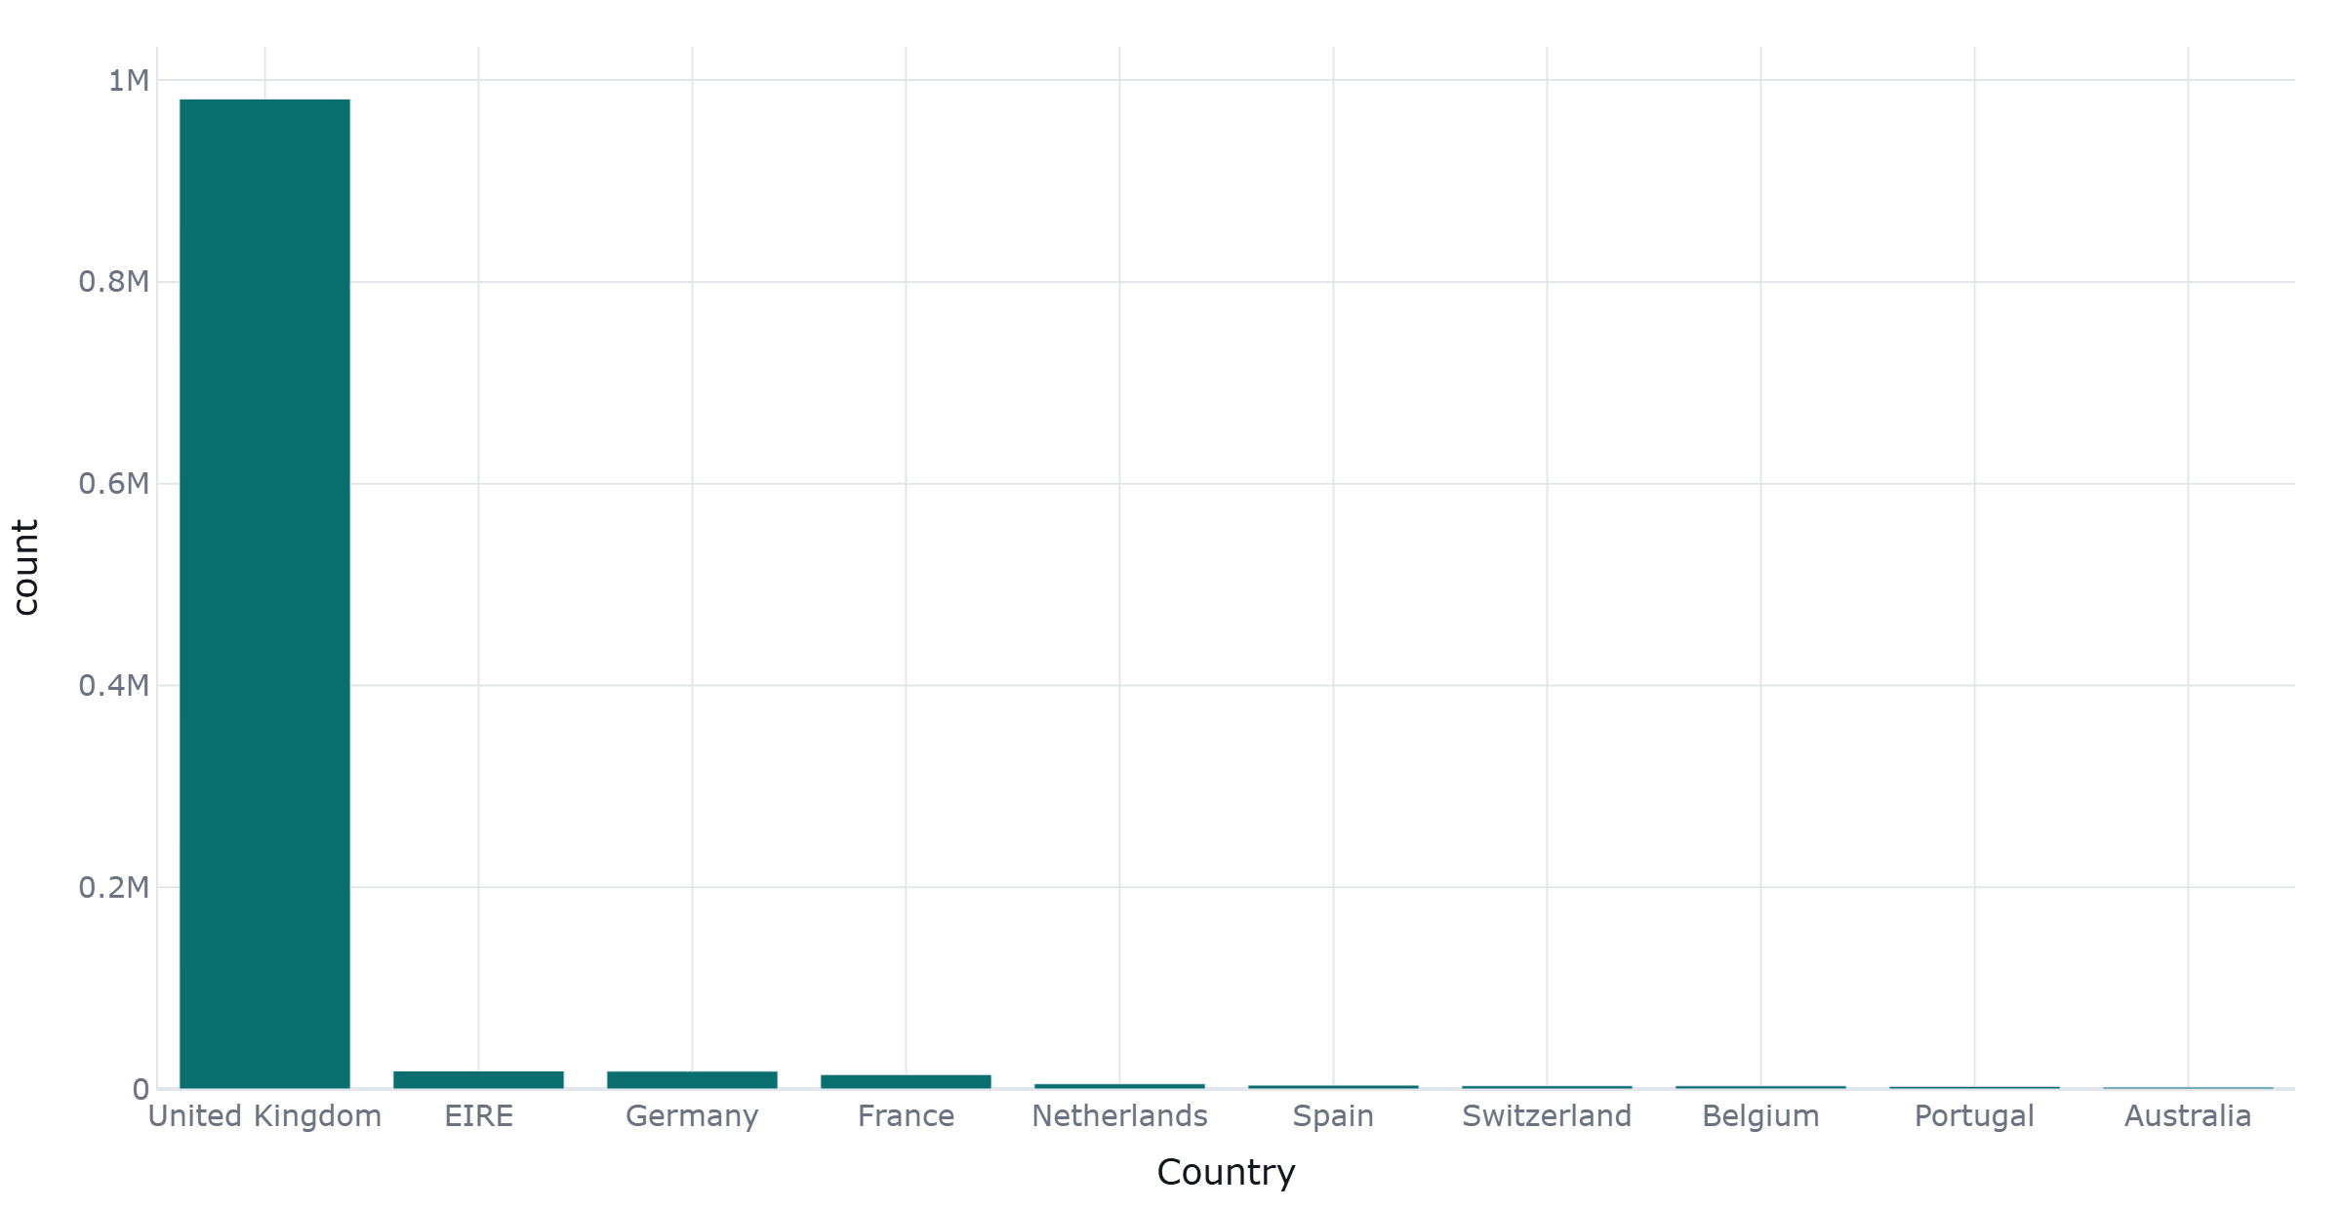
Country - category frequencies

Slide 11
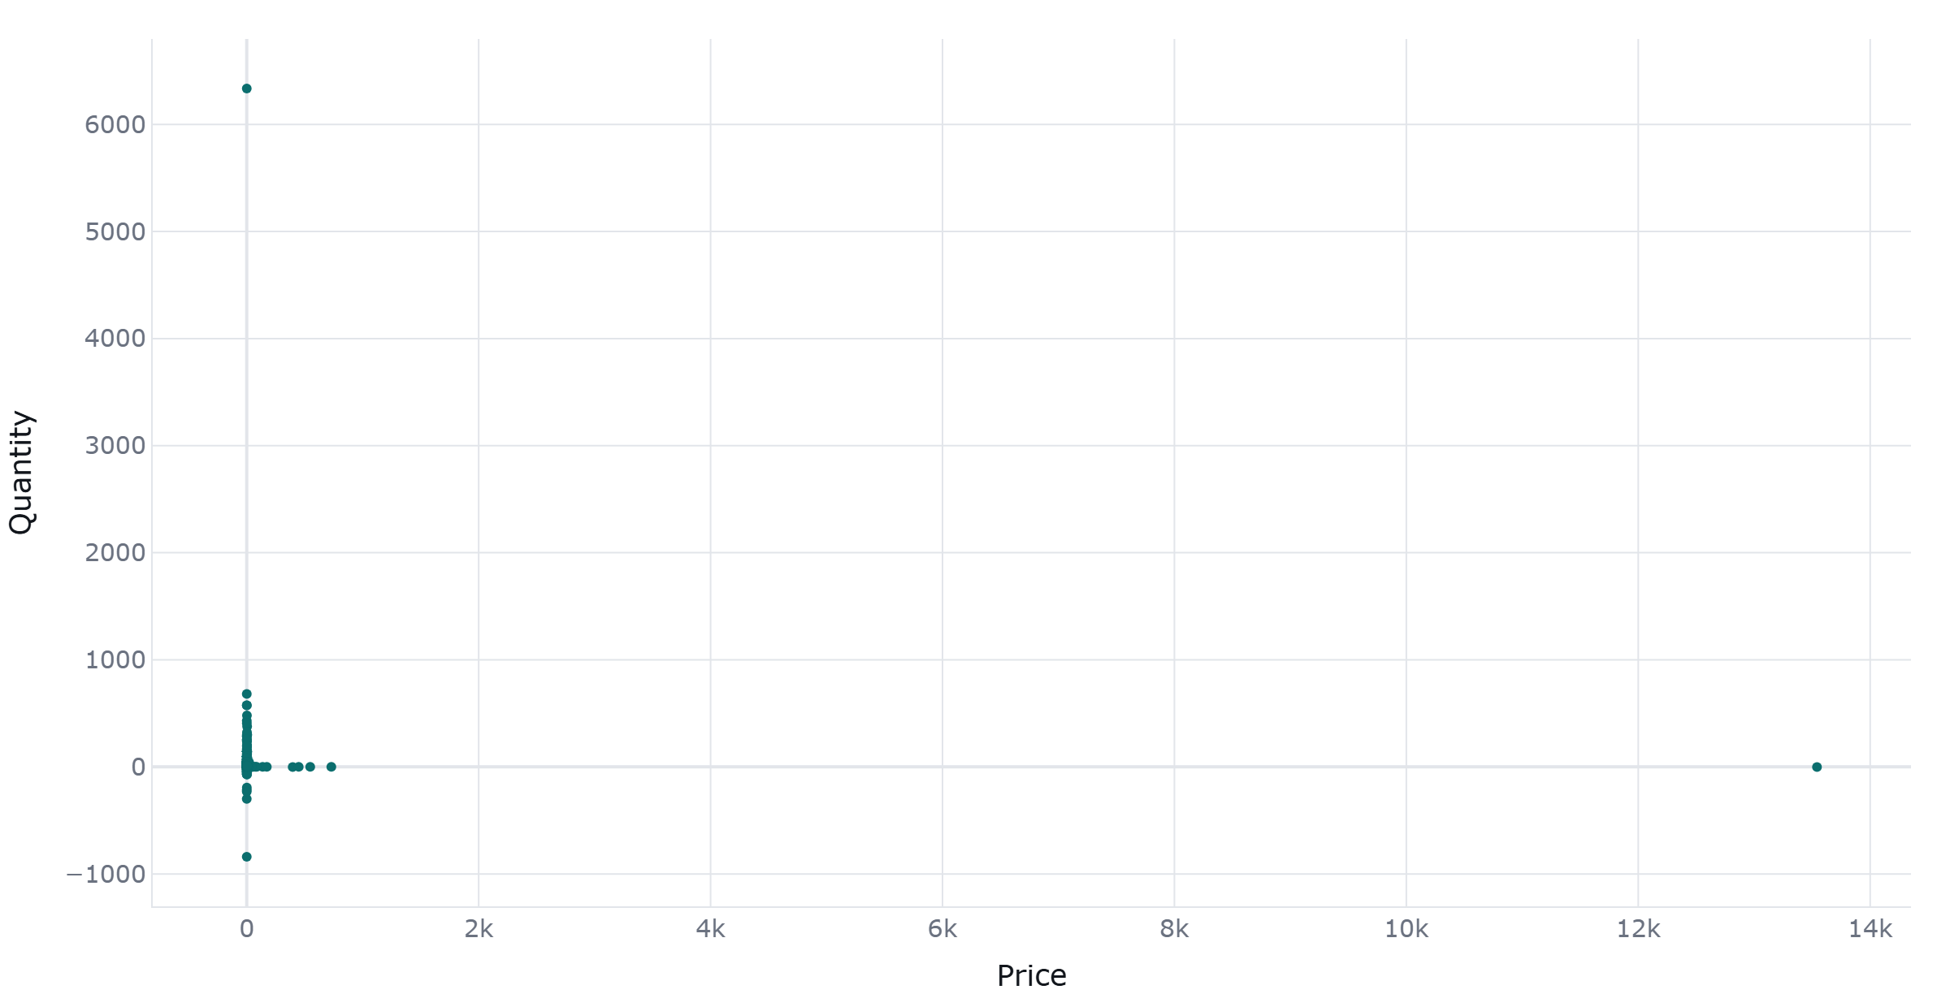
Price vs Quantity (every 213th of 1,067,371 points)

Slide 12
Business analytics
Value taken directly from `Price` - no quantity column was detected, so there is nothing to multiply by.
abc_pareto: 5 finding(s)
rfm: 7 finding(s)
cohort_retention: 1 finding(s)
behavioural_segmentation: 2 finding(s)
market_basket: 50 finding(s)
retention_churn: 1 finding(s)
historical_clv: 7 finding(s)

Slide 13
Analyses that did not apply
Every analysis was applicable to this run's data.

Slide 14
Model results
Quantity (forecast)
out-of-sample rmse: 152,220.1762 · baseline: naive=142,621.9712, seasonal_naive=100,048.2789
prediction interval: 121,275.7645 to 498,375.2902 at 80% confidence
Quantity (forecast)
out-of-sample rmse: 152,220.1762 · baseline: naive=142,621.9712, seasonal_naive=100,048.2789
prediction interval: 121,275.7645 to 498,375.2902 at 80% confidence

Slide 15
Audit trail
Nodes visited, and the edge taken out of each:
ingestion -> explore
exploration -> -
business_analytics -> -
narrative -> -
No escalation on this run required a human decision.

