Slide 1

RISK MATRIX IN POWER BI
Prepared by –
Sayanee Dutta
(Seth Anandram Jaipuria College)

Slide 2
INTRODUCTION
Risk Matrix:
A risk matrix is a tool risk assessment to visualize and assess risks by categorizing them based on their likelihood and severity (consequence), helping organizations prioritize and manage risks effectivity. The visual representation is easy to understand.
This report visualize risk categories using Power BI.
It helps in risk management for Finance, Infrastructure, Security.
2

Slide 3
Database Description
Visualization Used
This database includes risk status, likelihood categories and consequence level.
It help in identifying potential risks across different domains.
Key fields: Likelihood, Consequence, Risk status.
Matrix
Slicer
Source Of Dataset
Pie chart (2)
It is an excel data which I used in Power BI.

Slide 4
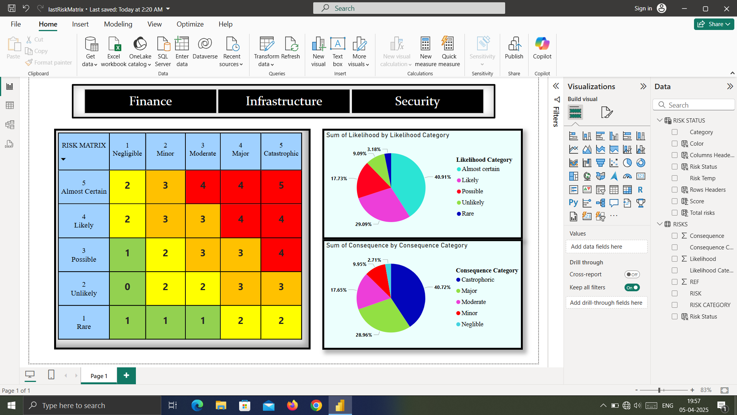

Slide 5
Different Visualization Making in Power BI(Step By Step)
Importing Excel Data into Power BI
1. Open Power BI Desktop → Click on Blank Report.
2. Go to the Home tab → Click on Get Data → Select Excel workbook → Select your .xlsx file.
3. Choose the table/sheet you need → Click Load.
Creating The Risk Matrix
1. Create a new table and name it as “RISK STATUS”.
Go to Modeling tab → Click on New Table and write the code.
RISK STATUS = CROSSJOIN(
DATATABLE(
"Risk Temp", INTEGER,
{
{11},{12},{13},{14},{15},
{21},{22},{23},{24},{25},
{31},{32},{33},{34},{35},
{41},{42},{43},{44},{45},
{51},{52},{53},{54},{55}
}
),DISTINCT(SELECTCOLUMNS(RISKS, "Category", RISKS[RISK CATEGORY])))

Slide 6
2. Create new columns named ‘Rows Headers’, ‘Columns Headers’, ‘Score’, ‘Risk Status’.
Right click on the table name in right pane → Click on New Column and write the codes.
Rows Headers =
var ConNo=VALUE(right('RISK STATUS'[Risk Temp]))
RETURN
if(ConNo=1,ConNo & "
Rare",
if(ConNo=2,ConNo & "
Unlikely",
if(ConNo=3,ConNo & "
Possible",
if(ConNo=4,ConNo & "
Likely",
if(ConNo=5,ConNo & "
Almost Certain")))))
Columns Headers =
var ConNo=VALUE(left('RISK STATUS'[Risk Temp]))
RETURN
if(ConNo=1,ConNo & "
Negligible",
if(ConNo=2,ConNo & "
Minor",
if(ConNo=3,ConNo & "
Moderate",
if(ConNo=4,ConNo & "
Major",
if(ConNo=5,ConNo & "
Catastrophic")))))
Score = VALUE(LEFT('RISK STATUS'[Risk Temp]))*VALUE(RIGHT('RISK STATUS'[Risk Temp]))
Risk Status = 'RISK STATUS'[Category] & "-" & 'RISK STATUS'[Risk Temp]

Slide 7
3. Create a new column in previous table “RISKS” named ‘Risk Status’(like previous way) using the code written below.
Risk Status = RISKS[RISK CATEGORY] & "-" & RISKS[Consequence] & RISKS[Likelihood]
4. Make link between two tables.
Go to Model view → Drag and drop ‘Risk Status’ column and select direction ‘Both’.
5. Create ‘Total risks’ and ‘Color’ column in “RISK STATUS” table using below codes.
Total risks = CALCULATE(COUNT(RISKS[REF]),FILTER(RISKS,'RISK STATUS'[Risk Status]=RISKS[Risk Status]), FILTER(RISKS,'RISK STATUS'[Category]=RISKS[RISK CATEGORY]))+0
Color = if('RISK STATUS'[Score]<=3,"#93D150",if('RISK STATUS'[Score]<=6,"#FFFF00",if('RISK STATUS'[Score]<=12, "#FFC100","#FF0000")))

Slide 8
6. Go to Report view → Use ‘Rows Headers’ as row (rename as ‘RISK MATRIX’), ‘Columns Headers’ as column and ‘Sum of Total Risks’ as values.
7. Adjust format using Format pane. Change font, grid, effects, background… .
[To use color: Go to cell elements → Select background color → Click on condition formatting → Select format value as format style and apply based on ‘Color’ column we created → Select ok.
Creating a Slicer for Filtering
1. On the right pane, under Visualizations, click on the Slicer icon.
2. Drag the field (e.g., Category) from the "Risk Status" table into the slicer.
3. Format the slicer using Format pane. Change background, visual border, shadow,... as needed.

Slide 9
Creating Pie Chart
Pie Chart 1: "Sum of Likelihood by Likelihood Category"
1. Click on the Pie Chart icon from the Visualizations pane.
2. From your table, drag ‘Category’ into the Legend field.
3. Drag ‘Likelihood’ into the Values field (make sure it says Sum of Likelihood).
4. Adjust the layout using the Format pane.
Pie Chart 2: "Sum of Consequence by Consequence Category"
This is similar to the previous pie chart, only the fields change.
(Use the ‘Consequence Category’ as Legend and ‘Consequence’ as Values field.)
Saving the Power BI File
1. Go to the File menu in Power BI Desktop.
2. Click on Save As.
3. Choose a name and location for your report file.

Slide 10
Precautions While Creating A Risk Matrix
Ensure that the data source is reliable and the data is clean and accurate.
Organize risk by types (financial, infrastructure, security,…).
Use clear and consistent scales for both likelihood (rare, unlikely, possible, likely, almost certain) and consequence (negligible, minor, moderate, major, catastrophic).
Use contrast color to ensure readability for all users.
Make the matrix easy to read and attractive using larger text, font style, background color, etc.
Use Of Risk Matrix In Real Life
Business and finance – identifying financial risks
Cybersecurity – assessing security weakness
Healthcare – patient risk assessment
Reference
THE END
(YouTube video): https://youtu.be/czwNmvzi8_c?feature=shared

