Slide 1


Movie Data Analysis

Slide 2

About Me & Project Overview
Hi, This is Sayan. I love working with Python and data analytics. I enjoy solving real business problems using data-driven logic.
This Netflix Data Analytics project aims to explore a dataset containing over 9,000 movie records to uncover valuable business insights. By leveraging Python libraries such as Pandas, Matplotlib, and Seaborn. The analysis focuses on identifying four major factors. These insights can help Netflix understand audience preferences, spot content trends, and make data-driven decisions to enhance its recommendation system and content strategy.

Slide 3

A Brief History
Netflix’s journey is marked by several key milestones that highlight its transformation from a DVD rental company to a global streaming giant. In 2007, Netflix made a game-changing move by launching its streaming service, allowing users to instantly watch movies and TV shows online — a shift that revolutionized home entertainment.
By 2010, Netflix began its international expansion, tapping into global markets and widening its viewer base. This was followed by a major leap in 2016, when the platform achieved availability in over 190 countries, making it a truly global content provider. As of 2024, Netflix continues to dominate the streaming industry with a revenue of nearly $10 billion (Q3) and profits of $2.4 billion.

Slide 4

Key Factors
Netflix is known for its work in data science, AI, and ML, particularly for building strong recommendation models and algorithms that understand customer behavior and patterns. Suppose you are working in a data-driven job role, and you have a dataset of more than 9,000 movies. You need to solve the following questions to help the company make informed business decisions accordingly.
What is the most frequent genre of movies released on Netflix?
Which has highest votes in vote avg column?
What movie got the highest popularity? what's its genre?
What movie got the lowest popularity? what's its genre?
Which year has the most filmmed movies?

Slide 5
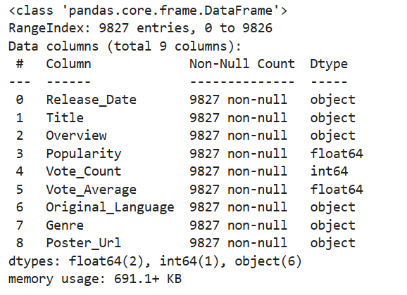
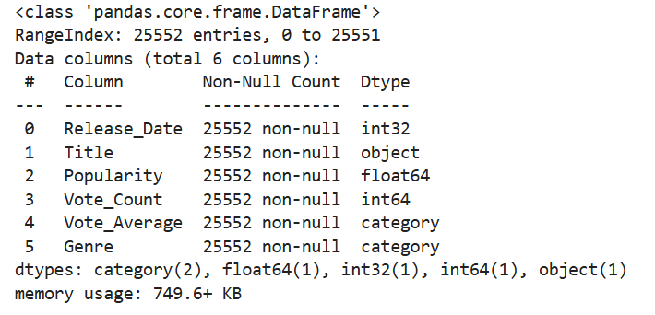

DataFrame Overview
Before Preprocessing
After Preprocessing

Slide 6
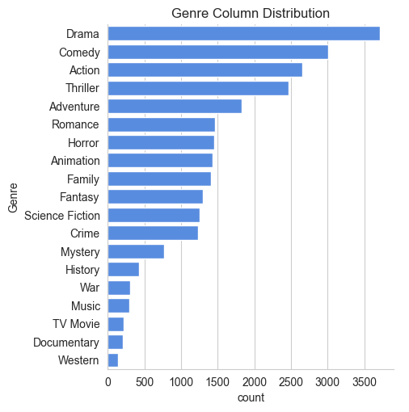

What is the most frequent genre of movies released on Netflix?

Slide 7
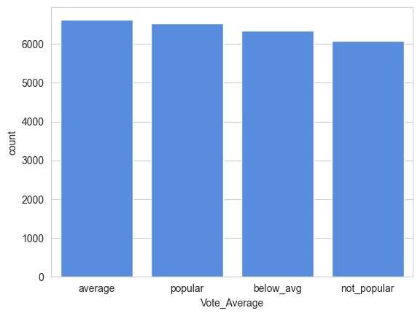

Which has the highest votes in vote average column?

Slide 8
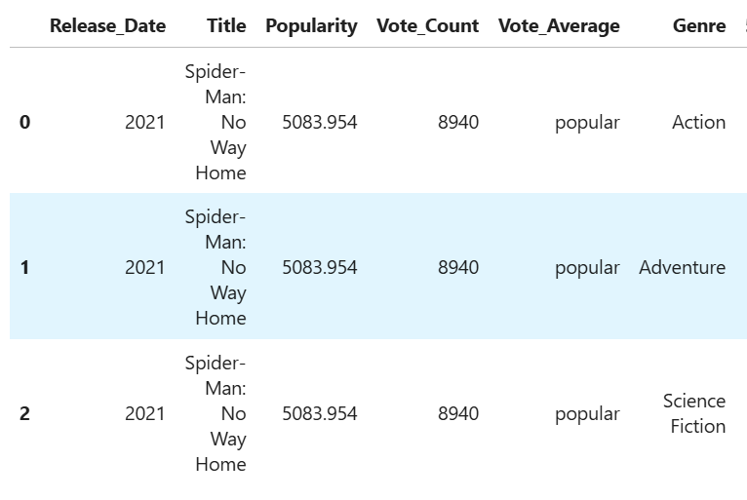
What movie got the highest popularity? what's its genre?

Slide 9
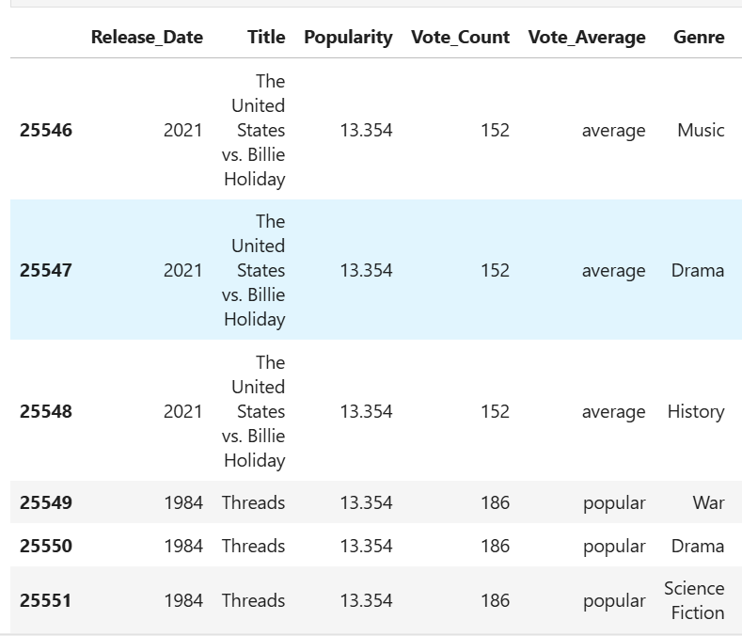
What movie got the lowest popularity? what's its genre?

Slide 10
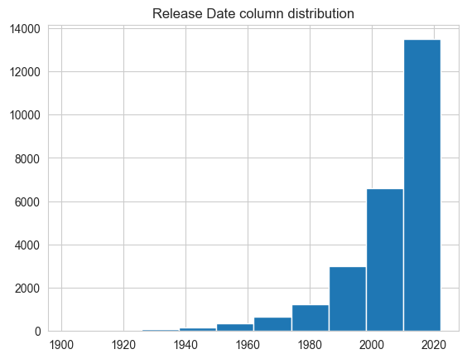
Which year has the most filmmed movies?

Slide 11
Thank You

