Slide 1

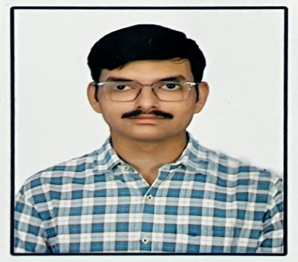






SHUBHADEEP
DAS
Student
SKILL
About Me
html,css,js
6291123845
django react node.js python cpp,c mysql oops dsa
sd6500349@gmail.com
Kalitala, Jaffarpur (CT), Barrackpore, North 24 Parganas, Kolkata-700122, West Bengal.
LANGUAGE
EDUCATION
Bengali English Hindi
Kendriya Vidyalaya No. 2 Ishapore School(H.S)
Secondary Education. 2020-2021
Kendriya Vidyalaya No. 2 Ishapore School (H.S)
Higher Secondary Education. 2022-2023
HOBBBY
Gaming and Streaming
RCC Institute of Information Technology College
Bachelor of Science in Computer Science
2023-2027

