Slide 1
Yelp Review
Classification
Zhansaya A.
Jeffrey C.

Slide 2



Motivation
Notes:
Jeff
So yelp had this yelp dataset challenge,

Slide 3
Experiment A
Predicting each reviews star rating.

Slide 4
Experiment B
This experiment is based on the Experiment A. It collects all predictions and calculates the average for each restaurant.
Notes:
For experiment B is a little different from A. we still train individual reviews except on the testing set.

Slide 5
Experiment C
Instead of predicting each review’s star rating, we tried merging all reviews for a restaurant and fed each of them as one sentence into CNN.

Slide 6
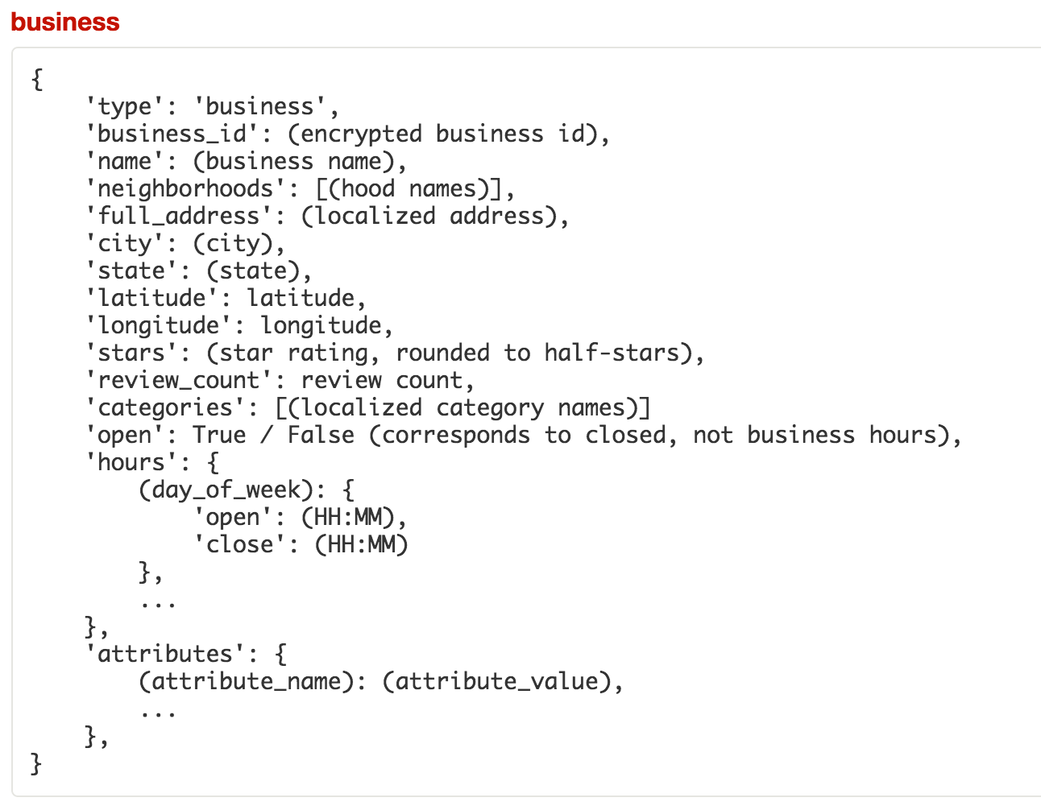
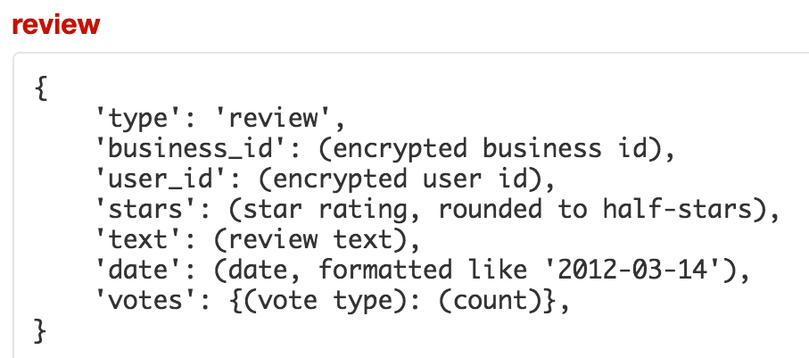
Data Features
Notes:
Saya
We only saved b

Slide 7

Cleaning the Data
Scan through business JSON file for business IDs with a “restaurant” category.
25,071 restaurants out of 77,445 businesses
From review JSON file, extract reviews of restaurants.
1,363,242 reviews out of 2,225,213 total
Delete unused features to save space and time when importing.
Export to new JSON files.
Notes:
Saya

Slide 8
Data Preprocessing - Experiment A
Read in all restaurant reviews from JSON file.
Tokenize each review using Regular Expression operations.
Pad each review to the length of the longest review using <pad> token.
Create vocabulary index that maps each word to an integer index from 0 to the vocabulary size.
Split list of reviews into training, validation, and testing sets.
Notes:
Saya

Slide 9
Data Preprocessing - Experiment B & C
Read in business IDs instead of individual reviews.
Split list of business IDs into training, validation, and testing sets.
For each business ID, retrieve all corresponding reviews.
Exp B: Store all reviews in one list.
Exp C: Combine all reviews into one review.
Notes:
Different from exp A, because we want to predict overall ratings for businesses.

Slide 10
Model Hyperparameters
Parameter | Description
Review Length | Length of longest review or sentence
Number of Classes | 5 stars (or 9 for overall)
Vocabulary Size | Number of unique words
Embedding Size | Dimensions of Weight Vectors
Filter Sizes | Convolutional Layer Filter Size {3, 4, 5}
Number of Filters | 128
L2 Regularization | 0.5
Dropout | 0.5
Learning Rate | 1e-3
Batch Size | 100 reviews or businesses
Notes:
Learning rate greater than 1e-3 exploding without converging
And smaller one was to slow for converging.

Slide 11
Architecture
Notes:
Jeff
Input is a single review, each neuron is a word from the review.
The embedding layer takes in the raw review and weight vector to return

Slide 12
Results
 | Train | Validation | Test
A | ~70% | ~55% | ~55%
B | ~70% | ~55% | ~55% Off by ~0.25 stars
C | ~60% | ~60% | ~60%

Slide 13
Future improvements
Improve prediction by incorporating other features such as:
Location (longitude, latitude, city, state)
Review votes
More tuning!
Optimize preprocessing steps
Can be very slow on big data set!
~40 minutes on 1.3 million reviews
Use GPU instead of CPU

Slide 14
Resources
Yelp Dataset Challenge
ADAM: A METHOD FOR STOCHASTIC OPTIMIZATION
Convolutional Neural Networks for Sentence Classification
IMPLEMENTING A CNN FOR TEXT CLASSIFICATION IN TENSORFLOW
UNDERSTANDING CONVOLUTIONAL NEURAL NETWORKS FOR NLP

Slide 15
Yelp Reviews
Classification
Thank You!
Notes:
Yay

