Slide 1
Neural Natural Language Processing
Lecture 4: Recurrent neural networks for natural language processing

Slide 2
Plan of the lecture
Part 1: Language modeling.
Part 2: Recurrent neural networks.
Part 3: Long-Short Term Memory (LSTM).
Part 4: LSTMs for sequence labelling.
Part 5: LSTMs for text categorization.

Slide 3
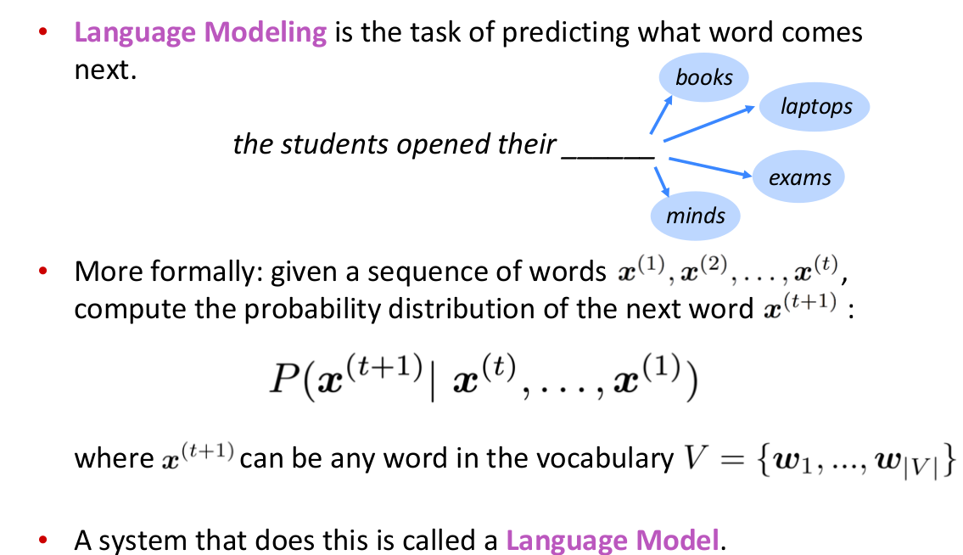
Language Models (LMs)
Probabilistic Multiclass
Classifier with
Variable length input
Source: Abigail See. CS224N/Ling284 slides: http://web.stanford.edu/class/cs224n/

Slide 4
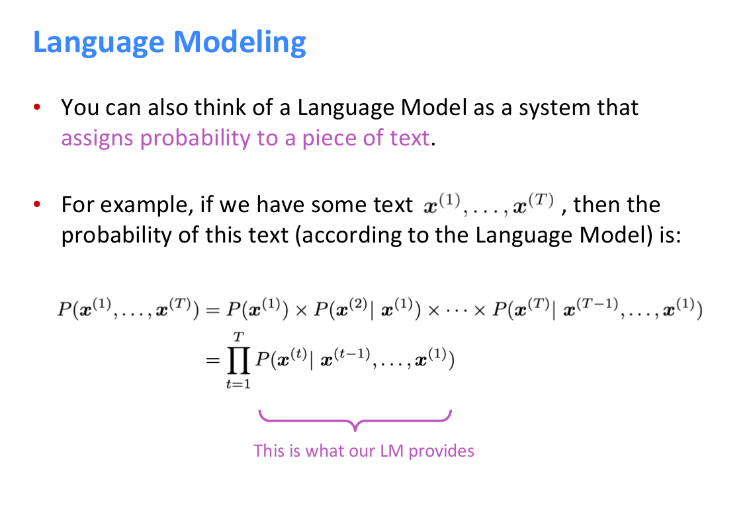
Language Models (LMs)
Source: Abigail See. CS224N/Ling284 slides: http://web.stanford.edu/class/cs224n/

Slide 5
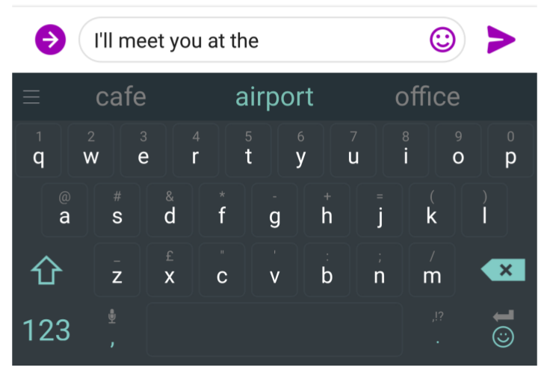
Language Models are useful for
Estimation of [conditional] probability of a sequence P(x), P(x|s)
  Ranking hypothesis
      Speech Recognition
      Machine Translation
Generation of texts from P(X), P(X|s)
  Autocomplete / autoreply
  Generate translation / image caption
  Neural poetry
Unsupervised Pretraining
Source: Abigail See. CS224N/Ling284 slides: http://web.stanford.edu/class/cs224n/

Slide 6
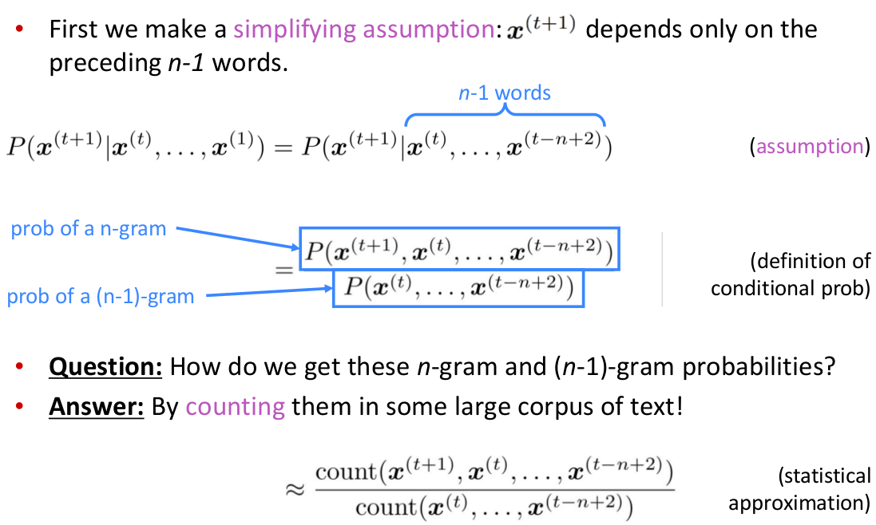
n-gram Language Modeling
Source: Abigail See. CS224N/Ling284 slides: http://web.stanford.edu/class/cs224n/

Slide 7
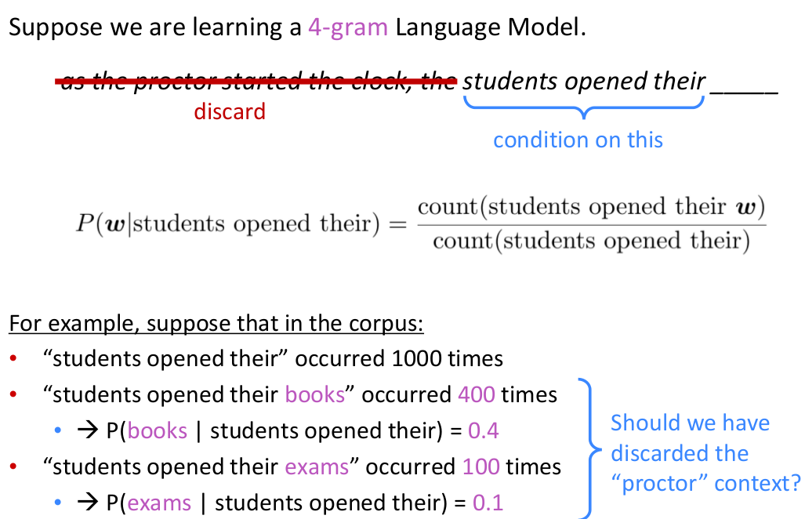
n-gram Language Modeling
Source: Abigail See. CS224N/Ling284 slides: http://web.stanford.edu/class/cs224n/

Slide 8
Problems of n-gram LMs
Small fixed-size context
  n>5 hardly can be used in practice
Lots of storage space to keep n-gram counts
Sparsity of data
  Most ngrams (both probable and improbable) never occur even in very large train corpus
  => cannot compare them
    The cat caught a frog on Monday → The kitten will catch a toad/*house on Friday
    Tezguino is an alcoholic beverage. It is made from corn and consumed during festivals. Tezguino makes us _

Slide 9
Neural Language Models: Motivation
Neural net-based language models turn out to have many advantages over the n-gram language models:
  neural language models don’t need smoothing
  they can handle much longer histories
    recurrent architectures
  they can generalize over contexts of similar words
    word embeddings / distributed representations
(+) a neural language model has much higher predictive accuracy than an n-gram language model!
(–) neural net language models are strikingly slower to train than traditional language models
Source: https://web.stanford.edu/~jurafsky/slp3/7.pdf

Slide 10



Neural Language Model based on FFNN by Bengio et al. (2003)
Input: at time t a representation of some number of previous words
  Similarly to the n-gram model approximates the probability of a word given the entire prior context
  ...by approximating based on the N previous words
Source: https://web.stanford.edu/~jurafsky/slp3/7.pdf

Slide 11
Neural Language Model based on FFNN by Bengio et al. (2003)
Representing the prior context as embeddings:
  rather than by exact words (n-gram LMs)
  allows neural LMs to generalize to unseen data:
“I have to make sure when I get home to feed the cat.”
  “feed the dog”
  cat ↔ dog, pet, hamster, ...
Source: https://web.stanford.edu/~jurafsky/slp3/7.pdf

Slide 12
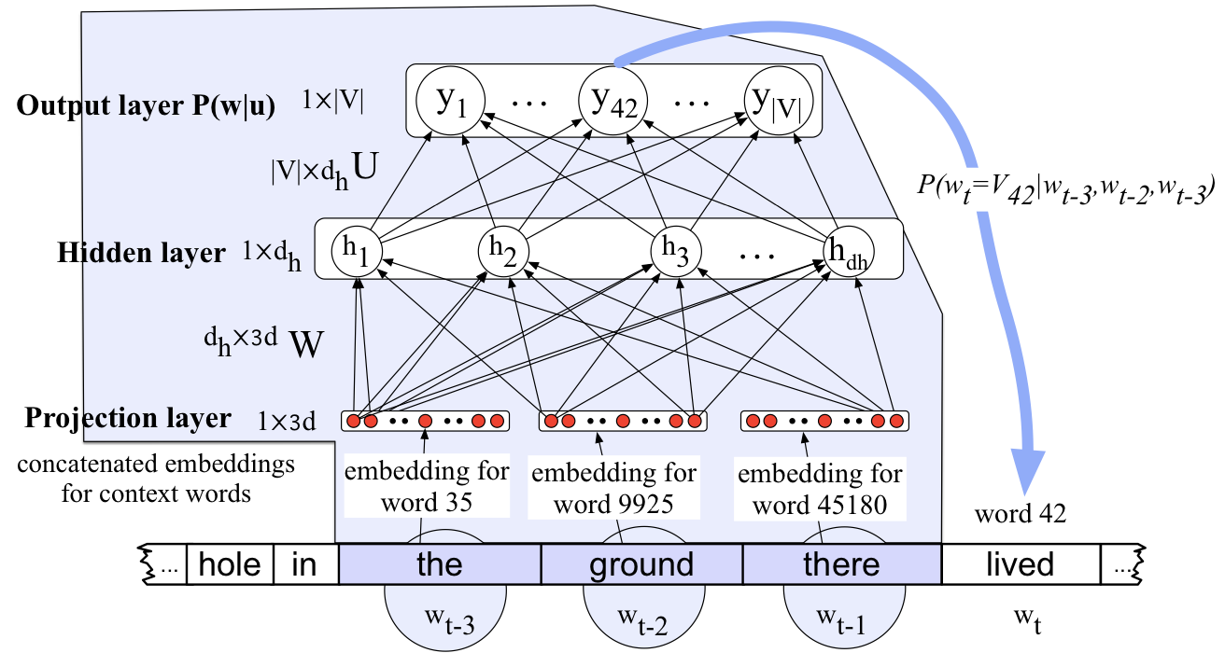

Neural Language Model based on FFNN by Bengio et al. (2003)
A moving window at time t with an embedding vector representing each of the N=3 previous words:
Source: https://web.stanford.edu/~jurafsky/slp3/7.pdf

Slide 13
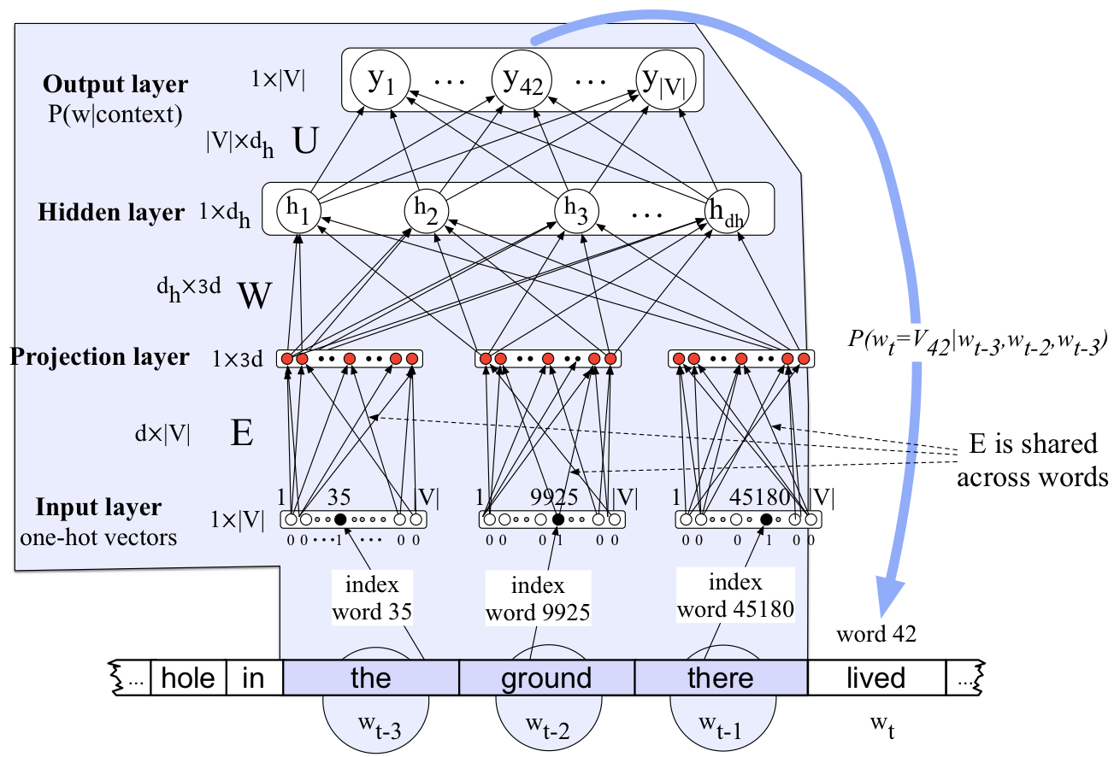
Neural Language Model based on FFNN: no pre-trained embeddings
Source: https://web.stanford.edu/~jurafsky/slp3/7.pdf

Slide 14
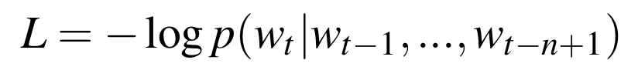
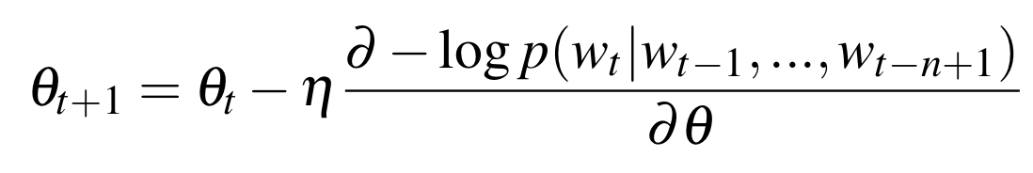
Neural Language Model based on FFNN: Training
At each word w_{t}, the cross-entropy (negative log likelihood) loss is:
The gradient for this loss is:
Source: https://web.stanford.edu/~jurafsky/slp3/7.pdf

Slide 15
Plan of the lecture
Part 1: Language modeling.
Part 2: Recurrent neural networks.
Part 3: Long-Short Term Memory (LSTM).
Part 4: LSTMs for sequence labelling.
Part 5: LSTMs for text categorization.

Slide 16
Language Modeling with a fixed context: issues
The sliding window approach is problematic for a number of reasons:
  limits the context from which information can be extracted;
  anything outside the context window has no impact on the decision being made.
Recurrent Neural Networks (RNNs):
  dealing directly with the temporal aspect of language;
  handle variable length inputs without the use of arbitrary fixed-sized windows.

Slide 17
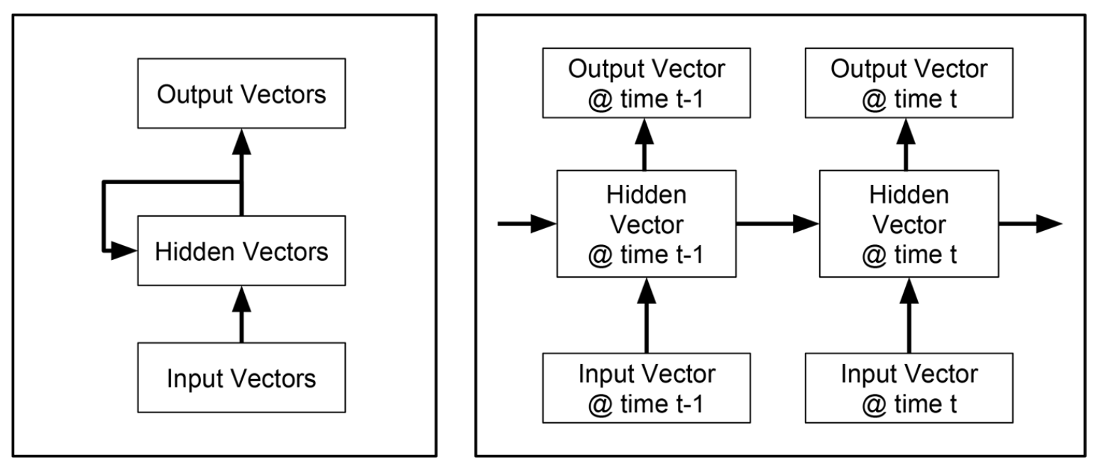
Elman (1990) Recurrent Neural Network (RNN)
Recurrent networks model sequences:
  The goal is to learn a representation of a sequence;
  Maintaining a hidden state vector that captures the current state of the sequence;
  Hidden state vector is computed from both a current input vector and the previous hidden state vector.
Source: Rao D. & McMahan (2019): Natural Language Processing with PyTorch: Build Intelligent Language Applications Using Deep Learning.

Slide 18
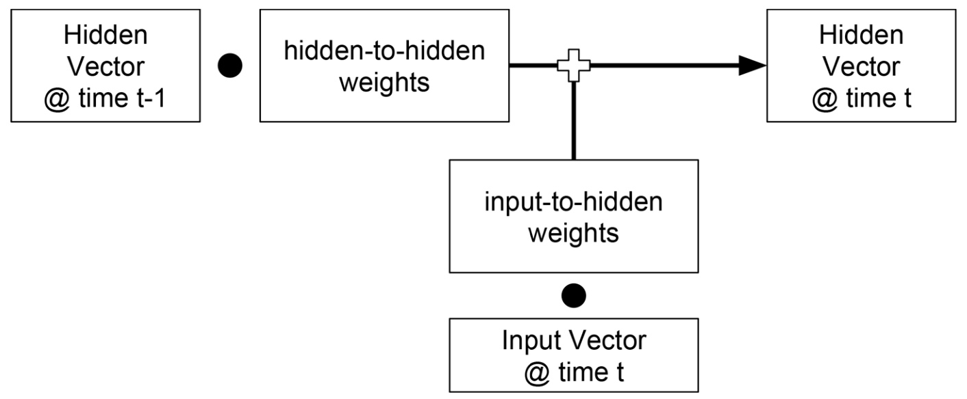
Elman (1990) Recurrent Neural Network (RNN)
Input vector from the current time step and the hidden state vector from the previous time step are mapped to the hidden state vector of the current time step:
Source: Rao D. & McMahan (2019): Natural Language Processing with PyTorch: Build Intelligent Language Applications Using Deep Learning.

Slide 19
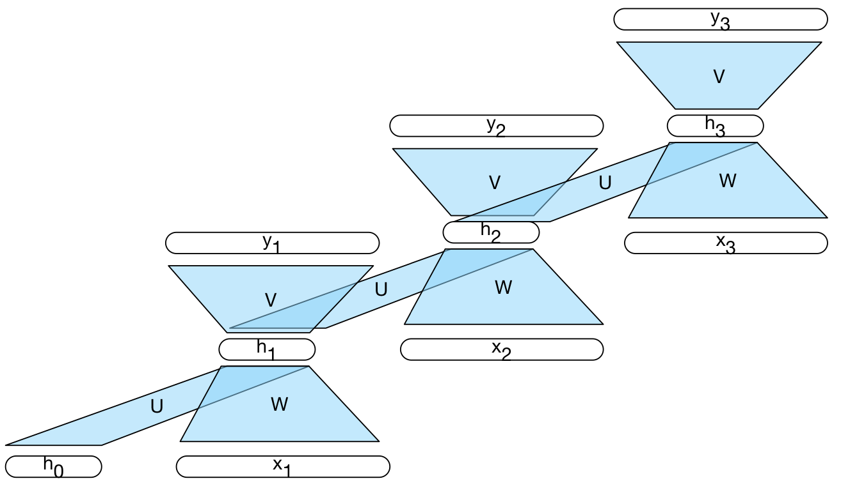
Elman (1990) Recurrent Neural Network (RNN)
Hidden-­to-­hidden and input­ to ­hidden weights are shared across the different time steps.
Weights will be adjusted so that the RNN is learning how to incorporate incoming information and maintain a state representation summarizing the input seen so far;
RNN does not have any way of knowing which time step it is on;
RNN is learning how to transition from one time step to another and maintain a state representation that will minimize its loss.
Source: Rao D. & McMahan (2019): Natural Language Processing with PyTorch: Build Intelligent Language Applications Using Deep Learning. And https://web.stanford.edu/~jurafsky/slp3/9.pdf

Slide 20
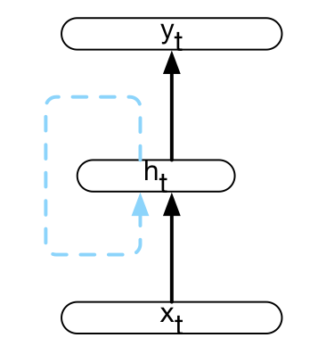



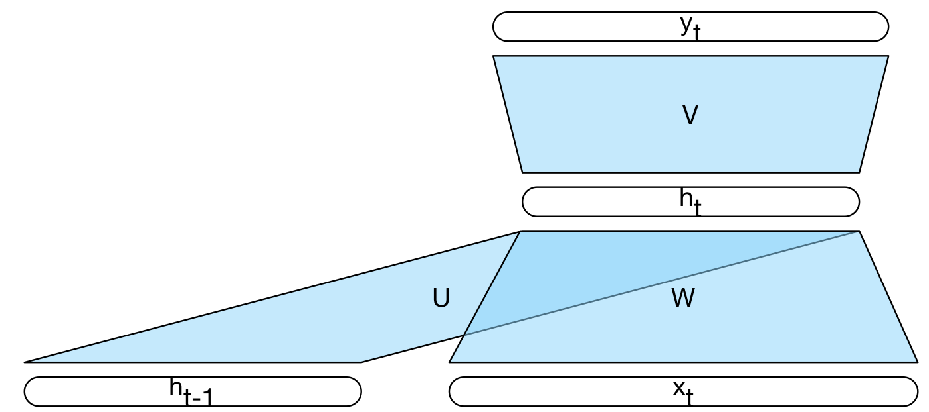
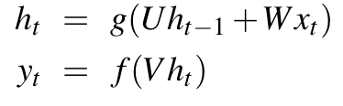

Elman (1990) or “Simple” RNN
input vector representing the current input element
hidden units
output
Source: https://web.stanford.edu/~jurafsky/slp3/9.pdf

Slide 21
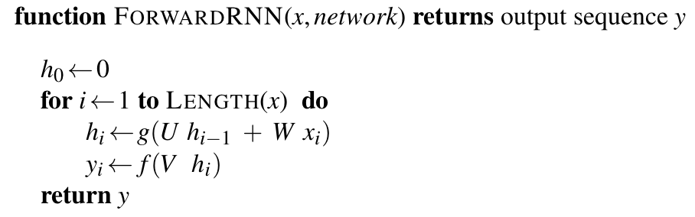
Forward inference in a simple recurrent network
The matrices U, V and W are shared across time, while new values for h and y are calculated with each time step.
Source: https://web.stanford.edu/~jurafsky/slp3/9.pdf

Slide 22
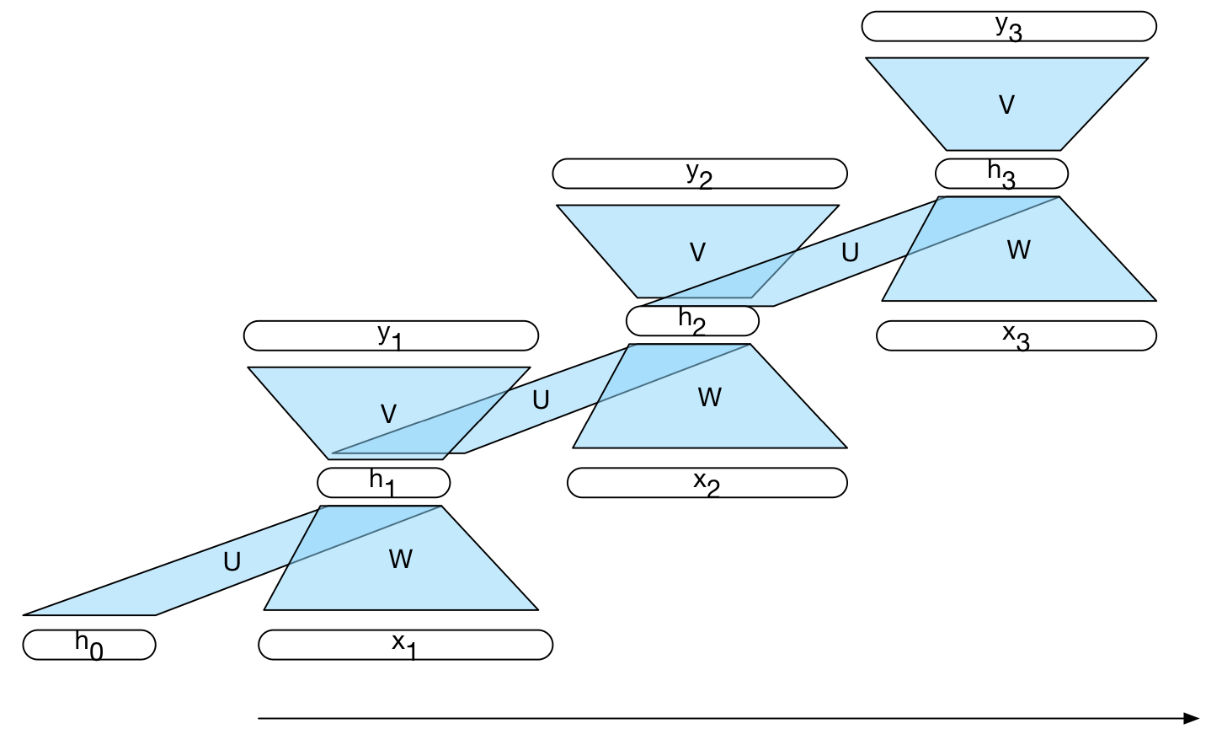
A simple recurrent neural network shown unrolled in time
Network layers are copied for each time step, while the weights U, V and W are shared in common across all time steps.
Source: https://web.stanford.edu/~jurafsky/slp3/9.pdf

Slide 23
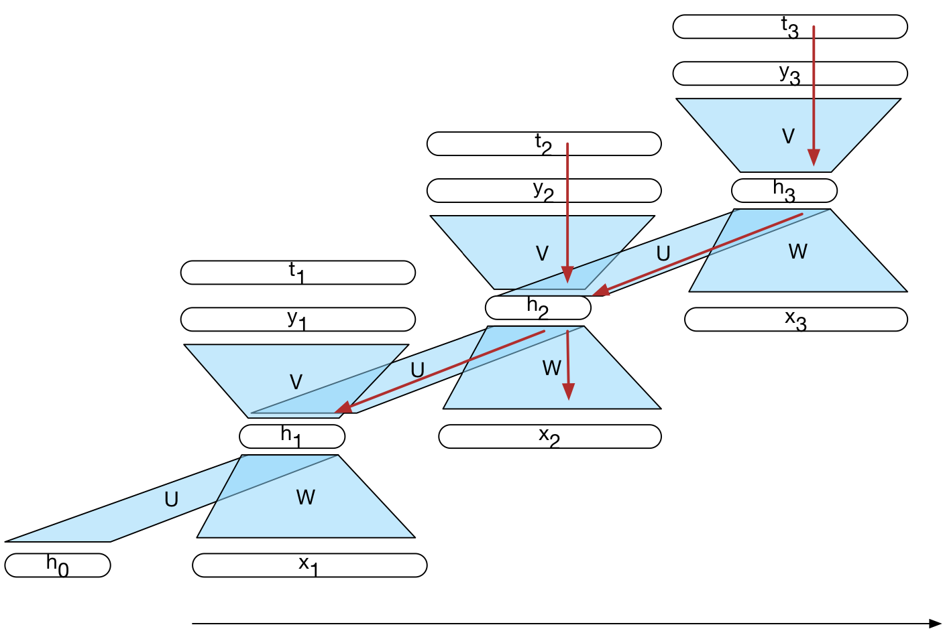
Training: backpropagation through time (BPTT)
Source: https://web.stanford.edu/~jurafsky/slp3/9.pdf

Slide 24
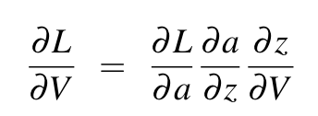
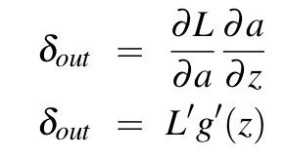
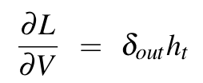

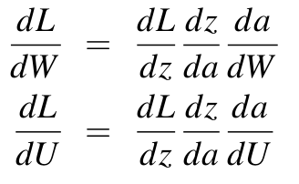
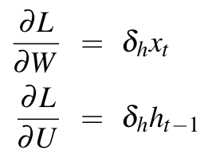

BPTT: backpropagation through time (Werbos, 1974; Rumelhart et al. 1986)
Gradient of the output weights V:
Gradient of the W and U weights:
Source: https://web.stanford.edu/~jurafsky/slp3/9.pdf

Slide 25
Optimization
Loss is differentiable w.r.t. parameters
  => use backprop+SGD
    BPTT – backpropagation through time
    Similar to FFNN (#layers = #words) with shared weights (same weights in all layers)
Truncated BPTT is used in practice
    Forward-backward pass on segments of seqlen (50-500) words
    Little better to use final hidden state from the previous segment as initial hidden state for the next segment (0 for the first segment)

Slide 26
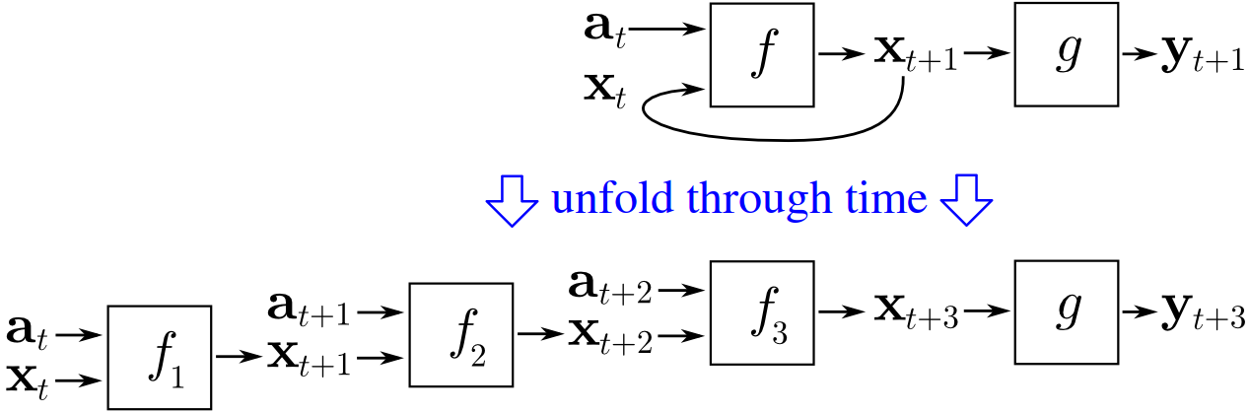
Unrolled Networks as Computation Graphs
With modern computational frameworks explicitly unrolling a recurrent network into a deep feedforward computational graph is practical for word-by-word approaches to sentence-level processing.

Slide 27
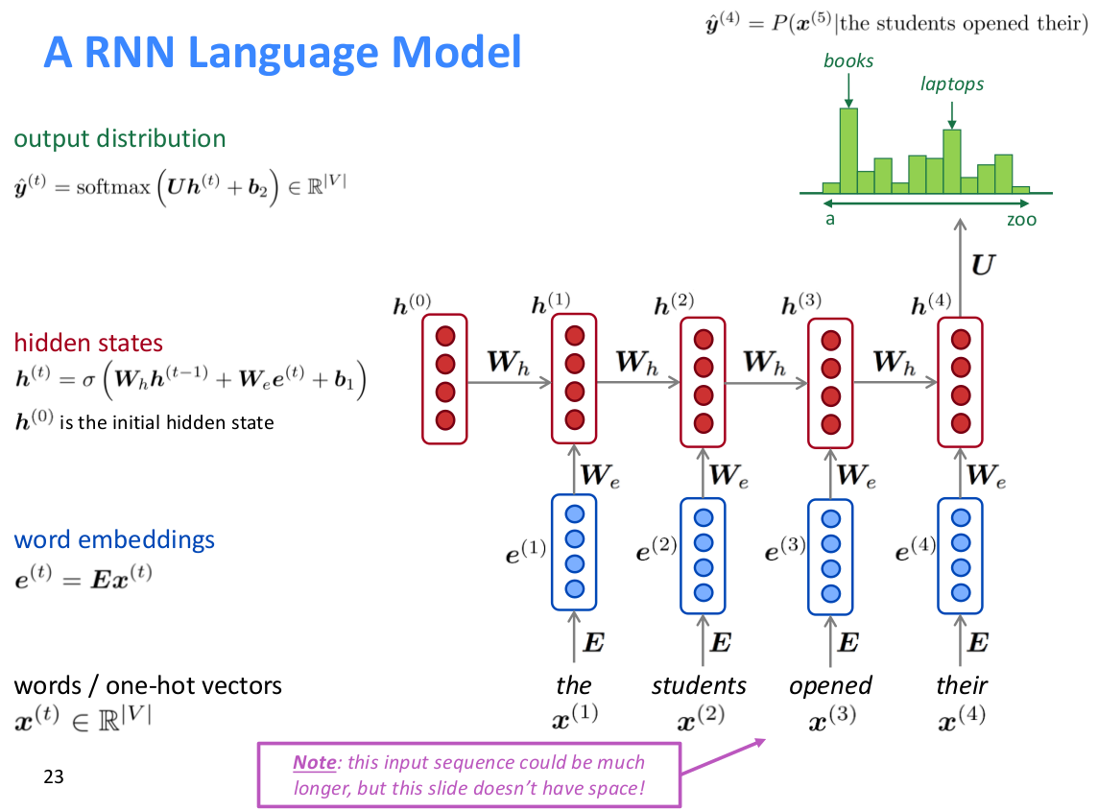
A RNN Language Model
Source: Abigail See. CS224N/Ling284 slides: http://web.stanford.edu/class/cs224n/

Slide 28
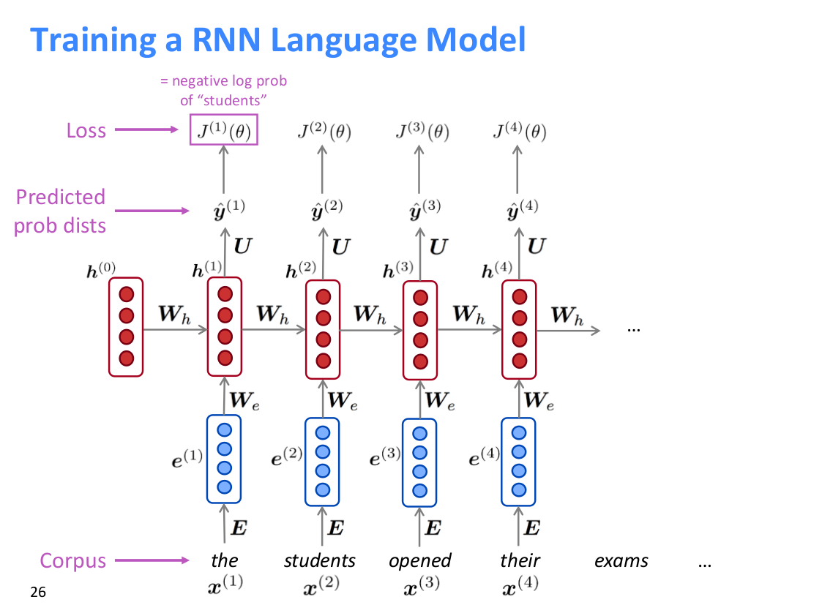
Training a RNN Language Model
Maximize predicted probability of real next word
Source: Abigail See. CS224N/Ling284 slides: http://web.stanford.edu/class/cs224n/

Slide 29
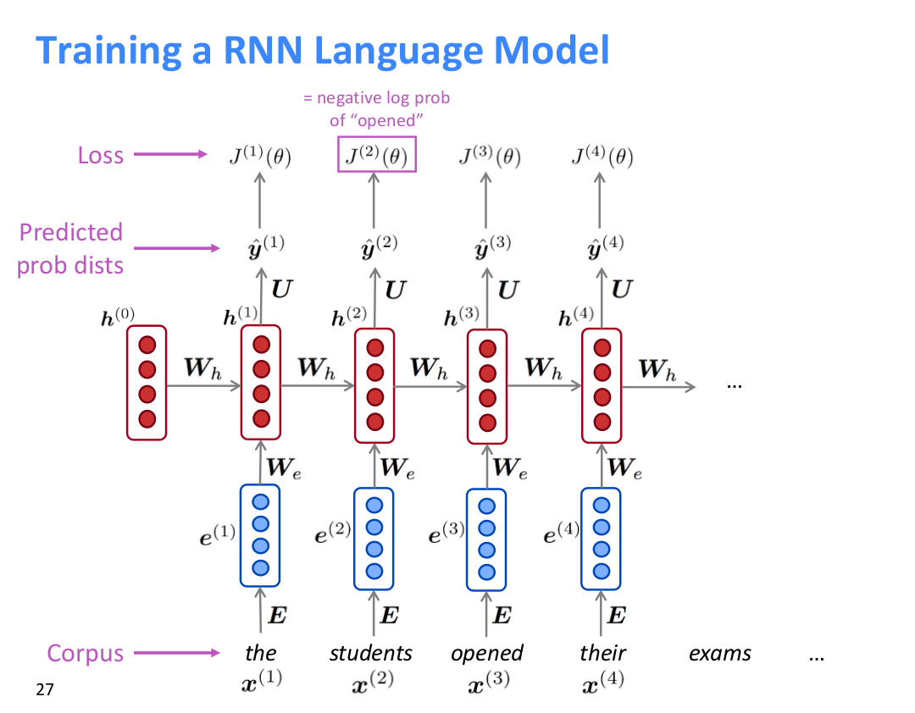
Training a RNN Language Model
Source: Abigail See. CS224N/Ling284 slides: http://web.stanford.edu/class/cs224n/

Slide 30
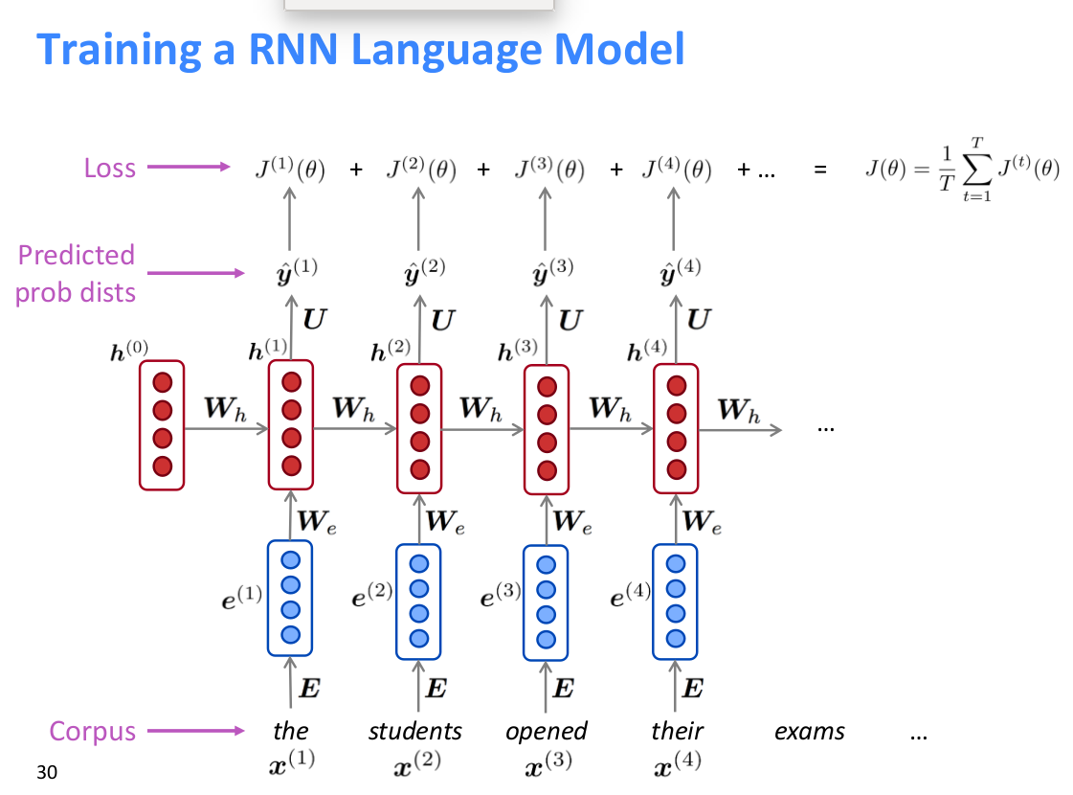
Training a RNN Language Model
Cross-entropy loss on each timestep → average across timesteps
Source: Abigail See. CS224N/Ling284 slides: http://web.stanford.edu/class/cs224n/

Slide 31
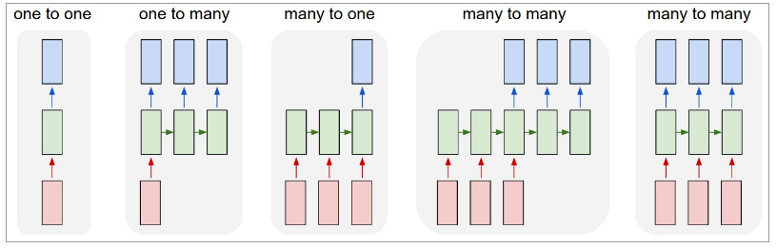
Applications of Recurrent NNs
1→1: FFNN
1→many: conditional generation (image captioning)
many→1: text classification
many→many:
  Non-aligned: sequence transduction (machine translation, summarization)
  Aligned: sequence tagging (POS, NER,Argument Mining, ...)
Source: Karpathy. The Unreasonable Effectiveness of Recurrent Neural Networks http://karpathy.github.io/2015/05/21/rnn-effectiveness/

Slide 32
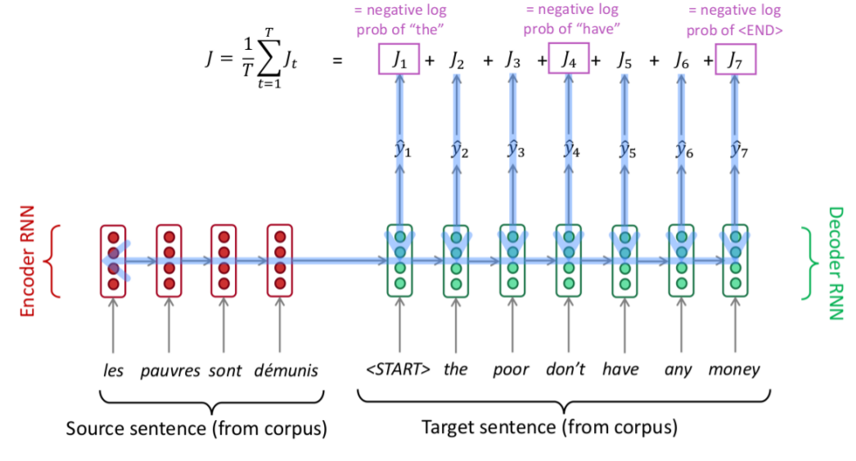
seq2seq
Source: Abigail See. CS224N/Ling284 slides: http://web.stanford.edu/class/cs224n/

Slide 33
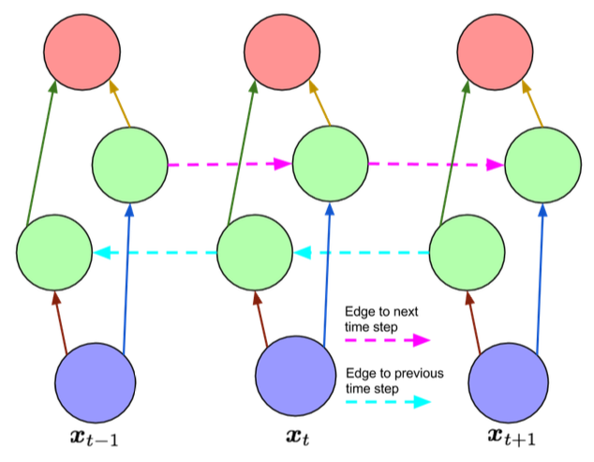
Bidirectional RNNs
Idea: if we are tagging whole sentences, we can use context representations from the ‘past’ and from the ‘future’ to predict the ‘current’ label
Not applicable in an online
incremental setting.
LSTM cells and bidirectional
networks can be combined
into Bi-LSTMs
Bidirectional recurrent network, unfolded in time

Slide 34
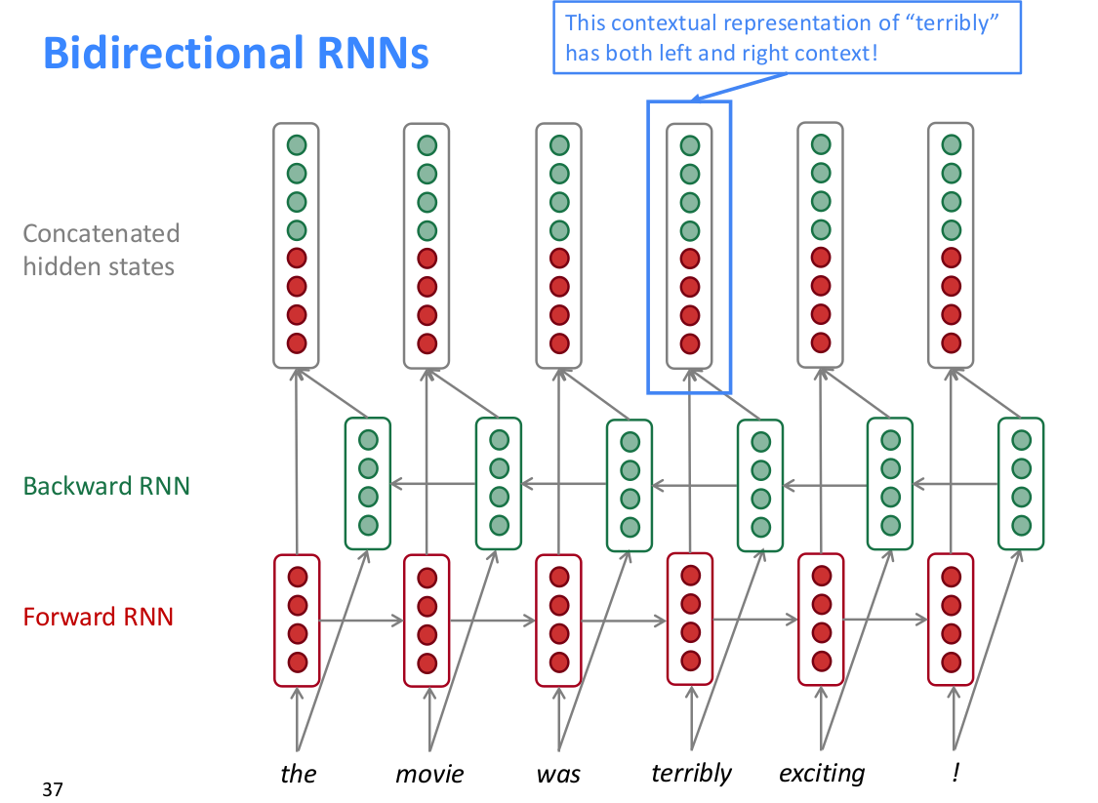
Bidirectional RNNs
Source: Abigail See. CS224N/Ling284 slides: http://web.stanford.edu/class/cs224n/

Slide 35
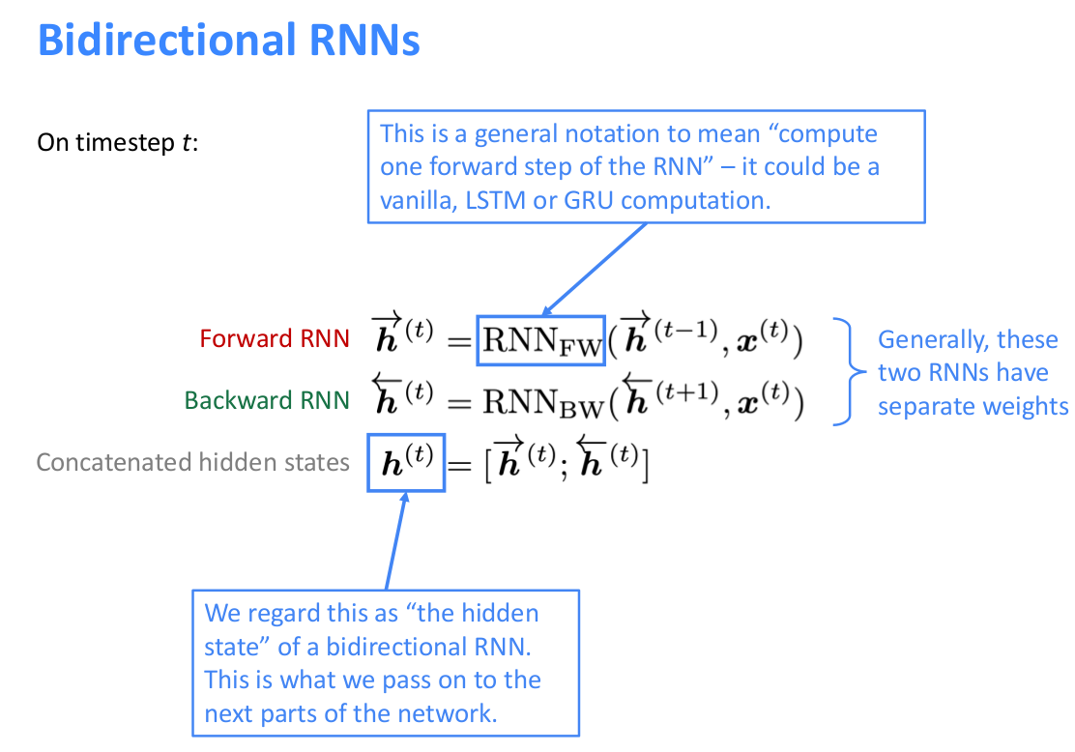
Bidirectional RNNs
Require full sequence available=>
not for LMs
But similar bidirectional LMs exists
which are 2 independent LMs
Source: Abigail See. CS224N/Ling284 slides: http://web.stanford.edu/class/cs224n/

Slide 36
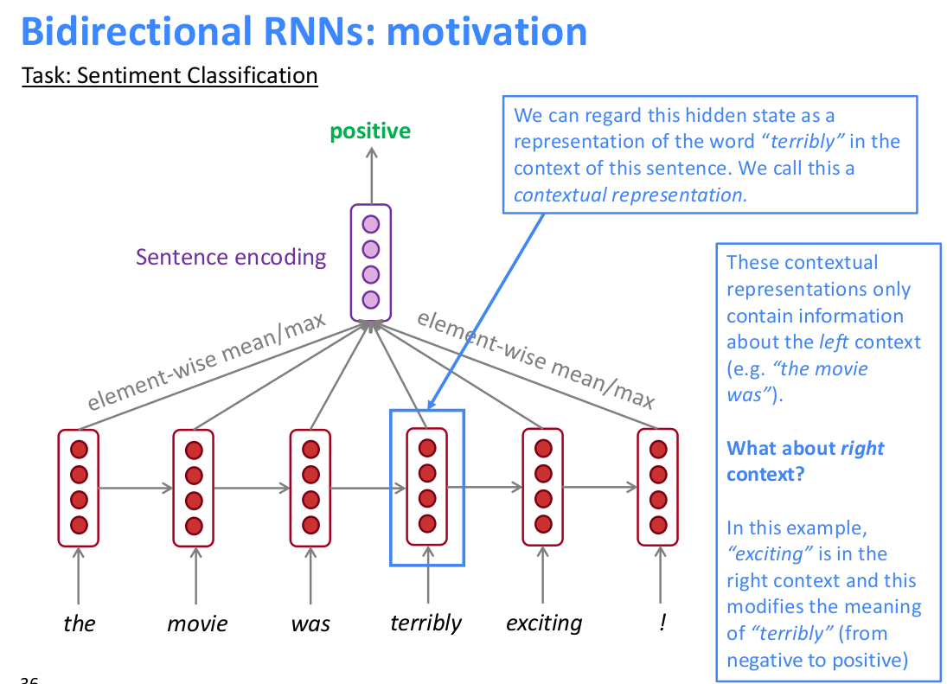
Bidirectional RNNs
Source: Abigail See. CS224N/Ling284 slides: http://web.stanford.edu/class/cs224n/

Slide 37
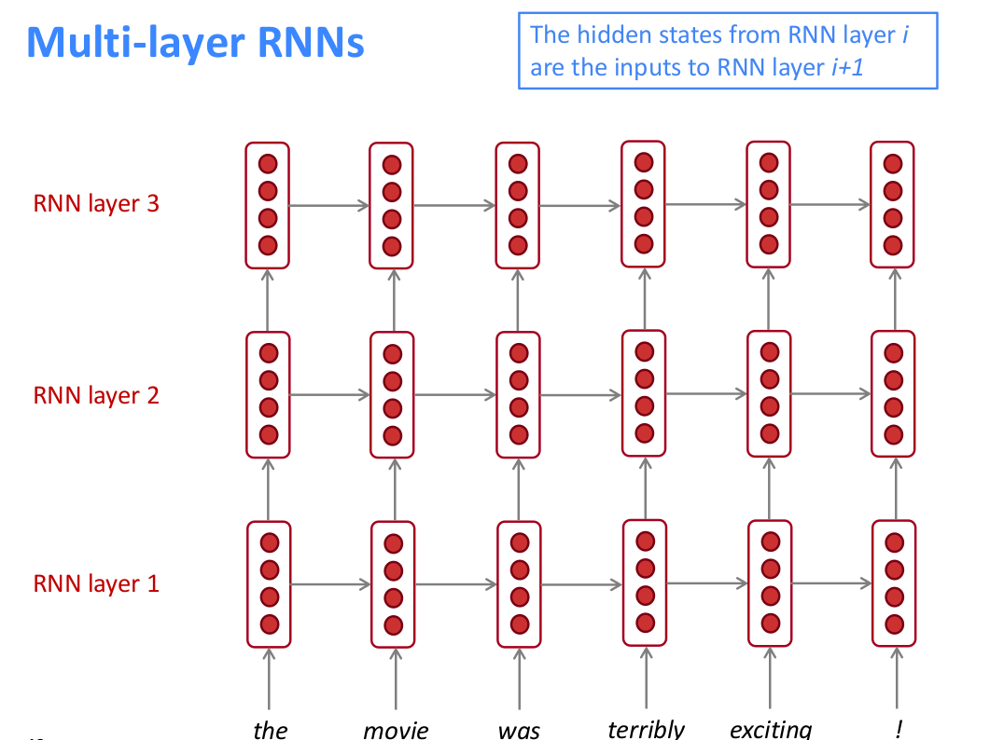
Multi-layer RNNs
Source: Abigail See. CS224N/Ling284 slides: http://web.stanford.edu/class/cs224n/

Slide 38
The Problem with Vanilla RNNs
(or Elman/Simple RNNs)
The inability to retain information for long­-range predictions:
  at each time step we simply updated the hidden state vector regardless of whether it made sense;
  RNN has no control over which values are retained and which are discarded in the hidden state;
    that is entirely determined by the input;
    no way to decide if the update is optional or not.
Gradient stability:
  tendency to cause gradients to spiral out of control to zero or to infinity;
  large absolute value of the gradient or a really small (less than 1) value can make the optimization procedure unstable: (Hochreiter et al., 2001; Pascanu et al., 2013)
Source: Rao D. & McMahan (2019): Natural Language Processing with PyTorch: Build Intelligent Language Applications Using Deep Learning.

Slide 39
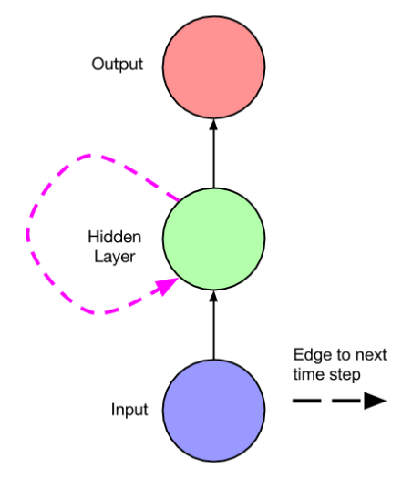
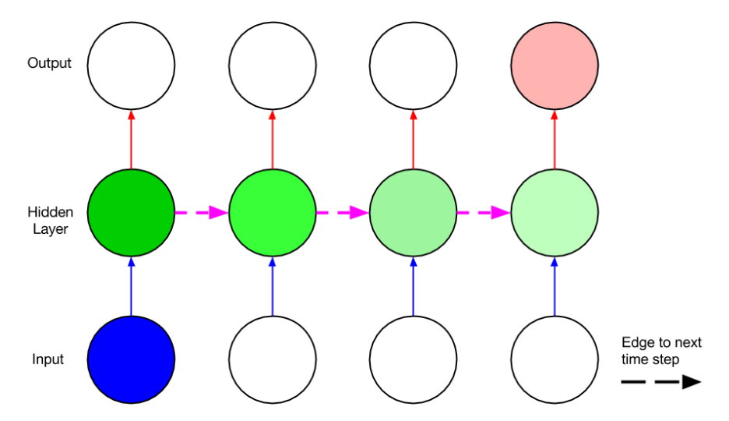
The Problem with Vanilla RNNs
(or Elman/Simple RNNs)
Simple recurrent network
Unfolded network, visualizing the vanishing gradient
Gradients vanish (explode) exponentially across time steps when the recurrent connection is <1 (>1)
Problem is connected to the fact that it is always the same connection weight
In the same way a product of n real numbers can shrink to zero or explode to infinity, so does this product of matrices
See details in the papers below:
  Pascanu, R., Tomas M., and Yoshua B. On the difficulty of training recurrent neural networks. ICML 2013
  Graves A. Supervised sequence labelling with recurrent neural networks, Volume 385. Springer, 2012.

Slide 40
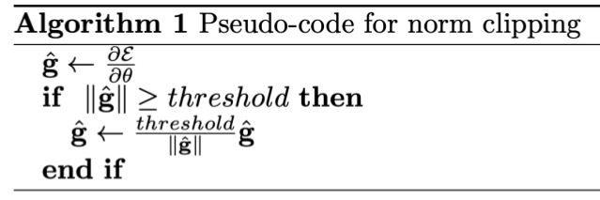
The Problem with Vanilla RNNs
(or Elman/Simple RNNs)
Vanishing/exploding gradients solutions:
  Vanishing gradients:
    LSTM/GRU cells
    ...and other gated cells
  Exploding gradients:
    Gradient norm clipping
Source: Pascanu et al. (2013): On the difficulty of training recurrent neural networks.

Slide 41
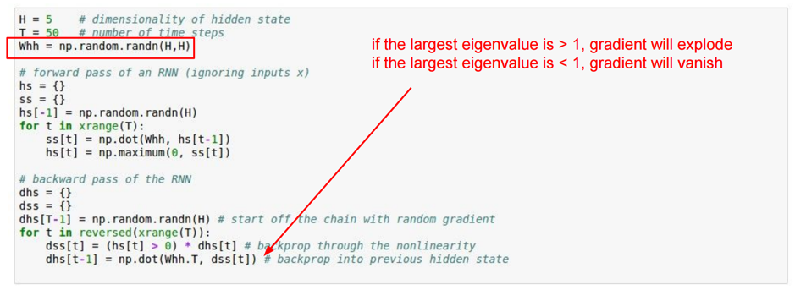
Exploding gradients in RNNs
The gradient signal going backwards in time through all the hidden states is always being multiplied by the same matrix (the recurrence matrix Whh), interspersed with non-linearity backprop
  Here we only compute the recurrence on the hidden state (equivalently, the input x could always be zero).
Source: https://medium.com/@karpathy/yes-you-should-understand-backprop-e2f06eab496b

Slide 42
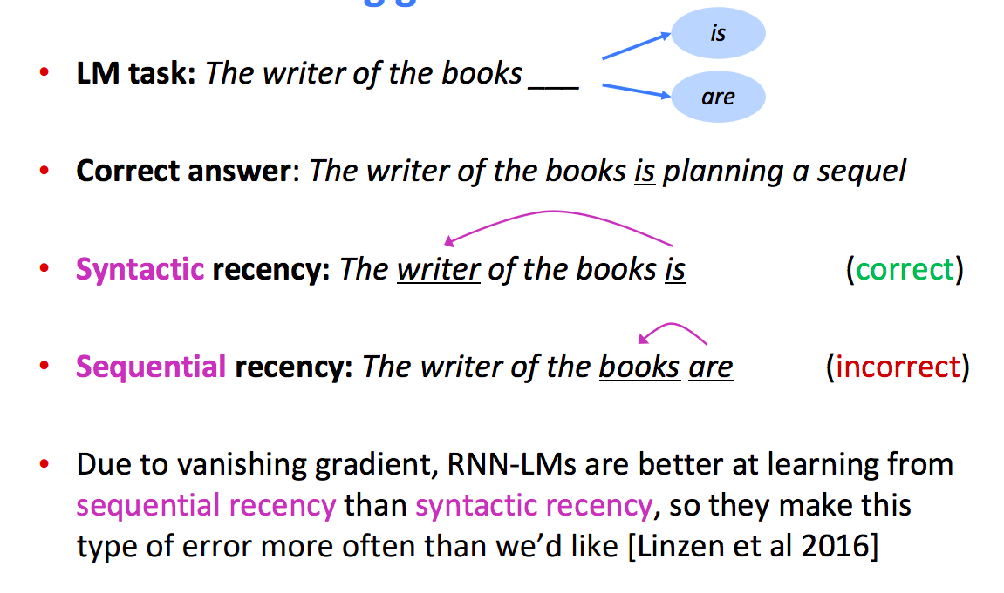
Effect of vanishing gradient on RNN language model
Source: Abigail See. CS224N/Ling284 slides: http://web.stanford.edu/class/cs224n/

Slide 43
Plan of the lecture
Part 1: Language modeling.
Part 2: Recurrent neural networks.
Part 3: Long-Short Term Memory (LSTM).
Part 4: LSTMs for sequence labelling.
Part 5: LSTMs for text categorization.

Slide 44

Intuition behind the gating mechanism
Suppose that you were adding two quantities, a and b, but you wanted to control how much of b gets into the sum:
λ is a value between 0 and 1.
λ acts as a “switch” or a “gate” in controlling the amount of b that gets into the sum.
Source: Rao D. & McMahan (2019): Natural Language Processing with PyTorch: Build Intelligent Language Applications Using Deep Learning.

Slide 45
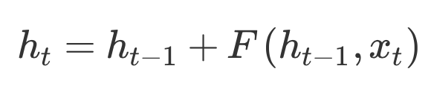
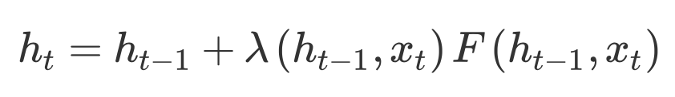
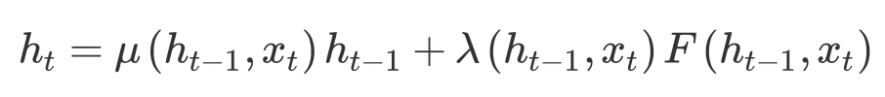
A simple gate example
Elman RNN:
A gated version of Elman RNN:
  function λ controls how much of the current input gets to update the state h_{t−1};
  function λ is context­-dependent.
Incorporate not only conditional updates, but also forgetting of the values in the previous state h_{t−1}
Source: Rao D. & McMahan (2019): Natural Language Processing with PyTorch: Build Intelligent Language Applications Using Deep Learning.

Slide 46
Long Short-Term Memory (LSTM)
LSTM resembles a standard RNN with a hidden layer
Nodes in the hidden layer are replaced by a memory cell
Memory cells contain a node with a self-connected recurrent edge of fixed weight 1 (no gradient issues)
Hochreiter S. and Schmidhuber H. (1997). Long short-term memory. Neural Computation, 9(8):1735–1780.
Greff, K., Srivastava, R. K., Koutník, J., Steunebrink, B. R., & Schmidhuber, J. (2017). LSTM: A search space odyssey. IEEE Trans. on neural networks and learning systems, 28(10)

Slide 47
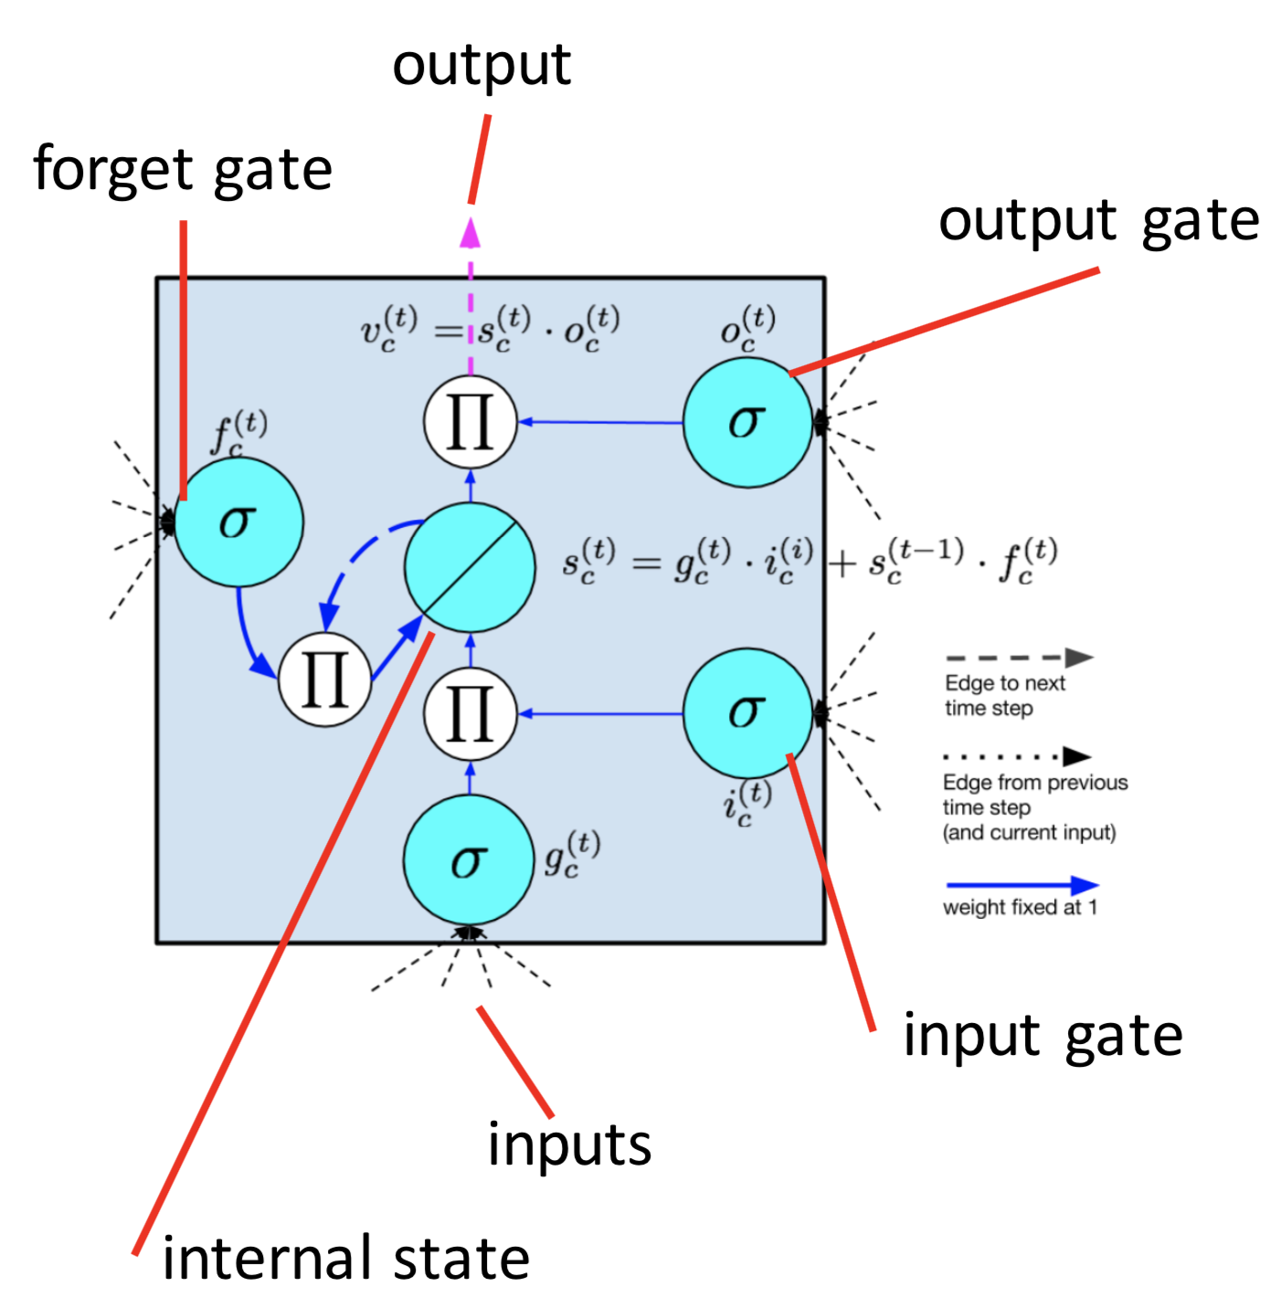
Memory Cell in LSTM
inputs: from sequence and from other memory cells
input gate: regulates whether to take input into account
output gate: regulates whether to output the internal state
forget gate: can flush internal state
recurrent link with weight 1: “constant error carousel”.

Slide 48
LSTM Intuitions
“long short-term memory”: standard NNs have
  long-term memory in the weights
  short-term memory in the activations
  LSTM mixes both notions
Gate: pointwise multiplication regulates how much is passed through, based on inputs
Internal state serves as a memory
Recurrent connection of weight 1: error can flow across time steps without vanishing or exploding
LSTM can learn:
  when to let the input (and error) in e.g. set the new grammatical subject
  when to let the output (and error) out e.g. predict verb that takes the subject
  when to reset its memory e.g. remove old subject once its taken

Slide 49
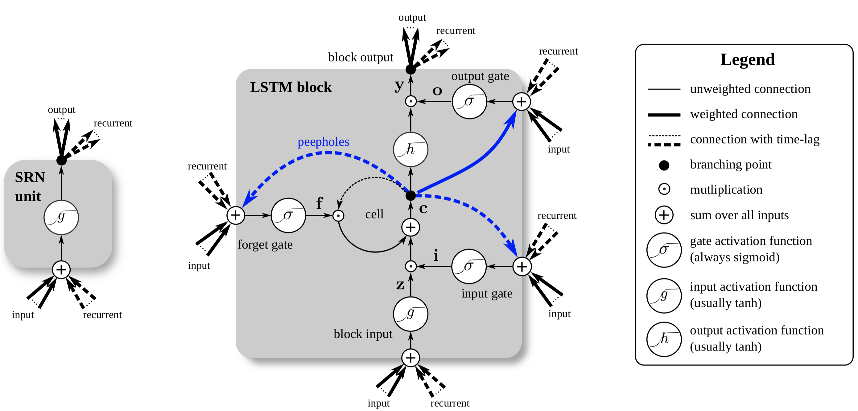
Long Short-Term Memory (LSTM)
Source: Greff, K., Srivastava, R. K., Koutník, J., Steunebrink, B. R., & Schmidhuber, J. (2017). LSTM: A search space odyssey. IEEE Trans. on neural networks and learning systems, 28(10)

Slide 50
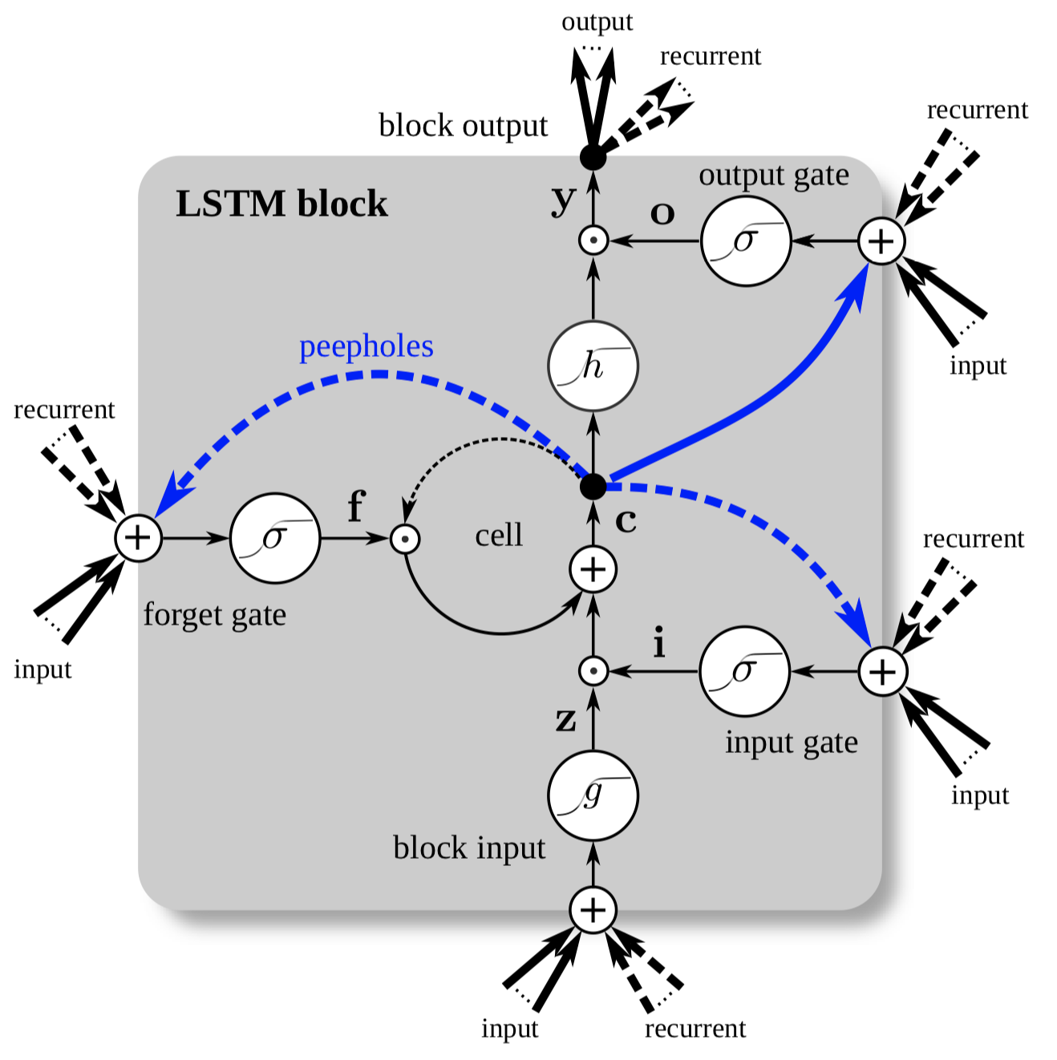
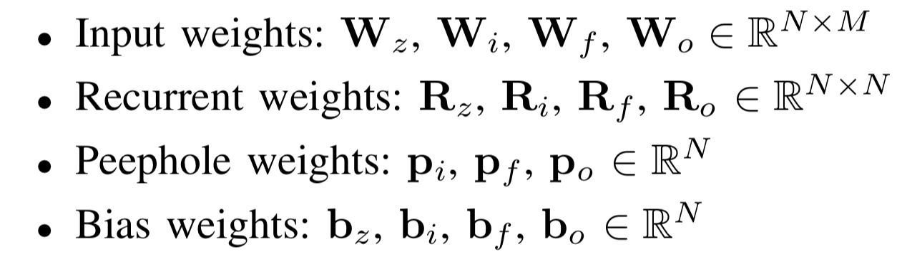
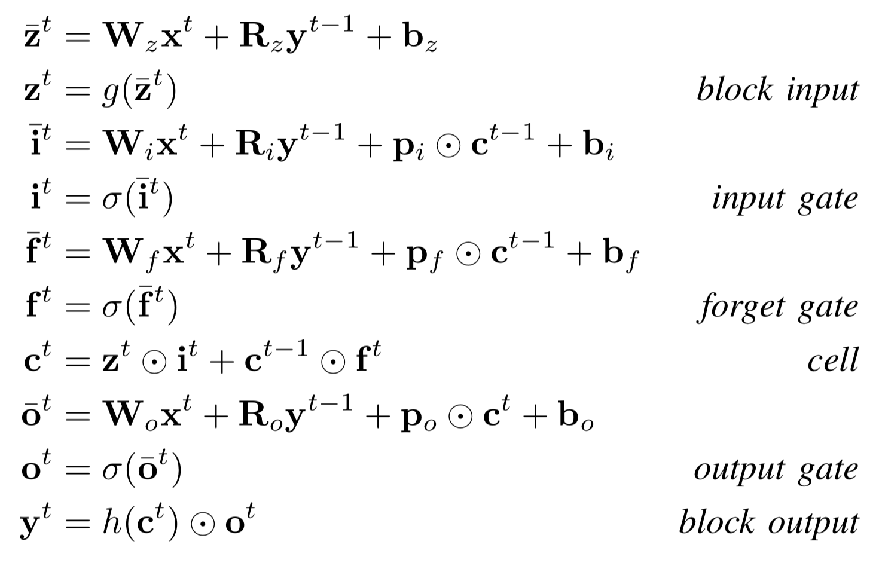
Long Short-Term Memory (LSTM)
Source: Greff, K., Srivastava, R. K., Koutník, J., Steunebrink, B. R., & Schmidhuber, J. (2017). LSTM: A search space odyssey. IEEE Trans. on neural networks and learning systems, 28(10)

Slide 51
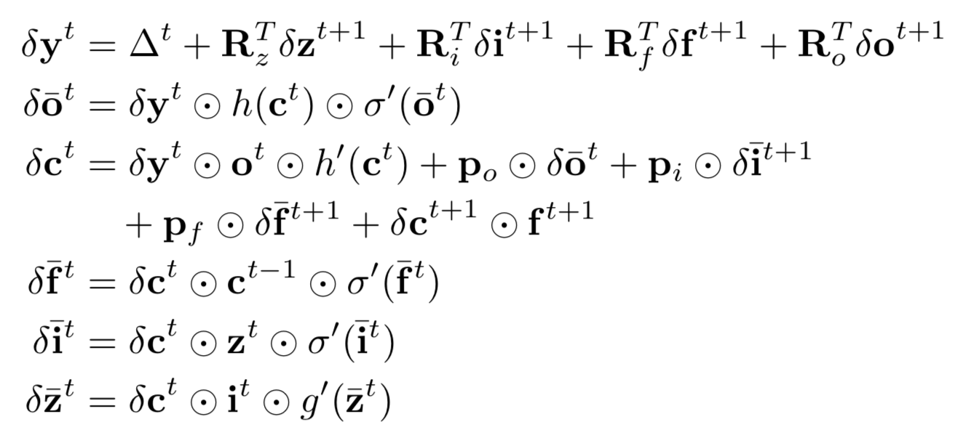
Long Short-Term Memory (LSTM)
Learnable parameters
Forward Pass backward pass (Bptt)

Slide 52
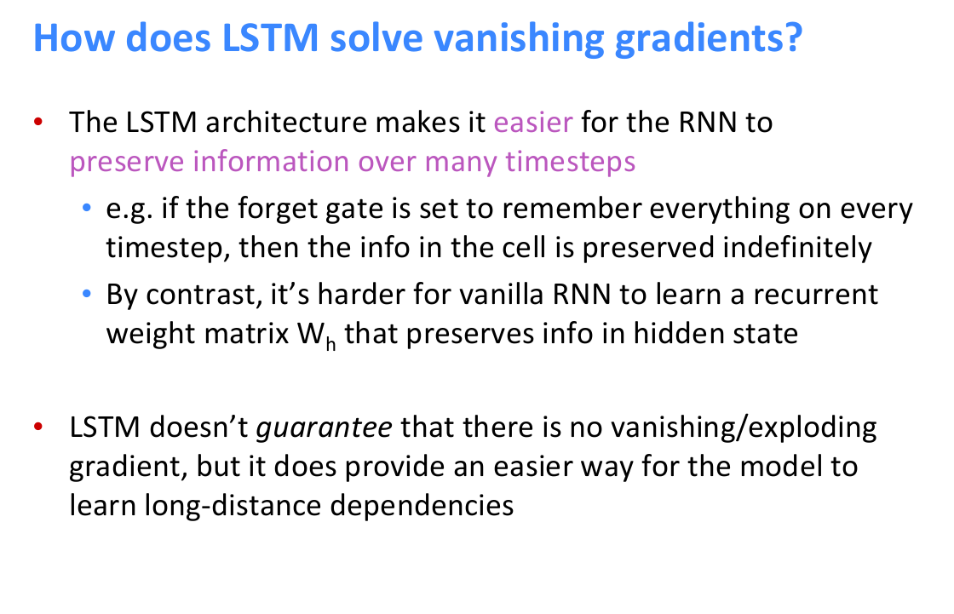
How does LSTM handles the vanishing gradient problem?
Source: Abigail See. CS224N/Ling284 slides: http://web.stanford.edu/class/cs224n/

Slide 53

Examples generated (Shakespeare)
Source: Karpathy. The Unreasonable Effectiveness of Recurrent Neural Networks http://karpathy.github.io/2015/05/21/rnn-effectiveness/

Slide 54

Examples generated (Linux kernel)
Source: Karpathy. The Unreasonable Effectiveness of Recurrent Neural Networks http://karpathy.github.io/2015/05/21/rnn-effectiveness/

Slide 55

Cells activations
Source: Karpathy. The Unreasonable Effectiveness of Recurrent Neural Networks http://karpathy.github.io/2015/05/21/rnn-effectiveness/

Slide 56


Cells are sometimes interpretable
Source: Karpathy. The Unreasonable Effectiveness of Recurrent Neural Networks http://karpathy.github.io/2015/05/21/rnn-effectiveness/

Slide 57

Sentiment Neuron Visualizations
How sentiment neuron changes while reading text?
  Source: [Radford et al. Learning to Generate Reviews and Discovering Sentiment, 2017]

Slide 58




Other variants of gated cells
Jozefowicz et al. (2015) tried about 10k various architectures: did not find anything substantially better than LSTM and GRU.
Source: http://proceedings.mlr.press/v37/jozefowicz15.pdf

Slide 59
Plan of the lecture
Part 1: Language modeling.
Part 2: Recurrent neural networks.
Part 3: Long-Short Term Memory (LSTM).
Part 4: LSTMs for sequence labelling.
Part 5: LSTMs for text categorization.

Slide 60
Sequence tagging
We want to know properties of words for further processing, e.g. word classes, names, etc.
It is possible to learn a method that assigns these properties from labeled training text.
In Machine Learning, this is a classification task. If the sequence of events is taken into account, this is called sequence tagging
Examples for tagged text:
Part-of-Speech:
I/PRO saw/V the/DET man/N with/P the/DET saw/N ./P
Name tagging:
Valerie/B-PERS and/O Rose/B-PERS travel/O
to/O New/B-LOC York/I-LOC ./O

Slide 61
No independence assumption on data samples
Standard ML setups: Assumption on the independence of training resp. test examples
  Can shuffle and sample training examples
  Can classify test examples in parallel
Sequence Learning
  Previous train/test examples are an informative context
  Previous classifications/outputs are an informative context
Examples for sequential data:
  Frames from video
  Snippets from audio
  Text: streams of words or characters
  DNA

Slide 62


The part-of-speech (POS) tagging: solving morphological ambiguity
Words often have more than one POS: back
The back door = JJ
On my back = NN
Win the voters back = RB
Promised to back the bill = VB
The POS tagging problem is to determine the POS tag label sequence L for a particular sequence of words W:

Slide 63

Named Entity Recognition (NER)
[Jim]_{Person} bought 300 shares of [Acme Corp.]_{Organization} in [2006]_{Time}.
Source: Rao D. & McMahan (2019): Natural Language Processing with PyTorch: Build Intelligent Language Applications Using Deep Learning.

Slide 64

Argument Mining
Premise-Claim model example annotations:

Slide 65
POS tagging and other sequence labelling problems
Commonly used approaches in the past:
Hidden Markov Models (HMM)
Maximum Entropy Markov Model (MEMM)
Conditional Random Fields (CRF)
Currently used approaches:
Bidirectional LSTMs, incl. CRF layer
Transformer-based models (BERT, ...)

Slide 66

Bi-LSTM for sequence tagging
Input: Word embeddings, additional word features
Combine two directions: usually concatenation
Output: 1-hot-encoding over labels (softmax)
Source: Fig. from: Zayats, V., Ostendorf, M., Hajishirzi, H. (2016): Disfluency Detection using a Bidirectional LSTM. Proceedings of Interspeech 2016
State size: there are many ‘parallel’ LSTM cells in each layer
LSTM layers can be stacked for deeper networks

Slide 67


Bi-LSTM for POS Tagging - Variants
Compose words from character embeddings to addess unseen words
Use combined outputs as features in CRF layer, better making use of neighboring labels
Ling, W., Dyer, C., Black, A.W., Trancoso, I., Fermandez, R., Amir, S., Marujo, L. and Luis, T. (2015): Finding Function in Form: Compositional Character Models for Open Vocabulary Word Representation, Proceedings of EMNLP
Lample, G., Ballesteros, M., Subramanian, S., Kawakami, K. and Dyer, C. (2016): Neural Architectures for Named Entity Recognition. Proceedings of NAACL.

Slide 68


2016 state-of-the-art in POS tagging and NER
=
One of the first papers that has state-of-the-art performance with end-to-end approach on standard text processing:
Ma, X. and Hovy, E. (2016): End-to-end Sequence Labeling via Bi-directional LSTM-CNNs-CRF. Proceedings of ACL 2016, pp. 1064-1074, Berlin, Germany

Slide 69
Plan of the lecture
Part 1: Language modeling.
Part 2: Recurrent neural networks.
Part 3: Long-Short Term Memory (LSTM).
Part 4: LSTMs for sequence labelling.
Part 5: LSTMs for text categorization.

Slide 70

Sentiment Analysis: Error Rates of various IMDB Models
Binary Multinomial Naive Bayes:
  15.7 on 1-grams
  11.6 on 2-3grams ← Assignment 1
Logistic Regression:
  11.5 on 1-grams
  9.3 on 1-3grams ← Assignment 2
NB scaler + linear classifier
  8.8 [Wang and Manning. Baselines and Bigrams: Simple, Good Sentiment and Topic Classification, 2012]
  8.1 [Mesnil et al. Ensemble of Generative and Discriminative Techniques for Sentiment Analysis of Movie Reviews, 2015]
FFNN on Glove average
  10.6 [Iyyer et al. Deep Unordered Composition Rivals Syntactic Methods for Text Classification, 2015] – worse then Logistic Regression?! ← Assignment 2
Best models all use LSTMs with unsupervised pretrain (and several other tricks)
  7.3 [Dai and Le. Semi-supervised Sequence Learning, 2015]
  7.1 [Radford et al. Learning to Generate Reviews and Discovering Sentiment, 2017]
  6.3 [Dieng et al. TopicRNN: A Recurrent Neural Network with Long-Range Semantic Dependency, 2016]
  5.9 [Miyato et al. Adversarial Training Methods for Semi-supervised Text Classification, 2017]
  5.9 [Johnson and Zhang. Supervised and Semi-Supervised Text Categorization using LSTM for Region Embeddings, 2016]
  4.6 [Howard and Ruder. Universal Language Model Fine-tuning for Text Classification, 2018]

Slide 71

LSTM classifier: a naive approach
The hidden state (=output) at last time step can represent the whole input sequence
  seq2seq
Add FFNN classifier on top
Dai and Le. (2015) in “Semi-supervised Sequence Learning” tried and it didn’t work that well:
  13.5% error rate (worse then NB)
  Very unstable training
  Too little information about outputs?
    Only 1 bit for each (long) review
    Complex model like LSTM can correlate it
    with lots of different input patterns
  Vanishing gradient is still a problem
  for (long) reviews?
  Source: Johnson and Zhang (2016): Supervised and Semi-Supervised Text Categorization using LSTM for Region Embeddings.

Slide 72

LSTM Unsupervised Pretraining
Give/require more information about outputs
  Pretraining: train another model on some (distantly) related task, for which we have / can generate a large train set (preferably)
    Language Model [unsupervised!]
    Sequence Autoencoder [unsupervised!]
  => sensible initial weights
  Fine-tuning: train classifier on the target task, initializing embeddings and LSTM weights non-randomly, FFNN weights – randomly
    can fine-tune or fix non-randomly initialized weights
  Source: Dai and Le. (2015): Semi-supervised Sequence Learning

Slide 73

IMDB Results
Embeddings initialized with word2vec are better than random
Embeddings and LSTM weights initialized with LM/SA weights is much better!
Paragraph Vectors results is invalid,
  Train and test sets were not shuffled: It is 11.3%
  [Mesnil et al. Ensemble of Generative and Discriminative Techniques for Sentiment Analysis of Movie Reviews, 2015]
s
This was improved to 7.33% with properly selected hyperparameters
  Source: Dai and Le. (2015): Semi-supervised Sequence Learning.

Slide 74



Results
Larger unlabeled corpus for pretraining helps!
IMDB: 50K
Amazon reviews: 8M
Character-level topic categorization:
=> long sequences, awful results without pretrain!
Stacking LSTMs help
sometimes LM is better than SA pretrain
  Source: Dai and Le (2015): Semi-supervised Sequence Learning.

Slide 75


Unsupervised Sentiment Neuron
After training byte-level mLSTM for LM they found “Sentiment neuron”
  Amazon Product Reviews: 82M reviews over 18 years, 38GB of unlabeled texts
  1 month of training of 4GPUs, 1 epoch / 1M steps
  Adam, initial lr: 5e-4 decayed linearly to 0, batch: 128 subsequences of length 256 bytes
7.70% - logistic regression on single neuron (it is simply 1 scalar threshold)!
  7.12% on all 4096 units
  Source: Radford et al. (2017): Learning to Generate Reviews and Discovering Sentiment

Slide 76
Sentiment Neuron Visualizations
How sentiment neuron changes while reading text?
  Source: Radford et al. Learning to Generate Reviews and Discovering Sentiment (2017)

Slide 77

Conditional text generation
LM can be used to generate new reviews
  fix sentiment neuron to generate desired sentiment
  Source: Radford et al. Learning to Generate Reviews and Discovering Sentiment (2017)

Slide 78

Adversarial training
Want predict the same class for nearby points
  add (to the loss) a penalty for low predicted probability of the correct class in the small neighborhood of a labeled example
r_{adv} can be small random perturbation, but the worst possible perturbation given epsilon works much better!
Need to calculate r_{adv} at each timestep (effectively)!
  use gradient ascent (linear approximation)
Source: Miyato, Adversarial Training Methods for Semi-Supervised Text Classification, 2017

Slide 79


Adversarial training for LSTM
For texts: add adversarial perturbation to (standardized) embeddings
Source: Miyato, Adversarial Training Methods for Semi-Supervised Text Classification, 2017

Slide 80

Results
SOTA on IMDB (and several other datasets)
Source: Miyato, Adversarial Training Methods for Semi-Supervised Text Classification, 2017

