Slide 1

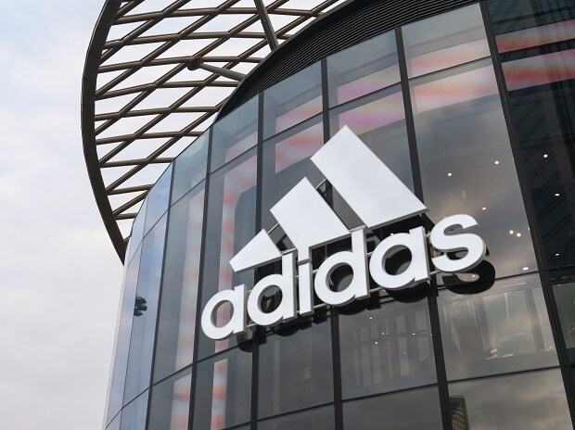
Adidas Sales Analysis Using SQL: by Sayan Kundu
Ivy Professional School – Top Ranked Corporate Education Provider

Slide 2
Overview of the Project:
Adidas, in full Adidas AG, German manufacturer of athletic shoes and apparel and sporting goods. In the early 21st century it was the largest sportswear manufacturer in Europe and the second largest in the world. We are going to analyze Adidas Sales in United States.
Problem Statement:
From the point of view of the company we want to know which retailers are providing good sales for the company, location wise sales performance of the firm and which products are the most demanding products of the firm. The purpose of sale analysis is to check the company's performance and how it can be improved.
Ivy Professional School – Top Ranked Corporate Education Provider

Slide 3
Overview of the Dataset:
Here I have used a dataset of having sales record of United States(US) of its different regions with the records of different states and city.
The Dataset contains 13 columns and 9648 records. I have collected the dataset from Kaggle.com. The columns contain the retailer names, retailers id, product category, date, region, state, city, price margin, profit amount, quantity, sales amount, profit, sales method.
Ivy Professional School – Top Ranked Corporate Education Provider

Slide 4
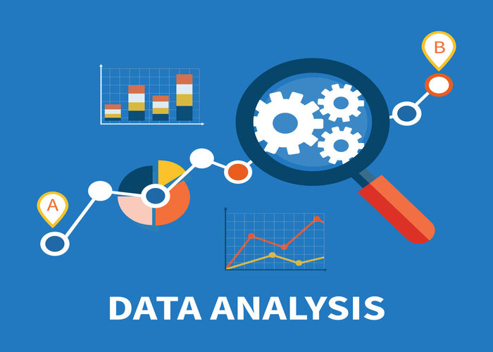
Ivy Professional School – Top Ranked Corporate Education Provider

Slide 5
Sales by Top 5 Retailers
250,000,000
200,000,000
150,000,000
100,000,000
50,000,000
0
Amazon
Kohl's
Sports Direct
Foot Locker
West Gear
Ivy Professional School – Top Ranked Corporate Education Provider

Slide 6
Sales by Region
Midwest
15.1%
West
30%
South
16.1%
Northeast
20.7%
Southeast
18.1%
Ivy Professional School – Top Ranked Corporate Education Provider

Slide 7
Sales by Top 5 States
75,000,000
50,000,000
25,000,000
0
South Carolina
Texas
Florida
California
New York
Ivy Professional School – Top Ranked Corporate Education Provider

Slide 8
Sales by Top 5 City
40,000,000
30,000,000
20,000,000
10,000,000
0
Portland
Miami
San Francisco
New York
Charleston
Ivy Professional School – Top Ranked Corporate Education Provider

Slide 9
TOP 5 PRODUCT SALES
250,000,000
200,000,000
150,000,000
100,000,000
50,000,000
0
Men's Apparel
Women's Apparel
Women's Street Footwear
Men's Athletic Footwear
Men's Street Footwear
Ivy Professional School – Top Ranked Corporate Education Provider

Slide 10
Method wise Sales
Online
27.5%
In-store
39.6%
Outlet
32.8%
Ivy Professional School – Top Ranked Corporate Education Provider

Slide 11
Year wise Sales
750,000,000
500,000,000
250,000,000
0
2020
2021
Ivy Professional School – Top Ranked Corporate Education Provider

Slide 12
Most profitable product year wise
Best Product Men's Street Footwear | 2021 | Total profit $ 67243476
Best Product Men's Street Footwear | 2020 | Total Profit $ 15558847
Ivy Professional School – Top Ranked Corporate Education Provider

Slide 13
Region | Retailers
West | West Gear
Northeast | Foot Locker
South | Sports Direct
Southeast | Foot Locker
Midwest | Foot Locker
1
Ivy Professional School – Top Ranked Corporate Education Provider

Slide 14
Findings:
‘West Gear’ and ‘Foot Locker’ are the best performing retailers for the firm. Firm should give priority to these retailers while distributing its product.
Firm should release it’s product first in ‘West Region’ as it is the best performing Region for the firm.
Top 5 most demanding product category of the firm on which firm should focus are: Men’s street footwear, Women’s apparel, Men’s Athletic Footwear, Women’s street Footwear, Men’s apparel.
Most popular product category of the firm is ‘Men’s Footwear’.
Firm’s sale is highly increased from the year 2020 to 2021(may be due to lockdown in 2020)
‘In-Store’ sales is the best selling method for the firm.
Ivy Professional School – Top Ranked Corporate Education Provider

Slide 15
Thank You
Ivy Professional School – Top Ranked Corporate Education Provider

