Slide 1
ECE584 L2 Discrete models, reachability, and Invariance
August 28th 2025, ECEB 3013
Sayan Mitra
CSL 266
mitras@illinois.edu
@Mitrasayn

Slide 2
Announcements
Class Campuswire created: https://campuswire.com/c/G0D38569B/feed
Use to create discuss projects
We may use it for announcements
Main source of information will be website
Links to notable past projects restored (mostly)
https://mitras.ece.illinois.edu/ECE584/project.html
HW1 out tomorrow due in 2 weeks

Slide 3
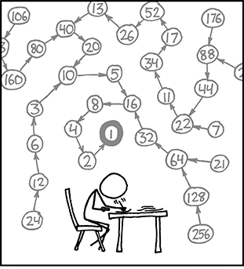
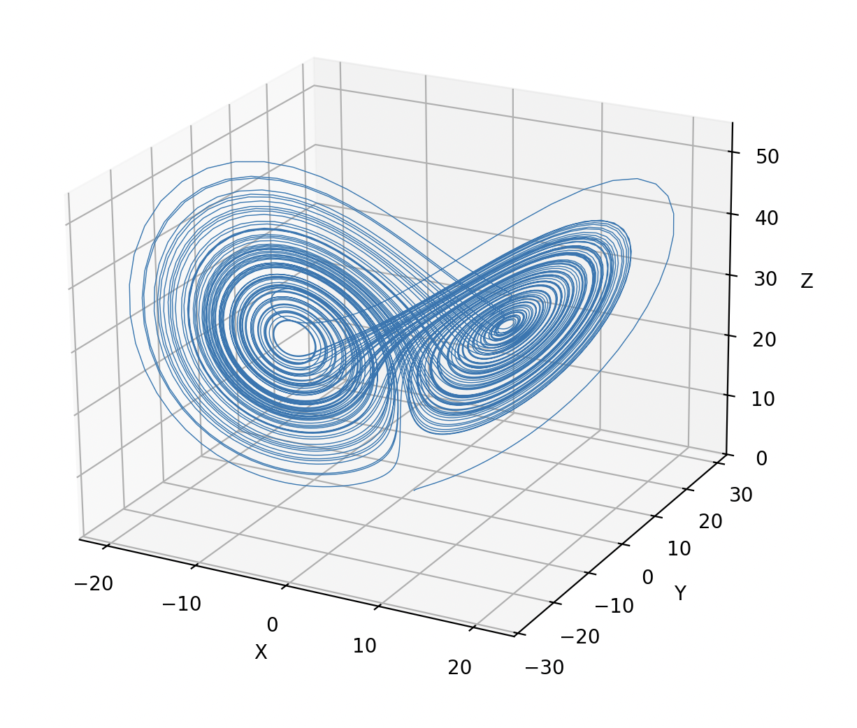
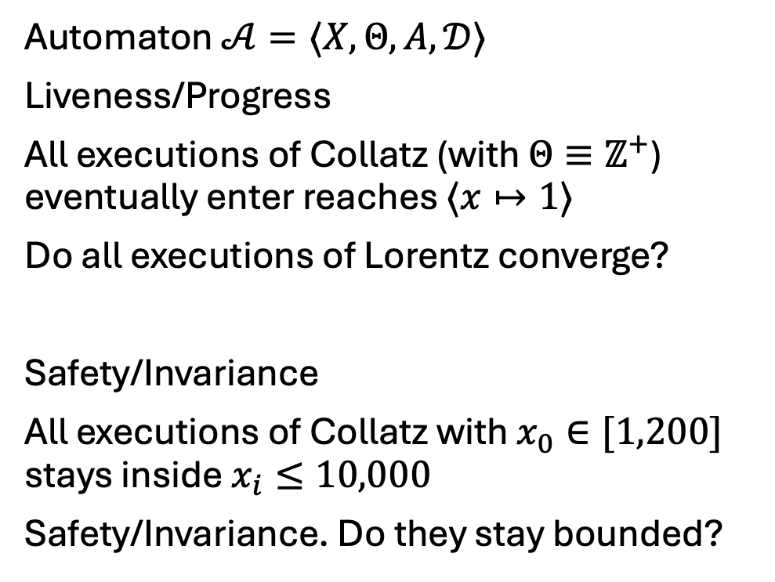
Recall automata and requirements
Automaton $𝒜=〈X,Θ, A, 𝒟〉$
Liveness/Progress
All executions of Collatz (with $Θ≡ℤ^{+}$) eventually enter reaches $⟨x↦1⟩$
Do all executions of Lorentz converge?
Safety/Invariance
All executions of Collatz with $x_{0}∈[1,200]$ stays inside $x_{i}≤10,000$
Safety/Invariance. Do they stay bounded?

Slide 4
Example 3: Dijkstra’s Token Ring algorithm
A mutual exclusion algorithm is a distributed algorithm that assures that a collection of participating processes can (1) always eventually access a shared resource (e.g., a printer) and (2) no two processes ever access the resource simultaneously.
A token-based mutual exclusion algorithm uses a ”token” to provide access to the shared resource
N processes with ids 0, 1, …, N-1
Unidirectional: each j>0 process P_{j} reads the state of only the predecessor P_{j-1}; P₀ reads only P_{N-1}
Legal configuration = exactly one “token” in the ring and this token circulates in the ring
Even if multiple tokens arise because of faults, if the algorithm continues to work correctly, then eventually there is a single token; this is the self stabilizing property
Legal configuration
Illegal
﻿Self-stabilizing Systems in Spite of Distributed Control, CACM, 1974.

Slide 5
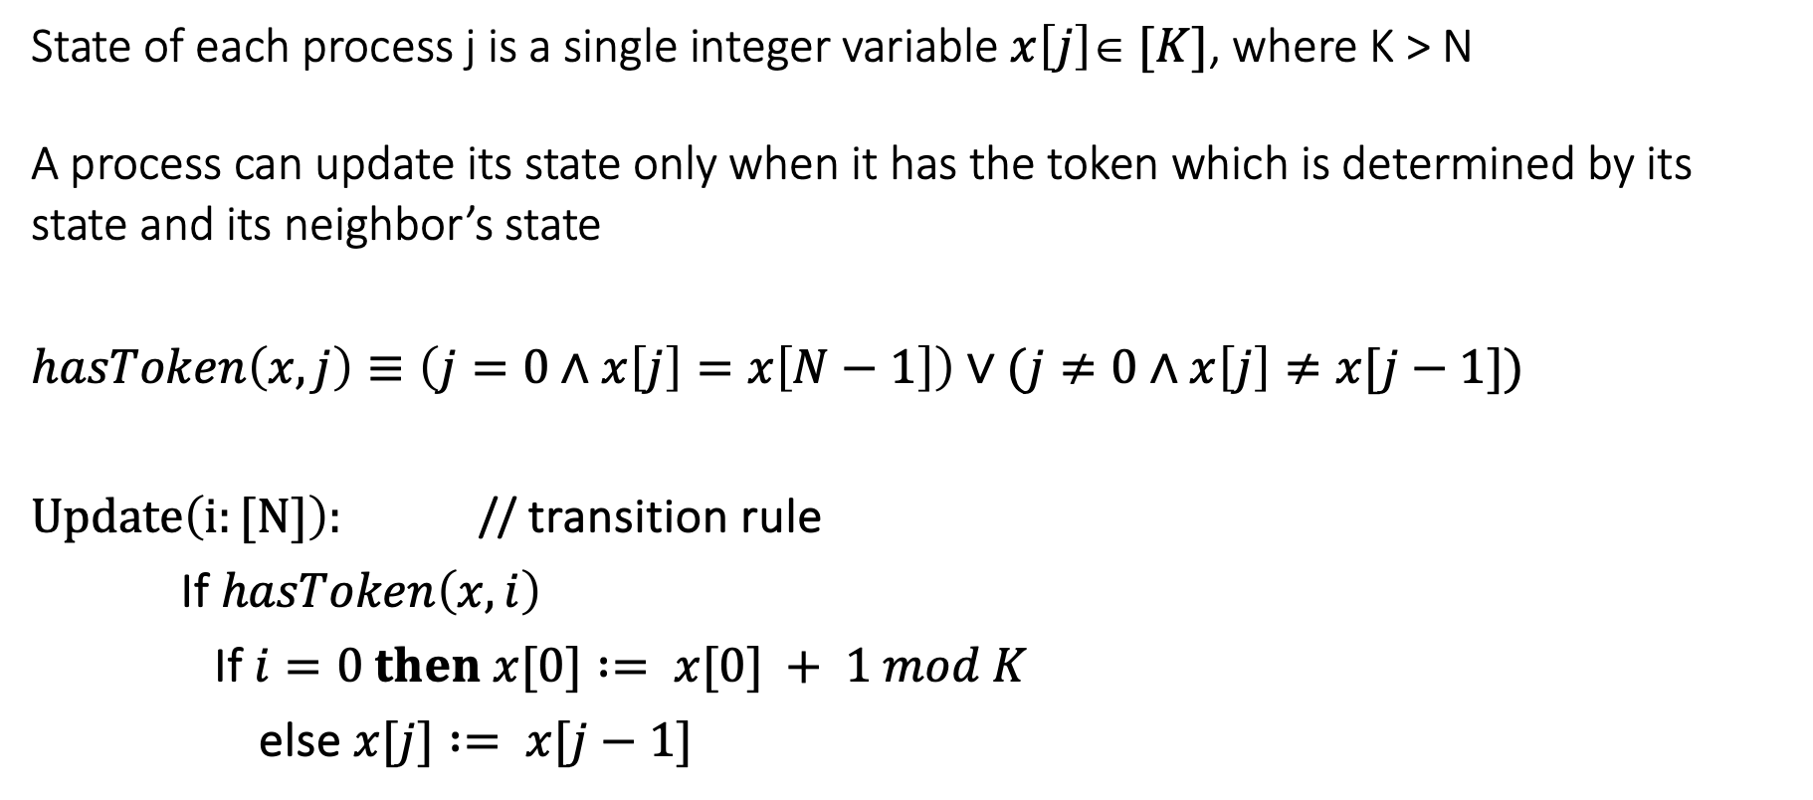
Dijkstra’s Algorithm [‘74]
State of each process j is a single integer variable $x\left[j\right]∈ [K]$, where K > N
A process can update its state only when it has the token which is determined by its state and its neighbor’s state
$$hasToken\left(x,j\right)≡\left(j=0∧x\left[j\right]=x\left[N−1\right]\right)∨(j≠0∧x\left[j\right]≠x[j−1])$$
$Update\left(i:[N]\right):$ // transition rule
If $hasToken\left(x,i\right)$
If $i=0 then x[0] := x[0] + 1 mod K$
else $x[j] := x[j−1]$

Slide 6
Sample executions: from a legal state (single token)
…
…
…
…

Slide 7
Execution from an illegal state
Legal in single “step”
Legal in two steps

Slide 8
Synchronous model: All processes update simultaneously
def has_token(x, i, N):
"""Return True if process i has the token."""
if i == 0:
return x[0] == x[N - 1]
else:
return x[i] != x[i - 1]
def simulate(N, K, T, delta_t):
x = [0]*N
while t <= T:
x_old = x.copy() // Update
for i in range(N):
if has_token(x_old, i, N):
if i == 0:
x[i] = (x_old[0] + 1) % K
else:
x[i] = x_old[i - 1]

Slide 9
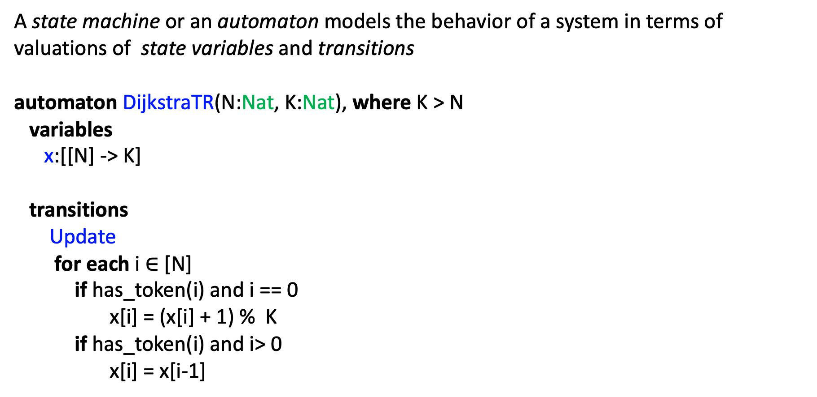
Synchronous state machine
A state machine or an automaton models the behavior of a system in terms of valuations of state variables and transitions
automaton DijkstraTR(N:Nat, K:Nat), where K > N
variables
x:[[N] -> K]
transitions
Update
for each i $∈$[N]
if has_token(i) and i == 0
x[i] = (x[i] + 1) % K
if has_token(i) and i> 0
x[i] = x[i-1]

Slide 10
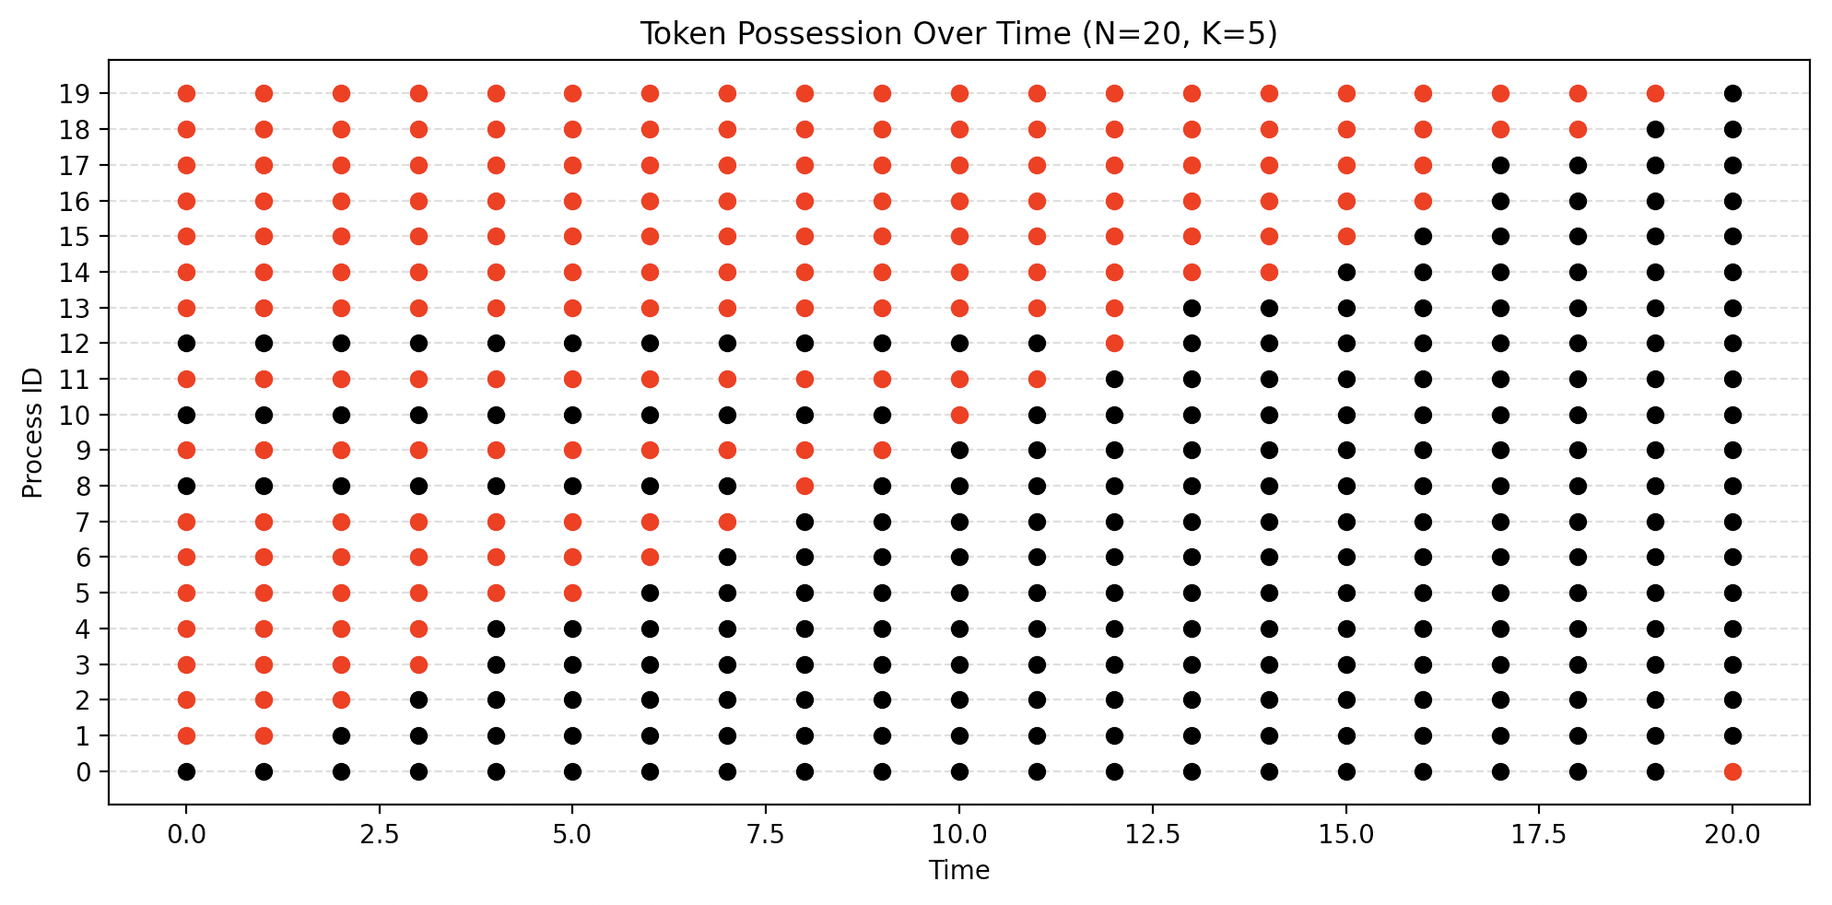
Synchronous Token Ring

Slide 11
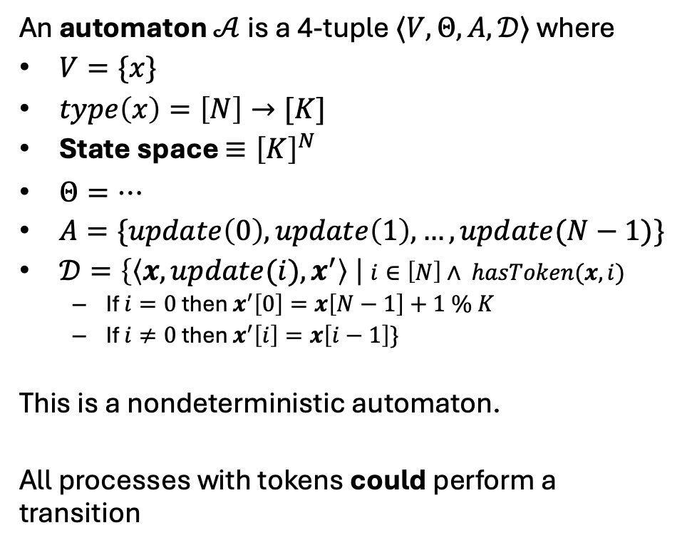

Asynchronous Nondeterministic Automaton
We will write automata precisely using this style
automaton DijkstraTR(N:$ℕ$, K: $ℕ$), where K > N
variables
x:[[N] -> [K]]
actions
update(i:[N])
transitions
Update(p=0)
Pre has_token(i) and i== p
Eff x[i] = (x[i] + 1) % K
Update(p>0)
Pre has_token(i) and i == p
Eff x[i] = x[i-1]
An automaton $𝒜$is a 4-tuple $〈V,Θ, A, 𝒟〉$ where
$V=\{x\}$
$type\left(x\right)=\left[N\right]→[K]$
State space $≡{\left[K\right]}^{N}$
$Θ=…$
$A=\{update\left(0\right), update\left(1\right),…,update(N−1)\}$
$𝒟=\left\{\left\langle x,{update(i), x}^{′}\right\rangle \right| i∈\left[N\right]∧ hasToken(x,i)$
If $i=0$ then $x^{′}\left[0\right]=x\left[N−1\right]+1 \% K$
If $i≠0$ then $x^{′}\left[i\right]=x\left[i−1\right]\}$
This is a nondeterministic automaton.
All processes with tokens could perform a transition

Slide 12
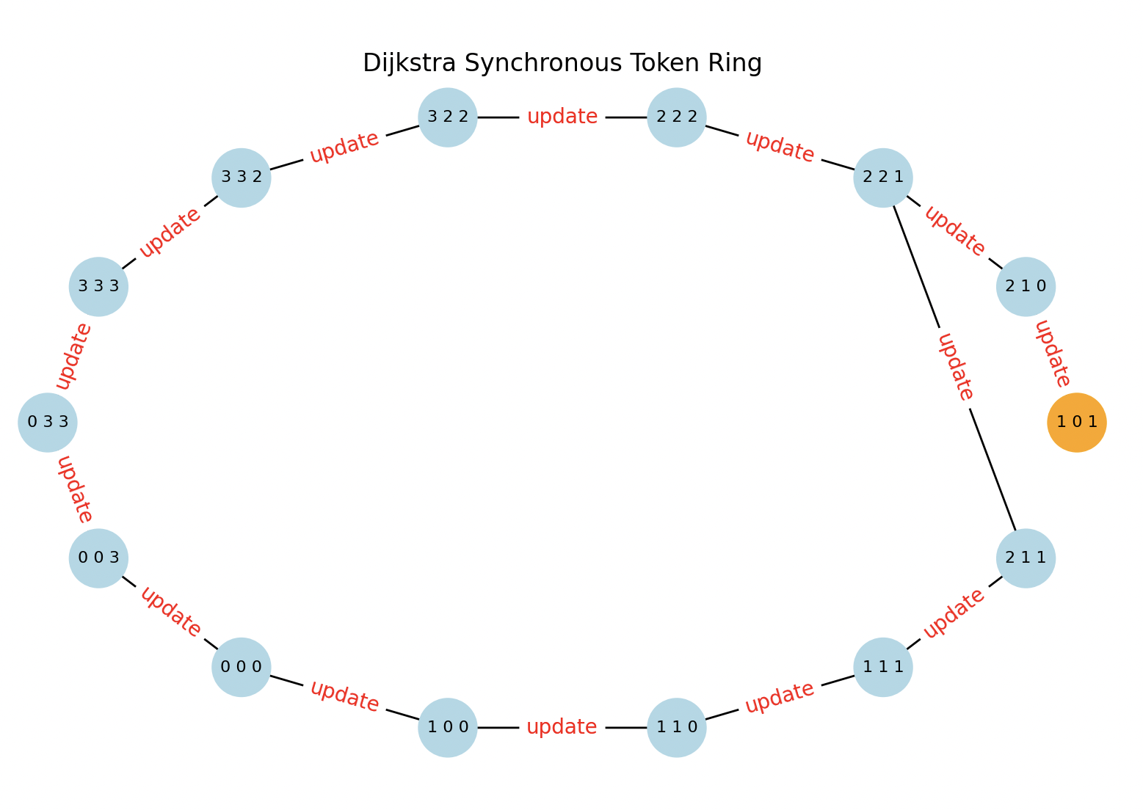

Slide 13
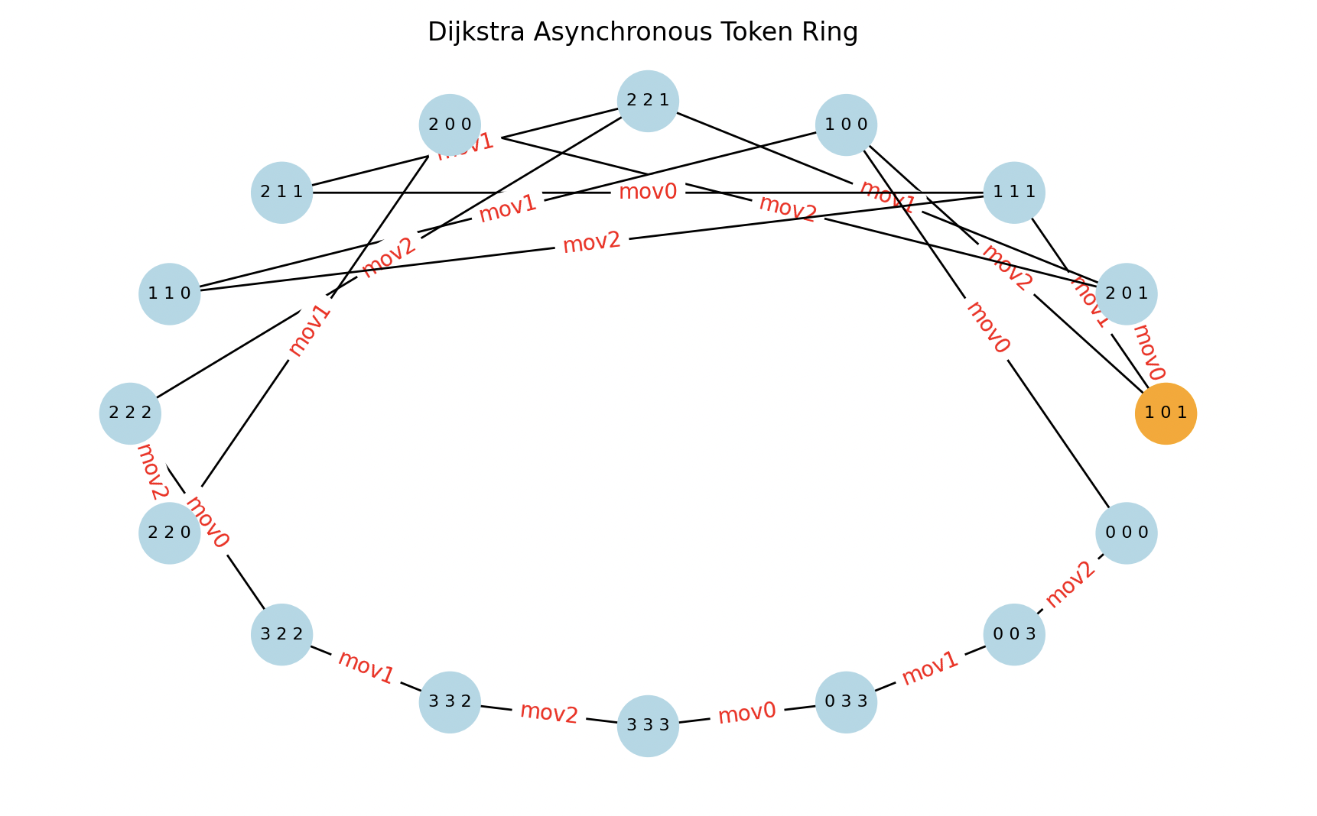
Nondeterministic execution

Slide 14
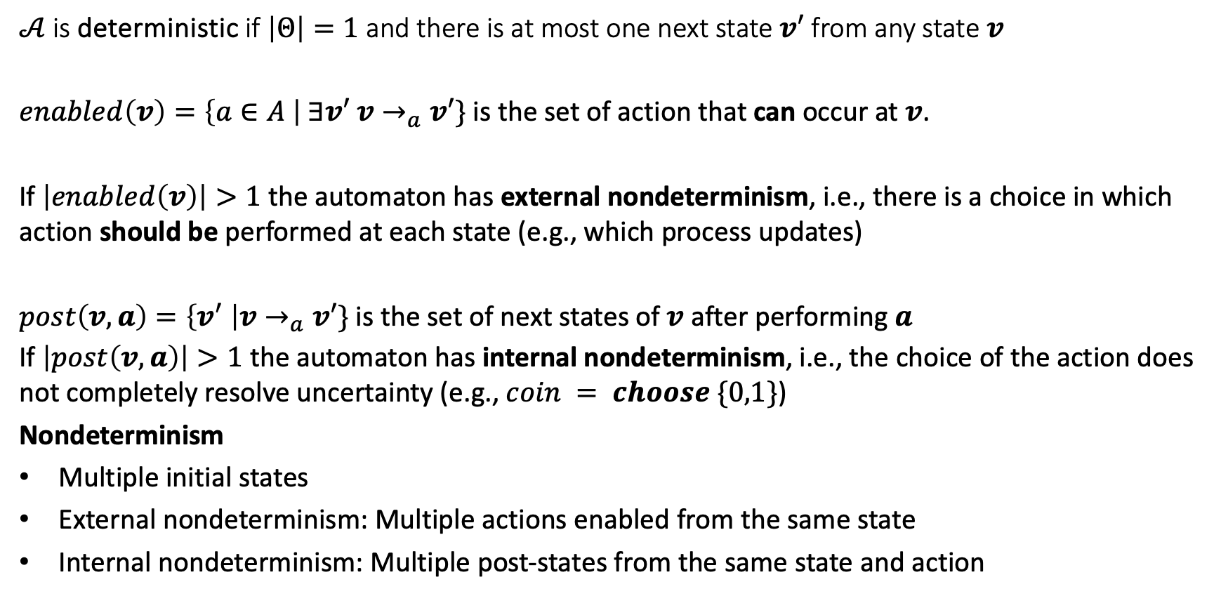
Internal and External Nondeterminism
$𝒜$is deterministic if $\left|Θ\right|=1$ and there is at most one next state $v′$ from any state $v$
$enabled\left(v\right)=\left\{a∈A \right| ∃v′$ $v→_{a}v′\}$ is the set of action that can occur at $v$.
If $\left|enabled\left(v\right)\right|>1$the automaton has external nondeterminism, i.e., there is a choice in which action should be performed at each state (e.g., which process updates)
$post\left(v,a\right)=\left\{v^{′} \right|v→_{a}v′\}$ is the set of next states of $v$ after performing $a$
If $\left|post\left(v,a\right)\right|>1$ the automaton has internal nondeterminism, i.e., the choice of the action does not completely resolve uncertainty (e.g., $coin = choose \{0,1\}$)
Nondeterminism
Multiple initial states
External nondeterminism: Multiple actions enabled from the same state
Internal nondeterminism: Multiple post-states from the same state and action

Slide 15
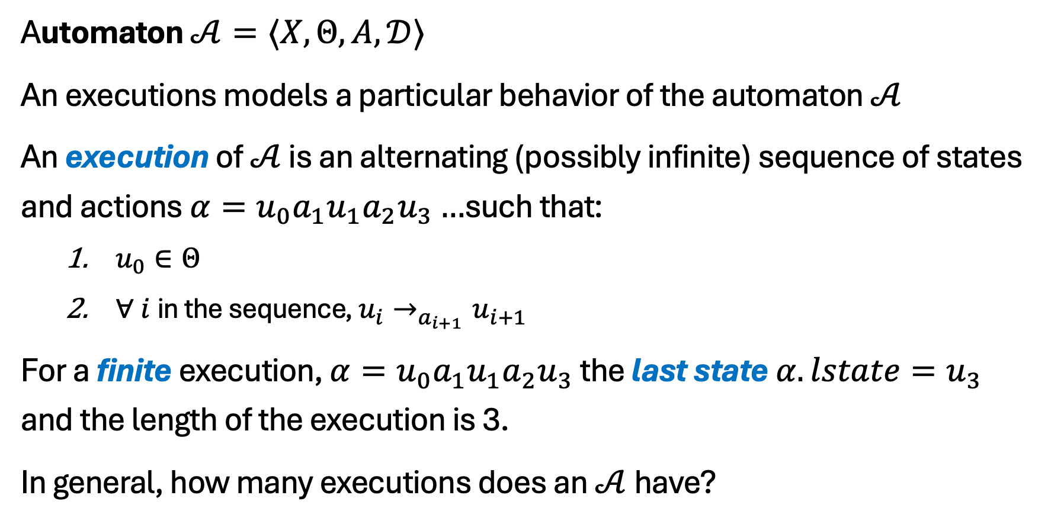
Executions, Reachability, and Invariants
Automaton $𝒜=〈X,Θ, A, 𝒟〉$
An executions models a particular behavior of the automaton $𝒜$
An execution of $𝒜$ is an alternating (possibly infinite) sequence of states and actions $α=u_{0}a_{1}u_{1}a_{2}u_{3}…$such that:
$u_{0}∈Θ$
$∀ i$in the sequence, $u_{i}→_{a_{i+1}}u_{i+1}$
For a finite execution, $α=u_{0}a_{1}u_{1}a_{2}u_{3}$ the last state $α.lstate=u_{3}$ and the length of the execution is 3.
In general, how many executions does an $𝒜$have?

Slide 16
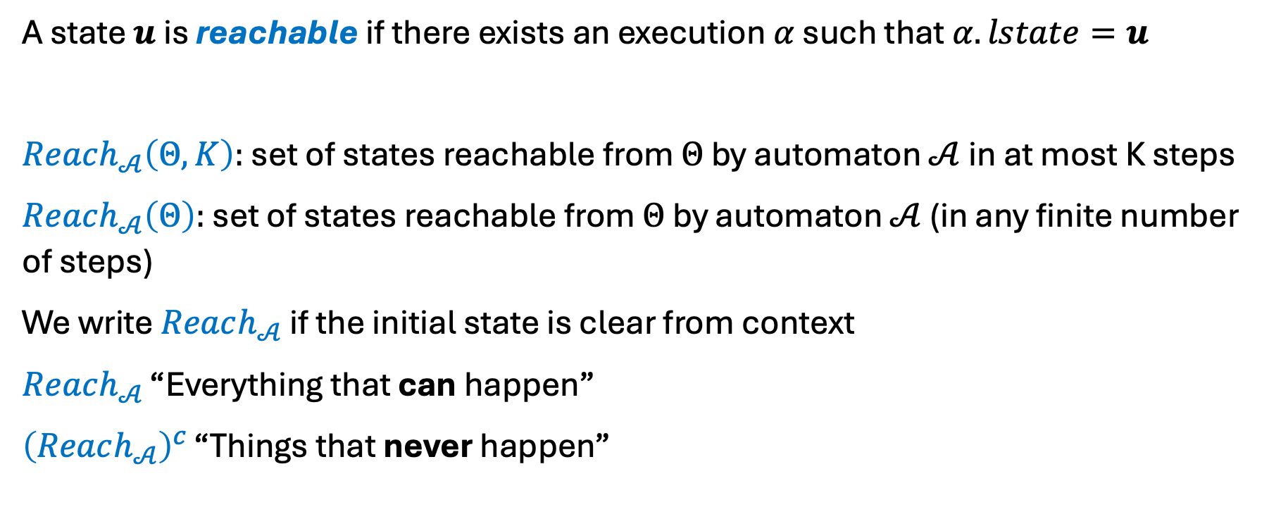
Reachable states and invariants
A state $u$ is reachable if there exists an execution $α$ such that $α.lstate=u$
$Reach_{𝒜}\left(Θ,K\right):$ set of states reachable from $Θ$ by automaton $𝒜$ in at most K steps
$Reach_{𝒜}\left(Θ\right):$ set of states reachable from $Θ$ by automaton $𝒜$ (in any finite number of steps)
We write $Reach_{𝒜}$ if the initial state is clear from context
$Reach_{𝒜}$ “Everything that can happen”
${\left(Reach_{𝒜}\right)}^{c}$ “Things that never happen”

Slide 17
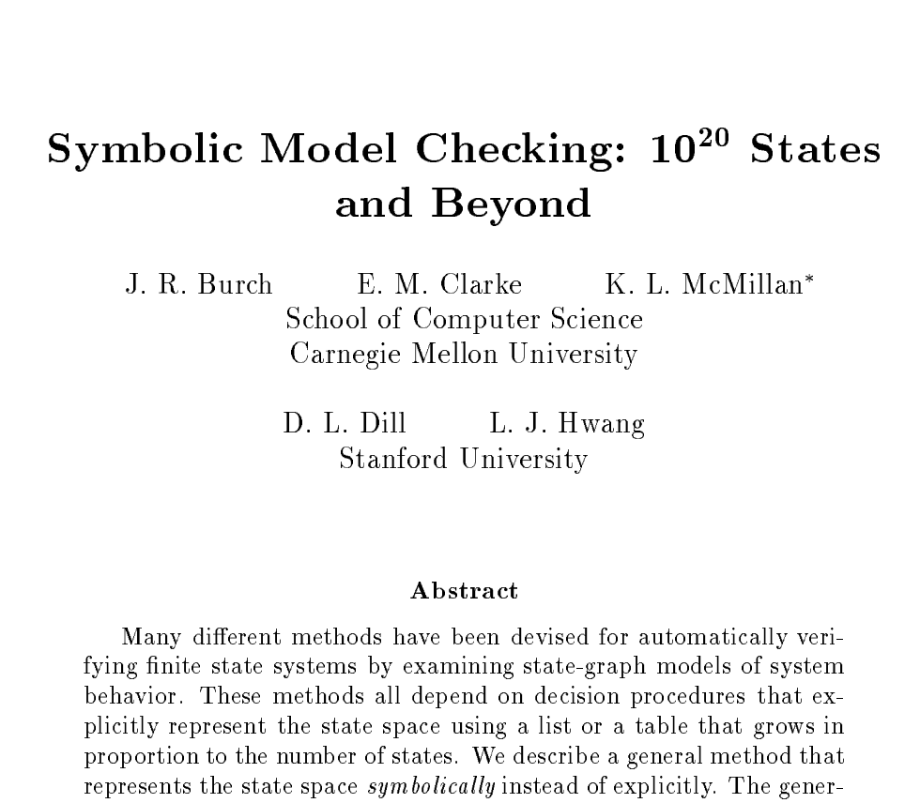
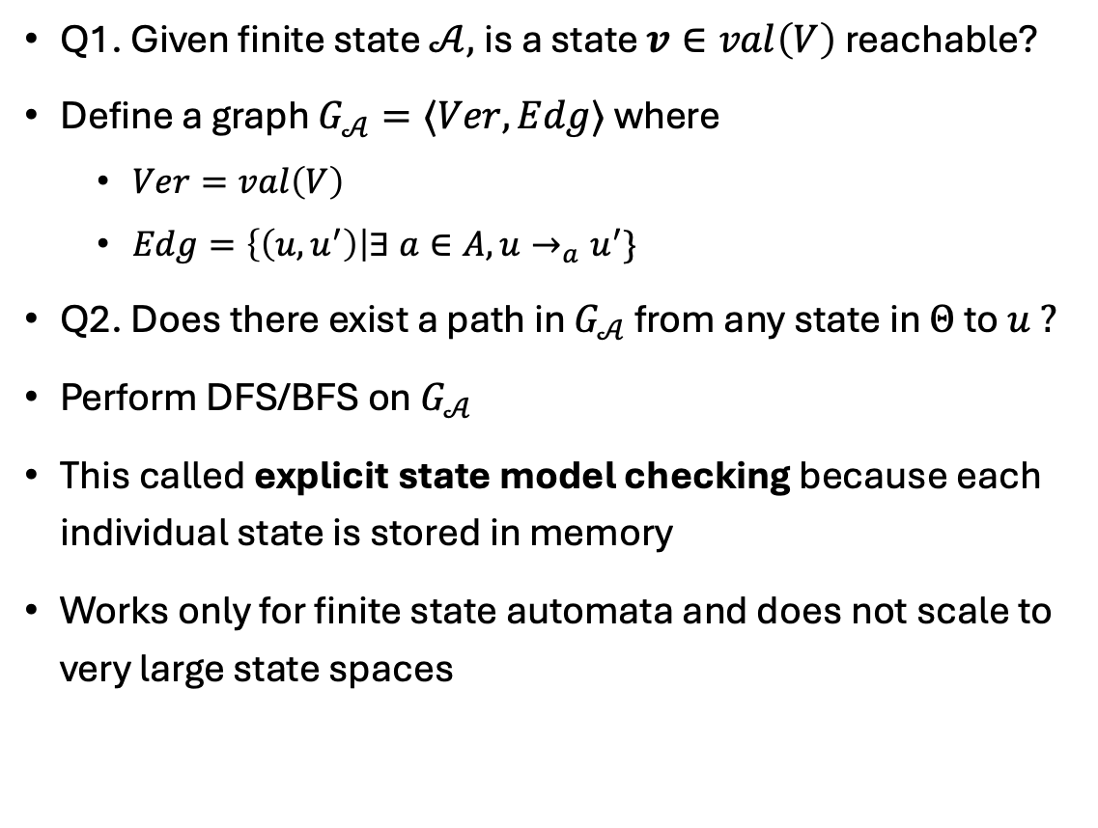
Reachability as graph search
Q1. Given finite state $𝒜,$is a state $v∈val\left(V\right)$ reachable?
Define a graph $G_{𝒜}=〈Ver,Edg〉$ where
$Ver=val\left(V\right)$
$Edg=\left\{\left(u,u^{′}\right)\right|∃ a∈A, u→_{a}u^{′}\}$
Q2. Does there exist a path in $G_{𝒜}$ from any state in $Θ$ to $u ?$
Perform DFS/BFS on $G_{𝒜}$
This called explicit state model checking because each individual state is stored in memory
Works only for finite state automata and does not scale to very large state spaces
Notes:
hundred quintillion

Slide 18
Perspectives on scalability
Solution does not scale
This is perfect!
Yay, decidable!
O(n)
O(n)
O(2^{n})
data scientist
algorithmist
verification engineer
Notes:
Roshomon

Slide 19
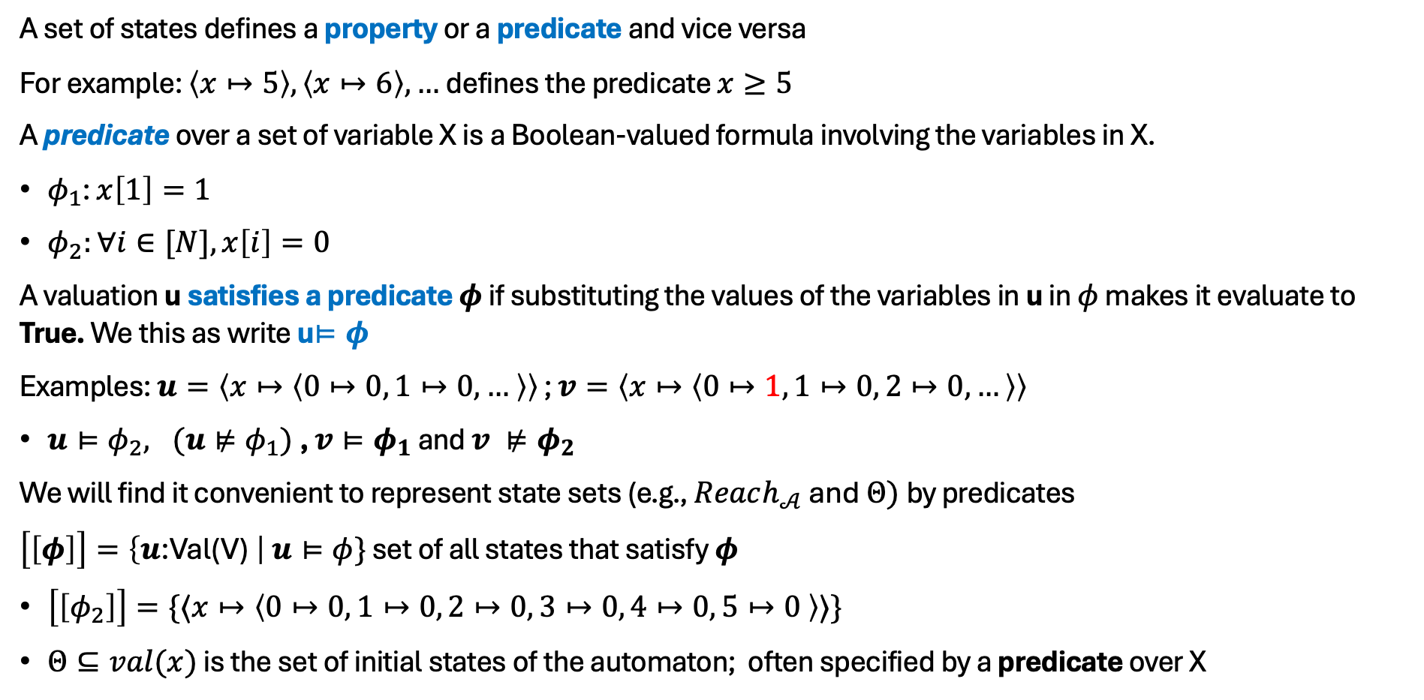
Sets of states are symbolic properties or predicates
A set of states defines a property or a predicate and vice versa
For example: $\left\langle x↦5\right\rangle ,\left\langle x↦6\right\rangle ,…$defines the predicate $x≥5$
A predicate over a set of variable X is a Boolean-valued formula involving the variables in X.
$φ_{1}$: $x\left[1\right]=1$
$φ_{2}:∀i∈[N], x\left[i\right]=0$
A valuation u satisfies a predicate $φ$ if substituting the values of the variables in u in $φ$ makes it evaluate to True. We this as write u$⊨φ$
Examples: $u=〈x↦〈0↦0, 1↦0, … 〉〉$ ; $v=〈x↦〈0↦1, 1↦0, 2↦0, …〉〉$
$u⊨φ_{2}, (u⊭φ_{1})$, $v⊨φ_{1}$ and $v ⊭φ_{2}$
We will find it convenient to represent state sets (e.g., $Reach_{𝒜}$ and $Θ)$by predicates
$\left[\left[φ\right]\right]=\left\{u\text{:}\text{Val}\text{(}\text{V}\text{)} \right| u⊨φ\}$ set of all states that satisfy $φ$
$\left[\left[φ_{2}\right]\right]=\{〈x↦〈0↦0, 1↦0, 2↦0, 3↦0, 4↦0, 5↦0 〉〉\}$
$Θ⊆val(x)$ is the set of initial states of the automaton; often specified by a predicate over X

Slide 20

Invariance
An invariant is a set of states (or a property) $I$ such that $Reach_{𝒜}⊆I$, i.e., a property that always holds
Invariants capture conservation laws

Slide 21




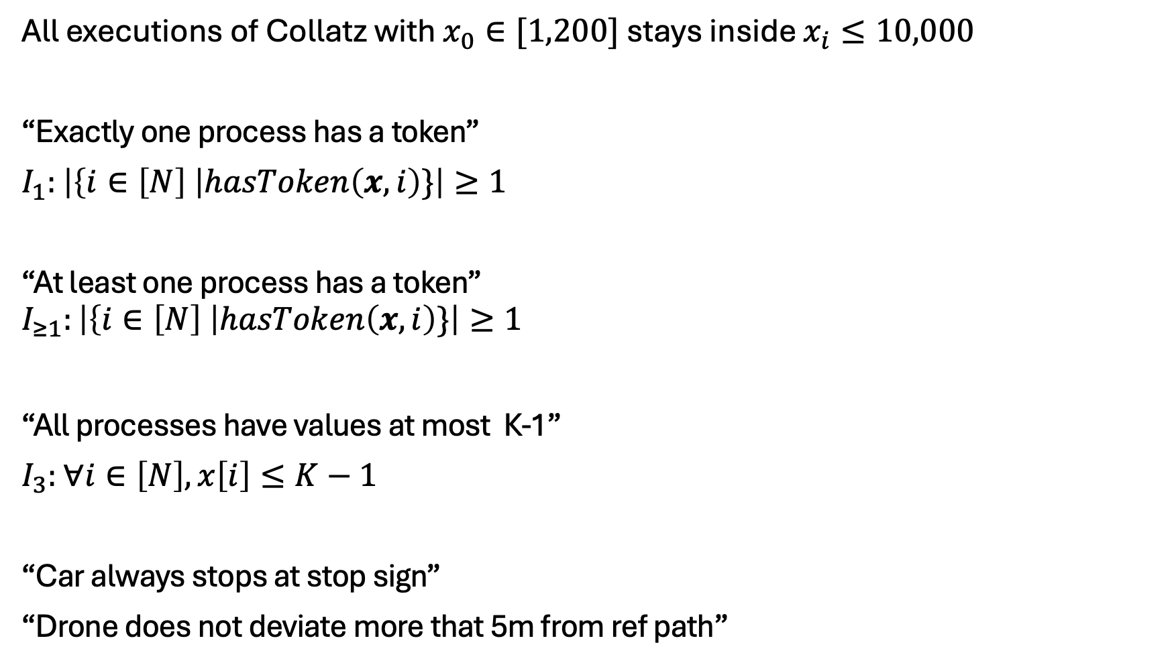
Invariants
All executions of Collatz with $x_{0}∈[1,200]$ stays inside $x_{i}≤10,000$
“Exactly one process has a token”
$I_{1}:$ $\left|\left\{i∈\left[N\right] \right|hasToken\left(x,i\right)\}\right|≥1$
“At least one process has a token”
$$I_{≥1}:\left|\left\{i∈\left[N\right] \right|hasToken\left(x,i\right)\}\right|≥1$$
“All processes have values at most K-1”
$I_{3}:$ $∀i∈\left[N\right], x\left[i\right]≤K−1$
“Car always stops at stop sign”
“Drone does not deviate more that 5m from ref path”
val(X): All states e.g. $I_{3}$
Invariant e.g. $I_{≥1}$
$${Reach}_{𝒜}(Θ)$$
$$Θ$$

Slide 22
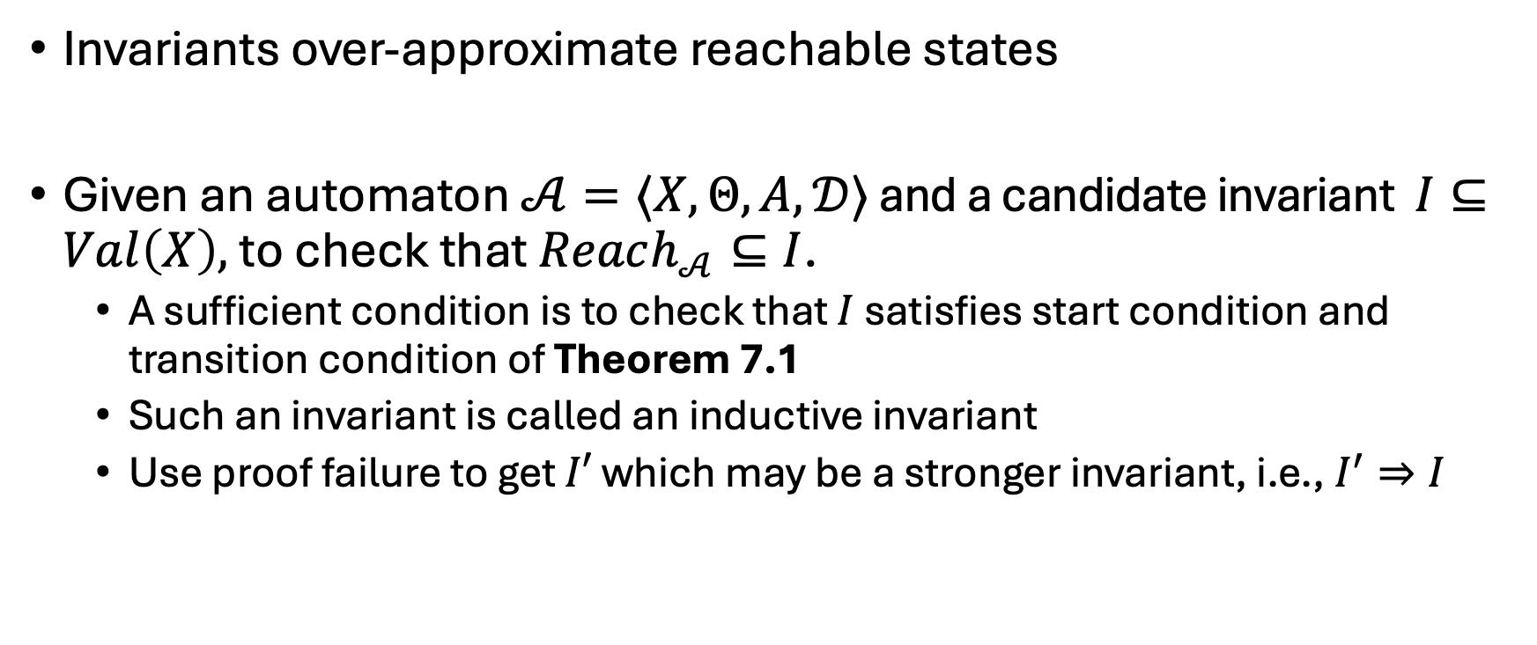
Summary
Invariants over-approximate reachable states
Given an automaton $𝒜=〈X,Θ, A, 𝒟〉$ and a candidate invariant $I⊆Val\left(X\right),$ to check that $Reach_{𝒜}⊆I$.
A sufficient condition is to check that $I$ satisfies start condition and transition condition of Theorem 7.1
Such an invariant is called an inductive invariant
Use proof failure to get $I′$ which may be a stronger invariant, i.e., $I^{′}⇒I$

Slide 23
Assignments
Read. Modeling computation: Chapter 2 of CPSBook, first part of Chapter 7, and section on SAT/SMT
Form team (optional*) and go through Project Jumpstart exercise
Next: Satisfiability

