Slide 1
Lecture 6: Satisfiability modulo theories Part 2: DPLL(T) and Simplex Algorithm
Sayan Mitra
Slides adapted from Prof. Huan Zhang’s slides in Spring 2025

Slide 2
Today
SMT (continued)
Difference Logic
Decision procedure for Linear Real Arithmetic
Simplex Algorithm [Dantzig 1947]
Next 2 - 3 weeks: Verification of Neural Networks and Machine Learning

Slide 3
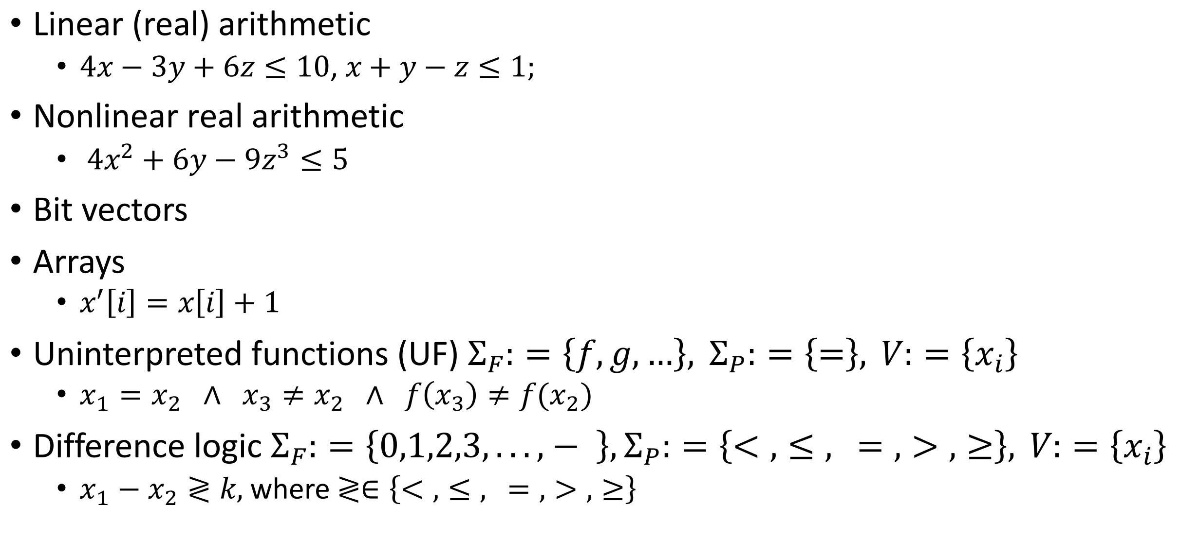
Review: theories in SMT
Linear (real) arithmetic
$4x−3y+6z≤10$, $x+y−z≤1;$
Nonlinear real arithmetic
$4x^{2}+6y−9z^{3}≤5$
Bit vectors
Arrays
$x^{′}\left[i\right]=x\left[i\right]+1$
Uninterpreted functions (UF) $Σ_{F}:=\left\{f,g,…\right\}, Σ_{P}:=\left\{=\right\}, V:=\left\{x_{i}\right\}$
$x_{1}=x_{2} ∧ x_{3}≠x_{2} ∧ f\left(x_{3}\right)≠f(x_{2})$
Difference logic $Σ_{F}:=\left\{0,1,2,3,...,− \right\},Σ_{P}:=\left\{<,≤, =,>,≥\right\}, V:=\left\{x_{i}\right\}$
$x_{1}−x_{2}≷k,$ where $≷∈\left\{<,≤, =,>,≥\right\}$

Slide 4
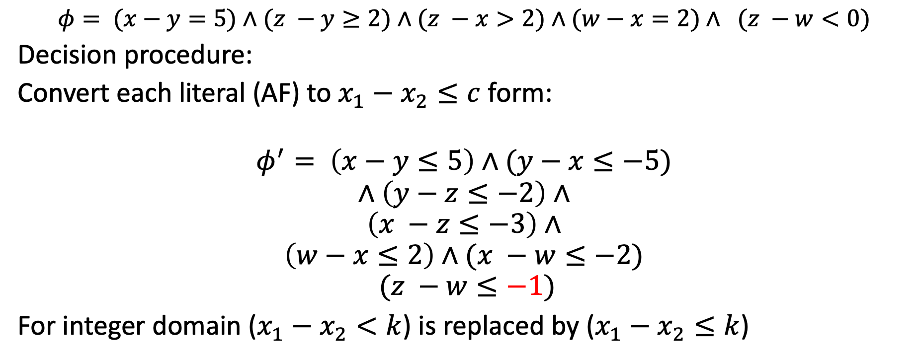
Example decision procedure 1: Difference logic
$$φ= (x−y=5)∧(z −y≥2)∧(z −x>2)∧(w−x=2)∧ (z −w<0)$$
Decision procedure:
Convert each literal (AF) to $x_{1}−x_{2}≤c$ form:
$$φ^{′}= \left(x−y≤5\right)∧(y−x≤−5)$$
$$∧\left(y−z≤−2\right)∧$$
$$\left(x −z≤−3\right)∧$$
$$\left(w−x≤2\right)∧(x −w≤−2)$$
$$(z −w≤−1)$$
For integer domain ($x_{1}−x_{2}<k$) is replaced by ($x_{1}−x_{2}≤k$)

Slide 5







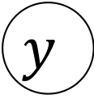

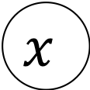


$$φ^{′}= \left(x−y≤5\right)∧(y−x≤−5)$$
$$∧\left(y−z≤−2\right)∧$$
$$\left(x −z≤−3\right)∧$$
$$\left(w−x≤2\right)∧(x −w≤−2)$$
$$(z −w≤−1)$$
Construct a graph with edge from $x→^{c}y$ for each literal $φ′$
$$y$$
$$5$$
$$−2$$
$$x$$
$$−5$$
$$z$$
$$−3$$
$$−2$$
$$2$$
$$w$$
$$−1$$

Slide 6

$$φ^{′}= \left(x−y≤5\right)∧(y−x≤−5)$$
$$∧\left(y−z≤−2\right)∧$$
$$\left(x −z≤−3\right)∧$$
$$\left(w−x≤2\right)∧(x −w≤−2)$$
$$(z −w≤−1)$$
Construct a graph $G_{φ′}$ with edge from $x→^{c}y$ for each $x−y≤c$literal $φ′$
$$y$$
$$5$$
$$−2$$
Proposition. $φ$ is satisfiable iff $G_{φ′}$is negative cycle free.
$$x$$
$$−5$$
$$z$$
$$−3$$
$$−2$$
$$2$$
$$w$$
$$−1$$

Slide 7
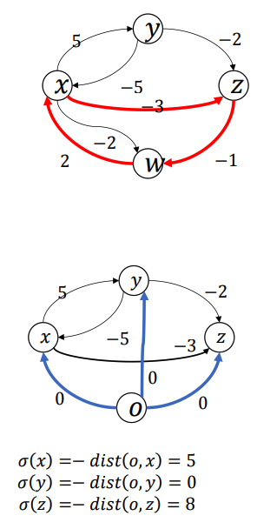
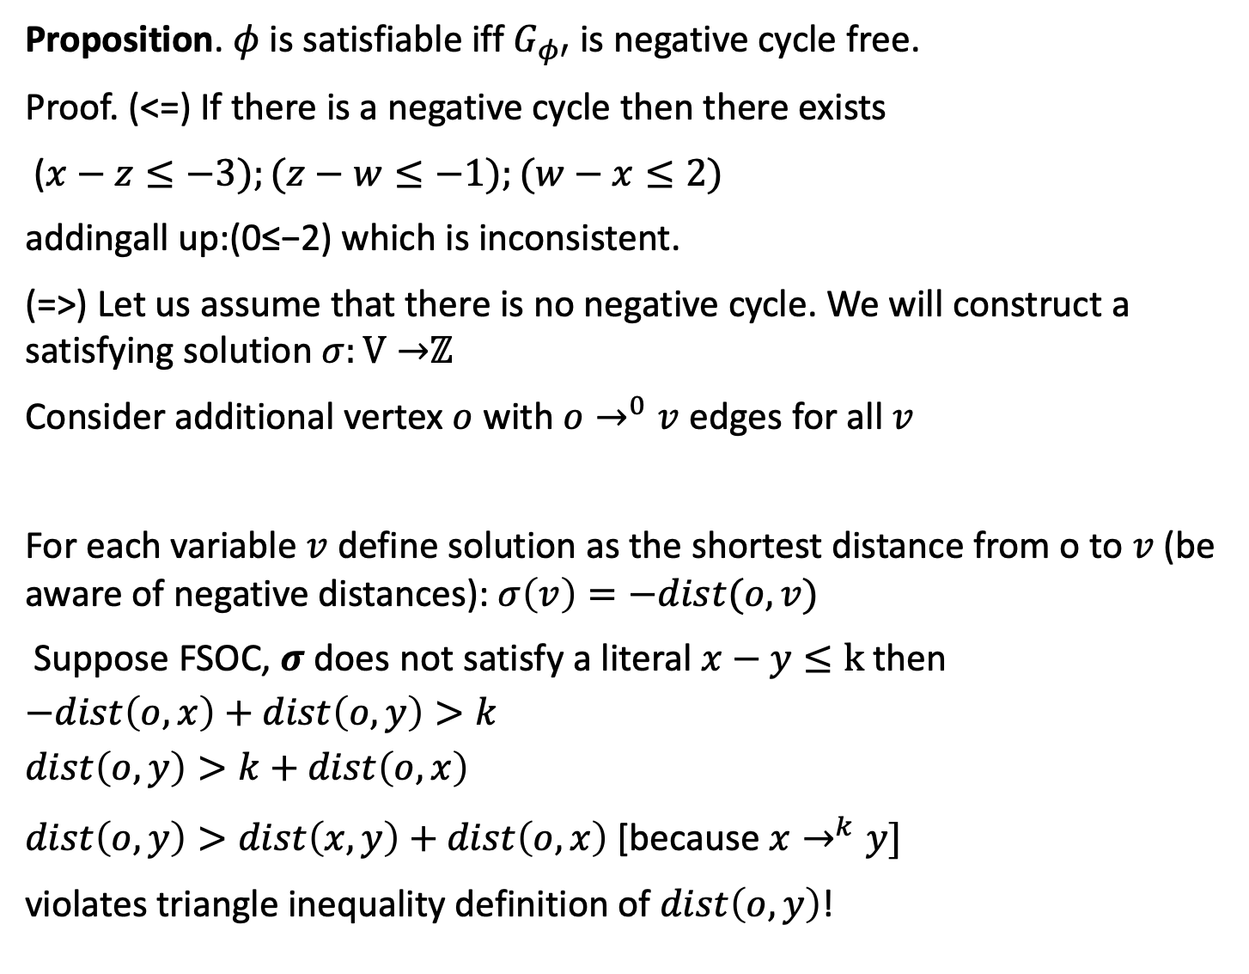
Proposition. $φ$ is satisfiable iff $G_{φ′}$ is negative cycle free.
Proof. (<=) If there is a negative cycle then there exists
($x−z≤−3);(z−w≤−1);(w−x≤2)$
addingall up:(0≤−2) which is inconsistent.
(=>) Let us assume that there is no negative cycle. We will construct a satisfying solution $σ:V→$ℤ
Consider additional vertex $o$ with $o→^{0}v$ edges for all $v$
For each variable $v$ define solution as the shortest distance from o to $v$ (be aware of negative distances): $σ\left(v\right)=−dist(o,v)$
Suppose FSOC, $σ$ does not satisfy a literal $x−y≤k$then
$$−dist\left(o,x\right)+dist\left(o,y\right)>k$$
$$dist\left(o,y\right)>k+dist\left(o,x\right)$$
$dist\left(o,y\right)>dist\left(x,y\right)+dist\left(o,x\right)$ [because $x→^{k}y]$
violates triangle inequality definition of $dist\left(o,y\right)$!

Slide 8
Decision Procedure for Difference Logic(DL)
Satisfiability check for difference procedure of DL can be performed using Bellman-Ford algorithm in time O(|V|.|E|)
Inconsistency/unsatisfiability explanations are negative cycles
Amenable to incremental check

Slide 9
DPLL^{T}:DPLL modulo theories
How can we extend DPLL to handle formulas over other theories like
Difference Logic (DL)
Uninterpreted functions (UF)
Linear Real Arithmetic (LRA)
Idea: Start with a Boolean abstraction (or skeleton) and incrementally add more theory information using decision procedure until we can conclusively say SAT or UNSAT

Slide 10
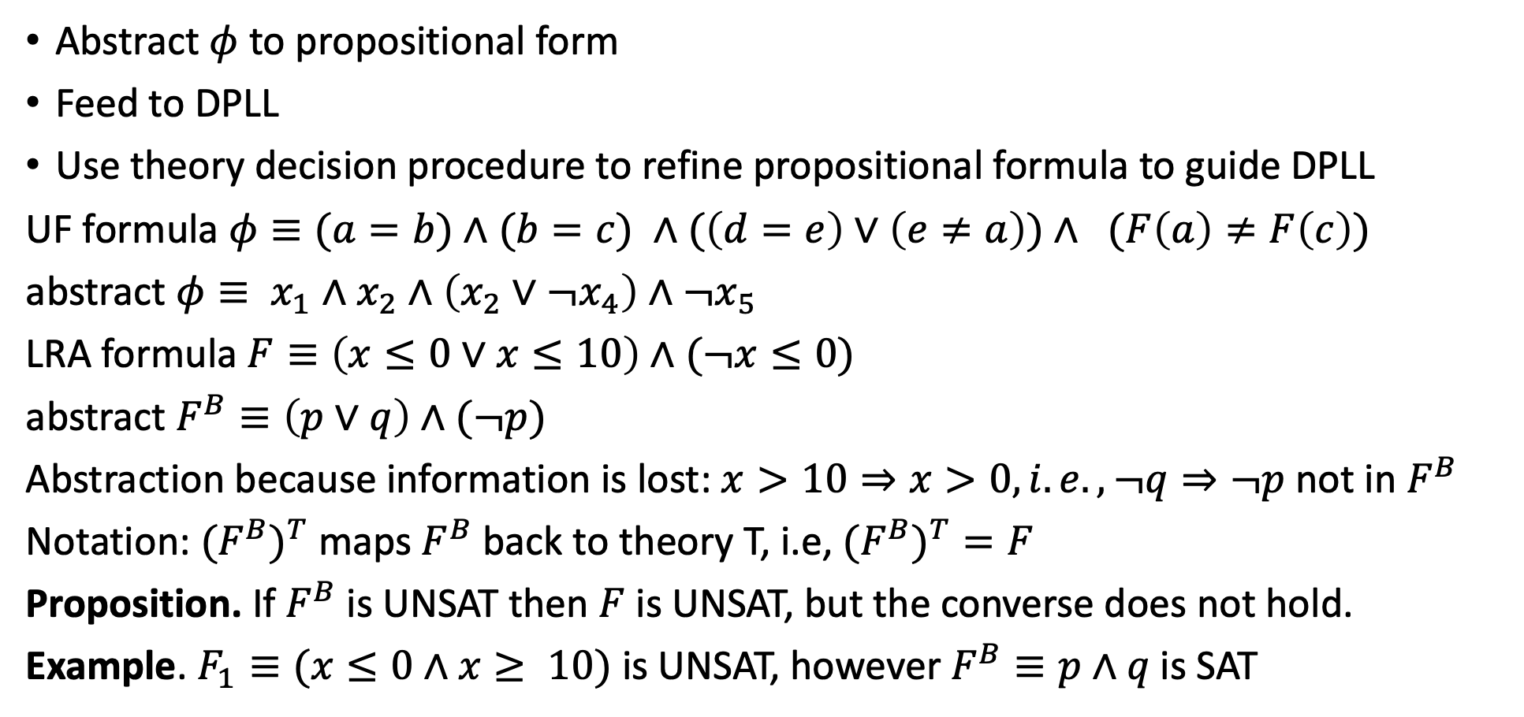
DPLL^{T}:DPLL modulo theories
Abstract $φ$ to propositional form
Feed to DPLL
Use theory decision procedure to refine propositional formula to guide DPLL
UF formula $φ≡(a=b)∧(b=c) ∧(\left(d=e\right)∨\left(e≠a\right))∧ (F\left(a\right)≠F\left(c\right))$
abstract $φ≡ x_{1}∧x_{2}∧\left(x_{2}∨¬x_{4}\right)∧¬x_{5}$
LRA formula $F≡\left(x≤0∨x≤10\right)∧(¬x≤0)$
abstract $F^{B}≡\left(p∨q\right)∧(¬p)$
Abstraction because information is lost: $x>10⇒x>0, i.e., ¬q⇒¬p$not in $F^{B}$
Notation: ${{(F}^{B})}^{T}$ maps $F^{B}$ back to theory T, i.e, ${{(F}^{B})}^{T}=F$
Proposition. If $F^{B}$ is UNSAT then $F$ is UNSAT, but the converse does not hold.
Example. $F_{1}≡(x≤0∧x≥ 10)$ is UNSAT, however $F^{B}≡p∧q$is SAT

Slide 11
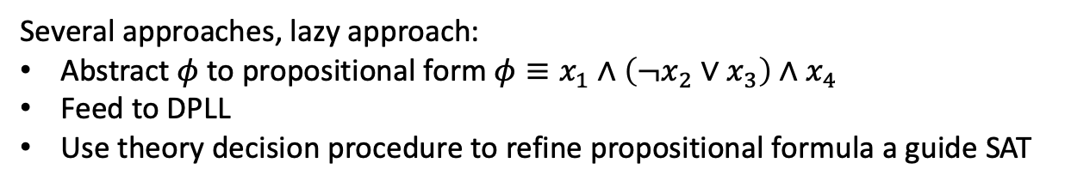
Return to SMT
$$φ≡g\left(a\right)=c∧f\left(g\left(a\right)\right)≠f\left(c\right)∨g\left(a\right)=d∧c≠d$$
Several approaches, lazy approach:
Abstract $φ$ to propositional form $φ≡x_{1}∧\left(¬x_{2}∨x_{3}\right)∧x_{4}$
Feed to DPLL
Use theory decision procedure to refine propositional formula a guide SAT
Theory solvers/decision procedures
literals/formula in
real arithmetic
boolean skeleton of problem
Arithmetic
Bitvectors
Core
DPLL
Difference logic
…
Uninterpreted functions
assertions
solution or
counterexample

Slide 12
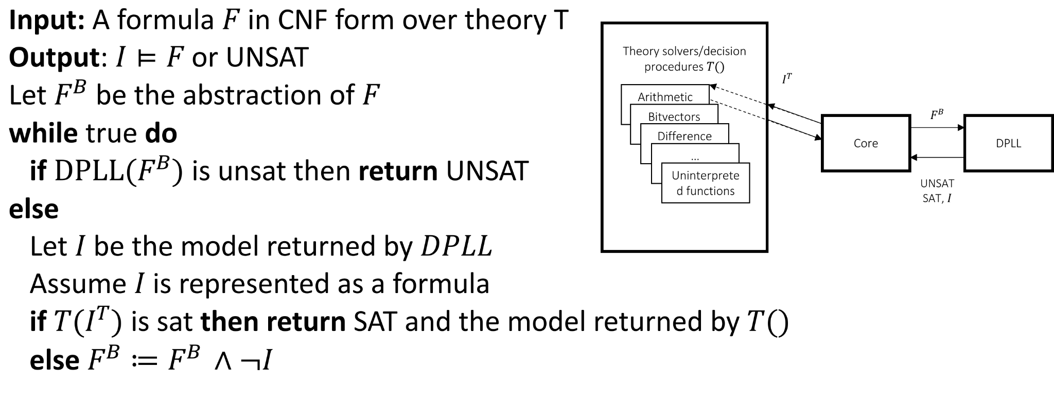
DPLL for SMT

Slide 13
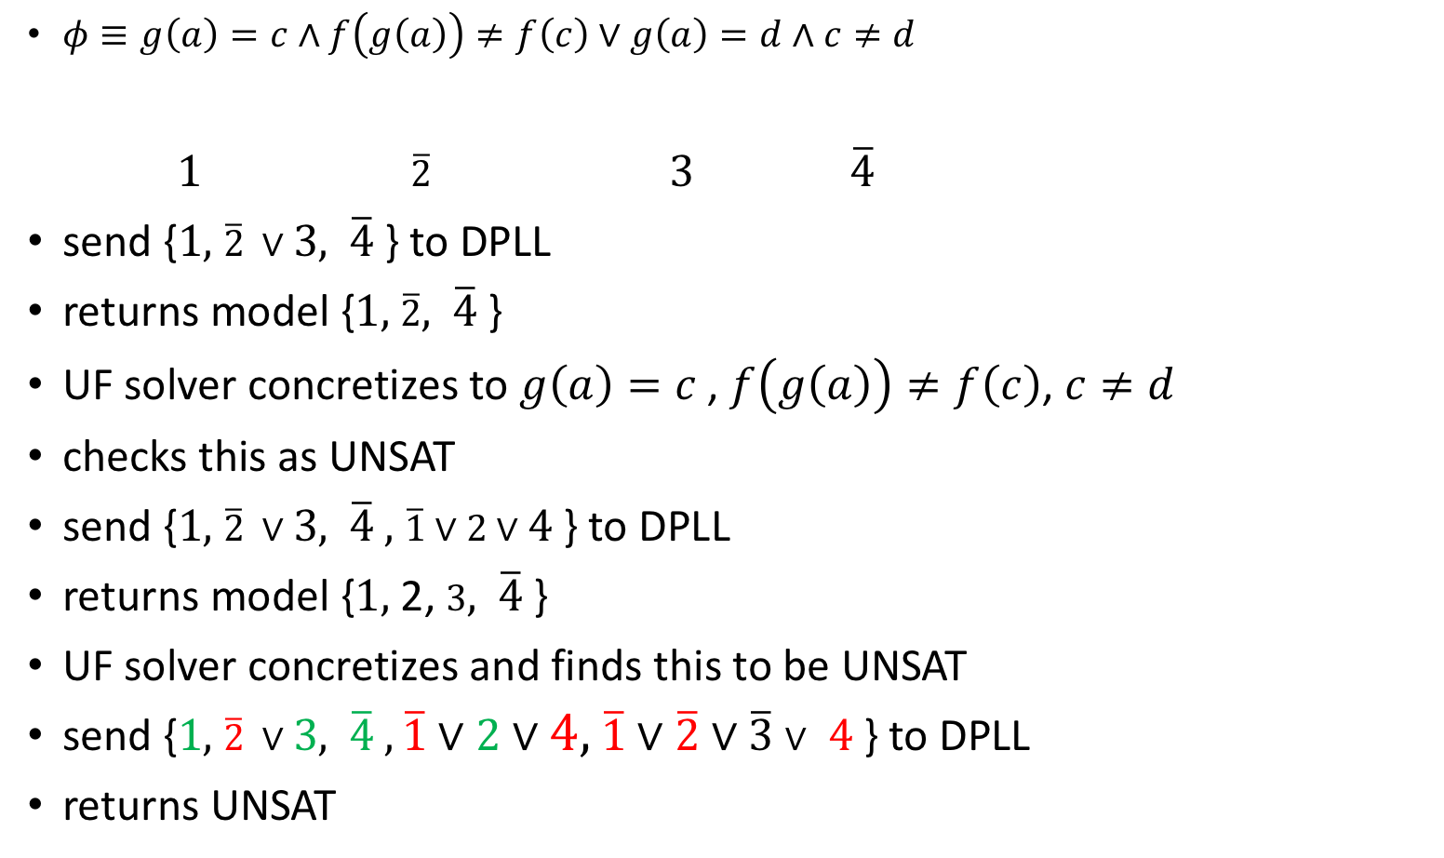
Theory solvers/decision procedures
literals/formula in
real arithmetic
boolean skeleton of problem
Arithmetic
Bitvectors
Core
DPLL
Difference logic
$φ≡g\left(a\right)=c∧f\left(g\left(a\right)\right)≠f\left(c\right)∨g\left(a\right)=d∧c≠d$
$1$ $\overline{2}$ $3$ $\overline{4}$
send {$1,$ $\overline{2} ∨3,$ $\overline{4}$} to DPLL
returns model {$1,$ $\overline{2},$ $\overline{4}$}
UF solver concretizes to $g\left(a\right)=c$, $f\left(g\left(a\right)\right)≠f\left(c\right)$, $c≠d$
checks this as UNSAT
send {$1,$ $\overline{2} ∨3,$ $\overline{4} ,$ $\overline{1}∨2∨4$} to DPLL
returns model {$1,$ 2, $3,$ $\overline{4}$}
UF solver concretizes and finds this to be UNSAT
send {$1,$ $\overline{2} ∨3,$ $\overline{4} ,\overline{1}∨2∨4,$ $\overline{1}∨\overline{2}∨\overline{3}∨$ $4$ } to DPLL
returns UNSAT
…
Uninterpreted functions
assertions
solution or
counterexample

Slide 14
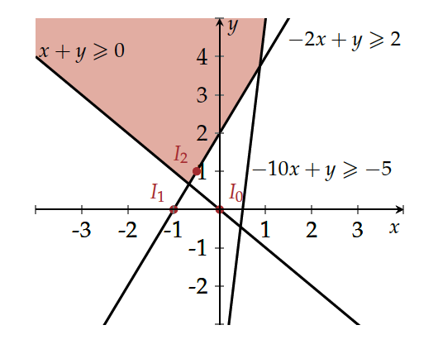
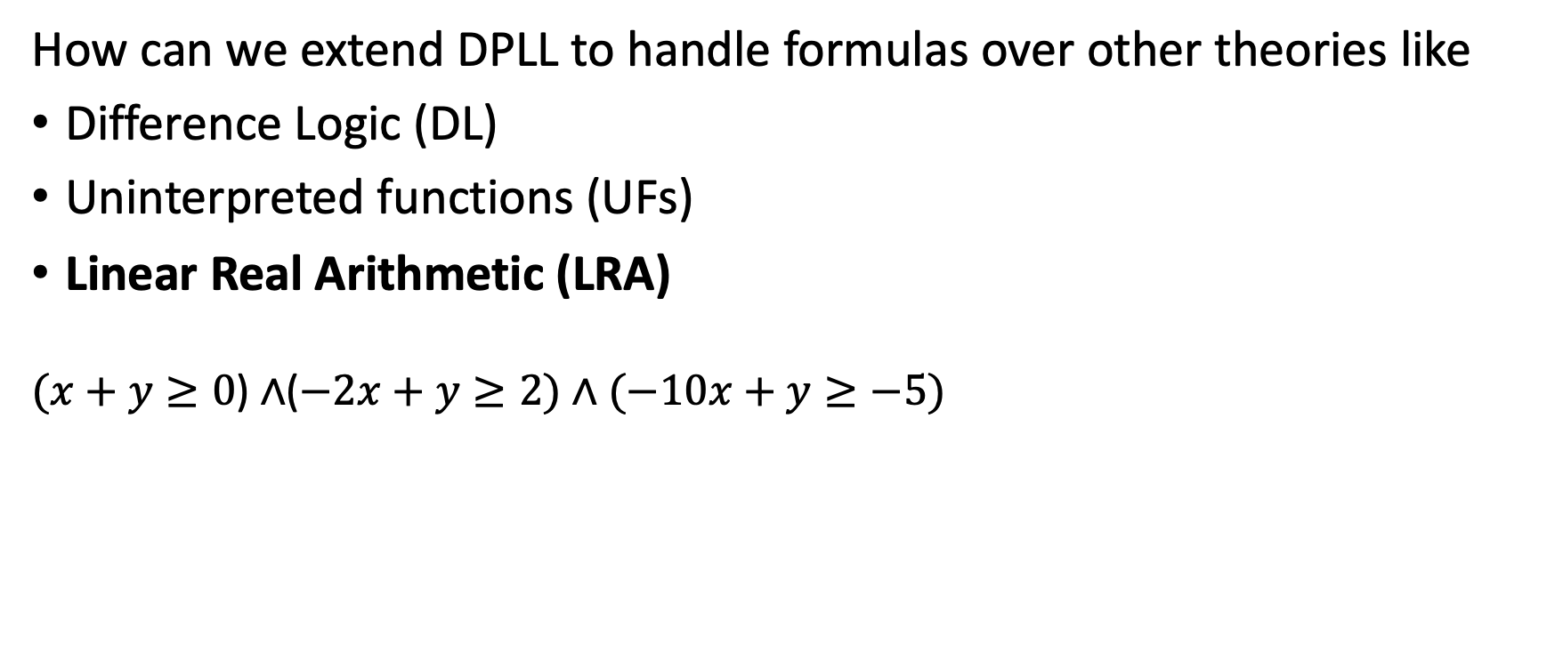
DPLL^{T:} DPLL modulo theories
How can we extend DPLL to handle formulas over other theories like
Difference Logic (DL)
Uninterpreted functions (UFs)
Linear Real Arithmetic (LRA)
($x+y≥0$) $∧$($−2x+y≥2)∧(−10x+y≥−5)$

Slide 15
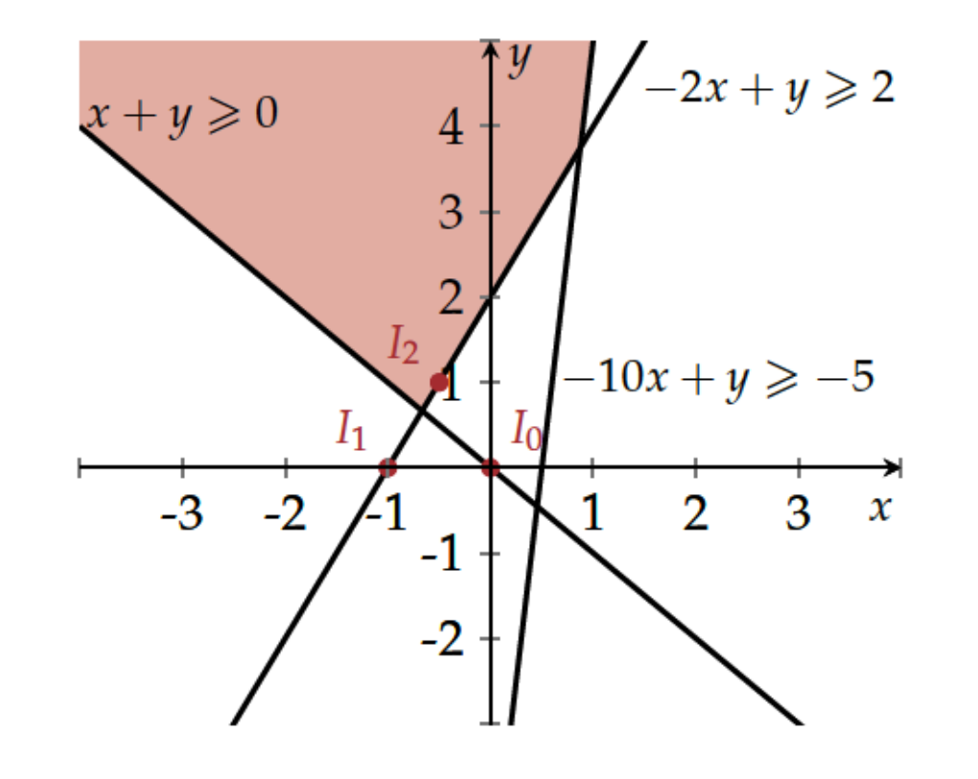
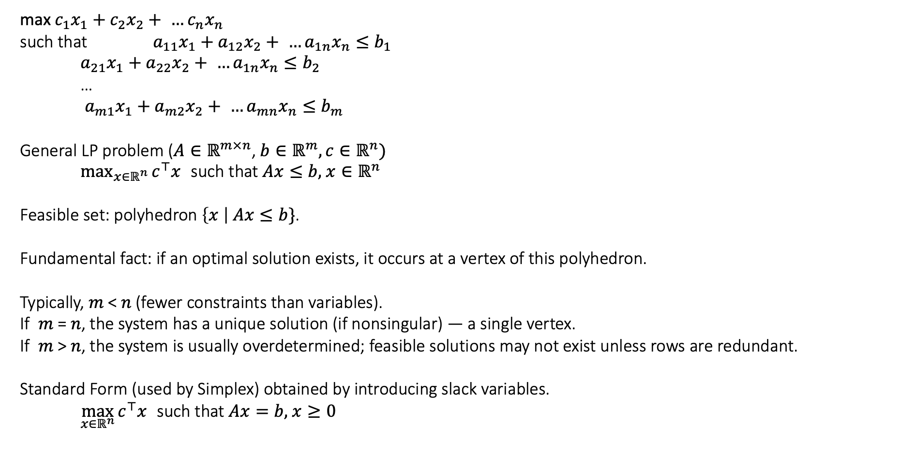
Linear Programming Setup
max $c_{1}x_{1}+c_{2}x_{2}+ …c_{n}x_{n}$
such that $a_{11}x_{1}+a_{12}x_{2}+ …a_{1n}x_{n}≤b_{1}$
$a_{21}x_{1}+a_{22}x_{2}+ …a_{1n}x_{n}≤b_{2}$
…
$a_{m1}x_{1}+a_{m2}x_{2}+ …a_{mn}x_{n}≤b_{m}$
General LP problem ($A∈ℝ^{m×n}$, $b∈ℝ^{m},c∈ℝ^{n})$
$\max_{x∈ℝ^{n}}{c^{⊤}x}$such that $Ax≤b,$ $x∈ℝ^{n}$
Feasible set: polyhedron $\left\{x \right| Ax≤b\}$.
Fundamental fact: if an optimal solution exists, it occurs at a vertex of this polyhedron.
Typically, 𝑚 < 𝑛 (fewer constraints than variables).
If 𝑚 = 𝑛, the system has a unique solution (if nonsingular) — a single vertex.
If 𝑚 > 𝑛, the system is usually overdetermined; feasible solutions may not exist unless rows are redundant.
Standard Form (used by Simplex) obtained by introducing slack variables.
$\max_{x∈ℝ^{n}}{c^{⊤}x}$such that $Ax=b,$ $x≥0$

Slide 16
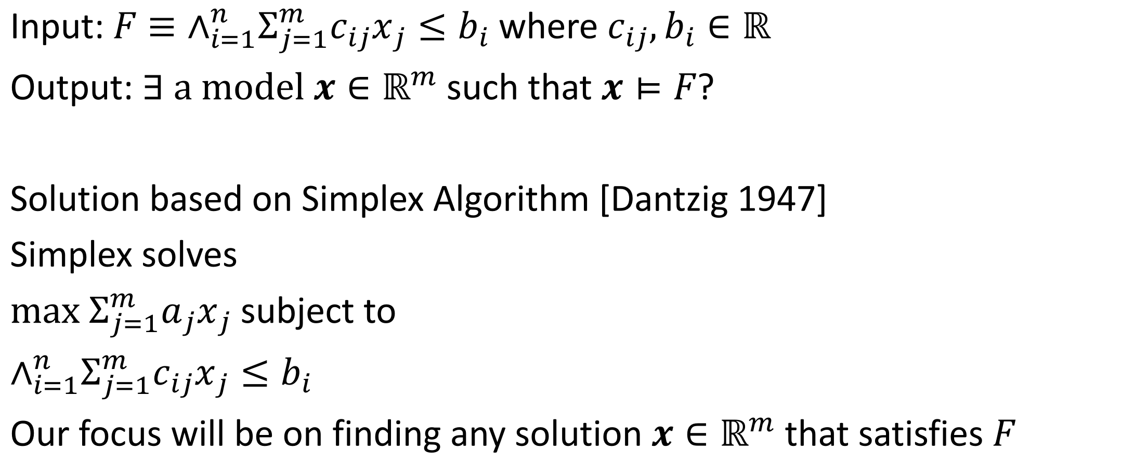
Decision Procedure for Linear Real Arithmetic
Input: $F≡∧_{i=1}^{n}Σ_{j=1}^{m}c_{ij}x_{j}≤b_{i}$ where $c_{ij},b_{i}∈ℝ$
Output: $∃ \text{a} \text{model} x∈ℝ^{m}$such that $x⊨F$?
Solution based on Simplex Algorithm [Dantzig 1947]
Simplex solves
$max Σ_{j=1}^{m}a_{j}x_{j}$ subject to
$∧_{i=1}^{n}Σ_{j=1}^{m}c_{ij}x_{j}≤b_{i}$
Our focus will be on finding any solution $x∈ℝ^{m}$ that satisfies $F$

Slide 17
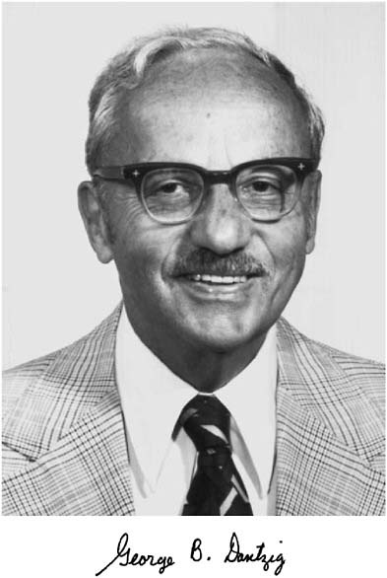
Notes:
Dantzig realized that one of the unsolved problems that he had mistaken as homework in his professor Jerzy Neyman's class (and actually later solved), was applicable to finding an algorithm for linear programs.
From: https://en.wikipedia.org/wiki/George_Dantzig#Mathematical_statistics
In 1939, a misunderstanding brought about surprising results. Near the beginning of a class, Professor Neyman wrote two problems on the blackboard. Dantzig arrived late and assumed that they were a homework assignment. According to Dantzig, they "seemed to be a little harder than usual", but a few days later he handed in completed solutions for both problems, still believing that they were an assignment that was overdue.^{[4][6]} Six weeks later, an excited Neyman eagerly told him that the "homework" problems he had solved were two of the most famous unsolved problems in statistics.
story persisted in the form of an urban legend and as an introductory scene in the movie Good Will Hunting.^{[6]}

Slide 18
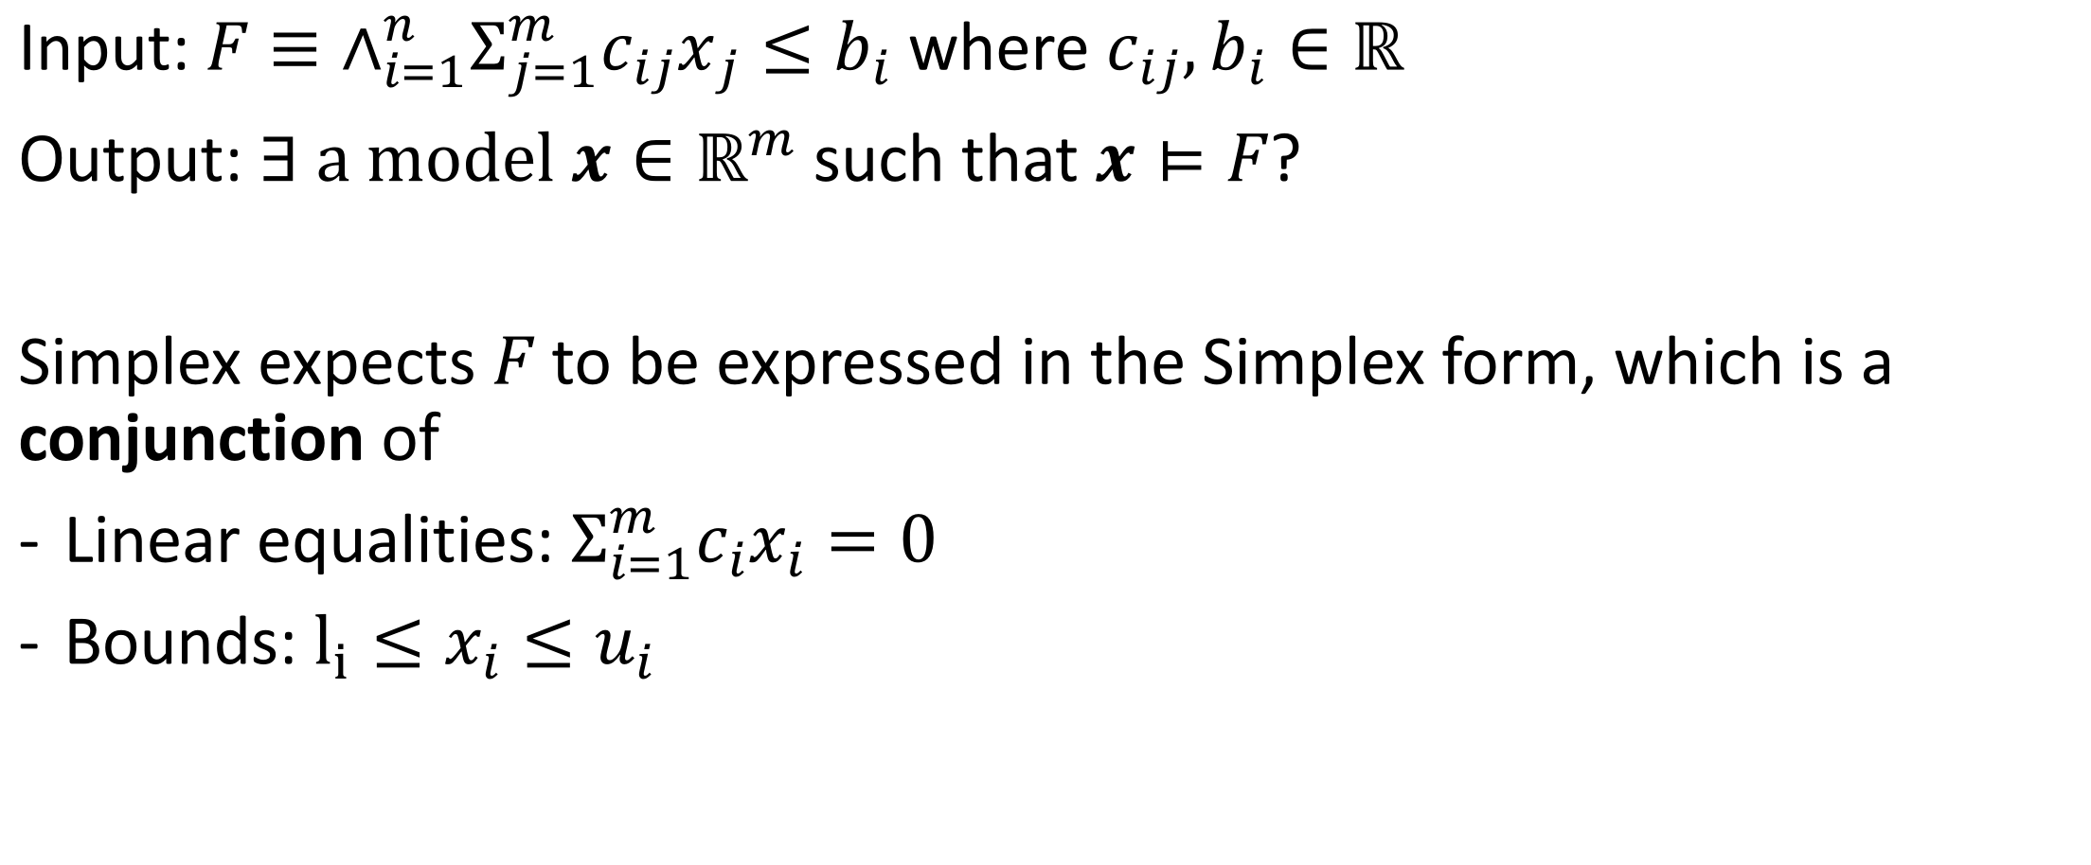
Decision Procedure for Linear Real Arithmetic
Input: $F≡∧_{i=1}^{n}Σ_{j=1}^{m}c_{ij}x_{j}≤b_{i}$ where $c_{ij},b_{i}∈ℝ$
Output: $∃ \text{a} \text{model} x∈ℝ^{m}$such that $x⊨F$?
Simplex expects $F$ to be expressed in the Simplex form, which is a conjunction of
Linear equalities: $Σ_{i=1}^{m}c_{i}x_{i}=0$
Bounds: $l_{i}≤x_{i}≤u_{i}$

Slide 19
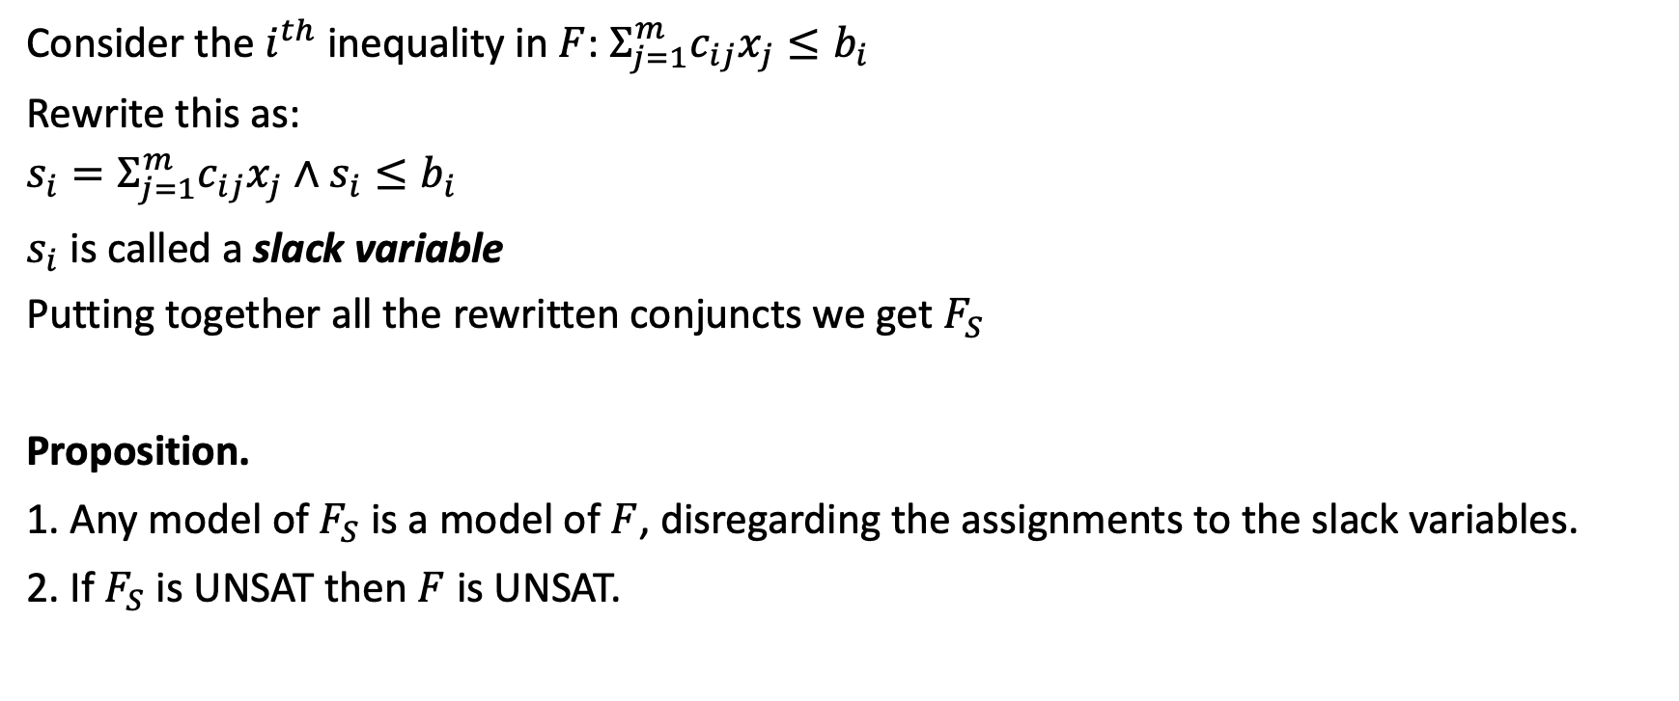
Transforming to Simplex Form
Consider the $i^{th}$ inequality in $F$: $Σ_{j=1}^{m}c_{ij}x_{j}≤b_{i}$
Rewrite this as:
$$s_{i}=Σ_{j=1}^{m}c_{ij}x_{j}∧s_{i}≤b_{i}$$
$s_{i}$ is called a slack variable
Putting together all the rewritten conjuncts we get $F_{S}$
Proposition.
1. Any model of $F_{S}$ is a model of $F$, disregarding the assignments to the slack variables.
2. If $F_{S}$ is UNSAT then $F$ is UNSAT.

Slide 20
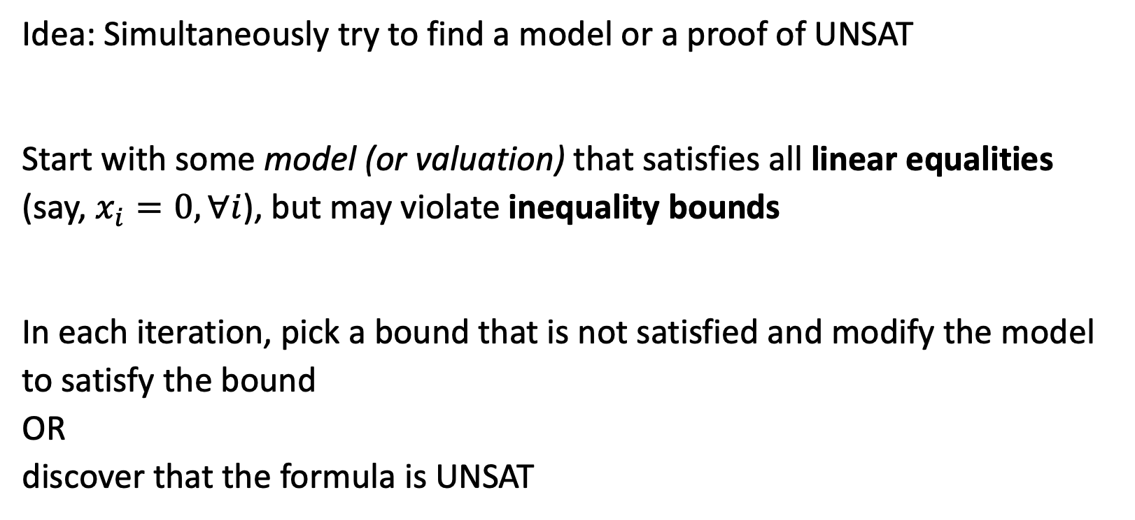
The decison procedure: simplex algorithm
Idea: Simultaneously try to find a model or a proof of UNSAT
Start with some model (or valuation) that satisfies all linear equalities (say, $x_{i}=0, ∀i$), but may violate inequality bounds
In each iteration, pick a bound that is not satisfied and modify the model to satisfy the bound OR discover that the formula is UNSAT

Slide 21
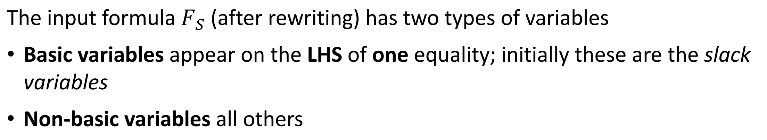
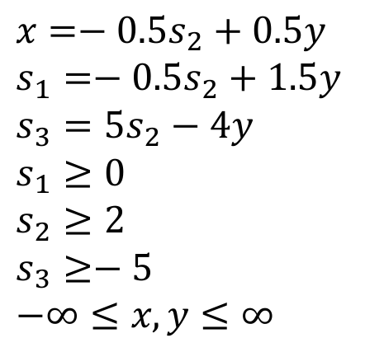
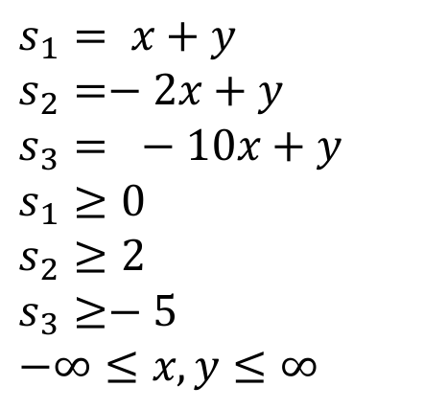
Variable naming and ordering for Simplex
The input formula $F_{S}$ (after rewriting) has two types of variables
Basic variables appear on the LHS of one equality; initially these are the slack variables
Non-basic variables all others
$$s_{1}= x+y$$
$$s_{2}=−2x+y$$
$$s_{3}= −10x+y$$
$$s_{1}≥0$$
$$s_{2}≥2$$
$$s_{3}≥−5$$
$$−∞≤x,y≤∞$$
$$x=−0.5s_{2}+0.5y$$
$$s_{1}=−0.5s_{2}+1.5y$$
$$s_{3}=5s_{2}−4y$$
$$s_{1}≥0$$
$$s_{2}≥2$$
$$s_{3}≥−5$$
$$−∞≤x,y≤∞$$

Slide 22
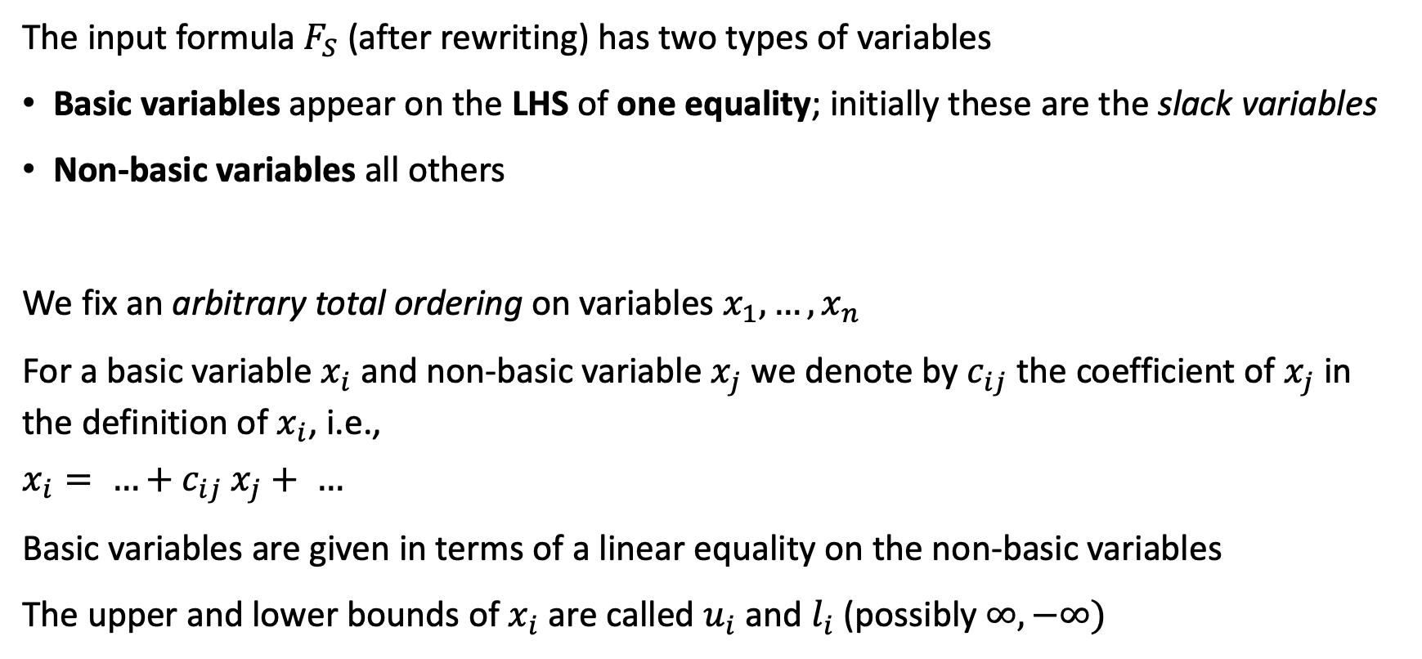
Variable naming and ordering for Simplex
The input formula $F_{S}$ (after rewriting) has two types of variables
Basic variables appear on the LHS of one equality; initially these are the slack variables
Non-basic variables all others
We fix an arbitrary total ordering on variables $x_{1},…,x_{n}$
For a basic variable $x_{i}$ and non-basic variable $x_{j}$ we denote by $c_{ij}$ the coefficient of $x_{j}$ in the definition of $x_{i}$, i.e.,
$$x_{i}= …+c_{ij} x_{j}+ …$$
Basic variables are given in terms of a linear equality on the non-basic variables
The upper and lower bounds of $x_{i}$ are called $u_{i}$ and $l_{i}$ (possibly $∞, −∞)$
Notes:
Basic variables appear on the LHS of exactly one equality (may also appear in other inequalities)

Slide 23
Pivoting: switch basic and non-basic variables
The pivoting operation changes one non-basic variable to a basic variable (we say this variable is “entering”), while one other basic variable is changed to non-basic (we say this variable is “leaving”)
$$s_{1}= x+y$$
$$s_{2}=−2x+y$$
$$s_{3}= −10x+y$$
$$s_{1}≥0$$
$$s_{2}≥2$$
$$s_{3}≥−5$$
$$−∞≤x,y≤∞$$
$$x=−0.5s_{2}+0.5y$$
$$s_{1}=−0.5s_{2}+1.5y$$
$$s_{3}=5s_{2}−4y$$
$$s_{1}≥0$$
$$s_{2}≥2$$
$$s_{3}≥−5$$
$$−∞≤x,y≤∞$$

Slide 24



Pivoting: switch basic and non-basic variables
The pivoting operation change one non-basic variable to a basic variable (we say this variable is “entering”), while one other basic variable is changed to non-basic (we say this variable is “leaving”)
pluggin new definition of x
$$s_{1}= x+y$$
$$s_{2}=−2x+y$$
$$s_{3}= −10x+y$$
$$s_{1}≥0$$
$$s_{2}≥2$$
$$s_{3}≥−5$$
$$−∞≤x≤∞$$
$$x=−0.5s_{2}+0.5y$$
$$s_{1}=−0.5s_{2}+1.5y$$
$$s_{3}=5s_{2}−4y$$
$$s_{1}≥0$$
$$s_{2}≥2$$
$$s_{3}≥−5$$
$$−∞≤x≤∞$$
$$x={−0.5s}_{2}+0.5y$$
pluggin new definition of x

Slide 25


Pivoting: switch basic and non-basic variables
The pivoting operation change one non-basic variable to a basic variable (we say this variable is “entering”), while one other basic variable is changed to non-basic (we say this variable is “leaving”)
$x_{i}=Σ_{k∈N}^{m}c_{ik}x_{k}$, $j∈N$
Pivoting $x_{i}$ and $x_{j}$ rewrites $x_{j}$ as basic variable
$$x_{i}={c_{ij}x}_{j}+Σ_{k∈N\backslash \{j\}}^{m}c_{ik}x_{k}$$
$$x_{j}=\frac{x_{i}}{c_{ij}}−Σ_{k∈N\backslash \{j\}}^{m}\frac{c_{ik}}{c_{ij}}x_{k}$$
$$s_{1}= x+y$$
$$s_{2}=−2x+y$$
$$s_{3}= −10x+y$$
$$s_{1}≥0$$
$$s_{2}≥2$$
$$s_{3}≥−5$$
$$−∞≤x≤∞$$
$$x=−0.5s_{2}+0.5y$$
$$s_{1}=−0.5s_{2}+1.5y$$
$$s_{3}=5s_{2}−4y$$
$$s_{1}≥0$$
$$s_{2}≥2$$
$$s_{3}≥−5$$
$$−∞≤x≤∞$$
$$x={−0.5s}_{2}+0.5y$$

Slide 26

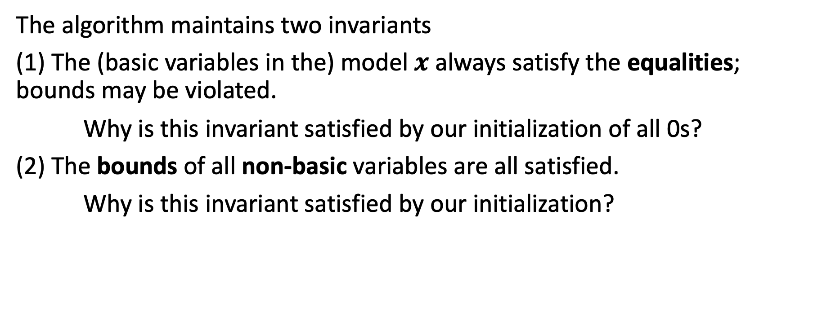
Simplex (Formal)
The algorithm maintains two invariants
(1) The (basic variables in the) model $x$ always satisfy the equalities; bounds may be violated.
Why is this invariant satisfied by our initialization of all 0s?
(2) The bounds of all non-basic variables are all satisfied.
Why is this invariant satisfied by our initialization?
$F≡∧_{i=1}^{n}Σ_{j=1}^{m}c_{ij}x_{j}≤b_{i}$ where $c_{ij},b_{i}∈ℝ$
Linear equalities: $Σ_{i=1}^{m}c_{i}x_{i}=0$
Bounds: $l_{i}≤x_{i}≤u_{i}$ (only for slack variables)

Slide 27
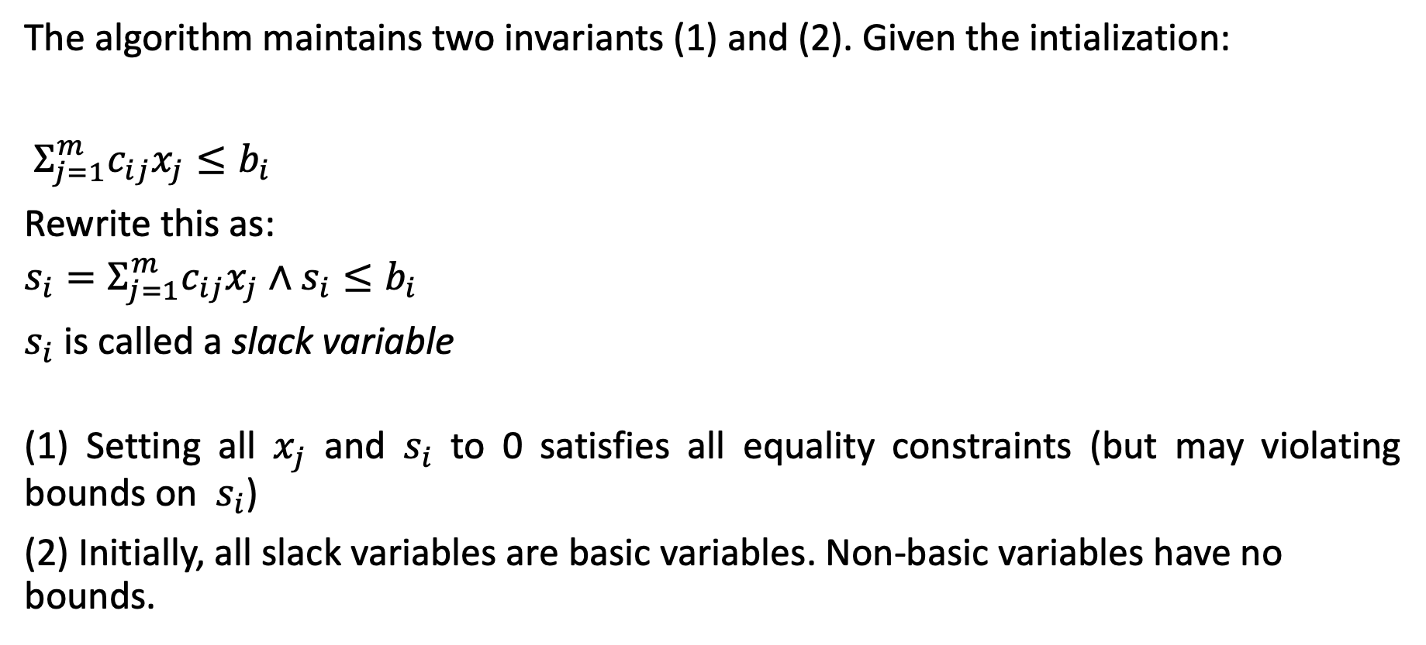
Transforming to Simplex Form
The algorithm maintains two invariants (1) and (2). Given the intialization:
$Σ_{j=1}^{m}c_{ij}x_{j}≤b_{i}$
Rewrite this as:
$$s_{i}=Σ_{j=1}^{m}c_{ij}x_{j}∧s_{i}≤b_{i}$$
$s_{i}$ is called a slack variable
(1) Setting all $x_{j}$ and $s_{i}$ to 0 satisfies all equality constraints (but may violating bounds on $s_{i}$)
(2) Initially, all slack variables are basic variables. Non-basic variables have no bounds.

Slide 28
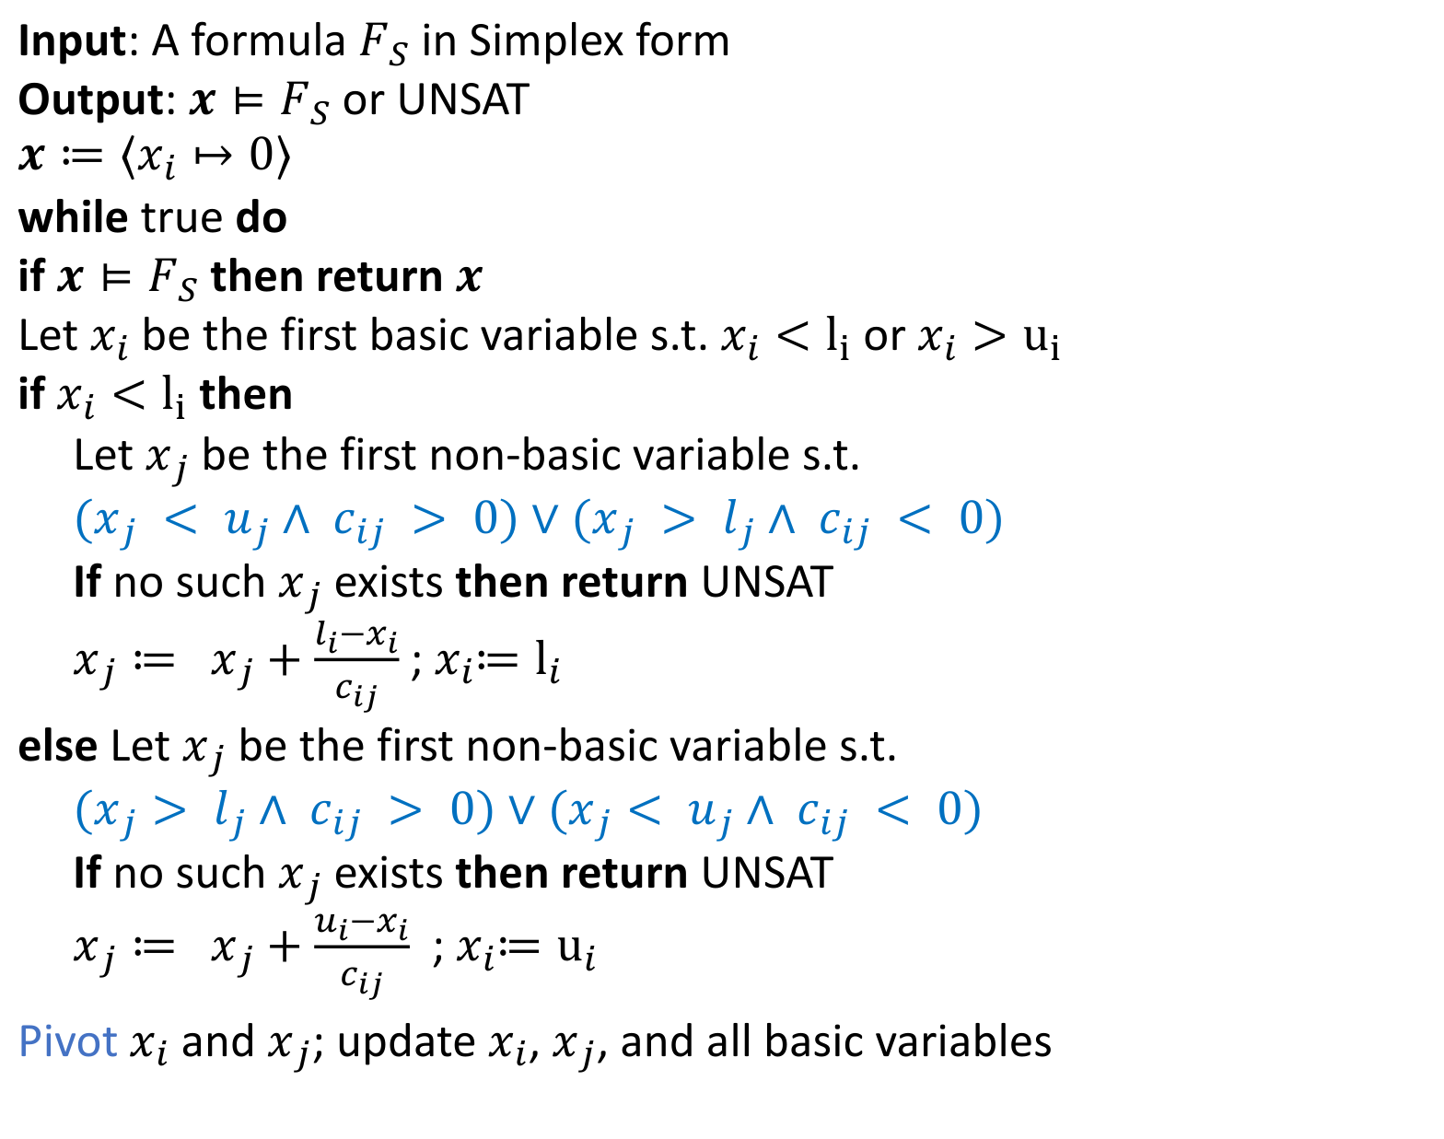
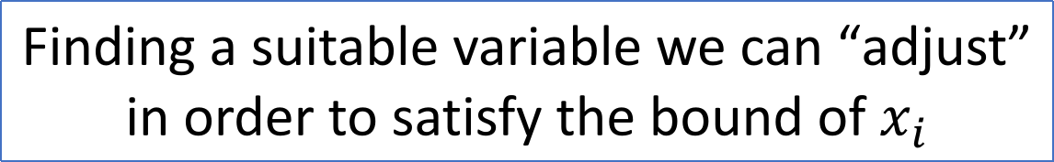
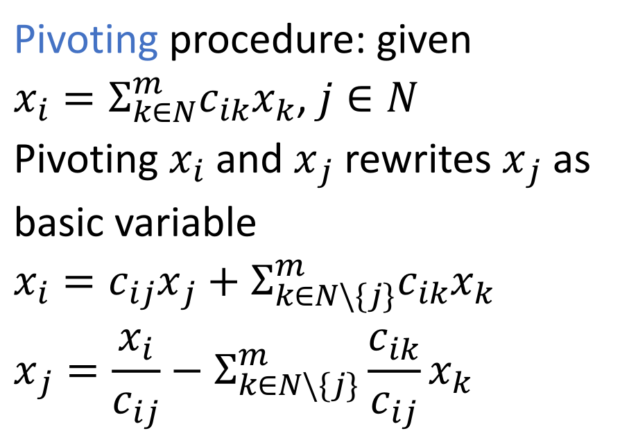
Simplex Algorithm: DP for LRA
Input: A formula $F_{S}$ in Simplex form
Output: $x⊨F_{S}$ or UNSAT
$$x≔⟨x_{i}↦0⟩$$
while true do
if $x⊨F_{S}$ then return $x$
Let $x_{i}$be the first basic variable s.t. $x_{i}<l_{i}$ or $x_{i}>u_{i}$
if $x_{i}<l_{i}$ then
Let $x_{j}$ be the first non-basic variable s.t.
$(x_{j} < u_{j}∧ c_{ij} > 0)∨(x_{j} > l_{j}∧ c_{ij} < 0)$
If no such $x_{j}$ exists then return UNSAT
$x_{j}≔$ $x_{j}+\frac{l_{i}−x_{i}}{c_{ij}}$ ; $x_{i}{≔l}_{i}$
else Let $x_{j}$ be the first non-basic variable s.t.
$(x_{j}> l_{j}∧ c_{ij} > 0)∨(x_{j}< u_{j}∧ c_{ij} < 0)$
If no such $x_{j}$ exists then return UNSAT
$x_{j}≔$ $x_{j}+\frac{u_{i}−x_{i}}{c_{ij}}$ ; $x_{i}{≔u}_{i}$
Pivot$x_{i}$ and $x_{j}$; update $x_{i}$, $x_{j}$, and all basic variables
$x_{i}$ currently violates its bounds
Finding a suitable variable we can “adjust” in order to satisfy the bound of $x_{i}$
“blue” conditions
Pivoting procedure: given
$x_{i}=Σ_{k∈N}^{m}c_{ik}x_{k}$, $j∈N$
Pivoting $x_{i}$ and $x_{j}$ rewrites $x_{j}$ as basic variable
$$x_{i}={c_{ij}x}_{j}+Σ_{k∈N\backslash \{j\}}^{m}c_{ik}x_{k}$$
$$x_{j}=\frac{x_{i}}{c_{ij}}−Σ_{k∈N\backslash \{j\}}^{m}\frac{c_{ik}}{c_{ij}}x_{k}$$
Notes:
When the algorithm encounters a basic variable x_i that is below its lower bound (xi​<li​), it must be adjusted upward to restore feasibility.
To do this, the method searches for a non-basic variable xj whose movement can increase x_i (depending on the sign of cij) while keeping xj within its own bounds. If no such xj exists, the system is declared UNSAT; otherwise, xj is shifted just enough so that xi reaches its lower bound, and then a pivot makes xj the new basic variable.

Slide 29
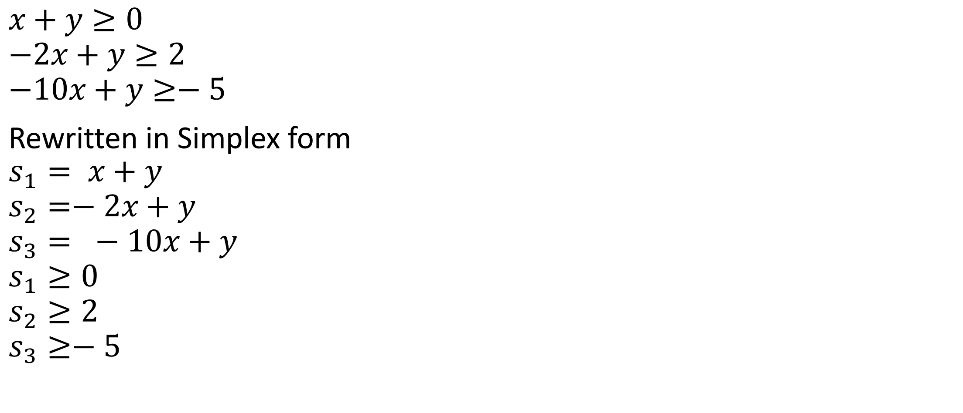
Example
$$x+y≥0$$
$$−2x+y≥2$$
$$−10x+y≥−5$$
Rewritten in Simplex form
$$s_{1}= x+y$$
$$s_{2}=−2x+y$$
$$s_{3}= −10x+y$$
$$s_{1}≥0$$
$$s_{2}≥2$$
$$s_{3}≥−5$$

Slide 30

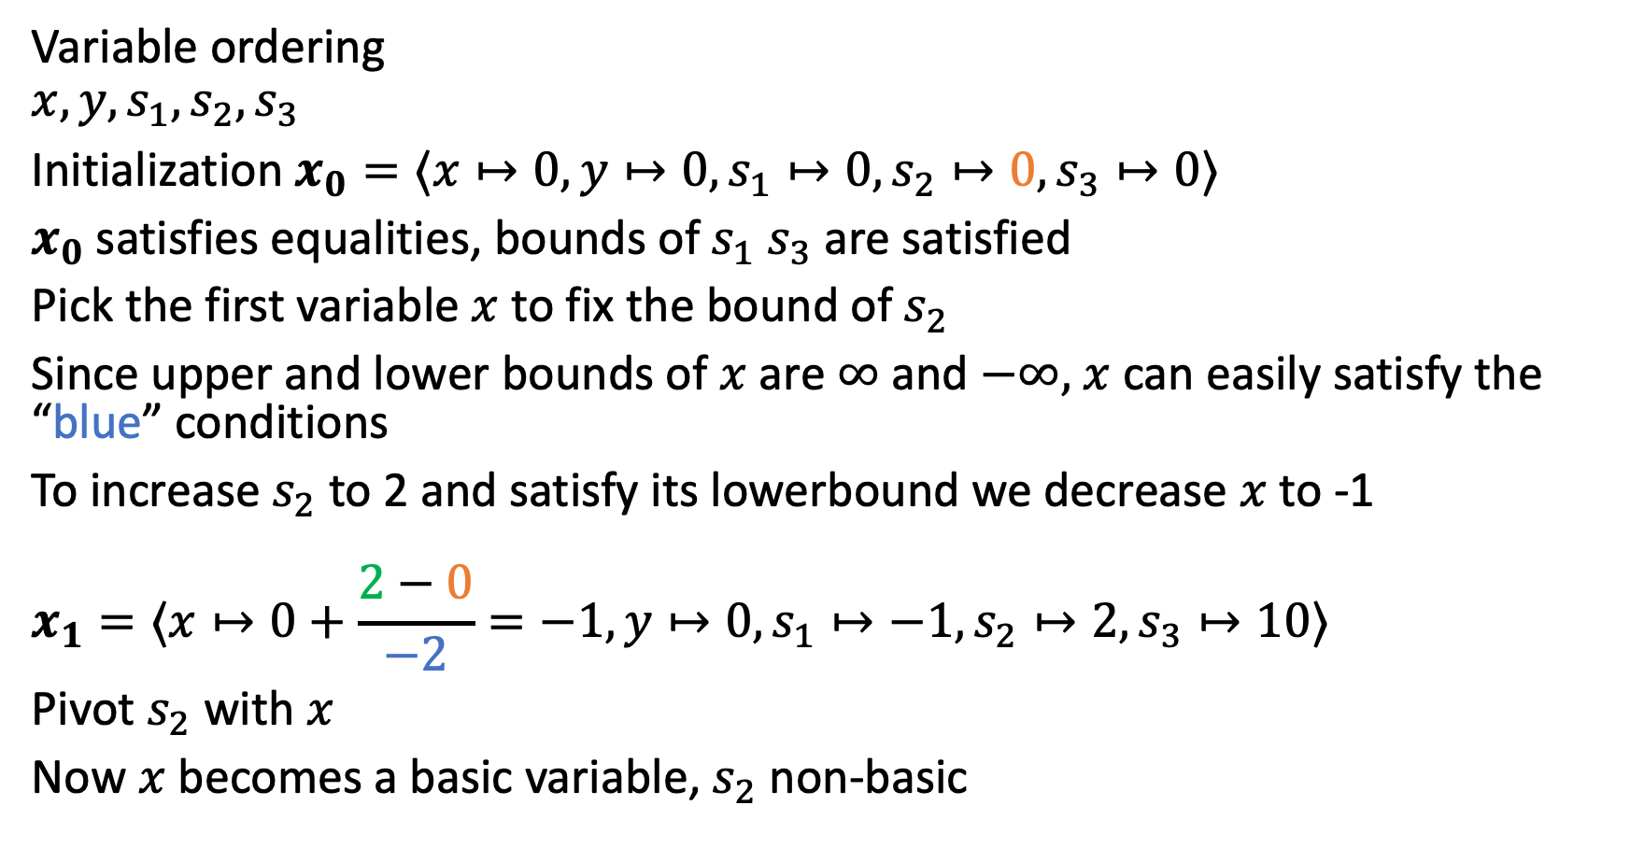

Example continued
$$s_{1}= x+y$$
$$s_{2}=−2x+y$$
$$s_{3}= −10x+y$$
$$s_{1}≥0$$
$$s_{2}≥2$$
$$s_{3}≥−5$$
$$−∞≤x,y≤∞$$
Variable ordering
$$x,y,s_{1},s_{2},s_{3}$$
Initialization $x_{0}=⟨x↦0,y↦0,s_{1}↦0,s_{2}↦0,s_{3}↦0⟩$
$x_{0}$ satisfies equalities, bounds of $s_{1}$ $s_{3}$ are satisfied
Pick the first variable $x$to fix the bound of $s_{2}$
Since upper and lower bounds of $x$ are $∞$ and $−∞,$ $x$ can easily satisfy the “blue” conditions
To increase $s_{2}$to 2 and satisfy its lowerbound we decrease $x$to -1
$$x_{1}=⟨x↦0+\frac{2−0}{−2}=−1,y↦0,s_{1}↦−1,s_{2}↦2,s_{3}↦10⟩$$
Pivot $s_{2}$with $x$
Now $x$ becomes a basic variable, $s_{2}$ non-basic
$$x=−0.5s_{2}+0.5y$$
$$s_{1}=−0.5s_{2}+1.5y$$
$$s_{3}=5s_{2}−4y$$
$$s_{1}≥0$$
$$s_{2}≥2$$
$$s_{3}≥−5$$
$$−∞≤x,y≤∞$$

Slide 31

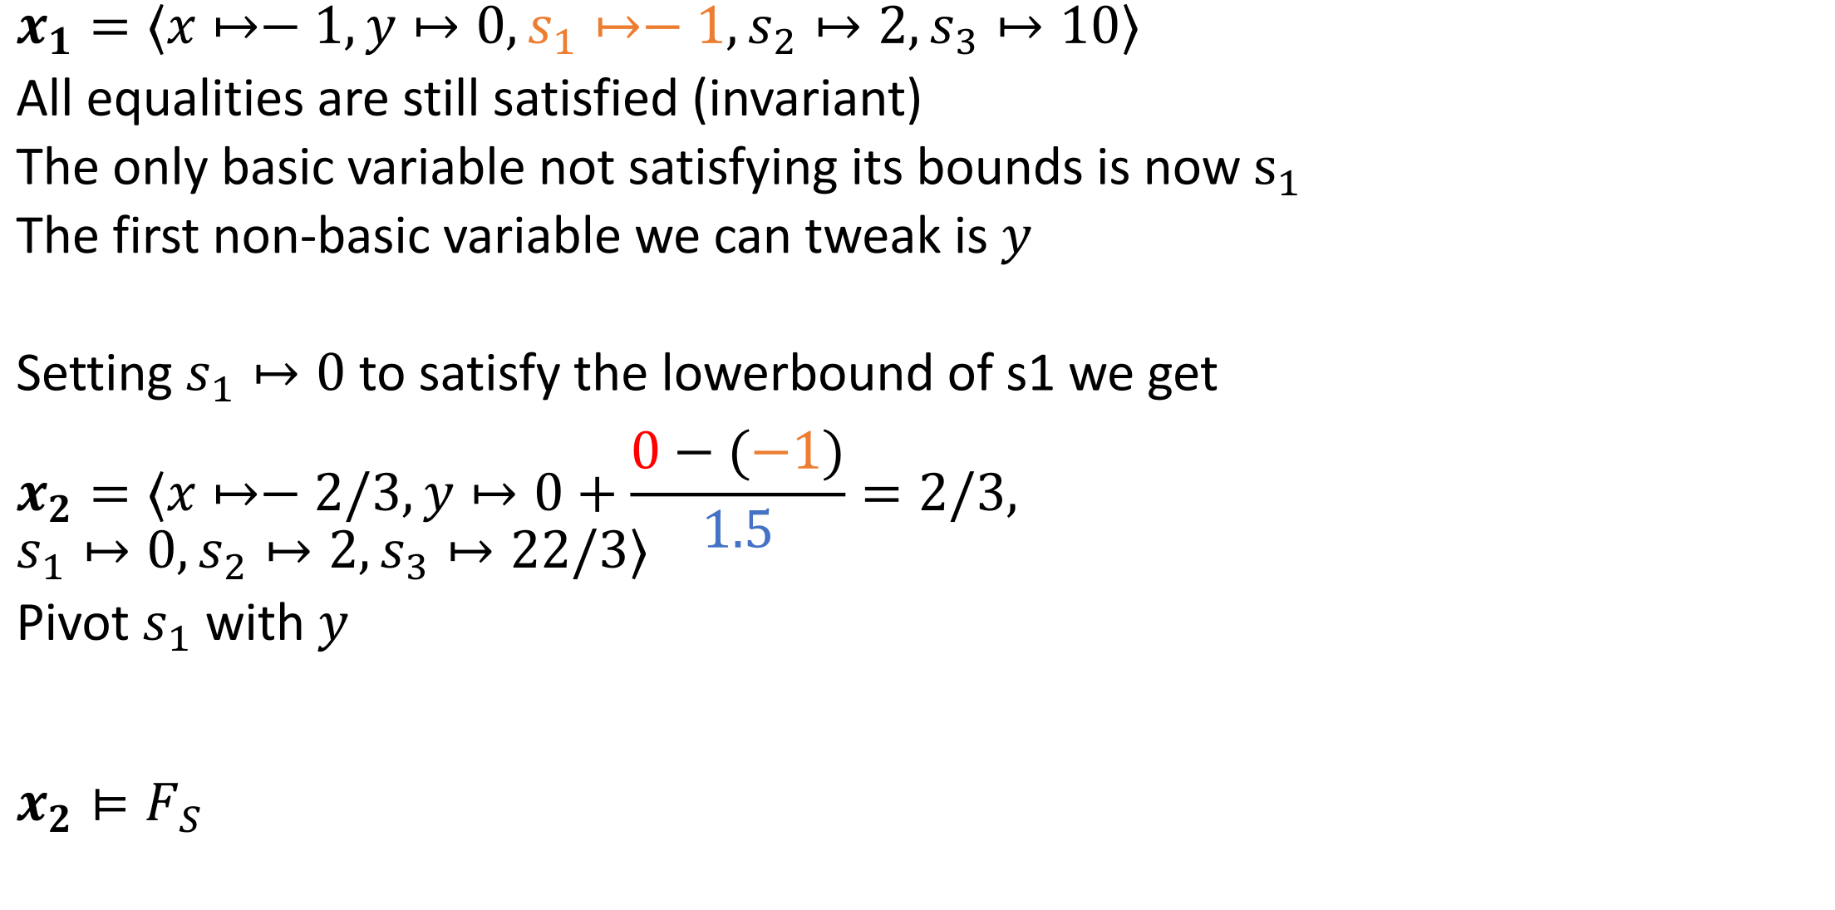
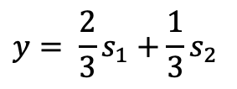


Example continued
$$x=−0.5s_{2}+0.5y$$
$$s_{1}=−0.5s_{2}+1.5y$$
$$s_{3}=5s_{2}−4y$$
$$s_{1}≥0$$
$$s_{2}≥2$$
$$s_{3}≥−5$$
$$−∞≤x,y≤∞$$
$$x_{1}=⟨x↦−1,y↦0,s_{1}↦−1,s_{2}↦2,s_{3}↦10⟩$$
All equalities are still satisfied (invariant)
The only basic variable not satisfying its bounds is now$s_{1}$
The first non-basic variable we can tweak is $y$
Setting $s_{1}↦0$ to satisfy the lowerbound of s1 we get
$$x_{2}=⟨x↦−2/3,y↦0+\frac{0−(−1)}{1.5}=2/3, \\ s_{1}↦0,s_{2}↦2,s_{3}↦22/3⟩$$
Pivot $s_{1}$ with $y$
$$x_{2}⊨F_{S}$$
$$y= \frac{2}{3}s_{1}+\frac{1}{3}s_{2}$$
$$x=\frac{1}{3}s_{1}−\frac{1}{3}s_{2}$$
$$s_{3}=−\frac{8}{3}s_{1}+\frac{11}{3}s_{2}$$
$$s_{2}≥2$$
$$s_{1}≥0$$
$$s_{3}≥−5$$
$$−∞≤x,y≤∞$$
$$s_{1}=−0.5s_{2}+1.5y$$
$$y= \frac{2}{3}s_{1}+\frac{1}{3}s_{2}$$

Slide 32
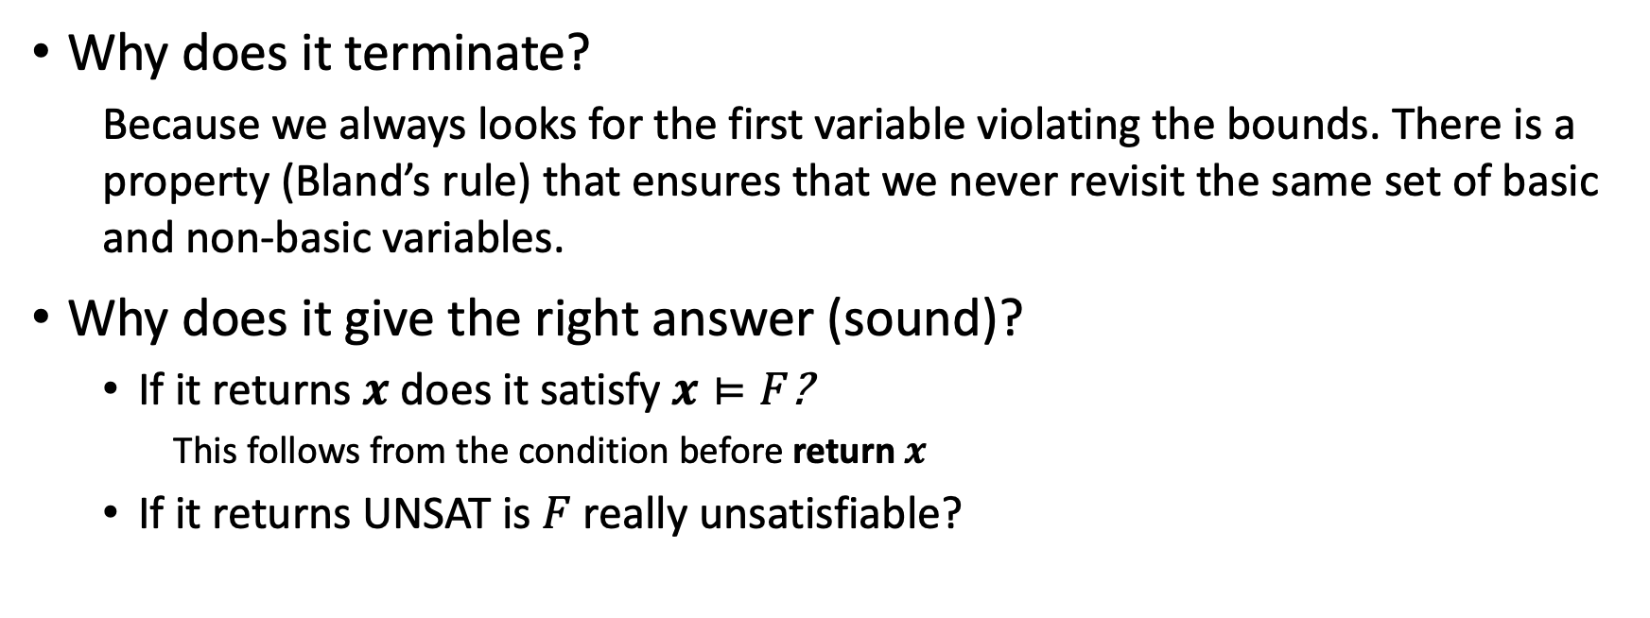
Why is simplex correct?
Why does it terminate?
Because we always looks for the first variable violating the bounds. There is a property (Bland’s rule) that ensures that we never revisit the same set of basic and non-basic variables.
Why does it give the right answer (sound)?
If it returns $x$ does it satisfy $x⊨F$?
This follows from the condition before return $x$
If it returns UNSAT is $F$ really unsatisfiable?
For proofs, check Dutertre, B., de Moura, L.: Integrating Simplex with DPLL(T). Technical report, CSL-06-01, SRI International (2006)

Slide 33
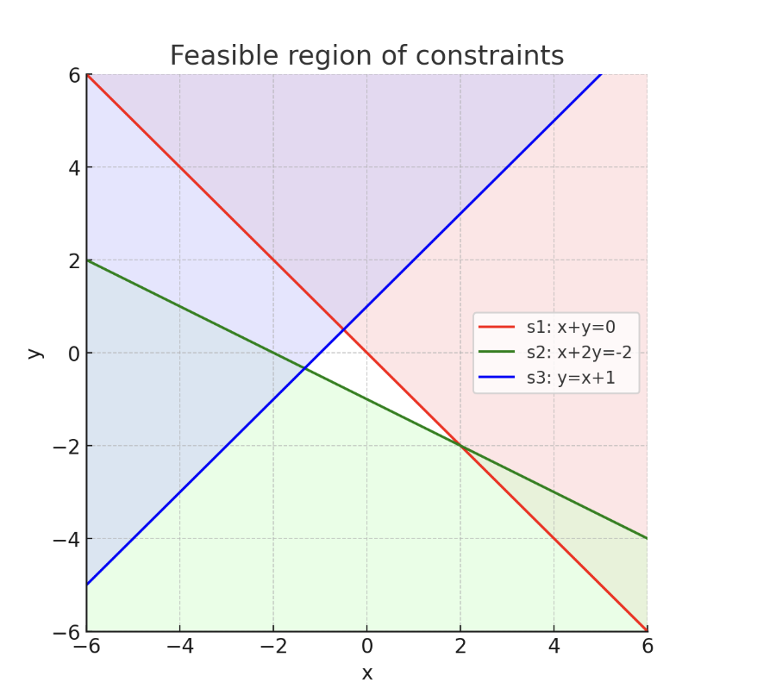
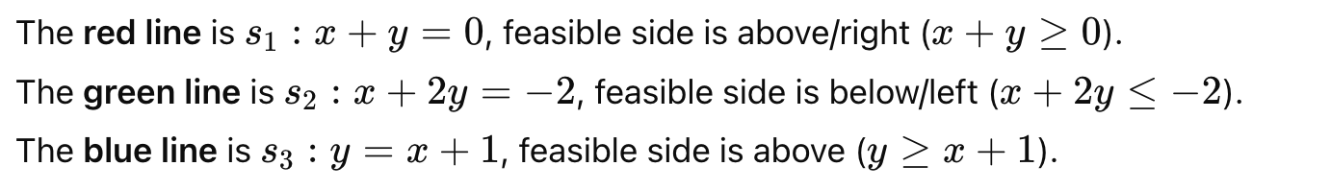

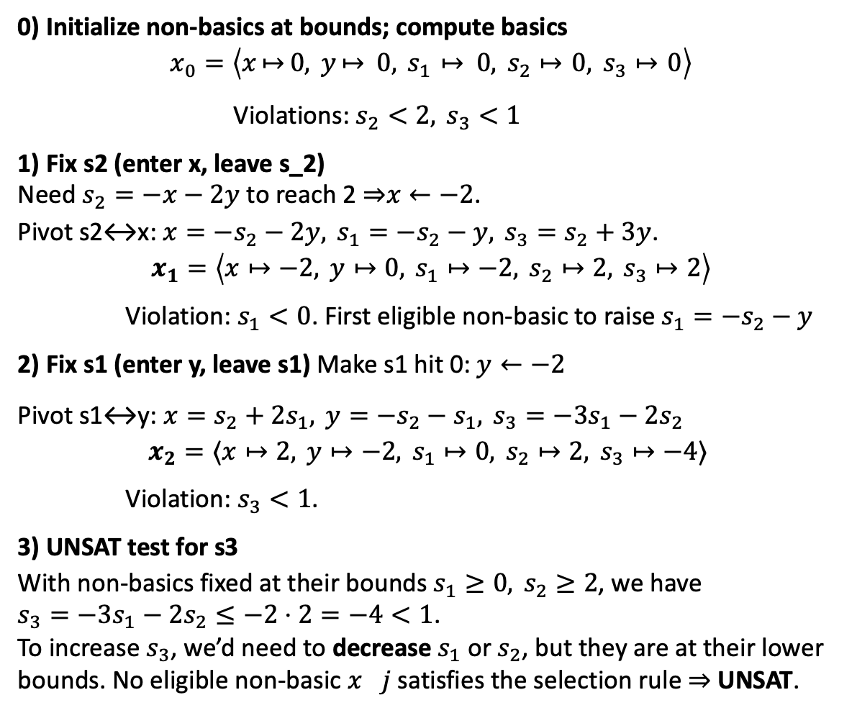
Unsatisfiable example
$$s_{1}= x+y$$
$$s_{2}=−x−2y$$
$$s_{3}= −x+y$$
$$s_{1}≥0$$
$$s_{2}≥2$$
$$s_{3}≥1$$
0) Initialize non-basics at bounds; compute basics
$$x_{0}=\left\langle x⁣↦⁣0, y⁣↦ 0, s_{1} ⁣↦ 0, s_{2}↦ ⁣0, s_{3}↦ ⁣0\right\rangle$$
Violations: $s_{2}<2, s_{3}<1$
1) Fix s2​ (enter x, leave s_2​) Need $s_{2}=−x−2y$to reach 2 ⇒$x←−2$. Pivot s2↔x: $x=−s_{2}−2y, s_{1}=−s_{2}−y, s_{3}=s_{2}+3y$.
$$x_{1}​=\left\langle x↦−2, y↦0, s_{1}​↦−2, s_{2}​↦2, s_{3}​↦2\right\rangle$$
Violation: $s_{1}<0$. First eligible non-basic to raise $s_{1}=−s_{2}−y$
2) Fix s1​ (enter y, leave s1​) Make s1​ hit 0: $y←−2$
Pivot s1​↔y: $x=s_{2}+2s_{1}, y=−s_{2}−s_{1}, s_{3}=−3s_{1}−2s_{2}$
$$x_{2}=⟨x↦2, y↦−2, s_{1}​↦0, s_{2}​↦2, s_{3}​↦−4⟩$$
Violation: $s_{3}​<1$.
3) UNSAT test for s3​ With non-basics fixed at their bounds $s_{1}​≥0, s_{2}​≥2$, we have $s_{3}=−3s_{1}−2s_{2}≤−2⋅2=−4<1$. To increase $s_{3}$, we’d need to decrease $s_{1}$​ or $s_{2}$​, but they are at their lower bounds. No eligible non-basic $x_{}j$​ satisfies the selection rule ⇒ UNSAT.

Slide 34
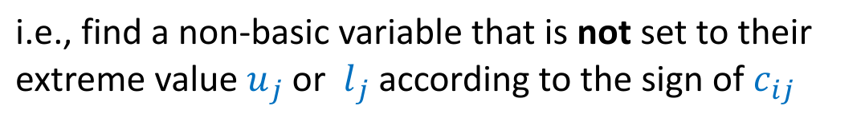
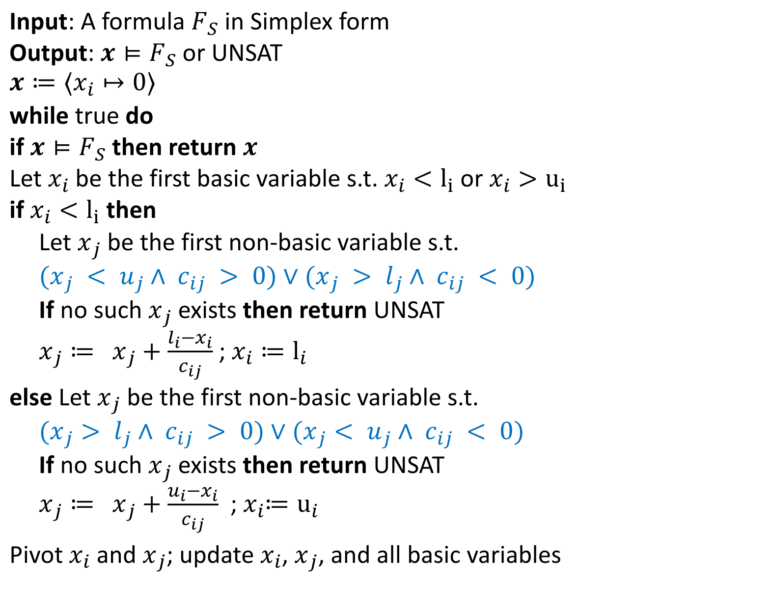

Simplex Algorithm: DP for LRA
Input: A formula $F_{S}$ in Simplex form
Output: $x⊨F_{S}$ or UNSAT
$$x≔⟨x_{i}↦0⟩$$
while true do
if $x⊨F_{S}$ then return $x$
Let $x_{i}$be the first basic variable s.t. $x_{i}<l_{i}$ or $x_{i}>u_{i}$
if $x_{i}<l_{i}$ then
Let $x_{j}$ be the first non-basic variable s.t.
$(x_{j} < u_{j}∧ c_{ij} > 0)∨(x_{j} > l_{j}∧ c_{ij} < 0)$
If no such $x_{j}$ exists then return UNSAT
$x_{j}≔$ $x_{j}+\frac{l_{i}−x_{i}}{c_{ij}}$ ; $x_{i}≔l_{i}$
else Let $x_{j}$ be the first non-basic variable s.t.
$(x_{j}> l_{j}∧ c_{ij} > 0)∨(x_{j}< u_{j}∧ c_{ij} < 0)$
If no such $x_{j}$ exists then return UNSAT
$x_{j}≔$ $x_{j}+\frac{u_{i}−x_{i}}{c_{ij}}$ ; $x_{i}{≔u}_{i}$
Pivot$x_{i}$ and $x_{j}$; update $x_{i}$, $x_{j}$, and all basic variables
i.e., find a non-basic variable that is not set to their extreme value $u_{j}$ or $l_{j}$ according to the sign of $c_{ij}$
If the non-basic variable $x_{j}$ has been set to its extreme, we cannot further change it to fix $x_{i}$

Slide 35
Summary and Takeaways
Satisfiability modulo theory solvers use theory solvers and DPLL to check satisfiability of formulas in other theories
DPLL takes care of disjunctions
Theory solvers take care of conjunctions
Simplex or more generally Linear programming (LP) solvers is a theory solver for linear real arithmetic
Simplex algorithm solves LP by incrementally fixing the bounds of basic variables

