Slide 1
Z3 tutorial
Chenxi Ji

Slide 2
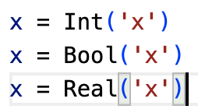
Type of Variables
Int, Bool, Real

Slide 3
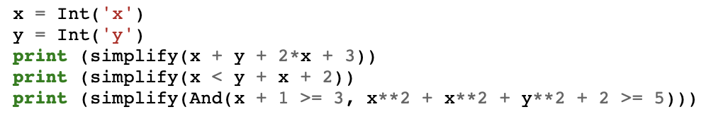
Define Math Expression and Simplify It

Slide 4
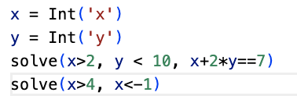
Define Constraints and Solve a Solution

Slide 5
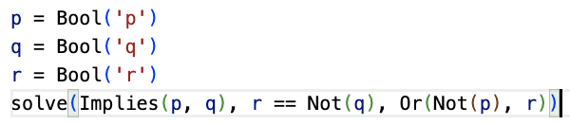
Solve Boolean Constraints

Slide 6
Dijkstra – Bound function
Math Expression: For all i in [0, N-1], 0<=x[i]<K
Steps:
Construct a list to store all constraints
Provide constraints for each x[i]: And(x[i]>=0,x[i]<K)
Combine all constraints together (And relation)

Slide 7
Dijkstra – has_token function
Math Expression:
If i==0 and x[i]==x[N-1], then return True
If i!=0 and x[i]!=x[i-1], then return True
Steps:
Consider case 1: And(i==0, x[i]==x[N-1])
Consider case 2: And(Not(i==0), Not(x[i]==x[i-1]))
Combine two cases (Or relation)

Slide 8
Dijkstra – legal_config function
Math Expression:
Sum of has_token(x,i) for all i in [0, N-1], denote as Args. If Args==1, then return True; else return False
Steps:
Generate a list of output of has_token function:
args = [has_token(x, i) for i in range(0, N)]
Sum of args <=1: AtMost(args + [1])
Sum of args >=1: AtLeast(args + [1])
Combine them together(And relation)

Slide 9
Dijkstra – transition_relation function
Math Expression:
If node 0 has_token, then new_x[0]==(old_x[0]+1)%K
Else for node 0, new_x[0]==old_x[0]
If node i!=0 has token, then new_x[i]==old_x[i-1]
Else for node i!=0, then new_x[i]==old_x[i]
Steps :
Case0_1=And(has_token(old_x,0), new_x[0]==(old_x[0]+1)%K)
Case0_2=And(Not(has_token(old_x,0)), new_x[0]==old_x[0])
Node_0 = Or(Case0_1, Case0_2)
Casei_1=And(has_token(old_x,i), new_x[i]==old_x[i-1])
Casei_2=And(Not(has_token(old_x,i)), new_x[i]==old_x[i])
Node_i = Or(Casei_1,Casei_2)
Combine constraints on all nodes together(And relation)

