Slide 1
Timed Automata
Sayan Mitra
Verifying cyberphysical systems
mitras@illinois.edu

Slide 2
Outline
Review: Modeling cyber-physical systems
Hybrid automata
Executions
Urgency
Zeno
Hybrid stability

Slide 3
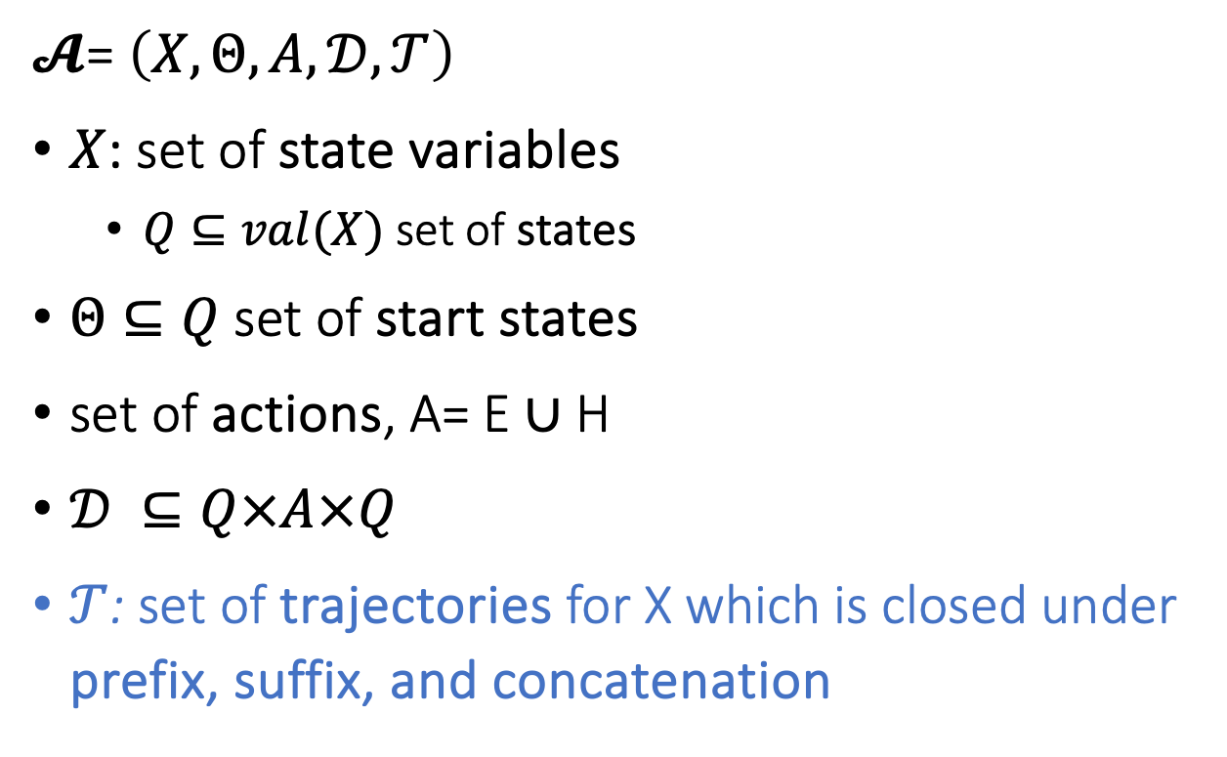
Hybrid Automaton
$𝓐$= $\left(X,Θ,A,𝒟,𝒯\right)$
$X$: set of state variables
$Q⊆val(X)$ set of states
$Θ⊆Q$ set of start states
set of actions, A= E ∪ H
$𝒟 ⊆Q×A×Q$
$𝒯$: set of trajectories for X which is closed under prefix, suffix, and concatenation
Notes:
Pick a couple of nice examples

Slide 4
Special Classes of Hybrid Automata
Algorithmic analysis of (Alur-Dill’s) Timed Automata[1]
Timed Automata are a restricted class of hybrid automata with only clock variables which are amenable to automatic verification
[1] Rajeev Alur and David L. Dill. A theory of timed automata. Theoretical Computer Science, 126:183-235, 1994.

Slide 5
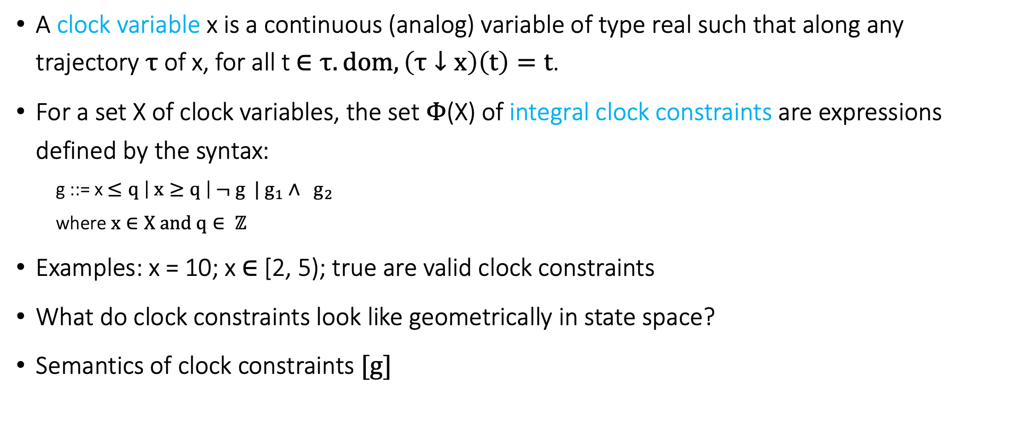
Clocks and Clock Constraints
A clock variable x is a continuous (analog) variable of type real such that along any trajectory $τ$ of x, for all t $∈τ.dom, \left(τ↓x\right)\left(t\right)=t$.
For a set X of clock variables, the set $Φ$(X) of integral clock constraints are expressions defined by the syntax:
g ::= x $≤q \left| x≥q \right| ¬ g | g_{1}∧ g_{2}$
where $x∈X and q∈ ℤ$
Examples: x = 10; x $∈$ [2, 5); true are valid clock constraints
What do clock constraints look like geometrically in state space?
Semantics of clock constraints $[g]$

Slide 6
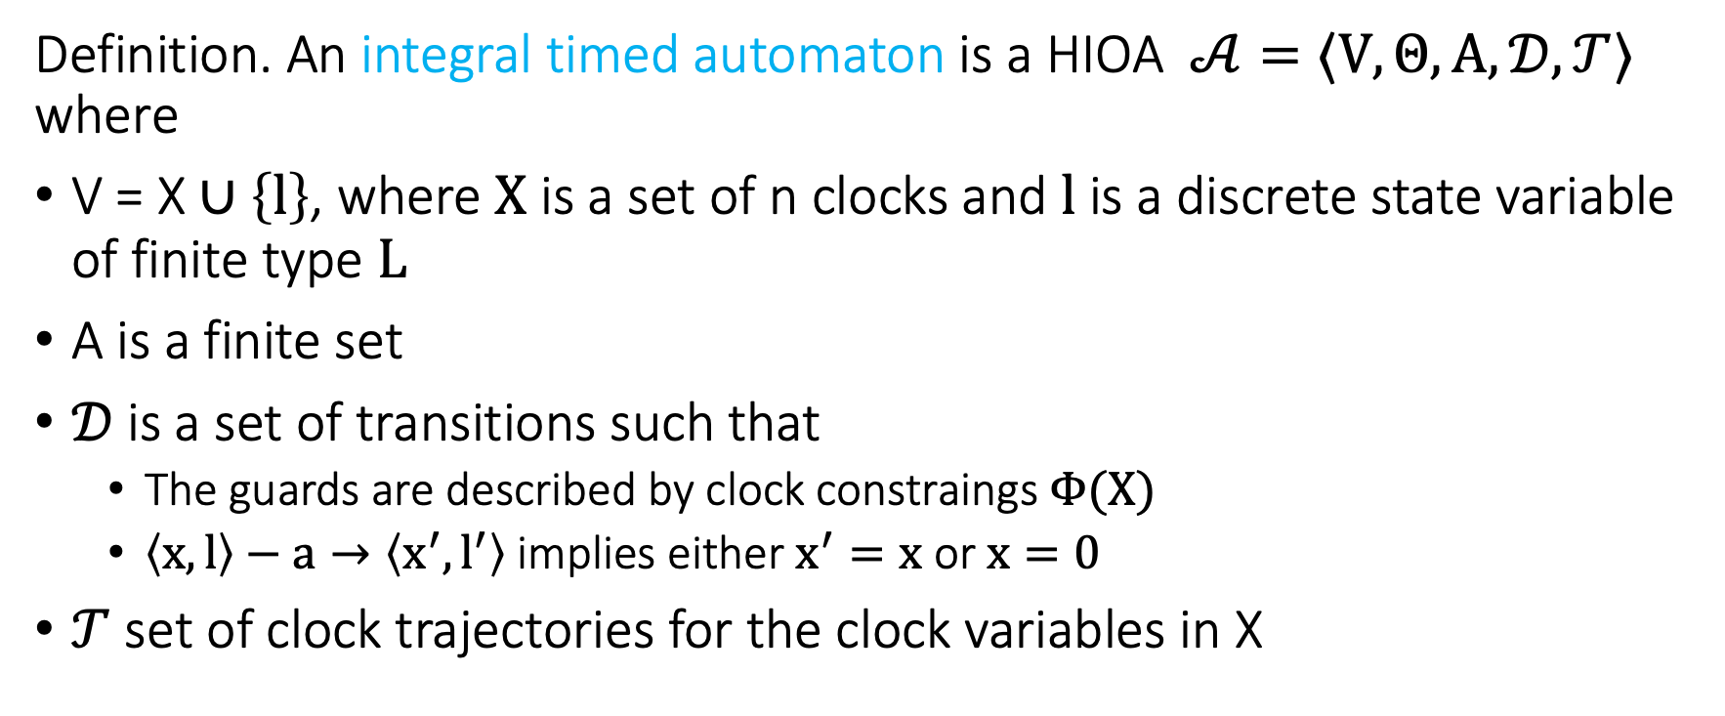
Integral Timed Automata
Definition. An integral timed automaton is a HIOA $𝒜=〈V, Θ, A, 𝒟, 𝒯〉$ where
V = X $∪\left\{l\right\}$, where $X$ is a set of n clocks and $l$ is a discrete state variable of finite type $L$
A is a finite set
$𝒟$is a set of transitions such that
The guards are described by clock constraings $Φ(X)$
$〈x,l〉−a→〈x^{′},l^{′}〉$ implies either $x^{′}=x$ or $x=0$
$𝒯$ set of clock trajectories for the clock variables in X

Slide 7
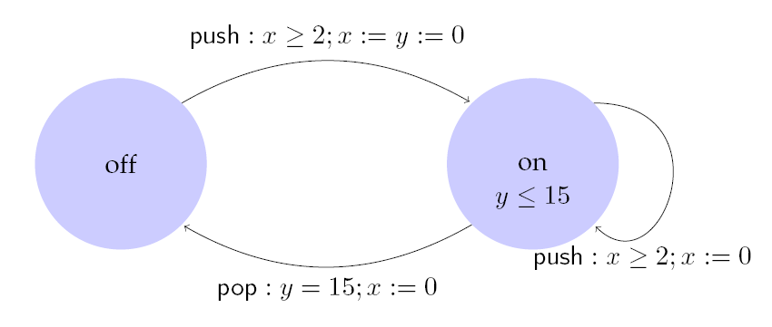
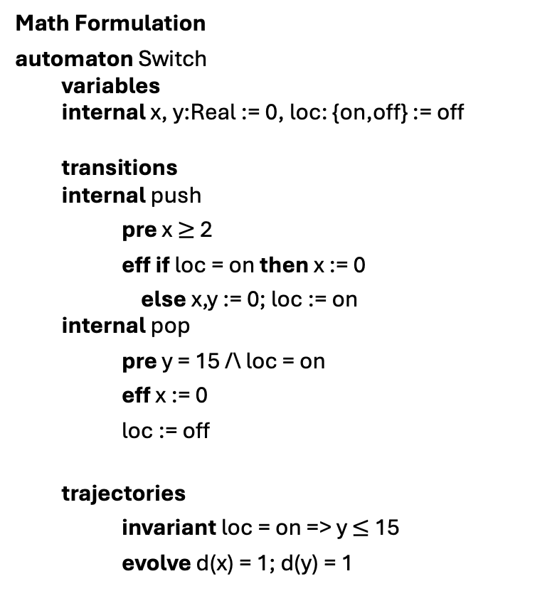
Example: Light switch
Math Formulation
automaton Switch
variables
internal x, y:Real := 0, loc: {on,off} := off
transitions
internal push
pre x $≥$ 2
eff if loc = on then x := 0
else x,y := 0; loc := on
internal pop
pre y = 15 /\ loc = on
eff x := 0
loc := off
trajectories
invariant loc = on => y $≤$ 15
evolve d(x) = 1; d(y) = 1
Description
Switch can be turned on whenever at least 2 time units have elapsed since the last turn on. Switches off automatically 15 time units after the last on.

Slide 8
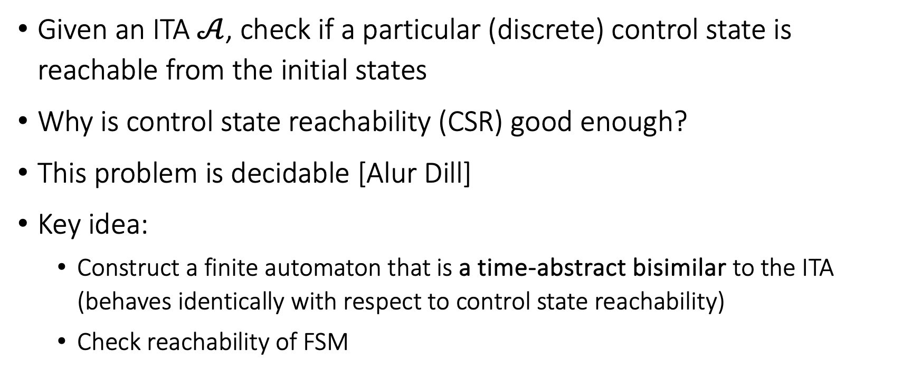
Control State (Location) Reachability Problem
Given an ITA $𝒜$, check if a particular (discrete) control state is reachable from the initial states
Why is control state reachability (CSR) good enough?
This problem is decidable [Alur Dill]
Key idea:
Construct a finite automaton that is a time-abstract bisimilar to the ITA (behaves identically with respect to control state reachability)
Check reachability of FSM

Slide 9
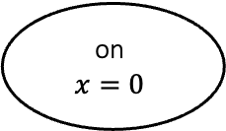
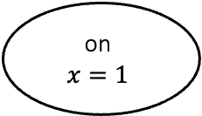

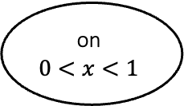

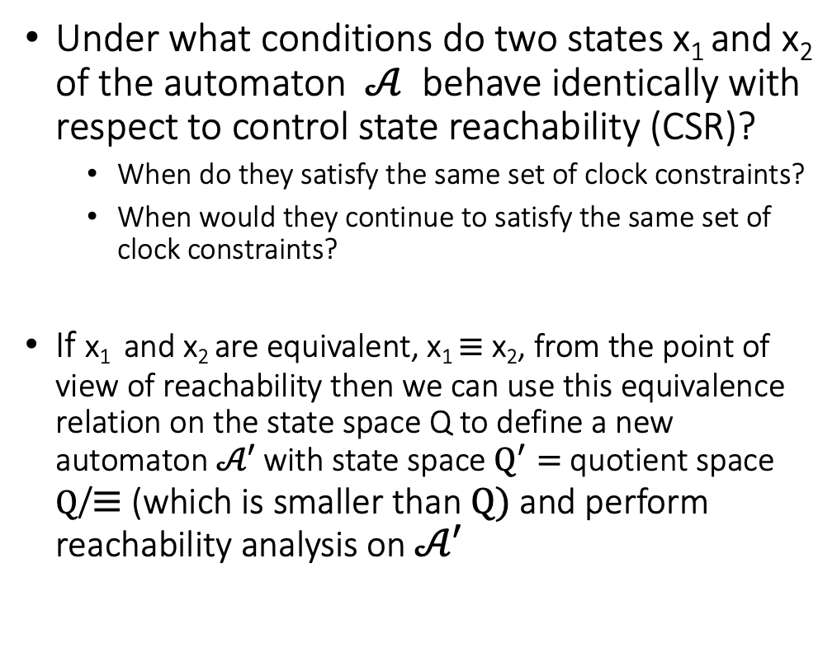


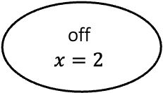


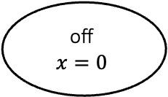

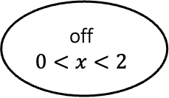

An equivalence relation with a finite quotient
turnoff
$$x≥1$$
$$x≔0$$
on
$$\dot{x}=1$$
$$x≤1$$
off
$$\dot{x}=1$$
$$x≤2$$
Under what conditions do two states x₁ and x₂ of the automaton $𝒜$ behave identically with respect to control state reachability (CSR)?
When do they satisfy the same set of clock constraints?
When would they continue to satisfy the same set of clock constraints?
If x₁ and x₂ are equivalent, x₁ $≡$ x₂, from the point of view of reachability then we can use this equivalence relation on the state space Q to define a new automaton $𝒜′$ with state space $Q^{′}=$ quotient space $Q$/$≡$ (which is smaller than $Q)$and perform reachability analysis on $𝒜′$
turnon
$$x≥2$$
$$x≔0$$
turnon
on
$$x=0$$
$$τ$$
on
$$0<x<1$$
$$τ$$
on
$$x=1$$
turnoff
off
$$x=0$$
$$τ$$
off
$$0<x<2$$
$$τ$$
off
$$x=2$$

Slide 10
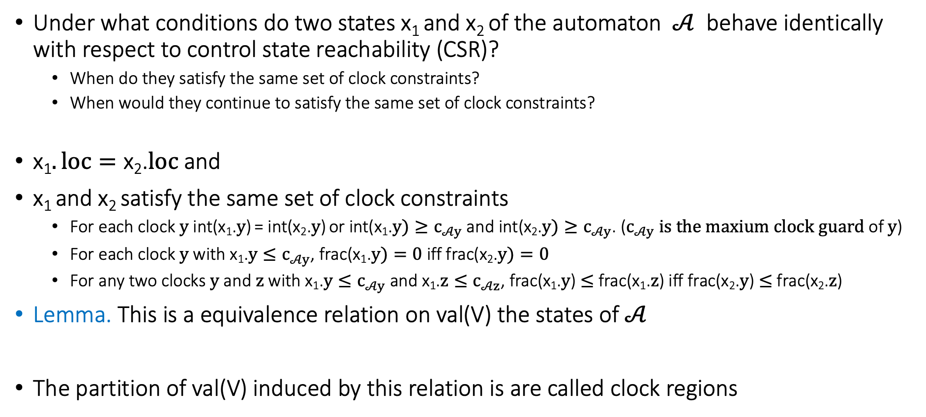
An equivalence relation with a finite quotient
Under what conditions do two states x₁ and x₂ of the automaton $𝒜$ behave identically with respect to control state reachability (CSR)?
When do they satisfy the same set of clock constraints?
When would they continue to satisfy the same set of clock constraints?
x₁$. loc=\text{x}\text{2}$.$loc$and
x₁ and x₂ satisfy the same set of clock constraints
For each clock $y$ int(x₁.$y$) = int(x₂.$y$) or int(x₁.$y)≥c_{𝒜y}$and int(x₂.$y)≥c_{𝒜y}$. ($c_{𝒜y} is the maxium clock guard$ of $y$)
For each clock $y$ with x₁.$y≤c_{𝒜y}$, frac(x₁.$y)=0$iff frac(x₂.$y)=0$
For any two clocks $y$ and $z$ with x₁.$y≤c_{𝒜y}$ and x₁.$z≤c_{𝒜z}$, frac(x₁.$y$) $≤$ frac(x₁.$z$) iff frac(x₂.$y$) $≤$ frac(x₂.$z$)
Lemma. This is a equivalence relation on val(V) the states of $𝒜$
The partition of val(V) induced by this relation is are called clock regions

Slide 11
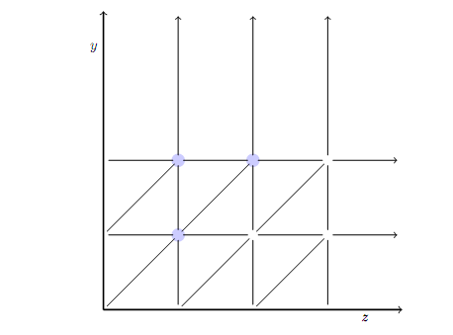
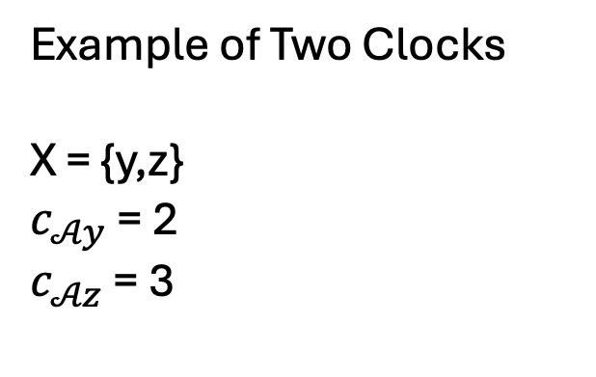
Geometry of clock regions
Example of Two Clocks
X = {y,z}
$c_{𝒜y}$ = 2
$c_{𝒜z}$ = 3

Slide 12
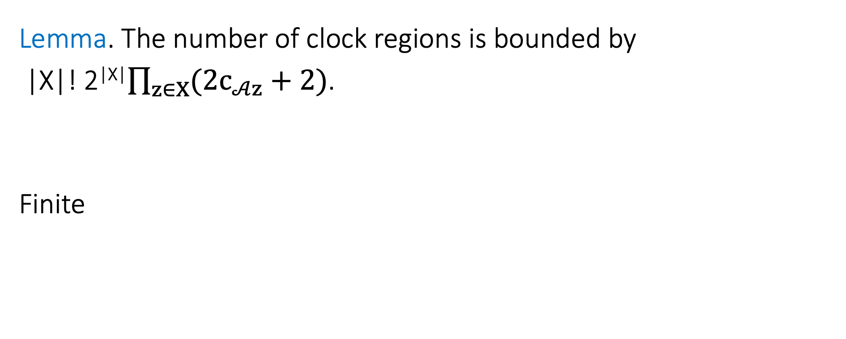
Complexity
Lemma. The number of clock regions is bounded by
|X|! 2^{|X|}$\prod_{z∈X}{(2c_{𝒜z}+2)}$.
Finite

Slide 13
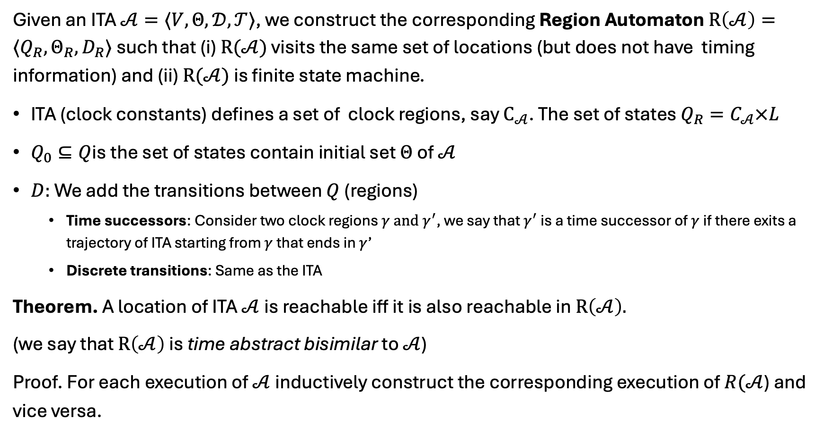

Region automaton $R(𝒜)$
Given an ITA $𝒜=〈V, Θ, 𝒟, 𝒯〉$, we construct the corresponding Region Automaton $R\left(𝒜\right)=⟨Q_{R},Θ_{R},D_{R}⟩$ such that (i) $R(𝒜)$ visits the same set of locations (but does not have timing information) and (ii) $R(𝒜)$ is finite state machine.
ITA (clock constants) defines a set of clock regions, say $C_{𝒜}$. The set of states $Q_{R}=C_{𝒜}×L$
$Q_{0}⊆Q$is the set of states contain initial set $Θ$of $𝒜$
$D:$We add the transitions between $Q$ (regions)
Time successors: Consider two clock regions $γ and γ^{′}$, we say that $γ^{′}$ is a time successor of $γ$ if there exits a trajectory of ITA starting from $γ$ that ends in $γ$’
Discrete transitions: Same as the ITA
Theorem. A location of ITA $𝒜$is reachable iff it is also reachable in $R\left(𝒜\right).$
(we say that $R\left(𝒜\right)$ is time abstract bisimilar to $𝒜$)
Proof. For each execution of $𝒜$ inductively construct the corresponding execution of $R(𝒜$) and vice versa.

Slide 14
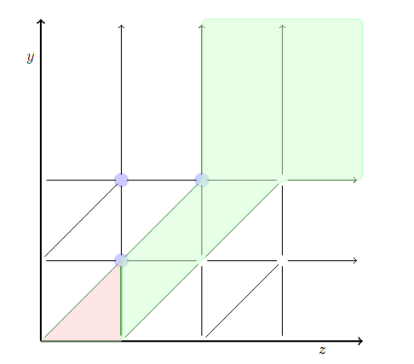
Time successors
The clock regions in blue are time successors of the clock region in red.

Slide 15

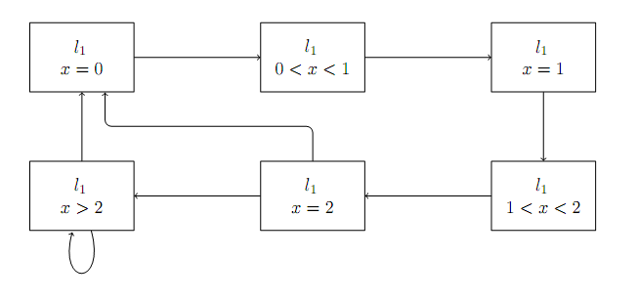
Example 1: Region Automata
ITA
Corresponding FA

Slide 16
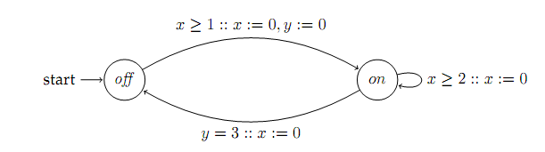
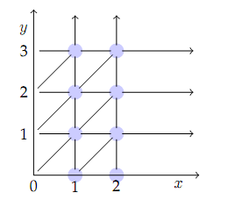
Example 2
ITA
Clock Regions

Slide 17
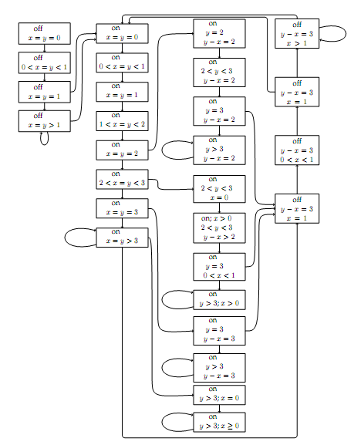
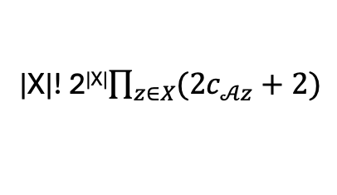
Corresponding FA
|X|! 2^{|X|}$\prod_{z∈X}{(2c_{𝒜z}+2)}$
Drastically increasing with the number of clocks

Slide 18
Summary
Big idea: If two states behave similarly---simulate each other---then a verification algorithm need not keep track of them separately
Related to notion of indistinguishability
Big savings in memory and computation
Many generalizations
Simulation (one way containment) as opposed to bi-simulation
Simulation-like relations for stability (not just reachability) and other kinds of requirements
Computing simulations offline vs online

