Slide 1
Generalizing from Timed to Hybrid Automata
Sayan Mitra
Verifying cyberphysical systems
mitras@illinois.edu

Slide 2
Special Classes of Hybrid Automata
Nonlinear Hybrid
Automata
Rectangular Initialized Hybrid Automata
Rectangular Hybrid Automata
Multirate Automata
Rational Timed Automata
Integral Timed Automata

Slide 3
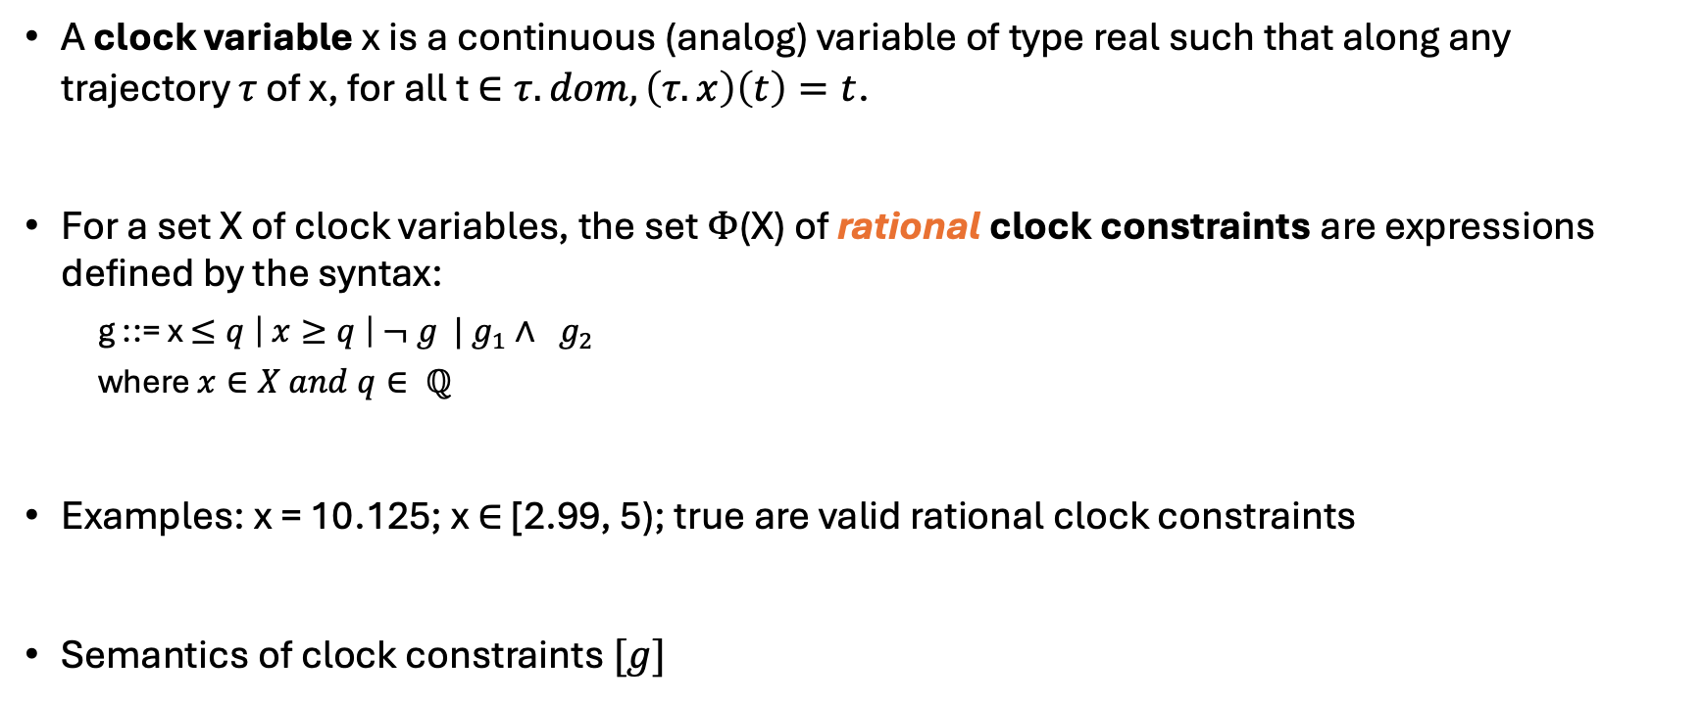
Clocks and Rational Clock Constraints
A clock variable x is a continuous (analog) variable of type real such that along any trajectory $τ$ of x, for all t $∈τ.dom, \left(τ.x\right)\left(t\right)=t$.
For a set X of clock variables, the set $Φ$(X) of rational clock constraints are expressions defined by the syntax:
g ::= x $≤q \left| x≥q \right| ¬ g | g_{1}∧ g_{2}$
where $x∈X and q∈ ℚ$
Examples: x = 10.125; x $∈$ [2.99, 5); true are valid rational clock constraints
Semantics of clock constraints $[g]$

Slide 4
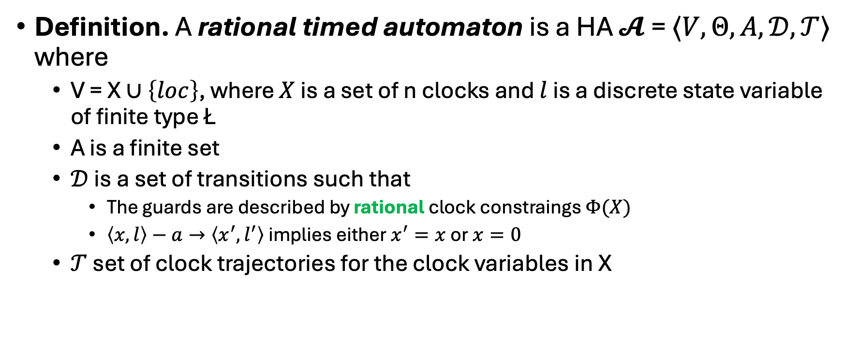
Step 1. Rational Timed Automata
Definition. A rational timed automaton is a HA $𝓐$ = $〈V, Θ, A, 𝒟, 𝒯〉$ where
V = X $∪\left\{loc\right\}$, where $X$ is a set of n clocks and $l$ is a discrete state variable of finite type Ł
A is a finite set
$𝒟$is a set of transitions such that
The guards are described by rational clock constraings $Φ(X)$
$〈x,l〉−a→〈x^{′},l^{′}〉$ implies either $x^{′}=x$ or $x=0$
$𝒯$ set of clock trajectories for the clock variables in X

Slide 5
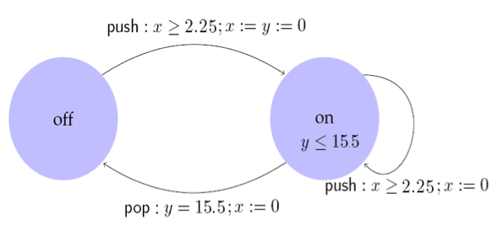
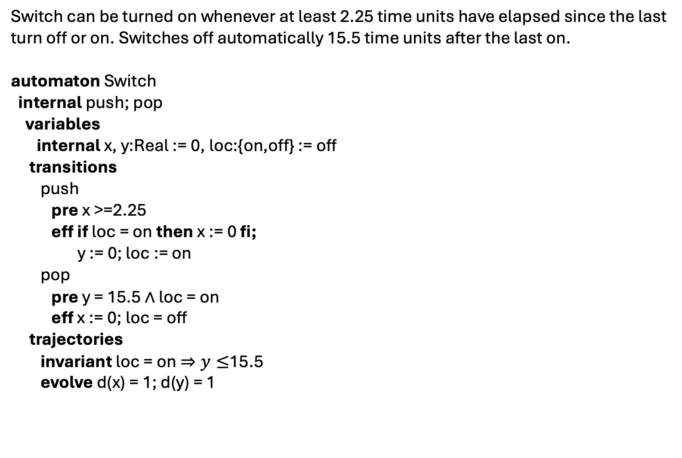
Example: Rational Light switch
Switch can be turned on whenever at least 2.25 time units have elapsed since the last turn off or on. Switches off automatically 15.5 time units after the last on.
automaton Switch
internal push; pop
variables
internal x, y:Real := 0, loc:{on,off} := off
transitions
push
pre x >=2.25
eff if loc = on then x := 0 fi;
y := 0; loc := on
pop
pre y = 15.5 $∧$ loc = on
eff x := 0; loc = off
trajectories
invariant loc = on $⇒y≤$15.5
evolve d(x) = 1; d(y) = 1

Slide 6
Control State (Location) Reachability Problem
Given an RTA, check if a particular location is reachable from the initial states
Is problem decidable?
Yes
Key idea:
Construct a ITA that is time-abstract bisimilar to the given RTA
Check CSR for ITA

Slide 7
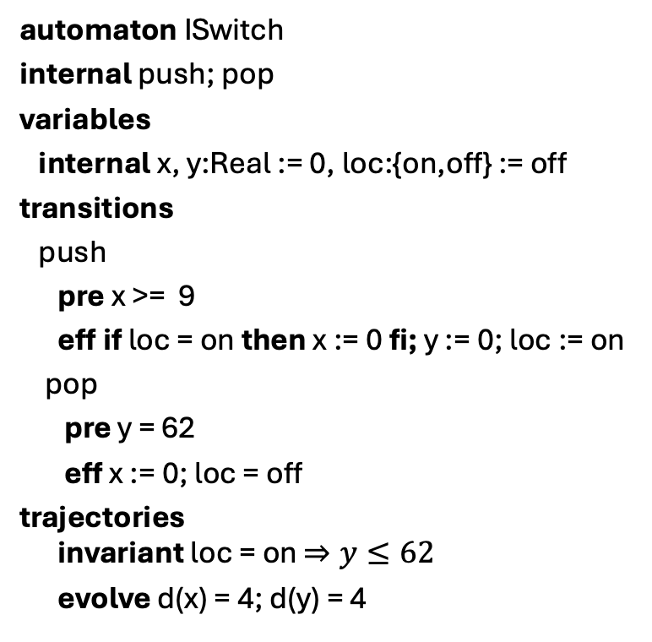
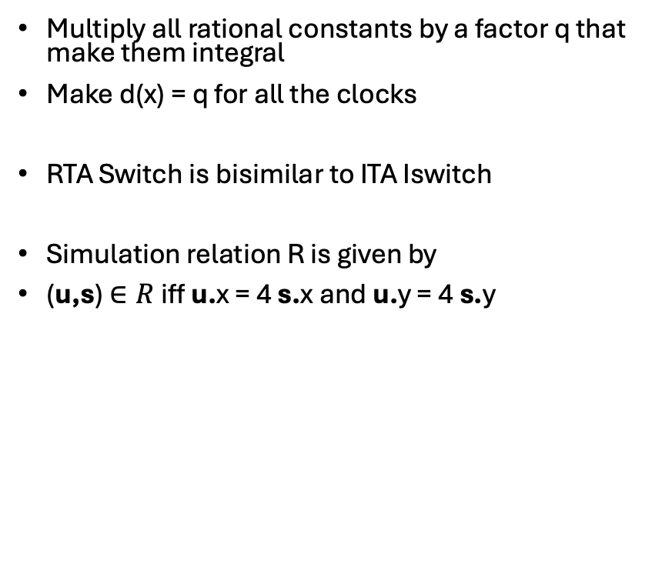
Construction of ITA from RTA
automaton ISwitch
internal push; pop
variables
internal x, y:Real := 0, loc:{on,off} := off
transitions
push
pre x >= 9
eff if loc = on then x := 0 fi; y := 0; loc := on
pop
pre y = 62
eff x := 0; loc = off
trajectories
invariant loc = on $⇒y≤62$
evolve d(x) = 4; d(y) = 4
Multiply all rational constants by a factor q that make them integral
Make d(x) = q for all the clocks
RTA Switch is bisimilar to ITA Iswitch
Simulation relation R is given by
(u,s) $∈R$iff u.x = 4 s.x and u.y = 4 s.y

Slide 8
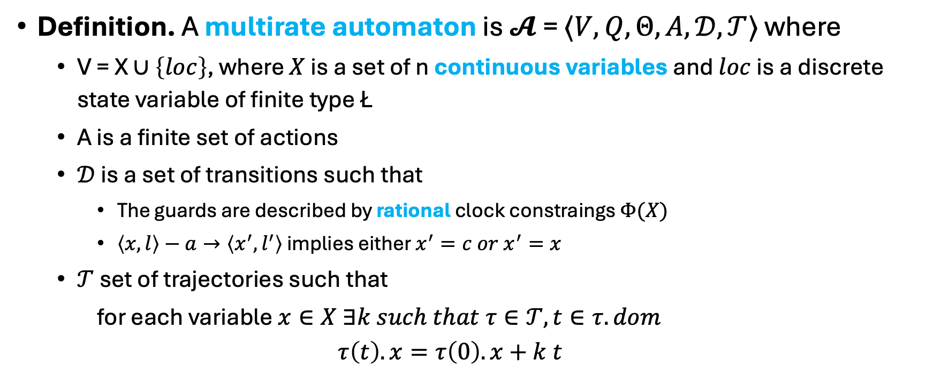
Step 2. Multi-Rate Automaton
Definition. A multirate automaton is $𝓐$ = $〈V, Q, Θ, A, 𝒟, 𝒯〉$ where
V = X $∪\left\{loc\right\}$, where $X$ is a set of n continuous variables and $loc$ is a discrete state variable of finite type Ł
A is a finite set of actions
$𝒟$is a set of transitions such that
The guards are described by rational clock constraings $Φ(X)$
$〈x,l〉−a→〈x^{′},l^{′}〉$ implies either $x^{′}=c{ or x}^{′}=x$
$𝒯$ set of trajectories such that
for each variable $x∈X ∃k such that τ∈𝒯, t∈τ.dom$
$$τ\left(t\right).x=τ\left(0\right).x+k t$$

Slide 9
Control State (Location) Reachability Problem
Given an MRA, check if a particular location is reachable from the initial states
Is problem is decidable? Yes
Key idea:
Construct a RTA that is bisimilar to the given MRA

Slide 10
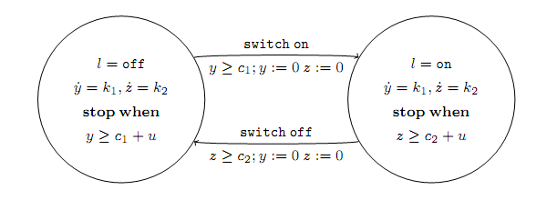
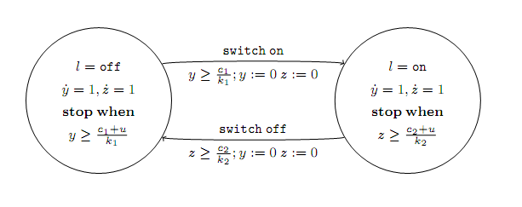
Example: Multi-rate to rational TA

Slide 11
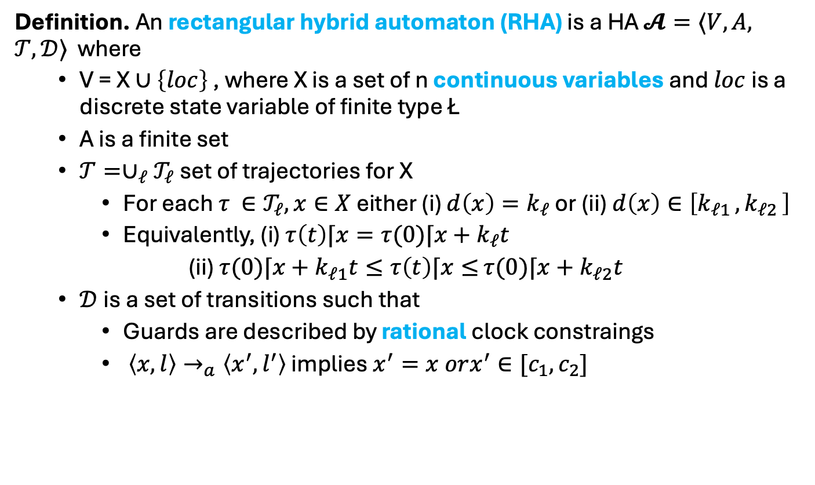
Step 3. Rectangular HA
Definition. An rectangular hybrid automaton (RHA) is a HA $𝓐=⟨V,A,$ $𝒯,𝒟⟩$ where
V = X $∪\left\{loc\right\}$ , where X is a set of n continuous variables and $loc$ is a discrete state variable of finite type Ł
A is a finite set
$𝒯={∪_{ℓ}𝒯}_{ℓ}$ set of trajectories for X
For each $τ ∈𝒯_{ℓ}, x∈X$ either (i) $d\left(x\right)=k_{ℓ}$ or (ii) $d\left(x\right)∈\left[k_{ℓ1 },k_{ℓ2 }\right]$
Equivalently, (i) $τ\left(t\right)⌈x=τ(0)⌈x+k_{ℓ}t$
(ii) $τ(0)⌈x+k_{ℓ1}t≤τ\left(t\right)⌈x≤$ $τ(0)⌈x+k_{ℓ2}t$
$𝒟$is a set of transitions such that
Guards are described by rational clock constraings
$〈x,l〉→_{a}〈x^{′},l^{′}〉$ implies $x^{′}=x orx^{′}∈[c_{1},c_{2}]$

Slide 12
CSR Decidable for RHA?
Given an RHA, check if a particular location is reachable from the initial states?
Is this problem decidable? No
[Henz95] Thomas Henzinger, Peter Kopke, Anuj Puri, and Pravin Varaiya. What's Decidable About Hybrid Automata?. Journal of Computer and System Sciences, pages 373–382. ACM Press, 1995.
CSR for RHA reduction to Halting problem for 2 counter machines
Halting problem for 2CM known to be undecidable
Reduction in next lecture

Slide 13
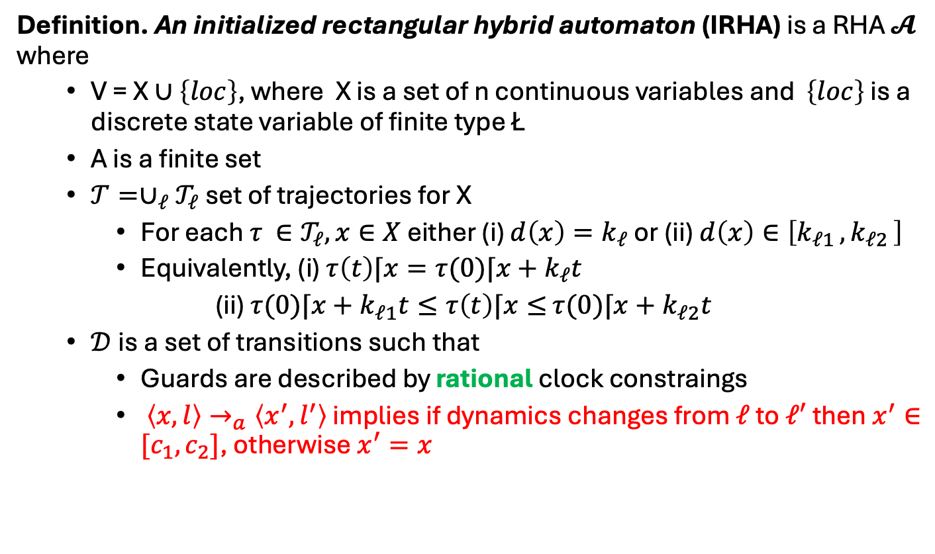
Step 4. Initialized Rectangular HA
Definition. An initialized rectangular hybrid automaton (IRHA) is a RHA $𝓐$ where
V = X $∪\left\{loc\right\}$, where X is a set of n continuous variables and $\left\{loc\right\}$ is a discrete state variable of finite type Ł
A is a finite set
$𝒯={∪_{ℓ}𝒯}_{ℓ}$ set of trajectories for X
For each $τ ∈𝒯_{ℓ}, x∈X$ either (i) $d\left(x\right)=k_{ℓ}$ or (ii) $d\left(x\right)∈\left[k_{ℓ1 },k_{ℓ2 }\right]$
Equivalently, (i) $τ\left(t\right)⌈x=τ(0)⌈x+k_{ℓ}t$
(ii) $τ(0)⌈x+k_{ℓ1}t≤τ\left(t\right)⌈x≤$ $τ(0)⌈x+k_{ℓ2}t$
$𝒟$is a set of transitions such that
Guards are described by rational clock constraings
$〈x,l〉→_{a}〈x^{′},l^{′}〉$ implies if dynamics changes from $ℓ$ to $ℓ′$ then $x^{′}∈[c_{1},c_{2}]$, otherwise $x^{′}=x$

Slide 14
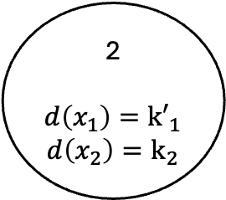

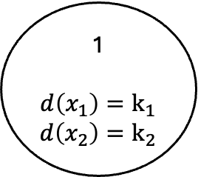
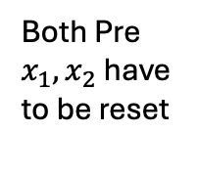
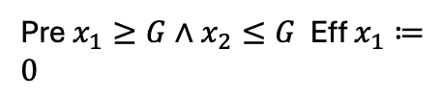
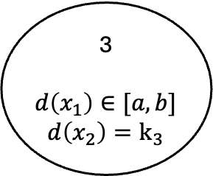
Example: Rectangular Initialized HA
Pre $x_{1}≥G∧x_{2}≤G$ Eff $x_{1}≔0$
1
$$d\left(x_{1}\right)=k_{1}$$
$$d\left(x_{2}\right)=k_{2}$$
2
$$d\left(x_{1}\right)={k′}_{1}$$
$$d\left(x_{2}\right)=k_{2}$$
Both Pre $x_{1}, x_{2}$ have to be reset
3
$$d\left(x_{1}\right)∈[a,b]$$
$$d\left(x_{2}\right)=k_{3}$$
Eff $x_{1}, x_{2}∈[c,d]$

Slide 15
CSR Decidable for IRHA?
Given an IRHA, check if a particular location is reachable from the initial states
Is this problem decidable? Yes
Key idea:
Construct a 2n-dimensional initialized multi-rate automaton that is bisimilar to the given IRHA
Construct a ITA that is bisimilar to the Singular TA

Slide 16
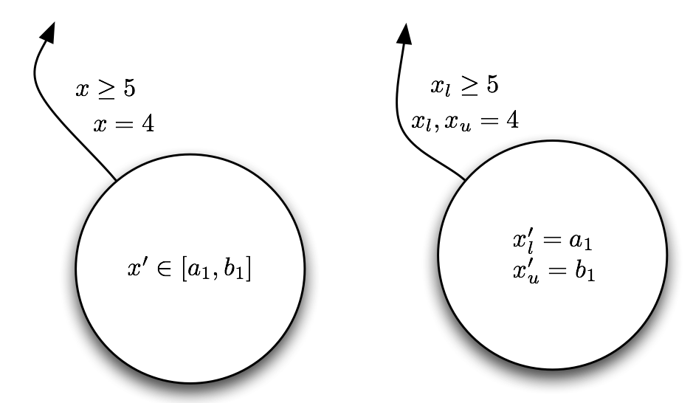
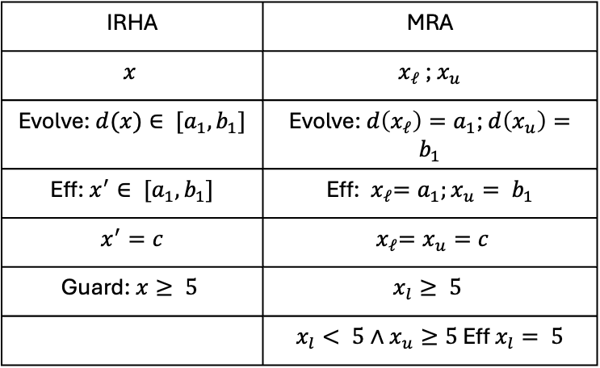
From IRHA to Singular HA conversion
For every variable create two variables---tracking the upper and lower bounds
IRHA | MRA
$$x$$ | $x_{ℓ}$ ; $x_{u}$
Evolve: $d(x)∈ [a_{1},b_{1}]$ | Evolve: $d\left(x_{ℓ}\right)=a_{1}$; $d\left(x_{u}\right)=b_{1}$
Eff: $x^{′}∈ [a_{1},b_{1}]$ | Eff:${ x}_{ℓ}=a_{1};x_{u}= b_{1}$
$x^{′}=c$ | $${ x}_{ℓ}=x_{u}=c$$
Guard: $x≥ 5$ | $$x_{l}≥ 5$$
 | $x_{l}< 5∧x_{u}≥5$ Eff $x_{l}= 5$

Slide 17
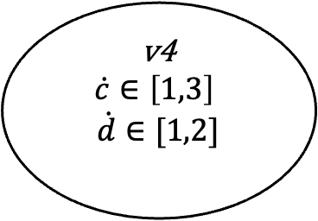
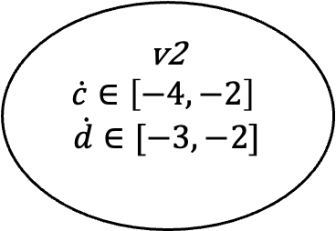
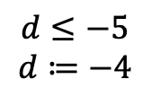
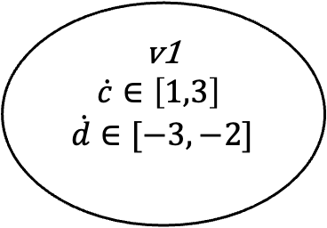
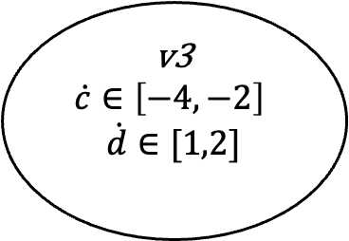
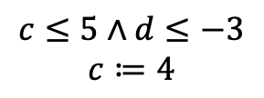
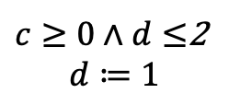

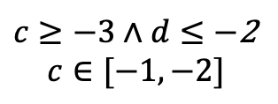
Example IRHA
$$c≔0;d≔1$$
v1
$$\dot{c}∈\left[1,3\right]$$
$$\dot{d}∈[−3,−2]$$
$c≥0∧d≤$2
$$d≔1$$
v4
$$\dot{c}∈\left[1,3\right]$$
$$\dot{d}∈[1,2]$$
$$c≤5∧d≤−3$$
$$c≔4$$
$c≥−3∧d≤−$2
$$c∈[−1,−2]$$
v2
$$\dot{c}∈\left[−4,−2\right]$$
$$\dot{d}∈[−3,−2]$$
$$d≤−5$$
$$d≔−4$$
v3
$$\dot{c}∈\left[−4,−2\right]$$
$$\dot{d}∈[1,2]$$

Slide 18
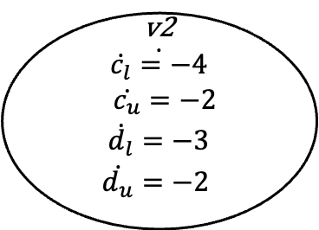
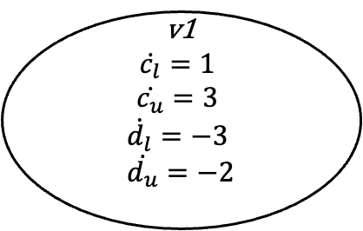
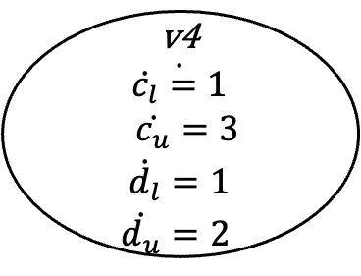
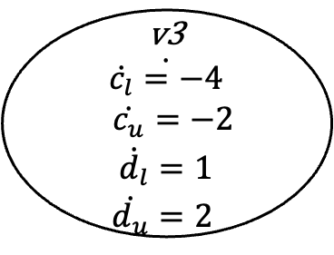

Initialized Singular HA
$$c_{l},c_{u}≔0;d_{l}, d_{u}≔1$$
v1
$$\dot{c_{l}}=1$$
$$\dot{c_{u}}=3$$
$$\dot{d_{l}}=−3$$
$$\dot{d_{u}}=−2$$
v4
$\dot{\begin{aligned}\dot{c_{l}}=1 \\ \dot{c_{u}}=3 \\ \begin{aligned} \dot{d_{l}}=1 \\ \dot{d_{u}}=2 \end{aligned}\end{aligned}}$
v2
$$\dot{\begin{aligned}\dot{c_{l}}=−4 \\ \dot{c_{u}}=−2 \\ \begin{aligned} \dot{d_{l}}=−3 \\ \dot{d_{u}}=−2 \end{aligned}\end{aligned}}$$
v3
$$\dot{\begin{aligned}\dot{c_{l}}=−4 \\ \dot{c_{u}}=−2 \\ \begin{aligned} \dot{d_{l}}=1 \\ \dot{d_{u}}=2 \end{aligned}\end{aligned}}$$

Slide 19
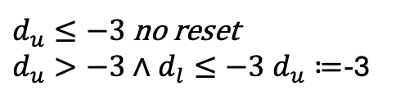
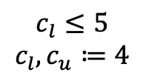




Transitions
v1
$$\dot{c_{l}}=1$$
$$\dot{c_{u}}=3$$
$$\dot{d_{l}}=−3$$
$$\dot{d_{u}}=−2$$
5
$$c_{u}$$
$$c_{l}$$
$$c_{l}≤5$$
$$c_{l}, c_{u}≔4$$
$d_{u}≤−3$ no reset
$d_{u}>−3∧d_{l}≤−3 d_{u}≔$-3
$${d_{u}}_{ }$$
-3
$$d_{l}$$

Slide 20
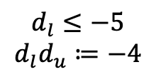

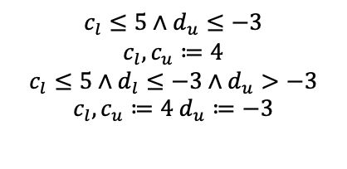
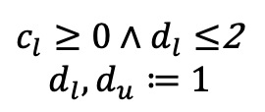
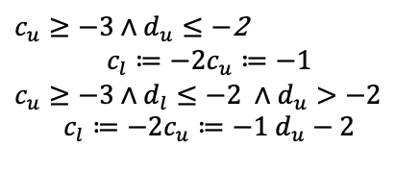
Initialized Singular HA
$$c_{l},c_{u}≔0;d_{l}, d_{u}≔1$$
v1
$$\dot{c_{l}}=1$$
$$\dot{c_{u}}=3$$
$$\dot{d_{l}}=−3$$
$$\dot{d_{u}}=−2$$
$c_{l}≥0∧d_{l}≤$2
$$d_{l}, d_{u}≔1$$
v4
$\dot{\begin{aligned}\dot{c_{l}}=1 \\ \dot{c_{u}}=3 \\ \begin{aligned} \dot{d_{l}}=1 \\ \dot{d_{u}}=2 \end{aligned}\end{aligned}}$
$c_{l}<0∧c_{u}≥0∧d_{l}≤$2
$$c_{l}≔0d_{l}, d_{u}≔1$$
$$c_{l}≤5∧d_{u}≤−3$$
$$c_{l}, c_{u}≔4$$
$$c_{l}≤5∧d_{l}≤−3∧d_{u}>−3$$
$$c_{l}, c_{u}≔4 d_{u}≔−3$$
$c_{u}≥−3∧d_{u}≤−$2
$$c_{l}≔−2c_{u}≔−1$$
$c_{u}≥−3∧d_{l}≤−2 ∧d_{u}>−2$
$$c_{l}≔−2c_{u}≔−1 d_{u}−2$$
v2
$$\dot{\begin{aligned}\dot{c_{l}}=−4 \\ \dot{c_{u}}=−2 \\ \begin{aligned} \dot{d_{l}}=−3 \\ \dot{d_{u}}=−2 \end{aligned}\end{aligned}}$$
$$d_{l}≤−5$$
$$d_{l}d_{u}≔−4$$
v3
$$\dot{\begin{aligned}\dot{c_{l}}=−4 \\ \dot{c_{u}}=−2 \\ \begin{aligned} \dot{d_{l}}=1 \\ \dot{d_{u}}=2 \end{aligned}\end{aligned}}$$

Slide 21
Can this be further generalized ?
For initialized Rectangular HA, control state reachability is decidable
Can we drop the initialization restriction?
No, problem becomes undecidable (next time)
Can we drop the rectangular restriction?
No, problem becomes undecidable

Slide 22
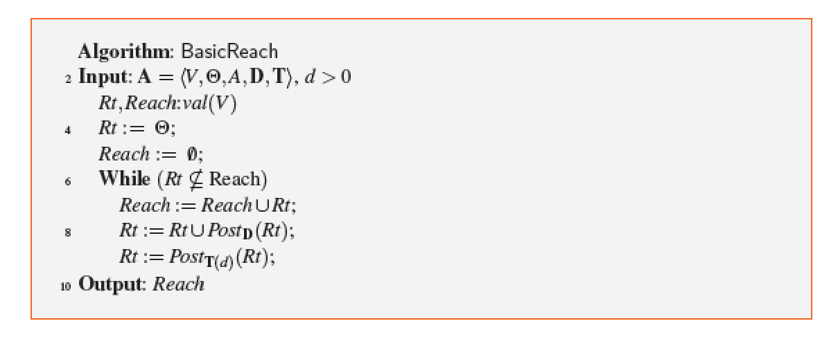
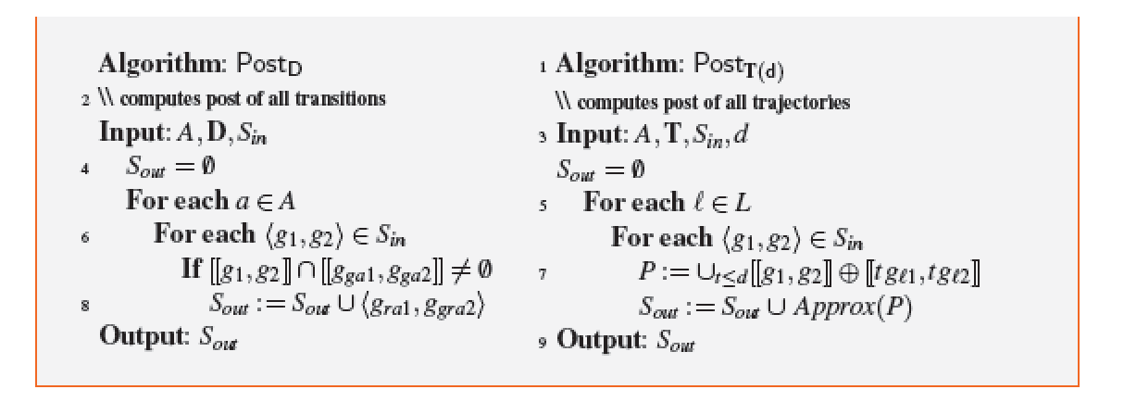
Verification in tools

Slide 23
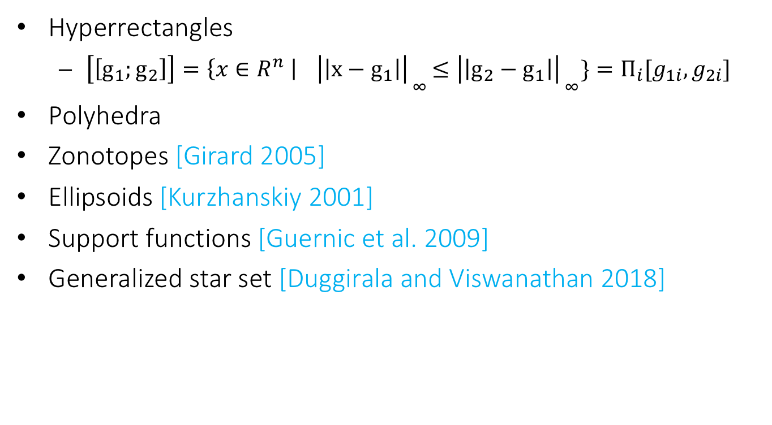
Data structures make reachability go around
Hyperrectangles
$\left[\left[g_{1};g_{2}\right]\right]=\left\{x∈R^{n} \right|{ \left|\left|x−g_{1}\right|\right|}_{ _{∞}}≤{\left|\left|g_{2}−g_{1}\right|\right|}_{ _{∞}}\}=Π_{i}[g_{1i},g_{2i}]$
Polyhedra
Zonotopes [Girard 2005]
Ellipsoids [Kurzhanskiy 2001]
Support functions [Guernic et al. 2009]
Generalized star set [Duggirala and Viswanathan 2018]

Slide 24
Data structures: rectangles and ellipsoids

Slide 25
Zonotopes and polytopes

Slide 26
Summary
ITA: Restricted class of hybrid automata
Clocks, integer constraints
No clock comparison, linear
Control state reachability with Alur-Dill’s algorithm (region automaton construction)
Rational coefficients; multirate Automata
Initialized Rectangular Hybrid Automata
HyTech, PHAVer use polyhedral reachability computations
Notes:
fix-point implementation in tools
We can remove the init. set. Hytech will accept the automaton, but there is no guarantee on termination

