Slide 1
Abstractions II: Counter Example-Guided Abstraction Refinement
Sayan Mitra
Verifying cyberphysical systems
mitras@illinois.edu

Slide 2
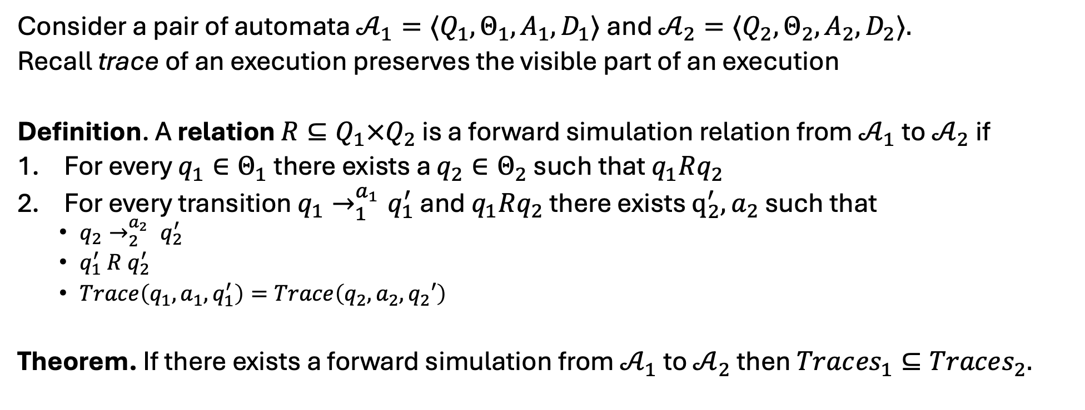
Forward simulation relation
Consider a pair of automata ${𝒜_{1}=⟨Q}_{1}, Θ_{1},A_{1},D_{1}⟩$and ${𝒜_{2}=⟨Q}_{2}, Θ_{2},A_{2},D_{2}⟩.$
Recall trace of an execution preserves the visible part of an execution
Definition. A relation $R⊆Q_{1}×Q_{2}$ is a forward simulation relation from $𝒜_{1}$to $𝒜_{2}$if
For every $q_{1}∈Θ_{1}$there exists a $q_{2}∈Θ_{2}$ such that $q_{1}Rq_{2}$
For every transition $q_{1}→_{1}^{a_{1}}q_{1}^{′}$ and $q_{1}Rq_{2}$ there exists $q_{2}^{′},a_{2}$ such that
$q_{2}→_{2}^{a_{2}} q_{2}^{′}$
$q_{1}^{′} R q_{2}^{′}$
$Trace\left(q_{1},a_{1},q_{1}^{′}\right)=Trace\left(q_{2},a_{2},q_{2}′\right)$
Theorem. If there exists a forward simulation from $𝒜_{1}$ to $𝒜_{2}$ then $Trac{es}_{1}⊆Traces_{2}.$

Slide 3

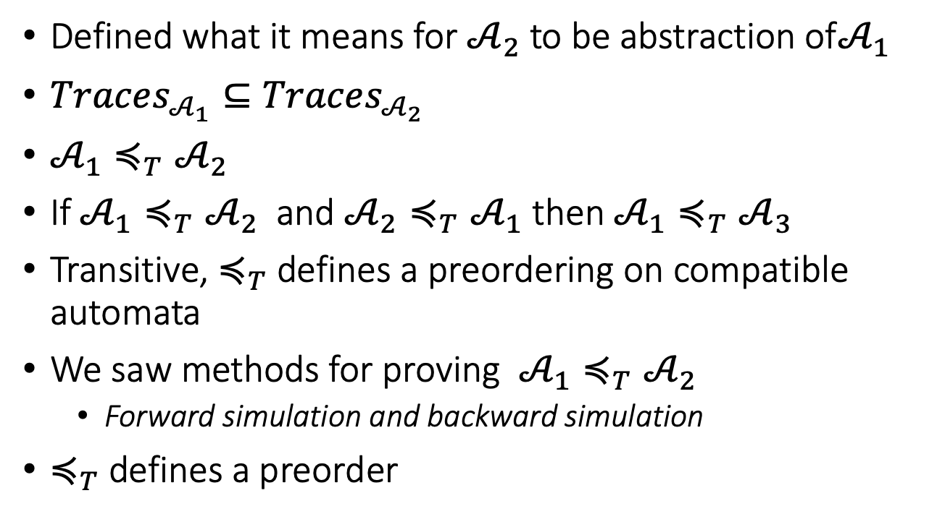


Abstraction recap
Defined what it means for $𝒜_{2}$ to be abstraction of$𝒜_{1}$
$Traces_{𝒜_{1}}⊆Traces_{𝒜_{2}}$
$𝒜_{1}≼_{T}𝒜_{2}$
If $𝒜_{1}≼_{T}𝒜_{2}$ and $𝒜_{2}≼_{T}𝒜_{1}$ then $𝒜_{1}≼_{T}𝒜_{3}$
Transitive, $≼_{T}$ defines a preordering on compatible automata
We saw methods for proving $𝒜_{1}≼_{T}𝒜_{2}$
Forward simulation and backward simulation
$≼_{T}$ defines a preorder
$$𝒜_{1}$$
$$𝒜_{2}$$
$$≼$$

Slide 4
Counter-example guided abstraction-refinement

Slide 5
Counterexample-guided abstraction refinement
Counterexample-guided abstraction refinement
Clarke, E., Grumberg, O., Jha, S., Lu, Y., & Veith, H. (2000, July).CAV 2000. Springer Berlin Heidelberg.

Slide 6
Counterexample guided abstraction refinement (CEGAR)
A general algorithmic framework for automatically constructing and verifying property-specific abstractions [Clarke:2000]
CEGAR has been applied to discrete automata, software, and hybrid systems [Holzman 00,Ball 01, Alur 2006,Clarke 2003, Fehnker2005, Prabhakar 15, Roohi 17]
We will discuss the basic idea of the CEGAR and the key design choices, and their implications.

Slide 7
Start with coarse abstraction B₀
Check B_{i} satisfies S ?
Idea of CEGAR
Yes
A is safe
No
β = q₀ q₁ q₂ … q_{n}
β counter-example for A?
Yes
A unsafe
No
Refine B_{i} to get B_{i+1}

Slide 8
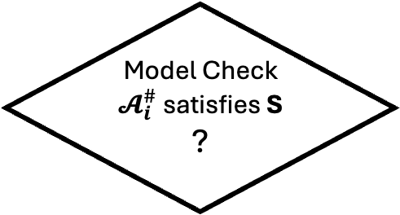

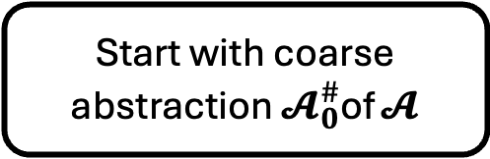

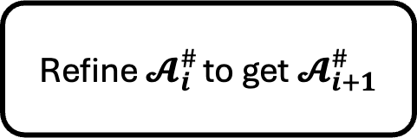
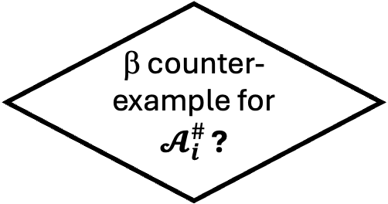
Start with coarse abstraction $𝓐_{0}^{\#}$of $𝓐$
Model Check $𝓐_{i}^{\#}$satisfies S ?
Idea of CEGAR
Yes
$𝓐$ is safe
No
β = q₀ q₁ q₂ … q_{n}
β counter-example for $𝓐_{i}^{\#}$ ?
Yes
$𝓐$ unsafe
No
Refine $𝓐_{i}^{\#}$ to get $𝓐_{i+1}^{\#}$

Slide 9
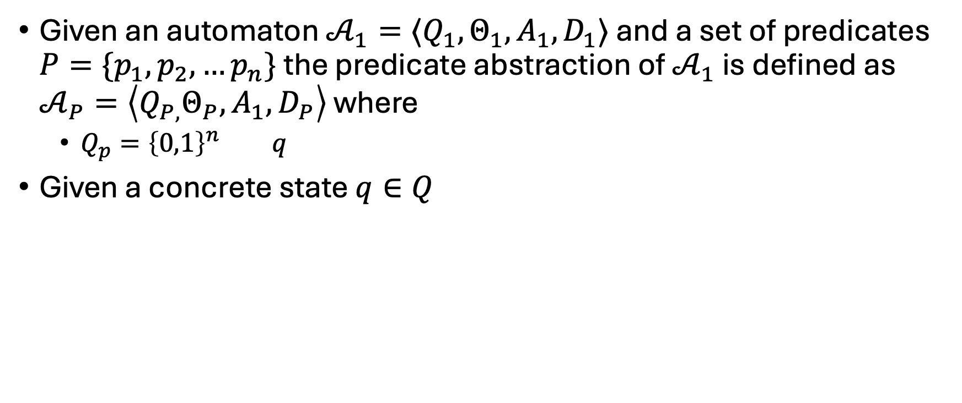
Predicate Abstraction
Given an automaton $𝒜_{1}=⟨Q_{1}, Θ_{1},A_{1},D_{1}⟩$ and a set of predicates $P=\{p_{1},p_{2},…p_{n}\}$ the predicate abstraction of $𝒜_{1}$ is defined as $𝒜_{P}=\left\langle Q_{P,}Θ_{P},A_{1},D_{P}\right\rangle$ where
$Q_{p}={\left\{0,1\right\}}^{n}$ $q$
Given a concrete state $q∈Q$
Flanagan, C., & Qadeer, S. (2002, January). Predicate abstraction for software verification. POPL 2002
Ball, T., Majumdar, R., Millstein, T., & Rajamani, S. K. (2001, May). PLDI 2001

Slide 10
Key design choices
Space of the abstract automata (finite, timed, linear)
Model checker for abstract automaton
Counter-example validation procedure
Refinement strategy

Slide 11




$$Unsafe$$
$$q_{0}$$
$$Θ$$
$$(0,0)$$

Slide 12


$$Unsafe$$
$$q_{0}$$
$$Θ$$
$$(0,0)$$

Slide 13










$$Unsafe$$
$$q_{5}$$
$$S_{4}= Pre_{A}\left(S_{5}\right)∩ R^{−1 }\left(q_{4}\right)≠∅$$
$$S_{3}= Pr{e_{A}(S_{4})}_{}∩R^{−1 }\left(q_{3}\right)≠ ∅$$
$$S_{2}= Pre_{A} \left(S_{3}\right)∩ R^{−1}\left(q_{2}\right)≠∅$$
$$S_{1}= Pre_{A} \left(S_{2}\right)∩ R^{−1} \left(q_{1}\right) =∅$$
$$q_{2}$$
$$q_{3}$$
$$q_{4}$$
$$q_{1}$$
$$q_{0}$$
$$Θ$$
$$(0,0)$$

Slide 14
Outline
Abstractions and composition
CEGAR

Slide 15
Substituting an automaton with its abstraction
Concrete system
Plant
Controller

Slide 16
Substituting an automaton with its abstraction
Abstract system
Plant
Abstract Controller
Controller

Slide 17


How is the abstract system related to the concrete system?
Controller
Abstract Controller
Does
$$≼$$
imply
Concrete system
Abstract system
Plant
Controller
$$≼$$
Plant
Abstract Controller
?

Slide 18
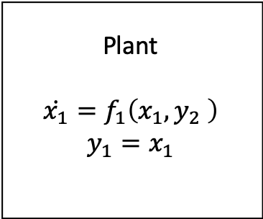
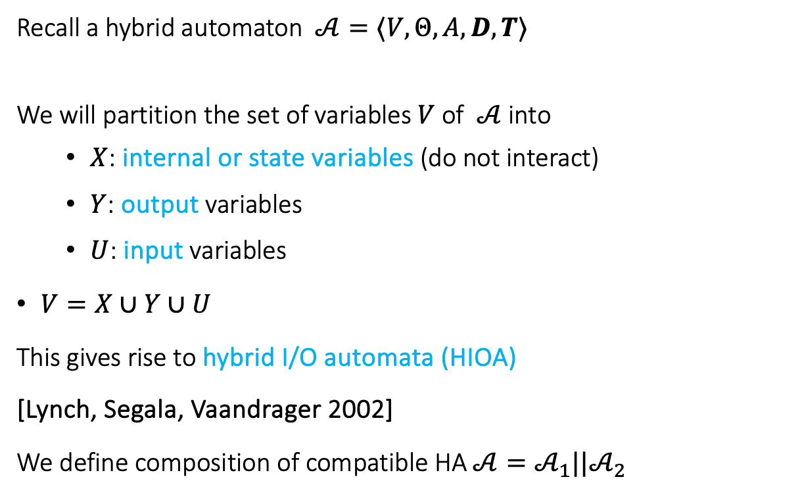


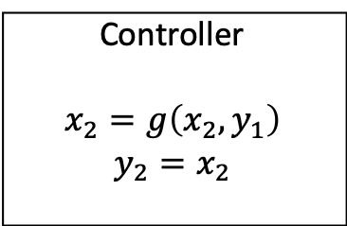
Hybrid IO Automaton
Recall a hybrid automaton $𝒜=⟨V,Θ,A, D,T⟩$
We will partition the set of variables $V$of $𝒜$ into
$X$: internal or state variables (do not interact)
$Y$: output variables
$U$: input variables
$V=X∪Y∪U$
This gives rise to hybrid I/O automata (HIOA)
[Lynch, Segala, Vaandrager 2002]
We define composition of compatible HA $𝒜=𝒜_{1}||𝒜_{2}$
Plant
$$\dot{x_{1}}=f_{1}\left(x_{1},y_{2} \right)$$
$$y_{1}=x_{1}$$
$$y_{2}$$
$$y_{1}$$
Controller
$$x_{2}=g\left(x_{2},y_{1}\right)$$
$$y_{2}=x_{2}$$

Slide 19
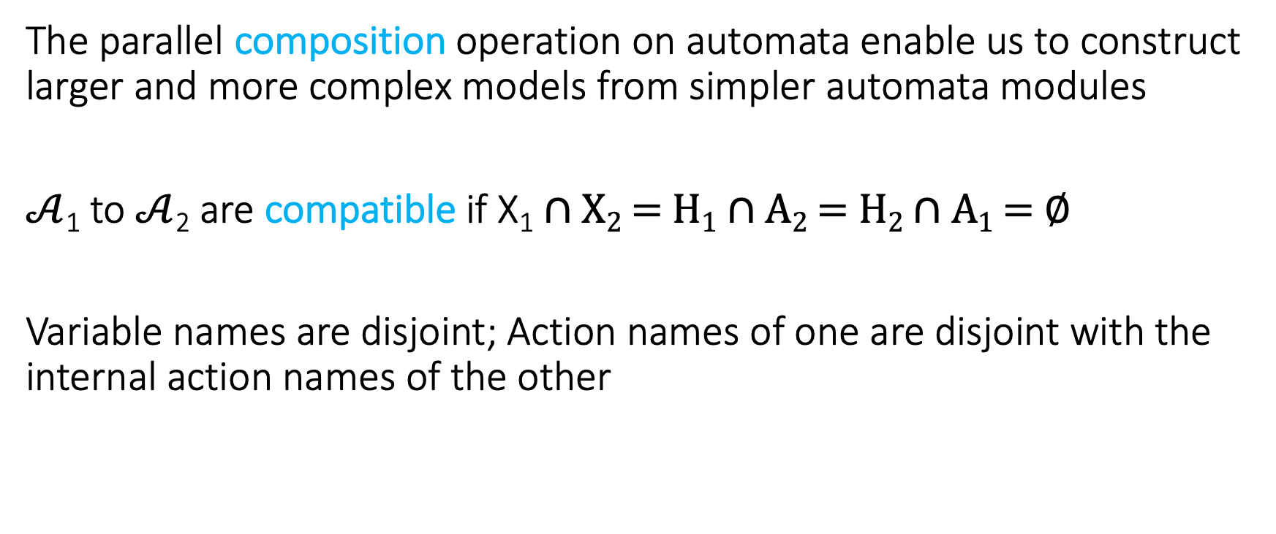
Composition of Hybrid Automata
The parallel composition operation on automata enable us to construct larger and more complex models from simpler automata modules
$𝒜$₁ to $𝒜$₂ are compatible if X₁ ∩ X₂ = H₁ ∩ A₂ = H₂ ∩ A₁ = ∅
Variable names are disjoint; Action names of one are disjoint with the internal action names of the other

Slide 20
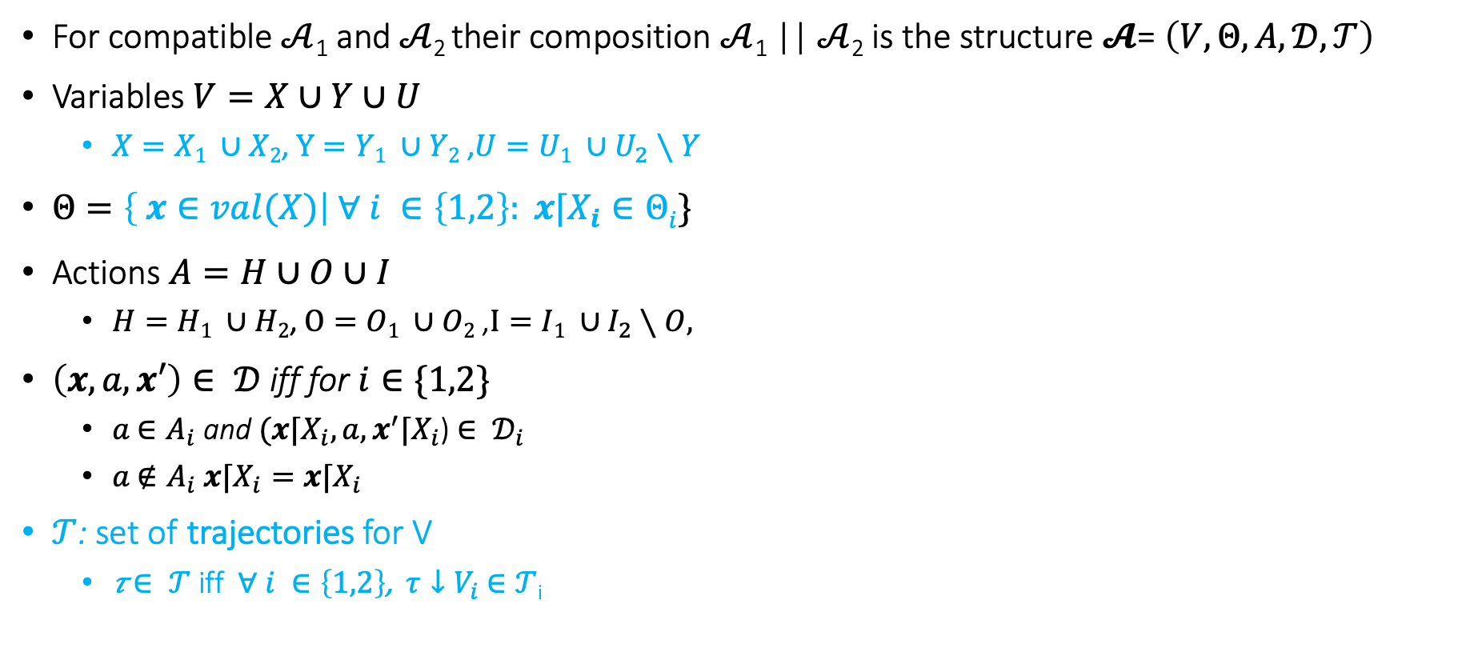
Composition
For compatible $𝒜$₁ and $𝒜$₂ their composition $𝒜$₁ || $𝒜$₂ is the structure $𝓐$= $\left(V,Θ,A,𝒟,𝒯\right)$
Variables $V=X∪Y∪U$
$X=X1 ∪X2$, $Y=Y1 ∪Y2$ ,$U=U1 ∪U_{2}∖Y$
$Θ=\left\{ x∈val(X)\right| ∀ i ∈\left\{1,2\right\}: x⌈X_{i}∈Θi\}$
Actions $A=H∪O∪I$
$H=H1 ∪H2$, $O=O1 ∪O2$ ,$I=I1 ∪I_{2}∖O,$
$\left(x,a,x′\right)∈ 𝒟$ iff for $i∈\{1,2\}$
$a$ $∈A_{i}$ and $(x⌈X_{i},a,x^{′}⌈X_{i}$) $∈ 𝒟_{i}$
$a$ $∉A_{i}$ $x⌈X_{i}=x⌈X_{i}$
$𝒯$: set of trajectories for V
𝜏 $∈ 𝒯$ iff $∀ i ∈\left\{1,2\right\}$, $τ↓V_{i}$ $∈𝒯$_{i}

Slide 21

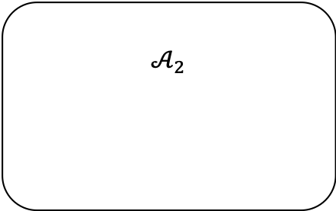
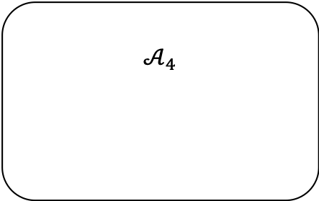

$$𝒜_{2}$$
u₂
u₂
$${\dot{x}}_{1}=f(x_{1},u_{2})$$
a₁
a₁
$$𝒜_{3}$$
a₁
e
e
f
f
a₁
$$𝒜_{4}$$

Slide 22
Modeling a Simple Failure Detector System
Periodic send
Channel
Timeout
Send
Send(m)
Channel
recv(m)
Failure Detector
fail
detect

Slide 23
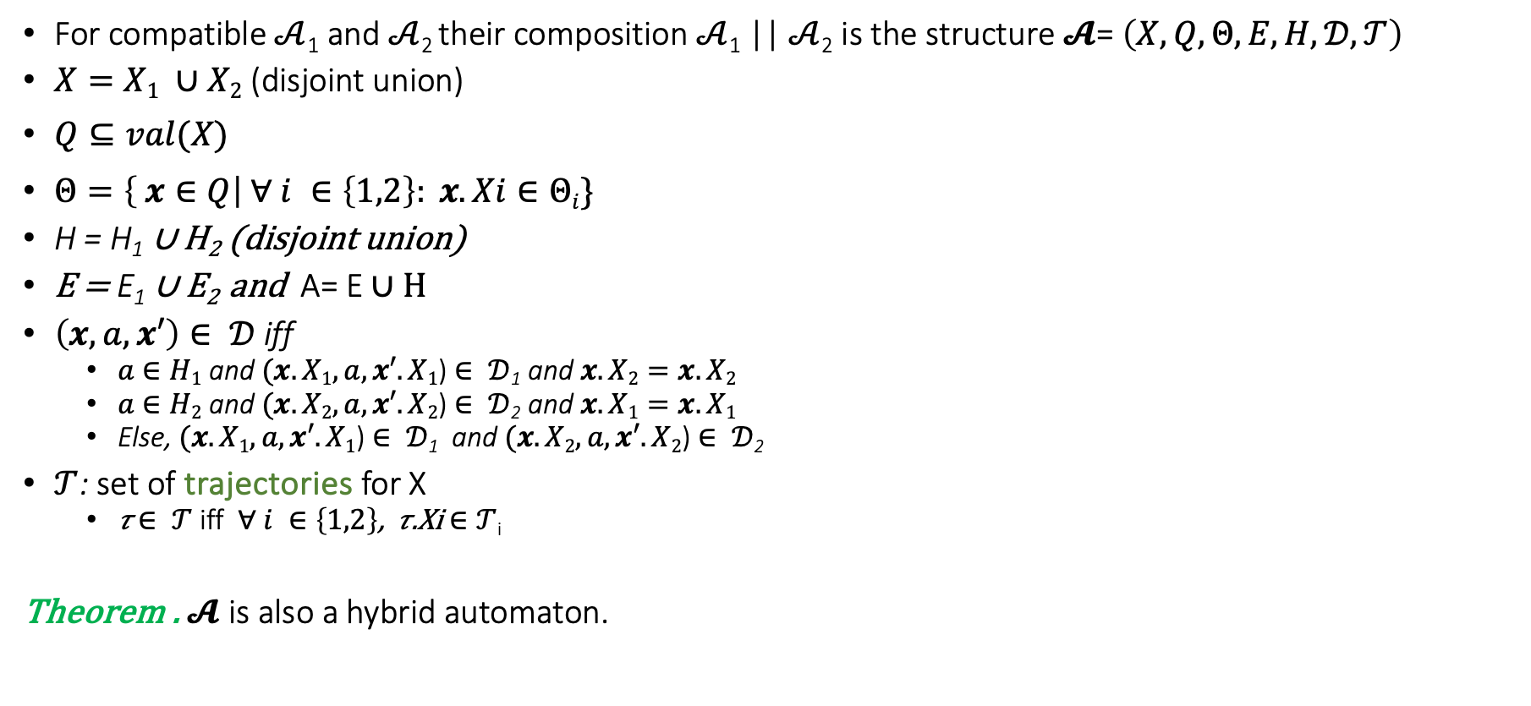
Composition
For compatible $𝒜$₁ and $𝒜$₂ their composition $𝒜$₁ || $𝒜$₂ is the structure $𝓐$= $\left(X,Q,Θ,E,H,𝒟,𝒯\right)$
$X=X1 ∪X2$ (disjoint union)
$Q⊆val(X)$
$Θ=\left\{ x∈Q\right| ∀ i ∈\left\{1,2\right\}: x.Xi∈Θi\}$
H = H₁ ∪ H₂ (disjoint union)
E = E₁ ∪ E₂ and A= E ∪ H
$\left(x,a,x′\right)∈ 𝒟$ iff
$a$ $∈H1$ and $(x.X1,a,x′.X1$) $∈ 𝒟$₁ and $x.X2=x.X2$
$a$ $∈H2$ and $(x.X2,a,x′.X2$) $∈ 𝒟$₂ and $x.X1=x.X1$
Else, $(x.X1,a,x′.X1$) $∈ 𝒟$₁ and $(x.X2,a,x′.X2$) $∈ 𝒟$₂
$𝒯$: set of trajectories for X
𝜏 $∈ 𝒯$ iff $∀ i ∈\left\{1,2\right\}$, 𝜏.Xi $∈𝒯$_{i}
Theorem . $𝓐$ is also a hybrid automaton.

Slide 24
Example: Send || TimedChannel
Automaton Channel(b,M)
variables: internal
queue: Queue[M,Reals] := {}
clock1: Reals := 0
actions: external send(m:M), receive(m:M)
transitions:
send(m)
pre true
eff queue := append(<m, clock1+b>, queue)
receive(m)
pre head(queue)[1] = m
eff queue := queue.tail
trajectories:
evolve d(clock1) = 1
stop when ∃ m, d, <m,d> ∈ queue
/\ clock=d
Automaton PeriodicSend(u, M)
variables: internal clock: Reals := 0
actions: external send(m:M)
transitions:
send(m)
pre clock = u
eff clock := 0
trajectories:
evolve d(clock) = 1
stop when clock=u

Slide 25
Composed Automaton
Automaton SC(b,u)
variables: internal queue: Queue[M,Reals] := {}
clock_s, clock_c: Reals := 0
actions: external send(m:M), receive(m:M)
transitions:
send(m)
pre clock_s = u
eff queue := append(<m, clock_c+b>, queue); clock_s := 0
receive(m)
pre head(queue)[1] = m
eff queue := queue.tail
trajectories:
evolve d(clock_c) = 1; d(clock_s) = 1
stop when
(∃ m, d, <m,d> ∈ queue /\ clock_c=d)
\/ (clock_s=u)

Slide 26
Modeling a Simple Failure Detector System
Periodic send || Channel
Periodic send || Channel || Timeout
Send
Send(m)
Channel
recv(m)
Failure Detector
fail
detect

Slide 27
Time bounded channel & Simple Failure Detector
Automaton Timeout(u,M)
variables: internal suspected: Boolean := F,
clock: Reals := 0
actions: external receive(m:M), timeout
transitions:
receive(m)
pre true
eff clock := 0; suspected := false;
timeout
pre ~suspected /\ clock = u
eff suspected := true
trajectories:
evolve d(clock) = 1
stop when clock = u /\ ~suspected

Slide 28


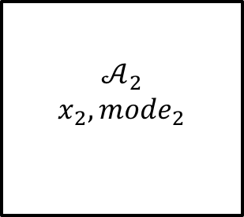


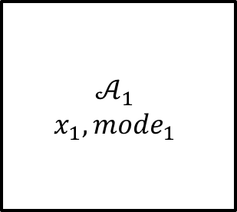





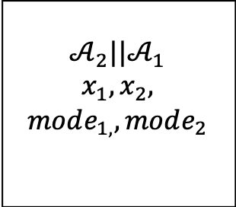

General composition
$$u_{1}$$
$${input}_{1}$$
$$a_{1}$$
$$𝒜_{1}$$
$$x_{1},mode_{1}$$
$$𝒜_{2}$$
$$x_{2},mode_{2}$$
$$var_{1}$$
$$y_{2}$$
$$a_{2}$$
$$u_{1},u_{2}$$
$$𝒜_{2}||𝒜_{1}$$
$$x_{1},x_{2},$$
$$mode_{1,},mode_{2}$$
$$var_{1},y_{2}$$
$${input}_{1}$$
$$a_{1},a_{2}$$

Slide 29
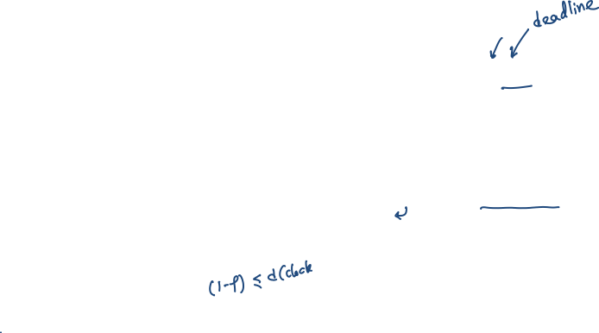
Time bounded channel & Simple Failure Detector
Automaton Timeout(u,M)
variables: suspected: Boolean := F,
clock: Reals := 0
actions: external receive(m:M), timeout
transitions:
receive(m)
pre true
eff clock := 0; suspected := false;
timeout
pre ~suspected /\ clock = u
eff suspected := true
trajectories:
evolve d(clock) = 1
stop when clock = u /\ ~suspected
Automaton Channel(b,M)
variables: queue: Queue[M,Reals] := {}
clock: Reals := 0
actions: external send(m:M), receive(m:M)
transitions:
send(m)
pre true
eff queue := append(<m, clock+b>, queue)
receive(m)
pre head(queue)[1] = m
eff queue := queue.tail
trajectories:
evolve d(clock) = 1
stop when ∃ m, d, <m,d> ∈ queue
/\ clock=d

Slide 30
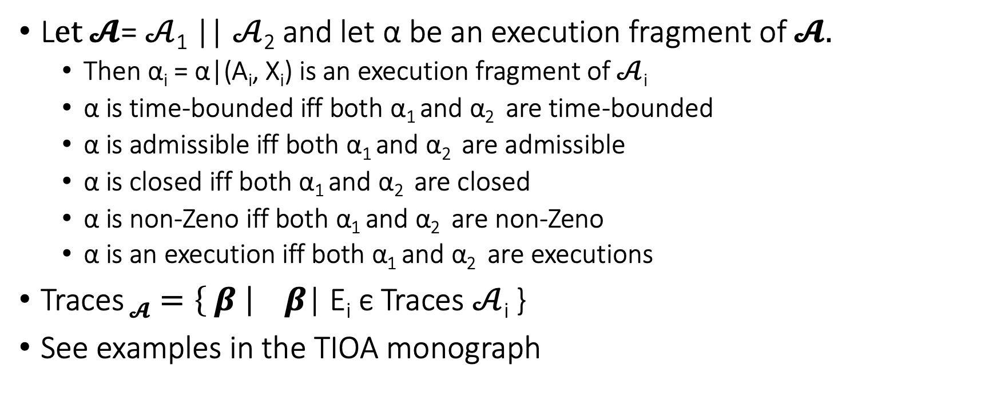
Some properties about composed automata
L$et 𝓐$= $𝒜$₁ || $𝒜$₂ and let α be an execution fragment of $𝓐.$
Then α_{i} = α|(A_{i}, X_{i}) is an execution fragment of $𝒜$_{i}
α is time-bounded iff both α₁ and α₂ are time-bounded
α is admissible iff both α₁ and α₂ are admissible
α is closed iff both α₁ and α₂ are closed
α is non-Zeno iff both α₁ and α₂ are non-Zeno
α is an execution iff both α₁ and α₂ are executions
Traces $𝓐=\left\{ β \right|$ $β$| E_{i} ϵ Traces $𝒜$_{i} }
See examples in the TIOA monograph

Slide 31
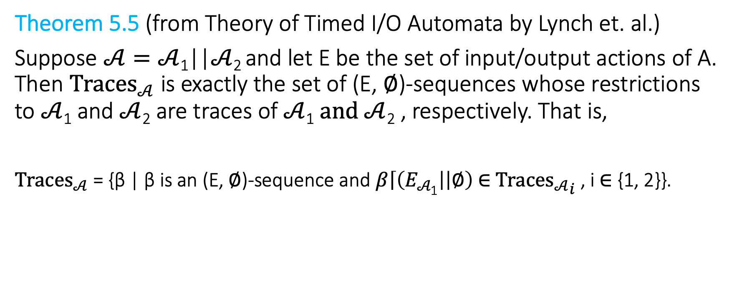
A trace theorem restriction from composition of I/O automata
Theorem 5.5 (from Theory of Timed I/O Automata by Lynch et. al.)
Suppose $𝒜=𝒜$₁||$𝒜$₂ and let E be the set of input/output actions of A. Then ${Traces}_{𝒜}$ is exactly the set of (E, ∅)-sequences whose restrictions to $𝒜$₁ and $𝒜$₂ are traces of $𝒜$₁ $and 𝒜$₂ , respectively. That is,
${Traces}_{𝒜}$ = {β | β is an (E, ∅)-sequence and $β\left\lceil \left(E_{𝒜\text{1}}\right| | ∅\right)$∈ ${{Traces}_{𝒜}}_{i}$ , i ∈ {1, 2}}.

Slide 32

Substitutivity
Theorem 1. Suppose $𝒜$₁ , $𝒜$₂ and $ℬ$ have the same external interface and $𝒜$₁ , $𝒜$₂ are compatible with $ℬ$. If $𝒜_{1}≼$ $𝒜$₂ then $𝒜$₁|| $ℬ≼$ $𝒜$₂ || $ℬ$

Slide 33
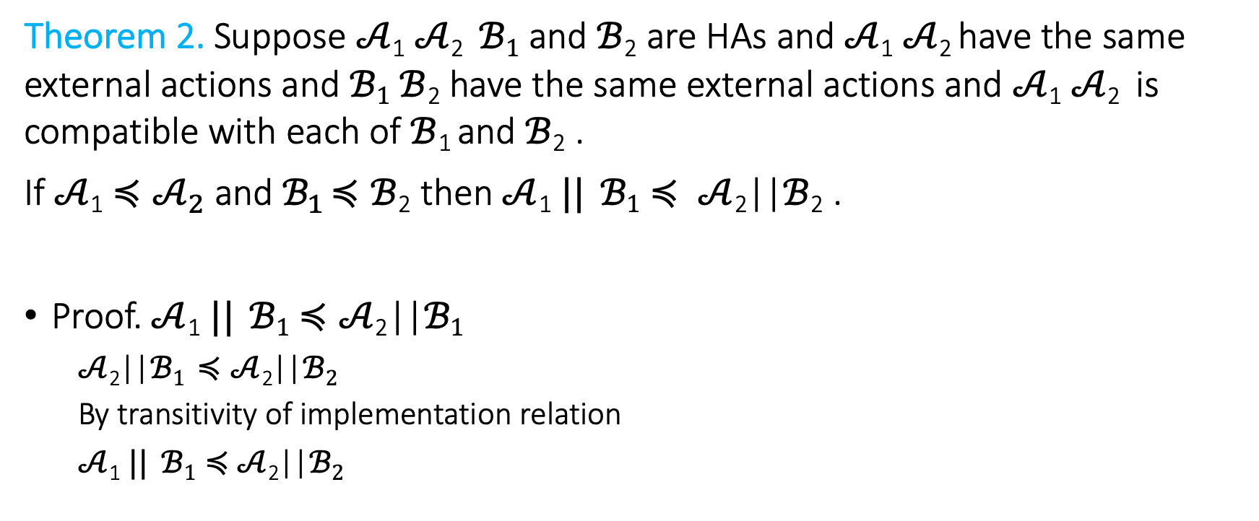
Substutivity
Theorem 2. Suppose $𝒜$₁ $𝒜$₂ $ℬ1$ and $ℬ$₂ are HAs and $𝒜$₁ $𝒜$₂ have the same external actions and $ℬ1$ $ℬ$₂ have the same external actions and $𝒜$₁ $𝒜$₂ is compatible with each of$ℬ$₁ and $ℬ$₂ .
If $𝒜$₁ $≼𝒜_{2}$ and$ℬ_{1}$ $≼ℬ$₂ then $𝒜$₁ $||$ $ℬ1$ $≼ 𝒜$₂||$ℬ$₂ .
Proof. $𝒜$₁ $||$ $ℬ1$ $≼𝒜$₂||$ℬ1$
$𝒜$₂||$ℬ1$ $≼𝒜$₂||$ℬ2$
By transitivity of implementation relation
$𝒜$₁ $||$ $ℬ1≼$ $𝒜$₂||$ℬ2$

Slide 34

A stronger substitutivity result
Theorem 3. $𝒜$₁ $||$ $ℬ2≼𝒜$₂||$ℬ$₂ and $ℬ1≼ℬ2$ then $𝒜$₁ $||$ $ℬ1$ $≼𝒜$₂||$ℬ$₂.

Slide 35
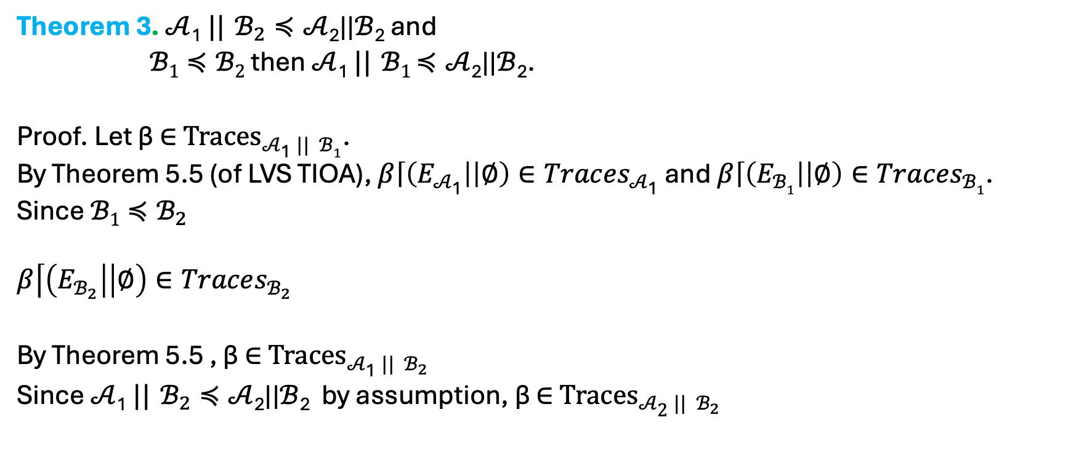
A stronger substitutivity result
Theorem 3. $𝒜$₁ $||$ $ℬ_{2}≼𝒜$₂||$ℬ$₂ and
$ℬ1≼ℬ2$ then $𝒜$₁ $||$ $ℬ1$ $≼𝒜$₂||$ℬ$₂.
Proof. Let β ∈ ${Traces}_{𝒜\text{1} || ℬ1}$.
By Theorem 5.5 (of LVS TIOA), $β\left\lceil \left(E_{𝒜\text{1}}\right| | ∅\right)∈Traces_{𝒜\text{1}}$ and $β\left\lceil \left(E_{ℬ1}\right| | ∅\right)∈Traces_{ℬ1}$.
Since $ℬ1≼ℬ_{2}$
$$β\left\lceil \left(E_{ℬ_{2}}\right| | ∅\right)∈Traces_{ℬ_{2}}$$
By Theorem 5.5 , β ∈ ${Traces}_{𝒜\text{1} || ℬ_{2}}$
Since $𝒜$₁ $||$ $ℬ_{2}≼𝒜$₂||$ℬ$₂ by assumption, β ∈ ${Traces}_{𝒜\text{2} || ℬ_{2}}$

