Slide 1

Composition
Sayan Mitra
Verifying cyberphysical systems
mitras@illinois.edu

Slide 2
Chapter 5

Slide 3
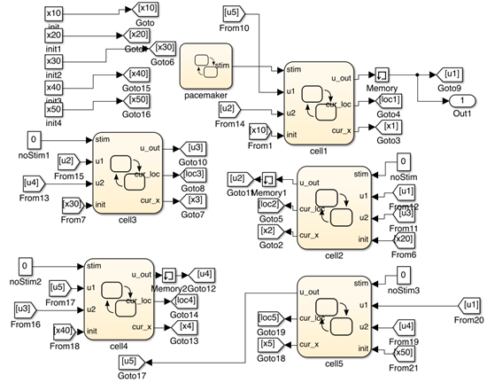
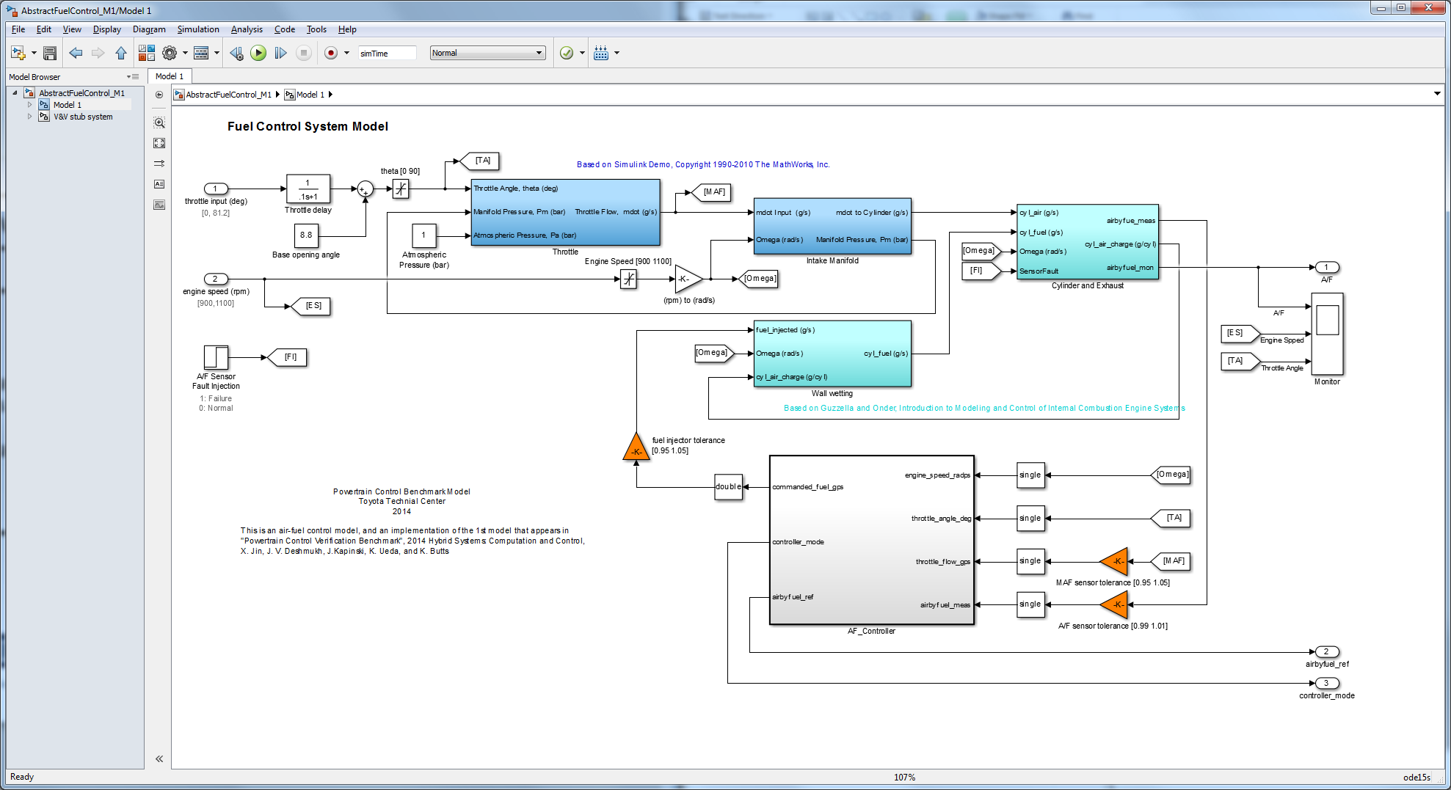
Why compose?
Complex models are built by putting together simpler components or modules
Enables portability, reuse, modular reasoning
Composition: operation of putting together
Gives precise definition of module interfaces
What properties are preserved under composition?
model of a network of oscillators [Huang et. al 14]
Powertrain model from Toyota [Jin et al. 15]

Slide 4
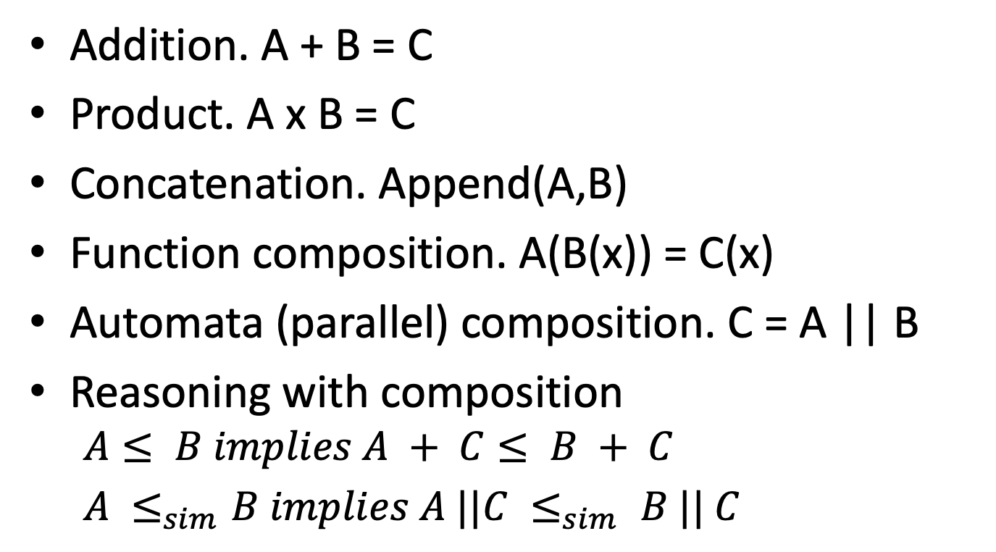
Examples of “composition”
Addition. A + B = C
Product. A x B = C
Concatenation. Append(A,B)
Function composition. A(B(x)) = C(x)
Automata (parallel) composition. C = A || B
Reasoning with composition
$$A≤ B implies A + C≤ B + C$$
$A ≤_{sim}B implies A ||C ≤_{sim} B || C$

Slide 5
Other examples of composition?
Is your notion of composition is captured by what we will define

Slide 6
Outline
Composition operation
Input/output interfaces
I/O automata
hybrid I/O automata
Examples
Properties of composition

Slide 7
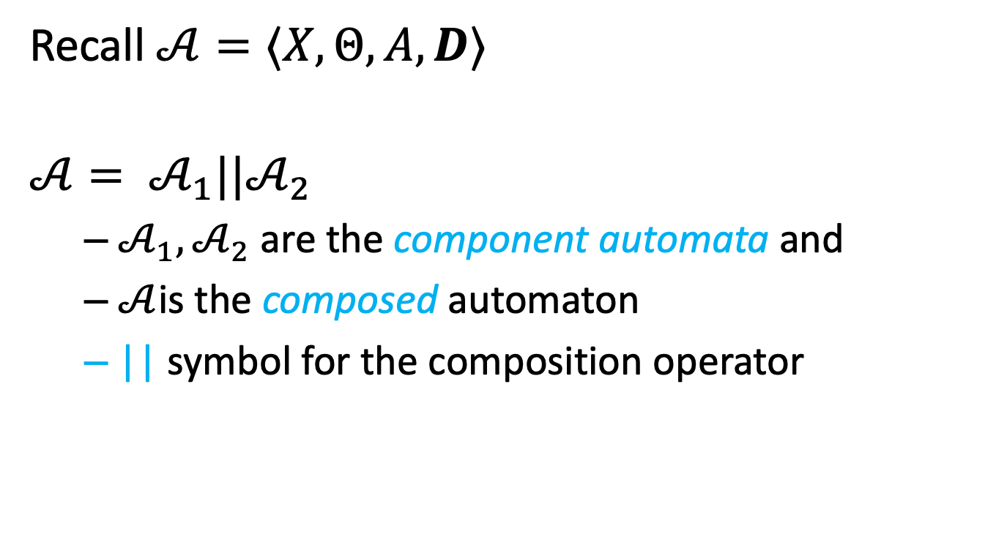
Composition of automata
Recall $𝒜=⟨X,Θ,A, D⟩$
$$𝒜= 𝒜_{1}||𝒜_{2}$$
$𝒜_{1}, 𝒜_{2}$ are the component automata and
$𝒜$is the composed automaton
|| symbol for the composition operator

Slide 8



Sequential composition
$$𝒜$$
$$ℬ$$
$𝒜$.$ℬ$
In general, every final state has to be merged with every start state.
Not particularly interesting
a
d
a
b
e
b
c
f
c
d
e
f

Slide 9



Parallel Composition: asynchronous transitions
$$𝒜||ℬ$$
$$𝒜$$
$$ℬ$$
a
d
a
d
b
d
a
e
b
e
c
d
b
e
a
f
c
e
b
f
c
f
c
f
$$𝒜||ℬ=⟨Q_{A}×Q_{B},Θ_{A}×Θ_{B},A, D⟩$$

Slide 10
parallel composition: synchronous transitions
$$𝒜$$
$$ℬ$$
a
d
a
d
b
d
a
e
b
e
c
d
b
e
a
f
c
e
b
f
c
f
c
f

Slide 11
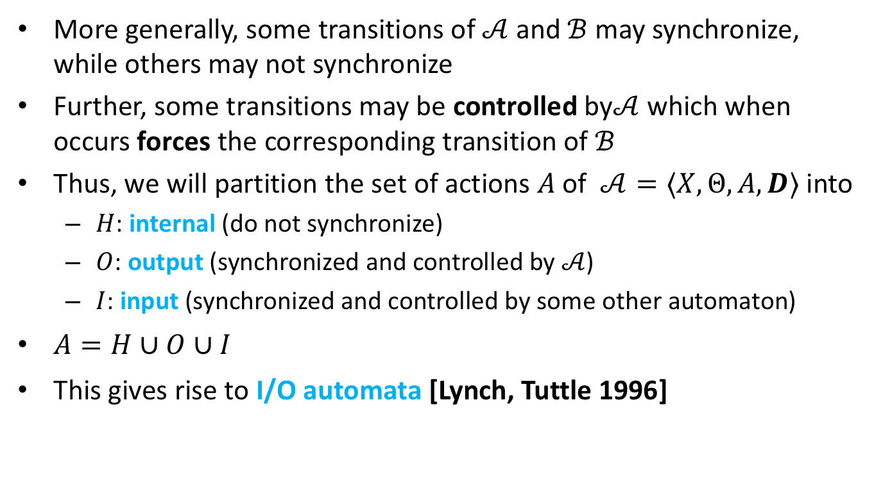
Composition of (discrete) automata
More generally, some transitions of $𝒜$ and $ℬ$ may synchronize, while others may not synchronize
Further, some transitions may be controlled by$𝒜$ which when occurs forces the corresponding transition of $ℬ$
Thus, we will partition the set of actions $A$of $𝒜=⟨X,Θ,A, D⟩$ into
$H$: internal (do not synchronize)
$O$: output (synchronized and controlled by $𝒜$)
$I$: input (synchronized and controlled by some other automaton)
$A=H∪O∪I$
This gives rise to I/O automata [Lynch, Tuttle 1996]

Slide 12
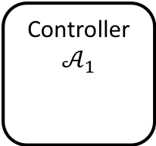

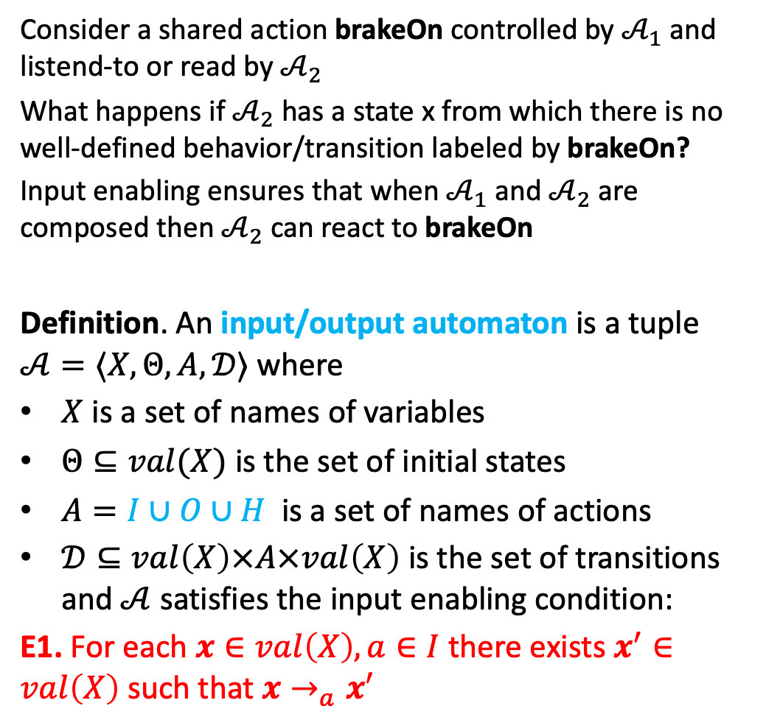
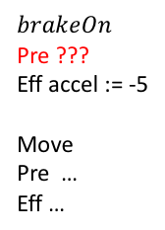
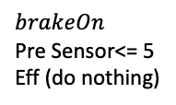
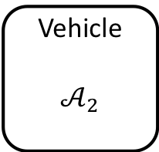
Reactivity: Input enabling
Consider a shared action brakeOn controlled by $𝒜_{1}$ and listend-to or read by $𝒜_{2}$
What happens if $𝒜_{2}$ has a state x from which there is no well-defined behavior/transition labeled by brakeOn?
Input enabling ensures that when $𝒜_{1}$ and $𝒜_{2}$ are composed then $𝒜_{2}$ can react to brakeOn
Definition. An input/output automaton is a tuple $𝒜=〈X,Θ, A, 𝒟〉$ where
$X$ is a set of names of variables
$Θ⊆val(X)$ is the set of initial states
$A=I∪O∪H$ is a set of names of actions
$𝒟⊆val\left(X\right)×A×val\left(X\right)$ is the set of transitions and $𝒜$ satisfies the input enabling condition:
E1. For each $x∈val\left(X\right), a∈I$ there exists $x^{′}∈val\left(X\right)$ such that $x→_{a}x′$
Controller
$$𝒜_{1}$$
$$brakeOn$$
Pre Sensor<= 5
Eff (do nothing)
$$brakeOn$$
Vehicle
$$𝒜_{2}$$
$$brakeOn$$
Pre ???
Eff accel := -5
Move
Pre …
Eff …

Slide 13
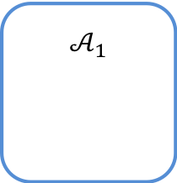

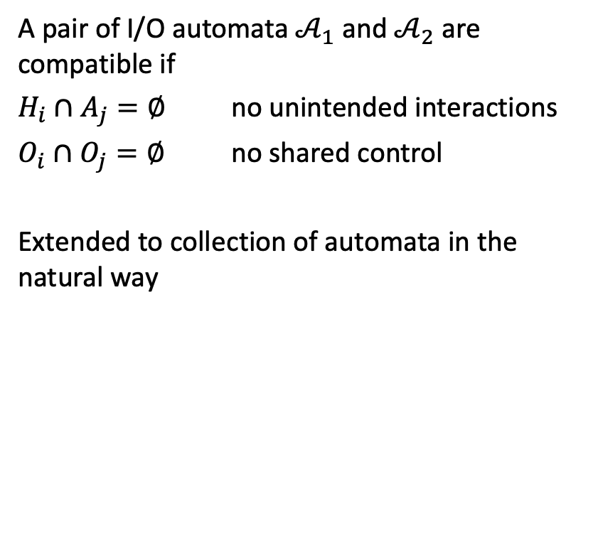
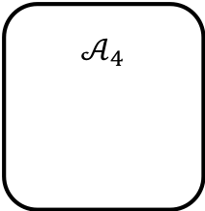
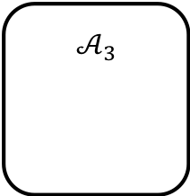
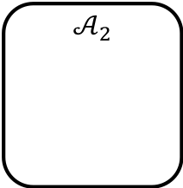
Compatibility IOA
$$𝒜_{1}$$
a
A pair of I/O automata $𝒜_{1}$ and $𝒜_{2}$ are compatible if
$H_{i}∩A_{j}=∅$ no unintended interactions
$O_{i}∩O_{j}=∅$ no shared control
Extended to collection of automata in the natural way
b
c
$$𝒜_{2}$$
$$𝒜_{3}$$
d
$$brakeOn$$
e
f
$$𝒜_{4}$$

Slide 14

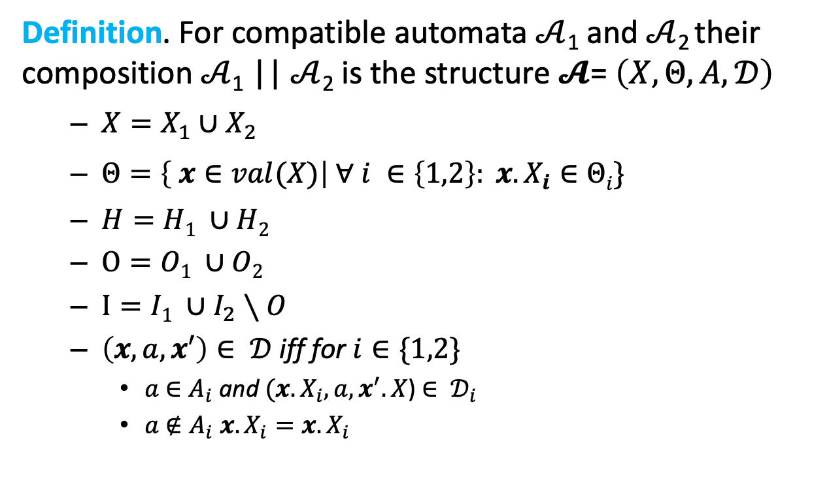
Composition of I/O automaton
Definition. For compatible automata $𝒜$₁ and $𝒜$₂ their composition $𝒜$₁ || $𝒜$₂ is the structure $𝓐$= $\left(X,Θ,A,𝒟\right)$
$X=X_{1}∪X_{2}$
$Θ=\left\{ x∈val(X)\right| ∀ i ∈\left\{1,2\right\}: x.X_{i}∈Θi\}$
$H=H1 ∪H2$
$O=O1 ∪O2$
$I=I1 ∪I_{2}∖O$
$\left(x,a,x′\right)∈ 𝒟$ iff for $i∈\{1,2\}$
$a$ $∈A_{i}$ and $(x.X_{i},a,x^{′}.X$) $∈ 𝒟_{i}$
$a$ $∉A_{i}$ $x.X_{i}=x.X_{i}$
$$\} A=H∪O∪I$$

Slide 15
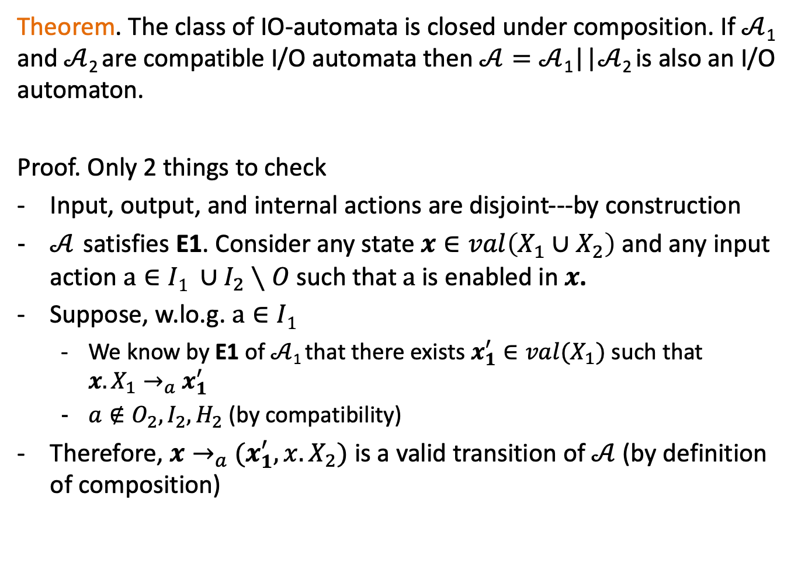
Theorem. The class of IO-automata is closed under composition. If $𝒜$₁ and $𝒜$₂ are compatible I/O automata then$𝒜=𝒜$₁||$𝒜$₂ is also an I/O automaton.
Proof. Only 2 things to check
Input, output, and internal actions are disjoint---by construction
$𝒜$ satisfies E1. Consider any state $x∈val\left(X_{1}∪X_{2}\right)$ and any input action$a∈I1 ∪I_{2}∖O$ such that $a$is enabled in $x$.
Suppose, w.lo.g. $a∈I1$
We know by E1 of $𝒜$₁ that there exists $x_{1}^{′}∈val(X_{1})$ such that $x.X_{1}→_{a}$ $x_{1}^{′}$
$a∉O_{2},I_{2},H_{2}$ (by compatibility)
Therefore, $x→_{a}$ $(x_{1}^{′},x.X_{2})$ is a valid transition of $𝒜$ (by definition of composition)

Slide 16
Example: Sending process and channel
System
Sender
Channel
Receiver
fail
send(m)
receive(m)
send(m)
~failed
Automaton Sender(u)
variables internal
failed:Boolean := F
output send(m:M)
input fail
transitions:
output send(m)
pre ~failed
eff
input fail
pre true
eff failed := T
Loc 1
failed
fail
true
failed := T

Slide 17
FIFO channel & Simple Failure Detector
Automaton Sender(u)
variables internal
failed:Boolean := F
output send(m:M)
input fail
transitions:
output send(m)
pre ~failed
eff
input fail
pre true
eff failed := T
Automaton System(M)
variables queue: Queue[M] := {}, failed: Bool
actions input fail
output send(m:M), receive(m:M)
transitions:
output send(m)
pre ~failed
eff queue := append(m, queue)
output receive(m)
pre head(queue)=m
eff queue := queue.tail
input fail
pre true
eff failed := true
Automaton Channel(M)
variables internal queue: Queue[M] := {}
actions input send(m:M)
output receive(m:M)
transitions:
input send(m)
pre true
eff queue := append(m, queue)
output receive(m)
pre head(queue)=m
eff queue := queue.tail

Slide 18
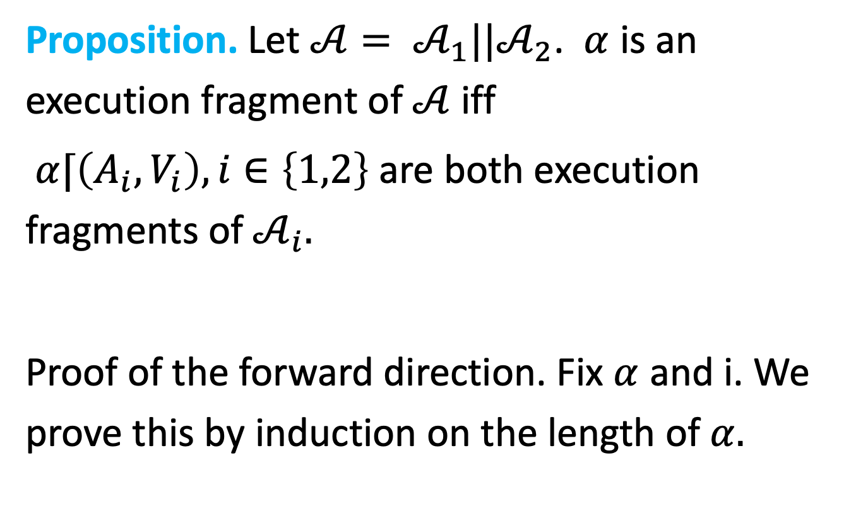
Properties of Compositions
Proposition. Let $𝒜= 𝒜_{1}||𝒜_{2}$. $α$ is an execution fragment of $𝒜$ iff
$α⌈\left(A_{i},V_{i}\right), i∈\left\{1,2\right\}$ are both execution fragments of $𝒜_{i}.$
Proof of the forward direction. Fix $α$ and i. We prove this by induction on the length of $α.$
Notes:
Fix 1.

Slide 19
Composition and Abstraction

Slide 20

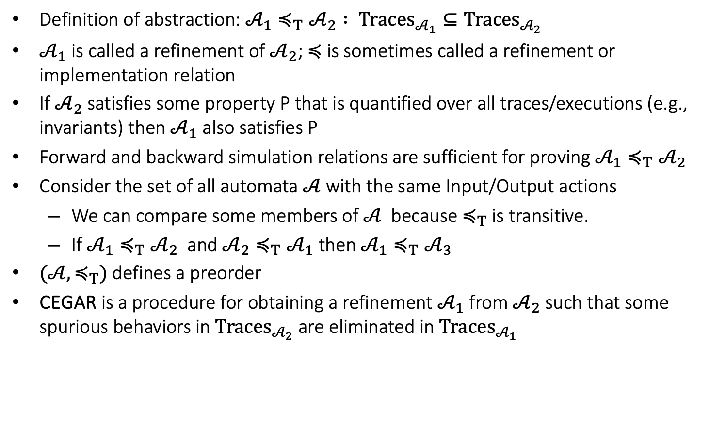


Abstraction recap
$$𝒜_{1}$$
$$𝒜_{2}$$
$$≼$$
Definition of abstraction: ${𝒜_{1}≼_{T}𝒜}_{2} : Traces_{𝒜_{1}}⊆Traces_{𝒜_{2}}$
$𝒜_{1}$ is called a refinement of $𝒜_{2}$; $≼$ is sometimes called a refinement or implementation relation
If $𝒜_{2}$ satisfies some property P that is quantified over all traces/executions (e.g., invariants) then $𝒜_{1}$ also satisfies P
Forward and backward simulation relations are sufficient for proving $𝒜_{1}≼_{T}𝒜_{2}$
Consider the set of all automata $𝒜$with the same Input/Output actions
We can compare some members of $𝒜$ because $≼_{T}$ is transitive.
If $𝒜_{1}≼_{T}𝒜_{2}$ and $𝒜_{2}≼_{T}𝒜_{1}$ then $𝒜_{1}≼_{T}𝒜_{3}$
$({𝒜,≼}_{T})$ defines a preorder
CEGAR is a procedure for obtaining a refinement $𝒜_{1}$ from $𝒜_{2}$ such that some spurious behaviors in $Traces_{𝒜_{2}}$ are eliminated in $Traces_{𝒜_{1}}$

Slide 21
Q. How does composition work with abstraction? Q. When can we substitute an automaton with its abstraction or its refinement?
Concrete system
Plant
Controller

Slide 22
Substituting an automaton with its abstraction
Abstract system
Plant
Abstract Controller
Controller

Slide 23

How is the abstract system related to the concrete system?
Controller
Abstract Controller
Does
$$≼$$
imply
Concrete system
Abstract system
Plant
Controller
$$≼$$
Plant
Abstract Controller
?

Slide 24
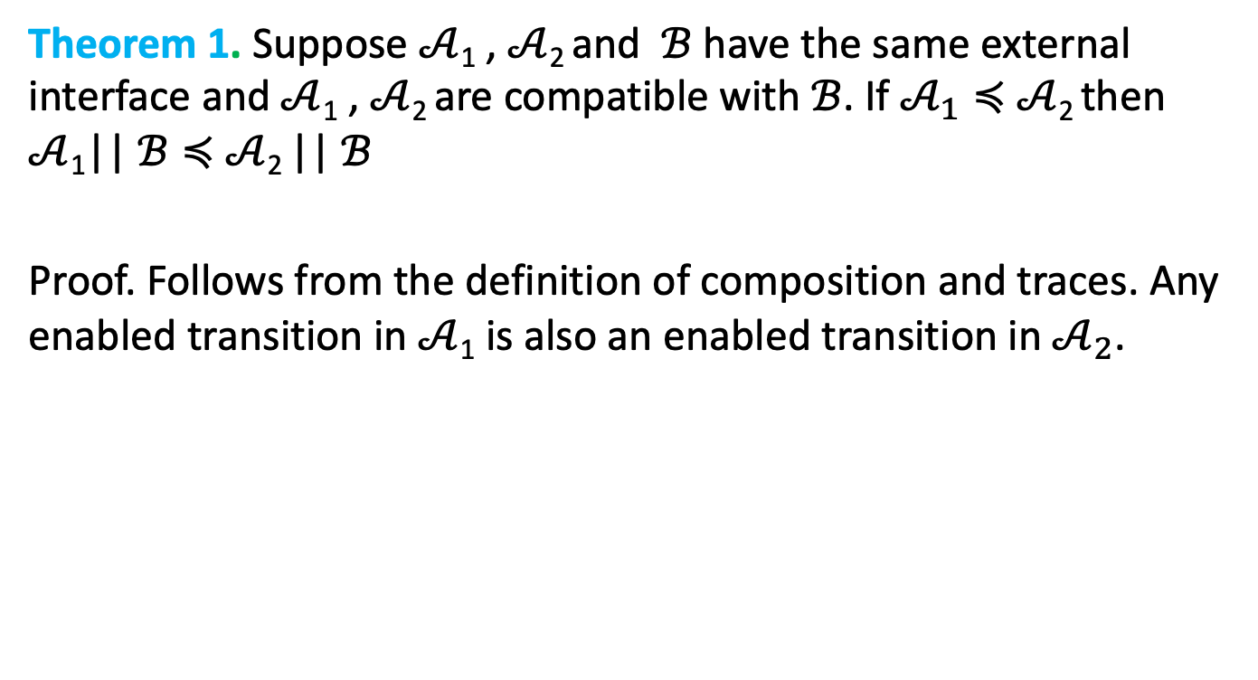
Substitutivity
Theorem 1. Suppose $𝒜$₁ , $𝒜$₂ and $ℬ$ have the same external interface and $𝒜$₁ , $𝒜$₂ are compatible with $ℬ$. If $𝒜_{1}≼$ $𝒜$₂ then $𝒜$₁|| $ℬ≼$ $𝒜$₂ || $ℬ$
Proof. Follows from the definition of composition and traces. Any enabled transition in $𝒜$₁ is also an enabled transition in $𝒜_{2}$.

Slide 25

Substutivity
Theorem 2. Suppose $𝒜$₁ $𝒜$₂ $ℬ1$ and $ℬ$₂ are HAs and $𝒜$₁ $𝒜$₂ have the same external actions and $ℬ1$ $ℬ$₂ have the same external actions and $𝒜$₁ $𝒜$₂ are compatible with each of$ℬ$₁ and $ℬ$₂ .
If $𝒜$₁ $≼𝒜_{2}$ and$ℬ_{1}$ $≼ℬ$₂ then $𝒜$₁ $||$ $ℬ1$ $≼ 𝒜$₂||$ℬ$₂ .
Proof. $𝒜$₁ $||$ $ℬ1$ $≼𝒜$₂||$ℬ1$
$𝒜$₂||$ℬ1$ $≼𝒜$₂||$ℬ2$
By transitivity of $≼$relation
$𝒜$₁ $||$ $ℬ1≼$ $𝒜$₂||$ℬ2$

Slide 26
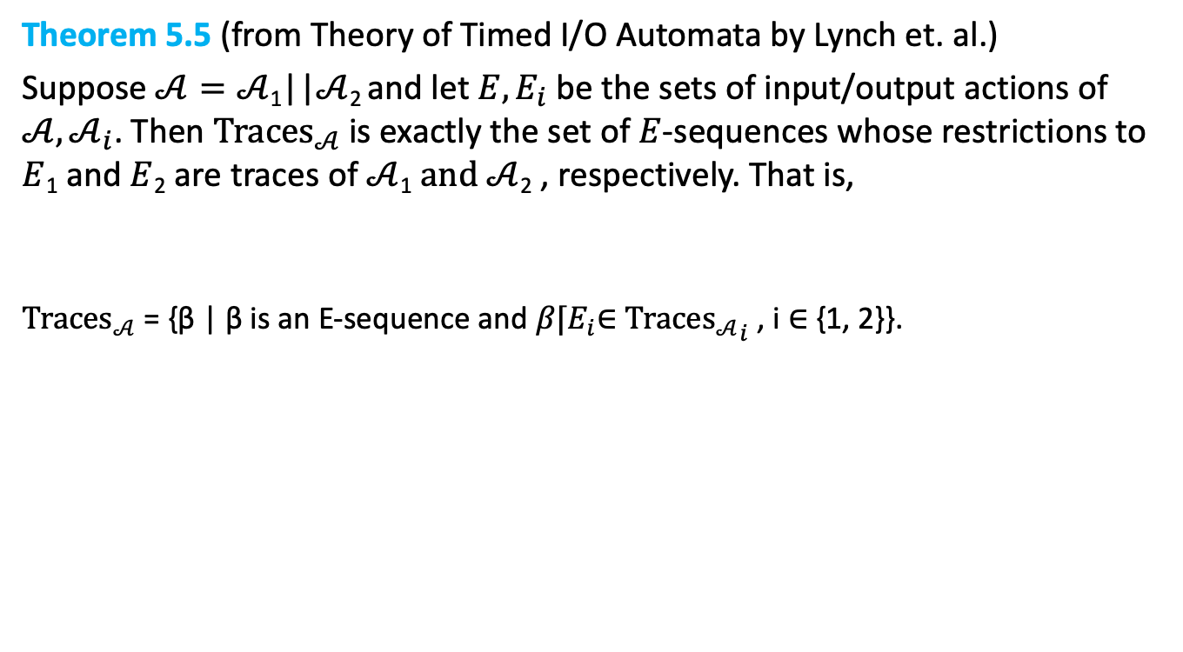
A natural trace theorem for compositions automata
Theorem 5.5 (from Theory of Timed I/O Automata by Lynch et. al.)
Suppose $𝒜=𝒜$₁||$𝒜$₂ and let $E,E_{i}$ be the sets of input/output actions of $𝒜,𝒜_{i}$. Then ${Traces}_{𝒜}$ is exactly the set of $E$-sequences whose restrictions to $E$₁ and $E$₂ are traces of $𝒜$₁ $and 𝒜$₂ , respectively. That is,
${Traces}_{𝒜}$ = {β | β is an E-sequence and $β⌈E_{i}$∈ ${{Traces}_{𝒜}}_{i}$ , i ∈ {1, 2}}.

Slide 27
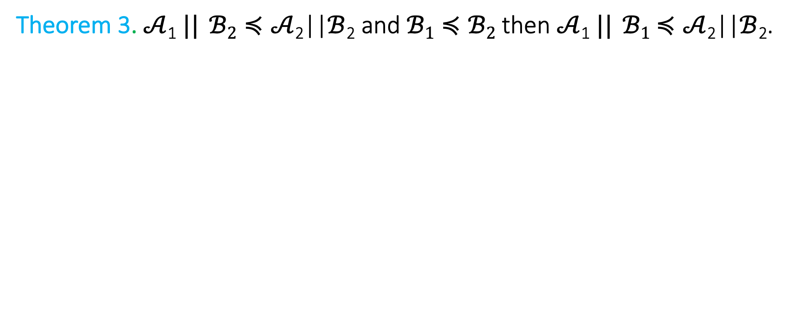
A stronger substitutivity result
Theorem 3. $𝒜$₁ $||$ $ℬ2≼𝒜$₂||$ℬ$₂ and $ℬ1≼ℬ2$ then $𝒜$₁ $||$ $ℬ1$ $≼𝒜$₂||$ℬ$₂.

Slide 28
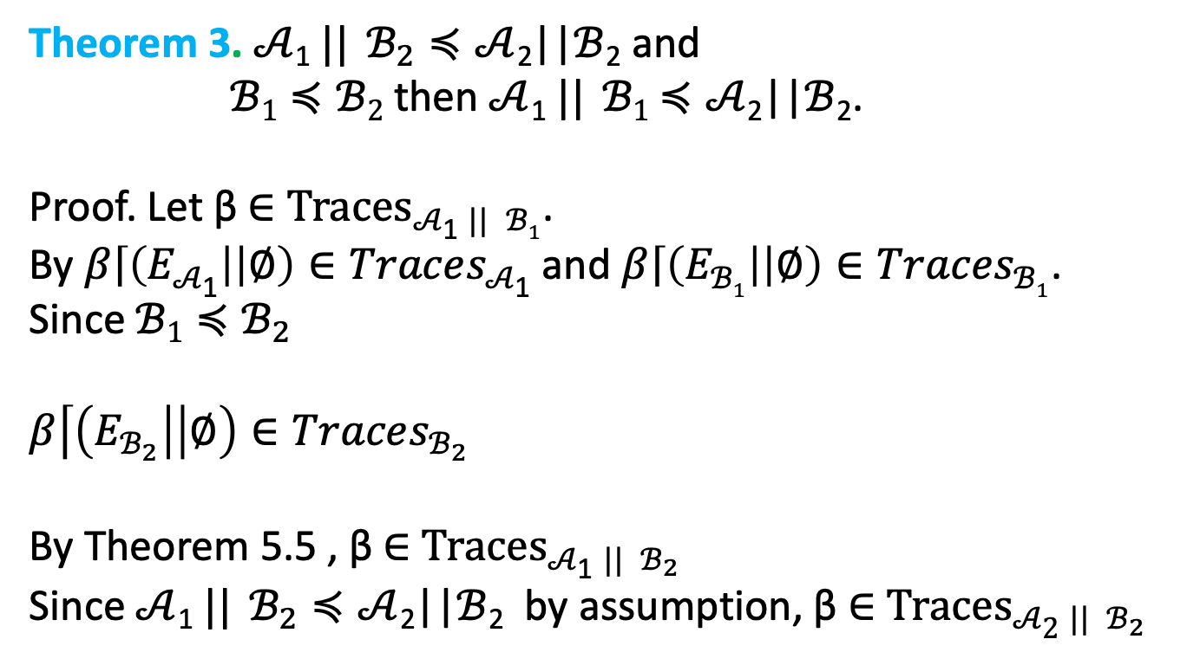
A stronger substitutivity result
Theorem 3. $𝒜$₁ $||$ $ℬ_{2}≼𝒜$₂||$ℬ$₂ and
$ℬ1≼ℬ2$ then $𝒜$₁ $||$ $ℬ1$ $≼𝒜$₂||$ℬ$₂.
Proof. Let β ∈ ${Traces}_{𝒜\text{1} || ℬ1}$.
By $β\left\lceil \left(E_{𝒜\text{1}}\right| | ∅\right)∈Traces_{𝒜\text{1}}$ and $β\left\lceil \left(E_{ℬ1}\right| | ∅\right)∈Traces_{ℬ1}$.
Since $ℬ1≼ℬ_{2}$
$$β\left\lceil \left(E_{ℬ_{2}}\right| | ∅\right)∈Traces_{ℬ_{2}}$$
By Theorem 5.5 , β ∈ ${Traces}_{𝒜\text{1} || ℬ_{2}}$
Since $𝒜$₁ $||$ $ℬ_{2}≼𝒜$₂||$ℬ$₂ by assumption, β ∈ ${Traces}_{𝒜\text{2} || ℬ_{2}}$

Slide 29
Counter-example guided abstraction-refinement

Slide 30
Counterexample guided abstraction refinement (CEGAR)
A general algorithmic framework for automatically constructing and verifying property-specific abstractions [Clarke:2000]
CEGAR has been applied to discrete automata, software, and hybrid systems [Holzman 00,Ball 01, Alur 2006,Clarke 2003, Fehnker2005, Prabhakar 15, Roohi 17]
We will discuss the basic idea of the CEGAR and the key design choices, and their implications.

Slide 31
Start with coarse abstraction B₀
Check B_{i} satisfies S ?
Idea of CEGAR
Yes
A is safe
No
β = q₀ q₁ q₂ … q_{n}
β counter-example for A?
Yes
A unsafe
No
Refine B_{i} to get B_{i+1}

Slide 32
Key design choices
Space of the abstract automata (finite, timed, linear)
Model checker for abstract automaton
Counter-example validation procedure
Refinement strategy

Slide 33




$$Unsafe$$
$$q_{0}$$
$$Θ$$
$$(0,0)$$

Slide 34


$$Unsafe$$
$$q_{0}$$
$$Θ$$
$$(0,0)$$

Slide 35





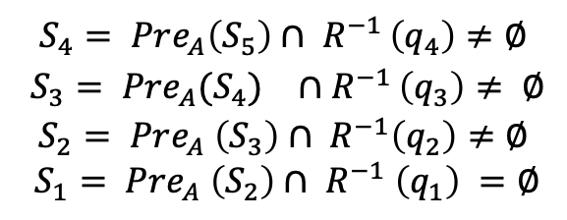



$$Unsafe$$
$$q_{5}$$
$$S_{4}= Pre_{A}\left(S_{5}\right)∩ R^{−1 }\left(q_{4}\right)≠∅$$
$$S_{3}= Pr{e_{A}(S_{4})}_{}∩R^{−1 }\left(q_{3}\right)≠ ∅$$
$$S_{2}= Pre_{A} \left(S_{3}\right)∩ R^{−1}\left(q_{2}\right)≠∅$$
$$S_{1}= Pre_{A} \left(S_{2}\right)∩ R^{−1} \left(q_{1}\right) =∅$$
$$q_{2}$$
$$q_{3}$$
$$q_{4}$$
$$q_{1}$$
$$q_{0}$$
$$Θ$$
$$(0,0)$$

Slide 36
composing hybrid systems

Slide 37
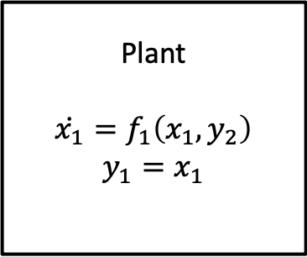
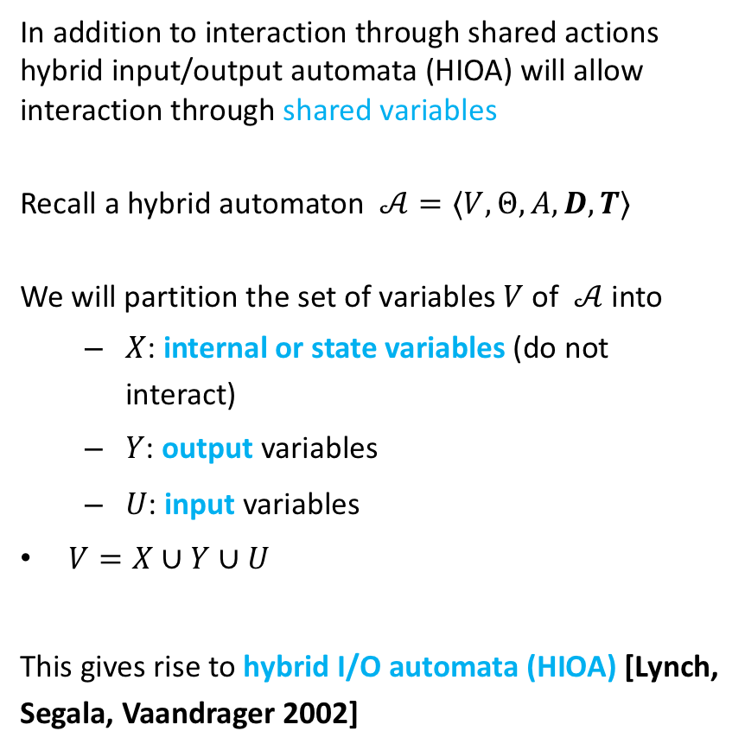


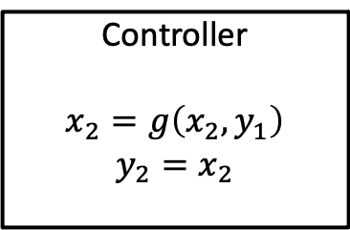
Hybrid IO Automaton
In addition to interaction through shared actions hybrid input/output automata (HIOA) will allow interaction through shared variables
Recall a hybrid automaton $𝒜=⟨V,Θ,A, D,T⟩$
We will partition the set of variables $V$of $𝒜$ into
$X$: internal or state variables (do not interact)
$Y$: output variables
$U$: input variables
$V=X∪Y∪U$
This gives rise to hybrid I/O automata (HIOA) [Lynch, Segala, Vaandrager 2002]
Plant
$$\dot{x_{1}}=f_{1}\left(x_{1},y_{2}\right)$$
$$y_{1}=x_{1}$$
$$y_{2}$$
$$y_{1}$$
Controller
$$x_{2}=g\left(x_{2},y_{1}\right)$$
$$y_{2}=x_{2}$$

Slide 38
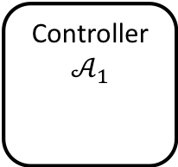
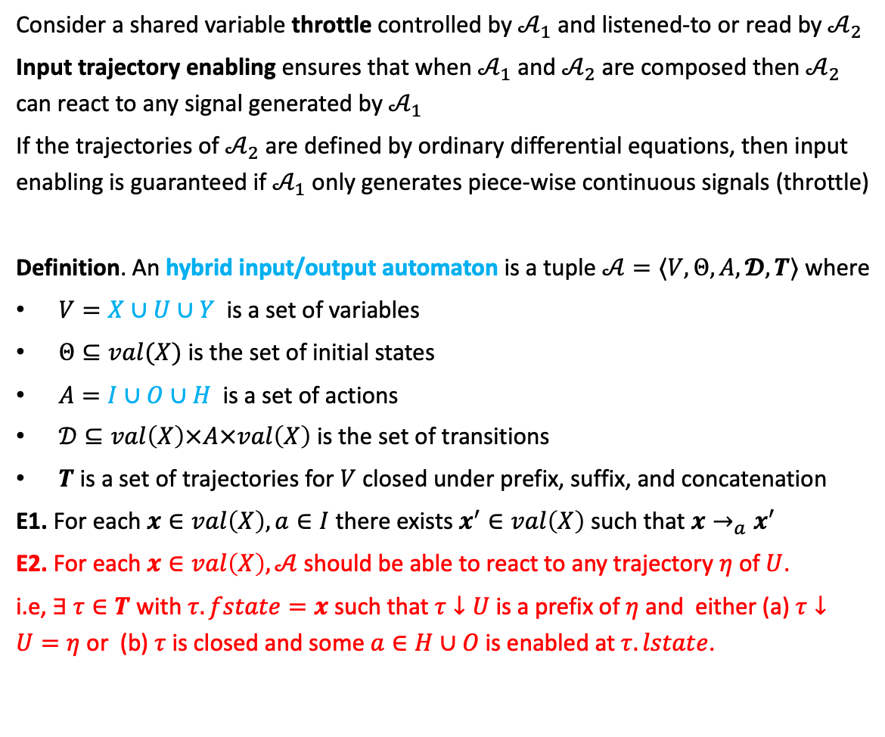


Reactivity: Input trajectory enabling
Consider a shared variable throttle controlled by $𝒜_{1}$ and listened-to or read by $𝒜_{2}$
Input trajectory enabling ensures that when $𝒜_{1}$ and $𝒜_{2}$ are composed then $𝒜_{2}$ can react to any signal generated by $𝒜_{1}$
If the trajectories of $𝒜_{2}$ are defined by ordinary differential equations, then input enabling is guaranteed if $𝒜_{1}$ only generates piece-wise continuous signals (throttle)
Definition. An hybrid input/output automaton is a tuple $𝒜=〈V,Θ, A, 𝓓,T〉$ where
$V=X∪U∪Y$ is a set of variables
$Θ⊆val(X)$ is the set of initial states
$A=I∪O∪H$ is a set of actions
$𝒟⊆val\left(X\right)×A×val\left(X\right)$ is the set of transitions
$T$ is a set of trajectories for $V$ closed under prefix, suffix, and concatenation
E1. For each $x∈val\left(X\right), a∈I$ there exists $x^{′}∈val\left(X\right)$ such that $x→_{a}x′$
E2. For each $x∈val\left(X\right), 𝒜$should be able to react to any trajectory $η$ of $U$.
i.e, $∃ τ∈T$ with $τ.fstate=x$such that $τ↓U$is a prefix of $η$ and either (a) $τ↓U=η$ or (b) $τ$ is closed and some $a∈H∪O$is enabled at $τ.lstate$.
Controller
$$𝒜_{1}$$
$$throttle$$
Vehicle
$$𝒜_{2}$$

Slide 39

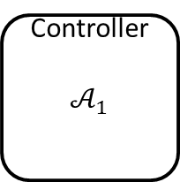

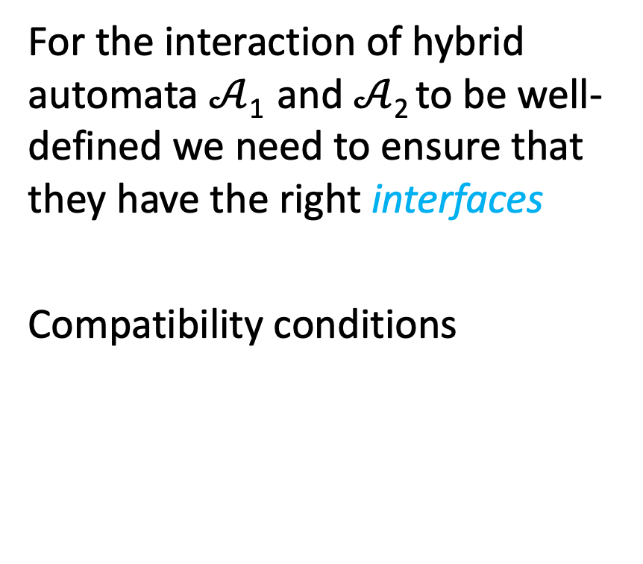
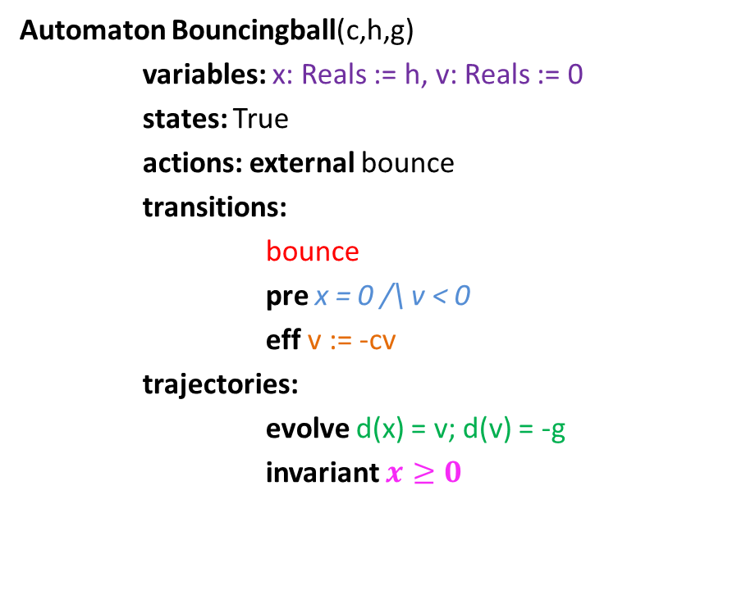



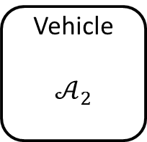

Compatibility of hybrid automata
For the interaction of hybrid automata $𝒜$₁ and $𝒜$₂ to be well-defined we need to ensure that they have the right interfaces
Compatibility conditions
Controller
$$𝒜_{1}$$
$$accel$$
Vehicle
$$𝒜_{2}$$
Output $accel$
Input $accel$
$$brakeOn$$
Output $brakeOn$
Input $brakeOn$
$$position$$

Slide 40
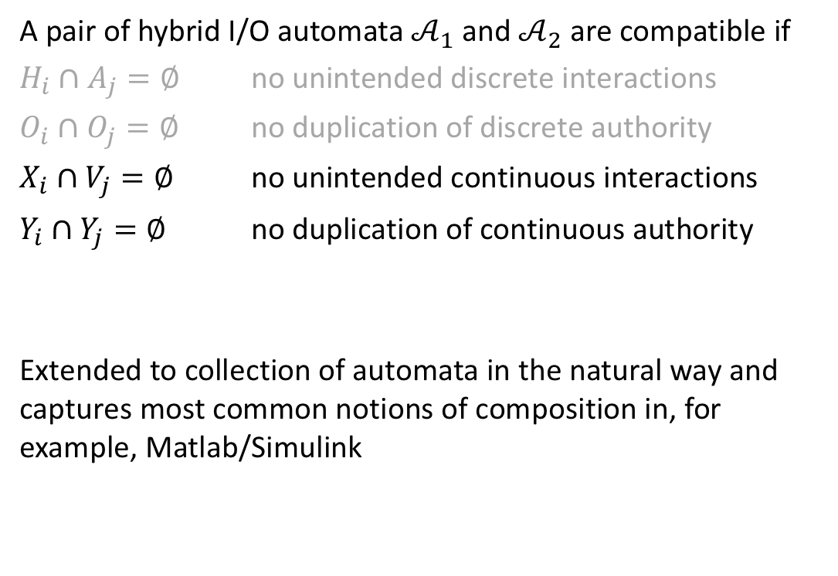
Compatibility HIOA
A pair of hybrid I/O automata $𝒜_{1}$ and $𝒜_{2}$ are compatible if
$H_{i}∩A_{j}=∅$ no unintended discrete interactions
$O_{i}∩O_{j}=∅$ no duplication of discrete authority
$X_{i}∩V_{j}=∅$ no unintended continuous interactions
$Y_{i}∩Y_{j}=∅$ no duplication of continuous authority
Extended to collection of automata in the natural way and captures most common notions of composition in, for example, Matlab/Simulink

Slide 41
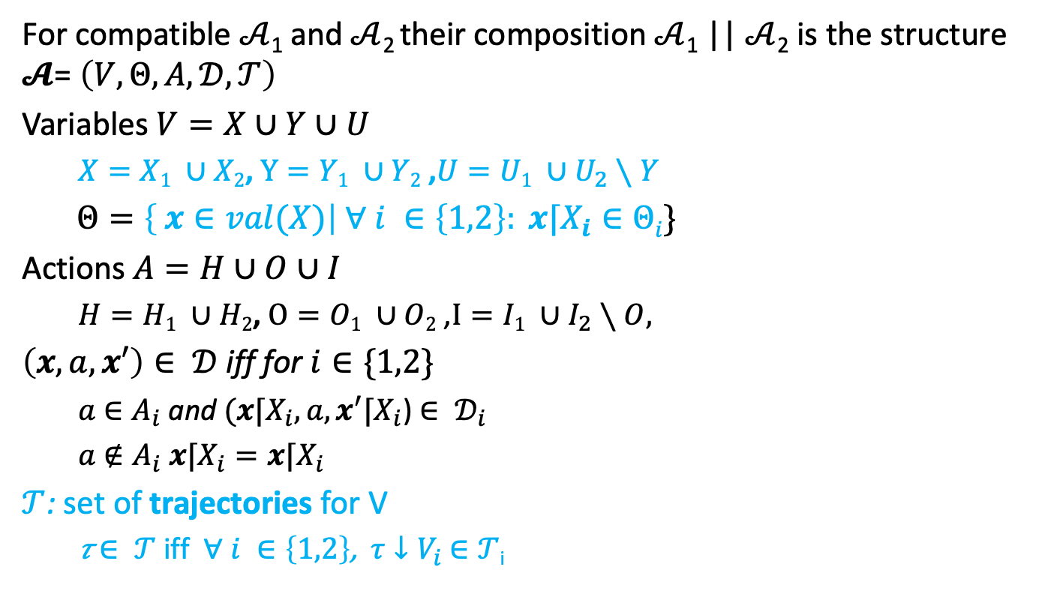
Composition
For compatible $𝒜$₁ and $𝒜$₂ their composition $𝒜$₁ || $𝒜$₂ is the structure $𝓐$= $\left(V,Θ,A,𝒟,𝒯\right)$
Variables $V=X∪Y∪U$
$X=X1 ∪X2$, $Y=Y1 ∪Y2$ ,$U=U1 ∪U_{2}∖Y$
$Θ=\left\{ x∈val(X)\right| ∀ i ∈\left\{1,2\right\}: x⌈X_{i}∈Θi\}$
Actions $A=H∪O∪I$
$H=H1 ∪H2$, $O=O1 ∪O2$ ,$I=I1 ∪I_{2}∖O,$
$\left(x,a,x′\right)∈ 𝒟$ iff for $i∈\{1,2\}$
$a$ $∈A_{i}$ and $(x⌈X_{i},a,x^{′}⌈X_{i}$) $∈ 𝒟_{i}$
$a$ $∉A_{i}$ $x⌈X_{i}=x⌈X_{i}$
$𝒯$: set of trajectories for V
𝜏 $∈ 𝒯$ iff $∀ i ∈\left\{1,2\right\}$, $τ↓V_{i}$ $∈𝒯$_{i}

Slide 42

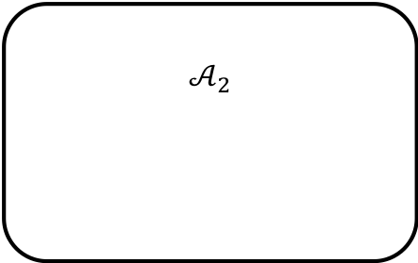
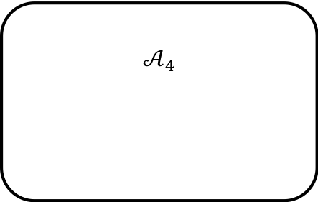
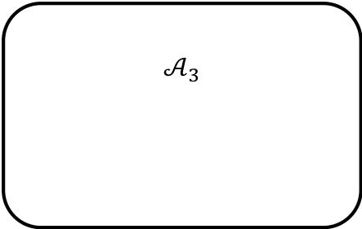
$$𝒜_{2}$$
u₂
u₂
$${\dot{x}}_{1}=f(x_{1},u_{2})$$
a₁
a₁
$$𝒜_{3}$$
a₁
e
e
f
f
a₁
$$𝒜_{4}$$

Slide 43
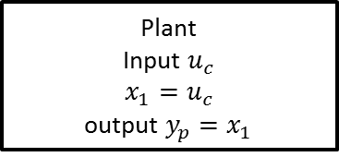
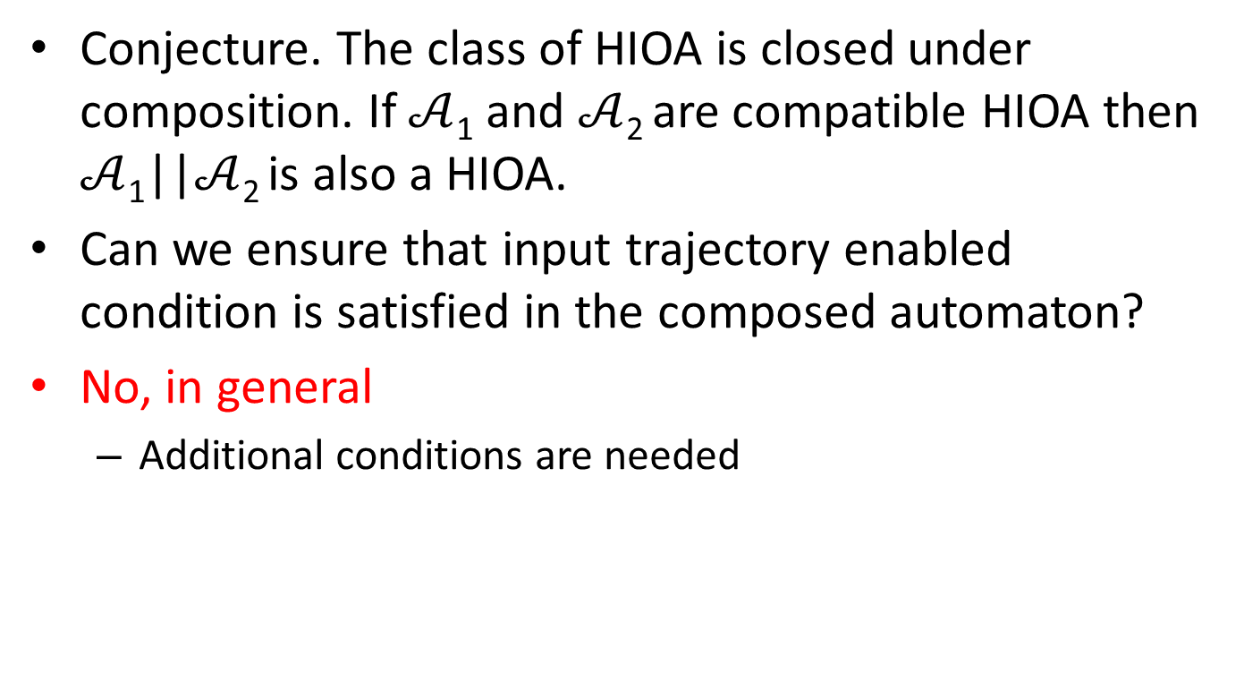


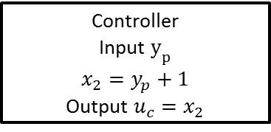
Closure under composition
Conjecture. The class of HIOA is closed under composition. If $𝒜$₁ and $𝒜$₂ are compatible HIOA then $𝒜$₁||$𝒜$₂ is also a HIOA.
Can we ensure that input trajectory enabled condition is satisfied in the composed automaton?
No, in general
Additional conditions are needed
Plant
Input $u_{c}$
$$x_{1}=u_{c}$$
output $y_{p}=x_{1}$
$$u_{c}$$
$$y_{p}$$
Controller
Input $y_{p}$
$$x_{2}=y_{p}+1$$
Output $u_{c}=x_{2}$

Slide 44
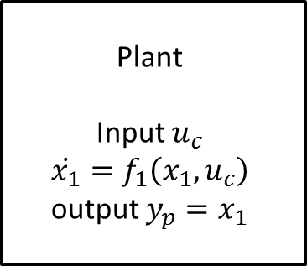
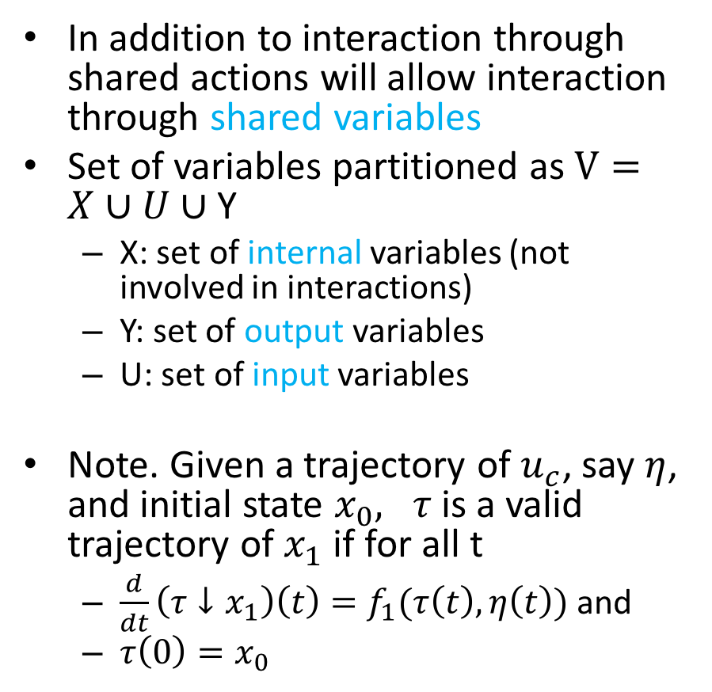


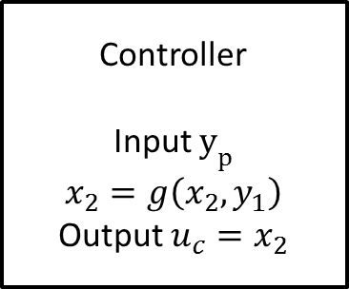
Hybrid IO Automaton
In addition to interaction through shared actions will allow interaction through shared variables
Set of variables partitioned as $V=X∪U∪$ Y
X: set of internal variables (not involved in interactions)
Y: set of output variables
U: set of input variables
Note. Given a trajectory of $u_{c}$, say $η$, and initial state $x_{0}, τ$ is a valid trajectory of $x_{1}$ if for all t
$\frac{d}{dt}\left(τ↓x_{1}\right)\left(t\right)=f_{1}(τ\left(t\right), η\left(t\right))$ and
$τ\left(0\right)=x_{0}$
Plant
Input $u_{c}$
$$\dot{x_{1}}=f_{1}\left(x_{1},u_{c}\right)$$
output $y_{p}=x_{1}$
$$u_{c}$$
$$y_{p}$$
Controller
Input $y_{p}$
$$x_{2}=g\left(x_{2},y_{1}\right)$$
Output $u_{c}=x_{2}$

Slide 45
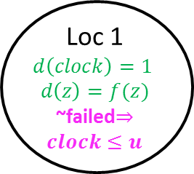
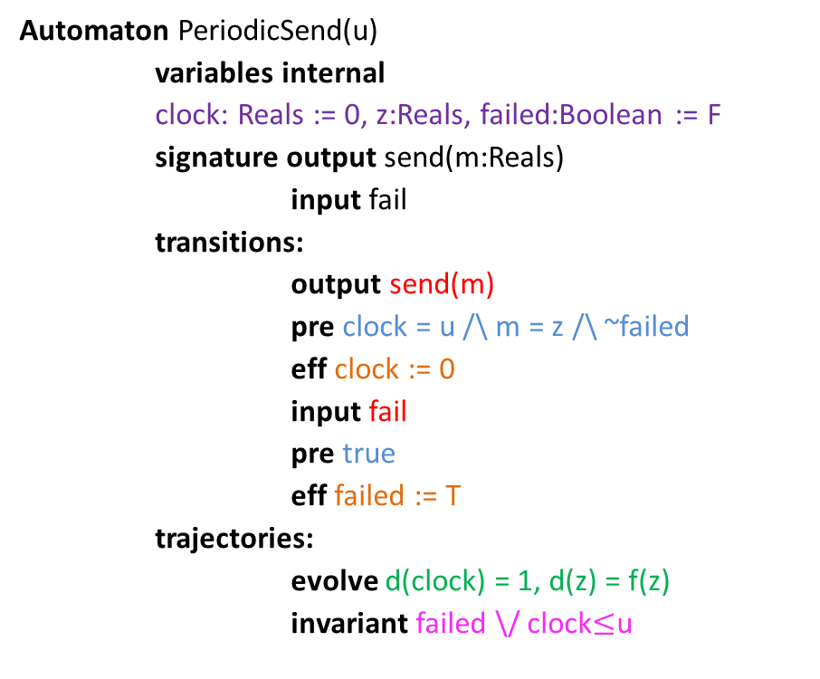
Example 2: Periodically Sending Process
Automaton PeriodicSend(u)
variables internal
clock: Reals := 0, z:Reals, failed:Boolean := F
signature output send(m:Reals)
input fail
transitions:
output send(m)
pre clock = u /\ m = z /\ ~failed
eff clock := 0
input fail
pre true
eff failed := T
trajectories:
evolve d(clock) = 1, d(z) = f(z)
invariant failed \/ clock$≤$u
send(m)
clock = u /\ m = z /\ ~failed
clock := 0
Loc 1
$$d\left(clock\right)=1$$
$$d\left(z\right)=f(z)$$
~failed$⇒clock≤u$
clock:= 0
fail
true
failed := T

Slide 46
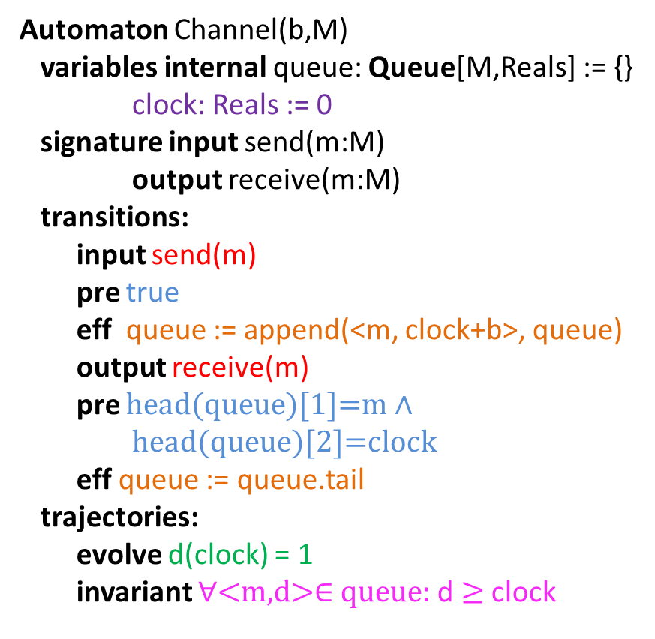
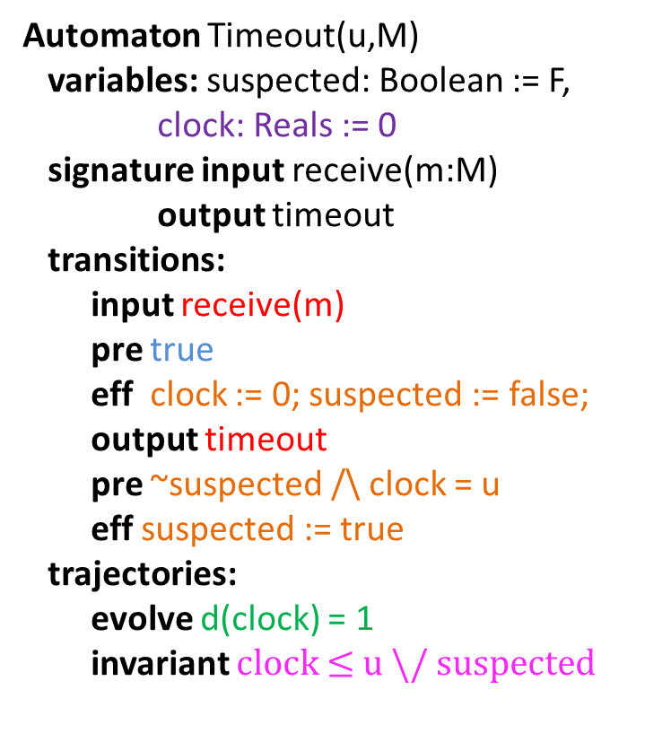
Time bounded channel & Simple Failure Detector
Automaton Timeout(u,M)
variables: suspected: Boolean := F,
clock: Reals := 0
signature input receive(m:M)
output timeout
transitions:
input receive(m)
pre true
eff clock := 0; suspected := false;
output timeout
pre ~suspected /\ clock = u
eff suspected := true
trajectories:
evolve d(clock) = 1
invariant clock $≤$ u \/ suspected
Automaton Channel(b,M)
variables internal queue: Queue[M,Reals] := {}
clock: Reals := 0
signature input send(m:M)
output receive(m:M)
transitions:
input send(m)
pre true
eff queue := append(<m, clock+b>, queue)
output receive(m)
pre head(queue)[1]=m $∧$
head(queue)[2]=clock
eff queue := queue.tail
trajectories:
evolve d(clock) = 1
invariant $∀$<m,d>∈ queue: d $≥$ clock

Slide 47
Example 3: Oscillator and pulse generator
pulseGen
Oscillator

Slide 48


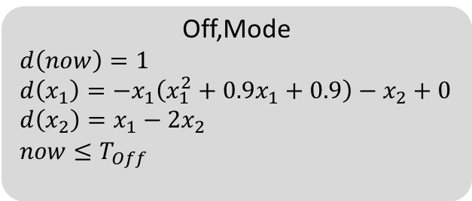
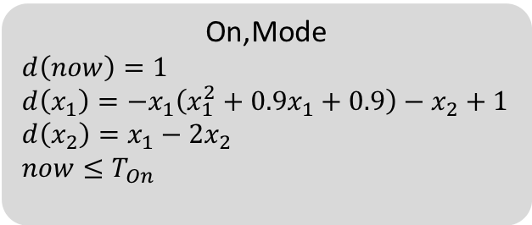
Composed automaton
On,Mode
$$d\left(now\right)=1$$
$$d\left(x_{1}\right)=−x_{1}\left(x_{1}^{2}+0.9x_{1}+0.9\right)−x_{2}+1$$
$$d\left(x_{2}\right)=x_{1}−2x_{2}$$
$$now≤T_{On}$$
Oscillator1
pre:$now≥T_{Off}$
eff: $now≔0$
pre:$now≥T_{On}$
eff: $now≔0$
Oscillator6
Oscillator2
pulseGen
Off,Mode
$$d\left(now\right)=1$$
$$d\left(x_{1}\right)=−x_{1}\left(x_{1}^{2}+0.9x_{1}+0.9\right)−x_{2}+0$$
$$d\left(x_{2}\right)=x_{1}−2x_{2}$$
$$now≤T_{Off}$$
Oscillator5
Oscillator3
Oscillator4
Cardiac oscillator network models, Grosu et al. CAV, HSCC 2007-2015

Slide 49

Restriction operation on exections
Sometimes it is useful to restrict our attention to only some subset of variables and actions in an execution
Recall the restriction operations $x⌈V and τ↓V$
Let $α=τ_{0}a_{1}τ_{1}a_{2}$ be an execution fragment of a hybrid automaton with set of variables $V$ and set of actions $A$. Let $A′$ be a set of actions and $V′$ be a set of variables.
Restriction of $α$to $(A′,V′)$, written as $α⌈(A′, V′)$ is the sequence defined inductively as:
$α⌈\left(A^{′},V^{′}\right)$ = $τ↓V^{′}$ if $α=τ$
$α a τ ⌈\left(A^{′},V^{′}\right)$ =
$α ⌈\left(A^{′},V^{′}\right) a (τ↓V^{′})$ if $a∈A′$
$α ⌈\left(A^{′},V^{′}\right) concat (τ↓V^{′})$ if $a∉A^{′}$
From the definition it follows $α.lstate ⌈V^{′}=α⌈\left(A′,V^{′}\right).lstate$ for any $A^{′},V′$

Slide 50

Properties of Compositions
Proposition. Let $𝒜= 𝒜_{1}||𝒜_{2}$. $α$ is an execution fragment of $𝒜$ iff
$α⌈\left(A_{i},V_{i}\right), i∈\left\{1,2\right\}$ are both execution fragments of $𝒜_{i}.$
Proof of the forward direction. Fix $α$ and i. We prove this by induction on the length of $α.$
Base case: $α=τ.$ $α⌈\left(A_{i},V_{i}\right)=τ↓V_{i}$ by definition of composition $τ↓V_{i}∈T_{i}$. So, $τ↓V_{i}∈Frag_{i}$
$α=α′ a τ ⌈\left(A_{i},V_{i}\right)$ and $a∈A_{i}$ and by induction hypothesis $α′⌈\left(A_{i},V_{i}\right)∈Frag_{i}$. Let $α′⌈\left(A_{i},V_{i}\right).lstate$= $v.$ By the definition of composition: $τ↓V_{i}∈T_{i}$.
It remains to show that $v⌈V_{i}→_{a}\left(τ↓V_{i}\right).fstate.$Since $a∈A_{i},$by the definition of composition: $α′⌈\left(A_{i},V_{i}\right).lstate →_{a}τ↓V_{i}.fstate$
$α=α′ a τ ⌈\left(A_{i},V_{i}\right)$ and $a∉A_{i}$ and by induction hypothesis $α′⌈\left(A_{i},V_{i}\right)∈Exec_{i}.$Let $τ′$ be the last trajectory in that execution.
Since $a∉A_{i},$by the definition of composition:$τ^{′}.lstate=τ↓V_{i}.fstate$. By concatenation closure of $Τ_{i}$, it follows that $τ^{′}concat τ↓V_{i}∈Τ_{i}.$ Therefore $α⌈\left(A_{i}, V_{i}\right)∈Exec_{i}$.
Notes:
Fix 1.

Slide 51

properties of executions of composed automata
$α$ is an execution iff $α⌈\left(A_{i},V_{i}\right), i∈\left\{1,2\right\}$ are both executions.
$α$ is time bounded iff $α⌈\left(A_{i},V_{i}\right), i∈\left\{1,2\right\}$ are both time bounded.
$α$ is admissible iff $α⌈\left(A_{i},V_{i}\right), i∈\left\{1,2\right\}$ are both admissible.
$α$ is closed iff $α⌈\left(A_{i},V_{i}\right), i∈\left\{1,2\right\}$ are both closed.
$α$ is non-Zeno iff $α⌈\left(A_{i},V_{i}\right), i∈\left\{1,2\right\}$ are both time non-Zeno.

Slide 52
Summary
Composition operation
I/O interfaces: actions and variables
Reactivity/input enabling
(non) Closure under composition
Properties of executions preserved under composition
Inductive invariants

