Slide 1
Undecidability of Rectangular Hybrid Automata
Sayan Mitra
Verifying cyberphysical systems
mitras@illinois.edu

Slide 2
Special Classes of Hybrid Automata
Nonlinear Hybrid
Automata
Rectangular Hybrid Automata
Rectangular Initialized
Hybrid Automata
Multirate Automata
Rational Timed Automata
Integral Timed Automata

Slide 3
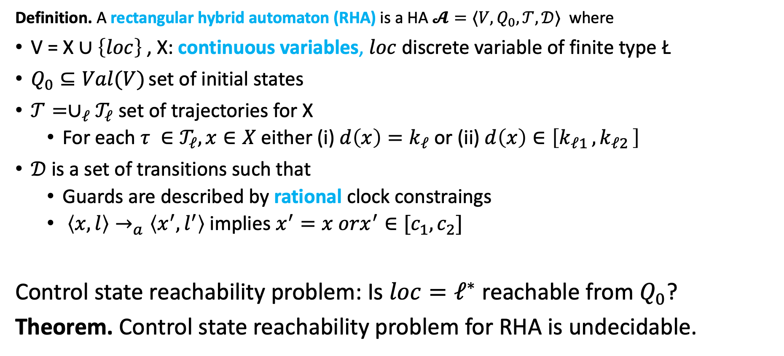
Control State Reachability of Rectangular HA
Definition. A rectangular hybrid automaton (RHA) is a HA $𝓐=⟨V,Q_{0},𝒯,𝒟⟩$ where
V = X $∪\left\{loc\right\}$ , X: continuous variables, $loc$ discrete variable of finite type Ł
$Q_{0}⊆Val(V)$ set of initial states
$𝒯={∪_{ℓ}𝒯}_{ℓ}$ set of trajectories for X
For each $τ ∈𝒯_{ℓ}, x∈X$ either (i) $d\left(x\right)=k_{ℓ}$ or (ii) $d\left(x\right)∈\left[k_{ℓ1 },k_{ℓ2 }\right]$
$𝒟$is a set of transitions such that
Guards are described by rational clock constraings
$〈x,l〉→_{a}〈x^{′},l^{′}〉$ implies $x^{′}=x orx^{′}∈[c_{1},c_{2}]$
Control state reachability problem: Is $loc=ℓ^{∗}$ reachable from $Q_{0}$?
Theorem. Control state reachability problem for RHA is undecidable.
Henzinger, Kopke, Puri, and Varaiya. What's Decidable About Hybrid Automata?. Journal of Computer and System Sciences. ACM Press, 1995.

Slide 4
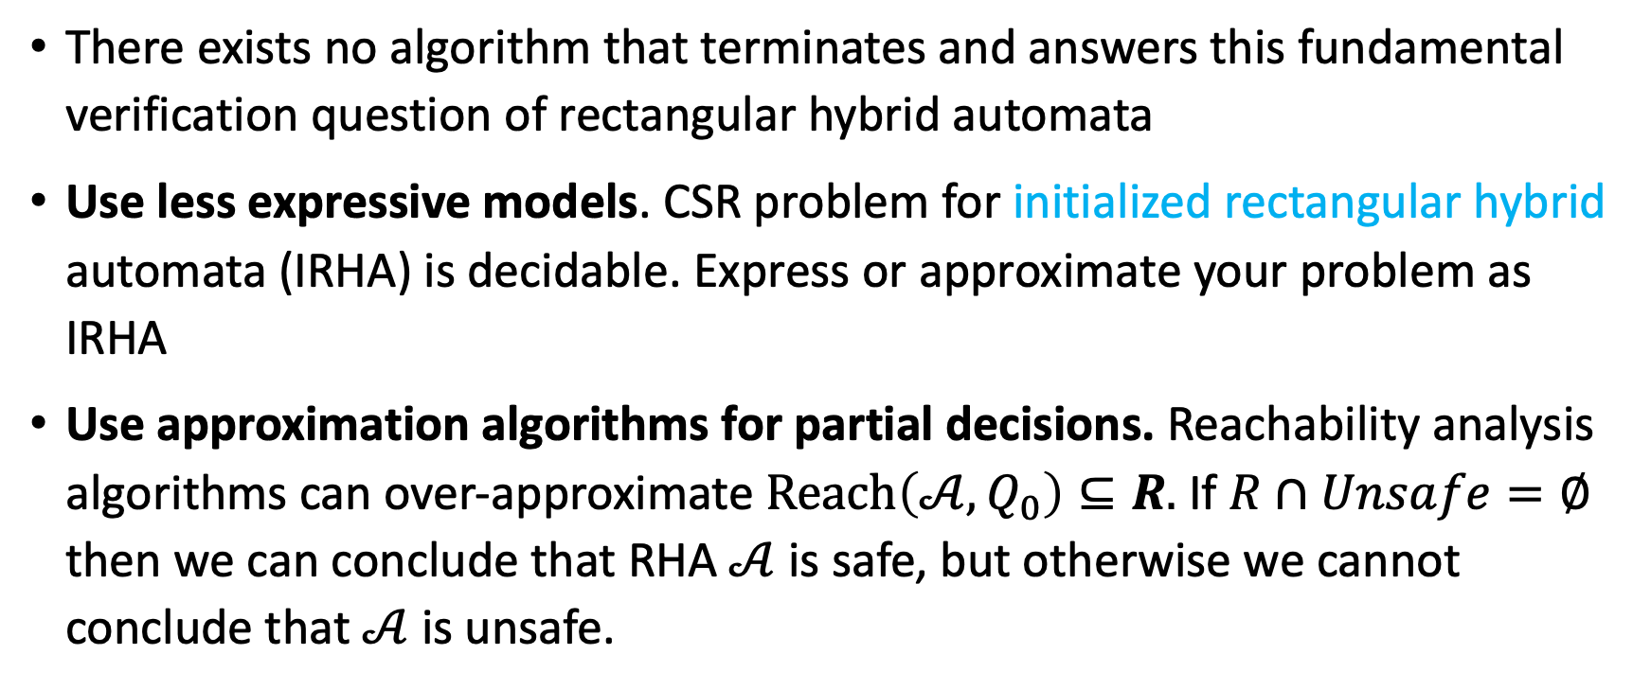
Implications
There exists no algorithm that terminates and answers this fundamental verification question of rectangular hybrid automata
Use less expressive models. CSR problem for initialized rectangular hybrid automata (IRHA) is decidable. Express or approximate your problem as IRHA
Use approximation algorithms for partial decisions. Reachability analysis algorithms can over-approximate $Reach\left({𝒜,Q}_{0}\right)⊆R.$If $R∩Unsafe=∅$ then we can conclude that RHA $𝒜$is safe, but otherwise we cannot conclude that $𝒜$is unsafe.

Slide 5
Outline
Hardness results
Halting problem
Reductions
Counter machines
RHA

Slide 6
One problem that is hard / undecidable

Slide 7
Halting Problem is Undecidable: Diagonalization
Theorem. There does not there exist an algorithm/compiler HALTS(P, x) that correctly answers yes iff a program P halts on x.
Assume, for contradiction, there is a correct procedure:
HALTS(P, x) returns:
TRUE if P halts on input x
FALSE if P runs forever on input x
Now define a new program D(P):
if HALTS(P, P) = TRUE then loop forever else halt immediately
What happens when we run D on itself, D(D)?
If HALTS(D, D) = TRUE, then D(D) should halt but by definition of D, in this case D(D) loops forever. Contradiction.
If HALTS(D, D) = FALSE, then D(D) should loop forever… but by definition of D, in this case D(D) halts. Contradiction.
Cantor: build a real number that differs from the n-th real at the n-th digit.
Halting proof: build a program that differs from the n-th program on input n.

Slide 8
How to show that RHA is undecidable?
Show that if RHA were decidable then Halting problem also becomes decidable.
Since Halting problem is undecidable, therefore CSR of RHA is also undecidable.
Do this in multiple steps
If Halting problem for 2-Counter Machines were decidable then Halting problem would be decidable
2 Counter Machines are as powerful/expressive as general programs
If RHA were decidable then 2-Counter machines would be decidable
RHA are as expressive / powerful as 2-CMs

Slide 9
General reductions: Using known hard problem B to show hardness of A
Decision procedure for B
Instance of B (known to be hard)
Translator f: B → A
instance of A
Purported Algorithm for Problem A
Yes
No
Given B is known to be hard
Suppose (for the sake of contradiction) A is solvable
If we can construct a reduction f: B→A (from B to A) then B becomes easy, which is a contradiction

Slide 10
Reduction from Halting Problem for 2CM
2 CM Halting problem decider
2CM Halting problem: p
Translator f(p)
CSR for RHA: f(p)
CSR algorithm for Rectangular HA
Yes
No
Suppose CSR for RHA is decidable
If we can construct a reduction from 2CM Halting Problem to CSR for RHA then 2CM Halting problem is also decidable

Slide 11
Counter Machines
An n-counter machine is an elementary computer with n-unbounded counters and a finite program written in a minimalistic assembly language.
More precisely: A 2-counter machine (2CM) is a discrete transition system with the following components:
Two nonnegative integer counters C and D. Both are initialized to $0$.
A finite program with one of these instructions at each location (or line):
INCC, INCD: increments counter C (or D)
DECC, DECD: decrements counter C (or D), provided it is not 0,
JNZC, JNZD [label]: moves the program control to line label provided that counter C (or D) is not zero.

Slide 12
Example 2CM for multiplication
A 2-counter machine for multiplying 2x3 is shown below.
INCC;
INCC; % C = 2
INCD; % LOOP
INCD;
INCD;
DECC;
JNZC 3; % Jump to LOOP
% HALT
Exercise: Show that any k-counter machine can be simulated by a 2CM.

Slide 13
Halting problem for 2CM
A configuration of a 2CM is a triple (pc, C, D)
pc is the program counter that stores the next line to be executed
C, D are values of the counter
A sequence of configurations (pc0, D0, C0), (pc1, D1, C1), … is an execution if the ith configuration goes to the (i+1)st configuration in the sequence executing the instruction in line pci
Given a 2CM M a special halting location (pc_halt), the Halting problem requires us to decide whether all executions of M reach the halting location
Theorem [Minsky 67]. The Halting problem for 2CMs is undecidable.

Slide 14
Reduction from Halting Problem
Halting problem decider
P Halting problem: p
Translator f(p)
2CM: f(p)
Halting algorithm for 2CM
Yes
No

Slide 15
Reduction from 2CM to CSR-RHS
We have to construct a function (reduction) that maps instances of 2CM-Halt to instances of CSR-RHA

Slide 16
Reduction from Halting Problem for 2CM
2 CM Halting problem decider
2CM Halting problem: p
Translator f(p)
CSR for RHA: f(p)
CSR algorithm for Rectangular HA
Yes
No
Suppose CSR for RHA is decidable
If we can construct a reduction from 2CM Halting Problem to CSR for RHA then 2CM Halting problem is also decidable

Slide 17
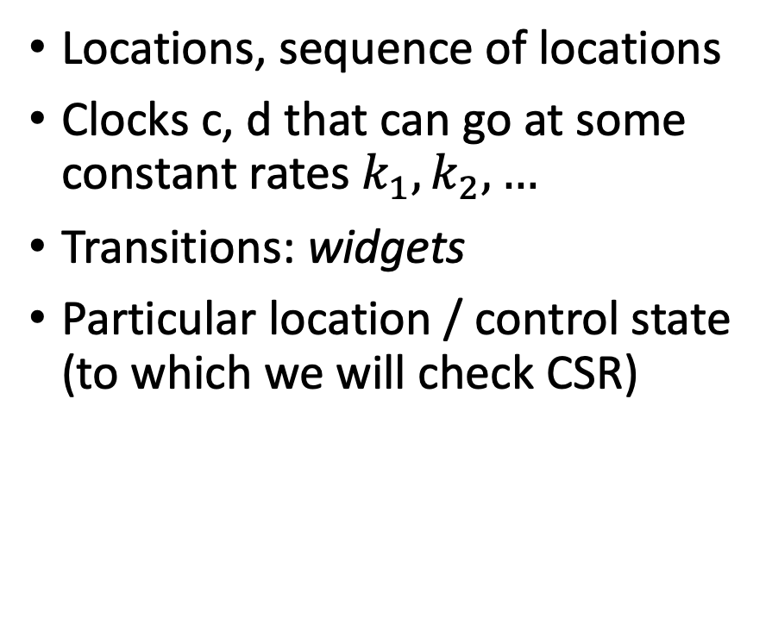
Translation/Reduction from 2CM to CSR-RHS
Program counter pc
Counters C, D
Instructions (program)
Halting location
Locations, sequence of locations
Clocks c, d that can go at some constant rates $k_{1},k_{2},…$
Transitions: widgets
Particular location / control state (to which we will check CSR)

Slide 18
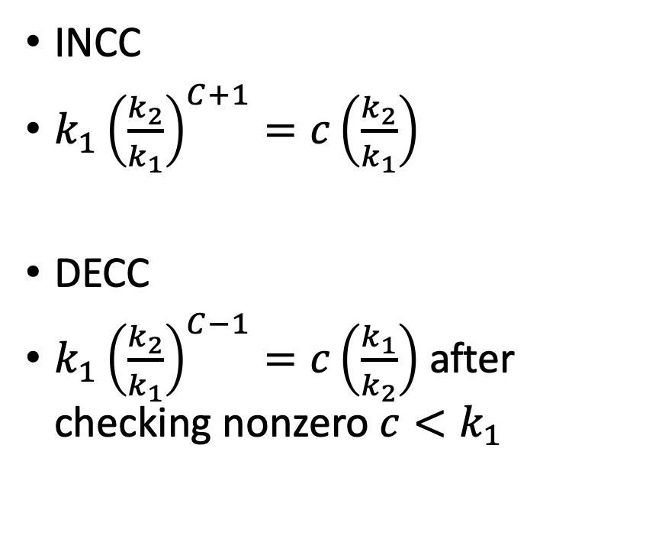

Idea of reduction: a compiler from 2CM->RHA
Two clocks
$c =k_{1}{\left(\frac{k_{2}}{k_{1}}\right)}^{C}$
d$=k_{1}{\left(\frac{k_{2}}{k_{1}}\right)}^{D}$
INCC
$k_{1}{\left(\frac{k_{2}}{k_{1}}\right)}^{C+1}=c\left(\frac{k_{2}}{k_{1}}\right)$
DECC
$k_{1}{\left(\frac{k_{2}}{k_{1}}\right)}^{C−1}=c\left(\frac{k_{1}}{k_{2}}\right)$ after checking nonzero $c<k_{1}$

Slide 19
A widget that preserves the value of clock c
W
k1W
c
a

Slide 20
A widget for checking JNZC (c < k_1)

Slide 21
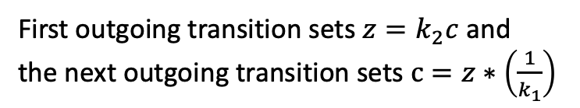
A widget implementing INCC
First outgoing transition sets $z=k_{2}c$ and
the next outgoing transition sets $c=z∗\left(\frac{1}{k_{1}}\right)$

Slide 22
Putting it all together
2 CM Halting problem decider
2CM:
INCC
INCC
DECC
JNC 1
DECC
HALT
Translator f(p)
CSR-RHA
CSR algorithm for Rectangular HA
Yes
No
Suppose CSR for RHA is decidable
If we can construct a reduction from 2CM Halting Problem to CSR for RHA then 2CM Halting problem is also decidable
Theorem: CSR for RHA is undecidable

