Slide 1
Neural Network Verification Integer and Linear Programming Formulations
Prof. Sayan Mitra
mitras@Illinois.edu

Slide 2

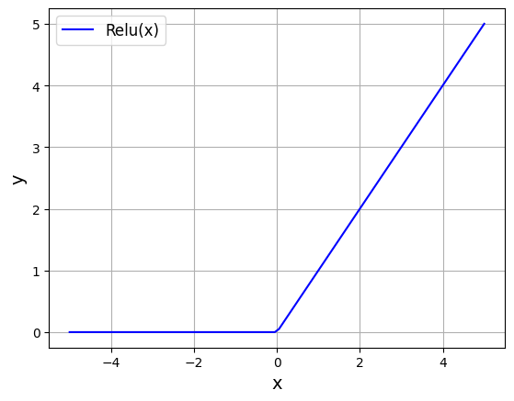


Review: Neural network verification as a satisfiability problem
0.9
z₁⁽¹⁾
ẑ₁⁽¹⁾
z⁽²⁾
ẑ⁽²⁾
x₁
z₂⁽¹⁾
ẑ₂⁽¹⁾
0.1
y=f(x)
z₃⁽¹⁾
Stop
Speed Limit
x₂
ẑ₃⁽¹⁾
$$ẑ_{j}^{(i)}$$
To verify for all x ∈ S, y > 0 ∧ y = f(x) we solve
Does there exist x, s.t. x ∈ S ∧ y ≤ 0 ∧ y = f(x)
$$z_{j}^{(i)}$$
Defines the neural network
Input domain under consideration
Negation of the desired property

Slide 3
Verification of neural networks
Satisfiability problem: ∃ x ∈ S ∧ y ≤ 0 ∧ y = f(x)
x_{i} ≤ u_{i} ∧ x_{i} ≥ l_{i} for each dimension of x
((z_{j}^{(i)} ≥ 0 ∧ ẑ_{j}^{(i)}= z_{j}^{(i)}) ∨ (z_{j}^{(i)} < 0 ∧ ẑ_{j}^{(i)}= 0)) for each ReLU neuron
z₁ =W⁽¹⁾ x ∧ z⁽²⁾ =W⁽²⁾ ẑ⁽¹⁾ ∧ y=w^{(3)T} ẑ⁽²⁾ ∧ y ≤ 0
Add all clauses to the formula and solve using DPLL(T) with Linear Real Arithmetic.
$$ẑ_{j}^{(i)}$$
In general this is very slow!
$$z_{j}^{(i)}$$

Slide 4
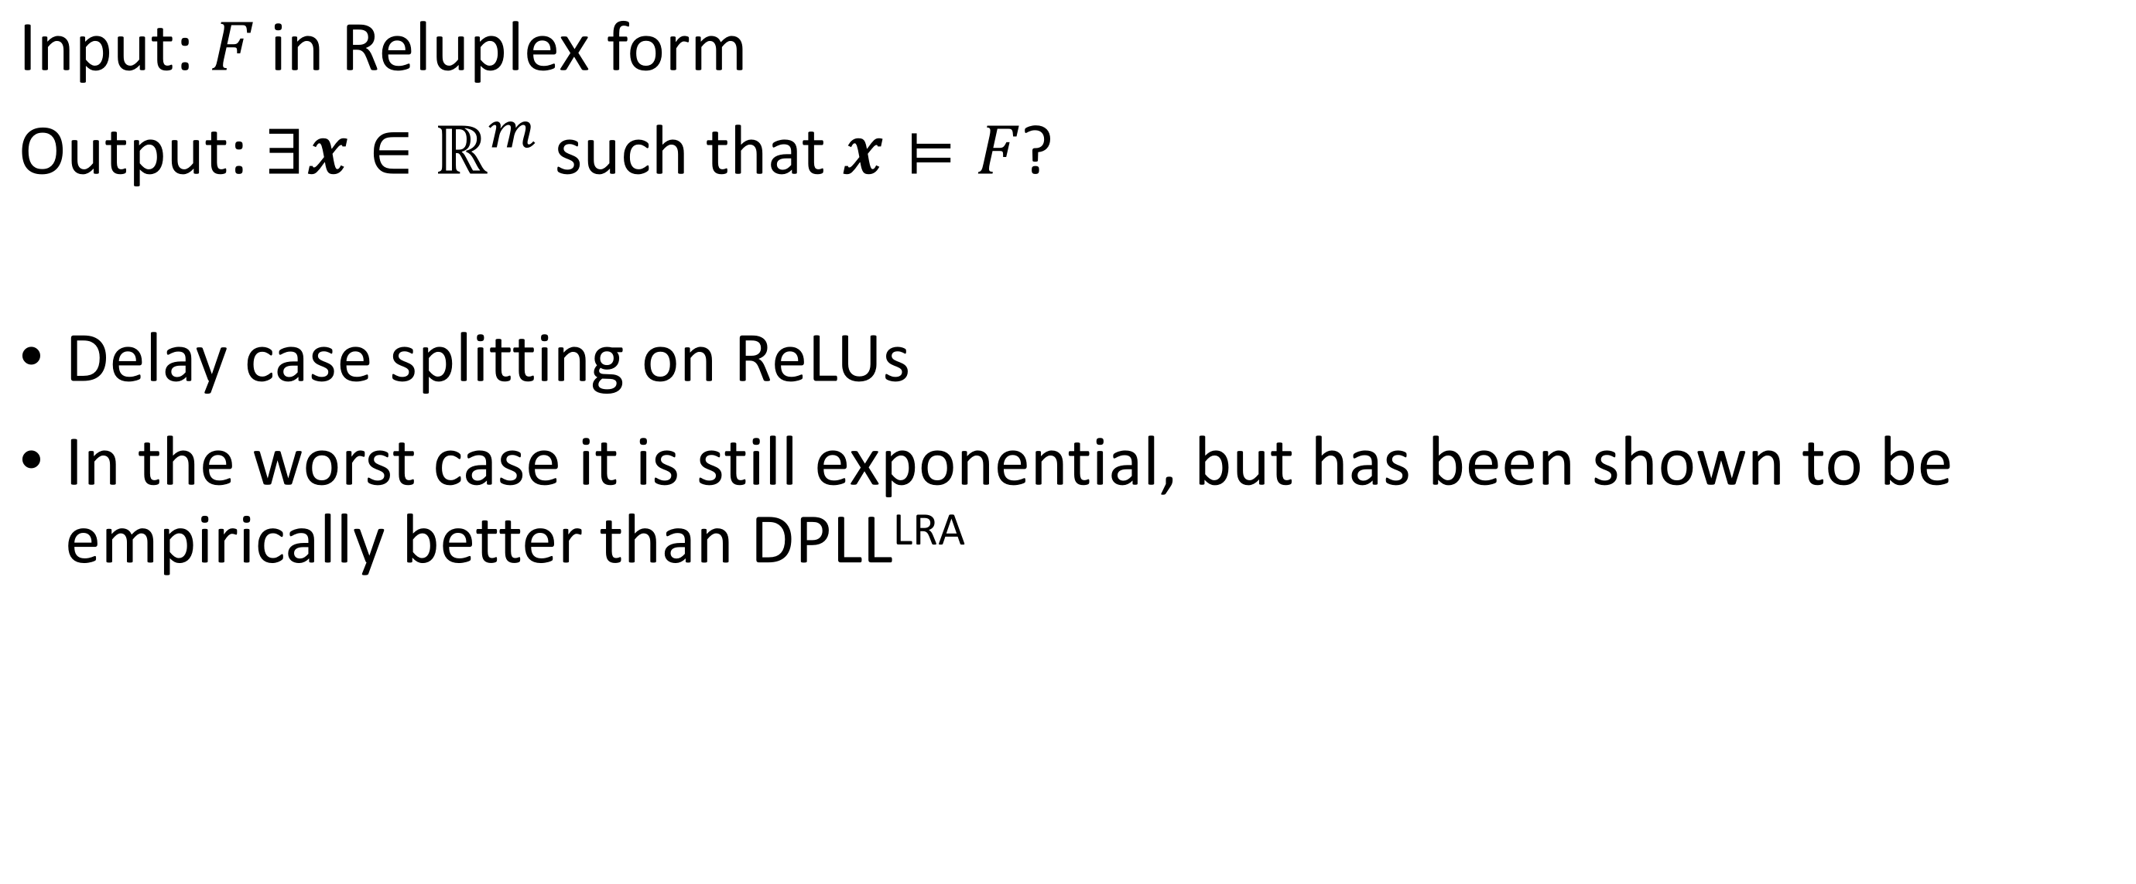
Reluplex: Decision Procedure for ReLU NNs
Input: $F$ in Reluplex form
Output: $∃x∈ℝ^{m}$such that $x⊨F$?
Delay case splitting on ReLUs
In the worst case it is still exponential, but has been shown to be empirically better than DPLL^{LRA}
Reluplex: An Efficient SMT Solver for Verifying Deep Neural Networks
Guy Katz, Clark Barrett, David Dill, Kyle Julian, Mykel Kochenderfer, 2017

Slide 5
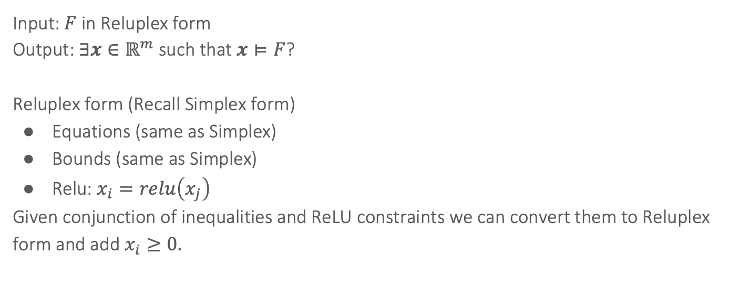
Reluplex Decision Procedure for ReLU NNs
Input: $F$ in Reluplex form
Output: $∃x∈ℝ^{m}$such that $x⊨F$?
Reluplex form (Recall Simplex form)
Equations (same as Simplex)
Bounds (same as Simplex)
Relu: $x_{i}=relu\left(x_{j}\right)$
Given conjunction of inequalities and ReLU constraints we can convert them to Reluplex form and add $x_{i}≥0.$

Slide 6
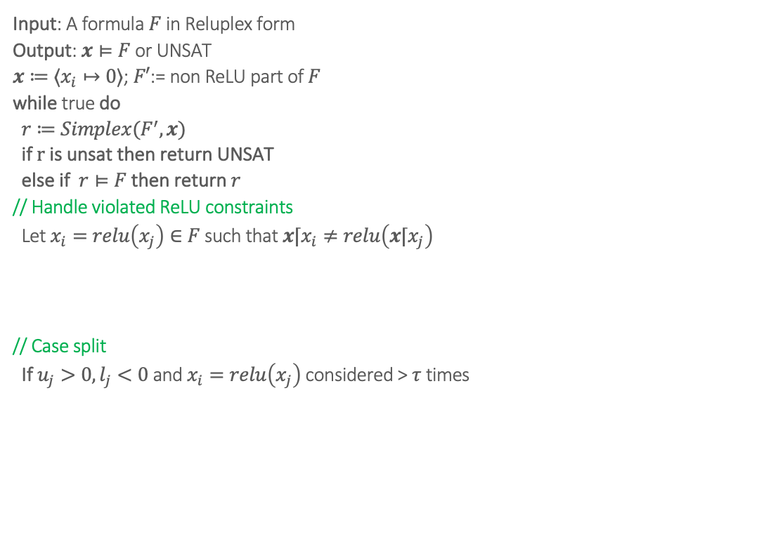
Reluplex
Input: A formula $F$ in Reluplex form
Output: $x⊨F$ or UNSAT
$x≔⟨x_{i}↦0⟩$; $F′$:= non ReLU part of $F$
while true do
$r≔Simplex(F^{′},x)$
if $r$ is unsat then return UNSAT
else if $r⊨F$ then return $r$
// Handle violated ReLU constraints
Let $x_{i}=relu\left(x_{j}\right)∈F$ such that ${x⌈x}_{i}≠relu\left(x⌈x_{j}\right)$
if $x_{i}$ is basic then pivot $x_{i}$ with non-basic variable $x_{k}$ where $k≠j$ and $c_{ik}≠0$
if $x_{j}$ is basic then pivot $x_{j}$ with non-basic variable $x_{k}$ where $k≠i$ and $c_{jk}≠0$
${x⌈x}_{i}≔relu(x⌈x_{j})$ OR ${x⌈x}_{j}≔x⌈x_{i}$
// Case split
If $u_{j}>0, l_{j}<0$ and $x_{i}=relu\left(x_{j}\right)$ considered > $τ$ times
$r_{1}=Reluplex(F∧x_{j}≥0∧x_{j}=x_{j})$
$r_{2}=Reluplex(F∧x_{j}≤0∧x_{i}=0)$
if $r_{1}=r_{2}=$ unsat then return UNSAT
else if $r_{1}=unsat$ then return $r_{1}$ else return $r_{2}$

Slide 7
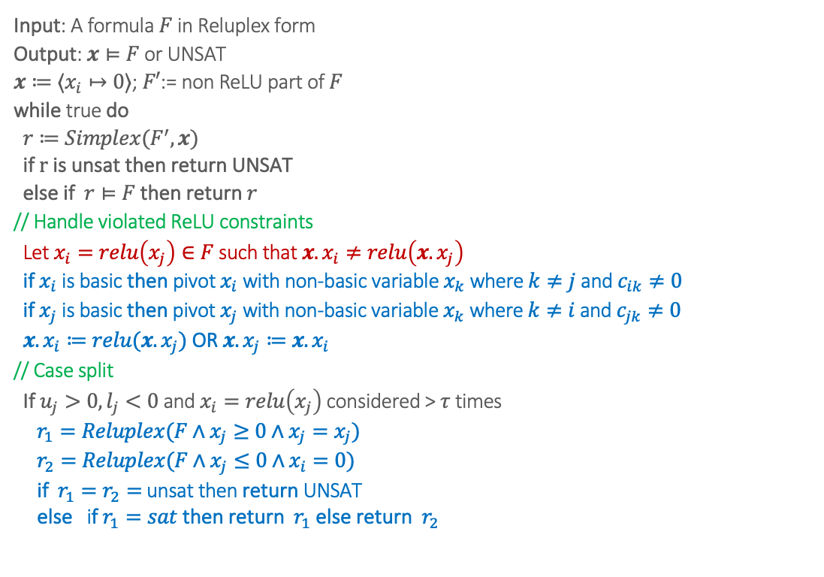
Reluplex
Input: A formula $F$ in Reluplex form
Output: $x⊨F$ or UNSAT
$x≔⟨x_{i}↦0⟩$; $F′$:= non ReLU part of $F$
while true do
$r≔Simplex(F^{′},x)$
if $r$ is unsat then return UNSAT
else if $r⊨F$ then return $r$
// Handle violated ReLU constraints
Let $x_{i}=relu\left(x_{j}\right)∈F$ such that ${x.x}_{i}≠relu\left(x.x_{j}\right)$
if $x_{i}$ is basic then pivot $x_{i}$ with non-basic variable $x_{k}$ where $k≠j$ and $c_{ik}≠0$
if $x_{j}$ is basic then pivot $x_{j}$ with non-basic variable $x_{k}$ where $k≠i$ and $c_{jk}≠0$
${x.x}_{i}≔relu(x.x_{j})$ OR ${x.x}_{j}≔x.x_{i}$
// Case split
If $u_{j}>0, l_{j}<0$ and $x_{i}=relu\left(x_{j}\right)$ considered > $τ$ times
$r_{1}=Reluplex(F∧x_{j}≥0∧x_{j}=x_{j})$
$r_{2}=Reluplex(F∧x_{j}≤0∧x_{i}=0)$
if $r_{1}=r_{2}=$ unsat then return UNSAT
else if $r_{1}=sat$ then return $r_{1}$ else return $r_{2}$
Notes:
The algorithm tries to repair the violation without branching, by nudging the current assignment using pivoting or direct reassignment.
If xi is a basic variable: Pivot it with some non-basic variable xk. This frees xi​ so that its value can be recomputed consistently with relu(x_j).
If xj is a basic variable: Similarly, pivot xj with some non-basic variable xk. This frees xj so that it can be recomputed consistently.
After pivoting, enforce the ReLU equation in one of two ways:
Set xi:=ReLU(xj) (i.e., update the output to match the ReLU of the input).
Or set xj:=xi (i.e., adjust the input to be consistent with the output).
If a particular ReLU constraint keeps getting violated too many times (> τ in the pseudocode), then Reluplex gives up on repairing it incrementally and performs a case split:

Slide 8
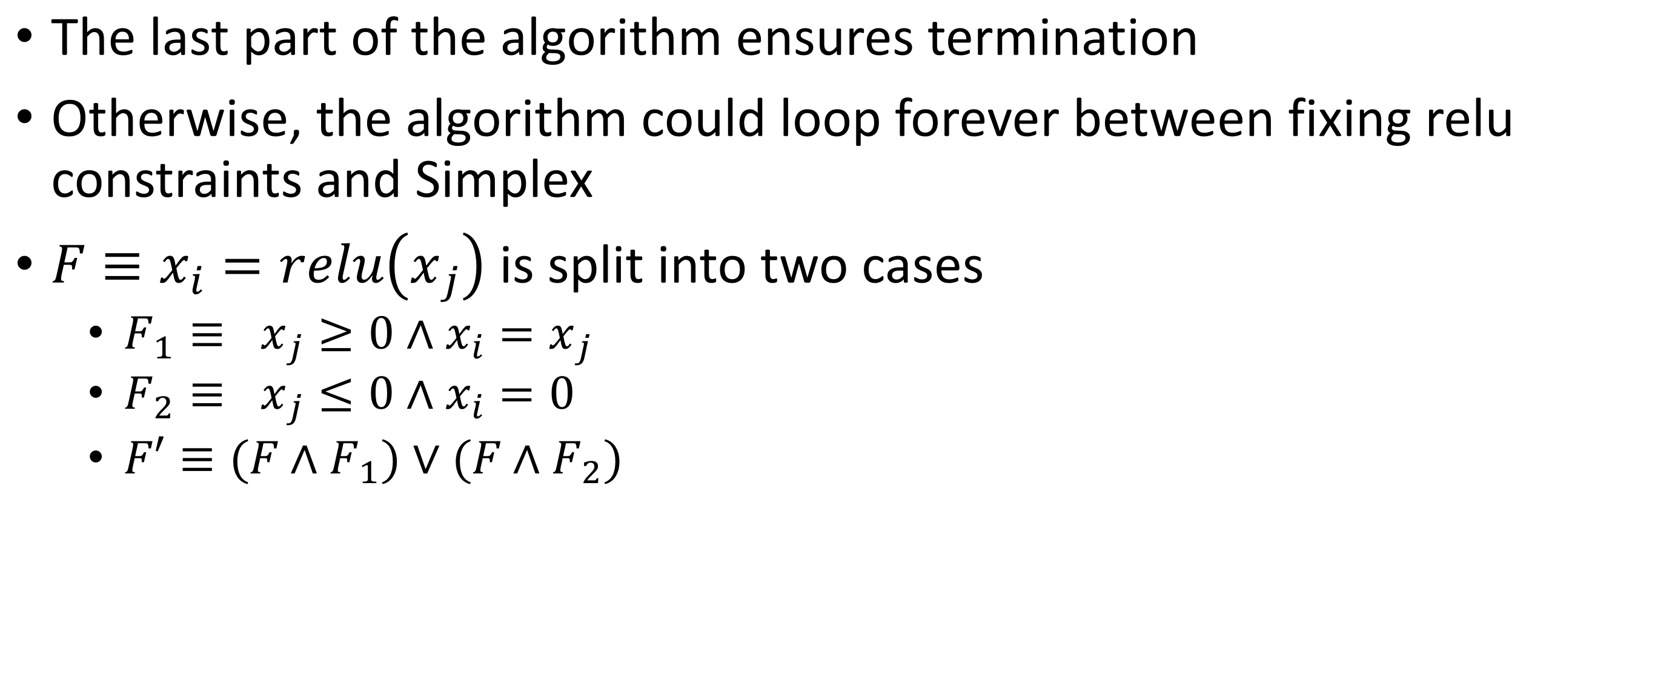
Termination
The last part of the algorithm ensures termination
Otherwise, the algorithm could loop forever between fixing relu constraints and Simplex
$F≡x_{i}=relu\left(x_{j}\right)$ is split into two cases
$F_{1}≡ x_{j}≥0∧x_{i}=x_{j}$
$F_{2}≡ x_{j}≤0∧x_{i}=0$
$F′≡{(F∧F}_{1})∨(F∧F_{2})$

Slide 9
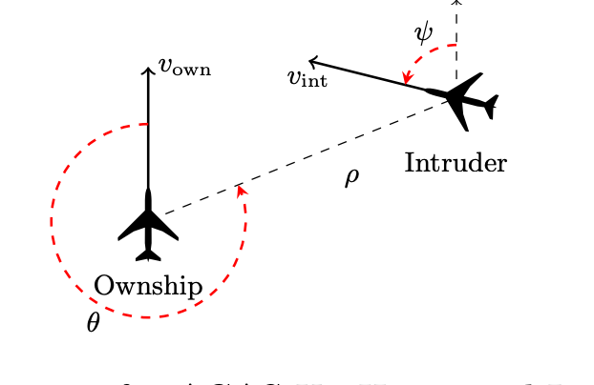
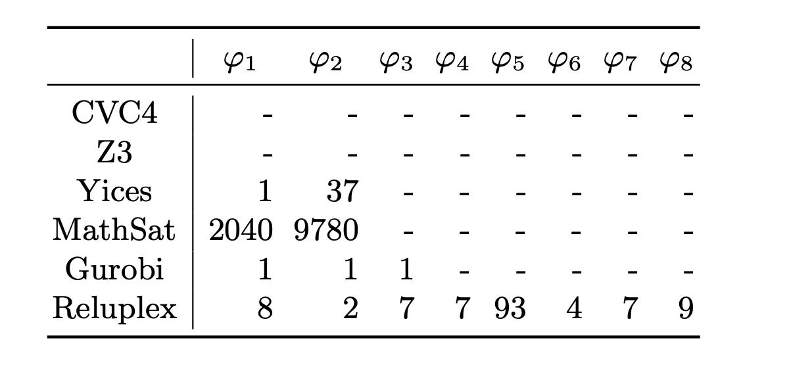
Performance of Reluplex on ACAS

Slide 10
Review: Neural network verification as a satisfiability problem
0.9
z₁⁽¹⁾
ẑ₁⁽¹⁾
z⁽²⁾
ẑ⁽²⁾
x₁
z₂⁽¹⁾
ẑ₂⁽¹⁾
0.1
y=f(x)
z₃⁽¹⁾
Stop
Speed Limit
x₂
ẑ₃⁽¹⁾
$$ẑ_{j}^{(i)}$$
Does there exist x, s.t. x ∈ S ∧ y ≤ 0 ∧ y = f(x)
Defines the neural network
$$z_{j}^{(i)}$$
Input domain under consideration
Negation of the desired property

Slide 11
Verification of neural networks
Satisfiability problem: ∃ x ∈ S ∧ y ≤ 0 ∧ y = f(x)
x_{i} ≤ u_{i} ∧ x_{i} ≥ l_{i} for each dimension of x
((z_{j}^{(i)} ≥ 0 ∧ ẑ_{j}^{(i)}= z_{j}^{(i)}) ∨ (z_{j}^{(i)} < 0 ∧ ẑ_{j}^{(i)}= 0)) for each ReLU neuron
z₁ =W⁽¹⁾ x ∧ z⁽²⁾ =W⁽²⁾ ẑ⁽¹⁾ ∧ y=w^{(3)T} ẑ⁽²⁾ ∧ y ≤ 0
Add all clauses to the formula and solve using DPLL(T) with Linear Real Arithmetic.
$$ẑ_{j}^{(i)}$$
In general this is very slow!
$$z_{j}^{(i)}$$

Slide 12
How does a SMT solver solve this problem?
Obtain the abstract version of the problem
x_{i} ≤ u_{i} ∧ x_{i} ≥ l_{i} (assuming box constraints)
((z_{j}^{(i)} ≥ 0 ∧ ẑ_{j}^{(i)}= z_{j}^{(i)}) ∨ (z_{j}^{(i)} < 0 ∧ ẑ_{j}^{(i)}= 0)) for each ReLU neuron
z₁ =W⁽¹⁾ x ∧ z⁽²⁾ =W⁽²⁾ ẑ⁽¹⁾ ∧ y=w^{(3)T} ẑ⁽²⁾ ∧ y ≤ 0
For each ReLU neuron: ((p_{j}^{(i)} ∧ q_{j}^{(i)}) ∨ (¬p_{j}^{(i)} ∧ r_{j}^{(i)}))
All other clauses contain only a single literal, and must be set to True
Notes:
Each ReLU neuron introduces a disjunctive clause

Slide 13
How does a SMT solver solve this problem?
Now convert to CNF form
For each ReLU neuron: ((p_{j}^{(i)} ∧ q_{j}^{(i)}) ∨ (¬p_{j}^{(i)} ∧ r_{j}^{(i)}))
Distribution: ((p_{j}^{(i)} ∨ ¬p_{j}^{(i)}) ∧ (p_{j}^{(i)} ∨ r_{j}^{(i)}) ∧(q_{j}^{(i)} ∨ ¬p_{j}^{(i)}) ∧(q_{j}^{(i)} ∨ r_{j}^{(i)}))
Rewrite: (p_{j}^{(i)} ∨ r_{j}^{(i)}) ∧(¬p_{j}^{(i)} ∨ q_{j}^{(i)} ) ∧(q_{j}^{(i)} ∨ r_{j}^{(i)}))
Observe that when p_{j}^{(i)}=True, q_{j}^{(i)} must be true; p_{j}^{(i)}=False, r_{j}^{(i)} must be true;
So, the clause q_{j}^{(i)} ∨ r_{j}^{(i)} is redundant

Slide 14
How does a SMT solver solve this problem?
(p_{j}^{(i)} ∨ r_{j}^{(i)}) ∧(¬p_{j}^{(i)} ∨ q_{j}^{(i)} )
When p_{j}^{(i)}=True, q_{j}^{(i)} must be true; p_{j}^{(i)}=False, r_{j}^{(i)} must be true;
SAT solver must try both cases of p_{j}^{(i)}
p_{j}^{(i)}=True (z_{j}^{(i)} ≥ 0)
p_{j}^{(i)}=False (z_{j}^{(i)} < 0)

Slide 15
Why using a SMT solver is very slow?
(p_{j}^{(i)} ∨ r_{j}^{(i)}) ∧(¬p_{j}^{(i)} ∨ q_{j}^{(i)} )
When p_{j}^{(i)}=True, q_{j}^{(i)} must be true; p_{j}^{(i)}=False, r_{j}^{(i)} must be true;
SAT solver must make decisions on p_{j}^{(i)}. In a satisfiable solution from DPLL, each p_{j}^{(i)} is set to True or False, then a theory solver (Simplex) invoked.
There are exponential number of cases here… and modern neural networks can have millions of neurons!
Can we solve the problem without setting every p_{j}^{(i)}?
We will tack this problem from an optimization point of view

Slide 16
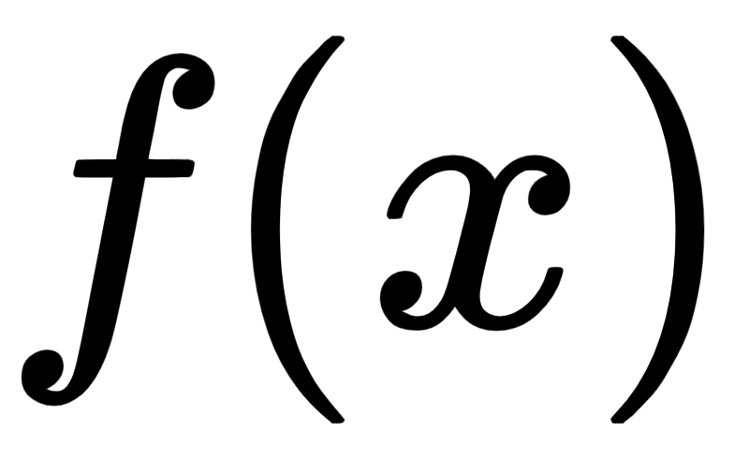
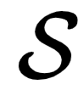
Mathematical optimization problems
Given an objective function f: S → R
Seek an optimal solution x* such that f(x*) ≤ f(x) for all x ∈ S

Slide 17
Some optimization problems are hard, some are easy
Given an objective function f: S → R
Hardness depends on the properties of f and S. For tractable solving they cannot be arbitrary!
Easy ones: convex optimization, linear programming, semidefinite programming
E.g., in linear programming, objective function and constraints must be linear functions
Hard ones: integer programming, general quadratic programming, general nonlinear programming, …

Slide 18
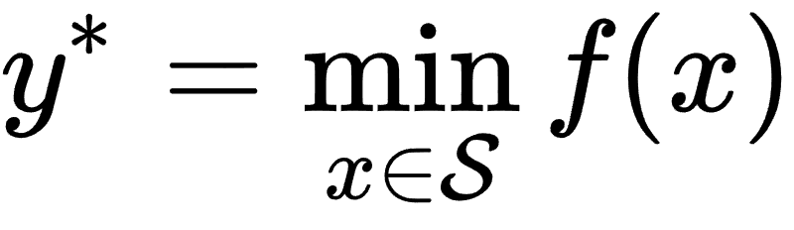

Verification Problem as an optimization problem
∃ x ∈ S ∧ y ≤ 0 ∧ y = f(x)
Can be solved with the following minimization problem:
If the optimal objective y*≤0, then the original Problem is satisfiable
y*
Notes:
\displaystyle f^* = \min_{x \in \mathcal{S}} f(x)

Slide 19
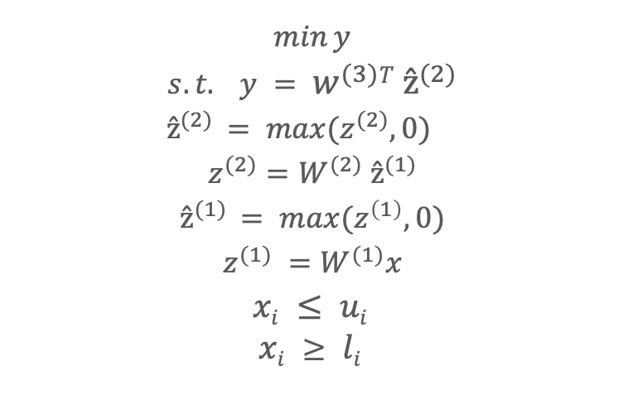
Verification Problem as an optimization problem
Now we rewrite the neural network verification problem as a constrained optimization problem (still using the simple network example):
$$min⁡y$$
$$s.t. y = w^{(3)}T ẑ^{(2)}$$
$$ẑ^{(2)} = max⁡(z^{(2)}, 0)$$
$$z^{(2)}=W^{(2)} ẑ^{(1)}$$
$$ẑ^{(1)} = max⁡(z^{\left(1\right)}, 0)$$
$$z^{(1)} =W^{(1)}x$$
$$xi ≤ ui$$
$$xi ≥ li$$
(linear layers)
(ReLU activation)
(element-wise input bounds)

Slide 20
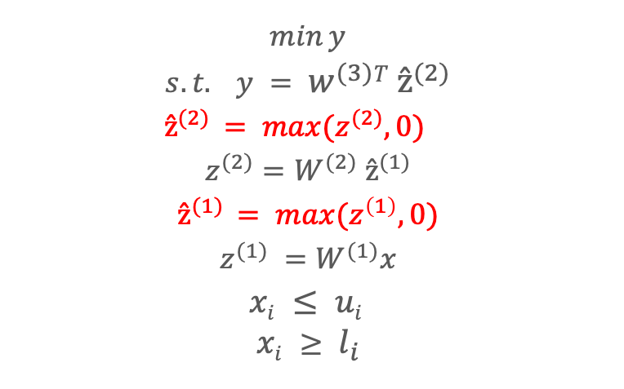
Verification Problem as an optimization problem
Now we rewrite the neural network verification problem as a constrained optimization problem (still using the simple network example):
$$min⁡y$$
$$s.t. y = w^{(3)}T ẑ^{(2)}$$
$$ẑ^{(2)} = max⁡(z^{(2)}, 0)$$
$$z^{(2)}=W^{(2)} ẑ^{(1)}$$
$$ẑ^{(1)} = max⁡(z^{\left(1\right)}, 0)$$
$$z^{(1)} =W^{(1)}x$$
$$xi ≤ ui$$
$$xi ≥ l_{i}$$
(linear constraints)
(nonlinear constraints)
(inputs bounds are also linear constraints)

Slide 21
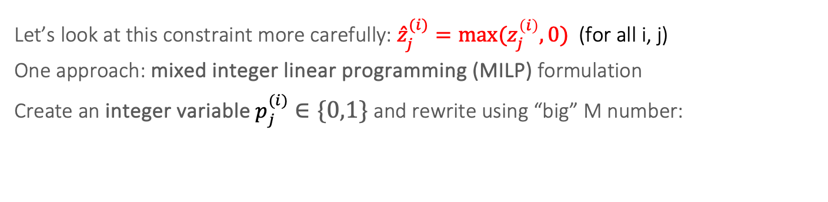
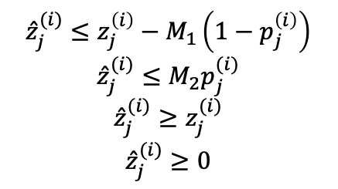
Optimization formulation for ReLU neurons
Let’s look at this constraint more carefully: ${\hat{z}}_{j}^{(i)}=max⁡(z_{j}^{\left(i\right)},0)$(for all i, j)
One approach: mixed integer linear programming (MILP) formulation
Create an integer variable $p_{j}^{(i)}∈\{0,1\}$ and rewrite using “big” M number:
$${\hat{z}}_{j}^{(i)}≤z_{j}^{\left(i\right)}−M_{1}\left(1−p_{j}^{\left(i\right)}\right)$$
$${\hat{z}}_{j}^{(i)}≤M_{2}p_{j}^{(i)}$$
$${\hat{z}}_{j}^{(i)}≥z_{j}^{(i)}$$
$${\hat{z}}_{j}^{(i)}≥0$$
ẑ_{j}^{(i)}
z_{j}^{(i)}
Notes:
\hat{z}^{(i)}_j \leq z_j^{(i)} - M_1 (1 - p^{(i)}_j)
\hat{z}^{(i)}_j \leq M_2 p^{(i)}_j
\hat{z}^{(i)}_j \leq z_j^{(i)}

Slide 22
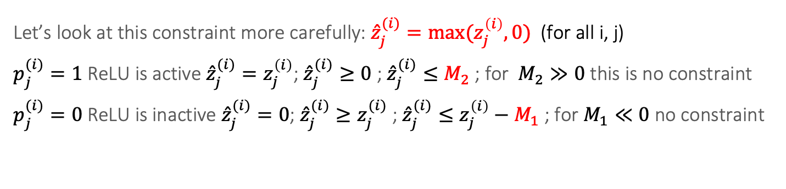
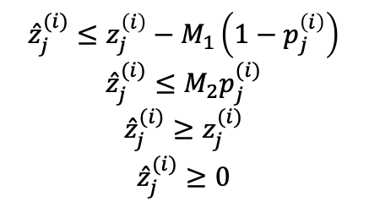
Optimization formulation for ReLU neurons
Let’s look at this constraint more carefully: ${\hat{z}}_{j}^{(i)}=max⁡(z_{j}^{\left(i\right)},0)$(for all i, j)
$p_{j}^{(i)}=1$ReLU is active ${\hat{z}}_{j}^{(i)}=z_{j}^{\left(i\right)}$; ${\hat{z}}_{j}^{(i)}≥0$ ; ${\hat{z}}_{j}^{(i)}≤M_{2}$ ; for $M_{2}≫0$ this is no constraint
$p_{j}^{(i)}=0$ReLU is inactive ${\hat{z}}_{j}^{(i)}=0$; ${\hat{z}}_{j}^{(i)}≥z_{j}^{(i)}$ ; ${\hat{z}}_{j}^{(i)}≤z_{j}^{\left(i\right)}−M_{1}$ ; for $M_{1}≪0$ no constraint
ẑ_{j}^{(i)}
$${\hat{z}}_{j}^{(i)}≤z_{j}^{\left(i\right)}−M_{1}\left(1−p_{j}^{\left(i\right)}\right)$$
$${\hat{z}}_{j}^{(i)}≤M_{2}p_{j}^{(i)}$$
$${\hat{z}}_{j}^{(i)}≥z_{j}^{(i)}$$
$${\hat{z}}_{j}^{(i)}≥0$$
z_{j}^{(i)}
M₁ needs to be small (negative) enough
M₂ needs to be large enough
Notes:
\hat{z}^{(i)}_j \leq z_j^{(i)} - M_1 (1 - p^{(i)}_j)
\hat{z}^{(i)}_j \leq M_2 p^{(i)}_j
\hat{z}^{(i)}_j \leq z_j^{(i)}

Slide 23
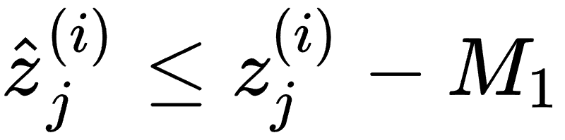
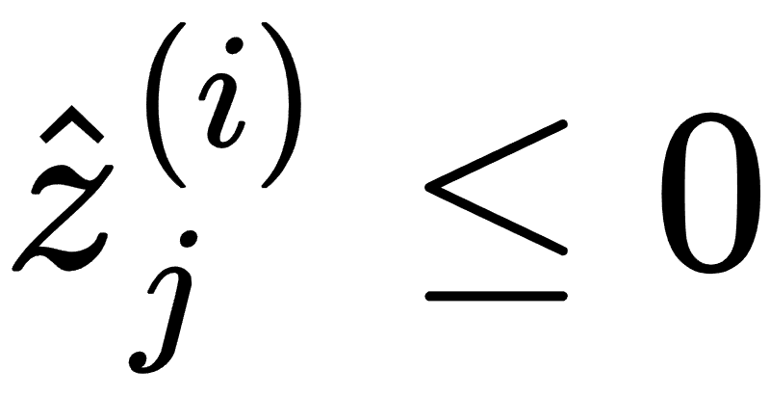
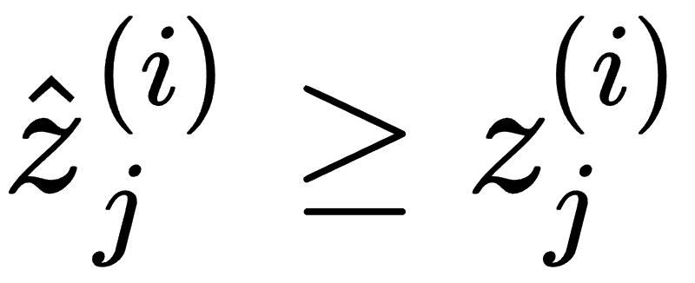
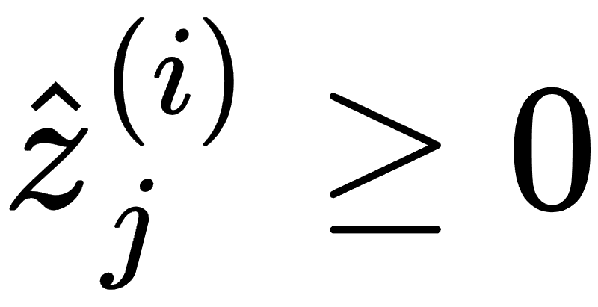
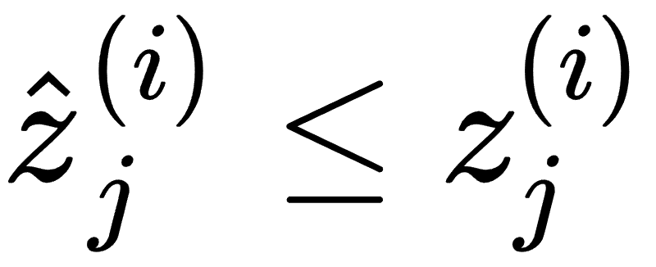
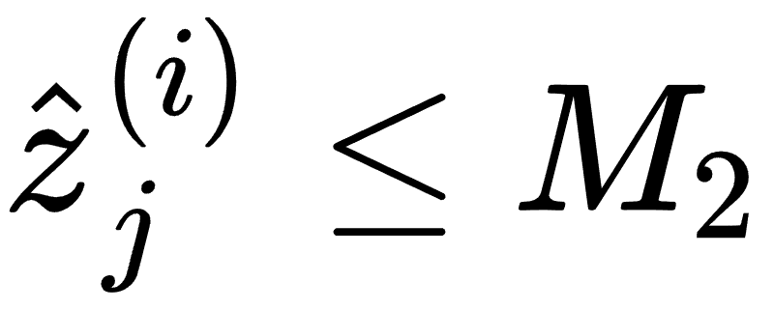
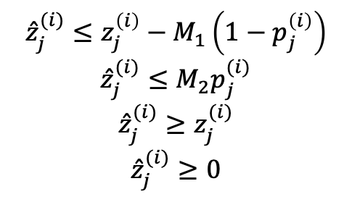
Optimization formulation for ReLU neurons
When p_{j}^{(i)} = 0:
When p_{j}^{(i)} = 1:
$${\hat{z}}_{j}^{(i)}≤z_{j}^{\left(i\right)}−M_{1}\left(1−p_{j}^{\left(i\right)}\right)$$
$${\hat{z}}_{j}^{(i)}≤M_{2}p_{j}^{(i)}$$
$${\hat{z}}_{j}^{(i)}≥z_{j}^{(i)}$$
$${\hat{z}}_{j}^{(i)}≥0$$
M₁
ẑ_{j}^{(i)}
M₂
M₁ needs to be small (negative) enough
M₂ needs to be large enough
z_{j}^{(i)}

Slide 24
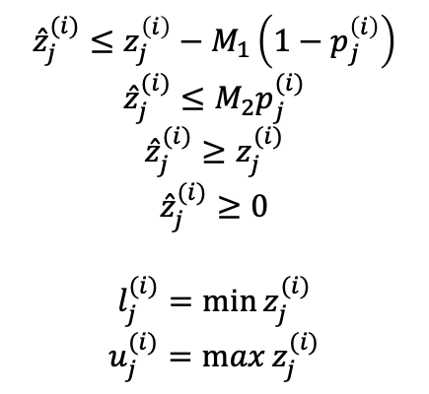
Pre-activation bounds
ẑ_{j}^{(i)}
z_{j}^{(i)}
For this to work, M₁ and M₂ must be properly selected.
If set too conservatively, like M₁ = -100000 and M₂ = 100000, too many constraints will be “active” slowing the solver
How to find appropriate M1 and M2?
We can use optimization to find these pre-activation bounds - the same formulation as our verification problem before, just changing the optimization variables
MILP, LP, or more efficient methods can be used
M₁
M₂
$${\hat{z}}_{j}^{(i)}≤z_{j}^{\left(i\right)}−M_{1}\left(1−p_{j}^{\left(i\right)}\right)$$
$${\hat{z}}_{j}^{(i)}≤M_{2}p_{j}^{(i)}$$
$${\hat{z}}_{j}^{(i)}≥z_{j}^{(i)}$$
$${\hat{z}}_{j}^{(i)}≥0$$
$$l_{j}^{(i)}=\min{z_{j}^{(i)}}$$
$$u_{j}^{(i)}=\max{z_{j}^{(i)}}$$

Slide 25

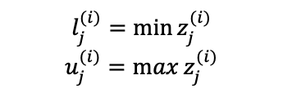
Putting it all together with Pre-activation bounds
$$min⁡y$$
$$s.t. y = w^{(3)}T ẑ^{(2)}$$
$$ẑ^{(2)} = max⁡(z^{(2)}, 0)$$
$$z^{(2)}=W^{(2)} ẑ^{(1)}$$
$$ẑ^{(1)} = max⁡(z^{\left(1\right)}, 0)$$
$$z^{(1)} =W^{(1)}x$$
$$xi ≤ ui$$
$$xi ≥ l_{i}$$
$$l_{j}^{(i)}=\min{z_{j}^{(i)}}$$
$$u_{j}^{(i)}=\max{z_{j}^{(i)}}$$
We can use optimization to find these pre-activation bounds - the same formulation as our verification problem before, just changing the optimization variables.
Notes:
l_j^{(i)} := \min z_j^{(i)}
u_j^{(i)} := \max z_j^{(i)}

Slide 26
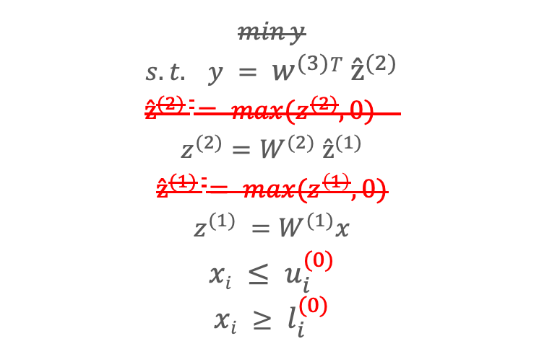
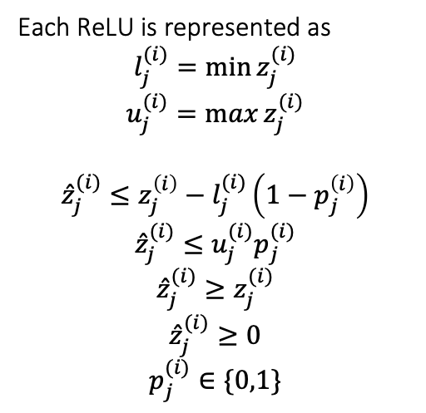
Putting it all together with Pre-activation bounds
$$min⁡y$$
$$s.t. y = w^{(3)}T ẑ^{(2)}$$
$$ẑ^{(2)} = max⁡(z^{(2)}, 0)$$
$$z^{(2)}=W^{(2)} ẑ^{(1)}$$
$$ẑ^{(1)} = max⁡(z^{\left(1\right)}, 0)$$
$$z^{(1)} =W^{(1)}x$$
$$xi ≤ u_{i}^{(0)}$$
$$xi ≥ l_{i}^{(0)}$$
Each ReLU is represented as
$$l_{j}^{(i)}=\min{z_{j}^{(i)}}$$
$$u_{j}^{(i)}=\max{z_{j}^{(i)}}$$
$${\hat{z}}_{j}^{(i)}≤z_{j}^{\left(i\right)}−l_{j}^{(i)}\left(1−p_{j}^{\left(i\right)}\right)$$
$${\hat{z}}_{j}^{(i)}≤u_{j}^{(i)}p_{j}^{(i)}$$
$${\hat{z}}_{j}^{(i)}≥z_{j}^{(i)}$$
$${\hat{z}}_{j}^{(i)}≥0$$
$$p_{j}^{(i)}∈\{0,1\}$$
We can use optimization to find these pre-activation bounds - the same formulation as our verification problem before, just changing the optimization variables.
Notes:
l_j^{(i)} := \min z_j^{(i)}
u_j^{(i)} := \max z_j^{(i)}

Slide 27
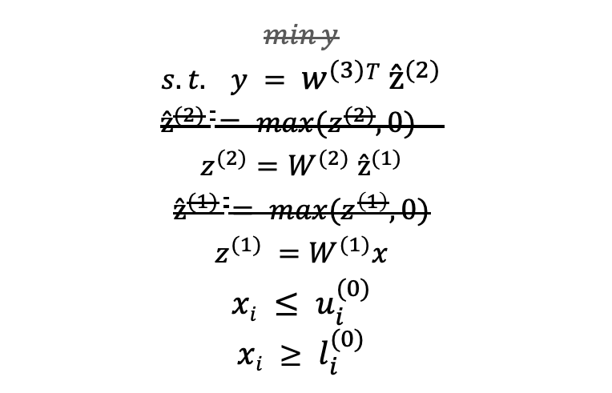
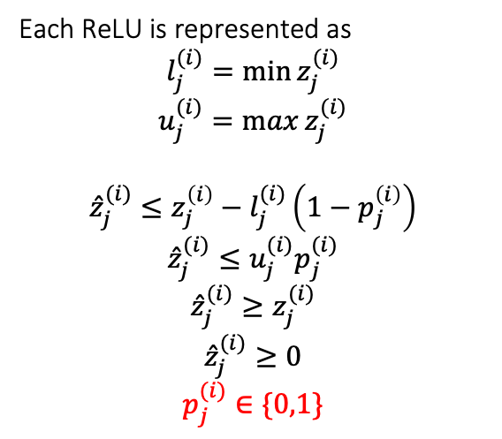
Putting it all together with Pre-activation bounds
$$min⁡y$$
$$s.t. y = w^{(3)}T ẑ^{(2)}$$
$$ẑ^{(2)} = max⁡(z^{(2)}, 0)$$
$$z^{(2)}=W^{(2)} ẑ^{(1)}$$
$$ẑ^{(1)} = max⁡(z^{\left(1\right)}, 0)$$
$$z^{(1)} =W^{(1)}x$$
$$xi ≤ u_{i}^{(0)}$$
$$xi ≥ l_{i}^{(0)}$$
Each ReLU is represented as
$$l_{j}^{(i)}=\min{z_{j}^{(i)}}$$
$$u_{j}^{(i)}=\max{z_{j}^{(i)}}$$
$${\hat{z}}_{j}^{(i)}≤z_{j}^{\left(i\right)}−l_{j}^{(i)}\left(1−p_{j}^{\left(i\right)}\right)$$
$${\hat{z}}_{j}^{(i)}≤u_{j}^{(i)}p_{j}^{(i)}$$
$${\hat{z}}_{j}^{(i)}≥z_{j}^{(i)}$$
$${\hat{z}}_{j}^{(i)}≥0$$
$$p_{j}^{(i)}∈\{0,1\}$$
Integer variables are still hard!
Notes:
l_j^{(i)} := \min z_j^{(i)}
u_j^{(i)} := \max z_j^{(i)}
Compute preactivation bounds per neuron (offline, before MILP).
Use interval propagation, LP relaxations, or stronger methods.
The tighter the bounds, the stronger the MILP encoding (fewer useless branch-and-bounds).
Build the MILP with those bounds “hard-coded” into the big-M constraints.
Solve the MILP once with an optimizer (e.g., Gurobi, CPLEX, SCIP).

Slide 28
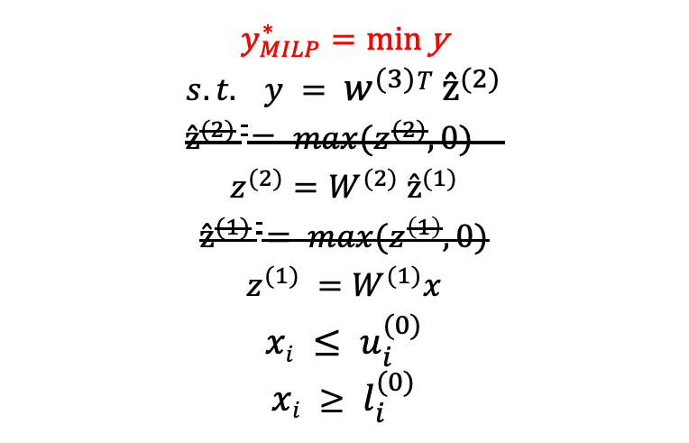
Putting it all together with Pre-activation bounds
$$y_{MILP}^{∗}=\text{min} \text{y}$$
$$s.t. y = w^{(3)}T ẑ^{(2)}$$
$$ẑ^{(2)} = max⁡(z^{(2)}, 0)$$
$$z^{(2)}=W^{(2)} ẑ^{(1)}$$
$$ẑ^{(1)} = max⁡(z^{\left(1\right)}, 0)$$
$$z^{(1)} =W^{(1)}x$$
$$xi ≤ u_{i}^{(0)}$$
$$xi ≥ l_{i}^{(0)}$$
Each ReLU is represented as
$$l_{j}^{(i)}=\min{z_{j}^{(i)}}$$
$$u_{j}^{(i)}=\max{z_{j}^{(i)}}$$
$${\hat{z}}_{j}^{(i)}≤z_{j}^{\left(i\right)}−l_{j}^{(i)}\left(1−p_{j}^{\left(i\right)}\right)$$
$${\hat{z}}_{j}^{(i)}≤u_{j}^{(i)}p_{j}^{(i)}$$
$${\hat{z}}_{j}^{(i)}≥z_{j}^{(i)}$$
$${\hat{z}}_{j}^{(i)}≥0$$
$$p_{j}^{(i)}∈\{0,1\}$$
Integer variables are still hard!
Notes:
l_j^{(i)} := \min z_j^{(i)}
u_j^{(i)} := \max z_j^{(i)}

Slide 29
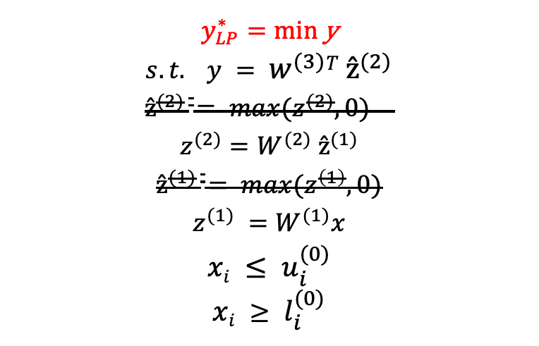
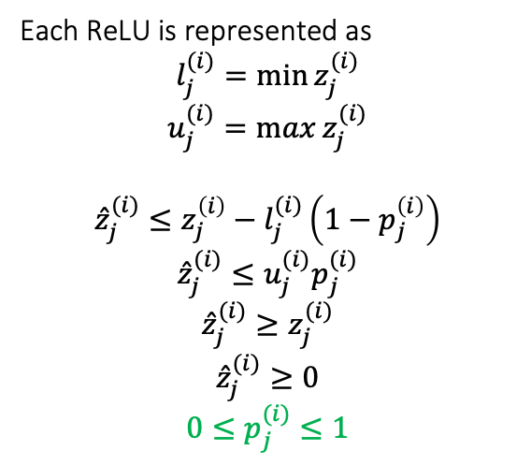
Putting it all together with Pre-activation bounds
$$y_{LP}^{∗}=\text{min} \text{y}$$
$$s.t. y = w^{(3)}T ẑ^{(2)}$$
$$ẑ^{(2)} = max⁡(z^{(2)}, 0)$$
$$z^{(2)}=W^{(2)} ẑ^{(1)}$$
$$ẑ^{(1)} = max⁡(z^{\left(1\right)}, 0)$$
$$z^{(1)} =W^{(1)}x$$
$$xi ≤ u_{i}^{(0)}$$
$$xi ≥ l_{i}^{(0)}$$
Each ReLU is represented as
$$l_{j}^{(i)}=\min{z_{j}^{(i)}}$$
$$u_{j}^{(i)}=\max{z_{j}^{(i)}}$$
$${\hat{z}}_{j}^{(i)}≤z_{j}^{\left(i\right)}−l_{j}^{(i)}\left(1−p_{j}^{\left(i\right)}\right)$$
$${\hat{z}}_{j}^{(i)}≤u_{j}^{(i)}p_{j}^{(i)}$$
$${\hat{z}}_{j}^{(i)}≥z_{j}^{(i)}$$
$${\hat{z}}_{j}^{(i)}≥0$$
$$0≤p_{j}^{(i)}≤1$$
Linear relaxation of integer constraints
How does this affect the solution?
Notes:
l_j^{(i)} := \min z_j^{(i)}
u_j^{(i)} := \max z_j^{(i)}

Slide 30
MILP vs LP
y*_{LP} ≤ y*_{MILP}
It’s not the original MILP solution, but it is a guaranteed lower bound
Solving LP is (weakly) polynomial time.
Simplex algorithm practically a few orders of magnitude faster
y*_{MILP}
y*_{LP}

Slide 31

Sound but Incomplete Verification with a Lower Bound
Satisfiability problem: ∃ x ∈ S ∧ y ≤ 0 ∧ y = f(x)
If y*_{LP} > 0 => y* > 0 => requirement verified (unsatisfiable)
y*_{LP} ≤ 0 => verification result unknown (incomplete)
y*_{MILP}=y*
y*_{LP}≤ y*
y*_{LP}≤ y*
?
Notes:
Resume here.

Slide 32
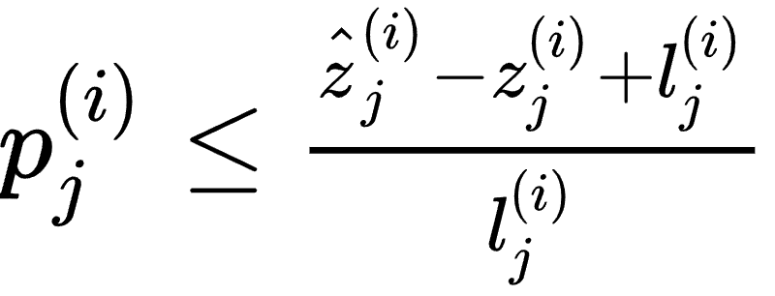
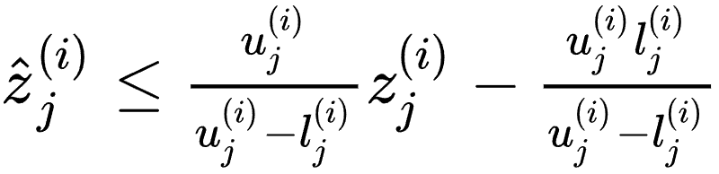
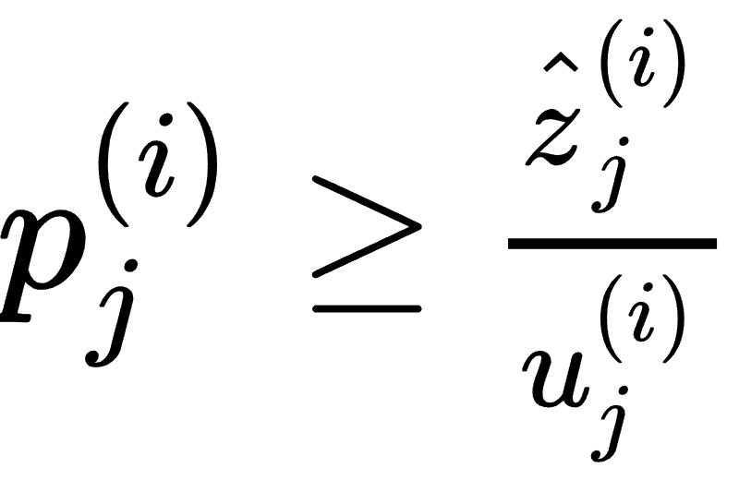
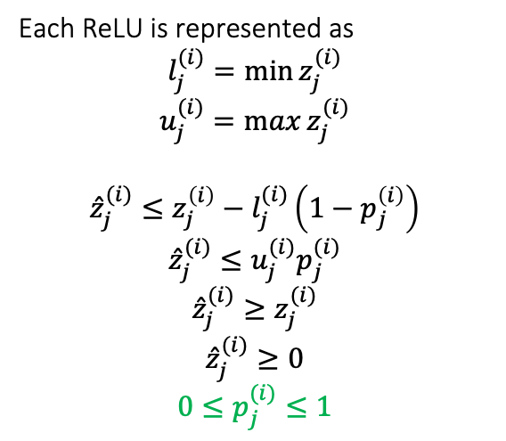
A closer look at the LP relaxation: “Triangle” relaxation
Each ReLU is represented as
$$l_{j}^{(i)}=\min{z_{j}^{(i)}}$$
$$u_{j}^{(i)}=\max{z_{j}^{(i)}}$$
$${\hat{z}}_{j}^{(i)}≤z_{j}^{\left(i\right)}−l_{j}^{(i)}\left(1−p_{j}^{\left(i\right)}\right)$$
$${\hat{z}}_{j}^{(i)}≤u_{j}^{(i)}p_{j}^{(i)}$$
$${\hat{z}}_{j}^{(i)}≥z_{j}^{(i)}$$
$${\hat{z}}_{j}^{(i)}≥0$$
$$0≤p_{j}^{(i)}≤1$$
Project out p
(Please note that l_{j}^{(i)} is negative during the above derivation)
Notes:
\hat{z}^{(i)}_j \leq z_j^{(i)} - l_j^{(i)} (1 - p^{(i)}_j)
\hat{z}^{(i)}_j \leq u^{(i)}_j p^{(i)}_j
p^{(i)}_j \leq \frac{\hat{z}^{(i)}_j - z_j^{(i)} + l_j^{(i)}}{l_j^{(i)}}
p^{(i)}_j \geq \frac{\hat{z}^{(i)}_j}{u_j^{(i)}}
\hat{z}_j^{(i)} \leq \frac{u_j^{(i)}}{u_j^{(i)}-l_j^{(i)}} z_j^{(i)} - \frac{u_j^{(i)}l_j^{(i)}}{u_j^{(i)} - l_j^{(i)}}

Slide 33
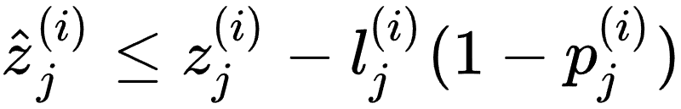
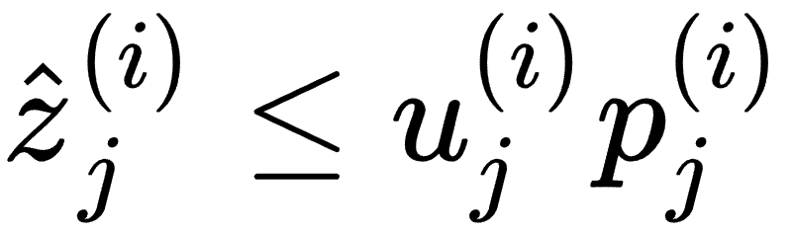
A closer look at the linear programming relaxation
Each ReLU is represented by
“Triangle” relaxation
ẑ_{j}^{(i)}
z_{j}^{(i)}
l_{j}^{(i)}
u_{j}^{(i)}
Notes:
\hat{z}^{(i)}_j \leq z_j^{(i)} - l_j^{(i)} (1 - p^{(i)}_j)
\hat{z}^{(i)}_j \leq u^{(i)}_j p^{(i)}_j
p^{(i)}_j \leq \frac{\hat{z}^{(i)}_j - z_j^{(i)} + l_j^{(i)}}{l_j^{(i)}}
p^{(i)}_j \geq \frac{\hat{z}^{(i)}_j}{u_j^{(i)}}
\hat{z}_j^{(i)} \leq \frac{u_j^{(i)}}{u_j^{(i)}-l_j^{(i)}} z_j^{(i)} - \frac{u_j^{(i)}l_j^{(i)}}{u_j^{(i)} - l_j^{(i)}}

Slide 34
A closer look at the linear programming relaxation
MILP: solutions are constrained on ReLU function
Linear programming: solutions are constrained on the triangle
ẑ_{j}^{(i)}
z_{j}^{(i)}
l_{j}^{(i)}
u_{j}^{(i)}
Notes:
\hat{z}^{(i)}_j \leq z_j^{(i)} - l_j^{(i)} (1 - p^{(i)}_j)
\hat{z}^{(i)}_j \leq u^{(i)}_j p^{(i)}_j
p^{(i)}_j \leq \frac{\hat{z}^{(i)}_j - z_j^{(i)} + l_j^{(i)}}{l_j^{(i)}}
p^{(i)}_j \geq \frac{\hat{z}^{(i)}_j}{u_j^{(i)}}
\hat{z}_j^{(i)} \leq \frac{u_j^{(i)}}{u_j^{(i)}-l_j^{(i)}} z_j^{(i)} - \frac{u_j^{(i)}l_j^{(i)}}{u_j^{(i)} - l_j^{(i)}}

Slide 35
A closer look at the linear programming relaxation
MILP: solutions are constrained on ReLU function
Linear programming: solutions are constrained on the triangle
We want the triangle to be as small as possible! So tight pre-activation bounds are necessary.
ẑ_{j}^{(i)}
ẑ_{j}^{(i)}
z_{j}^{(i)}
z_{j}^{(i)}
l_{j}^{(i)}
u_{j}^{(i)}
l_{j}^{(i)}
u_{j}^{(i)}
Notes:
\hat{z}^{(i)}_j \leq z_j^{(i)} - l_j^{(i)} (1 - p^{(i)}_j)
\hat{z}^{(i)}_j \leq u^{(i)}_j p^{(i)}_j
p^{(i)}_j \leq \frac{\hat{z}^{(i)}_j - z_j^{(i)} + l_j^{(i)}}{l_j^{(i)}}
p^{(i)}_j \geq \frac{\hat{z}^{(i)}_j}{u_j^{(i)}}
\hat{z}_j^{(i)} \leq \frac{u_j^{(i)}}{u_j^{(i)}-l_j^{(i)}} z_j^{(i)} - \frac{u_j^{(i)}l_j^{(i)}}{u_j^{(i)} - l_j^{(i)}}

Slide 36
Stable vs. unstable neurons
If bounds are tight enough so l_{j}^{(i)} ≥ 0 or u_{j}^{(i)} ≤ 0, it is called stable neurons (active or inactive); otherwise it is a unstable neuron
In stable neuron cases, a binary variable in MILP or relaxation in LP is not needed - ReLU becomes a linear function.
ẑ_{j}^{(i)}
ẑ_{j}^{(i)}
ẑ_{j}^{(i)}
z_{j}^{(i)}
z_{j}^{(i)}
z_{j}^{(i)}
l_{j}^{(i)}
u_{j}^{(i)}
l_{j}^{(i)}
u_{j}^{(i)}
l_{j}^{(i)}
u_{j}^{(i)}
unstable
inactive
active
Notes:
\hat{z}^{(i)}_j \leq z_j^{(i)} - l_j^{(i)} (1 - p^{(i)}_j)
\hat{z}^{(i)}_j \leq u^{(i)}_j p^{(i)}_j
p^{(i)}_j \leq \frac{\hat{z}^{(i)}_j - z_j^{(i)} + l_j^{(i)}}{l_j^{(i)}}
p^{(i)}_j \geq \frac{\hat{z}^{(i)}_j}{u_j^{(i)}}
\hat{z}_j^{(i)} \leq \frac{u_j^{(i)}}{u_j^{(i)}-l_j^{(i)}} z_j^{(i)} - \frac{u_j^{(i)}l_j^{(i)}}{u_j^{(i)} - l_j^{(i)}}

Slide 37
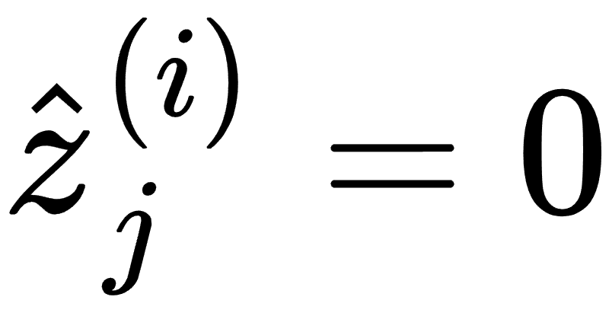
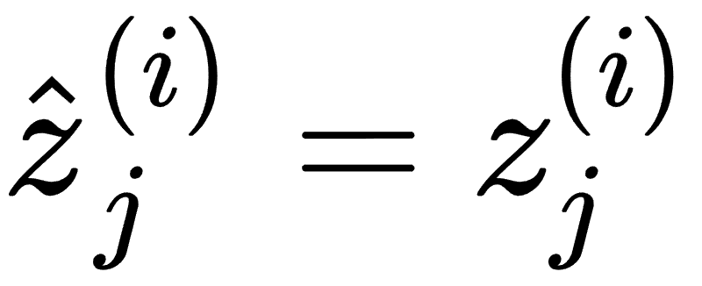
Stable vs. unstable neurons
ẑ_{j}^{(i)}
ẑ_{j}^{(i)}
ẑ_{j}^{(i)}
z_{j}^{(i)}
z_{j}^{(i)}
z_{j}^{(i)}
l_{j}^{(i)}
u_{j}^{(i)}
l_{j}^{(i)}
u_{j}^{(i)}
l_{j}^{(i)}
u_{j}^{(i)}
unstable
inactive
active
Notes:
\hat{z}^{(i)}_j \leq z_j^{(i)} - l_j^{(i)} (1 - p^{(i)}_j)
\hat{z}^{(i)}_j \leq u^{(i)}_j p^{(i)}_j
p^{(i)}_j \leq \frac{\hat{z}^{(i)}_j - z_j^{(i)} + l_j^{(i)}}{l_j^{(i)}}
p^{(i)}_j \geq \frac{\hat{z}^{(i)}_j}{u_j^{(i)}}
\hat{z}_j^{(i)} \leq \frac{u_j^{(i)}}{u_j^{(i)}-l_j^{(i)}} z_j^{(i)} - \frac{u_j^{(i)}l_j^{(i)}}{u_j^{(i)} - l_j^{(i)}}

Slide 38
Summary: MILP vs LP vs DPLL(T) in Neural Network Verification
MILP:
Branch and bound is used to make decisions only on certain number of binary variables
No decision needed on stable neurons (with the help of pre-activation bounds)
Specialized methods to accelerate solving (e.g., branching heuristics, cutting planes)
Complete (solve y* exactly)
Typically scales much better than DPLL(T)
Linear programming:
No integer variables
No variable decisions needed (no exponential time search)
Simplex algorithm can solve it relatively fast, a few thousands neurons are ok
Incomplete (has to return unknown in some cases)
Notes:
\hat{z}^{(i)}_j \leq z_j^{(i)} - l_j^{(i)} (1 - p^{(i)}_j)
\hat{z}^{(i)}_j \leq u^{(i)}_j p^{(i)}_j
p^{(i)}_j \leq \frac{\hat{z}^{(i)}_j - z_j^{(i)} + l_j^{(i)}}{l_j^{(i)}}
p^{(i)}_j \geq \frac{\hat{z}^{(i)}_j}{u_j^{(i)}}
\hat{z}_j^{(i)} \leq \frac{u_j^{(i)}}{u_j^{(i)}-l_j^{(i)}} z_j^{(i)} - \frac{u_j^{(i)}l_j^{(i)}}{u_j^{(i)} - l_j^{(i)}}

