Slide 1
Neural Network Verification Integer and Linear Programming Formulations
Prof. Sayan Mitra
mitras@Illinois.edu
Slides adapted from Prof. Huan Zhang’s lectures, Spring 2025

Slide 2

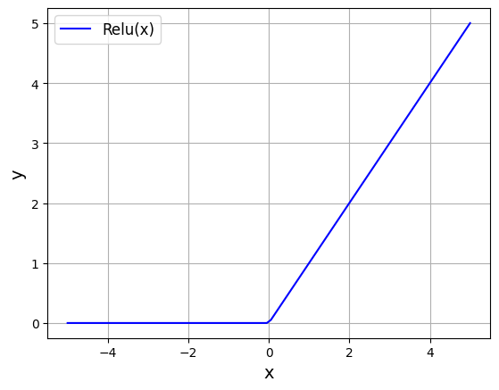


Review: Neural network verification as a satisfiability problem
0.9
z₁⁽¹⁾
ẑ₁⁽¹⁾
z⁽²⁾
ẑ⁽²⁾
x₁
z₂⁽¹⁾
ẑ₂⁽¹⁾
0.1
y=f(x)
z₃⁽¹⁾
Stop
Speed Limit
x₂
ẑ₃⁽¹⁾
$$ẑ_{j}^{(i)}$$
To verify for all x ∈ S, y > 0 ∧ y = f(x) we solve
Does there exist x, s.t. x ∈ S ∧ y ≤ 0 ∧ y = f(x)
$$z_{j}^{(i)}$$
Defines the neural network
Input domain under consideration
Negation of the desired property

Slide 3
Verification of neural networks
Satisfiability problem: ∃ x ∈ S ∧ y ≤ 0 ∧ y = f(x)
x_{i} ≤ u_{i} ∧ x_{i} ≥ l_{i} for each dimension of x
((z_{j}^{(i)} ≥ 0 ∧ ẑ_{j}^{(i)}= z_{j}^{(i)}) ∨ (z_{j}^{(i)} < 0 ∧ ẑ_{j}^{(i)}= 0)) for each ReLU neuron
z₁ =W⁽¹⁾ x ∧ z⁽²⁾ =W⁽²⁾ ẑ⁽¹⁾ ∧ y=w^{(3)T} ẑ⁽²⁾ ∧ y ≤ 0
Add all clauses to the formula and solve using DPLL(T) with Linear Real Arithmetic.
$$ẑ_{j}^{(i)}$$
In general this is very slow!
$$z_{j}^{(i)}$$

Slide 4
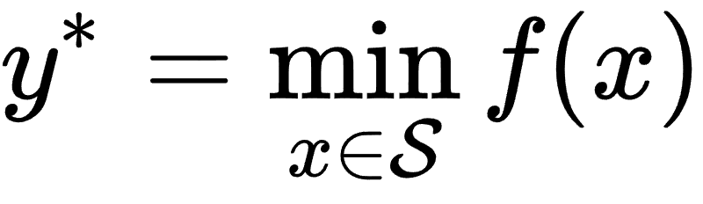

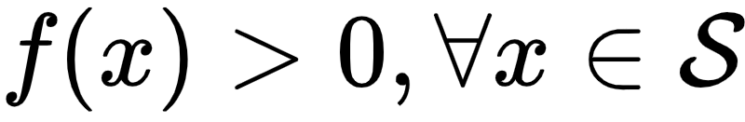
Today: More efficient algorithms for NN verification
Solving neural network verification using SMT solvers
Solving neural network verification using optimization (MIP/LP)
Solving neural network verification using bound propagation
Interval bound propagation (IBP)
Linear (symbolic) bound propagation (CROWN)
f(x)
Efficient methods are typically incomplete (solving a lower bound, as tight as possible)

Slide 5
Any faster ways to calculate the bounds on f(x)?
x₁
y=f(x)
x₂
f(x)

Slide 6
A closer look at the linear programming relaxation
MILP: solutions are constrained on ReLU function
Linear programming: solutions are constrained on the triangle
We want the triangle to be as small as possible! So tight pre-activation bounds are necessary.
ẑ_{j}^{(i)}
ẑ_{j}^{(i)}
z_{j}^{(i)}
z_{j}^{(i)}
l_{j}^{(i)}
u_{j}^{(i)}
l_{j}^{(i)}
u_{j}^{(i)}
Notes:
\hat{z}^{(i)}_j \leq z_j^{(i)} - l_j^{(i)} (1 - p^{(i)}_j)
\hat{z}^{(i)}_j \leq u^{(i)}_j p^{(i)}_j
p^{(i)}_j \leq \frac{\hat{z}^{(i)}_j - z_j^{(i)} + l_j^{(i)}}{l_j^{(i)}}
p^{(i)}_j \geq \frac{\hat{z}^{(i)}_j}{u_j^{(i)}}
\hat{z}_j^{(i)} \leq \frac{u_j^{(i)}}{u_j^{(i)}-l_j^{(i)}} z_j^{(i)} - \frac{u_j^{(i)}l_j^{(i)}}{u_j^{(i)} - l_j^{(i)}}

Slide 7
Stable vs. unstable neurons
If bounds are tight enough so l_{j}^{(i)} ≥ 0 or u_{j}^{(i)} ≤ 0, it is called stable neurons (active or inactive); otherwise it is a unstable neuron
In stable neuron cases, a binary variable in MILP or relaxation in LP is not needed - ReLU becomes a linear function.
ẑ_{j}^{(i)}
ẑ_{j}^{(i)}
ẑ_{j}^{(i)}
z_{j}^{(i)}
z_{j}^{(i)}
z_{j}^{(i)}
l_{j}^{(i)}
u_{j}^{(i)}
l_{j}^{(i)}
u_{j}^{(i)}
l_{j}^{(i)}
u_{j}^{(i)}
unstable
inactive
active
Notes:
\hat{z}^{(i)}_j \leq z_j^{(i)} - l_j^{(i)} (1 - p^{(i)}_j)
\hat{z}^{(i)}_j \leq u^{(i)}_j p^{(i)}_j
p^{(i)}_j \leq \frac{\hat{z}^{(i)}_j - z_j^{(i)} + l_j^{(i)}}{l_j^{(i)}}
p^{(i)}_j \geq \frac{\hat{z}^{(i)}_j}{u_j^{(i)}}
\hat{z}_j^{(i)} \leq \frac{u_j^{(i)}}{u_j^{(i)}-l_j^{(i)}} z_j^{(i)} - \frac{u_j^{(i)}l_j^{(i)}}{u_j^{(i)} - l_j^{(i)}}

Slide 8
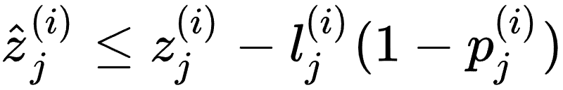
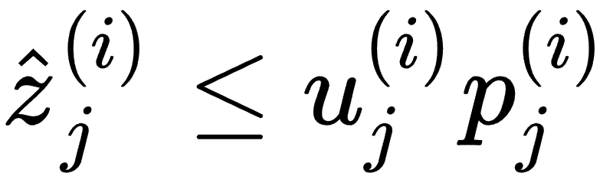
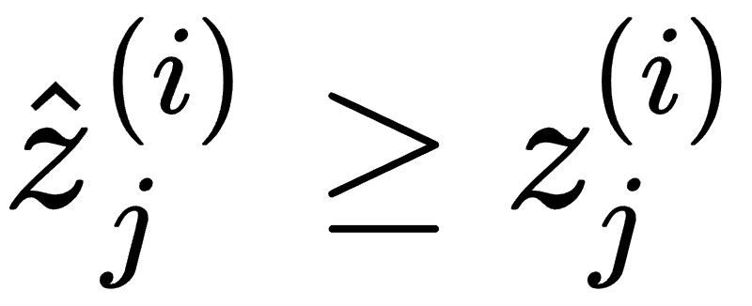
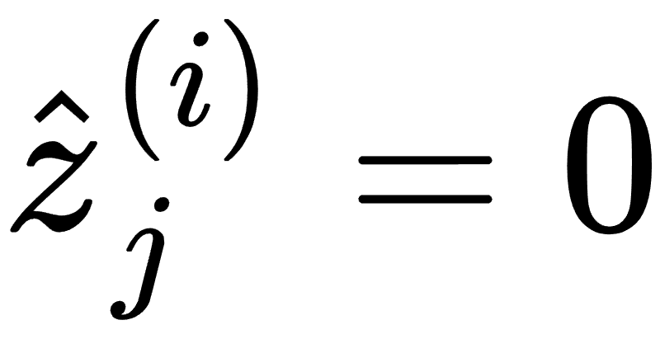
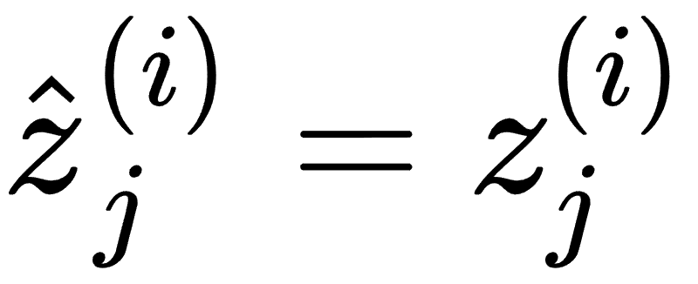
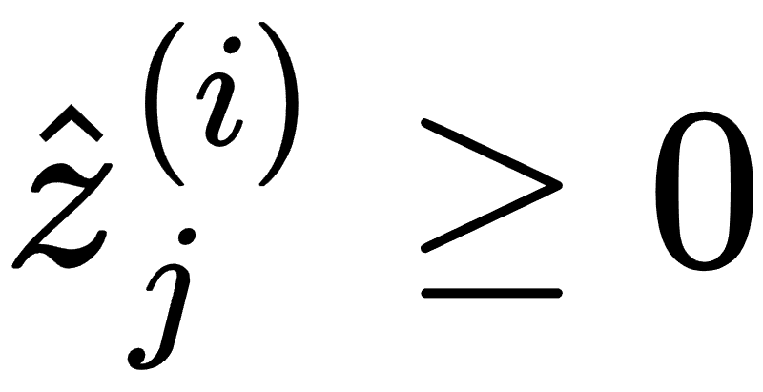
Stable vs. unstable neurons
ẑ_{j}^{(i)}
ẑ_{j}^{(i)}
ẑ_{j}^{(i)}
z_{j}^{(i)}
z_{j}^{(i)}
z_{j}^{(i)}
l_{j}^{(i)}
u_{j}^{(i)}
l_{j}^{(i)}
u_{j}^{(i)}
l_{j}^{(i)}
u_{j}^{(i)}
unstable
inactive
active
Notes:
\hat{z}^{(i)}_j \leq z_j^{(i)} - l_j^{(i)} (1 - p^{(i)}_j)
\hat{z}^{(i)}_j \leq u^{(i)}_j p^{(i)}_j
p^{(i)}_j \leq \frac{\hat{z}^{(i)}_j - z_j^{(i)} + l_j^{(i)}}{l_j^{(i)}}
p^{(i)}_j \geq \frac{\hat{z}^{(i)}_j}{u_j^{(i)}}
\hat{z}_j^{(i)} \leq \frac{u_j^{(i)}}{u_j^{(i)}-l_j^{(i)}} z_j^{(i)} - \frac{u_j^{(i)}l_j^{(i)}}{u_j^{(i)} - l_j^{(i)}}

Slide 9

Let’s look at one layer first and interval bounds on input
z₁⁽¹⁾
Given bounds on x, can we calculate the bounds on z?
x₁
z₂⁽¹⁾
x₂
z₃⁽¹⁾
Notes:
x_1 \in [-1, 2], \ x_2 \in [-2,1]

Slide 10
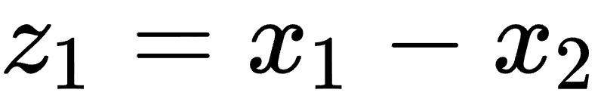
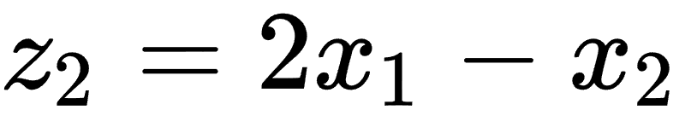
Let’s look at one layer first
z₁
Given bounds on x, can we calculate the bounds on z?
x₁
x₂
z₂
As an illustration, suppose we have
Can you infer bounds on z given bounds on x?
Notes:
z_1 = x_1 - x_2
z_2 = 2x_1 - x_2

Slide 11
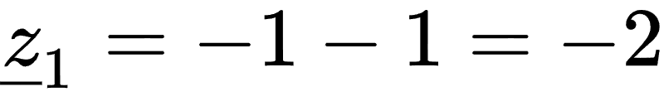
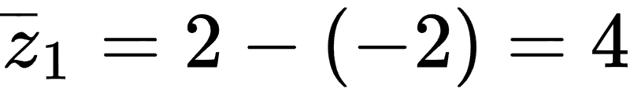
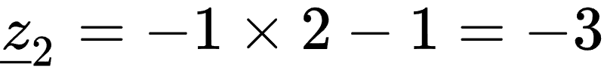
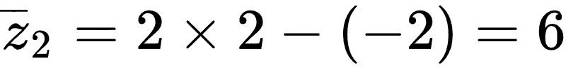
Interval Bound Propagation (IBP)
Lower bounds
Upper bounds
Notes:
\underline{z}_1 = -1 - 1 = -2
\overline{z}_1 = 2 - (-2) = 4
\overline{z}_2 = 2 \times 2 - (-2) = 6

Slide 12
Interval Bound Propagation (IBP)
In general:
Elements lower and upper bounds of x
Notes:
\displaystyle \sum_{i \in \{i| w_i \geq 0\}} w_i l_i + \sum_{i \in \{i| w_i < 0\}} w_i u_i \leq \sum_{i} w_i x_i \leq \sum_{i \in \{i| w_i \geq 0\}} w_i u_i + \sum_{i \in \{i| w_i < 0\}} w_i l_i

Slide 13
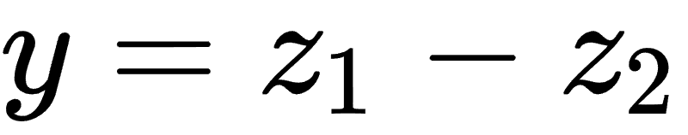
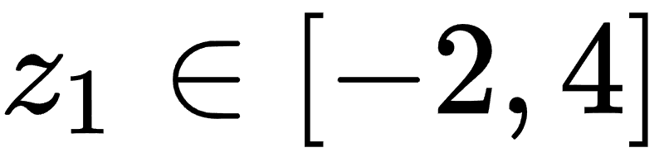
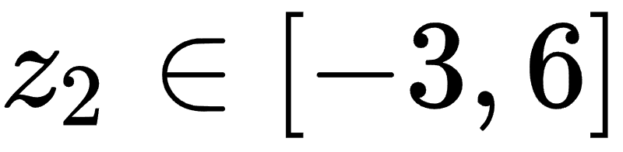
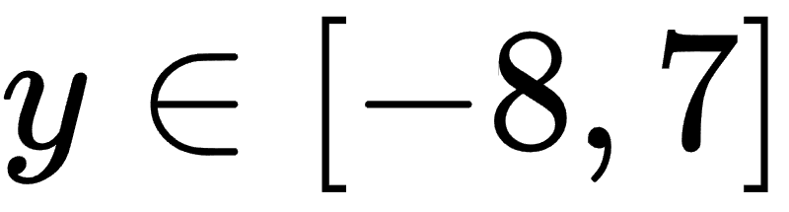
Interval Bound Propagation: continue to the next layer
z₁
Let’s say
We also know that:
x₁
y
z₂
x₂
Then what can we conclude about y?
Notes:
z_1 \in [ -2, 4 ]
z_2 \in [ -3, 6 ]

Slide 14
Interval Bound Propagation: limitations
z₁
Apply IBP we obtain for this simple linear network.
However observe that
x₁
y
z₂
x₂
The actual bounds is [-2, 1], much tighter than [-8, 7]

Slide 15
A Better Idea: Keep the correlations between x and z
The actual bounds is [-2, 1], much tighter than [-8, 7]
It is important to keep the correlations between z and x to obtain this tighter result!
We treat z as a symbolic function of x, rather than intervals

Slide 16
A Better Idea: linear bound propagation
The actual bounds is [-2, 1], much tighter than [-8, 7]
It is important to keep the correlations between z and x to obtain this tighter result!
We treat z as a linear function of x, rather than intervals

Slide 17
A Better Idea: linear bound propagation
Plug in
We treat z as a linear function of x, rather than concrete intervals.
After we plug in linear functions (z w.r.t. x), we still get a linear function (y w.r.t. x)
Notes:
y \geq x_1 - x_2 - (2x_1 - x_2)

Slide 18
Bound propagation: how about nonlinear functions?
z₁
ẑ₁
x₁
Instead of y = z₁ - z₂
Now we have y = ReLU(z₁) - ReLU(z₂)
From IBP we already know that
z₁∈[-2, 4], z₂∈[-3, 6],
y
x₂
z₂
ẑ₂
Can we improve IBP using symbolic linear bounds?
ReLU(z₁) ∈[0, 4], ReLU(z₂) ∈[0, 6]
y ∈ [-6, 4]
Notes:
y \geq x_1 - x_2 - (2x_1 - x_2)

Slide 19
Linear bound propagation for ReLU function (CROWN)
Instead of y = z₁ - z₂
Now we have y = ReLU(z₁) - ReLU(z₂)
We already know that
z₁∈[-2, 4], z₂∈[-3, 6],
ẑ₁=ReLU(z₁)
z₁
-2
4
(Preactivation bounds)
Notes:
y \geq x_1 - x_2 - (2x_1 - x_2)

Slide 20

Linear bound propagation for ReLU function (CROWN)
Linear upper bound (same as the one of triangle relaxation in LP)
Linear lower bound (actually not unique)
ẑ₁=ReLU(z₁)
z₁
-2
4
Notes:
\frac{2}{3}z_1 \leq \text{ReLU}(z_1) \leq \frac{2}{3} z_1 + \frac{4}{3}

Slide 21

Linear bound propagation for ReLU function (CROWN)
ReLU(z₂) can be bounded using linear functions similarly.
Now let’s consider y = ReLU(z₁) - ReLU(z₂). How to bound it using linear functions of z₁ and z₂?
ẑ₂=ReLU(z₂)
z₂
-3
6
Notes:
\frac{2}{3}z_2 \leq \text{ReLU}(z_2) \leq \frac{2}{3} z_2 + 2

Slide 22
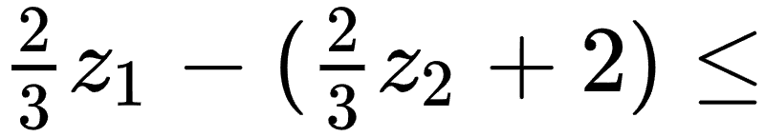

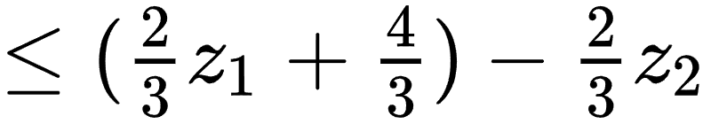
Linear bound propagation for ReLU function (CROWN)
Negative coefficient, take upper bound
positive coefficient, take lower bound
Notes:
\frac{2}{3}z_1 - \frac{2}{3} z_2 - 2 \leq
y = \text{ReLU}(z_1) - \text{ReLU}(z_2)
\leq (\frac{2}{3}z_1+ \frac{4}{3}) - \frac{2}{3} z_2

Slide 23
Linear bound propagation for ReLU function (CROWN)
Now we have linear inequalities for y w.r.t. z!
Next step we can simply plug in, as in the linear (y=z₁-z₂) case.
Notes:
\frac{2}{3}z_1 - (\frac{2}{3} z_2 + 2) \leq y \leq \frac{2}{3}z_1+ \frac{4}{3}) - \frac{2}{3} z_2

Slide 24

Linear bound propagation for ReLU function (CROWN)
Plug in
Notes:
\frac{2}{3}z_1 - (\frac{2}{3} z_2 + 2) \leq
y = \text{ReLU}(z_1) - \text{ReLU}(z_2)
\leq \frac{2}{3}z_1 - (\frac{2}{3} z_2 + \frac{4}{3})

Slide 25
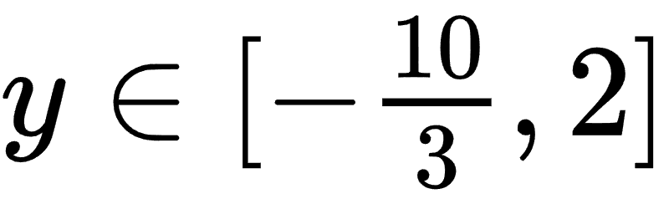
Linear bound propagation for ReLU function (CROWN)
We now have symbolic linear bounds for y w.r.t. x
Take lower bound given x
Take upper bound given x
Concrete interval bounds
A lot more tighter than IBP bounds y ∈ [-6, 4]
Notes:
\frac{2}{3}z_1 - (\frac{2}{3} z_2 + 2) \leq
y = \text{ReLU}(z_1) - \text{ReLU}(z_2)
\leq \frac{2}{3}z_1 - (\frac{2}{3} z_2 + \frac{4}{3})

Slide 26
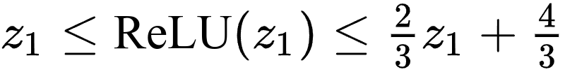
Can we do even better?
Let’s recall that when we linearly bound the ReLU function, there are some flexibilities
Linear upper bound (same as the one of triangle relaxation in LP)
Linear lower bound (actually not unique)
ẑ₁=ReLU(z₁)
z₁
-2
4
Also valid:
Notes:
z_1 \leq \text{ReLU}(z_1) \leq \frac{2}{3} z_1 + \frac{4}{3}

Slide 27
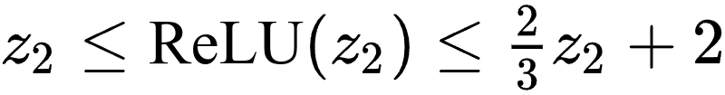
Choosing different linear bounds (α-CROWN)
Now what are the linear bounds of
y = ReLU(z₁) - ReLU(z₂)?
ẑ₂=ReLU(z₂)
z₂
-3
6
Notes:
-\frac{1}{3} x_1 -\frac{1}{3} x_2 - 2\leq y \leq -\frac{4}{3} x_1 + \frac{1}{3} x_2 + \frac{4}{3}

Slide 28
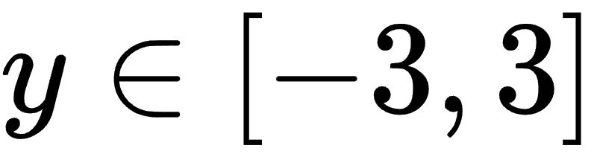
Choosing different linear bounds (α-CROWN)
Plug in
Concretize
Notes:
-\frac{1}{3} x_1 -\frac{1}{3} x_2 - 2\leq y \leq -\frac{4}{3} x_1 + \frac{1}{3} x_2 + \frac{4}{3}

Slide 29
Linear lower bounds for ReLU function matters!
Which one is correct?
Notes:
\frac{2}{3}z_2 \leq \text{ReLU}(z_2) \leq \frac{2}{3} z_2 + 2

Slide 30
Linear lower bounds for ReLU function matters!
Both results are correct! But we want the bounds to be as tight as possible! So best result is y ∈ [-3, 2]
In general, the slope of the linear lower bound for every ReLU neuron can be optimized to find the best result.

Slide 31


Linear lower bounds for ReLU function matters!
In general, the slope of the linear lower bound for every ReLU neuron can be optimized to find the best result.
For optimal lower bound of y, set α₁=1, α₂=1
For optimal upper bound of y, set α₁=⅔, α₂=⅔
(note that the optimal α₁ and α₂ do not equal in general)
Notes:
\alpha_2 z_2 \leq \text{ReLU}(z_2) \leq \frac{2}{3} z_2 + 2
\alpha_1 z_2 \leq \text{ReLU}(z_2) \leq \frac{2}{3} z_2 + \frac{4}{3}

Slide 32
Linear bound propagation method (CROWN)
Obtain all pre-activation bounds (can be done via CROWN recursively)
Start from the output layer, form the initial linear (in)equality y = y
Recursively propagate linear inequality y <= a^{T}z + b through each layer:
For a linear layer, z=Wz’, directly plug in a^{T}z + b to get a linear bound of z’
For a non-linear layer (e.g., z=ReLU(z’)), we first form the linear inequalities to bound the nonlinear layer itself. Then multiply either the lower or upper bound based on the sign of element in a
When the linear inequality propagates to the input layer, we can concretize the linear bound using bounds on input layer.
ẑ₁
x₁
y
x₂
ẑ₂
Notes:
As you propagate an inequality backwards through the network (from output toward input), you keep it in a symbolic linear form like:
y ≤ a⊤x+by \;\le\; a^\top x + by≤a⊤x+b where a,ba, ba,b are coefficients updated layer by layer. At this point, the inequality is still abstract — it depends on the input vector xxx, which can vary within its allowed range (say, a box or polytope).

Slide 33



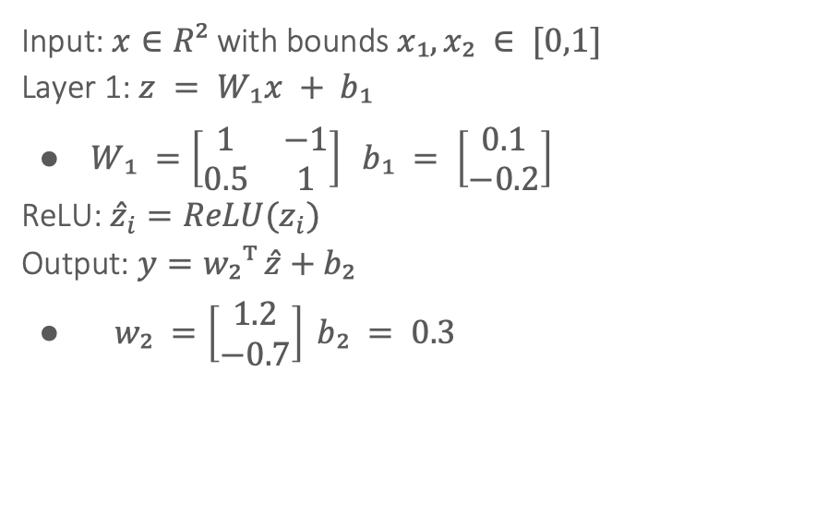




Example: MLP with 1 Layer
Input: $x∈R²$ with bounds $x₁,x₂ ∈ [0,1]$
Layer 1: $z = W₁x + b₁$
$W₁ =\left[\begin{matrix}1 & −1 \\ 0.5 & 1\end{matrix}\right] b₁ = \left[\begin{matrix}0.1 \\ −0.2\end{matrix}\right]$
ReLU: ${\hat{z}}_{i}=ReLU(z_{i})$
Output: $y=w₂ᵀ \hat{z}+b₂$
$w₂ =\left[\begin{matrix}1.2 \\ −0.7\end{matrix}\right] b₂ = 0.3$
$$x_{1}$$
$$z_{1}$$
$${\hat{z}}_{1}$$
$$y$$
$$x_{2}$$
$$z_{2}$$
$${\hat{z}}_{2}$$

Slide 34


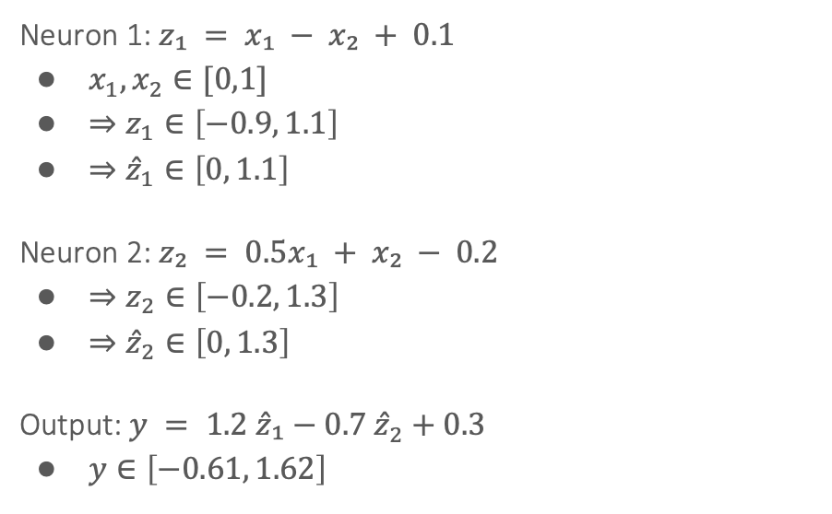

Forward Propagation of Interval Bounds
Neuron 1: $z₁ = x₁ − x₂ + 0.1$
$x_{1},x_{2}∈[0,1]$
$⇒z_{1}∈\left[−0.9, 1.1\right]$
$⇒{\hat{z}}_{1}∈\left[0, 1.1\right]$
Neuron 2: $z₂ = 0.5x₁ + x₂ − 0.2$
$⇒z_{2}∈\left[−0.2, 1.3\right]$
$⇒{\hat{z}}_{2}∈\left[0, 1.3\right]$
Output: $y = 1.2 \hat{z}₁−0.7 {\hat{z}}_{2}+0.3$
$y∈\left[−0.61, 1.62\right]$
$$[0,1]$$
$$x_{1}$$
$$z_{1}$$
$${\hat{z}}_{1}$$
$$y$$
$$x_{2}$$
$$z_{2}$$
$${\hat{z}}_{2}$$

Slide 35
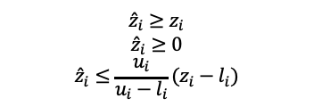
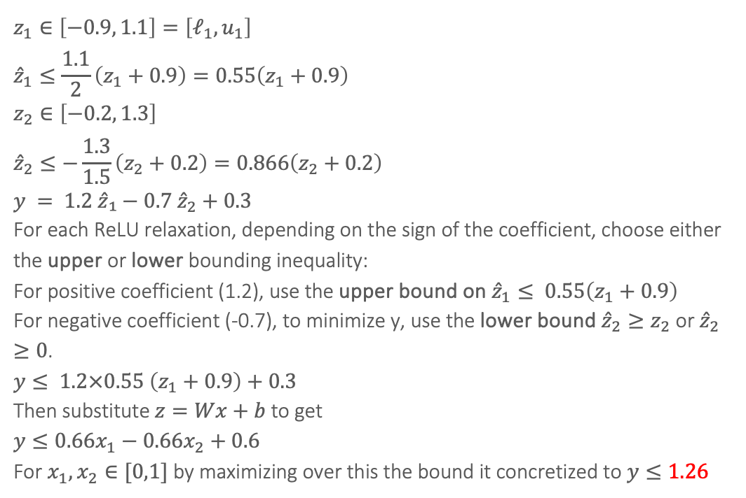
3. Backward Propagation of Linear bounds (Crown)
$$z_{1}∈\left[−0.9, 1.1\right]=\left[ℓ_{1},u_{1}\right]$$
$${\hat{z}}_{1}≤\frac{1.1}{2}\left(z_{1}+0.9\right)=0.55\left(z_{1}+0.9\right)$$
$$z_{2}∈\left[−0.2, 1.3\right]$$
$${\hat{z}}_{2}≤−\frac{1.3}{1.5}\left(z_{2}+0.2\right)=0.866\left(z_{2}+0.2\right)$$
$$y = 1.2 \hat{z}₁−0.7 {\hat{z}}_{2}+0.3$$
For each ReLU relaxation, depending on the sign of the coefficient, choose either the upper or lower bounding inequality:
For positive coefficient (1.2), use the upper bound on ${\hat{z}}_{1}≤ 0.55\left(z_{1}+0.9\right)$
For negative coefficient (-0.7), to minimize y, use the lower bound ${\hat{z}}_{2}≥z_{2}$ or ${\hat{z}}_{2}≥0$​.
$y≤ 1.2×0.55 \left(z_{1}+0.9\right)+0.3$
Then substitute $z=Wx+b$ to get
$$y≤0.66x_{1}−0.66x_{2}+0.6$$
For $x_{1},x_{2}∈[0,1]$ by maximizing over this the bound it concretized to $y≤1.26$
$${\hat{z}}_{i}≥z_{i}$$
$${\hat{z}}_{i}≥0$$
$${\hat{z}}_{i}≤\frac{u_{i}}{u_{i}−l_{i}}(z_{i}−l_{i})$$
ẑ_{i}
z_{i}
l_{i}
u_{i}

Slide 36

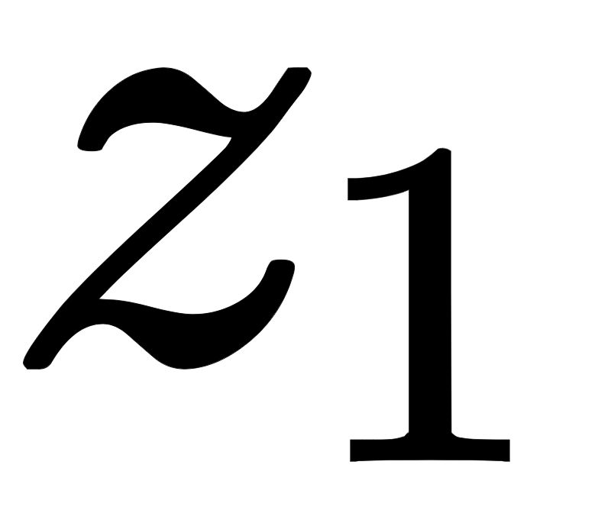
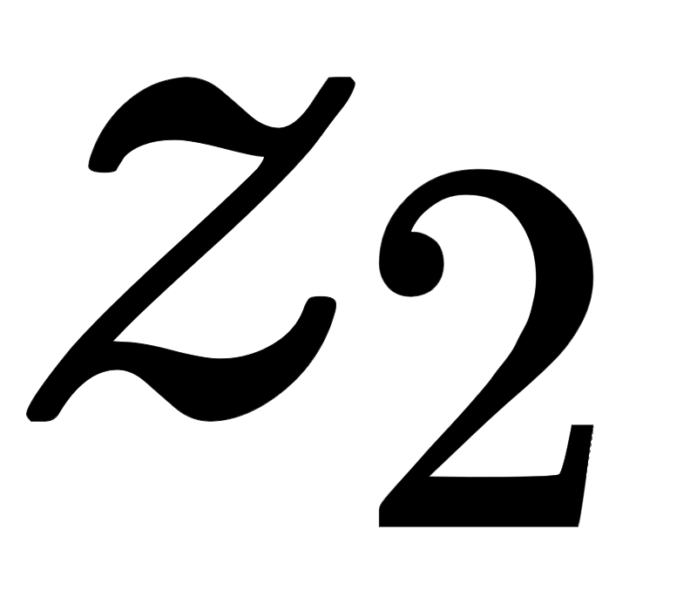
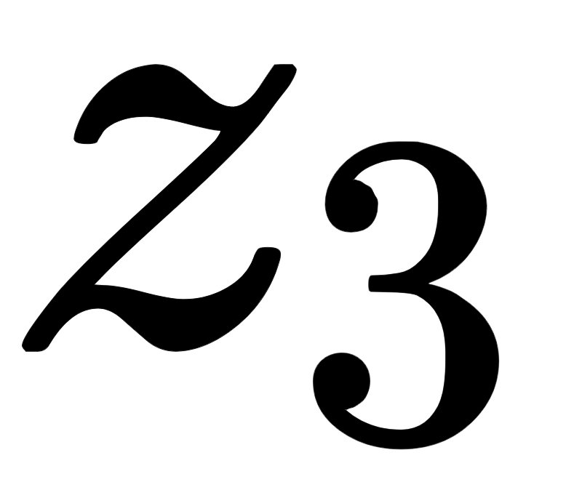
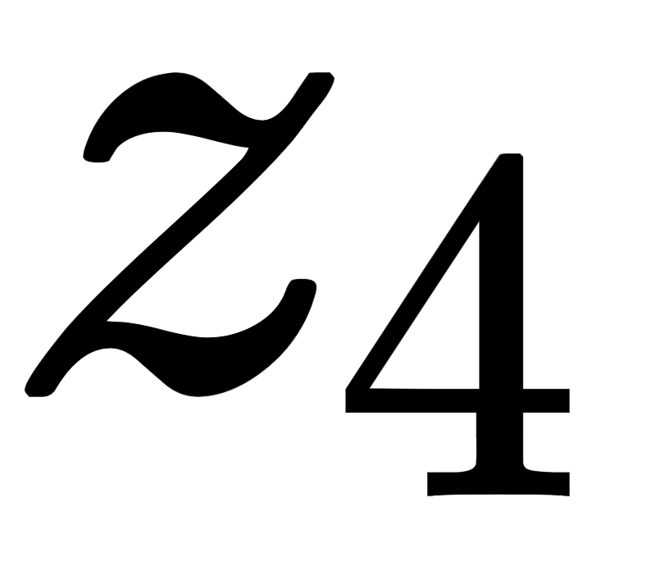
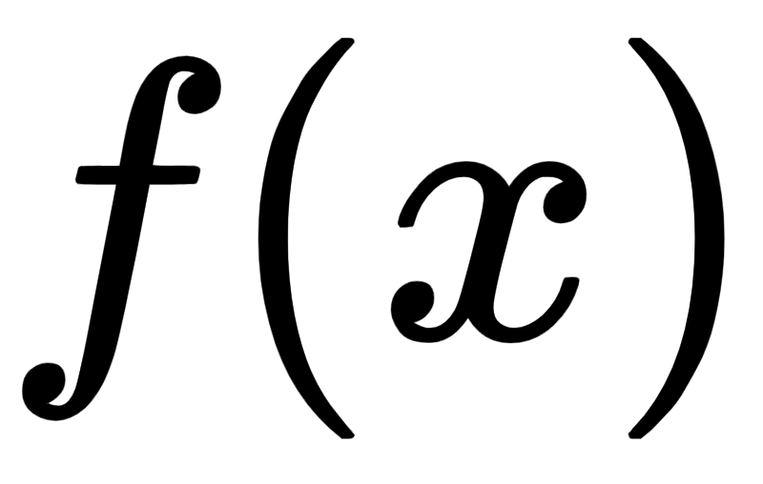
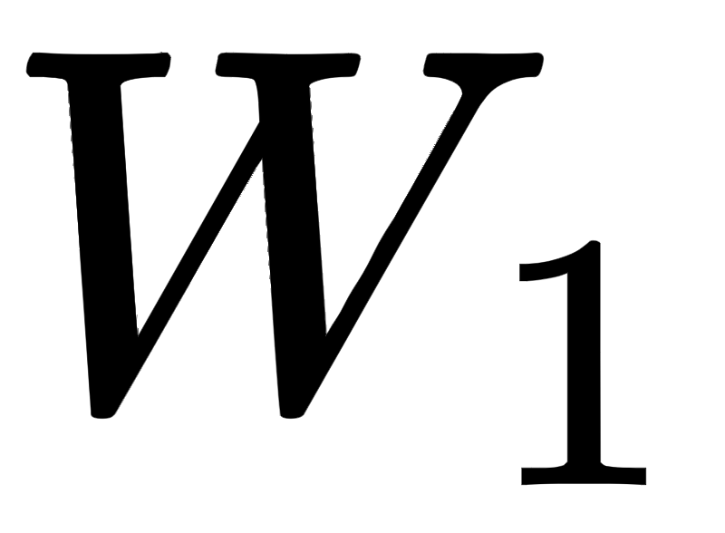
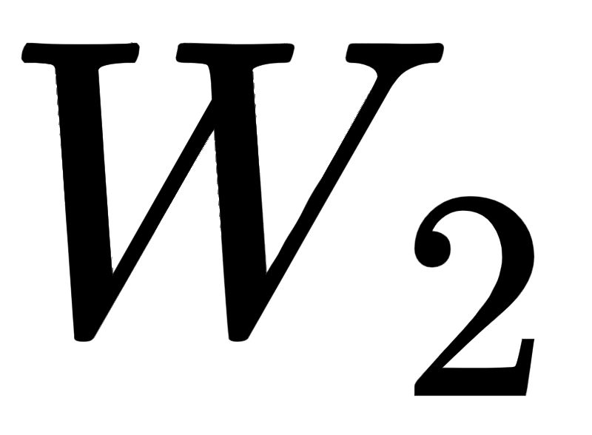
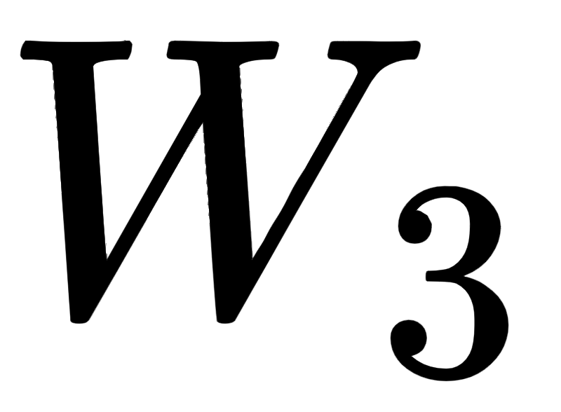
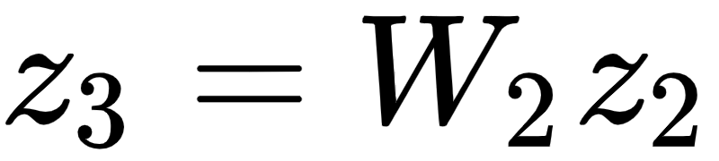
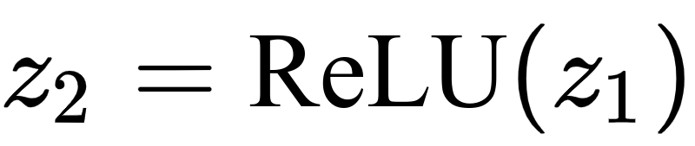
Illustration: Linear bound propagation process
Efficient Incomplete Verification with CROWN
Non-linear (activation) layer
Linear layer
Steps:
• Propagate bounds through linear layers
• Propagate bounds through non-linear layers

Slide 37
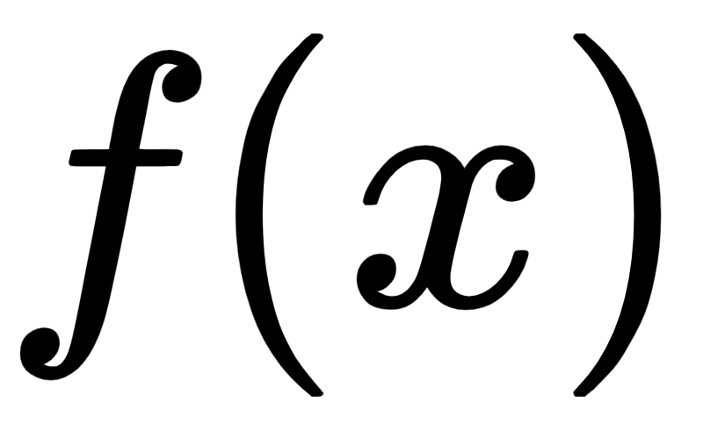
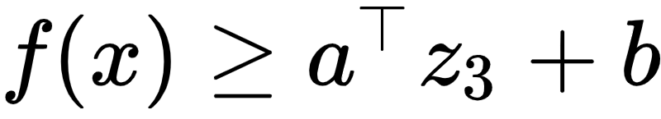
Illustration: Linear bound propagation process
Efficient Incomplete Verification with CROWN
1-D case for illustration.
Generally it’s a linear hyperplane
A linear lower bound for an intermediate layer

Slide 38
Illustration: Linear bound propagation process
Efficient Incomplete Verification with CROWN
?
Propagate it to one layer before,
while keeping the lower bound valid

Slide 39
Illustration: Linear bound propagation process
Efficient Incomplete Verification with CROWN
?

Slide 40
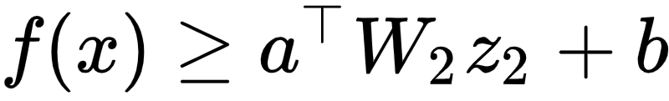
Illustration: Linear bound propagation process
Efficient Incomplete Verification with CROWN
Inequality updated after propagation

Slide 41
Illustration: Linear bound propagation process
Efficient Incomplete Verification with CROWN
?
ReLU is NOT a simple linear function

Slide 42
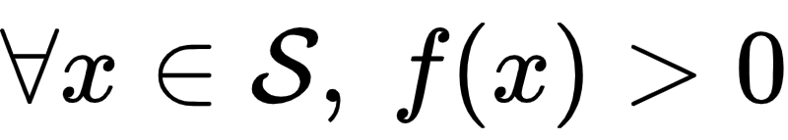
Illustration: Linear bound propagation process
Efficient Incomplete Verification with CROWN
?

Slide 43
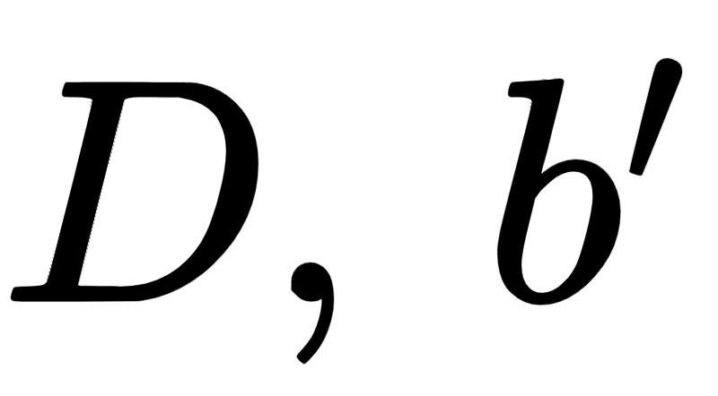
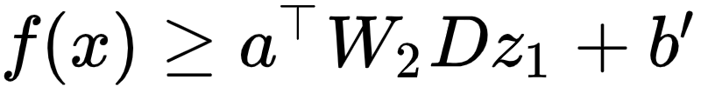
Illustration: Linear bound propagation process
Efficient Incomplete Verification with CROWN
Theorem (informal): we can efficiently find such that:
[Z*W*CHD NeurIPS 2018]

Slide 44
Illustration: Linear bound propagation process
Efficient Incomplete Verification with CROWN
Proof sketch: conservatively use linear bounds to replace a non-linear function.
Pre-activation bounds
(can be pre-computed using CROWN)
Theorem (informal): we can efficiently find such that:
[Z*W*CHD NeurIPS 2018]

Slide 45
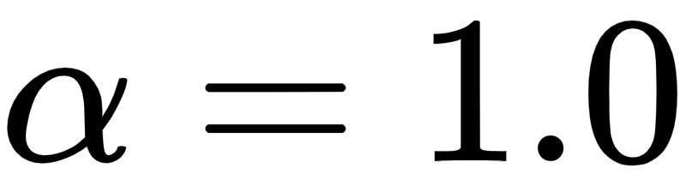
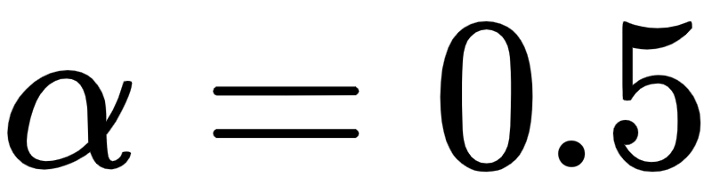
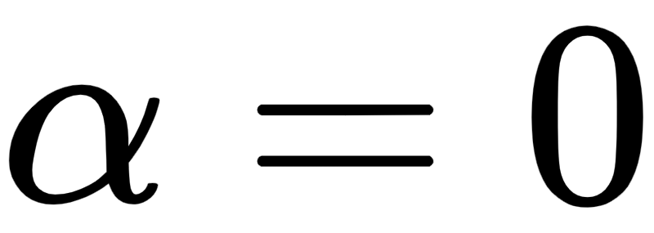
Illustration: Linear bound propagation process
Efficient Incomplete Verification with CROWN
Proof sketch: conservatively use linear bounds to replace a non-linear function.
Pre-activation bounds
(can be pre-computed using CROWN)
ReLU’s lower bound can be optimized (α-CROWN)
Theorem (informal): we can efficiently find such that:
[Z*W*CHD NeurIPS 2018]

Slide 46
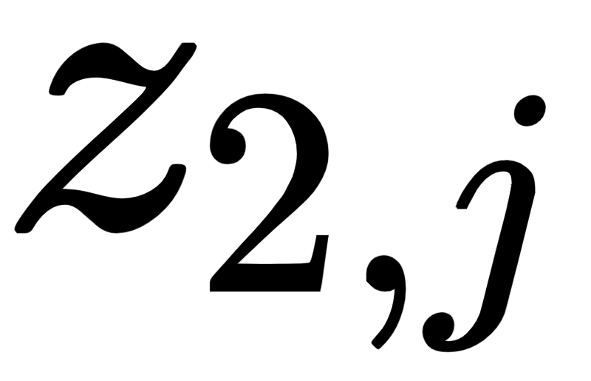
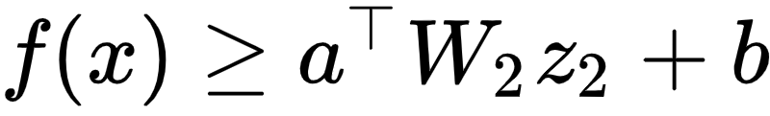




Illustration: Linear bound propagation process
Efficient Incomplete Verification with CROWN
Proof sketch: conservatively use linear bounds to replace a non-linear function.
Choose lower bound
Choose upper bound
Theorem (informal): we can efficiently find such that:
[Z*W*CHD NeurIPS 2018]
Notes:
f(x) \geq a^\top W_2 z_2 + b
\displaystyle f(x) \geq \sum_{j} \left [ (a^\top W_2)_j \cdot z_{2,j} \right ] + b
(a^\top W_2)_j < 0

Slide 47







Illustration: Linear bound propagation process
Efficient Incomplete Verification with CROWN
Initial (in)equality:
Always keep valid lower bounds
CROWN main theorem (simplified):
[Z*W*CHD NeurIPS 2018]

Slide 48



Illustration: Linear bound propagation process
Efficient Incomplete Verification with CROWN
Bounds propagated through simple matrix multiplations!
Fast and GPU-friendly
Always keep valid lower bounds
CROWN main theorem (simplified):
[Z*W*CHD NeurIPS 2018]

Slide 49



Use Linear Bounds to Prove Robustness
Efficient Incomplete Verification with CROWN
Prove:
CROWN lower bound
…
Lower bound > 0 verified (always a stop sign)

Slide 50




Benchmarks: CROWN-family bound propagation algorithms
Verified images% (higher is better)
Avg. time (s) (lower is better)
Upper bound 76.5%
53.0%
1 day -> 1 minute
Pixel perturbation magnitude: 0.3 for MNIST, 2/255 for CIFAR
Model size: ~5k neurons
Integer programming and semidefinite programming not plotted (~1 day)
Key enablers: specialized bound propagation solver + GPU acceleration + BaB

Slide 51
MILP/LP vs Bound Propagation
Bound propagation:
Scalable and fast propagation
GPU friendly
Incomplete verification (can be made complete with partitioning the input domain)
Bounds are looser compared to LP; much looser compared to MILP
MILP/LP:
Tighter solution
Does no scale (MILP ~10k neurons, LP ~100k neurons)
Much slower; cannot utilize GPU
Notes:
\hat{z}^{(i)}_j \leq z_j^{(i)} - l_j^{(i)} (1 - p^{(i)}_j)
\hat{z}^{(i)}_j \leq u^{(i)}_j p^{(i)}_j
p^{(i)}_j \leq \frac{\hat{z}^{(i)}_j - z_j^{(i)} + l_j^{(i)}}{l_j^{(i)}}
p^{(i)}_j \geq \frac{\hat{z}^{(i)}_j}{u_j^{(i)}}
\hat{z}_j^{(i)} \leq \frac{u_j^{(i)}}{u_j^{(i)}-l_j^{(i)}} z_j^{(i)} - \frac{u_j^{(i)}l_j^{(i)}}{u_j^{(i)} - l_j^{(i)}}

Slide 52
Example branching heuristic
S = {x₁ ∈ [-1, 1], x₂ ∈ [-1, 1]} =>
S₁ = {x₁ ∈ [-1, 0], x₂ ∈ [-1, 1]}, S₂ = {x₂ ∈ [0, 1], x₂ ∈ [-1, 1]}
OR
S₁ = {x₁ ∈[-1, 1] x₂ ∈ [-1, 0]}, S₂ = {x₂ ∈ [-1, 1], x₂ ∈ [0, 1]}
We can estimate the impact on lower bound given changes on x₁ and x₂
Given the CROWN linear bound y>= a₁ x₁ + a₂ x₂+c, we branch on dimension i where |a_{i}| is largest.

Slide 53


auto_LiRPA: Verification Library for General Computation Graphs
The auto_LiRPA Robustness Verification Library
Colab Demo:
http://PaperCode.cc/AutoLiRPA-Demo
The auto_LiRPA library on GitHub:
http://PaperCode.cc/AutoLiRPA

