Slide 1
Introduction Verifying learning-enabled cyberphysical systems
August 26th 2025, ECEB 3013
Sayan Mitra
CSL 266
mitras@illinois.edu
@Mitrasayn

Slide 2
What is verification?
Definition. Verification is the action of demonstrating or proving statements to be true by means of evidence. OED
This class:
statement = formal specifications (or requirements) about learning-enabled cyber-physical systems
evidence = mathematical proof

Slide 3
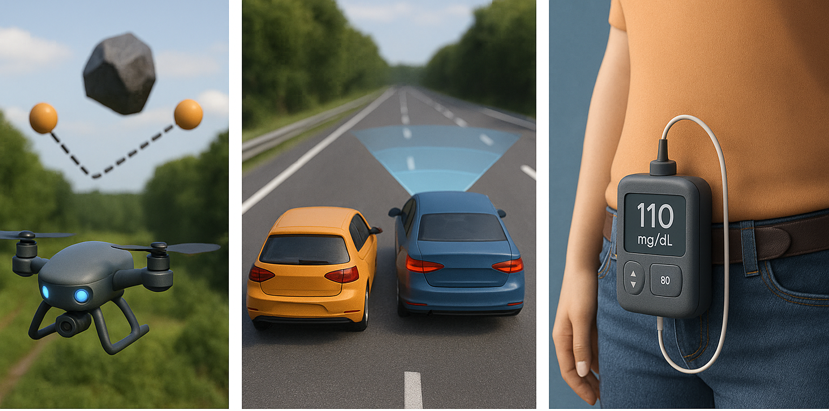
Learning-enabled cyber-physical systems
A cyber-physical system is a computer system monitoring or controlling a physical process.
A learning-enabled system uses machine learning models for perception or control
Examples: drone delivery, autonomous car, smart electric grid, insulin pump
The number of possible behaviors of such systems is usually uncountably infinite

Slide 4
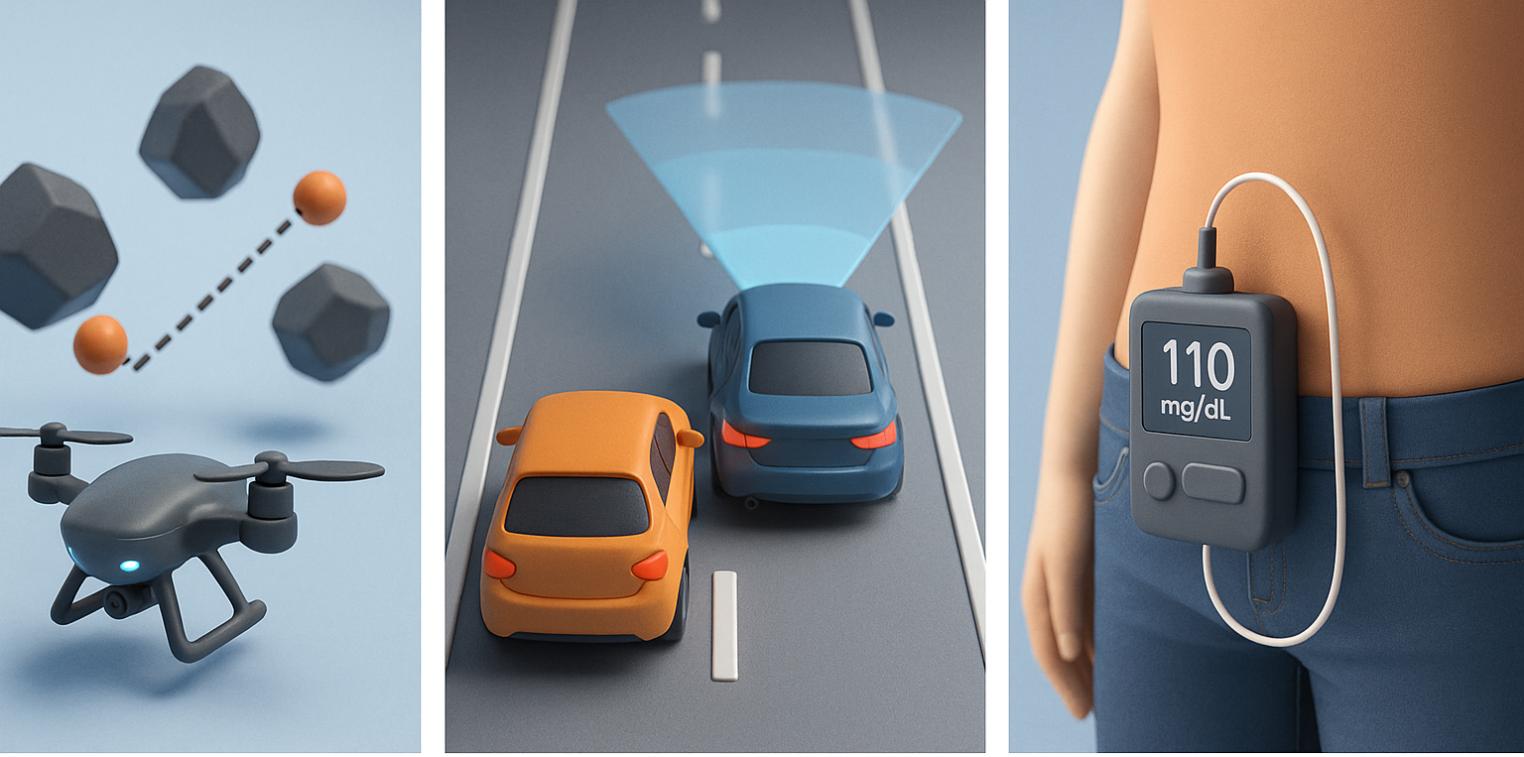
Formal Specifications or Requirements
Requirements are statements about behaviors of a system
Drone visits waypoints while avoiding collisions
The vehicle stays within the lanes and maintains distance to leading car
Insulin pump maintains blood glucose level to within the prescribed range
Testing: evaluates requirements on a finite number of behaviors
Testing can show presence of bugs but not their absence --- E. Dijkstra
Verification: aims to prove requirements over all behaviors

Slide 5
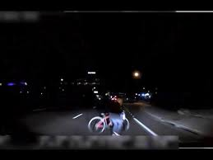
Failures in real world: Uber Fatality (Tempe, 2018)
An Uber autonomous test vehicle struck and killed Elaine Herzberg pushing a bicycle across a dark road.
The perception system had detected her six seconds before impact — but kept switching labels: first a vehicle, then a bicycle, then an “unknown object.” Because of this uncertainty, the system never triggered emergency braking.
Uber had disabled the car’s automatic emergency braking to avoid “jerky” rides, leaving only the human backup driver, who was looking at her phone.
Without verified fail-safes and robust uncertainty handling, autonomy can see a hazard but still fail to act.
Notes:
Lesson: Without verified fail-safes and robust uncertainty handling, autonomy can see a hazard but still fail to act.

Slide 6
Failures in real world: Toyota Unintended Acceleration (2009–11)
Drivers reported sudden, uncontrollable acceleration in Toyota vehicles.
Lawsuits and investigations revealed evidence of software flaws in the electronic throttle control: stack overflows, race conditions, and inadequate fail-safes.
Hundreds of crashes and fatalities were attributed to this failure mode, and Toyota paid billions in settlements.
NASA’s technical team found that memory corruption could disable safety tasks, leaving the throttle stuck open.
Notes:
Lesson: Even when hardware is fine, poorly verified embedded software can undermine an entire safety-critical system. Concurrency and memory safety are not academic details when people’s lives are at stake.

Slide 7
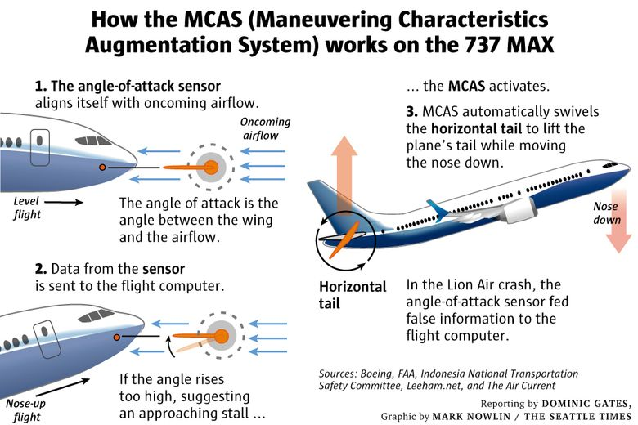
Failures in real world: Boeing 737 MAX – MCAS (2018–19)
Boeing added the MCAS system to the 737 MAX to automatically push the nose down if it sensed a high angle of attack, preventing stalls.
The flaw was that MCAS relied on a single angle-of-attack sensor. When that sensor failed, the system kept forcing the nose down, while the pilots, unaware of MCAS’s authority, fought back.
Two crashes in Indonesia and Ethiopia killed 346 people and grounded the global fleet for almost two years.
Investigators pointed not only to the sensor design but also to Boeing’s assumptions about pilot response times and training.
Notes:
Lesson: Verification is not just about checking code — it’s about system-level guarantees that account for sensors, humans, and control loops.

Slide 8

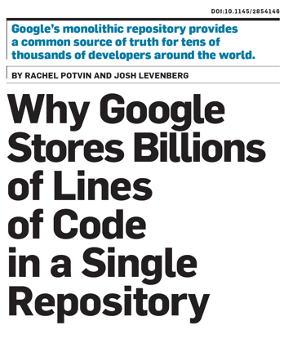
Successes of Verification
Hardware verification now standard in EDA tools from Synopsys, Cadence, etc.
SLAM tool from MSR routinely used for verification of Device Drivers at Microsoft:
AMAZON AWS developers write proofs using CBMC and other Automated reasoning tools
Goolge runs static analysis tools on their entire codebase
Formal modeling and analysis is becoming part of certification process for avionics (e.g., ASTREE); DO-333 supplement of DO-178C identifies aspects of airworthiness certification that pertains to of software using formal methods
Coverity, Galois, SRI, and others
LE-CPS, Automotive, and manufacturing ...
Sadowski, et al. Lessons from Building Static Analysis Tools at Google. CACM, 18.
Chong, et al. Code-level model checking in the software development workﬂow. ICSE, 20.
O’Hearn. Continuous reasoning: Scaling the impact of formal methods. LICS ’18.

Slide 9





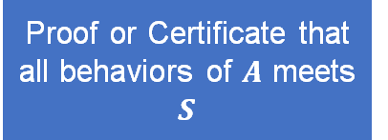

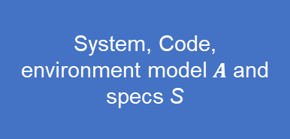
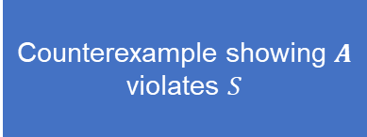
Verification: Certifies, discover edge cases & operating domains
Verification in Engineering Ecosystem
Proof or Certificate that all behaviors of $A$ meets $S$
System, Code, environment model $A$ and specs S
Testing, verification, and validation
Counterexample showing $A$ violates $S$
$$\dot{x}=f(x,u)$$
edge-case, improve logic, ODD
Engineers, Product managers, models
Public trust in products and services
Notes:
hyper focused on complexity of algorithms… I’d claim understanding the constraints / expectations from users can help us make sharper algorithmic contributions AND
succeed in practice.

Slide 10
Verification: Certifies, discover edge cases & operating domains
Verification in the engineering ecosystem
System. sort(int a[])for sorting an array in some programming language, e.g. C
counterexample. A particular input array a and initialization of sort that produces wrong output
A model M for execution of programs in C
Proof or Certificate that all behaviors of $A$ meets $S$
System, Code, environment model $A$ and specs S
Testing, verification, and validation
A mathematical proof that sort()works for all inputs in the given model M of C
Counterexample showing $A$ violates $S$
Requirement. Output of sort(int a[])
is the sorted version of the input array a[]
$$\dot{x}=f(x,u)$$
Engineers, Product managers, models
Public trust in products and services
Notes:
hyper focused on complexity of algorithms… I’d claim understanding the constraints / expectations from users can help us make sharper algorithmic contributions AND
succeed in practice.

Slide 11
The Reach of Formal Verification
Formal Verification Covers and connects ideas in CS, control, ML
Turing Awards: Lamport (2014), Clarke, Sifakis & Emerson (2008), Pnueli (1997), Lampson (1992), Milner (1991), Hoare (1980), Dijkstra (1972) …
ACM Doctoral Dissertation Award: Chuchu Fan (2020) alumni of this class
Vibrant community: CAV, TACAS, ATVA, PLDI (programming languages),
HSCC, EMSoft, ICCPS (hybrid and cyber-physical systems)
Special tracks in Robotics (ICRA, RSS), automatic control
Ideas permeating into AI and machine learning (Neural network verification)
Faculty and research positions: Alumni of this course are professors at WashU, Vanderbilt, UNC Chapel Hill, MIT, Stoney Brook, and researchers at Waymo, Tesla, Amazon, Toyota, Boeing

Slide 12
Course Objectives
Learn to write verification algorithms and tools
Understand fundamental limits of creating such tools
Learn how to create models of of LE-CPS and the trade-offs in different modeling paradigms
Execute a research project in formal verification

Slide 13
Learning objectives
discrete and continuous states, valuations, equilibria, programs, solutions, trajectories, executions, observables, measurements, composition, abstraction
Learn a unified mathematical language for modeling state machines combining automata (CS) and differential equations (ODEs)
Learn fundamental concepts such as invariance, reachability, contraction, stability and how they cut across automata, ODEs, and ML models
Learn powerful algorithms and tools for reasoning about invariance, stability, contraction
Jumpstart research
Invariance, safety, induction, reachability, liveness, Lyapunov theory, ranking functions, dwell time, CEGAR, SMT, temporal logics,
SMT solvers, CVXOPT, theorem provers, CROWN, Verse
semester-long project, feedback, presentation, hardware, software, and data resources

Slide 14
Administrivia
How the course works

Slide 15
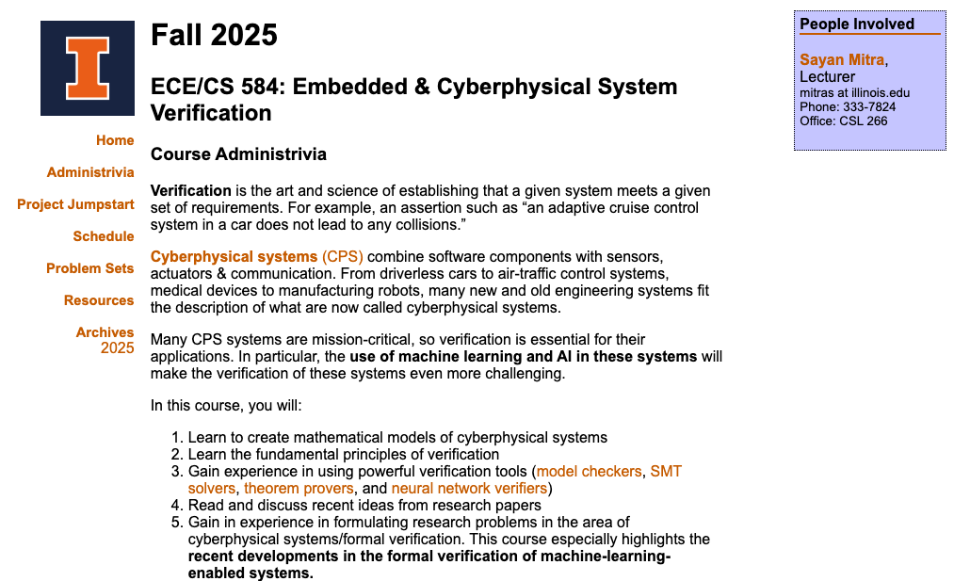
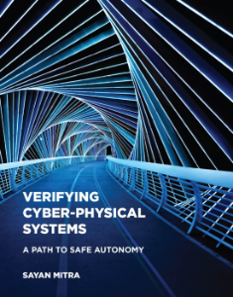
Fall 2025 Edition
https://mitras.ece.illinois.edu/ECE584/
Lectures TR 12:30 – 1:50
ECEB: 3013
Textbook
Homework: 4-5 sets. Analysis and some coding
Midterm Exam --- in class Oct 21
Project: Semester long research project, becomes basis for publication

Slide 16
Expectations and grading
Preparation: Do the readings, review notes, and come with questions.
Engagement: Participate actively in discussions and project reviews.
Integrity: Collaboration is encouraged, but all submitted work must be your own.
Professionalism: Be respectful, give constructive feedback, and contribute fairly in group work.
Research mindset: Treat assignments and the project as opportunities to explore publishable ideas, not just homework.
Individual Homework (4-5 sets): 40%
Problems will involve some coding and pencil paper proofs
Midterm 15 %
Project in teams of 2: 40%
Proposal: 5%
Midterm presentation: 5%
Final presentation (EOS): 15%
Report (EOS): 15%
Code and documentation: 5%
Participation: 5%
Class participation
Feedback on projects
New problem suggestions and solutions

Slide 17
Course Project
You will work on a semester-long research project building a verification system. Often the projects become publishable.
Good project will require ~6-8 hours/week — higher towards the end of the semester.
Start early, and get frequent feedback. This week: Read and start here
Projects can either be individual or be done in a team of 2 people. If you are sure that you want to work in a larger team (3 or more people), you can make a case and we can consider.
Projects will be graded based on
soundness of claims,
significance (novelty, impact, harness),
presentation quality, and
effort
Advice
Choose a high-risk project that if success will make you proud
Clearly define the problem ASAP
Get feedback frequently

Slide 18
Course Staff
Prof. Sayan Mitra
CSL 266
Office Hour:
TA: Chenxi Ji
CSL 247
Office Hour:
TA’s role: Grading HWs, exams, explain lecture/HW materials
Provide constructive feedback on project ideas

Slide 19
Discrete Models
Preliminaries

Slide 20
Outline
State machines or Automata
Semantics: executions, reachable states
Examples
Invariance
Reachable state
Inductive invariance

Slide 21
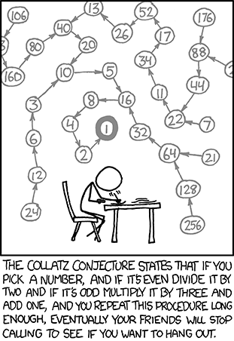
Models: State machines or Automata
A state machine or an automaton is a discrete-time(step-by-step) mathematical model describing the evolution of a system in term of its states
Example run: x = 5, x=16, x=8, x=4, 2, 1, 4, 2, 1, 4, 2, 1
Another run: x = 6, x=3, 10, 5, 16, 8, 4, 2, 1, 4, 2, 1, …
Another run: x = 7, x=22, x=11, x=34, x=17, x=52, … ?
Do all runs end in the 4,2,1 loop?
“Mathematics is not yet ready for such problems.” --- Paul Erdös
Example 1:
x: Int = 5
While True // step
If x % 2 == 0 then x = x / 2 else x = 3x + 1

Slide 22
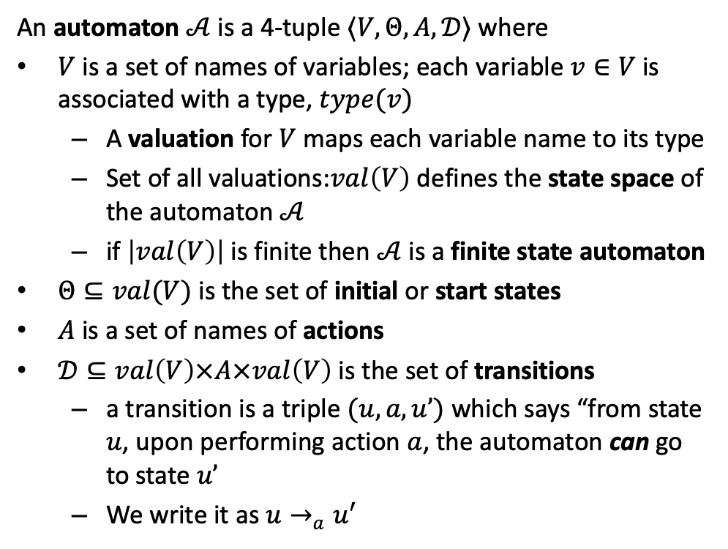
Models: State machines or Automata
A state machine or an automaton is a discrete-time(step-by-step) mathematical model describing the evolution of a system in term of its states
Example run: x = 5, x=16, x=8, x=4, 2, 1, 4, 2, 1, 4, 2, 1
Another run: x = 6, x=3, 10, 5, 16, 8, 4, 2, 1, 4, 2, 1, …
Another run: x = 7, x=22, x=11, x=34, x=17, x=52, … ?
Do all runs end in the 4,2,1 loop?
“Mathematics is not yet ready for such problems.” --- Paul Erdös
An automaton $𝒜$is a 4-tuple $〈V,Θ, A, 𝒟〉$ where
$V$ is a set of names of variables; each variable $v∈V$is associated with a type, $type(v)$
A valuation for $V$ maps each variable name to its type
Set of all valuations:$val\left(V\right)$ defines the state space of the automaton $𝒜$
if $\left|val\left(V\right)\right|$ is finite then $𝒜$ is a finite state automaton
$Θ⊆val(V)$ is the set of initial or start states
$A$ is a set of names of actions
$𝒟⊆val\left(V\right)×A×val\left(V\right)$ is the set of transitions
a transition is a triple $(u,a,u’)$ which says “from state $u$, upon performing action $a$, the automaton can go to state $u’$
We write it as $u→_{a}u′$
Example 1:
x: Int = 5
While True // step
If x % 2 == 0 then x = x / 2 else x = 3x + 1

Slide 23
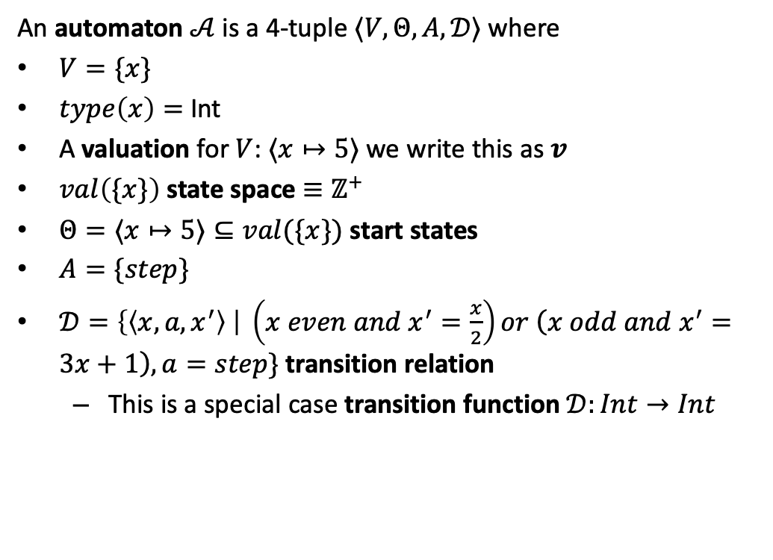
Collatz Automata
A state machine or an automaton is a discrete-time(step-by-step) mathematical model describing the evolution of a system in term of its states
Example run: x = 5, x=16, x=8, x=4, 2, 1, 4, 2, 1, 4, 2, 1
Another run: x = 6, x=3, 10, 5, 16, 8, 4, 2, 1, 4, 2, 1, …
Another run: x = 7, x=22, x=11, x=34, x=17, x=52, … ?
An automaton $𝒜$is a 4-tuple $〈V,Θ, A, 𝒟〉$ where
$V=\{x\}$
$type\left(x\right)=$ Int
A valuation for $V$: $⟨x↦5⟩$ we write this as $v$
$val\left(\{x\}\right)$ state space $≡ℤ^{+}$
$Θ=⟨x↦5⟩⊆val(\{x\})$ start states
$A=\{step\}$
$𝒟=\left\{\left\langle x,{a, x}^{′}\right\rangle \right| \left(x even and x^{′}=\frac{x}{2}\right)or \left(x odd and x^{′}=3x+1\right), a=step\}$ transition relation
This is a special case transition function $𝒟:Int→Int$
Collatz:
x: Int = 5
While True // step
If x % 2 == 0 then x = x / 2 else x = 3x + 1

Slide 24
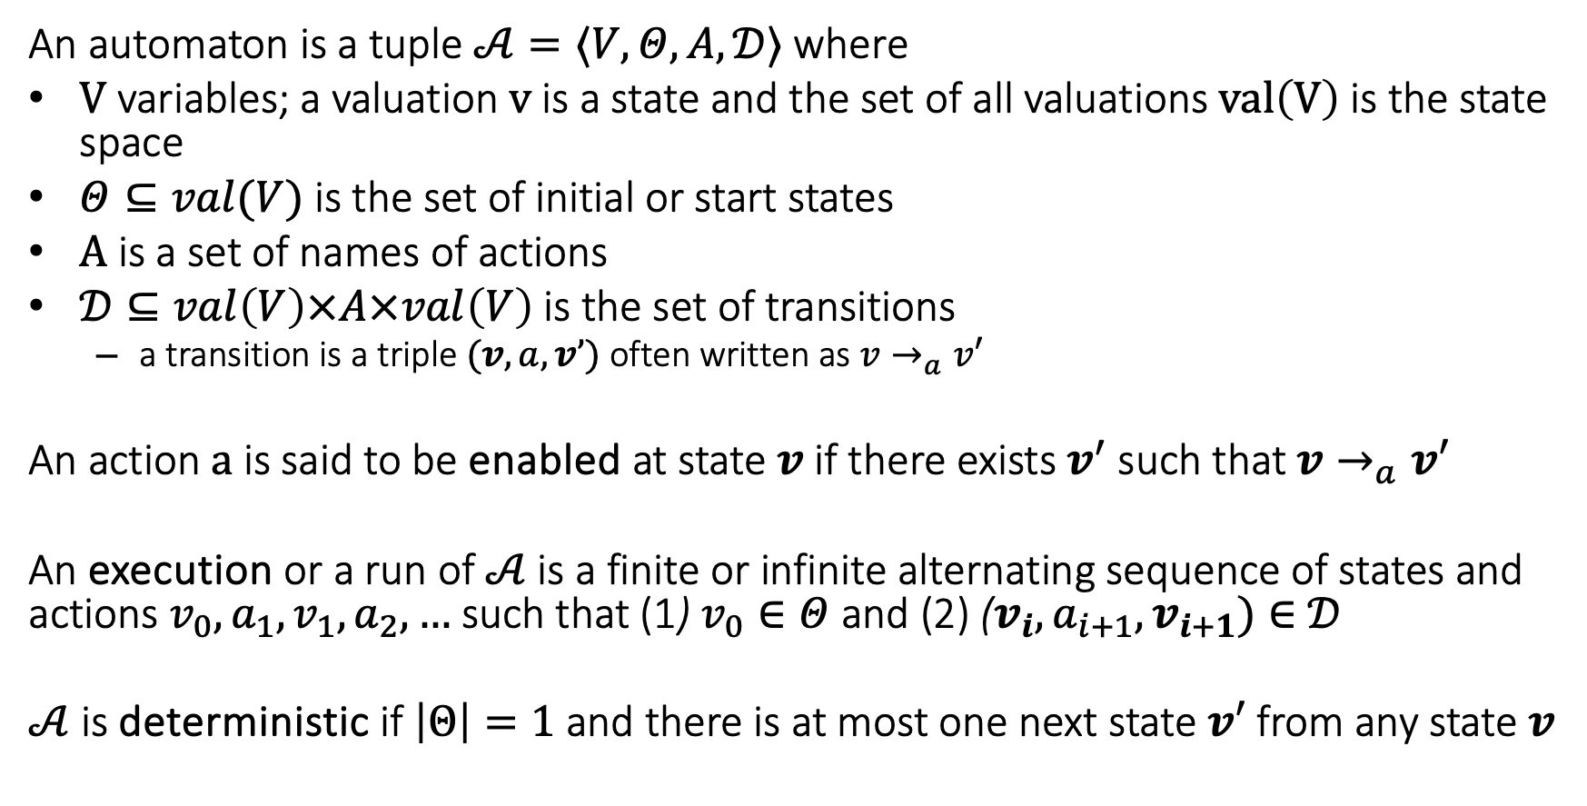
Automata, executions, and determinism
An automaton is a tuple $𝒜=〈V,Θ, A, 𝒟〉$ where
$V$ variables; a valuation $v$ is a state and the set of all valuations $val\left(V\right)$ is the state space
$Θ⊆val(V)$ is the set of initial or start states
$A$ is a set of names of actions
$𝒟⊆val\left(V\right)×A×val\left(V\right)$ is the set of transitions
a transition is a triple $(v,a,v’)$ often written as $v→_{a}v′$
An action $a$ is said to be enabled at state $v$ if there exists $v^{′}$ such that $v→_{a}v′$
An execution or a run of $𝒜$ is a finite or infinite alternating sequence of states and actions$v_{0},a_{1},v_{1},a_{2},…$ such that (1) $v_{0}∈Θ$ and (2) ($v_{i},a_{i+1},v_{i+1})∈$ $𝒟$
$𝒜$is deterministic if $\left|Θ\right|=1$ and there is at most one next state $v′$ from any state $v$

Slide 25
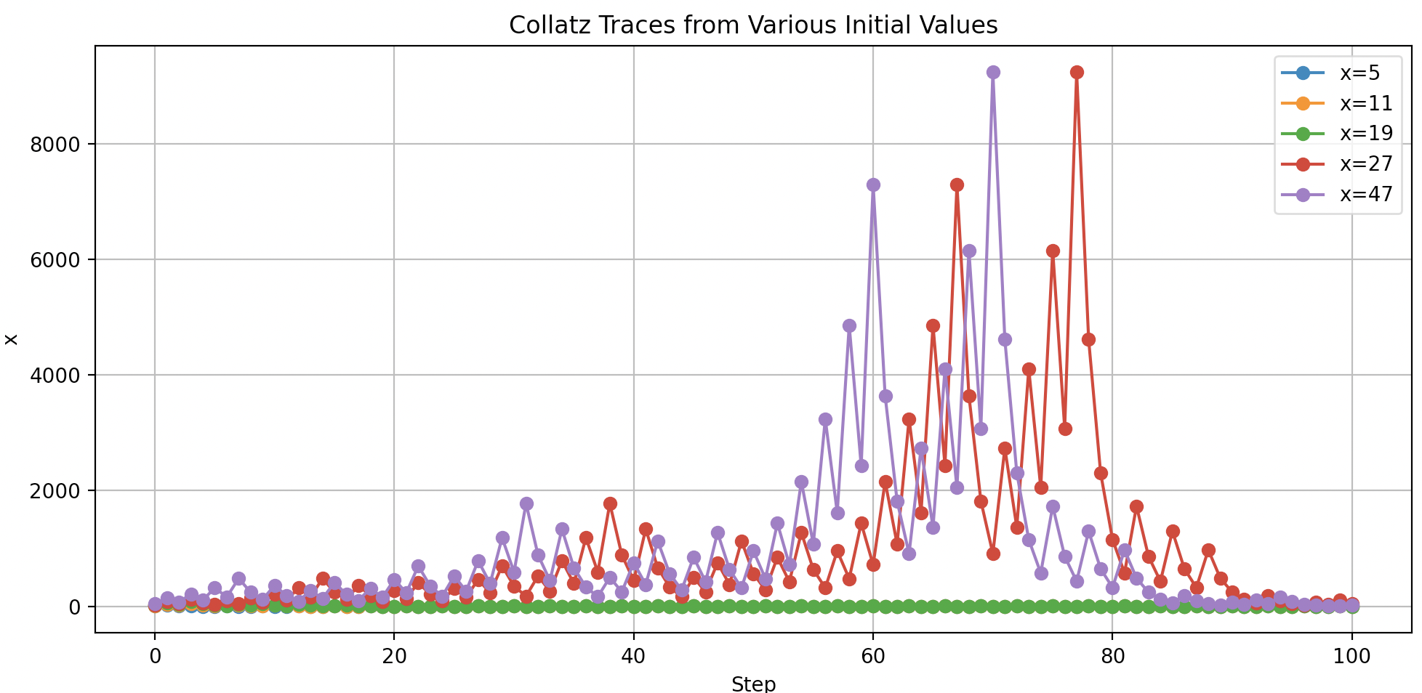
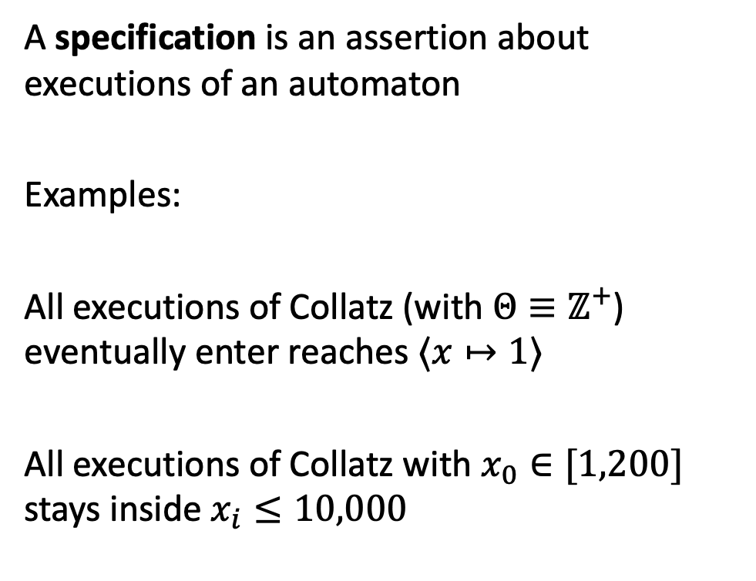
Specifications and verification
A specification is an assertion about executions of an automaton
Examples:
All executions of Collatz (with $Θ≡ℤ^{+}$) eventually enter reaches $⟨x↦1⟩$
All executions of Collatz with $x_{0}∈[1,200]$ stays inside $x_{i}≤10,000$
Notes:
Run collatz on Vscode

Slide 26
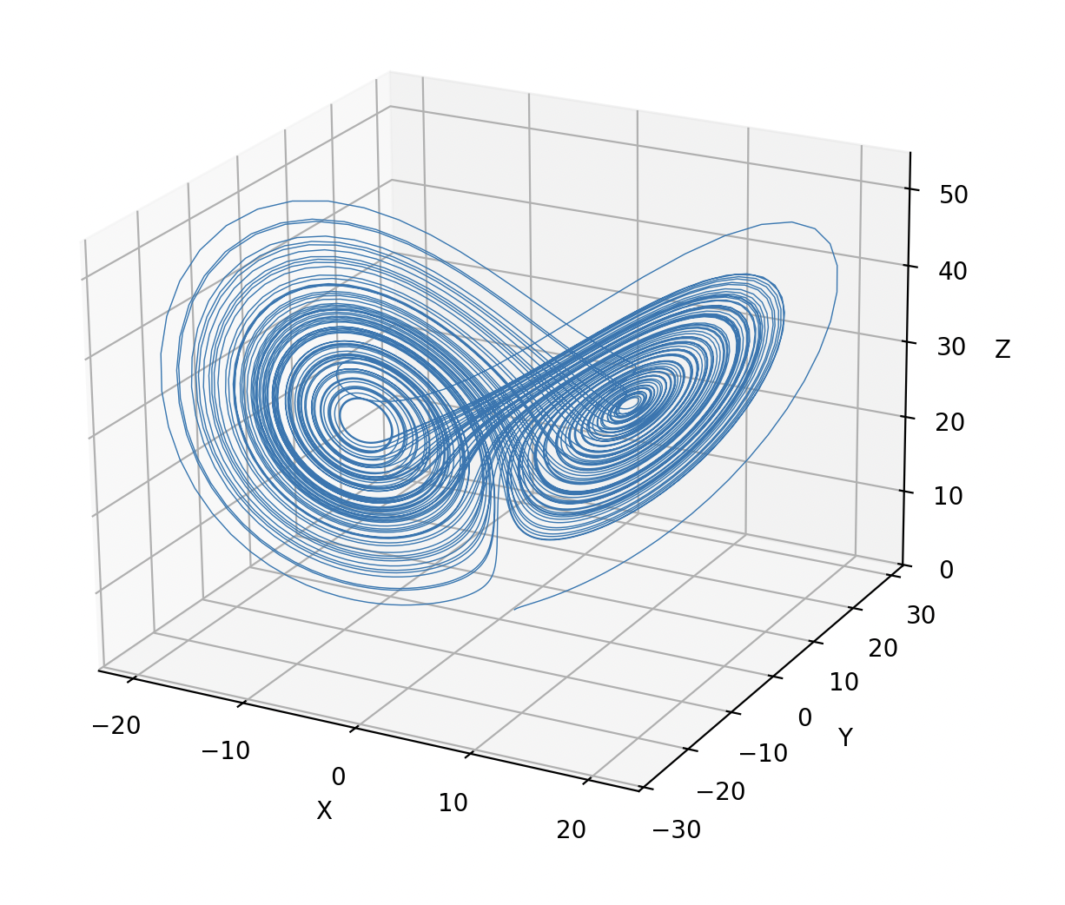
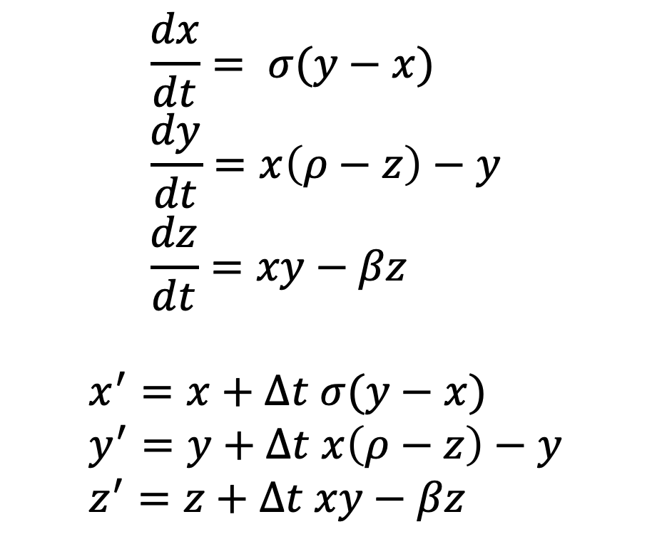
Example 2: Butterfly effect and the Lorentz Attractor
$$\frac{dx​}{dt}= σ(y−x) \\ \frac{dy}{​dt}=x\left(ρ−z\right)−y \\ \frac{dz}{dt}=xy−βz​$$
$$x^{′}=x+Δt σ(y−x) \\ y^{′}=y+Δt x\left(ρ−z\right)−y \\ z^{′}=z+Δt xy−βz​$$
In 1961, while working on models of atmospheric convection to improve weather forecasting, Edward Lorenz made a surprising discovery. He reran a computer simulation of ODEs but started it from intermediate values rounded to three decimal places instead of the full six.
To his astonishment, the new simulation initially matched the previous run but soon diverged completely, producing a different weather pattern. This unexpected sensitivity to initial conditions led Lorenz to realize that deterministic systems could behave unpredictably, laying the foundation for chaos theory.
Notes:
Weather prediction

Slide 27
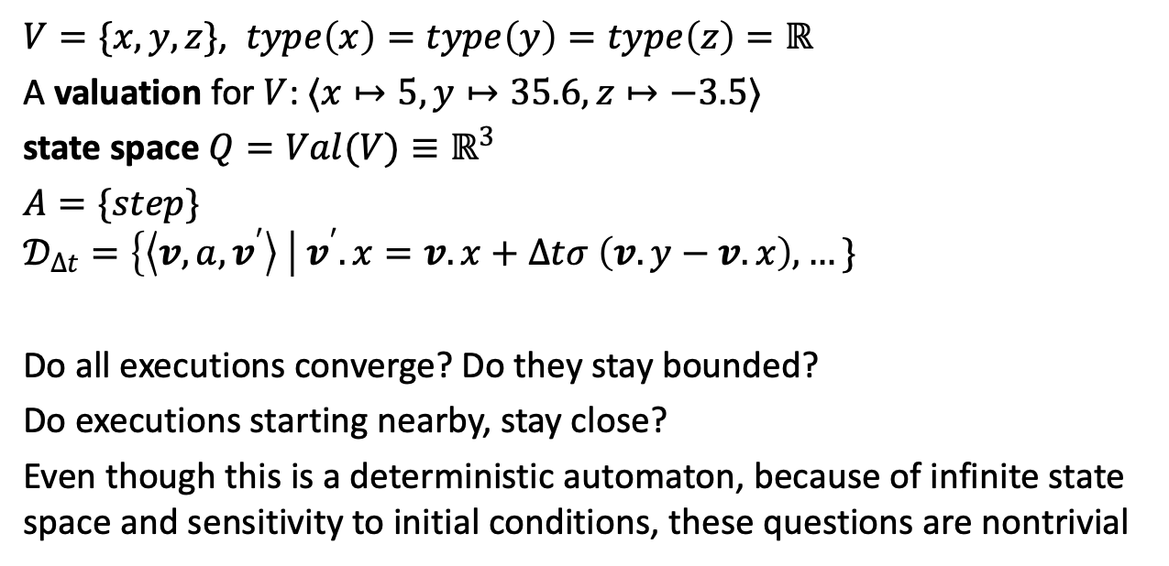
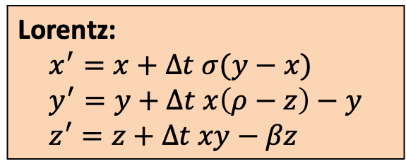
Lorentz Automaton
Lorentz:
$$x^{′}=x+Δt σ(y−x) \\ y^{′}=y+Δt x\left(ρ−z\right)−y \\ z^{′}=z+Δt xy−βz​$$
$V=\{x,y,z\}$, $type\left(x\right)=type\left(y\right)=type\left(z\right)=ℝ$
A valuation for $V$: $⟨x↦5,y↦35.6,z↦−3.5⟩$
state space $Q=Val(V)≡ℝ^{3}$
$A=\{step\}$
$$𝒟_{Δt}=\left\{\left\langle v,{a, v}^{′}\right\rangle \right| v^{′}.x=v.x+Δtσ \left(v.y−v.x\right), …\}$$
Do all executions converge? Do they stay bounded?
Do executions starting nearby, stay close?
Even though this is a deterministic automaton, because of infinite state space and sensitivity to initial conditions, these questions are nontrivial

Slide 28
Assignments
Read. Modeling computation: Chapter 2 of CPSBook, first part of Chapter 7, and section on SAT/SMT
Form team (optional*) and go through Project Jumpstart exercise
Next: Invariance and reachability

