Slide 1
Modeling Physics: Dynamical Systems
Sayan Mitra
Verifying cyberphysical systems
mitras@illinois.edu

Slide 2
Plan
Dynamical system models
notions of solutions
Linear dynamical systems
Connection to automata
Stability
Lyapunov method

Slide 3
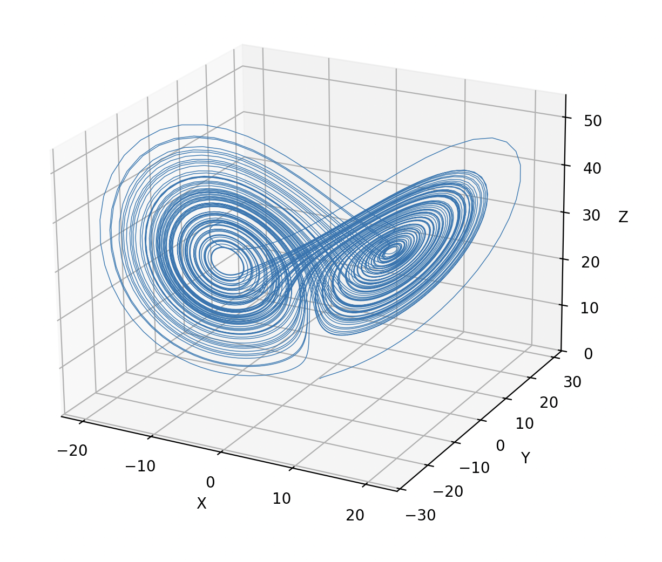

Example: The Lorentz Attractor
$\frac{dx​}{dt}= σ(y−x)$ $\frac{dy}{​dt}=x\left(ρ−z\right)−y$ $x=[x,y,z]∈ℝ^{3}$ $\frac{dz}{dt}=xy−βz​$
$\dot{\left[\begin{matrix}x \\ y \\ z\end{matrix}\right]}=\left[\begin{matrix}σ(y−x) \\ x\left(ρ−z\right)−y \\ xy−βz​\end{matrix}\right]$
Notes:
Weather prediction

Slide 4
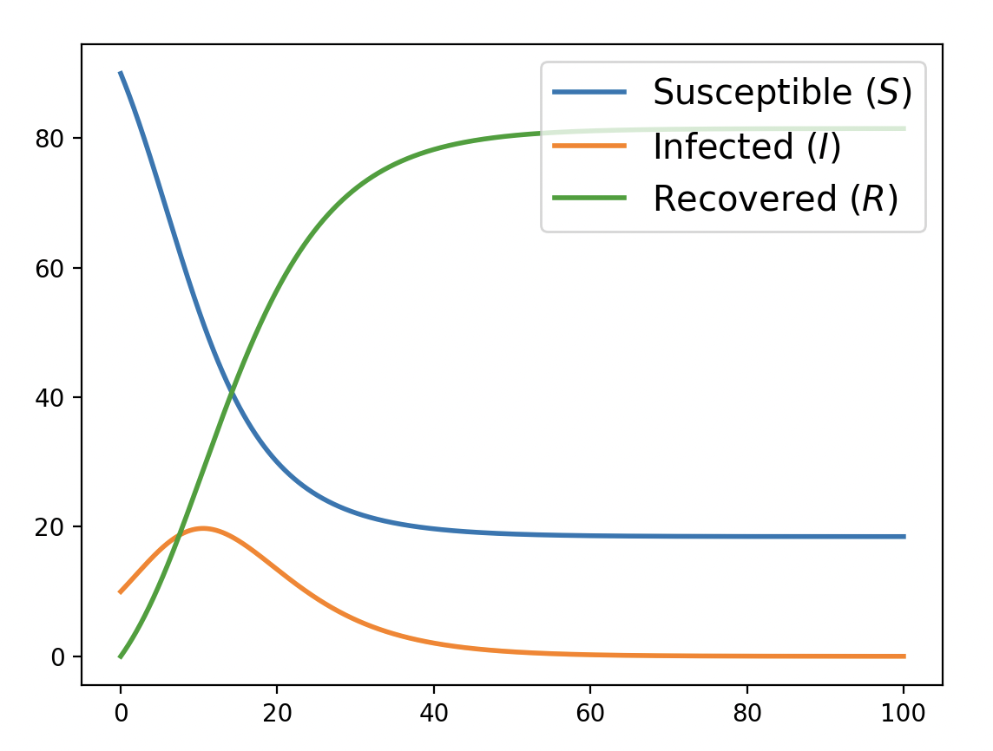
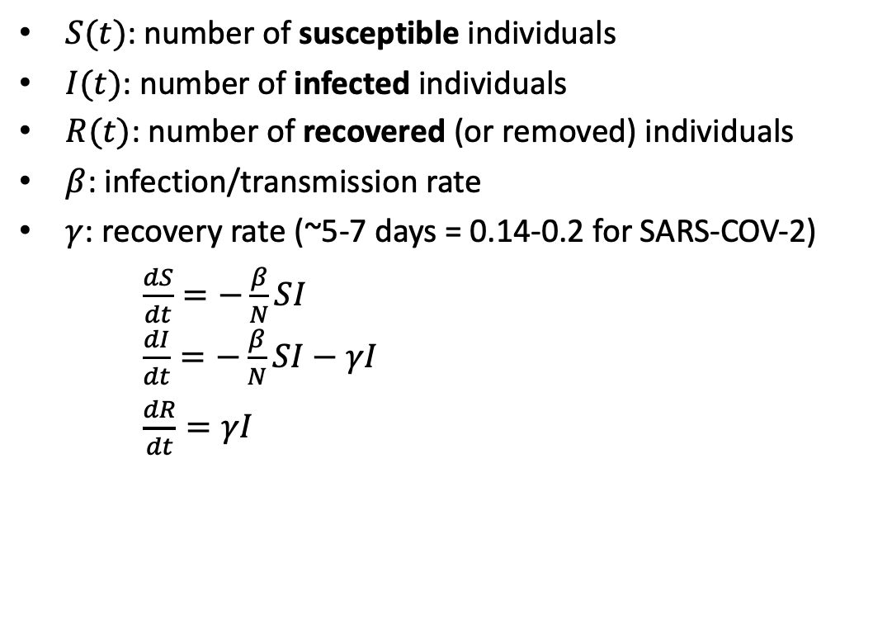
Example: Epidemiology
$S(t)$: number of susceptible individuals
$I(t)$: number of infected individuals
$R(t)$: number of recovered (or removed) individuals
$β$: infection/transmission rate
$γ$: recovery rate (~5-7 days = 0.14-0.2 for SARS-COV-2)
$\frac{dS​}{dt}=−\frac{β}{N}SI$ $\frac{dI}{​dt}=−\frac{β}{N}SI−γI$
$\frac{dR}{dt}=γI​$

Slide 5
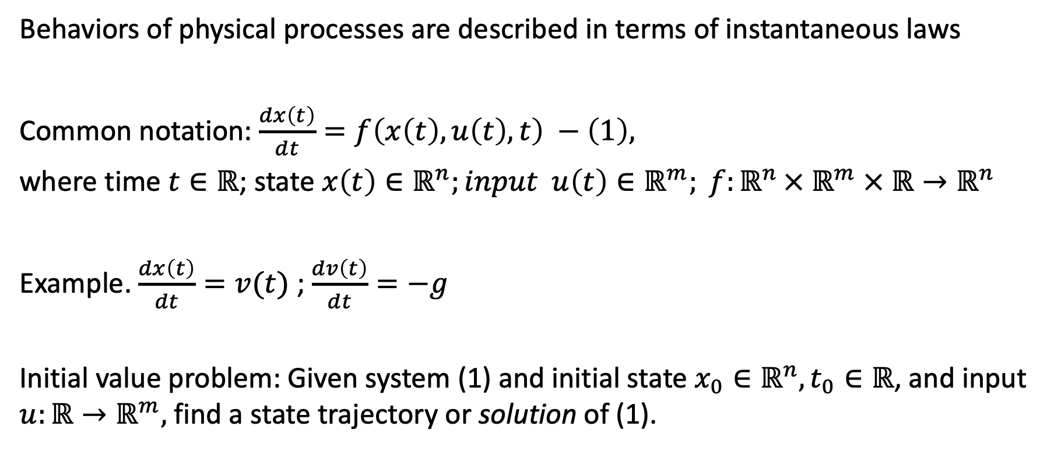
Introduction to dynamical systems
Behaviors of physical processes are described in terms of instantaneous laws
Common notation: $\frac{dx\left(t\right)}{dt}=f\left(x\left(t\right),u\left(t\right),t\right) −\left(1\right),$
where time $t∈ℝ$; state $x\left(t\right)∈ℝ^{n};input u\left(t\right)∈ℝ^{m}; f:ℝ^{n }×{ ℝ}^{m} × ℝ→ℝ^{n}$
Example. $\frac{dx\left(t\right)}{dt}=v(t)$ ; $\frac{dv\left(t\right)}{dt}=−g$
Initial value problem: Given system (1) and initial state $x_{0}∈ℝ^{n}, t_{0}∈ℝ$, and input $u:ℝ→ℝ^{m},$ find a state trajectory or solution of (1).

Slide 6
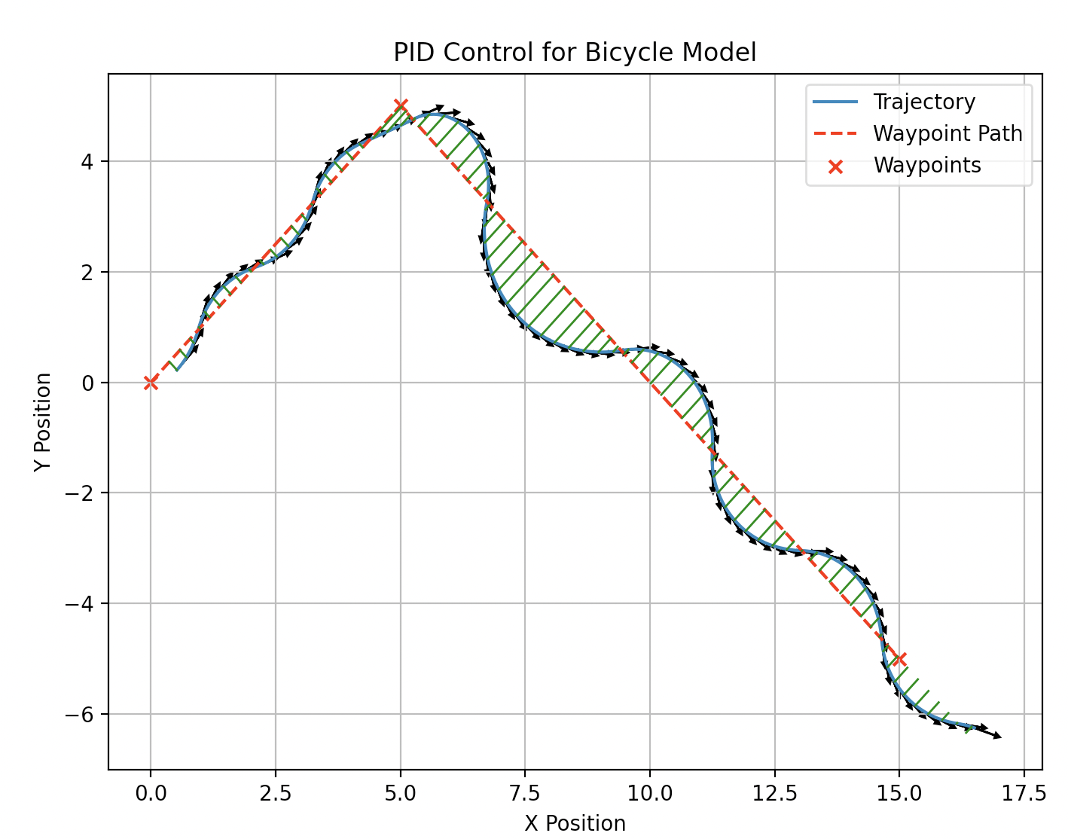
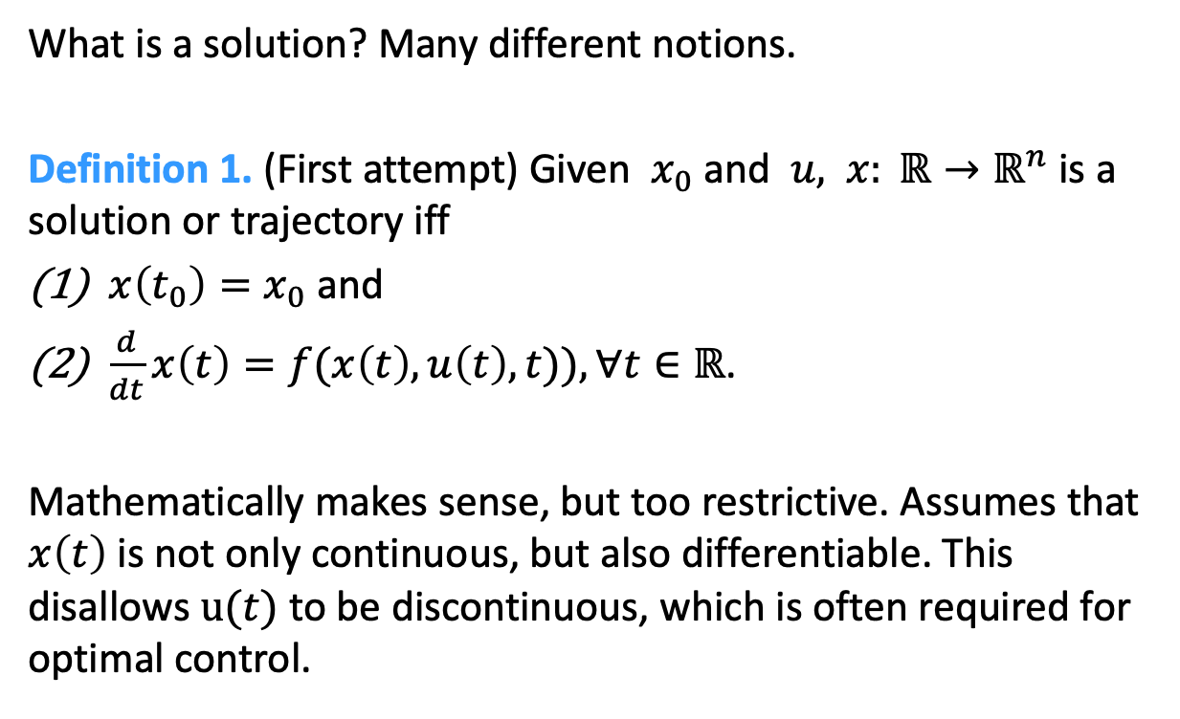
Notions of solution
What is a solution? Many different notions.
Definition 1. (First attempt) Given $x_{0}$ and $u,$ $x: ℝ→ℝ^{n}$ is a solution or trajectory iff
$x\left(t_{0}\right)=x_{0}$ and
$\frac{d}{dt}x\left(t\right)=f(x\left(t\right),u\left(t\right),t)), ∀t∈ℝ$.
Mathematically makes sense, but too restrictive. Assumes that $x\left(t\right)$ is not only continuous, but also differentiable. This disallows $u(t)$ to be discontinuous, which is often required for optimal control.

Slide 7
Getting from point a to point b

Slide 8

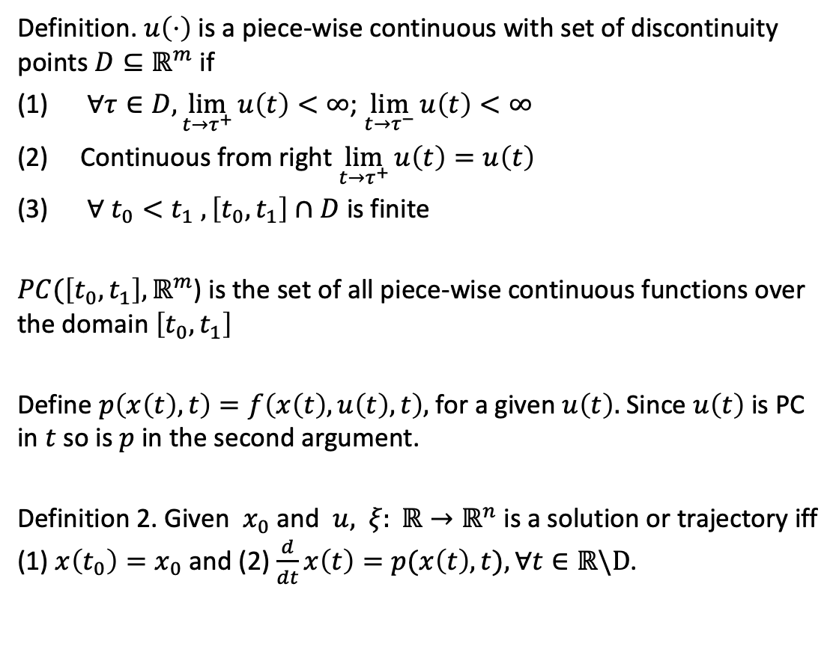


Modified notion
Definition. $u\left(⋅\right)$ is a piece-wise continuous with set of discontinuity points $D⊆ℝ^{m}$ if
$∀τ∈D,\lim_{t→τ^{+}}{u\left(t\right)}<∞$; $\lim_{t→τ^{−}}{u\left(t\right)<∞}$
Continuous from right$\lim_{t→τ^{+}}{u\left(t\right)}=u\left(t\right)$
$∀ t_{0}<t_{1}$ $,\left[t_{0},t_{1}\right]∩D$ is finite
$PC(\left[t_{0},t_{1}\right],ℝ^{m}$) is the set of all piece-wise continuous functions over the domain $\left[t_{0},t_{1}\right]$
Define $p\left(x\left(t\right),t\right)=f\left(x\left(t\right),u\left(t\right),t\right),$ for a given $u\left(t\right).$ Since $u\left(t\right)$ is PC in $t$ so is $p$ in the second argument.
Definition 2. Given $x_{0}$ and $u,$ $ξ: ℝ→ℝ^{n}$ is a solution or trajectory iff (1) $x\left(t_{0}\right)=x_{0}$ and (2) $\frac{d}{dt}x\left(t\right)=p(x\left(t\right),t), ∀t∈ℝ\backslash D$.
$$u\left(t\right)$$
$$τ_{1}$$
$$τ_{2}$$

Slide 9
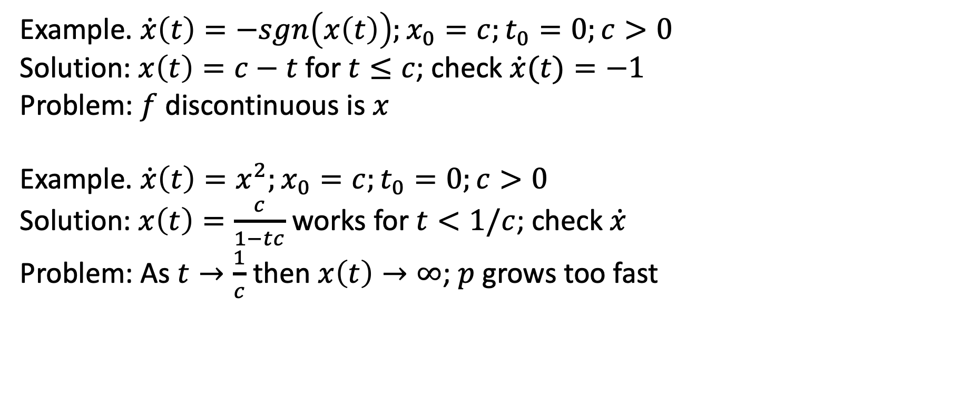

Is PC input $u\left(t\right)$ adequate for guaranteeing existence of solutions?
Example. $\dot{x}\left(t\right)=−sgn\left(x\left(t\right)\right);x_{0}=c;t_{0}=0;c>0$
Solution: $x\left(t\right)=c−t$ for $t≤c$; check $\dot{x}(t)=−1$
Problem: $f$ discontinuous is $x$
Example. $\dot{x}\left(t\right)=x^{2};x_{0}=c;t_{0}=0;c>0$
Solution: $x\left(t\right)=\frac{c}{1−tc}$ works for $t<1/c$; check $\dot{x}$
Problem: As $t→\frac{1}{c}$ then $x\left(t\right)→∞$; $p$ grows too fast

Slide 10
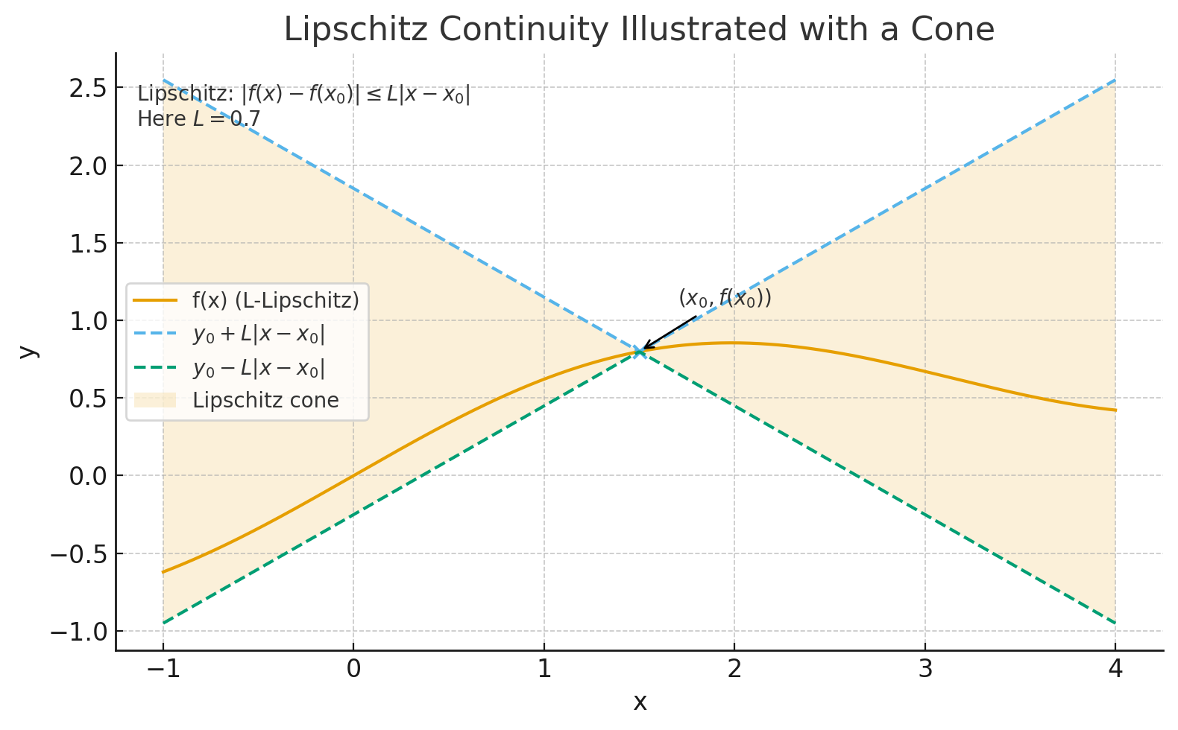
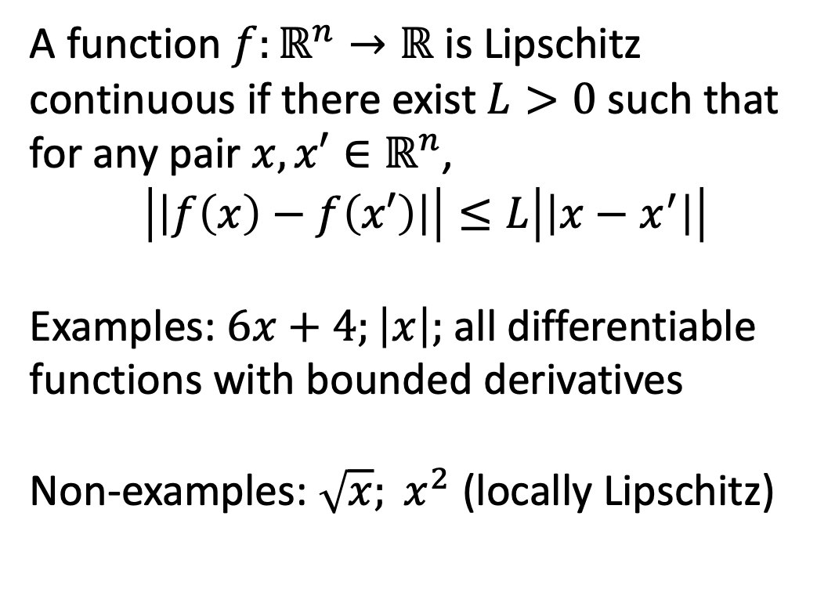
Lipschitz continuity
A function $f:ℝ^{n}→ℝ$ is Lipschitz continuous if there exist $L>0$ such that for any pair $x,x′∈ℝ^{n}$,
$$\left|\left|f\left(x\right)−f\left(x′\right)\right|\right|≤L\left|\left|x−x^{′}\right|\right|$$
Examples: $6x+4;\left|x\right|;$ all differentiable functions with bounded derivatives
Non-examples: $\sqrt{x}; x^{2}$ (locally Lipschitz)

Slide 11
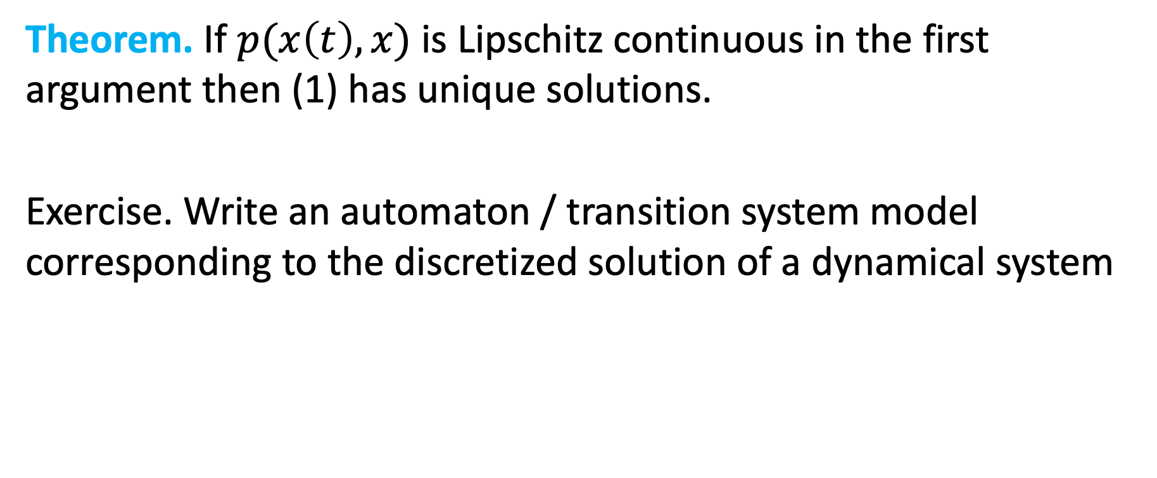
Existence and uniqueness of solutions
Theorem. If $p(x\left(t\right),x)$ is Lipschitz continuous in the first argument then (1) has unique solutions.
Exercise. Write an automaton / transition system model corresponding to the discretized solution of a dynamical system

Slide 12
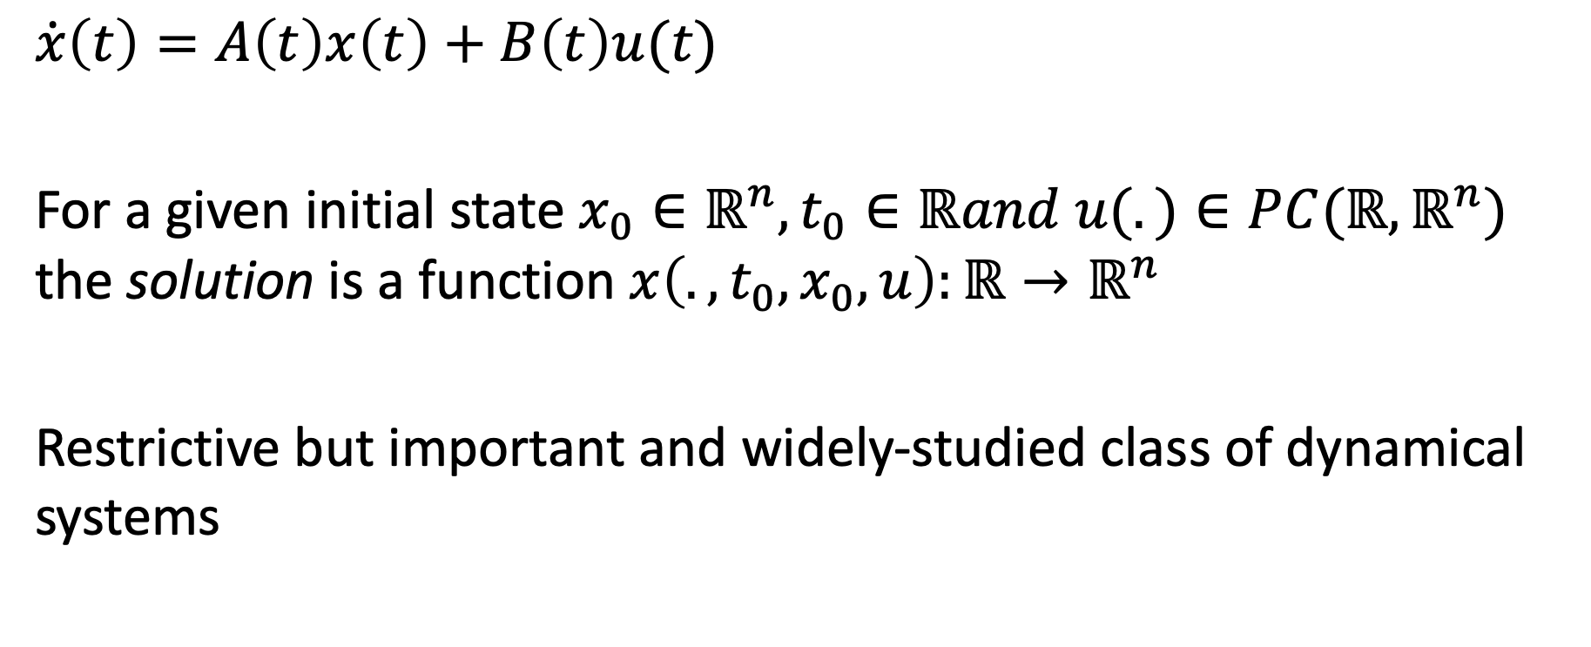
Linear system and solutions
$$\dot{x}\left(t\right)=A\left(t\right)x\left(t\right)+B\left(t\right)u(t)$$
For a given initial state $x_{0}∈ℝ^{n},t_{0}∈ℝand u(.)∈PC(ℝ,ℝ^{n})$ the solution is a function $x\left(.,t_{0},x_{0},u\right):{ℝ→ℝ}^{n}$
Restrictive but important and widely-studied class of dynamical systems

Slide 13
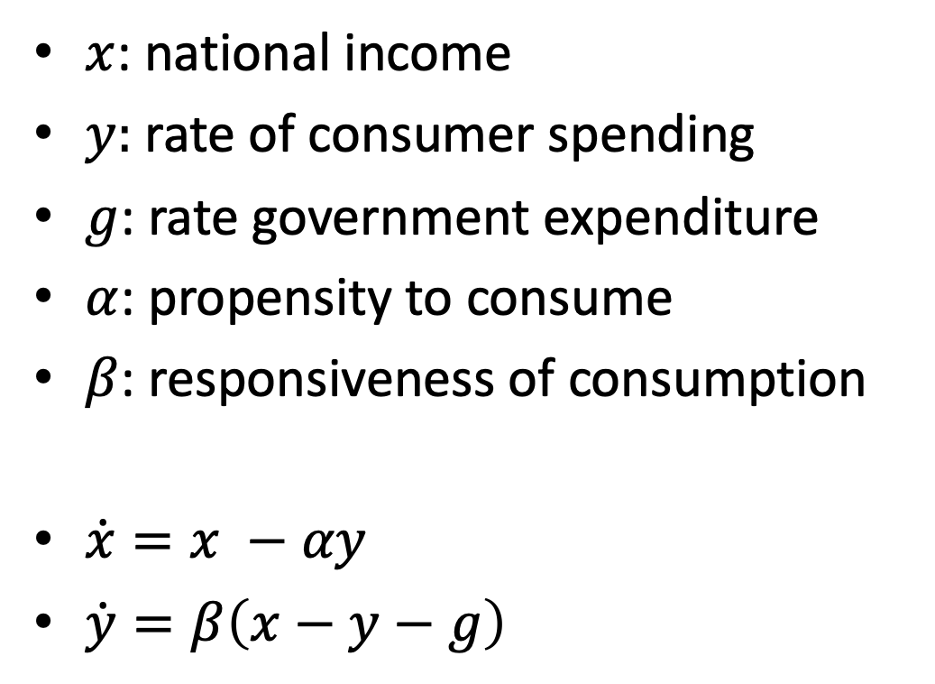
Example: Simple model of an economy
$x$: national income
$y:$ rate of consumer spending
$g$: rate government expenditure
$α$: propensity to consume
$β$: responsiveness of consumption
$\dot{x}=x −αy$
$\dot{y}=β\left(x−y−g\right)$

Slide 14
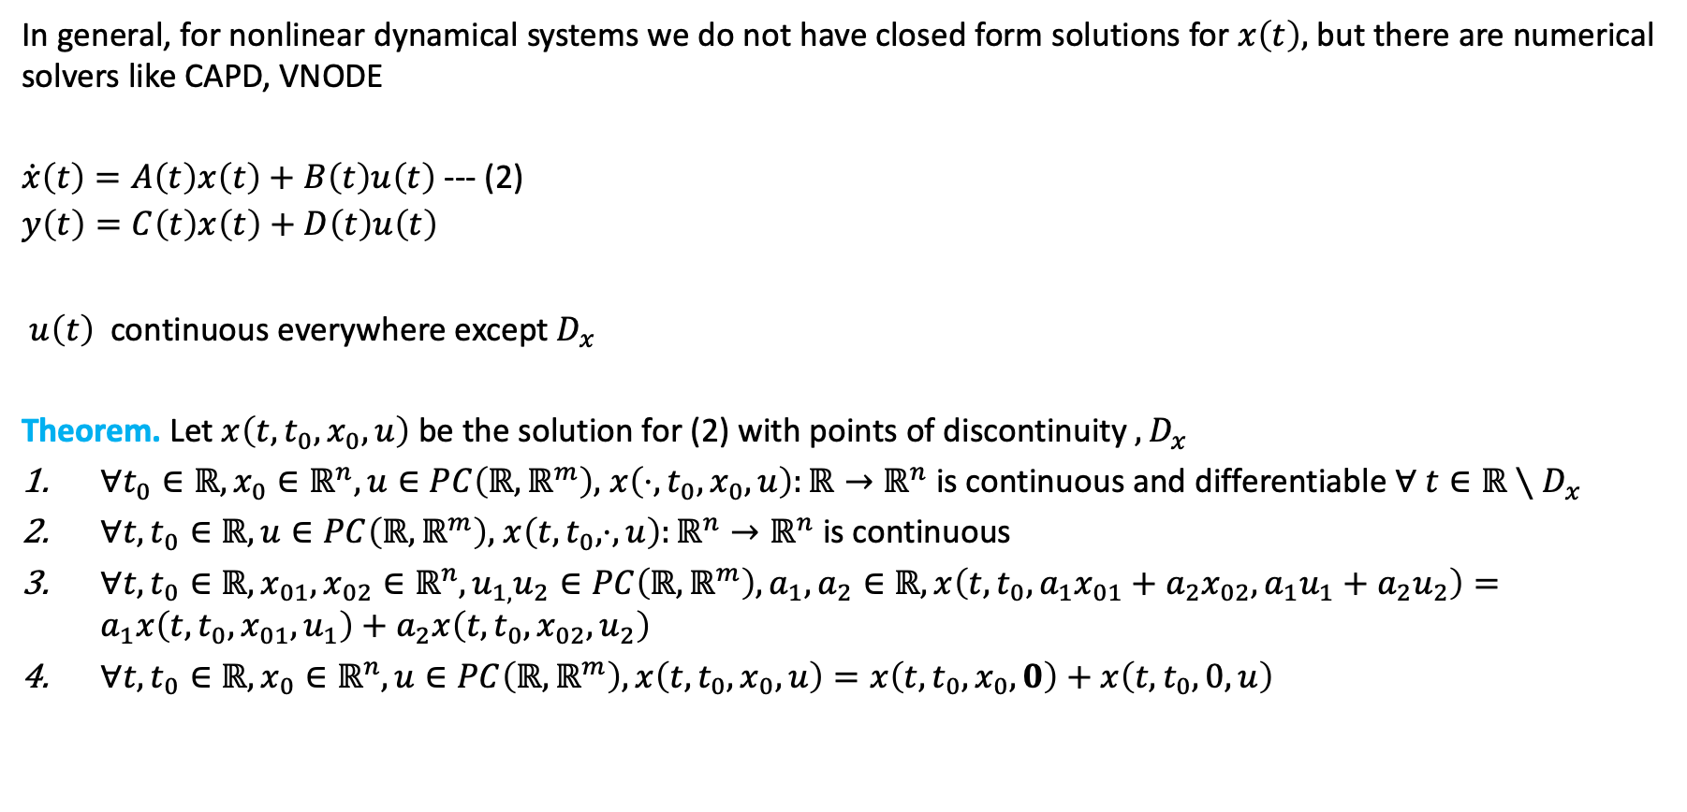
Linear time-varying systems
In general, for nonlinear dynamical systems we do not have closed form solutions for $x\left(t\right),$ but there are numerical solvers like CAPD, VNODE
$\dot{x}\left(t\right)=A\left(t\right)x\left(t\right)+B\left(t\right)u\left(t\right)$ --- (2)
$$y\left(t\right)=C\left(t\right)x\left(t\right)+D\left(t\right)u\left(t\right)$$
$u\left(t\right)$ continuous everywhere except $D_{x}$
Theorem. Let $x\left(t,t_{0},x_{0},u\right)$ be the solution for (2) with points of discontinuity $,D_{x}$
$∀t_{0}∈ℝ,x_{0}∈ℝ^{n},u∈PC\left(ℝ,ℝ^{m}\right),$ $x\left(⋅,t_{0},x_{0},u\right):ℝ→ℝ^{n}$ is continuous and differentiable $∀ t∈ℝ∖D_{x}$
$∀t,t_{0}∈ℝ, u∈PC\left(ℝ,ℝ^{m}\right),$ $x\left(t,t_{0},⋅,u\right):ℝ^{n}→ℝ^{n}$ is continuous
$∀{t,t}_{0}∈ℝ,x_{01},x_{02}∈ℝ^{n},u_{1,}u_{2}∈PC\left(ℝ,ℝ^{m}\right),a_{1},a_{2}∈ℝ, x\left(t,t_{0},a_{1}x_{01}+a_{2}x_{02},a_{1}u_{1}+a_{2}u_{2}\right)=a_{1}x\left(t,t_{0}, x_{01}, u_{1}\right)+a_{2}x\left(t,t_{0}, x_{02}, u_{2}\right)$
$∀{t,t}_{0}∈ℝ, x_{0}∈ℝ^{n},u∈PC\left(ℝ,ℝ^{m}\right), x\left(t,t_{0}, x_{0}, u\right)=x\left(t,t_{0}, x_{0}, 0\right)+x\left(t,t_{0}, 0, u\right)$

Slide 15
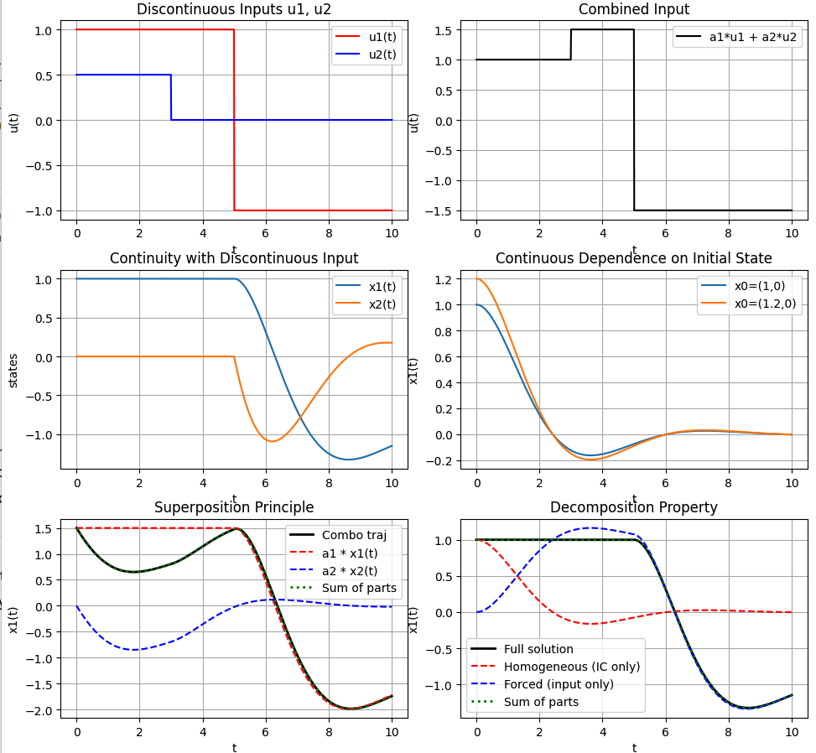
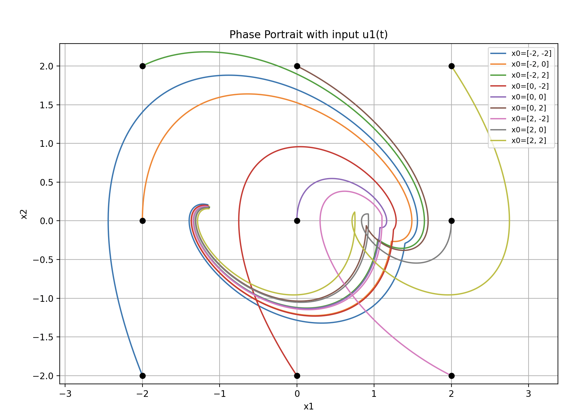

Properties of linear dynamical systems
$$\dot{x}\left(t\right)=A\left(t\right)x\left(t\right)+B\left(t\right)u\left(t\right)$$
$$A=\left[\begin{matrix}0 & 1 \\ −1 & −1\end{matrix}\right] B=\left[\begin{matrix}0 \\ 1\end{matrix}\right]$$

Slide 16
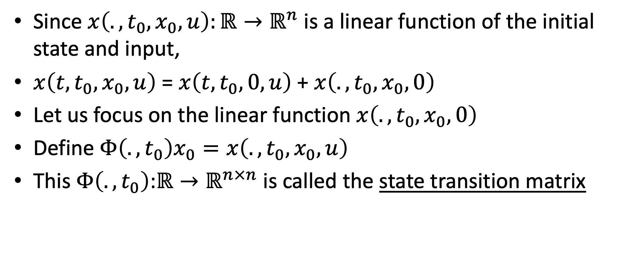
Linear system and solutions
Since $x\left(.,t_{0},x_{0},u\right):{ℝ→ℝ}^{n}$ is a linear function of the initial state and input,
$x\left(t,t_{0},x_{0},u\right)$ = $x\left(t,t_{0},0,u\right)$ + $x\left(.,t_{0},x_{0},0\right)$
Let us focus on the linear function $x\left(.,t_{0},x_{0},0\right)$
Define $Φ\left(.,t_{0}\right)x_{0}=x\left(.,t_{0},x_{0},u\right)$
This $Φ\left(.,t_{0}\right)$:${ℝ→ℝ}^{n×n}$ is called the state transition matrix

Slide 17


Properties of $Φ$
$Φ\left(.,t_{0}\right):{ℝ→ℝ}^{n×n}$ is the unique solution of (2) and is defined by a (Peano-Baker) infinite sequence of integrals
$\frac{∂}{∂t}Φ\left(t,t_{0}\right)=A\left(t\right)Φ(t,t_{0})$ with $Φ\left(t,t\right)=I$
Continuous everywhere
Differentiable everywhere except $D_{x}$ ($A\left(t\right)$ isn’t)
$∀t_{0},t_{1},t$ $Φ\left(t,t_{0}\right)=Φ\left(t,t_{1}\right)Φ\left(t_{1},t_{0}\right)$
$Φ\left(t,t_{0}\right)$ is invertible ${\left[Φ\left(t,t_{0}\right)\right]}^{−1}=Φ\left(t_{0},t\right)$

Slide 18
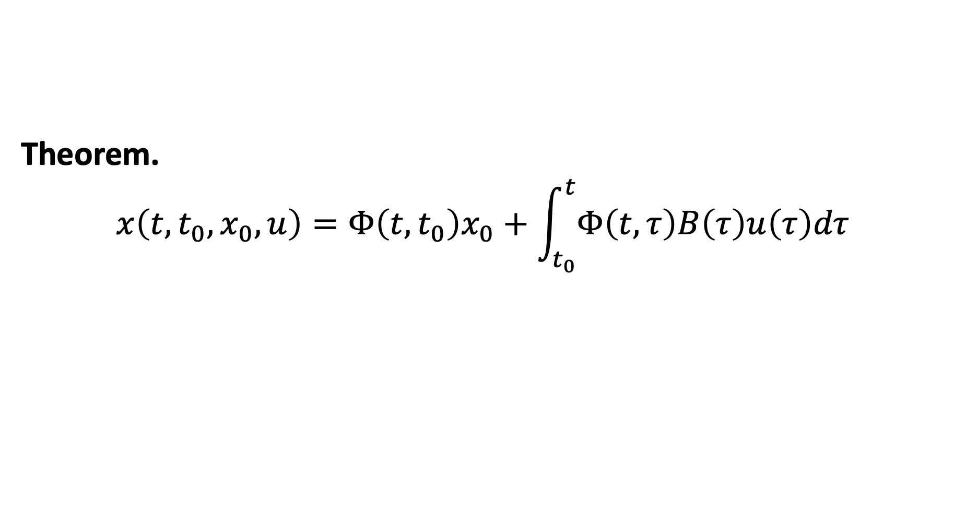

Solution of linear systems in $Φ$
Theorem.
$$x\left(t,t_{0},x_{0},u\right)=Φ\left(t,t_{0}\right)x_{0}+\int_{t_{0}}^{t}{Φ\left(t,τ\right)B\left(τ\right)u\left(τ\right)dτ}$$

Slide 19
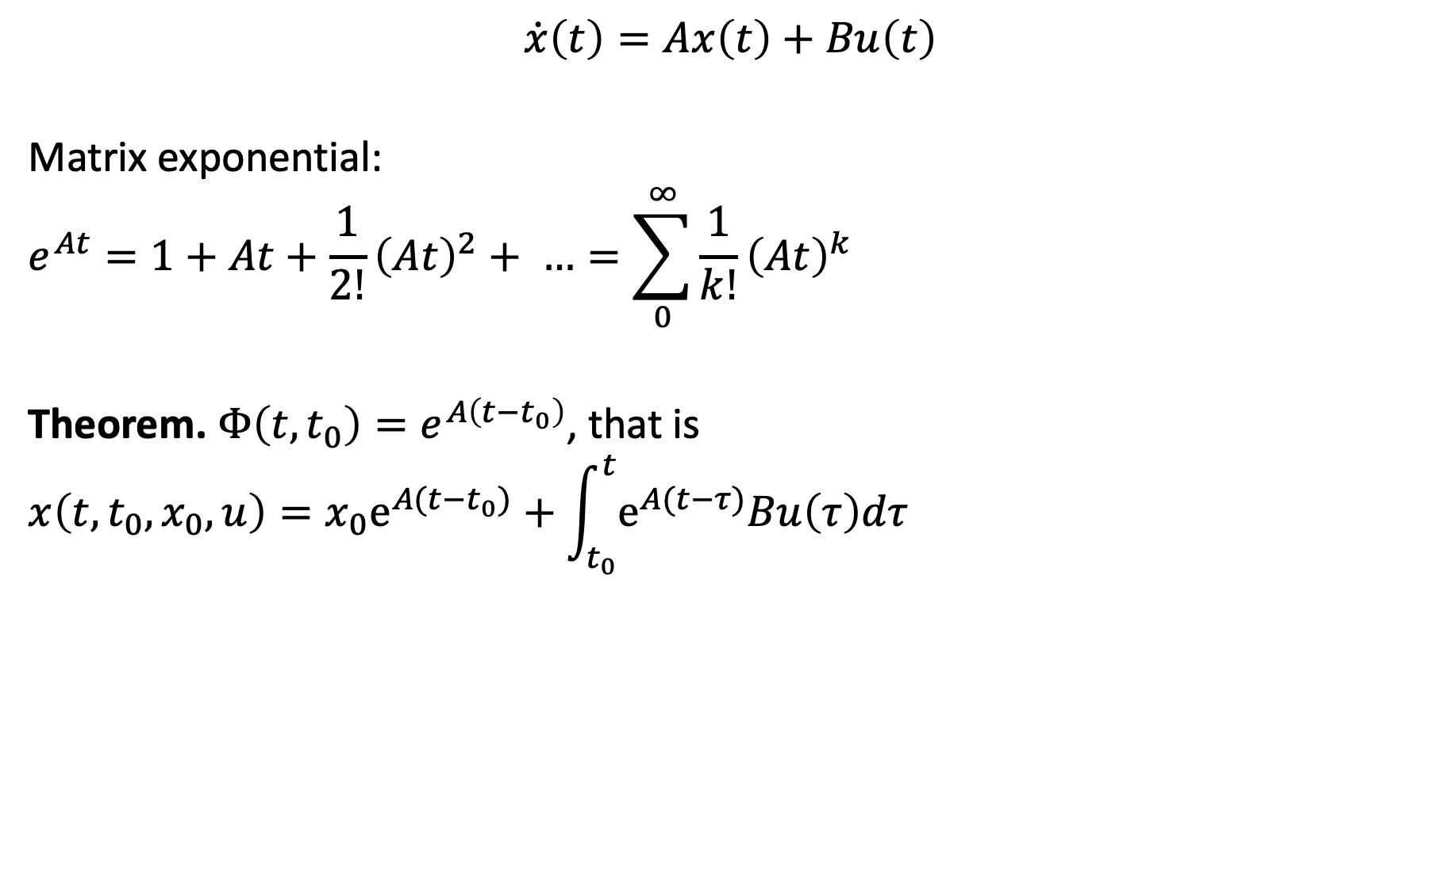
Linear time invariant system
$$\dot{x}\left(t\right)=Ax\left(t\right)+Bu\left(t\right)$$
Matrix exponential:
$$e^{At}=1+At+\frac{1}{2!}{\left(At\right)}^{2}+ …=\sum_{0}^{∞}{\frac{1}{k!}{\left(At\right)}^{k}}$$
Theorem. $Φ\left(t,t_{0}\right)=e^{A\left(t−t_{0}\right)}$, that is
$$x\left(t,t_{0},x_{0},u\right)={x_{0}e}^{A(t−t_{0})}+\int_{t_{0}}^{t}{e^{A(t−τ)}Bu\left(τ\right)dτ}$$

Slide 20
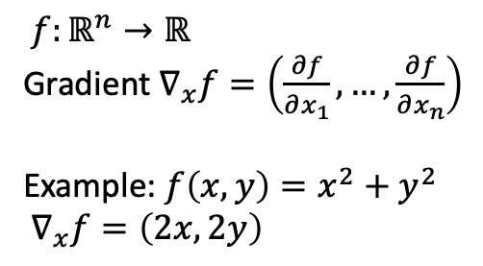
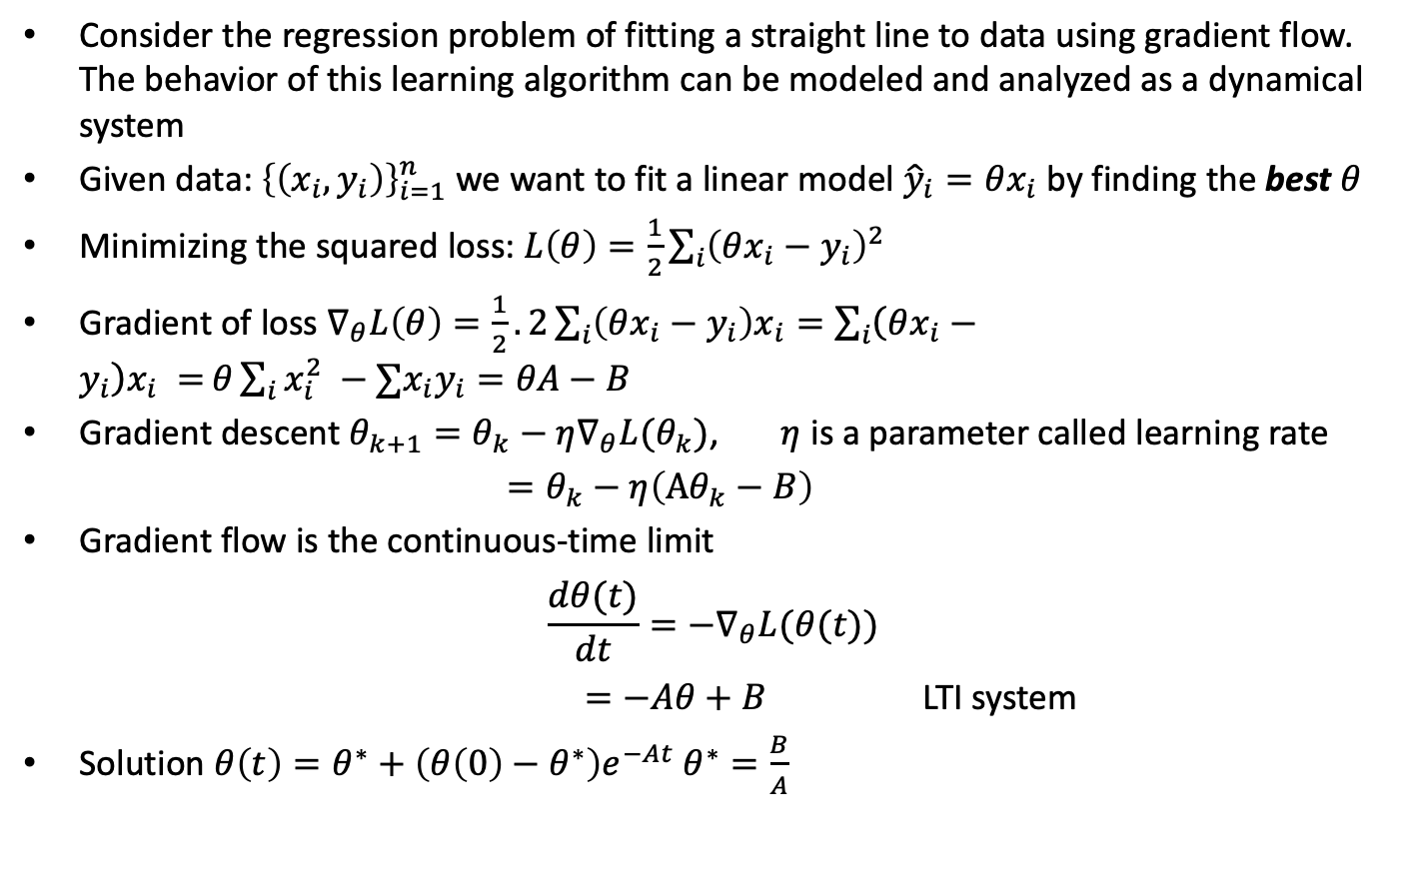
Example: Gradient flow
Consider the regression problem of fitting a straight line to data using gradient flow. The behavior of this learning algorithm can be modeled and analyzed as a dynamical system
Given data: ${\left\{\left(x_{i},y_{i}\right)\right\}}_{i=1}^{n}$ we want to fit a linear model ${\hat{y}}_{i}=θx_{i}$ by finding the best $θ$
Minimizing the squared loss: $L\left(θ\right)=\frac{1}{2}\sum_{i}{{\left(θx_{i}−y_{i}\right)}^{2} }$
Gradient of loss $∇_{θ}L\left(θ\right)=\frac{1}{2}.2\sum_{i}{\left(θx_{i}−y_{i}\right)x_{i}=\sum_{i}{\left(θx_{i}−y_{i}\right)x_{i} =}}θ\sum_{i}{x_{i}^{2} −∑x_{i}y_{i}}=θA−B$
Gradient descent $θ_{k+1}=θ_{k}−η∇_{θ}L(θ_{k})$, $η$ is a parameter called learning rate
$=θ_{k}−η\left(Aθ_{k}−B\right)$
Gradient flow is the continuous-time limit
$$\frac{dθ(t)}{dt}=−∇_{θ}L(θ(t))$$
$=−Aθ+B$ LTI system
Solution $θ\left(t\right)=θ^{∗}+\left(θ\left(0\right)−θ^{∗}\right)e^{−At} θ^{∗}=\frac{B}{A}$
$f:ℝ^{n}→ℝ$
Gradient $∇_{x}f=\left(\frac{∂f}{∂x_{1}},…,\frac{∂f}{∂x_{n}}\right)$
Example: $f\left(x,y\right)=x^{2}+y^{2}$
$∇_{x}f=\left(2x,2y\right)$

Slide 21
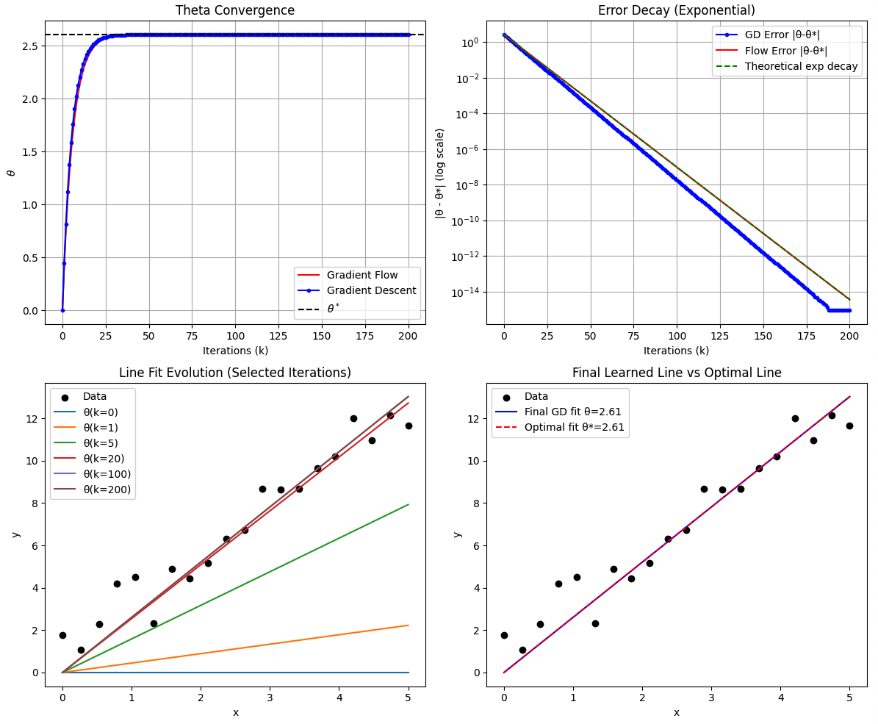
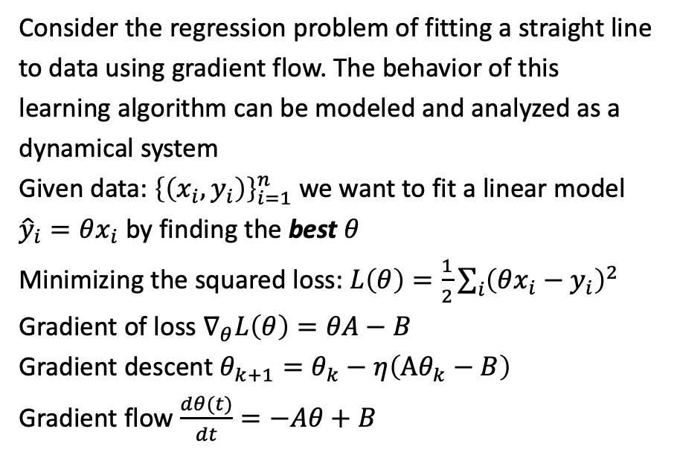
Gradient flow convergence to an optimal model
Consider the regression problem of fitting a straight line to data using gradient flow. The behavior of this learning algorithm can be modeled and analyzed as a dynamical system
Given data: ${\left\{\left(x_{i},y_{i}\right)\right\}}_{i=1}^{n}$ we want to fit a linear model ${\hat{y}}_{i}=θx_{i}$ by finding the best $θ$
Minimizing the squared loss: $L\left(θ\right)=\frac{1}{2}\sum_{i}{{\left(θx_{i}−y_{i}\right)}^{2} }$
Gradient of loss $∇_{θ}L\left(θ\right)=θA−B$
Gradient descent $θ_{k+1}=θ_{k}−η\left(Aθ_{k}−B\right)$
Gradient flow $\frac{dθ(t)}{dt}=−Aθ+B$

Slide 22
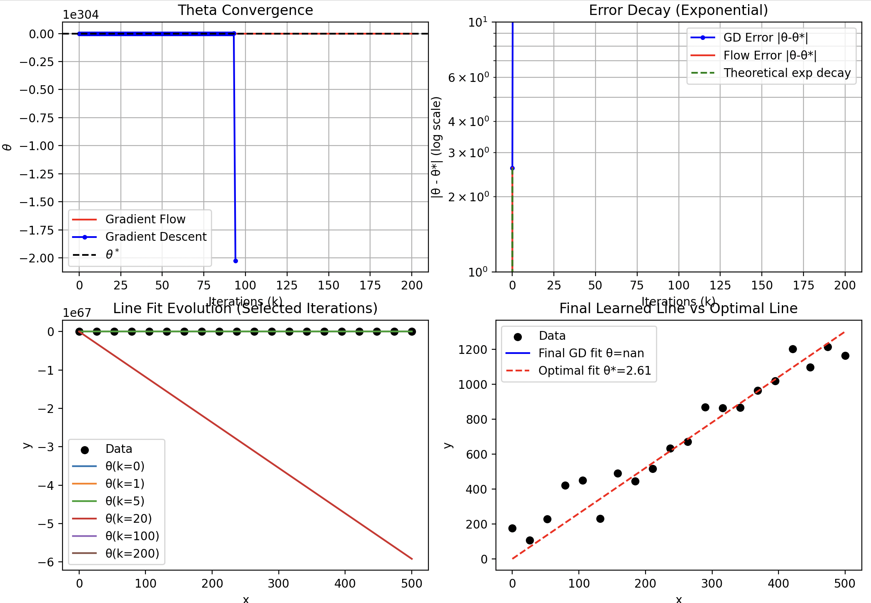
Grad flow converging but to an undesirable value

Slide 23
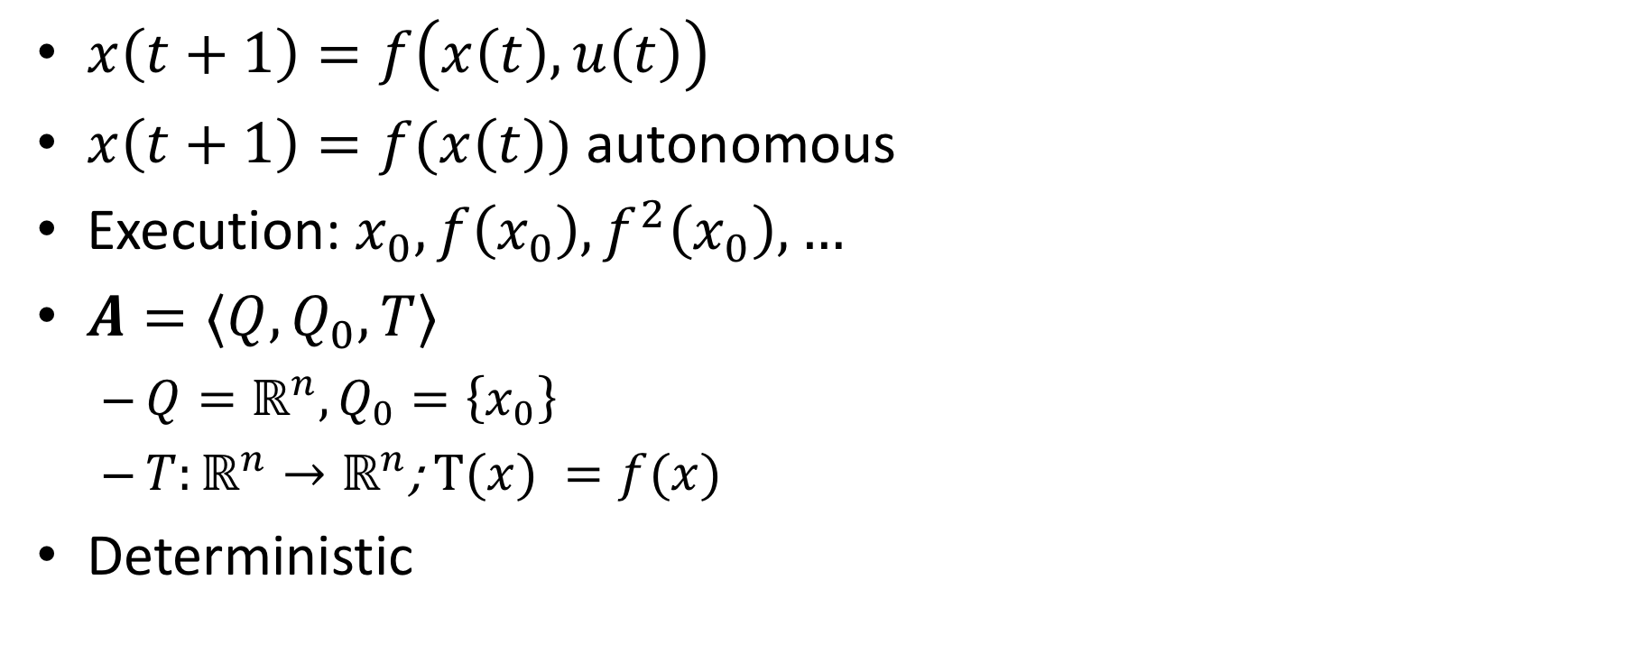
Discrete time models / discrete transition systems
$x\left(t+1\right)=f\left(x\left(t\right), u\left(t\right)\right)$
$x\left(t+1\right)=f(x\left(t\right))$ autonomous
Execution: $x_{0},f\left(x_{0}\right), f^{2}\left(x_{0}\right),…$
$A=⟨Q,Q_{0},T⟩$
$Q=ℝ^{n}, Q_{0}=\left\{x_{0}\right\}$
${T:ℝ}^{n}→ℝ^{n}$; $T(x) =f(x)$
Deterministic

Slide 24
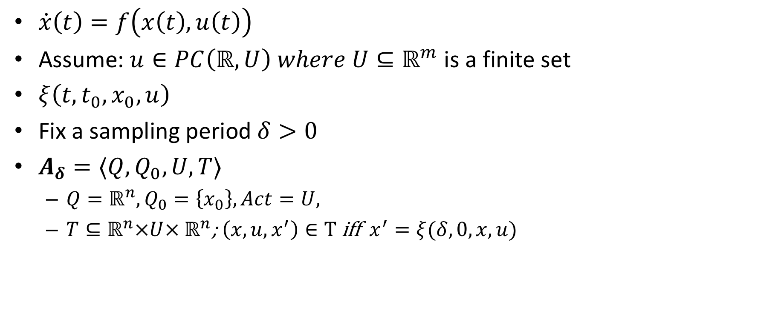
Discretized or sampled-time model
$\dot{x}\left(t\right)=f\left(x\left(t\right), u\left(t\right)\right)$
Assume: $u∈PC\left(ℝ,U\right) where U⊆ℝ^{m}$ is a finite set
$ξ\left(t,t_{0},x_{0},u\right)$
Fix a sampling period $δ>0$
$A_{δ}=⟨Q,Q_{0},U,T⟩$
$Q=ℝ^{n}, Q_{0}=\left\{x_{0}\right\}, Act=U,$
${T⊆ℝ}^{n}×U× ℝ^{n}$; $\left(x,u,x^{′}\right)∈T$iff $x^{′}=ξ(δ, 0,x,u)$

