Slide 1
Verifying Dynamical Systems: Stability
Sayan Mitra
Verifying cyberphysical systems
mitras@illinois.edu

Slide 2
Plan
Dynamical system models
Stability
Lyapunov method
Stability of linear systems

Slide 3
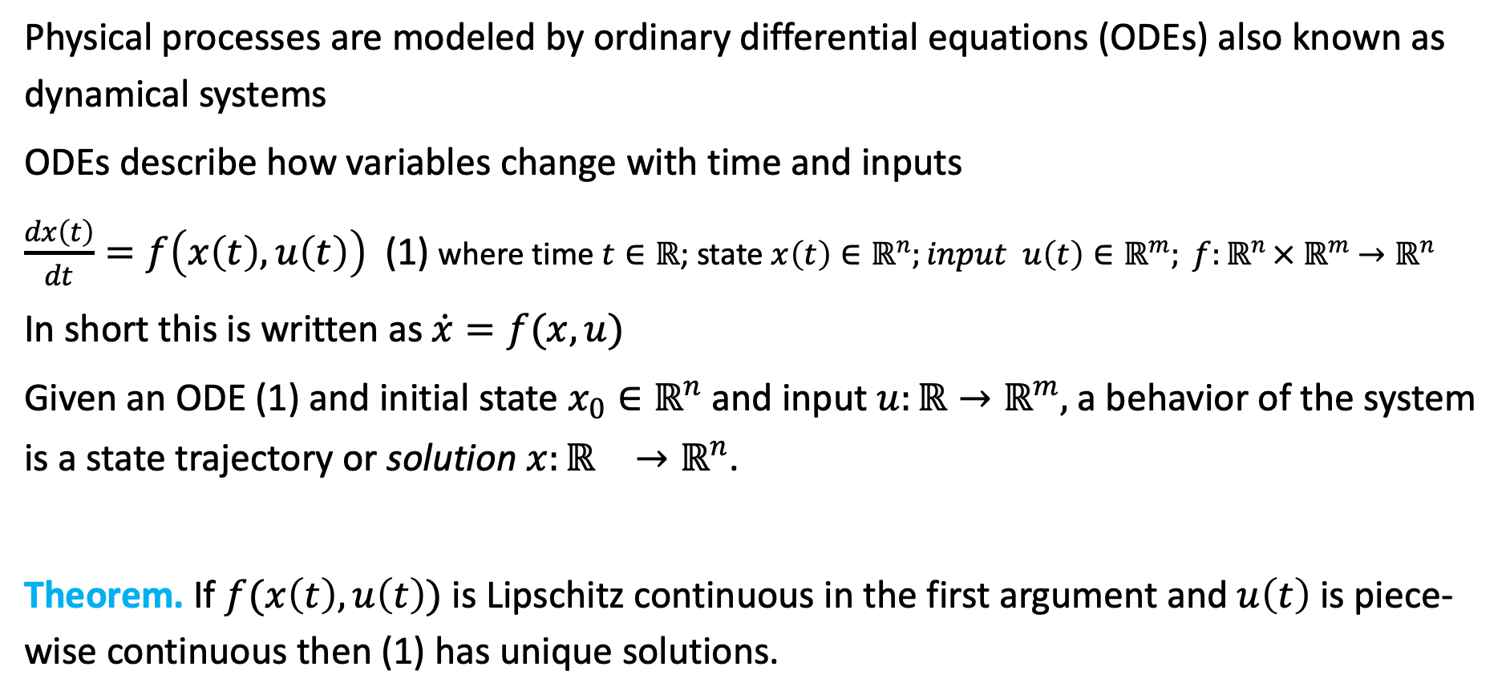
Review dynamical systems
Physical processes are modeled by ordinary differential equations (ODEs) also known as dynamical systems
ODEs describe how variables change with time and inputs
$\frac{dx\left(t\right)}{dt}=f\left(x\left(t\right),u\left(t\right)\right)$ (1) where time $t∈ℝ$; state $x\left(t\right)∈ℝ^{n};input u\left(t\right)∈ℝ^{m}; f:ℝ^{n }×{ ℝ}^{m} →ℝ^{n}$
In short this is written as $\dot{x}=f(x,u)$
Given an ODE (1) and initial state $x_{0}∈ℝ^{n}$and input $u:ℝ→ℝ^{m},$ a behavior of the system is a state trajectory or solution $x:{ℝ^{}→ℝ}^{n}$.
Theorem. If $f(x\left(t\right),u\left(t\right))$ is Lipschitz continuous in the first argument and $u\left(t\right)$is piece-wise continuous then (1) has unique solutions.

Slide 4
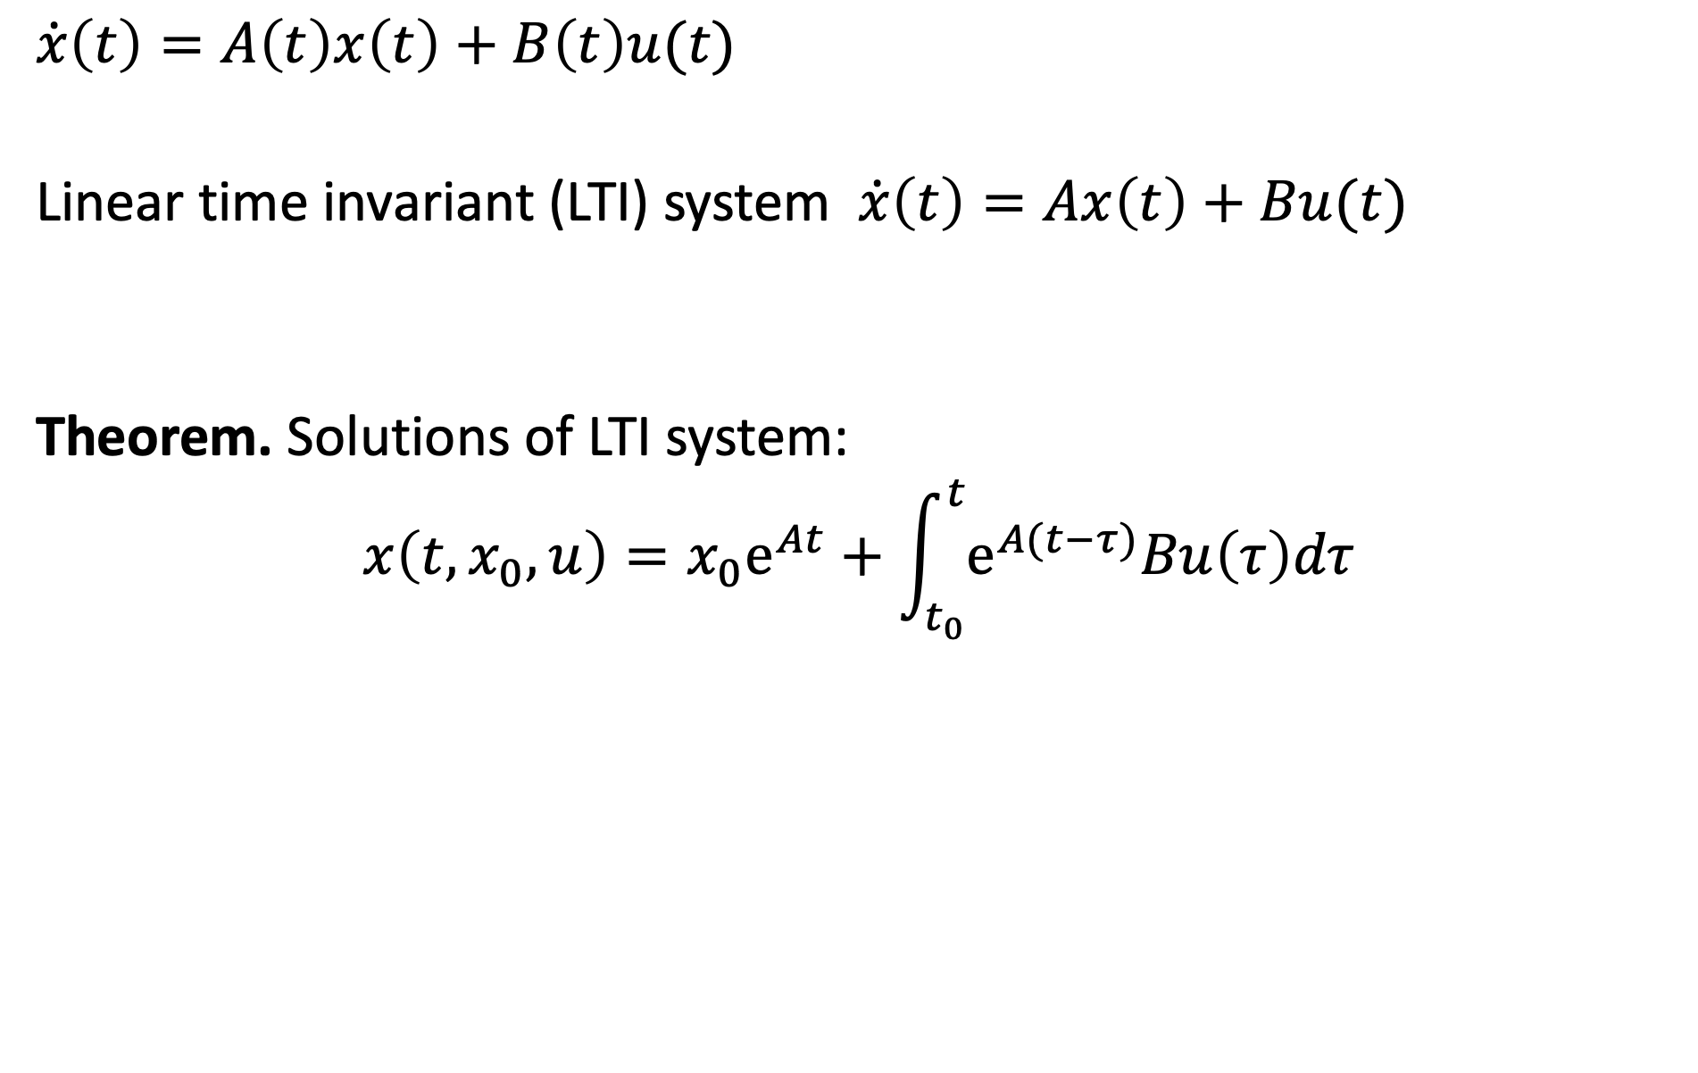
Review. Linear dynamical system
$$\dot{x}\left(t\right)=A\left(t\right)x\left(t\right)+B\left(t\right)u(t)$$
Linear time invariant (LTI) system $\dot{x}\left(t\right)=Ax\left(t\right)+Bu(t)$
Theorem. Solutions of LTI system:
$$x\left(t,x_{0},u\right)={x_{0}e}^{At}+\int_{t_{0}}^{t}{e^{A(t−τ)}Bu\left(τ\right)dτ}$$

Slide 5
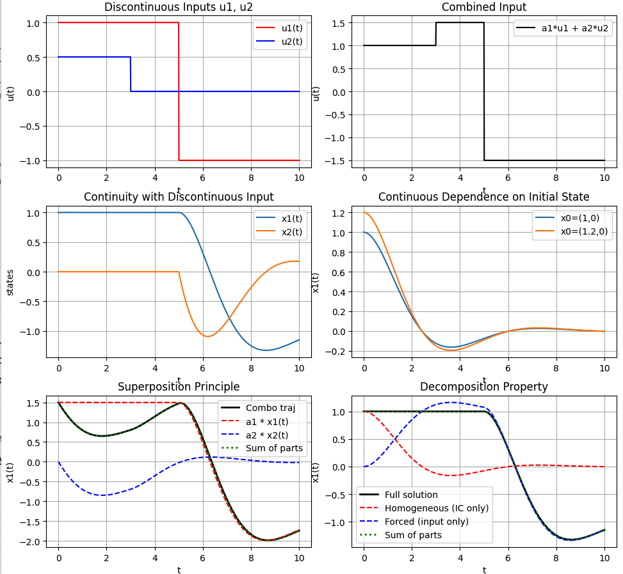
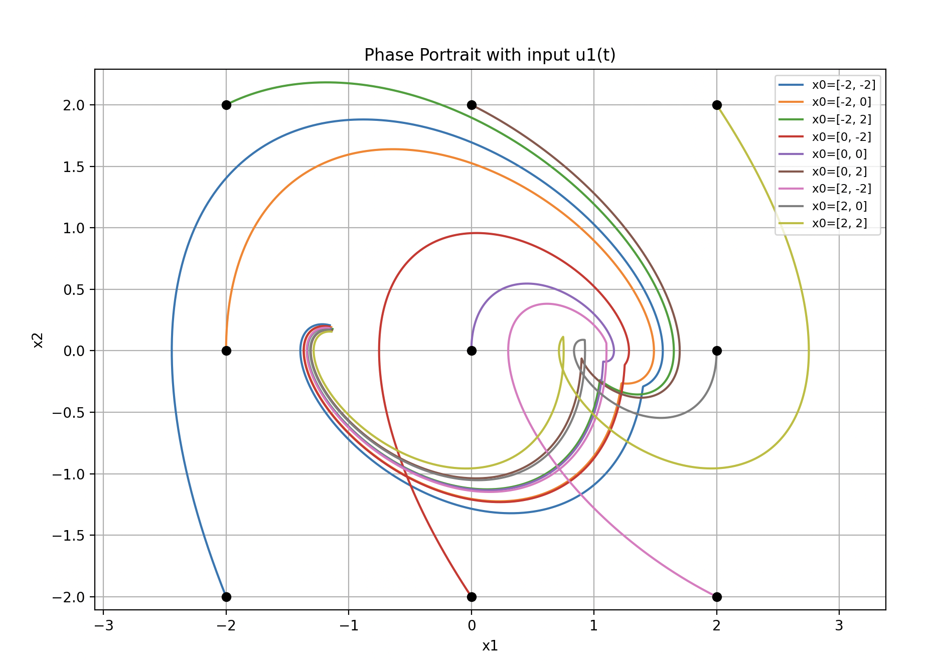

Properties of linear dynamical systems
$$\dot{x}\left(t\right)=A\left(t\right)x\left(t\right)+B\left(t\right)u\left(t\right)$$
$$A=\left[\begin{matrix}0 & 1 \\ −1 & −1\end{matrix}\right] B=\left[\begin{matrix}0 \\ 1\end{matrix}\right]$$

Slide 6
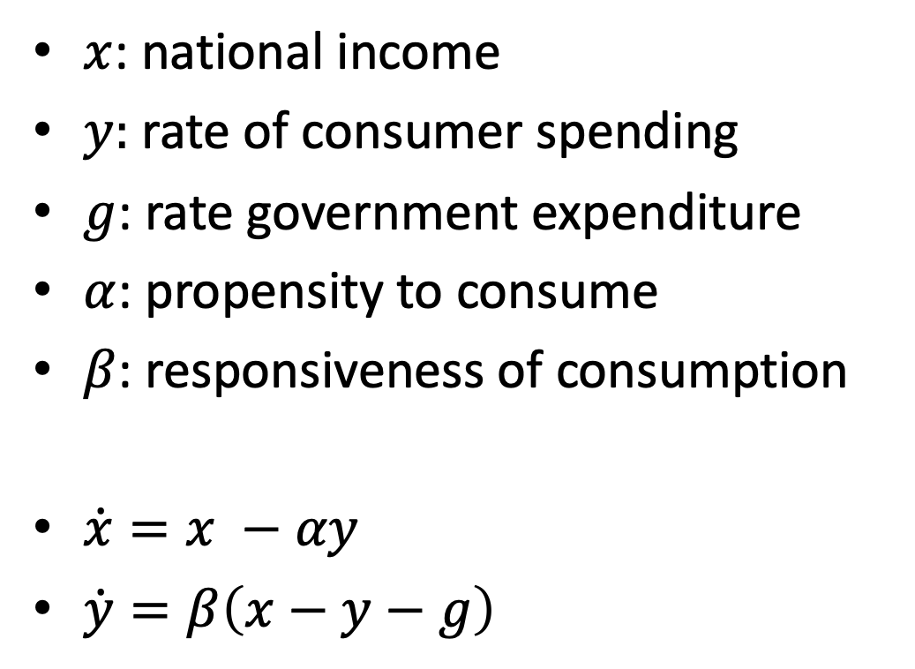
Example: Simple model of an economy
$x$: national income
$y:$ rate of consumer spending
$g$: rate government expenditure
$α$: propensity to consume
$β$: responsiveness of consumption
$\dot{x}=x −αy$
$\dot{y}=β\left(x−y−g\right)$

Slide 7
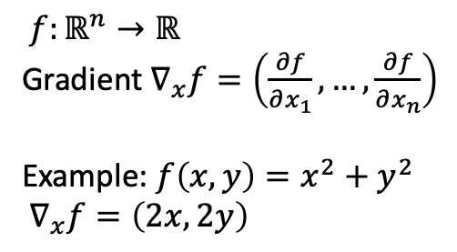
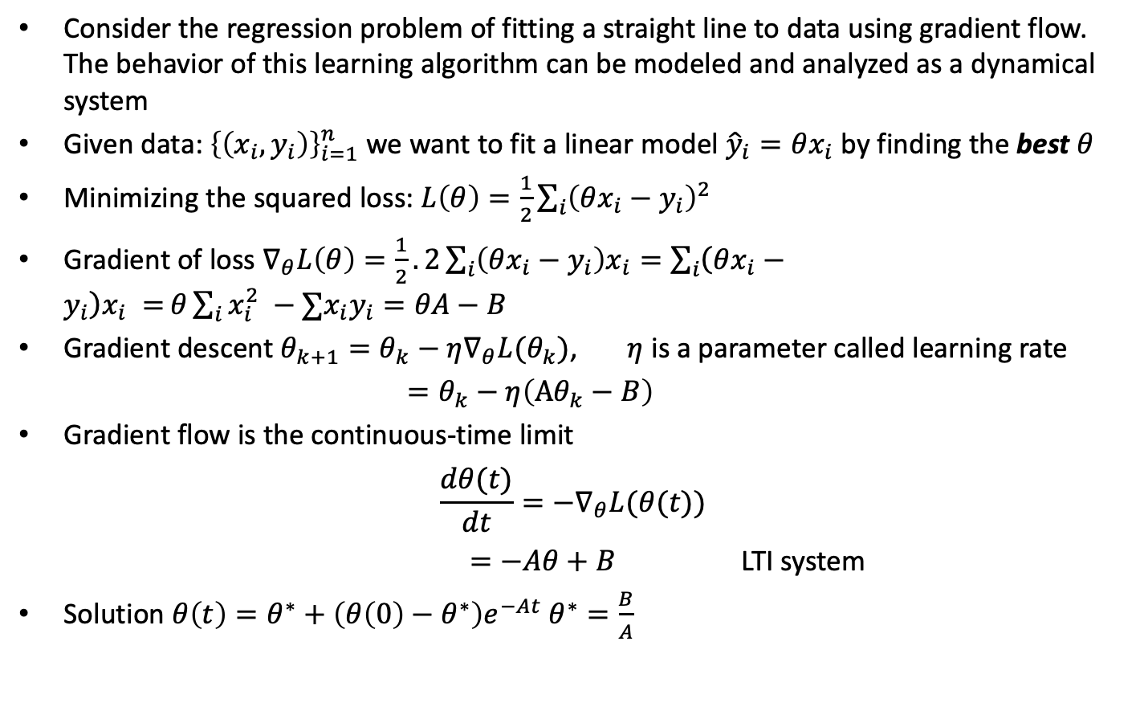
Example: Gradient flow
Consider the regression problem of fitting a straight line to data using gradient flow. The behavior of this learning algorithm can be modeled and analyzed as a dynamical system
Given data: ${\left\{\left(x_{i},y_{i}\right)\right\}}_{i=1}^{n}$ we want to fit a linear model ${\hat{y}}_{i}=θx_{i}$ by finding the best $θ$
Minimizing the squared loss: $L\left(θ\right)=\frac{1}{2}\sum_{i}{{\left(θx_{i}−y_{i}\right)}^{2} }$
Gradient of loss $∇_{θ}L\left(θ\right)=\frac{1}{2}.2\sum_{i}{\left(θx_{i}−y_{i}\right)x_{i}=\sum_{i}{\left(θx_{i}−y_{i}\right)x_{i} =}}θ\sum_{i}{x_{i}^{2} −∑x_{i}y_{i}}=θA−B$
Gradient descent $θ_{k+1}=θ_{k}−η∇_{θ}L(θ_{k})$, $η$ is a parameter called learning rate
$=θ_{k}−η\left(Aθ_{k}−B\right)$
Gradient flow is the continuous-time limit
$$\frac{dθ(t)}{dt}=−∇_{θ}L(θ(t))$$
$=−Aθ+B$ LTI system
Solution $θ\left(t\right)=θ^{∗}+\left(θ\left(0\right)−θ^{∗}\right)e^{−At} θ^{∗}=\frac{B}{A}$
$f:ℝ^{n}→ℝ$
Gradient $∇_{x}f=\left(\frac{∂f}{∂x_{1}},…,\frac{∂f}{∂x_{n}}\right)$
Example: $f\left(x,y\right)=x^{2}+y^{2}$
$∇_{x}f=\left(2x,2y\right)$

Slide 8
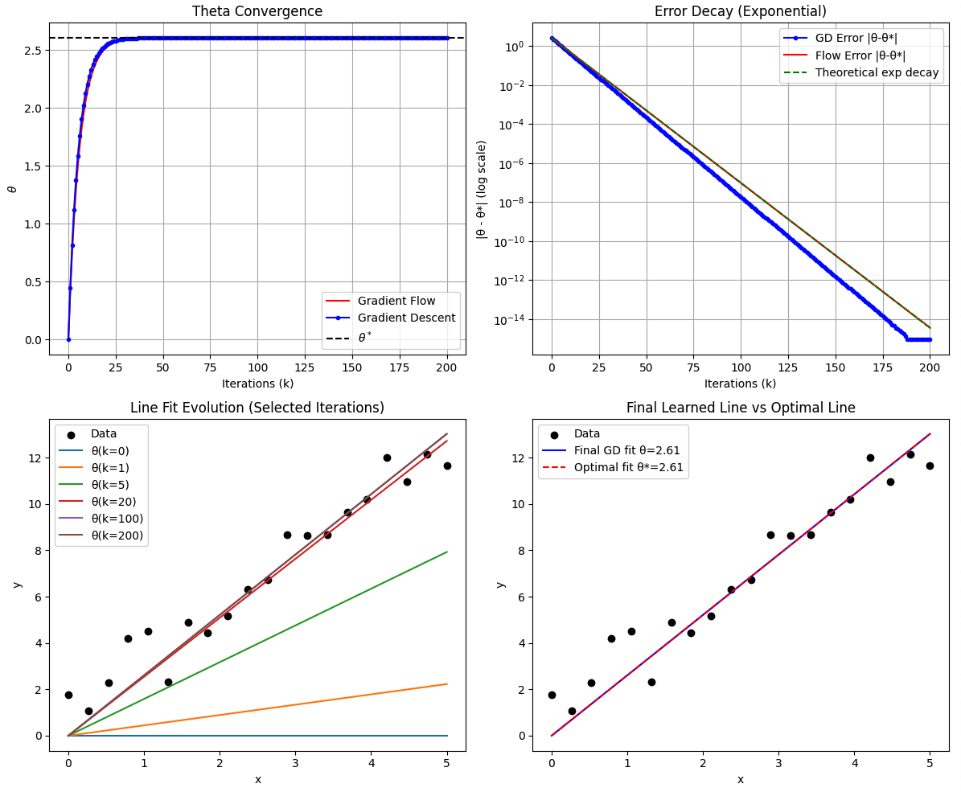
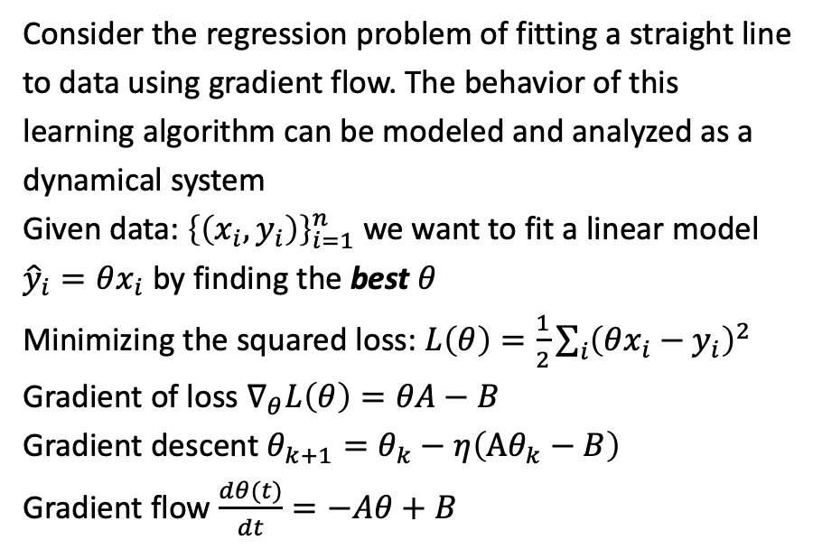
Gradient flow convergence to an optimal model
Consider the regression problem of fitting a straight line to data using gradient flow. The behavior of this learning algorithm can be modeled and analyzed as a dynamical system
Given data: ${\left\{\left(x_{i},y_{i}\right)\right\}}_{i=1}^{n}$ we want to fit a linear model ${\hat{y}}_{i}=θx_{i}$ by finding the best $θ$
Minimizing the squared loss: $L\left(θ\right)=\frac{1}{2}\sum_{i}{{\left(θx_{i}−y_{i}\right)}^{2} }$
Gradient of loss $∇_{θ}L\left(θ\right)=θA−B$
Gradient descent $θ_{k+1}=θ_{k}−η\left(Aθ_{k}−B\right)$
Gradient flow $\frac{dθ(t)}{dt}=−Aθ+B$

Slide 9
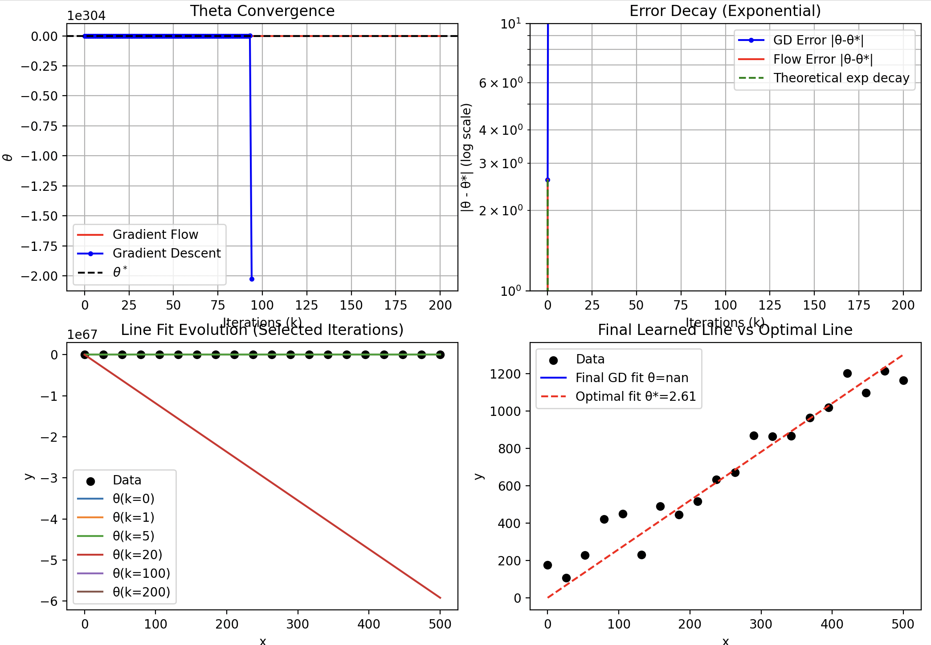
Grad flow converging but to an undesirable value

Slide 10
Requirements for dynamical systems
What type of properties are we interested in?
Invariance (as in the case of automata)
State remains bounded
State converges to target
Bounded input or disturbance gives bounded output (BIBO)

Slide 11
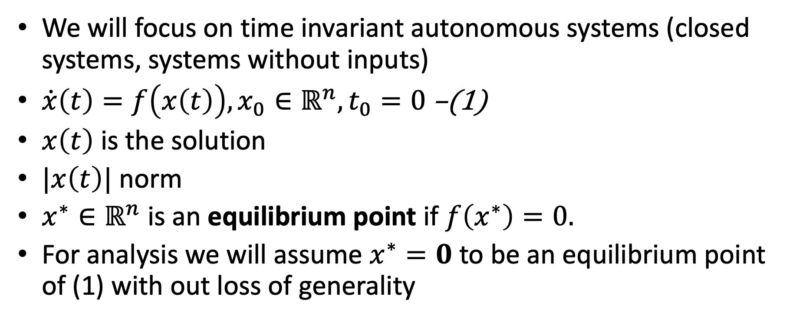
Requirements: Stability
We will focus on time invariant autonomous systems (closed systems, systems without inputs)
$\dot{x}\left(t\right)=f\left(x\left(t\right)\right), x_{0}∈ℝ^{n}, t_{0}=0$ –(1)
$x\left(t\right)$ is the solution
$|x\left(t\right)|$ norm
$x^{∗}∈ℝ^{n}$ is an equilibrium point if $f\left(x^{∗}\right)=0.$
For analysis we will assume $x^{∗}=0$ to be an equilibrium point of (1) with out loss of generality

Slide 12
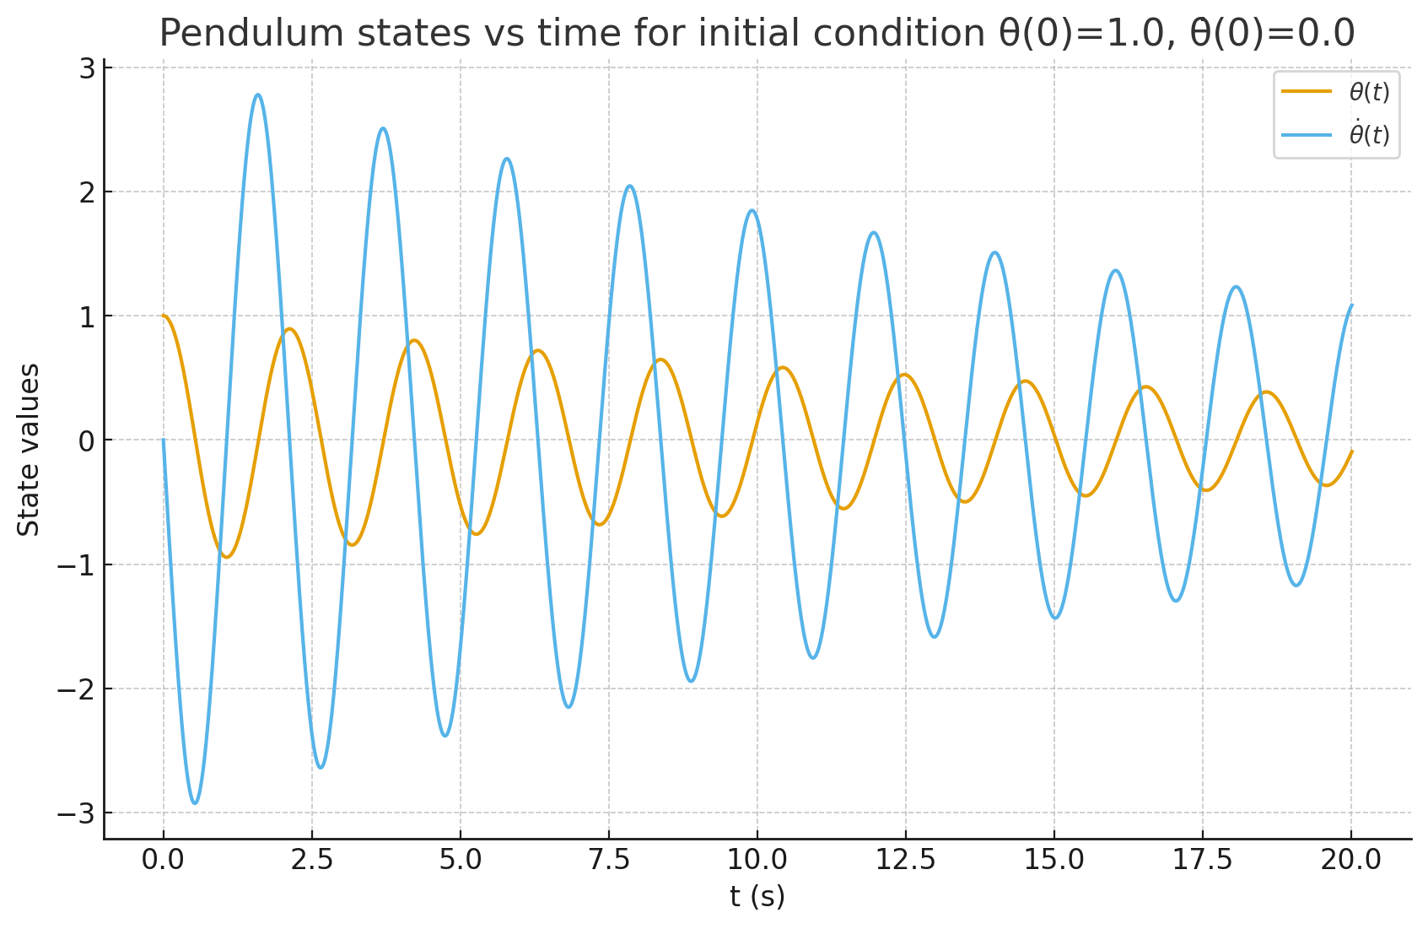

Example: Pendulum
Pendulum equation
$$x_{1}=θ x_{2}=\dot{θ}$$
$$x_{2}={\dot{x}}_{1}$$
$${\dot{x}}_{2}=−\frac{g}{l}\sin\left(x_{1}\right)−\frac{k}{m}x_{2}$$
$\left[\begin{matrix}\dot{x_{2}} \\ \dot{x_{1}}\end{matrix}\right]$= $\left[\begin{matrix}−\frac{g}{l}\sin\left(x_{1}\right)−\frac{k}{m}x_{2} \\ x_{2}\end{matrix}\right]$
$k:$ friction coefficient
Two equilibrium points: $\left(0,0\right), (π,0)$
upright
down

Slide 13
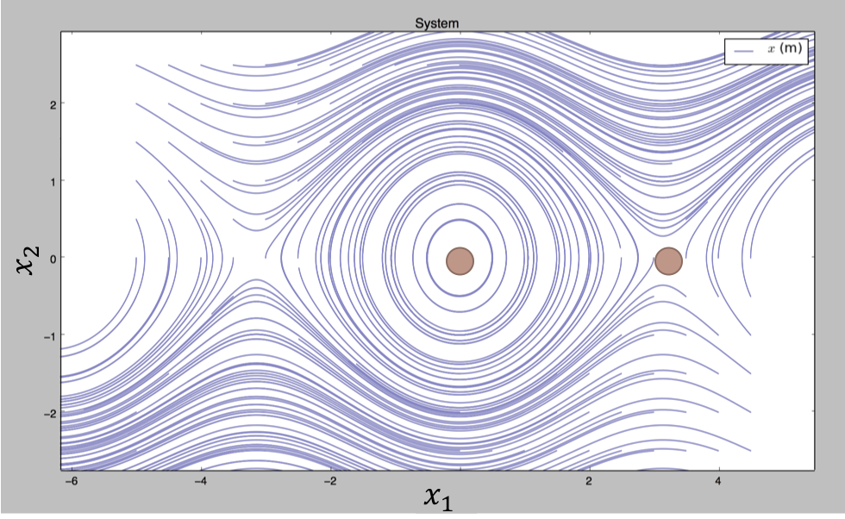
CW
stable
speed=0
unstable
upright
down
CCW
Notes:
left to right angle of the pendulum: line : hanging right at the bottom
up : higher speed CW, down higher speed CCW, on this line speed 0
Now as its hanging at the bottom I give the pen a slight tap.. give it some speed… and plot all the angles and the corresponding speeds… what would this look like?

Slide 14
Aleksandr M. Lyapunov
Aleksandr Mikhailovich Lyapunov (June 6 1857–November 3, 1918), Russian mathematician and physicist.

Slide 15

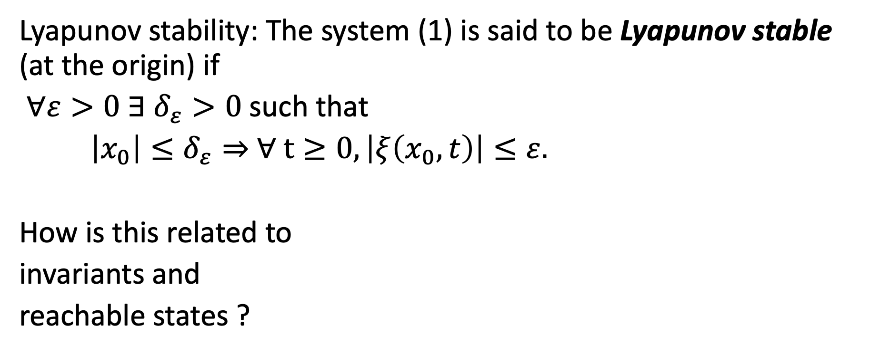


Lyapunov stability
Lyapunov stability: The system (1) is said to be Lyapunov stable (at the origin) if
$∀ε>0 ∃$ $δ_{ε}>0$such that
$\left|x_{0}\right|≤δ_{ε}⇒$ $∀ t≥0, \left|ξ\left(x_{0},t\right)\right|≤ε.$
How is this related to
invariants and
reachable states ?
$$δ_{ε}$$
$$ε$$
$$x_{0}$$

Slide 16

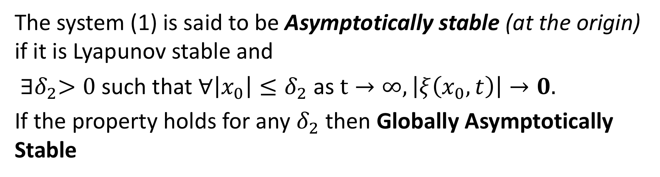

Asymptotically stability
The system (1) is said to be Asymptotically stable (at the origin) if it is Lyapunov stable and
${∃δ}_{2}>0$such that $∀\left|x_{0}\right|≤δ_{2}$ as $t→∞, \left|ξ\left(x_{0},t\right)\right|→0.$
If the property holds for any $δ_{2}$ then Globally Asymptotically Stable
$$δ_{2}$$
$$x_{0}$$

Slide 17
Phase portrait of pendulum with friction

Slide 18
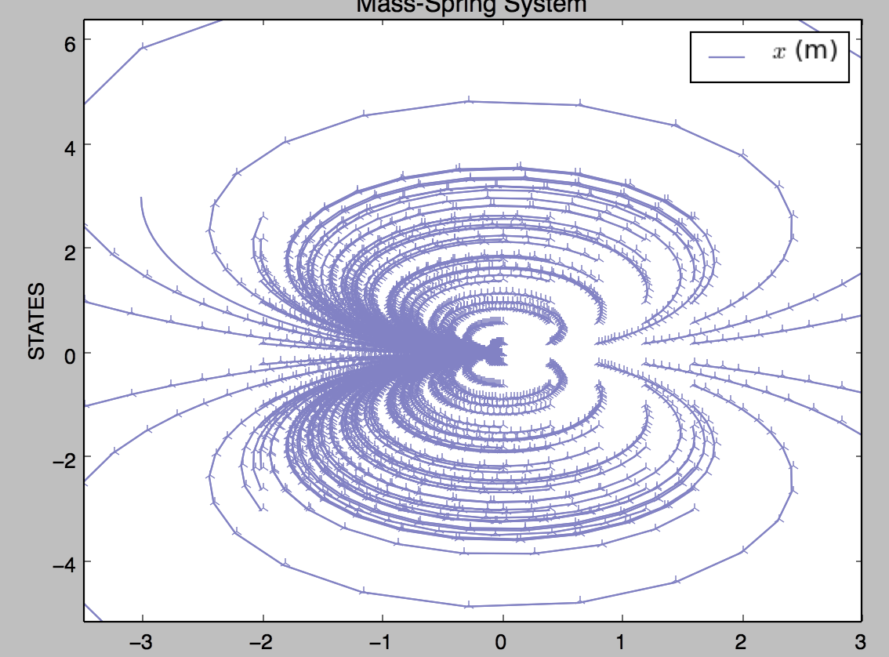
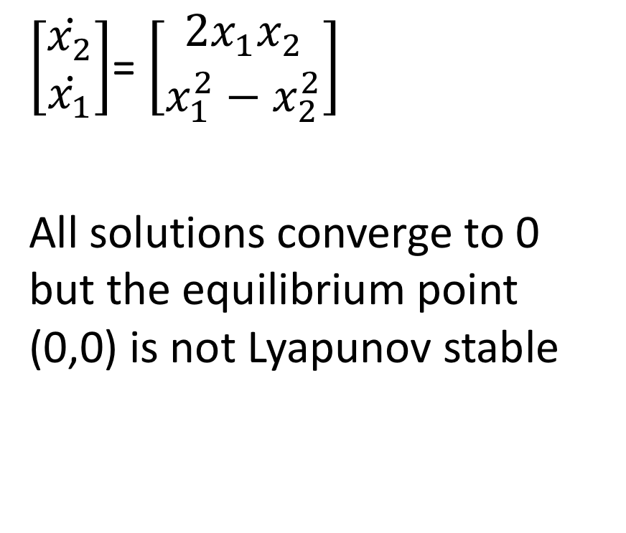
Butterfly*
$\left[\begin{matrix}\dot{x_{2}} \\ \dot{x_{1}}\end{matrix}\right]$= $\left[\begin{matrix}2x_{1}x_{2} \\ x_{1}^{2}−x_{2}^{2}\end{matrix}\right]$
All solutions converge to 0 but the equilibrium point (0,0) is not Lyapunov stable
*Not discussed in class

Slide 19
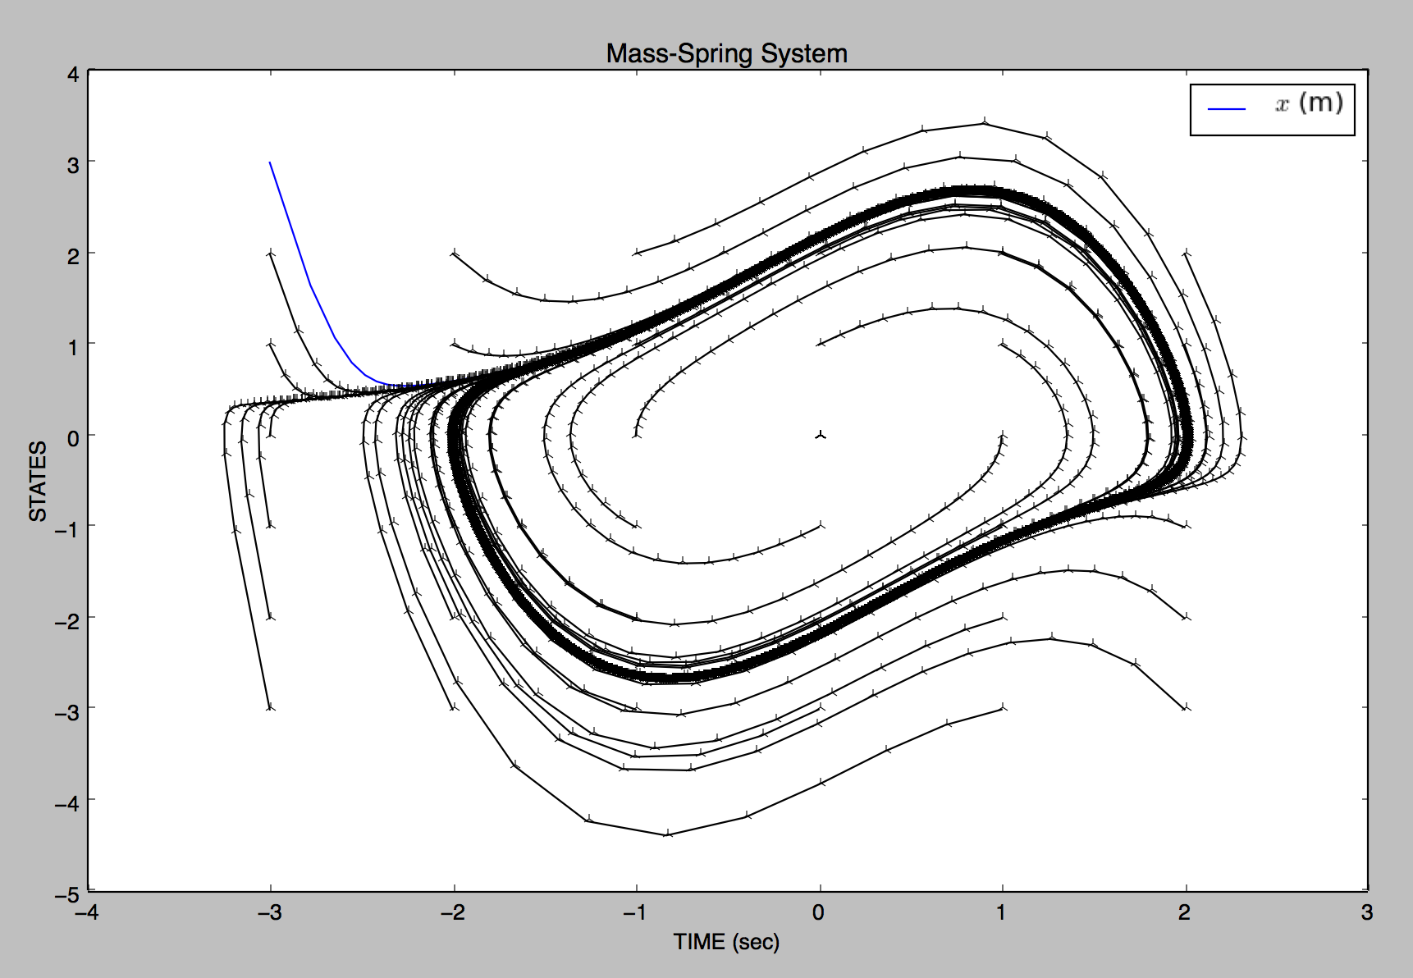
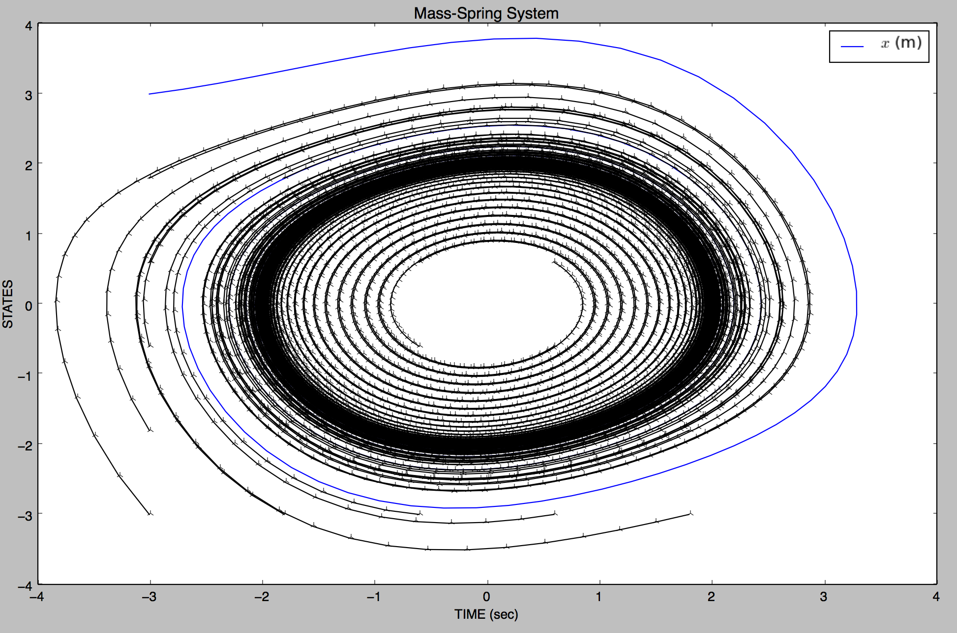
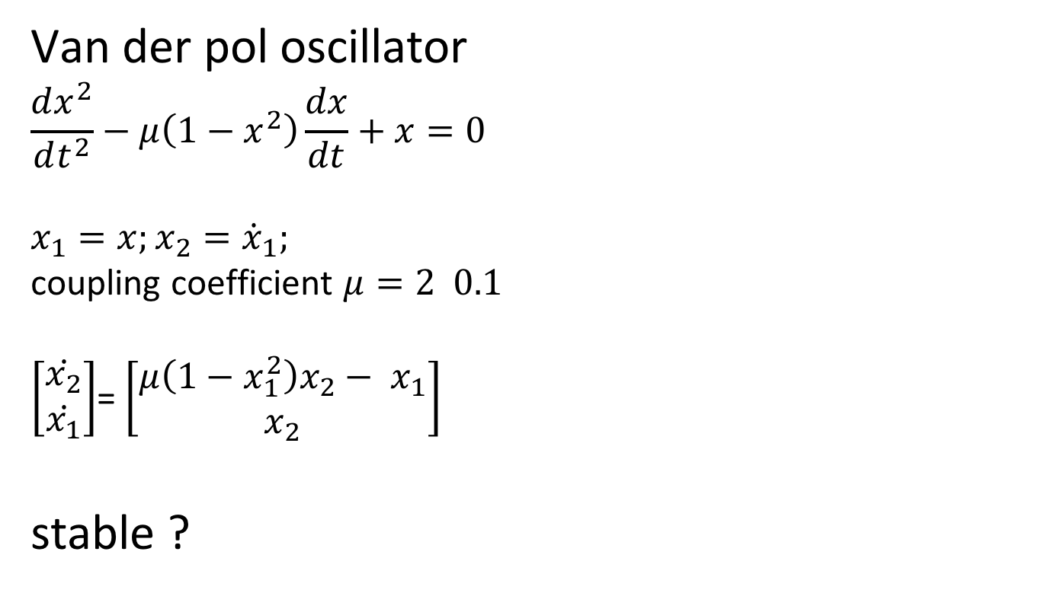
Van der pol oscillator
Van der pol oscillator
$$\frac{dx^{2}}{dt^{2}}−μ\left(1−x^{2}\right)\frac{dx}{dt}+x=0$$
$$x_{1}=x;x_{2}={\dot{x}}_{1};$$
coupling coefficient $μ=2 0.1$
$\left[\begin{matrix}\dot{x_{2}} \\ \dot{x_{1}}\end{matrix}\right]$= $\left[\begin{matrix}μ\left(1−x_{1}^{2}\right)x_{2}− x_{1} \\ x_{2}\end{matrix}\right]$
stable ?

Slide 20
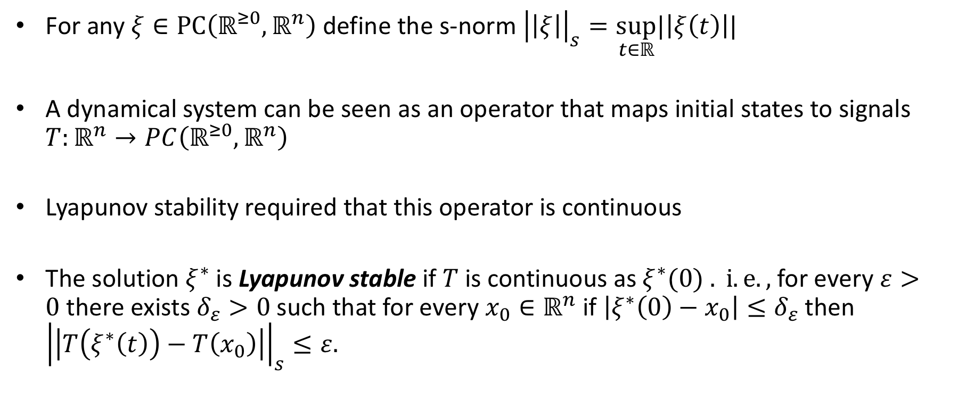
Stability of solutions* (instead of points)
For any $ξ∈PC\left(ℝ^{≥0},ℝ^{n}\right)$ define the s-norm ${\left|\left|ξ\right|\right|}_{s}=\sup_{t∈ℝ}|\left|ξ\left(t\right)\right||$
A dynamical system can be seen as an operator that maps initial states to signals $T:ℝ^{n}→PC\left(ℝ^{≥0},ℝ^{n}\right)$
Lyapunov stability required that this operator is continuous
The solution $ξ^{∗}$ is Lyapunov stable if $T$ is continuous as $ξ^{∗}(0) . i.e.,$for every $ε>0$there exists $δ_{ε}>0$such that for every $x_{0}∈ℝ^{n}$ if $\left|ξ^{∗}\left(0\right)−x_{0}\right|≤δ_{ε}$ then ${\left|\left|T\left(ξ^{∗}\left(t\right)\right)−T\left(x_{0}\right)\right|\right|}_{s}≤ε.$
*Not discussed in class

Slide 21
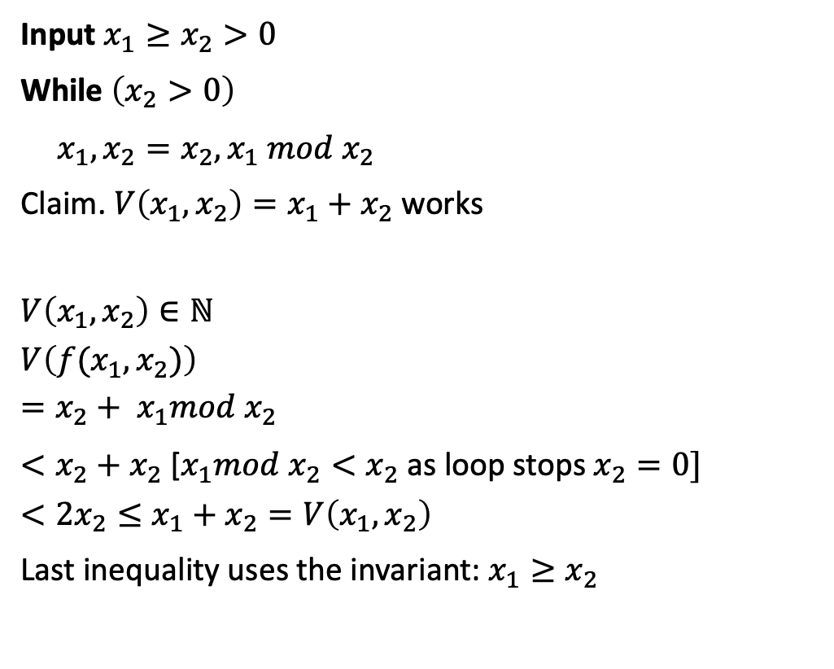
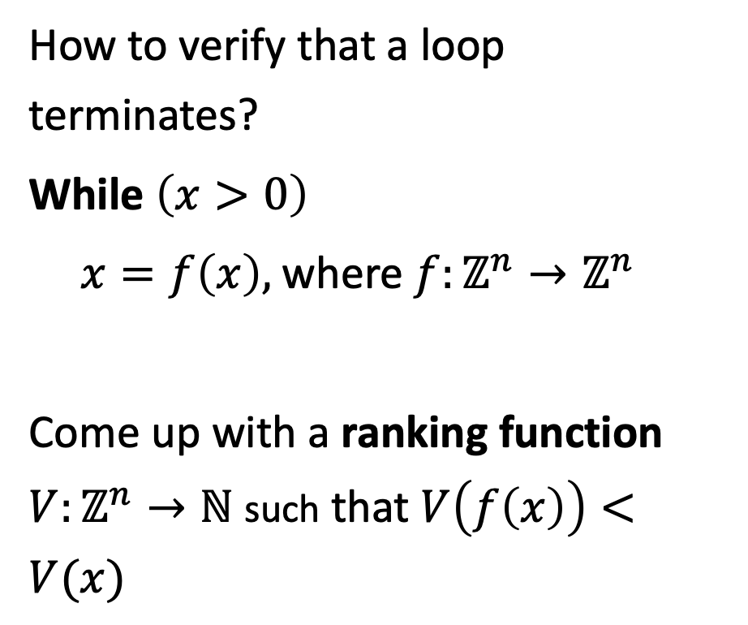
Verifying Termination
How to verify that a loop terminates?
While $\left(x>0\right)$
$x=f\left(x\right),$where $f:ℤ^{n}→ℤ^{n}$
Come up with a ranking function $V:ℤ^{n}→ℕ$ such that $V\left(f\left(x\right)\right)<V(x)$
Input $x_{1}≥x_{2}>0$
While $\left(x_{2}>0\right)$
$x_{1},x_{2}=x_{2},x_{1} mod x_{2}$
Claim. $V\left(x_{1},x_{2}\right)=x_{1}+x_{2}$ works
$$V\left(x_{1},x_{2}\right)∈ℕ$$
$$V\left(f(x_{1},x_{2})\right)$$
$$=x_{2}+ x_{1}mod x_{2}$$
$<x_{2}+x_{2}$ [$x_{1}mod x_{2}<x_{2}$ as loop stops $x_{2}=0]$
$$<{2x}_{2}≤x_{1}+x_{2}=V\left(x_{1},x_{2}\right)$$
Last inequality uses the invariant: $x_{1}≥x_{2}$

Slide 22
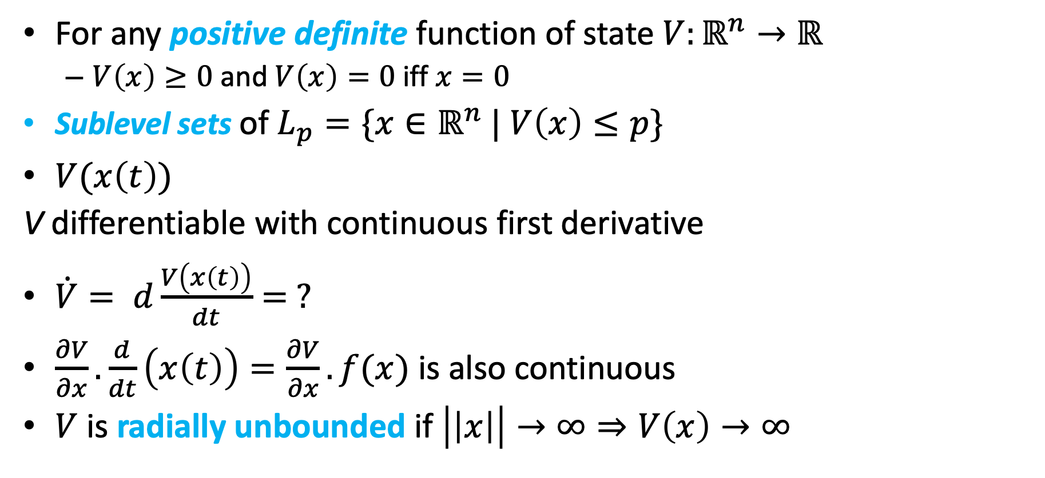

Stability of nonlinear systems
For any positive definite function of state $V:ℝ^{n}→ℝ$
$V\left(x\right)≥0$ and $V\left(x\right)=0$iff $x=0$
Sublevel sets of $L_{p}=\{x∈ℝ^{n}$ | $V\left(x\right)≤p\}$
$V(x\left(t\right))$
V differentiable with continuous first derivative
$\dot{V}= d\frac{V\left(x\left(t\right)\right)}{dt}= ?$
$\frac{∂V}{∂x}.\frac{d}{dt}\left(x\left(t\right)\right)=\frac{∂V}{∂x}.f(x)$ is also continuous
$V$ is radially unbounded if $\left|\left|x\right|\right|→∞⇒V\left(x\right)→∞$

Slide 23
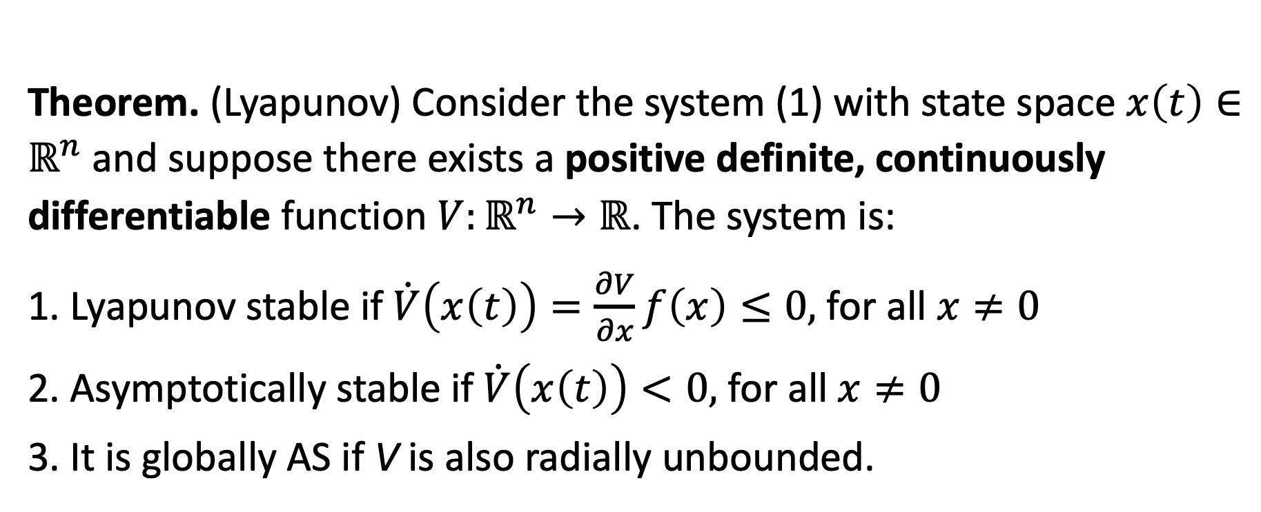

Verifying Stability
Theorem. (Lyapunov) Consider the system (1) with state space $x\left(t\right)∈ℝ^{n}$ and suppose there exists a positive definite, continuously differentiable function $V:ℝ^{n}→ℝ$. The system is:
1. Lyapunov stable if $\dot{V}\left(x\left(t\right)\right)=\frac{∂V}{∂x}f\left(x\right)≤0,$ for all $x≠0$
2. Asymptotically stable if $\dot{V}\left(x\left(t\right)\right)<0,$ for all $x≠0$
3. It is globally AS if V is also radially unbounded.

Slide 24
Small puzzle
Platonic solids. Solid bodies whose faces are regular polygons, all identical, that meet in identical fashion at every vertex. How many such are there? Exactly five!
Platonic solids.
Wilczek, Frank. A Beautiful Question: Finding Nature's Deep Design (p. 39).

