Slide 1
Abstractions
Sayan Mitra
Verifying cyberphysical systems
mitras@illinois.edu

Slide 2
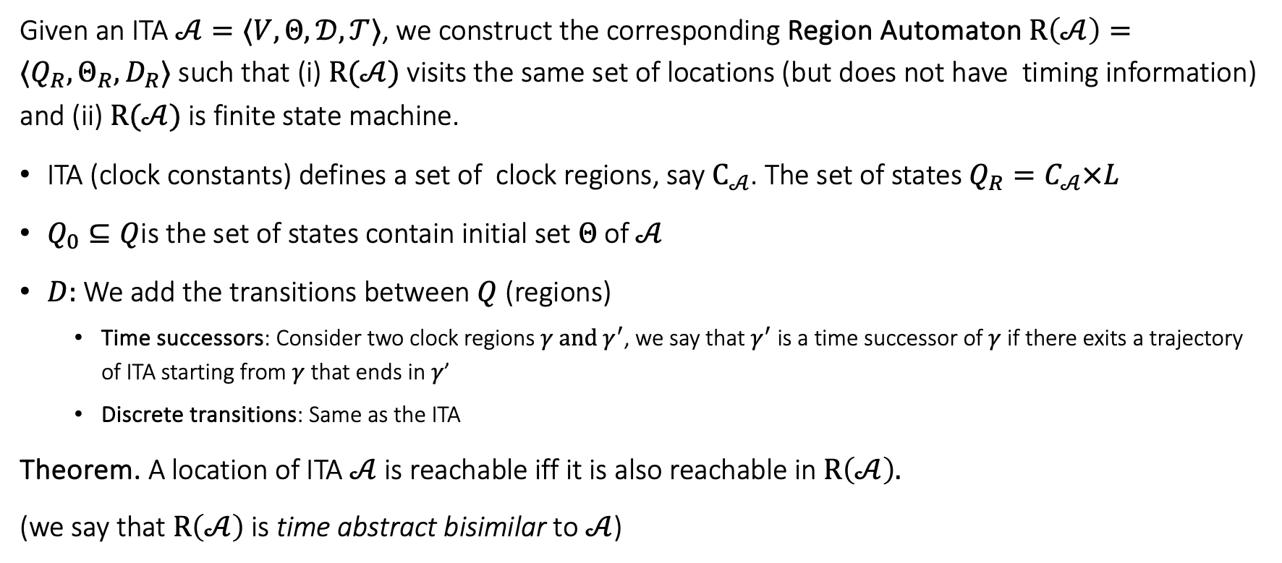

Review. Region automaton $R(𝒜)$
Given an ITA $𝒜=〈V, Θ, 𝒟, 𝒯〉$, we construct the corresponding Region Automaton $R\left(𝒜\right)=⟨Q_{R},Θ_{R},D_{R}⟩$ such that (i) $R(𝒜)$ visits the same set of locations (but does not have timing information) and (ii) $R(𝒜)$ is finite state machine.
ITA (clock constants) defines a set of clock regions, say $C_{𝒜}$. The set of states $Q_{R}=C_{𝒜}×L$
$Q_{0}⊆Q$is the set of states contain initial set $Θ$of $𝒜$
$D:$We add the transitions between $Q$ (regions)
Time successors: Consider two clock regions $γ and γ^{′}$, we say that $γ^{′}$ is a time successor of $γ$ if there exits a trajectory of ITA starting from $γ$ that ends in $γ$’
Discrete transitions: Same as the ITA
Theorem. A location of ITA $𝒜$is reachable iff it is also reachable in $R\left(𝒜\right).$
(we say that $R\left(𝒜\right)$ is time abstract bisimilar to $𝒜$)

Slide 3
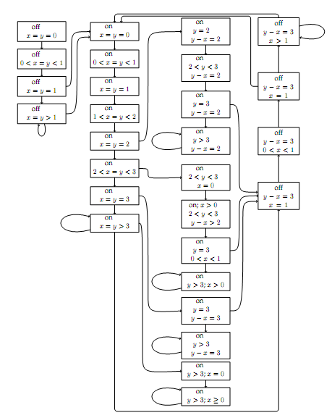
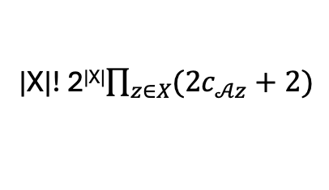
Corresponding FA
|X|! 2^{|X|}$\prod_{z∈X}{(2c_{𝒜z}+2)}$
Drastically increasing with the number of clocks

Slide 4
Later we will study how far the idea of abstractions can help analyze a hierarchy of Hybrid Automata
Nonlinear Hybrid
Automata
Rectangular Initialized Hybrid Automata
Rectangular Hybrid Automata
Multirate Automata
Rational Timed Automata
Integral Timed Automata

Slide 5
Outline
Abstractions
Simulation relations
Composition and substitutivity

Slide 6
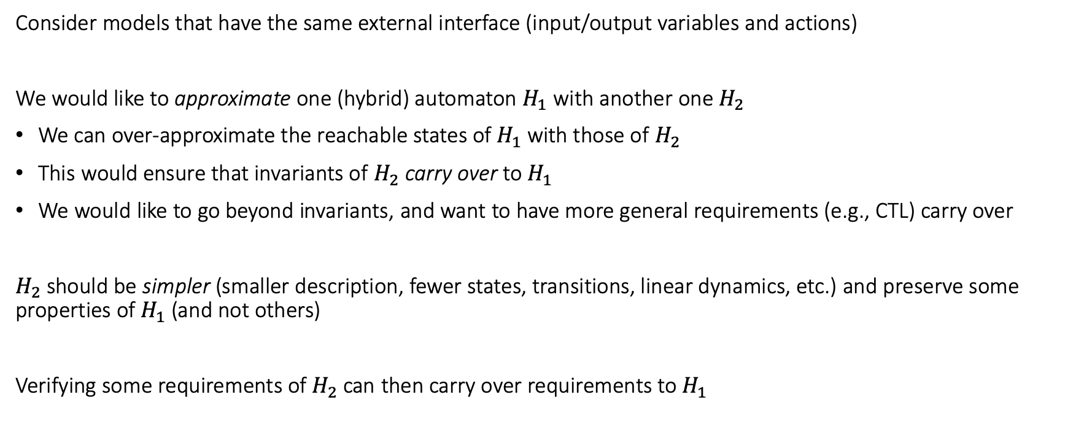
Abstractions and Simulations
Consider models that have the same external interface (input/output variables and actions)
We would like to approximate one (hybrid) automaton $H_{1}$ with another one $H_{2}$
We can over-approximate the reachable states of $H_{1}$ with those of $H_{2}$
This would ensure that invariants of $H_{2}$ carry over to $H_{1}$
We would like to go beyond invariants, and want to have more general requirements (e.g., CTL) carry over
$H_{2}$ should be simpler (smaller description, fewer states, transitions, linear dynamics, etc.) and preserve some properties of $H_{1}$ (and not others)
Verifying some requirements of $H_{2}$ can then carry over requirements to $H_{1}$

Slide 7
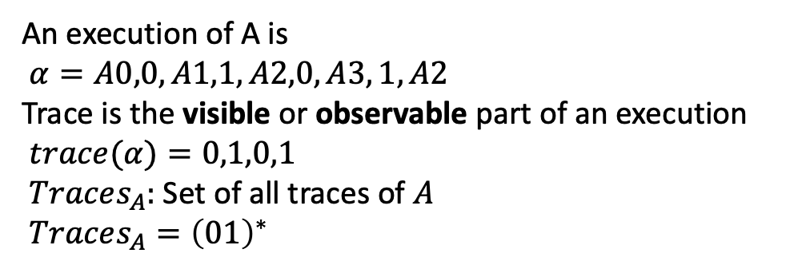
Finite state examples
An execution of A is
$α=A0,0,A1,1,A2,0,A3, 1, A2$
Trace is the visible or observable part of an execution
$trace(α)=0,1,0,1$
$Traces_{A}:$ Set of all traces of $A$
$Traces_{A}={\left(01\right)}^{∗}$
0
1
0
A0
A1
A2
A3
A
1
0
1
0
B02
B13
B
Traces_{B}= 01*
1
C03
Traces_{C}= {0,1}*
C
0,1

Slide 8
Finite state examples
0
1
0
A0
A1
A2
A3
A
1
0
1
0
B simulates A and vice versa.
A and B are bisimilar.
B02
B13
B
1
C simulates both A and B.
C is an abstraction of both A and B.
C03
C
0,1

Slide 9
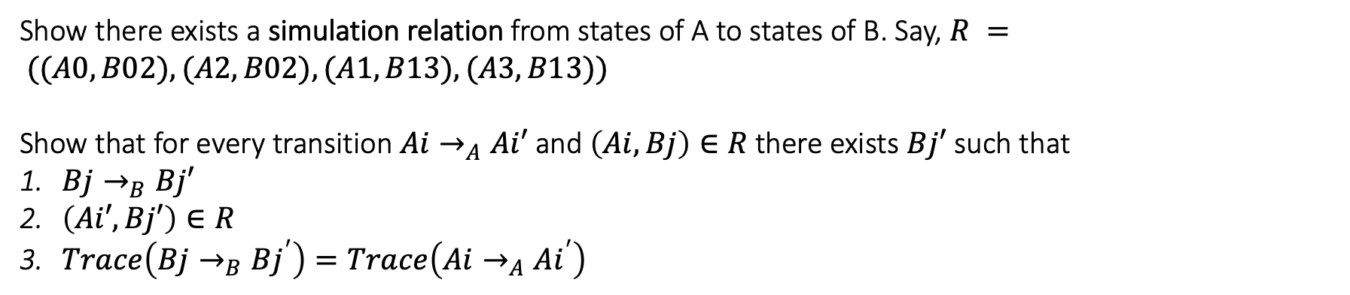
How to prove B simulates A?
0
1
0
A0
A1
A2
A3
A
1
0
1
0
B
B02
B13
1
Show there exists a simulation relation from states of A to states of B. Say, $R = ((A0,B02), (A2,B02), (A1, B13), (A3, B13))$
Show that for every transition $Ai→_{A}Ai′$ and $\left(Ai,Bj\right)∈R$ there exists $Bj′$ such that
$Bj→_{B}Bj′$
$\left(Ai′,Bj′\right)∈R$
$Trace\left(Bj→_{B}Bj^{′}\right)=Trace\left(Ai→_{A}Ai^{′}\right)$

Slide 10
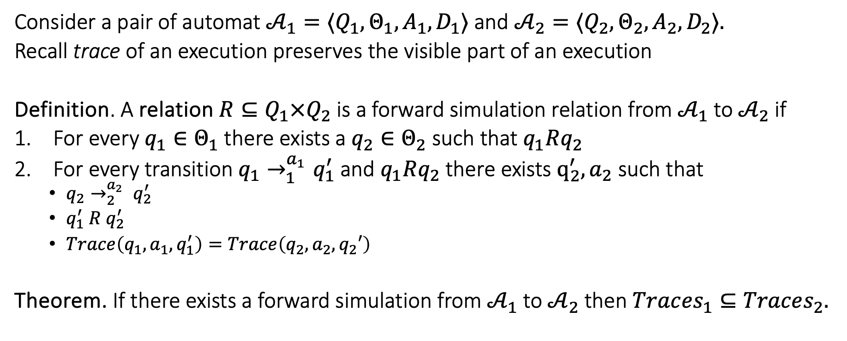
Forward simulation relation
Consider a pair of automat ${𝒜_{1}=⟨Q}_{1}, Θ_{1},A_{1},D_{1}⟩$and ${𝒜_{2}=⟨Q}_{2}, Θ_{2},A_{2},D_{2}⟩.$
Recall trace of an execution preserves the visible part of an execution
Definition. A relation $R⊆Q_{1}×Q_{2}$ is a forward simulation relation from $𝒜_{1}$to $𝒜_{2}$if
For every $q_{1}∈Θ_{1}$there exists a $q_{2}∈Θ_{2}$ such that $q_{1}Rq_{2}$
For every transition $q_{1}→_{1}^{a_{1}}q_{1}^{′}$ and $q_{1}Rq_{2}$ there exists $q_{2}^{′},a_{2}$ such that
$q_{2}→_{2}^{a_{2}} q_{2}^{′}$
$q_{1}^{′} R q_{2}^{′}$
$Trace\left(q_{1},a_{1},q_{1}^{′}\right)=Trace\left(q_{2},a_{2},q_{2}′\right)$
Theorem. If there exists a forward simulation from $𝒜_{1}$ to $𝒜_{2}$ then $Trac{es}_{1}⊆Traces_{2}.$

Slide 11
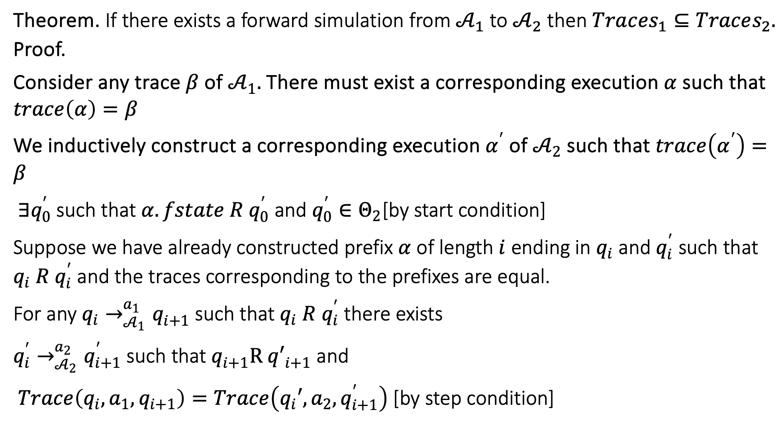
Theorem. If there exists a forward simulation from $𝒜_{1}$ to $𝒜_{2}$ then $Trac{es}_{1}⊆Traces_{2}.$
Proof.
Consider any trace $β$ of $𝒜_{1}.$There must exist a corresponding execution $α$ such that $trace\left(α\right)=β$
We inductively construct a corresponding execution $α^{′}$of $𝒜_{2}$ such that $trace\left(α^{′}\right)=β$
$∃q_{0}^{′}$ such that $α.fstate R q_{0}^{′}$ and $q_{0}^{′}∈Θ_{2}$[by start condition]
Suppose we have already constructed prefix $α$of length $i$ ending in $q_{i}$ and $q_{i}^{′}$ such that $q_{i} R q_{i}^{′}$ and the traces corresponding to the prefixes are equal.
For any $q_{i}→_{𝒜_{1}}^{a_{1}}q_{i+1}^{}$such that $q_{i} R q_{i}^{′}$ there exists
$q_{i}^{′}→_{𝒜_{2}}^{a_{2}}q_{i+1}^{′}$ such that $q_{i+1}^{}R {q′}_{i+1}^{}$ and
$Trace\left(q_{i},a_{1},q_{i+1}\right)=Trace\left(q_{i}′,a_{2},q_{i+1}^{′}\right)$ [by step condition]

Slide 12
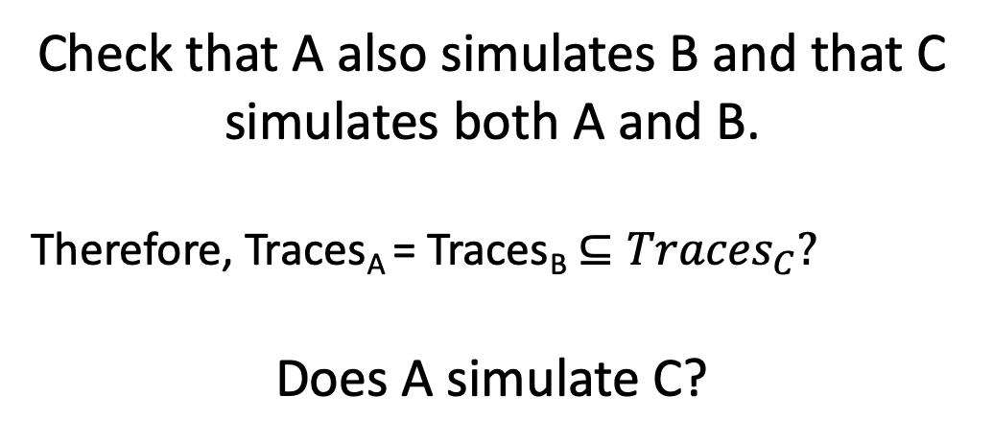
Finite state examples
0
1
0
A0
A1
A2
A3
A
1
0
1
0
Check that A also simulates B and that C simulates both A and B.
Therefore, Traces_{A} = Traces_{B} $⊆Traces_{C}?$
Does A simulate C?
B02
B13
B
1
0
C03
1
C

Slide 13
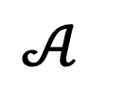
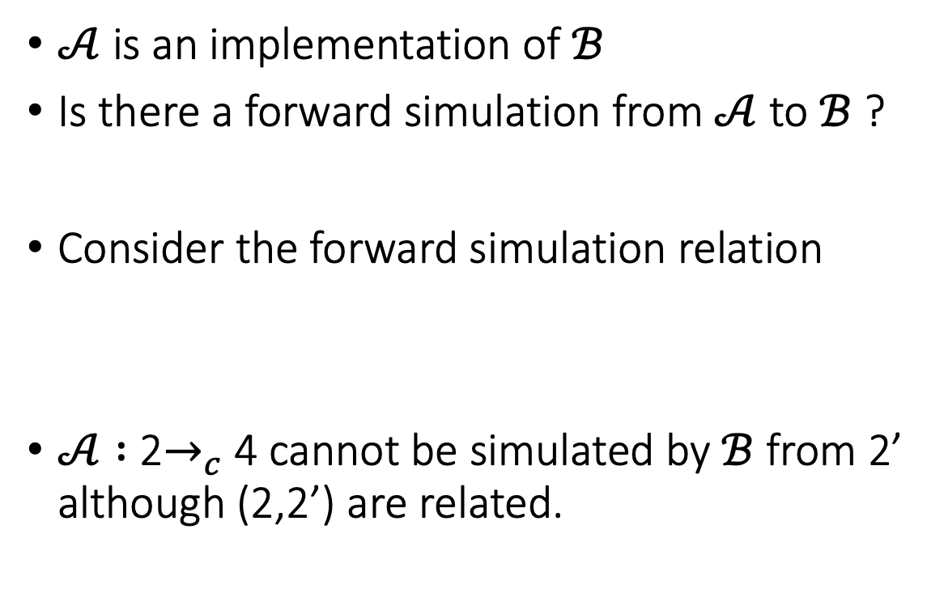


A Simulation Example
$$ℬ$$
$𝒜$ is an implementation of $ℬ$
Is there a forward simulation from $𝒜$ to $ℬ$ ?
Consider the forward simulation relation
$𝒜 :$ 2$→_{c}$4 cannot be simulated by $ℬ$ from 2’ although (2,2’) are related.
a
3
2’
b
1
a
c
2
4
$$𝒜$$
3
b
a
1
2
c
4

Slide 14
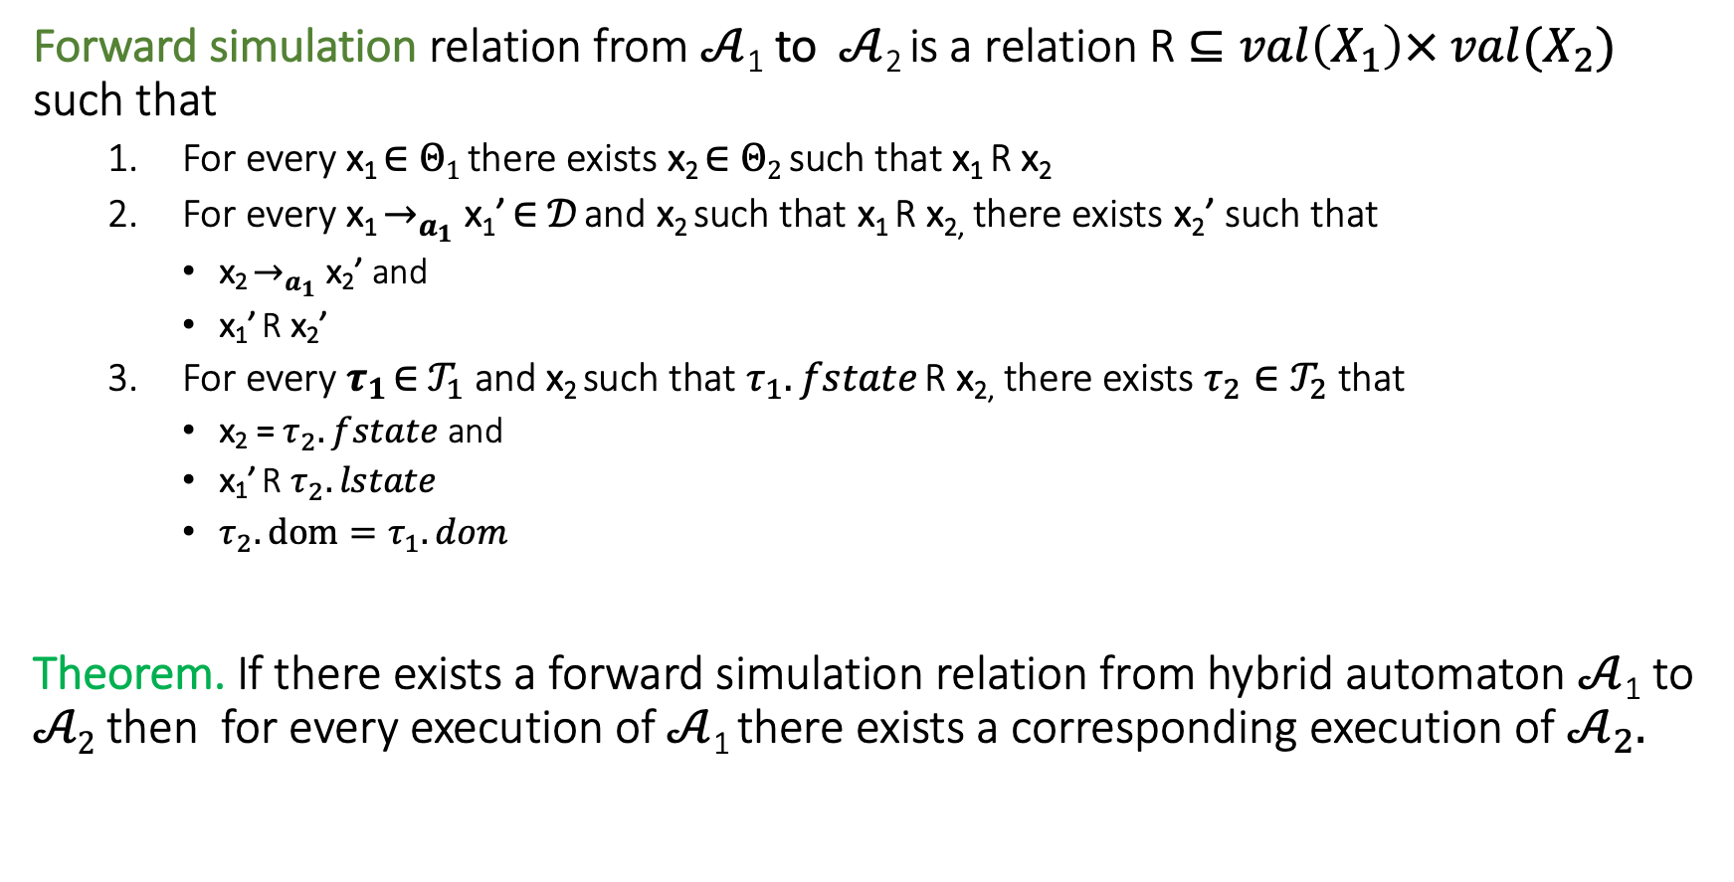
Simulations for hybrid systems
Forward simulation relation from $𝒜$₁ to $𝒜$₂ is a relation R $⊆val\left(X_{1}\right)× {val(X_{2})}_{}$ such that
For every x₁ ∈ $Θ1$ there exists x₂ ∈ $Θ2$ such that x₁ R x₂
For every x₁ $→_{a_{1}}$ x₁’ ∈ $𝒟$ and x₂ such that x₁ R x_{2,} there exists x₂’ such that
x₂ $→_{a_{1}}$ x₂’ and
x₁’ R x₂’
For every $τ_{1}$ ∈ $𝒯_{1}$ and x₂ such that $τ_{1}.fstate$ R x_{2,} there exists $τ_{2}∈𝒯_{2}$ that
x₂ = $τ_{2}.fstate$ and
x₁’ R $τ_{2}.lstate$
$τ_{2}.dom=τ_{1}.dom$
Theorem. If there exists a forward simulation relation from hybrid automaton $𝒜$₁ to $𝒜2$ then for every execution of $𝒜$₁ there exists a corresponding execution of $𝒜_{2}.$

Slide 15
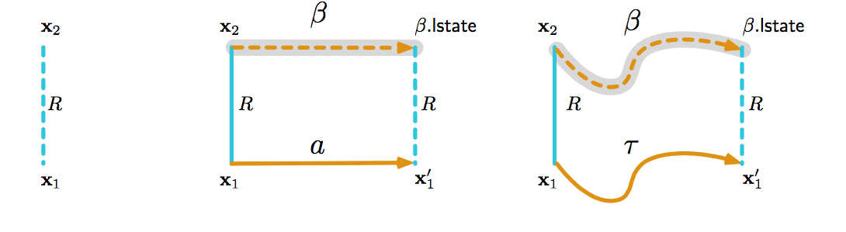
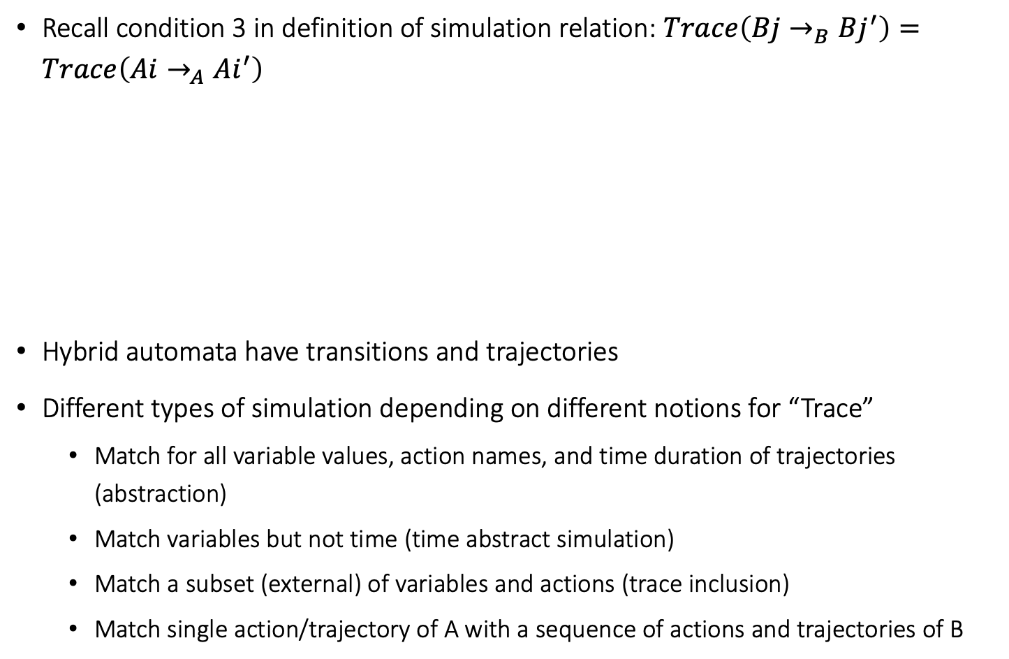
Simulation relations for hybrid automata
Recall condition 3 in definition of simulation relation: $Trace\left(Bj→_{B}Bj^{′}\right)=Trace\left(Ai→_{A}Ai^{′}\right)$
Hybrid automata have transitions and trajectories
Different types of simulation depending on different notions for “Trace”
Match for all variable values, action names, and time duration of trajectories (abstraction)
Match variables but not time (time abstract simulation)
Match a subset (external) of variables and actions (trace inclusion)
Match single action/trajectory of A with a sequence of actions and trajectories of B

Slide 16
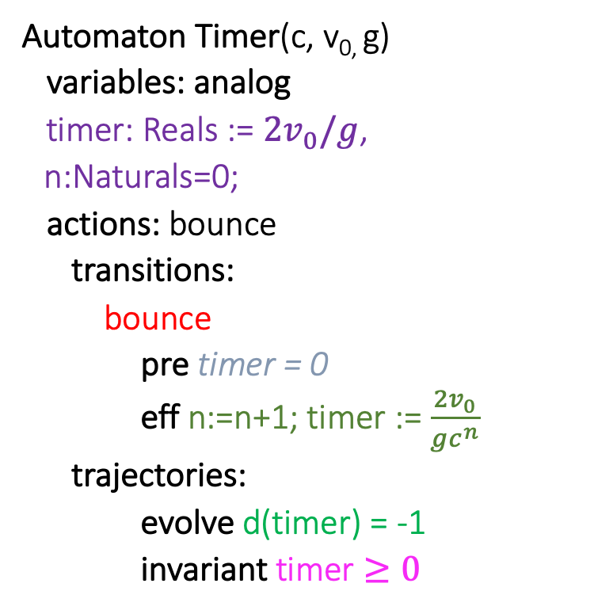

Timer simulates Ball (w.r.t. timing of bounce actions)
Automaton Timer(c, v_{0,} g)
variables: analog
timer: Reals := $2v_{0}/g$,
n:Naturals=0;
actions: bounce
transitions:
bounce
pre timer = 0
eff n:=n+1; timer := $\frac{2v_{0}}{gc^{n}}$
trajectories:
evolve d(timer) = -1
invariant timer $≥0$
Automaton Ball(c,v₀,g)
variables:
x: Reals := 0
v: Reals := v₀
actions: bounce
transitions:
bounce
pre x = 0 /\ v < 0
eff v := -cv
trajectories:
evolve d(x) = v; d(v) = -g
invariant $x≥0$

Slide 17
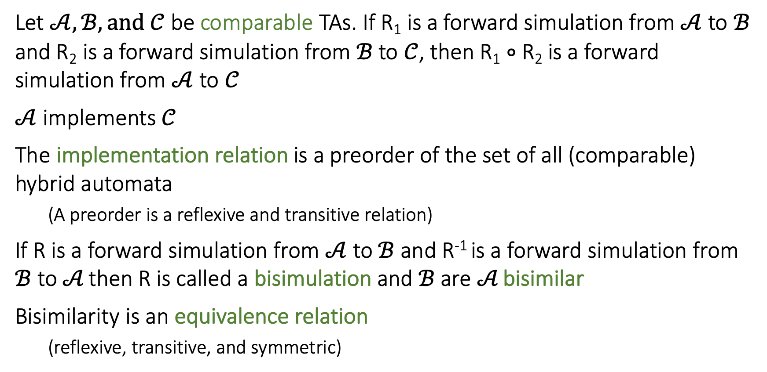
Some nice properties of Forward Simulation
Let $𝒜, ℬ, and 𝒞$ be comparable TAs. If R₁ is a forward simulation from $𝒜$ to $ℬ$ and R₂ is a forward simulation from $ℬ$ to $𝒞$, then R₁ $∘$ R₂ is a forward simulation from $𝒜$ to $𝒞$
$𝒜$ implements $𝒞$
The implementation relation is a preorder of the set of all (comparable) hybrid automata
(A preorder is a reflexive and transitive relation)
If R is a forward simulation from $𝒜$ to $ℬ$ and R⁻¹ is a forward simulation from $ℬ$ to $𝒜$ then R is called a bisimulation and $ℬ$ are $𝒜$ bisimilar
Bisimilarity is an equivalence relation
(reflexive, transitive, and symmetric)
Notes:
Relational composition

Slide 18
Remark on Simulations and Stability
Stability not preserved by ordinary simulations and bisimulations [Prabhakar, et. al 15]
time
time
Stability Preserving Simulations and Bisimulations for Hybrid Systems, Prabhakar, Dullerud, Viswanathan IEEE Trans. Automatic Control 2015

Slide 19
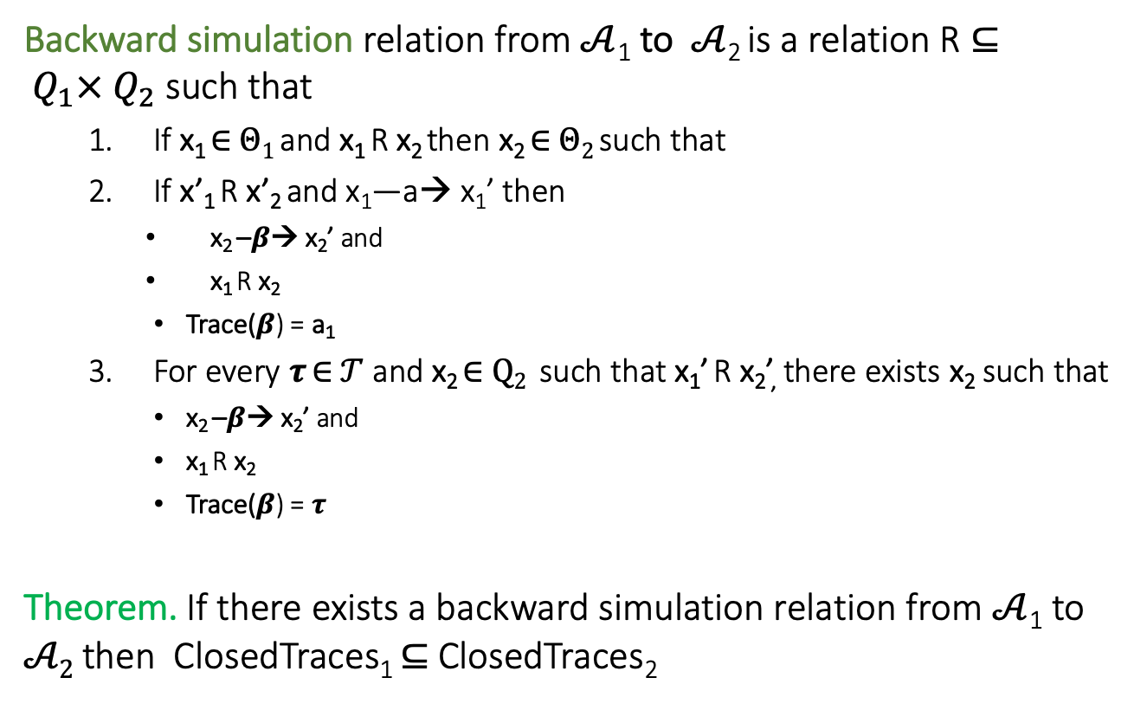
Backward Simulations
Backward simulation relation from $𝒜$₁ to $𝒜$₂ is a relation R $⊆ Q_{1}× Q_{2}$ such that
If x₁ ∈ $Θ1$ and x₁ R x₂ then x₂ ∈ $Θ2$ such that
If x’₁ R x’₂ and x₁—a→ x₁’ then
x₂ –$β$→ x₂’ and
x₁ R x₂
Trace($β$) = a₁
For every $τ$ ∈ $𝒯$ and x₂ ∈ $Q2$ such that x₁’ R x₂’, there exists x₂ such that
x₂ –$β$→ x₂’ and
x₁ R x₂
Trace($β$) = $τ$
Theorem. If there exists a backward simulation relation from $𝒜$₁ to $𝒜2$ then ClosedTraces₁ $⊆$ ClosedTraces₂
Notes:
skip this maybe

