Slide 1
Cyberphysical Systems: Part 2
Sayan Mitra
Verifying cyberphysical systems
mitras@illinois.edu

Slide 2
Outline
Review: Modeling cyber-physical systems
Hybrid automata
Executions
Urgency
Zeno
Hybrid stability

Slide 3
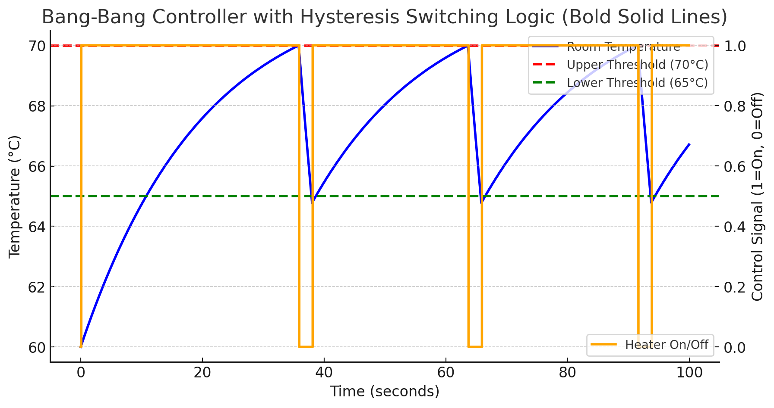
Example. Thermostat automaton
automaton Thermostat(u, l, K, h : Real) where u > l
type Status enumeration [on, off ] actions
turnOn; turnOff;
variables
x: Real := l loc: Status := on
transitions
turnOn
pre x≤l ∧ loc=off
eff loc := on
trajectories
modeOn
evolve d(x) = K(h − x)
invariant loc = on ∧ x ≤ u
turnOff
pre x≥u ∧ loc=on
eff loc := off
modeOff
evolve d(x) = −Kx
invariant loc = off ∧ x ≥ l
Determinism vs nondeterminism
mode invariants

Slide 4
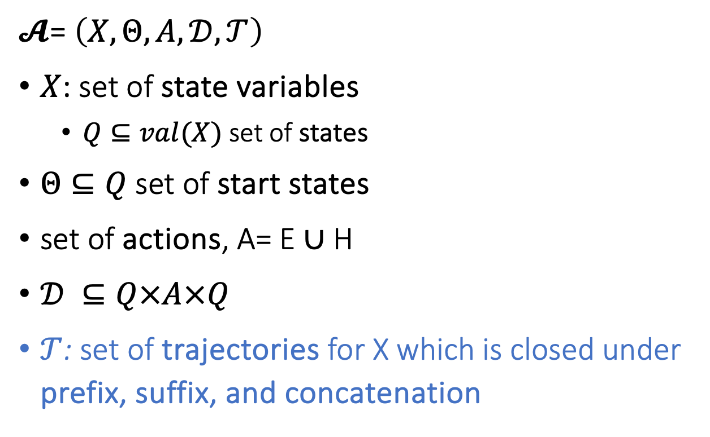
Hybrid Automaton
$𝓐$= $\left(X,Θ,A,𝒟,𝒯\right)$
$X$: set of state variables
$Q⊆val(X)$ set of states
$Θ⊆Q$ set of start states
set of actions, A= E ∪ H
$𝒟 ⊆Q×A×Q$
$𝒯$: set of trajectories for X which is closed under prefix, suffix, and concatenation
Notes:
Pick a couple of nice examples

Slide 5
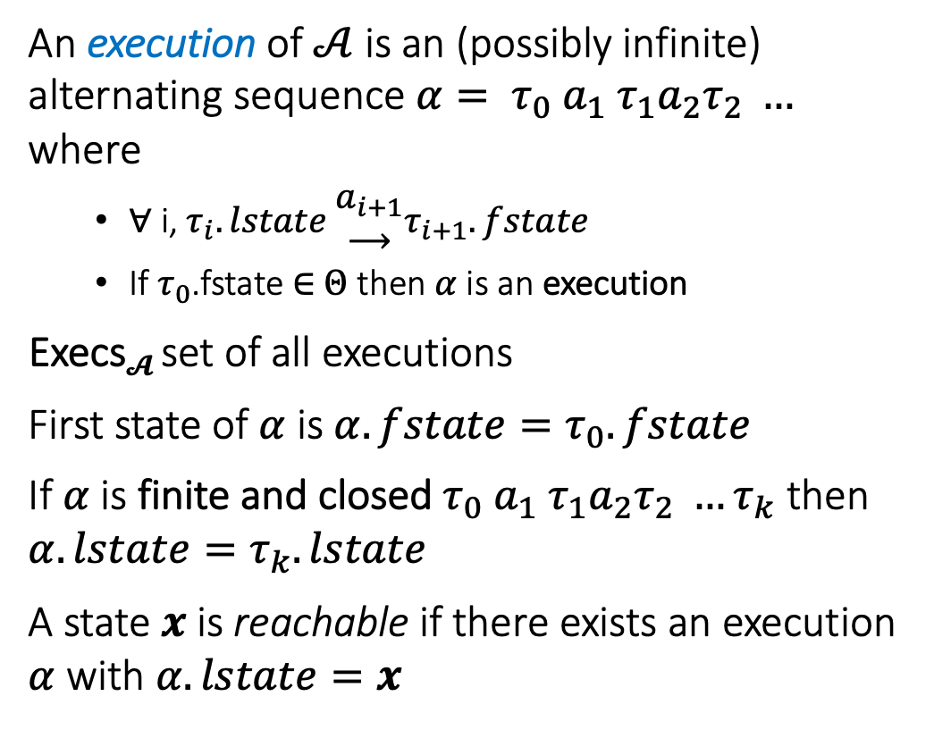
Semantics: Executions and Traces
An execution of $𝒜$ is an (possibly infinite) alternating sequence $α= τ_{0} a_{1} τ_{1}a_{2}τ_{2} …$ where
∀ i, $τ_{i}.lstate \begin{matrix}a_{i+1} \\ ⟶\end{matrix}τ_{i+1}.fstate$
If $τ_{0}$.fstate ∈ $Θ$ then $α$is an execution
Execs$𝓐$ set of all executions
First state of $α$ is $α.fstate=τ_{0}.fstate$
If $α$is finite and closed $τ_{0} a_{1} τ_{1}a_{2}τ_{2} …τ_{k}$ then $α.lstate=τ_{k}.lstate$
A state $x$is reachable if there exists an execution $α$ with $α.lstate=x$
turnOff
turnOff
turnOn
turnOn
turnOn

Slide 6
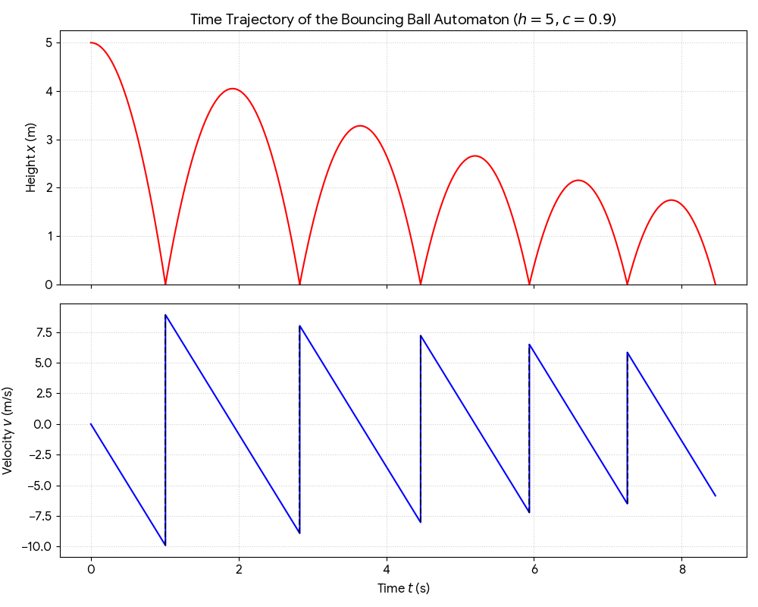
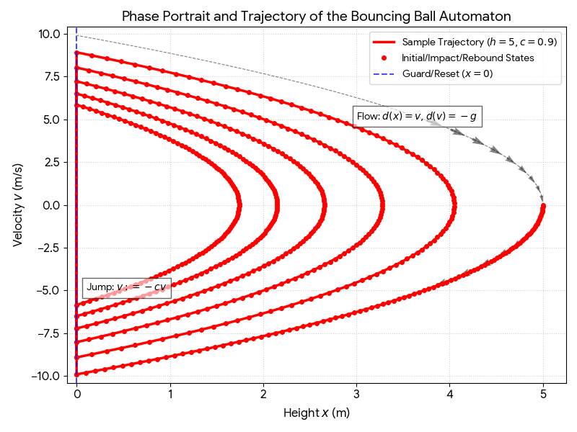
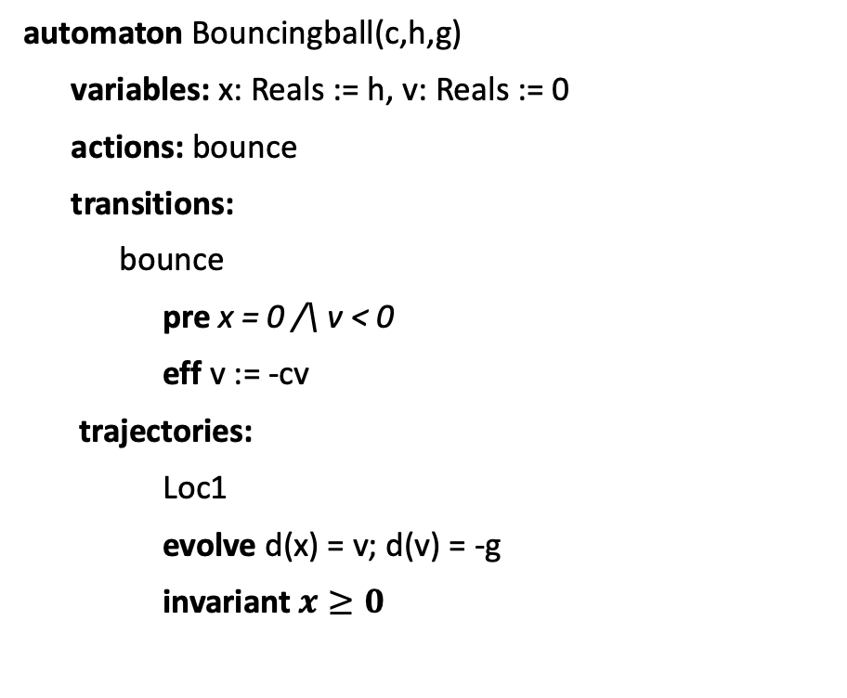
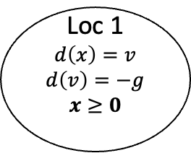
Example. Bouncing Ball
automaton Bouncingball(c,h,g)
variables: x: Reals := h, v: Reals := 0
actions: bounce
transitions:
bounce
pre x = 0 /\ v < 0
eff v := -cv
trajectories:
Loc1
evolve d(x) = v; d(v) = -g
invariant $x≥0$
bounce
x = 0 /\ v < 0
v’ := -cv
Loc 1
$$d\left(x\right)=v$$
$$d\left(v\right)=−g$$
$$x≥0$$
x:= h
mode invariant, not to be confused with invariants of the automaton
Graphical Representation used in many articles
Notes:
Guard, Precondition
Effect, Reset map
Invariance

Slide 7
Urgency: Must transitions
automaton Thermostat(u, l, K, h,d : Real) where u > l
type Status enumeration [on, off ] actions
turnOn; turnOff;
variables
x: Real := l loc: Status := on
transitions
turnOn
pre x≤l ∧ loc=off
eff loc := on
trajectories
modeOn
evolve d(x) = K(h − x)
invariant loc = on ∧ x ≤ u + d
turnOff
pre x≥u ∧ loc=on
eff loc := off
modeOff
evolve d(x) = −Kx
invariant loc = off ∧ x ≥ l - d
An urgent transition (or action) is an action that has to occur as soon as it is enabled
Introduce special syntax for creating urgent transitions, but we can use mode invariants to accomplish this

Slide 8


Zeno’s Paradox
Achilles, the fastest athlete, greatest warrior
Zeno, Greek philosopher
whatever!
You couldn’t even beat a turtle
Achilles runs 10 times faster than than the tortoise, but the turtle gets to start 1 second earlier. Can Achilles ever catch Turtle?
Lesson: Mixing discrete transitions with continuous motion can be tricky!
After 1/10th of a second, Achilles reaches where the Turtle (T) started, and T has a head start of 1/10th second.
After another 1/100th of a second, A catches up to where T was at t=1/10 sec, but T has a head start of 1/100th
…
T is always ahead …
Notes:
5 mins.

Slide 9
Stability of a hybrid automaton
Each of the modes of a walking robot are asymptotically stable
Is it possible to switch between them to make the system unstable?
Walk
Run

Slide 10
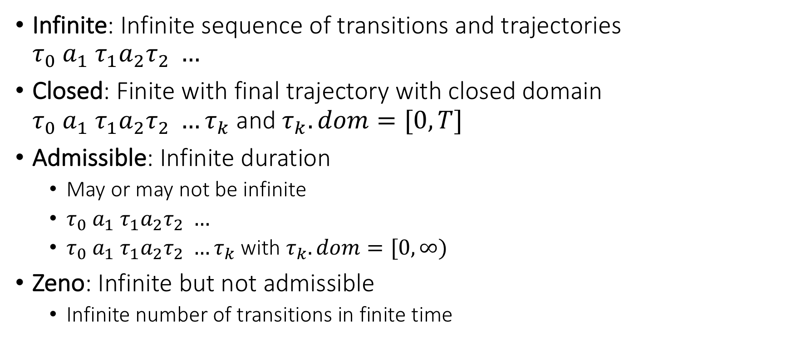
Special kinds of executions
Infinite: Infinite sequence of transitions and trajectories $τ_{0} a_{1} τ_{1}a_{2}τ_{2} …$
Closed: Finite with final trajectory with closed domain $τ_{0} a_{1} τ_{1}a_{2}τ_{2} …τ_{k}$ and $τ_{k}.dom=[0,T]$
Admissible: Infinite duration
May or may not be infinite
$τ_{0} a_{1} τ_{1}a_{2}τ_{2} …$
$τ_{0} a_{1} τ_{1}a_{2}τ_{2} …τ_{k}$ with $τ_{k}.dom=[0,∞)$
Zeno: Infinite but not admissible
Infinite number of transitions in finite time

Slide 11
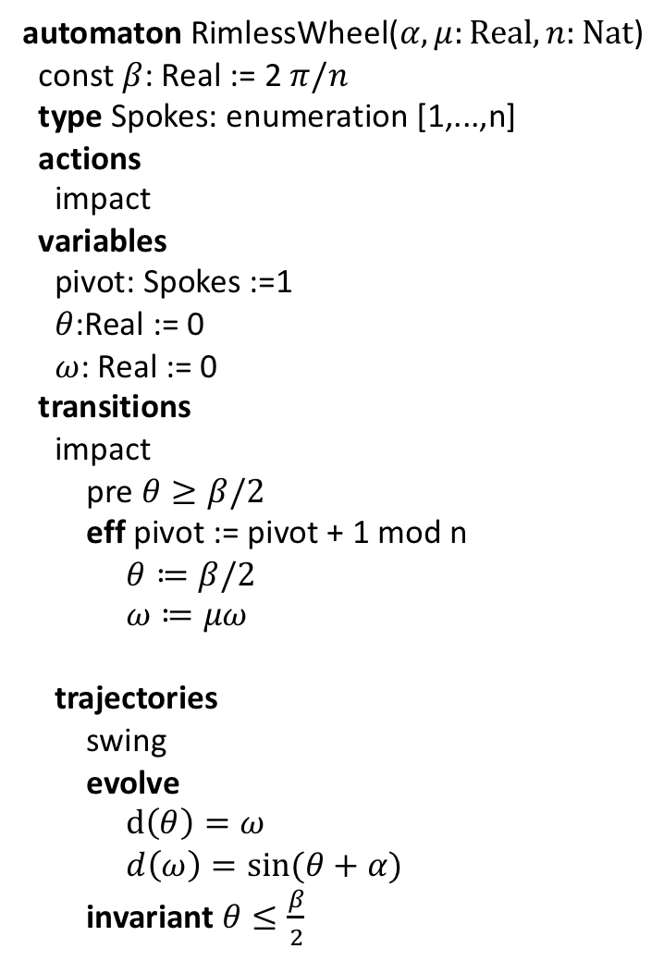
Rimless wheel
automaton RimlessWheel($α,μ:Real, n:Nat$)
const $β$: Real := 2 $π/n$
type Spokes: enumeration [1,...,n]
actions
impact
variables
pivot: Spokes :=1
$θ$:Real := 0
$ω$: Real := 0
transitions
impact
pre $θ≥β/2$
eff pivot := pivot + 1 mod n
$θ≔β/2$
$ω≔μω$
trajectories
swing
evolve
$d\left(θ\right)=ω$
$d\left(ω\right)=\sin{(θ+α)}$
invariant $θ≤\frac{β}{2}$

Slide 12
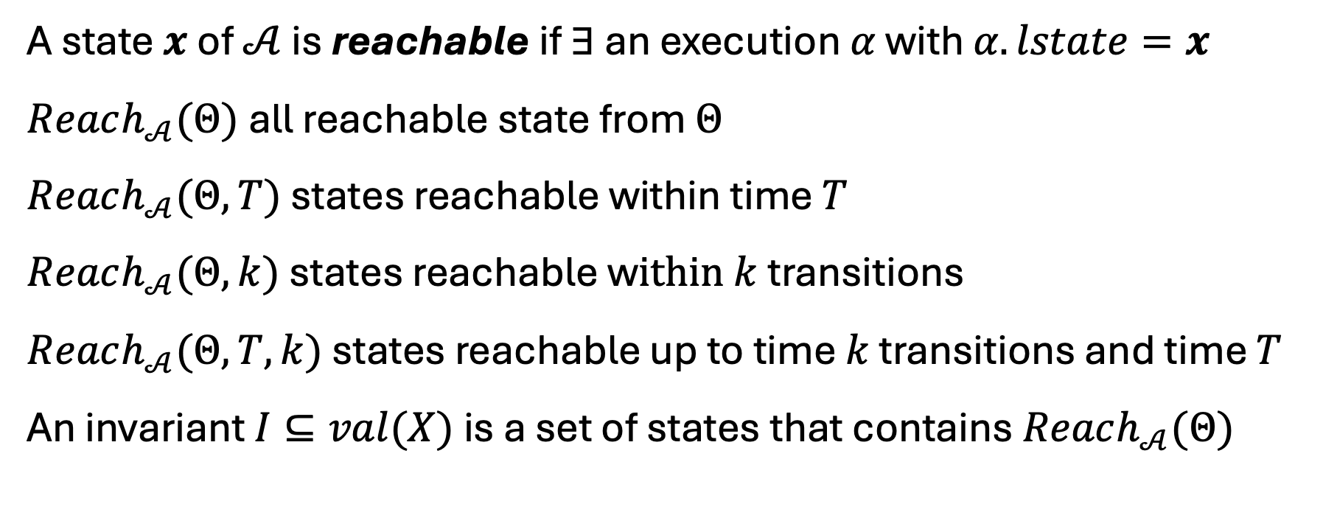
Invariants and reachability
A state $x$of $𝒜$ is reachable if $∃$ an execution $α$ with $α.lstate=x$
$Reach_{𝒜}(Θ)$ all reachable state from $Θ$
$Reach_{𝒜}(Θ,T)$ states reachable within time $T$
$Reach_{𝒜}(Θ,k)$ states reachable w$ithin k$ transitions
$Reach_{𝒜}(Θ,T,k)$ states reachable up to time $k$ transitions and time $T$
An invariant $I⊆val(X)$ is a set of states that contains $Reach_{𝒜}(Θ)$

Slide 13

How to prove invariants of hybrid automata
Recall the theorem we used for proving I is an invariant for automaton$𝒜=⟨X,Θ, A,D⟩$
Theorem 7.1. Given an automaton $𝒜=⟨X,Θ, A,D⟩$, if a set of states $I⊆val\left(X\right)$ satisfies the following:
(Start condition) For any starting state $x∈Θ, x∈I$ and
(Transition closure) For any action $a∈A$, if and $x→_{a}x^{′}$and $x∈I$ then $x^{′}∈I$, and
Then $I$ is an inductive invariant of $𝒜$.

Slide 14

How to prove invariants of hybrid automata
Theorem 7.1. Given an HIOA $𝒜=⟨X,Θ, A,D, T⟩$, if a set of states $I⊆val\left(X\right)$ satisfies the following:
(Start condition) For any starting state $x∈Θ, x∈I$ and
(Transition closure) For any action $a∈A$, if and $x→_{a}x^{′}$and $x∈I$ then $x^{′}∈I$, and
(Trajectory closure) For any trajectory $τ∈T$ if $τ.fstate∈I$ then $τ.lstate∈I$
Then $I$ is an inductive invariant of $𝒜$.

Slide 15
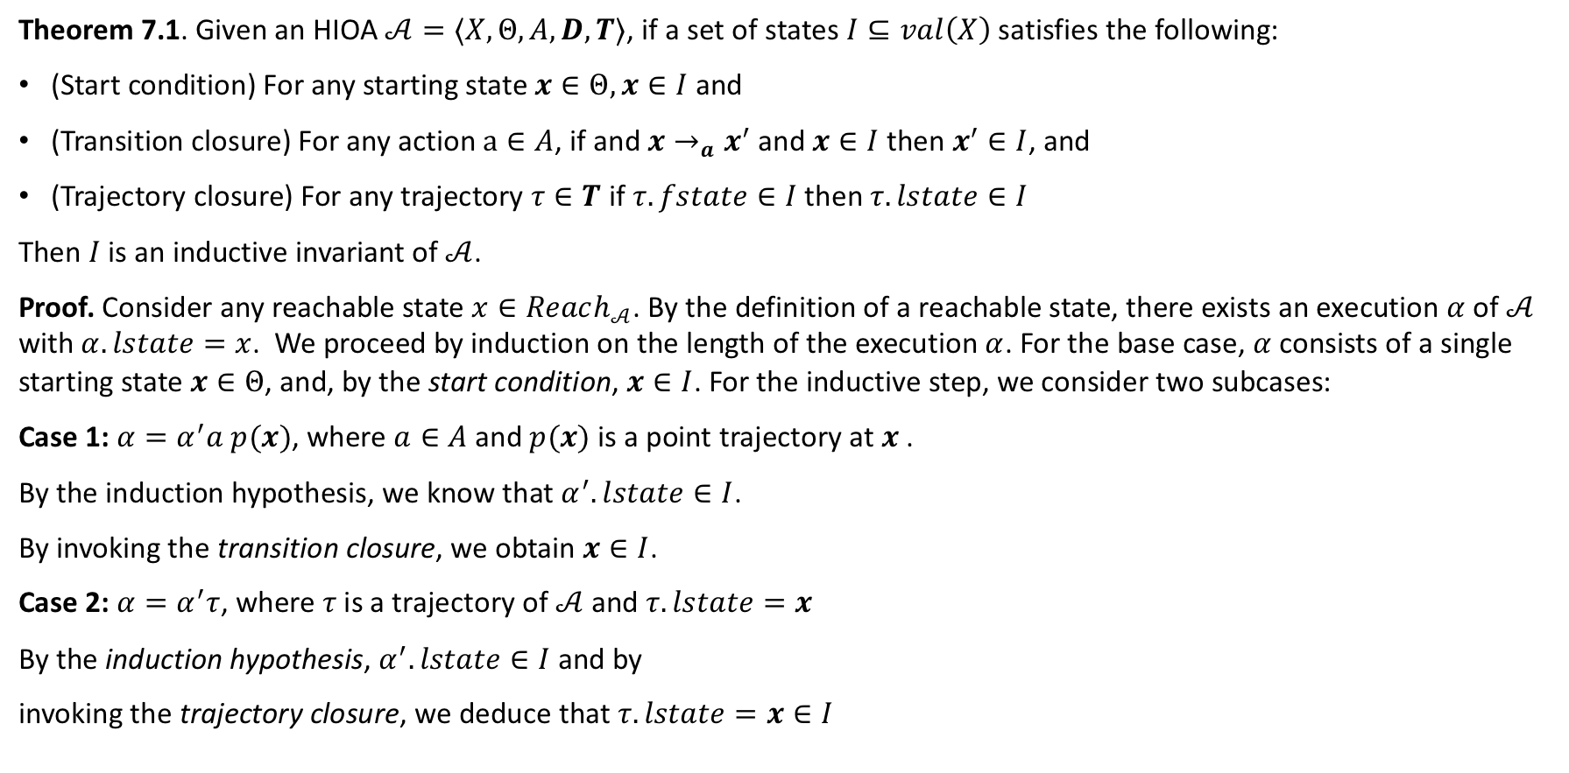
How to prove invariants of hybrid automata
Theorem 7.1. Given an HIOA $𝒜=⟨X,Θ, A,D, T⟩$, if a set of states $I⊆val\left(X\right)$ satisfies the following:
(Start condition) For any starting state $x∈Θ, x∈I$ and
(Transition closure) For any action $a∈A$, if and $x→_{a}x^{′}$and $x∈I$ then $x^{′}∈I$, and
(Trajectory closure) For any trajectory $τ∈T$ if $τ.fstate∈I$ then $τ.lstate∈I$
Then $I$ is an inductive invariant of $𝒜$.
Proof. Consider any reachable state $x∈Reach_{𝒜}$. By the definition of a reachable state, there exists an execution $α$ of $𝒜$ with $α.lstate=x$. We proceed by induction on the length of the execution $α$. For the base case, $α$consists of a single starting state $x∈Θ$, and, by the start condition, $x∈I$. For the inductive step, we consider two subcases:
Case 1: $α=α^{′}a p(x)$, where $a∈A$ and $p(x)$ is a point trajectory at $x$ .
By the induction hypothesis, we know that $α^{′}.lstate∈I$.
By invoking the transition closure, we obtain $x∈I$.
Case 2: $α=α^{′}τ$, where $τ$is a trajectory of $𝒜$ and $τ.lstate=x$
By the induction hypothesis, $α^{′}.lstate∈I$ and by
invoking the trajectory closure, we deduce that $τ.lstate=x∈I$

Slide 16
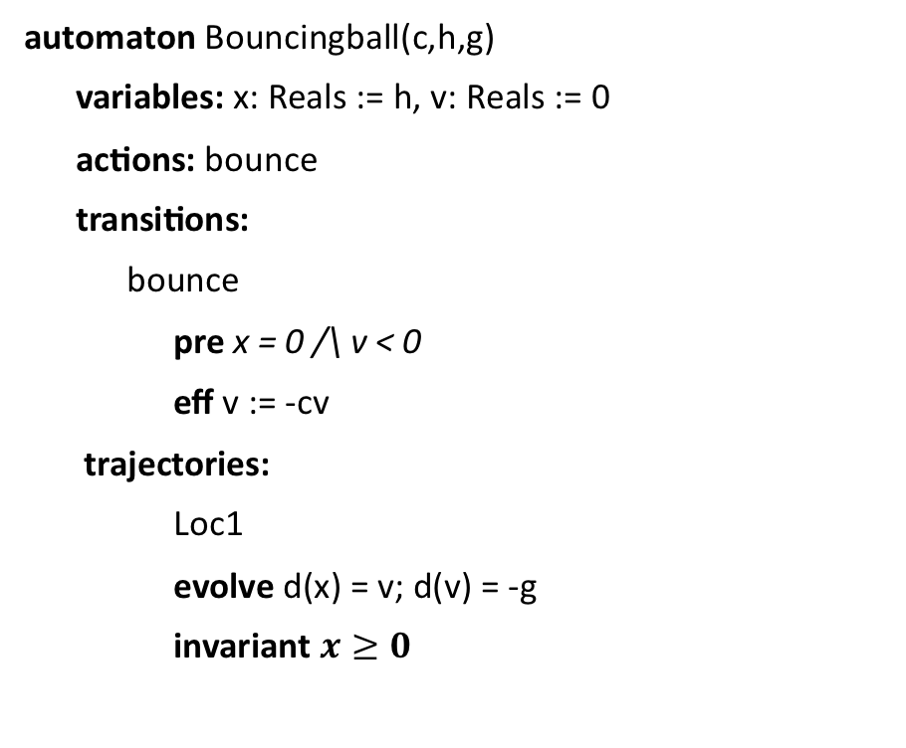
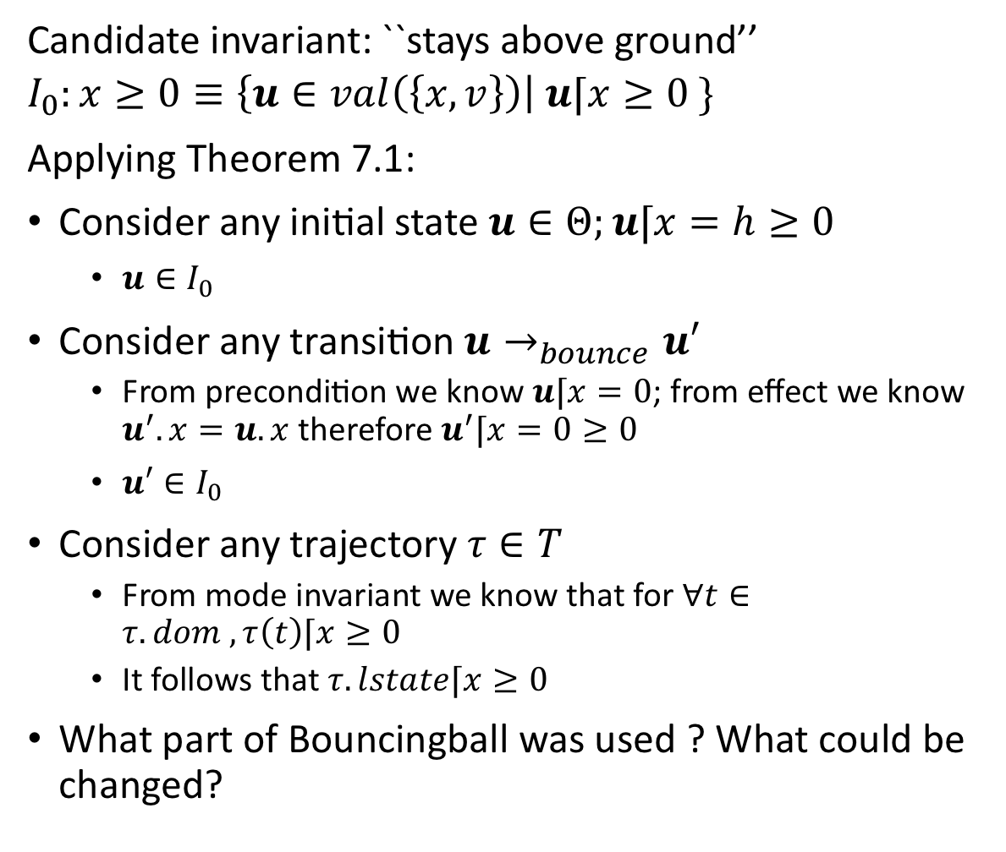
An application
Candidate invariant: ``stays above ground’’
$$I_{0}:x≥0≡\left\{u∈val\left(\left\{x,v\right\}\right)\right| u⌈x≥0 \}$$
Applying Theorem 7.1:
Consider any initial state $u∈Θ;u⌈x=h≥0$
$u∈I_{0}$
Consider any transition $u→_{bounce}u′$
From precondition we know $u⌈x=0$; from effect we know $u^{′}.x=u.x$ therefore $u^{′}⌈x=0≥0$
$u′∈I_{0}$
Consider any trajectory $τ∈T$
From mode invariant we know that for $∀t∈τ. dom , τ\left(t\right)⌈x≥0$
It follows that $τ.lstate⌈x≥0$
What part of Bouncingball was used ? What could be changed?
automaton Bouncingball(c,h,g)
variables: x: Reals := h, v: Reals := 0
actions: bounce
transitions:
bounce
pre x = 0 /\ v < 0
eff v := -cv
trajectories:
Loc1
evolve d(x) = v; d(v) = -g
invariant $x≥0$

Slide 17
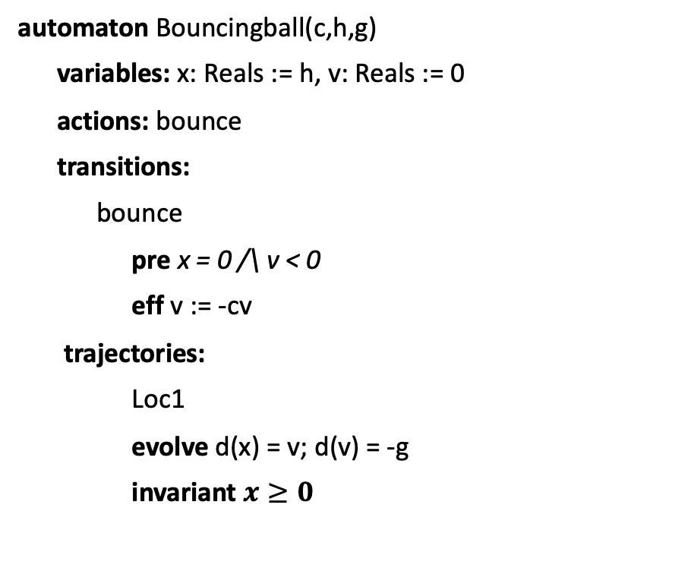
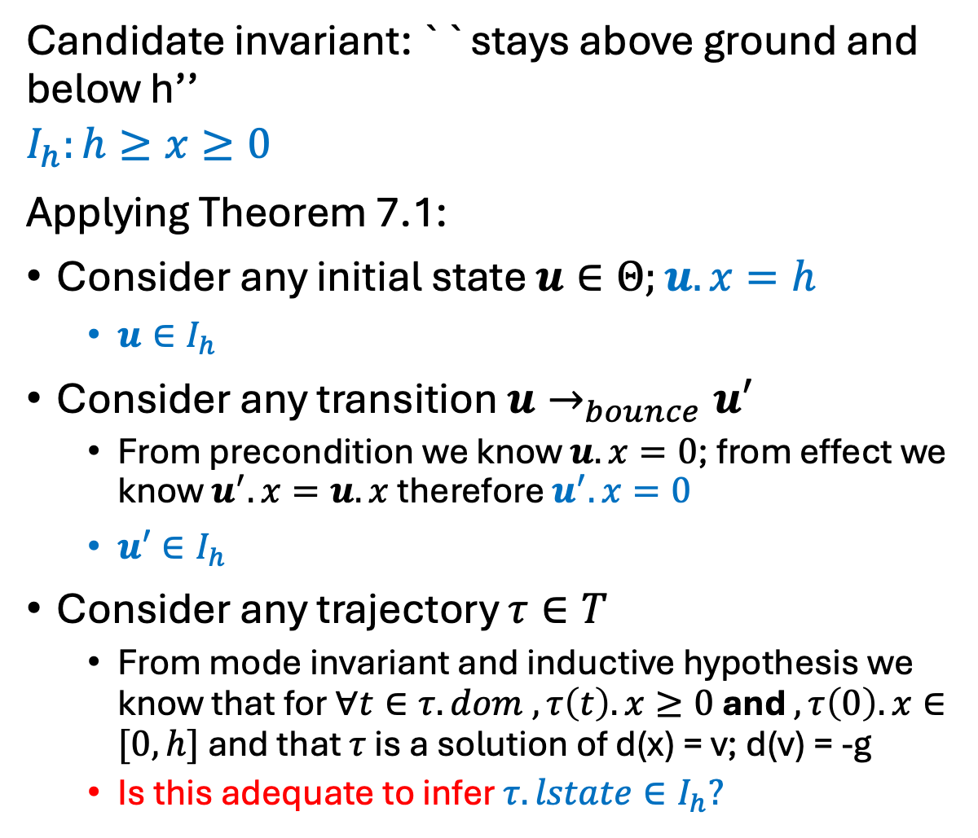
An application
Candidate invariant: ``stays above ground and below h’’
$$I_{h}:h≥x≥0$$
Applying Theorem 7.1:
Consider any initial state $u∈Θ;u.x=h$
$u∈I_{h}$
Consider any transition $u→_{bounce}u′$
From precondition we know $u.x=0$; from effect we know $u^{′}.x=u.x$ therefore $u^{′}.x=0$
$u′∈I_{h}$
Consider any trajectory $τ∈T$
From mode invariant and inductive hypothesis we know that for $∀t∈τ. dom , τ\left(t\right).x≥0$ and $, τ\left(0\right).x∈[0,h]$ and that $τ$ is a solution of d(x) = v; d(v) = -g
Is this adequate to infer $τ. lstate∈I_{h}?$
automaton Bouncingball(c,h,g)
variables: x: Reals := h, v: Reals := 0
actions: bounce
transitions:
bounce
pre x = 0 /\ v < 0
eff v := -cv
trajectories:
Loc1
evolve d(x) = v; d(v) = -g
invariant $x≥0$

Slide 18
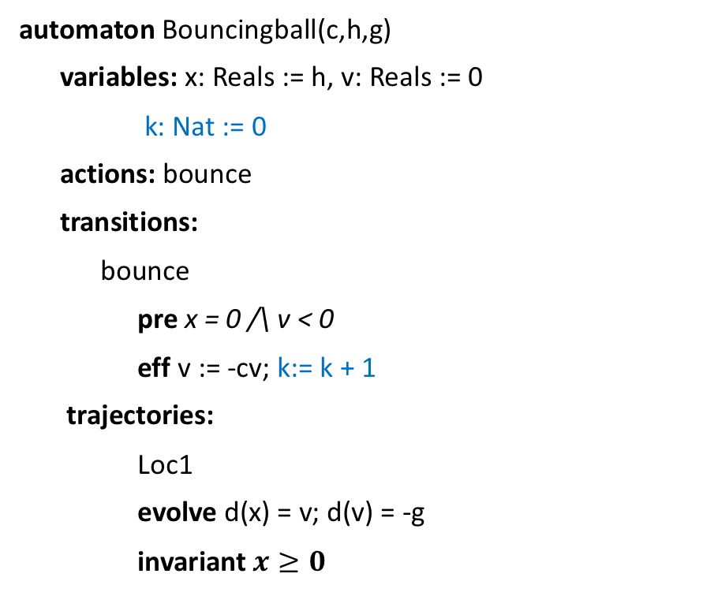
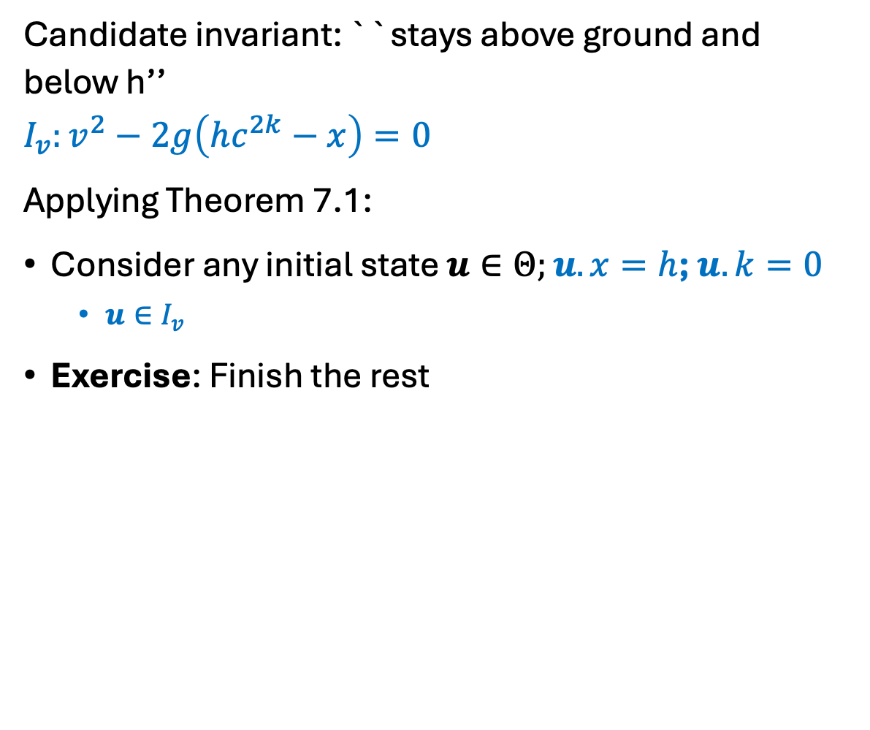
Strengthened invariant
Candidate invariant: ``stays above ground and below h’’
$$I_{v}:v^{2}−2g\left(hc^{2k}−x\right)=0$$
Applying Theorem 7.1:
Consider any initial state $u∈Θ;u.x=h$; $u.k=0$
$u∈I_{v}$
Exercise: Finish the rest
automaton Bouncingball(c,h,g)
variables: x: Reals := h, v: Reals := 0
k: Nat := 0
actions: bounce
transitions:
bounce
pre x = 0 /\ v < 0
eff v := -cv; k:= k + 1
trajectories:
Loc1
evolve d(x) = v; d(v) = -g
invariant $x≥0$

Slide 19
Summary so far
Theorem 7.1 gives a sufficient condition for proving inductive invariants
Not all invariants are inductive
We often have to strengthen invariants to make them inductive
Read examples in Chapter 7

Slide 20

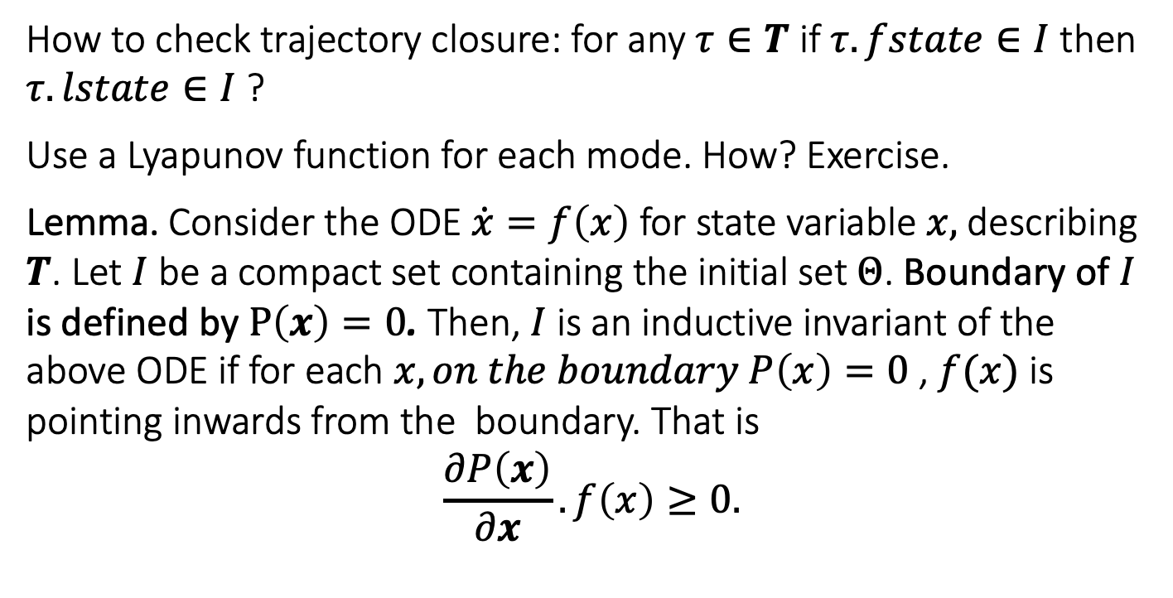


Sub-tangential conditions. Checking trajectory conditions without solving ODEs [Bhatia and Szegö 67]
How to check trajectory closure: for any $τ∈T$ if $τ.fstate∈I$ then $τ.lstate∈I$ ?
Use a Lyapunov function for each mode. How? Exercise.
Lemma. Consider the ODE $\dot{x}=f\left(x\right)$ for state variable $x,$ describing $T$. Let $I$ be a compact set containing the initial set $Θ$. Boundary of $I$ is defined by $P\left(x\right)=0$. Then, $I$ is an inductive invariant of the above ODE if for each $x,on the boundary P\left(x\right)=0$ , $f(x)$ is pointing inwards from the boundary. That is
$$\frac{∂P\left(x\right)}{∂x}.f\left(x\right)≥0.$$
$$f(x)$$
$$I$$
$$P\left(x\right)=0$$
Related to the notions of Barrier Certificates and more general Control Barrier Functions.

Slide 21
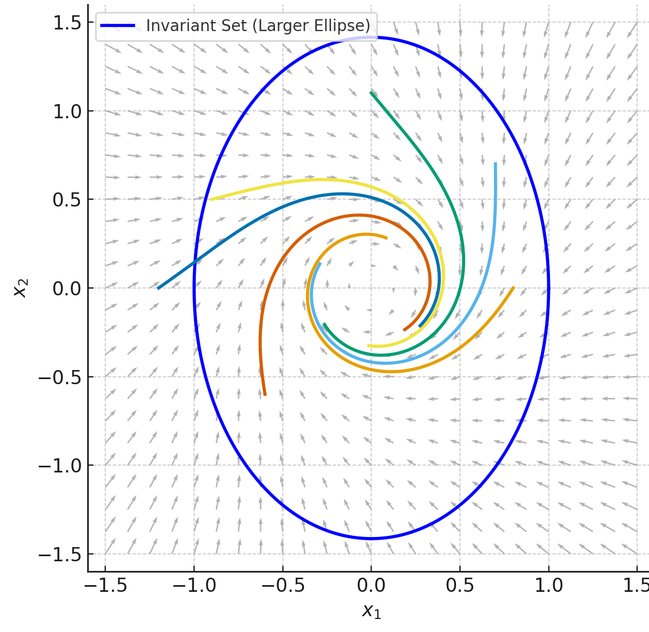
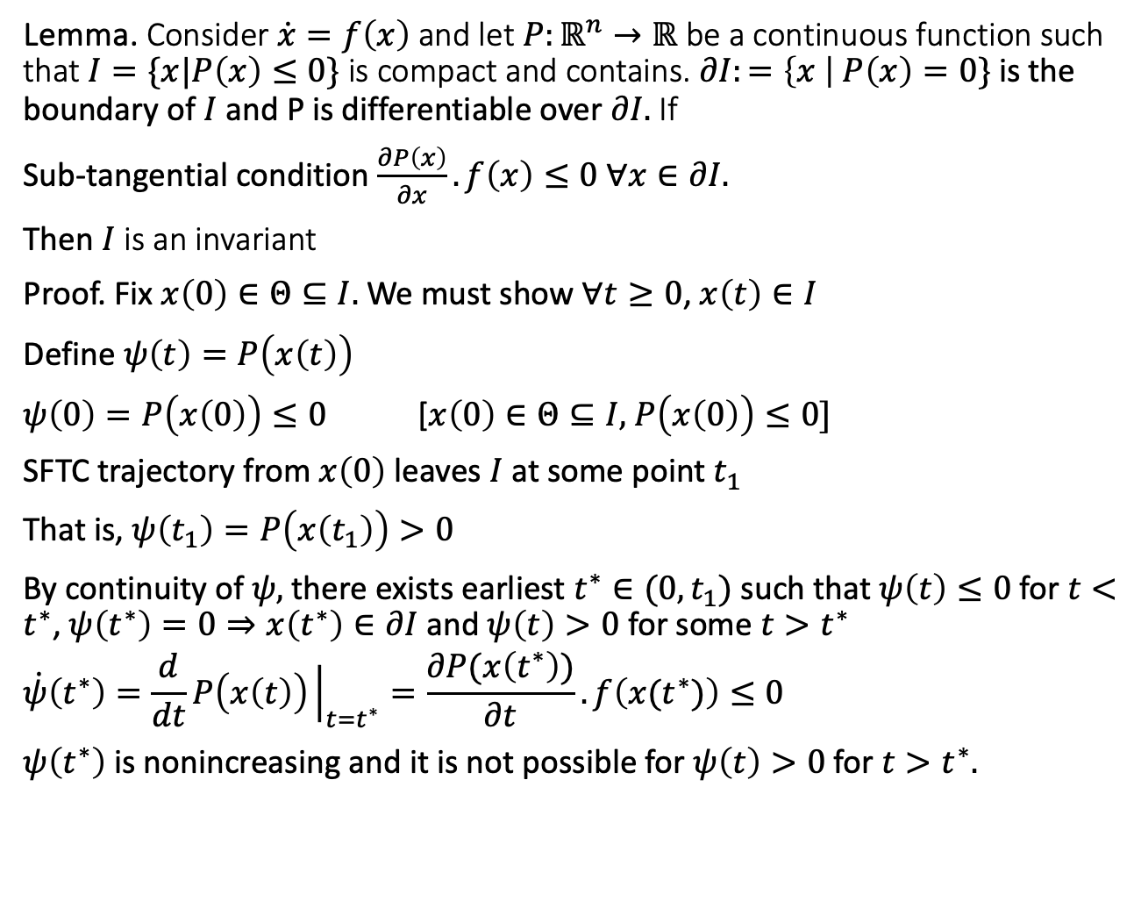
Proving invariance using subtangential condition
Lemma. Consider $\dot{x}=f\left(x\right)$ and let $P:ℝ^{n}→ℝ$ be a continuous function such that $I=\{x|P\left(x\right)≤0\}$ is compact and contains. $∂I:=\left\{x \right|$ $P\left(x\right)=0\}$ is the boundary of $I$ and P is differentiable over $∂I.$ If
Sub-tangential condition $\frac{∂P\left(x\right)}{∂x}.f\left(x\right)≤0 ∀x∈∂I.$
Then $I$ is an invariant
Proof. Fix $x\left(0\right)∈Θ⊆I.$ We must show $∀t≥0$, $x\left(t\right)∈I$
Define $ψ\left(t\right)=P\left(x\left(t\right)\right)$
$ψ\left(0\right)=P\left(x\left(0\right)\right)≤0$ [$x\left(0\right)∈Θ⊆I,$ $P\left(x\left(0\right)\right)≤0]$
SFTC trajectory from $x\left(0\right)$ leaves $I$ at some point $t_{1}$
That is, $ψ\left(t_{1}\right)=P\left(x\left(t_{1}\right)\right)>0$
By continuity of $ψ,$ there exists earliest $t^{∗}∈(0,t_{1})$ such that $ψ\left(t\right)≤0$ for $t<t^{∗}$, $ψ\left(t^{∗}\right)=0⇒x\left(t^{∗}\right)∈∂I$and $ψ\left(t\right)>0$ for some $t>t^{∗}$
$$\dot{ψ}\left(t^{∗}\right)=\frac{d}{dt}P\left(x\left(t\right)\right){\left.​\right|}_{t=t^{∗}}=\frac{∂P(x\left(t^{∗}\right))}{∂t}. f\left(x(t^{∗})\right)≤0$$
$ψ\left(t^{∗}\right)$ is nonincreasing and it is not possible for $ψ\left(t\right)>0$ for $t>t^{∗}.$

Slide 22
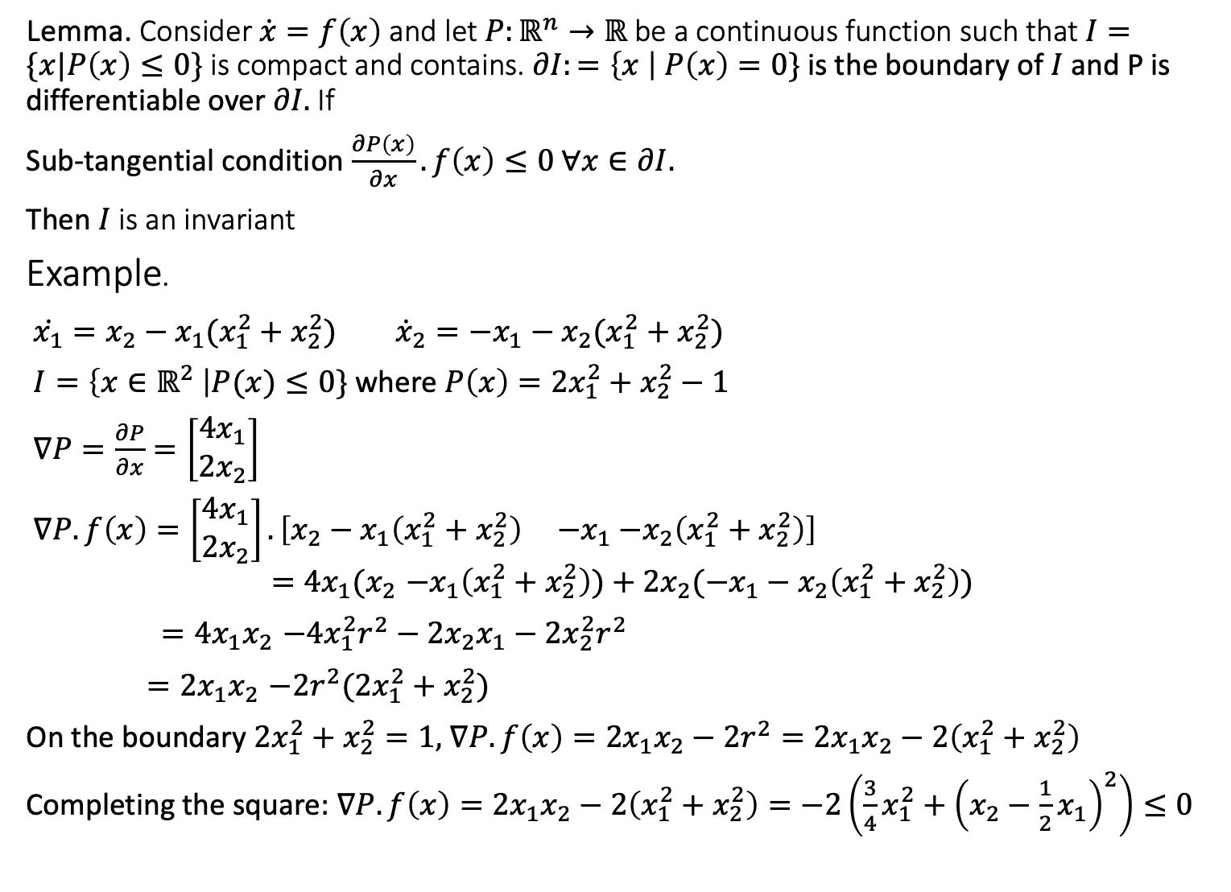
Lemma. Consider $\dot{x}=f\left(x\right)$ and let $P:ℝ^{n}→ℝ$ be a continuous function such that $I=\{x|P\left(x\right)≤0\}$ is compact and contains. $∂I:=\left\{x \right|$ $P\left(x\right)=0\}$ is the boundary of $I$ and P is differentiable over $∂I.$ If
Sub-tangential condition $\frac{∂P\left(x\right)}{∂x}.f\left(x\right)≤0 ∀x∈∂I.$
Then $I$ is an invariant
Example.
$\dot{x_{1}}=x_{2}−x_{1}(x_{1}^{2}+x_{2}^{2})$ ${\dot{x}}_{2}=−x_{1}−x_{2}(x_{1}^{2}+x_{2}^{2})$
$I=\left\{x∈ℝ^{2} \right|P(x)≤0\}$ where $P\left(x\right)=2x_{1}^{2}+x_{2}^{2}−1$
$∇P=\frac{∂P}{∂x}=\left[\begin{matrix}4x_{1} \\ 2x_{2}\end{matrix}\right]$
$∇P.f\left(x\right)=\left[\begin{matrix}4x_{1} \\ 2x_{2}\end{matrix}\right].\left[x_{2}−x_{1}\left(x_{1}^{2}+x_{2}^{2}\right) {−x}_{1}−x_{2}\left(x_{1}^{2}+x_{2}^{2}\right)\right]$
$${=4x_{1}(x}_{2}−x_{1}\left(x_{1}^{2}+x_{2}^{2}\right))+2x_{2}({−x}_{1}−x_{2}\left(x_{1}^{2}+x_{2}^{2}\right))$$
${=4x_{1}x}_{2}−{4x}_{1}^{2}r^{2}−2x_{2}x_{1}−{2x}_{2}^{2}r^{2}$
${=2x_{1}x}_{2}−2r^{2}({2x}_{1}^{2}+x_{2}^{2})$
On the boundary $2x_{1}^{2}+x_{2}^{2}=1,$ $∇P.f\left(x\right)={2x_{1}x}_{2}−2r^{2}={2x_{1}x}_{2}−2\left(x_{1}^{2}+x_{2}^{2}\right)$
Completing the square: $∇P.f\left(x\right)={2x_{1}x}_{2}−2\left(x_{1}^{2}+x_{2}^{2}\right)=−2\left(\frac{3}{4}x_{1}^{2}+{\left(x_{2}−\frac{1}{2}x_{1}\right)}^{2}\right)≤0$

Slide 23
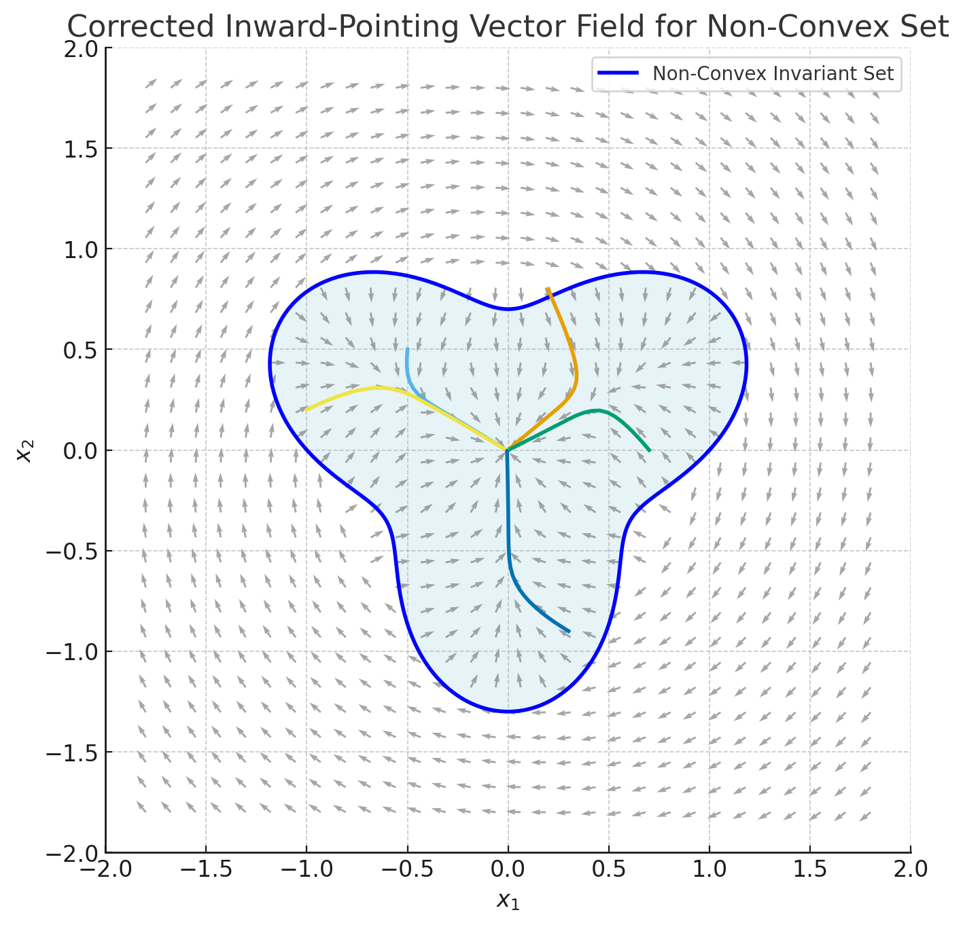
Another example

Slide 24
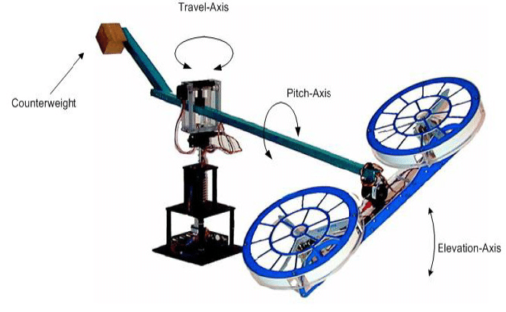
Piece-wise sub-tangential conditions
If the boundary is defined in pieces, for example, one for each mode, then check the condition for each piece separately
Safety verification of model helicopter controller using hybrid input/output automata, Mitra, Wang, Lynch & Feron, HSCC 2003.

Slide 25
Summary
Definitions of reachability and invariance for hybrid automata generalize those definitions for (discrete) automata by introducing trajectories
We can prove inductive invariants for hybrid automata by checking trajectory closure, in addition to transition closure
Trajectory closure for trajectories defined by ODEs can be checked using the subtangential conditions which do not require solving ODEs

