Slide 1
Modeling Cyberphysical Systems
Sayan Mitra
Verifying cyberphysical systems
mitras@illinois.edu

Slide 2
Outline
Modeling cyber-physical systems
Hybrid automata
Executions
Urgency
Zeno
Hybrid stability

Slide 3
Why combine discrete and continuous time models?
Engineering systems can have dynamics with widely different time constants
Software for AV updates at 1 GHz --- human scale motion 10 Hz
Electrical circuit breakers 50 Hz --- power system dynamics 0.1 – 1 Hz
Widely different time constants can make computation numerically unstable
Some state changes are naturally described by automata:
programs, automata, SMT, switching rules, etc.
while others are naturally described by ODEs:
motion of planets and satellites, physical laws, weather

Slide 4
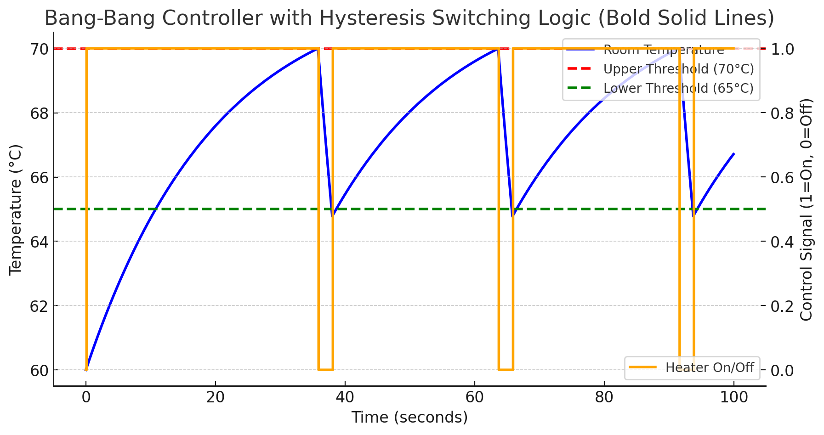
Example. Thermostat automaton
automaton Thermostat(u, l, K, h : Real) where u > l
type Status enumeration [on, off ] actions
turnOn; turnOff;
variables
x: Real := l loc: Status := on
transitions
turnOn
pre x≤l ∧ loc=off
eff loc := on
trajectories
modeOn
evolve d(x) = K(h − x)
invariant loc = on ∧ x ≤ u
turnOff
pre x≥u ∧ loc=on
eff loc := off
modeOff
evolve d(x) = −Kx
invariant loc = off ∧ x ≥ l
Determinism vs nondeterminism
mode invariants

Slide 5
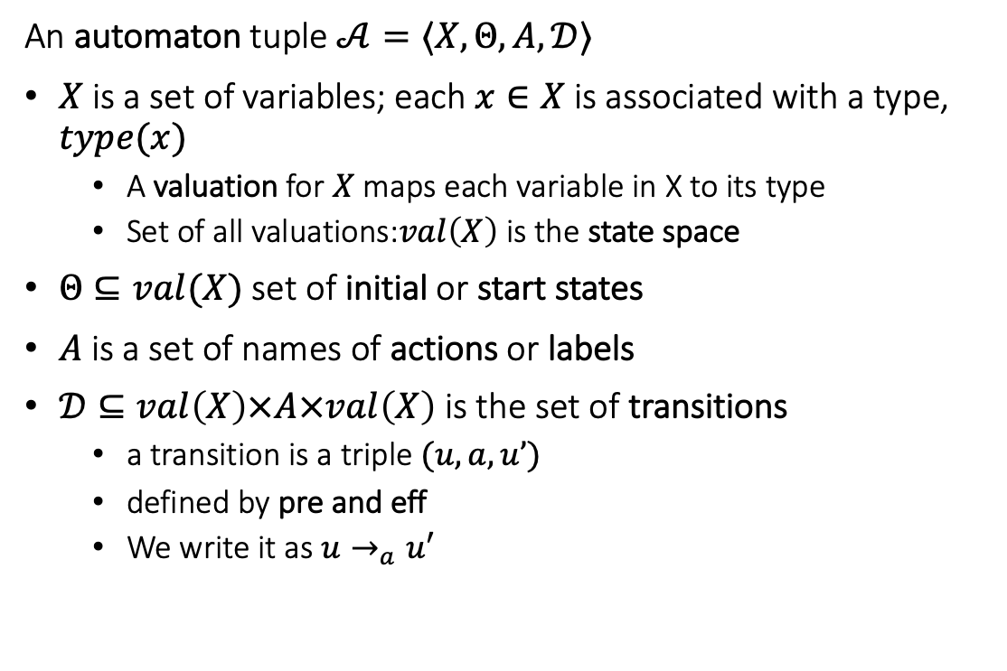
Recall language for automata
An automaton tuple $𝒜=〈X,Θ, A, 𝒟〉$
$X$ is a set of variables; each $x∈X$is associated with a type, $type(x)$
A valuation for $X$ maps each variable in X to its type
Set of all valuations:$val\left(X\right)$ is the state space
$Θ⊆val(X)$ set of initial or start states
$A$ is a set of names of actions or labels
$𝒟⊆val\left(X\right)×A×val\left(X\right)$ is the set of transitions
a transition is a triple $(u,a,u’)$
defined by pre and eff
We write it as $u→_{a}u′$
automaton DijkstraTR(N:Nat, K:Nat), where K > N
type ID: enumeration [0,...,N-1]
type Val: enumeration [0,...,K]
actions
update(i:ID)
variables
x:[ID -> Val]
transitions
update(i:ID)
pre i = 0 /\ x[i] = x[N-1]
eff x[i] := (x[i] + 1) % K
update(i:ID)
pre i >0 /\ x[i] ~= x[i-1]
eff x[i] := x[i-1]

Slide 6
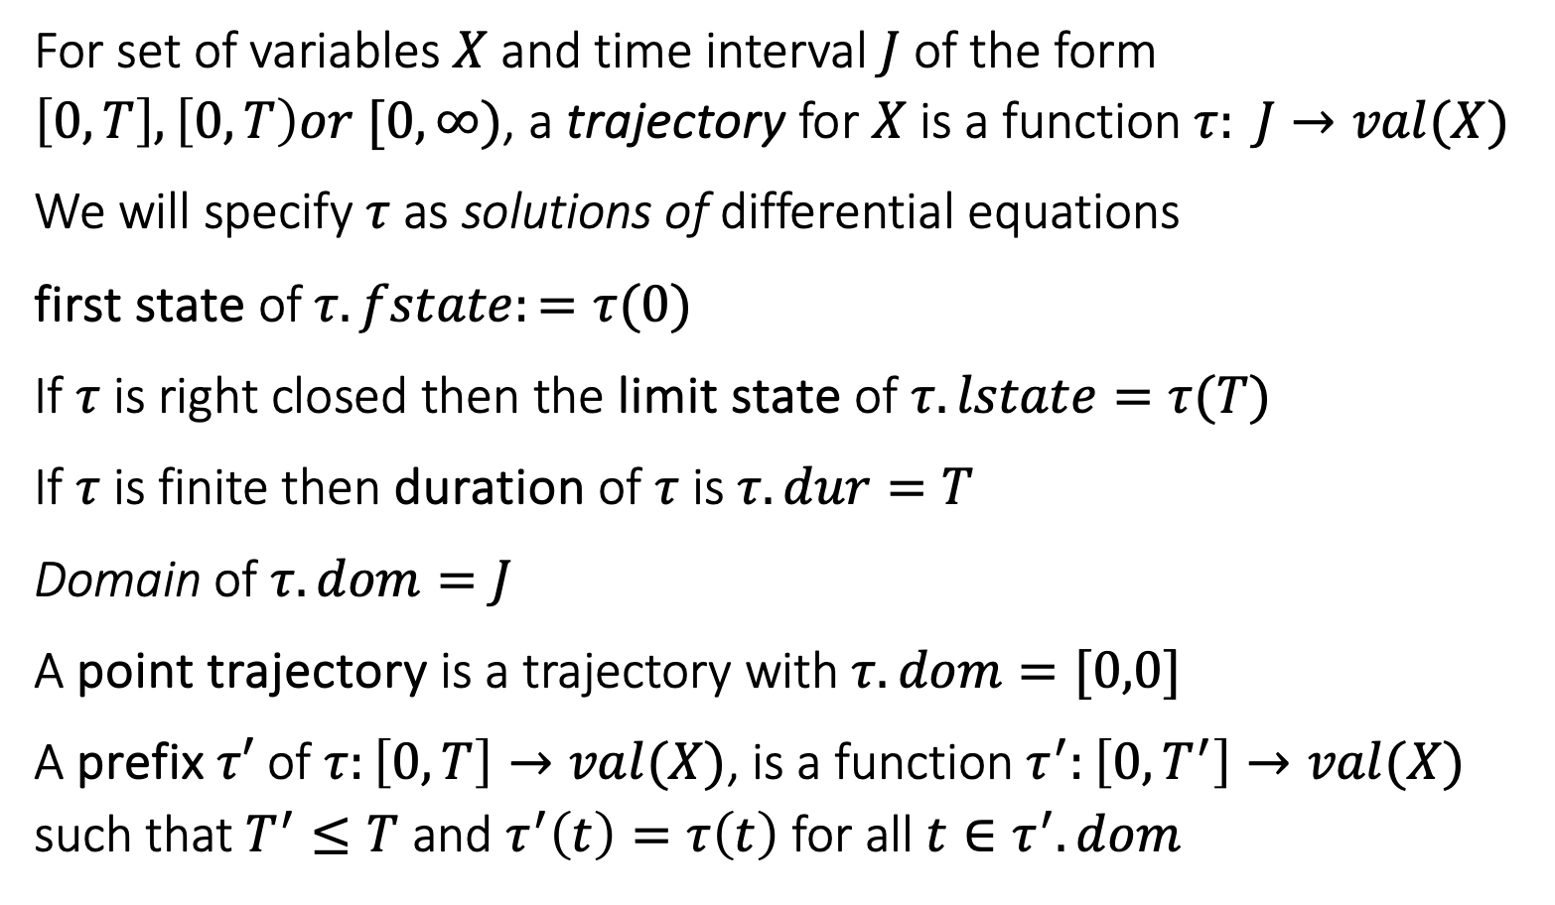
Trajectories
For set of variables $X$ and time interval $J$ of the form $\left[0,T\right], \left[0,T\right)or [0,∞)$, a trajectory for $X$ is a function $τ: J→val(X)$
We will specify $τ$ as solutions of differential equations
first state of $τ.fstate:=τ(0)$
If $τ$ is right closed then the limit state of $τ.lstate=τ(T)$
If $τ$ is finite then duration of $τ$ is $τ.dur=T$
Domain of $τ.dom=J$
A point trajectory is a trajectory with $τ.dom=[0,0]$
A prefix $τ′$ of $τ:\left[0,T\right]→val(X)$, is a function $τ^{′}:\left[0,T^{′}\right]→val(X)$ such that $T^{′}≤T$ and $τ^{′}\left(t\right)=τ\left(t\right)$ for all $t∈τ^{′}.dom$

Slide 7
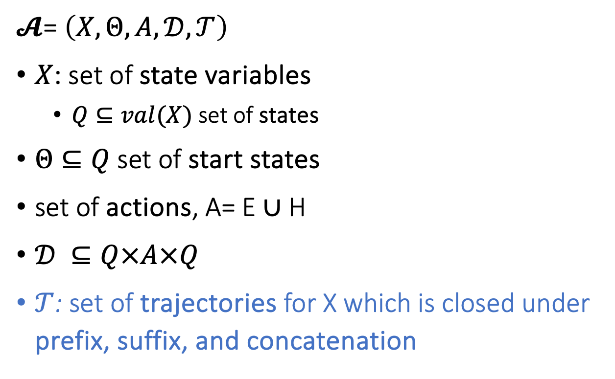
Hybrid Automaton
$𝓐$= $\left(X,Θ,A,𝒟,𝒯\right)$
$X$: set of state variables
$Q⊆val(X)$ set of states
$Θ⊆Q$ set of start states
set of actions, A= E ∪ H
$𝒟 ⊆Q×A×Q$
$𝒯$: set of trajectories for X which is closed under prefix, suffix, and concatenation
Notes:
Pick a couple of nice examples

Slide 8
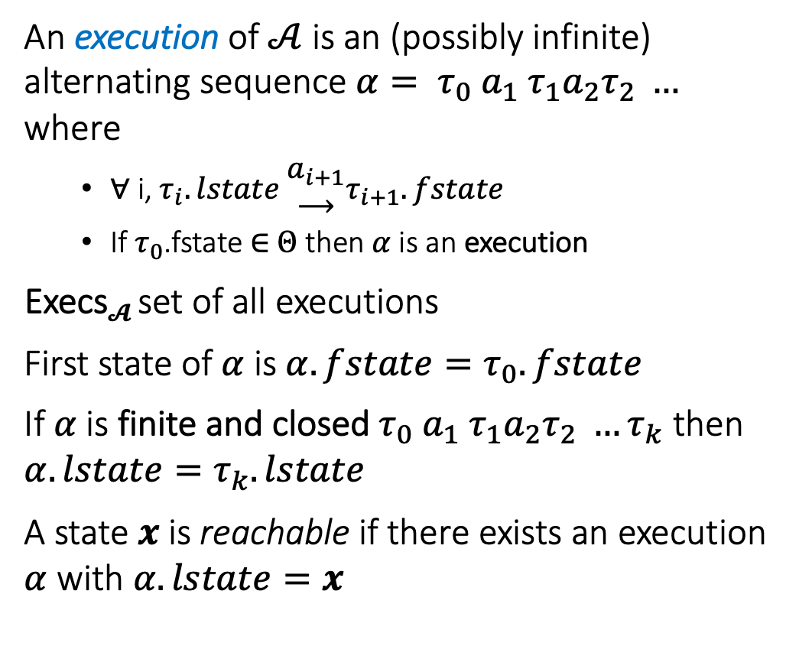
Semantics: Executions and Traces
An execution of $𝒜$ is an (possibly infinite) alternating sequence $α= τ_{0} a_{1} τ_{1}a_{2}τ_{2} …$ where
∀ i, $τ_{i}.lstate \begin{matrix}a_{i+1} \\ ⟶\end{matrix}τ_{i+1}.fstate$
If $τ_{0}$.fstate ∈ $Θ$ then $α$is an execution
Execs$𝓐$ set of all executions
First state of $α$ is $α.fstate=τ_{0}.fstate$
If $α$is finite and closed $τ_{0} a_{1} τ_{1}a_{2}τ_{2} …τ_{k}$ then $α.lstate=τ_{k}.lstate$
A state $x$is reachable if there exists an execution $α$ with $α.lstate=x$
turnOff
turnOff
turnOn
turnOn
turnOn

Slide 9
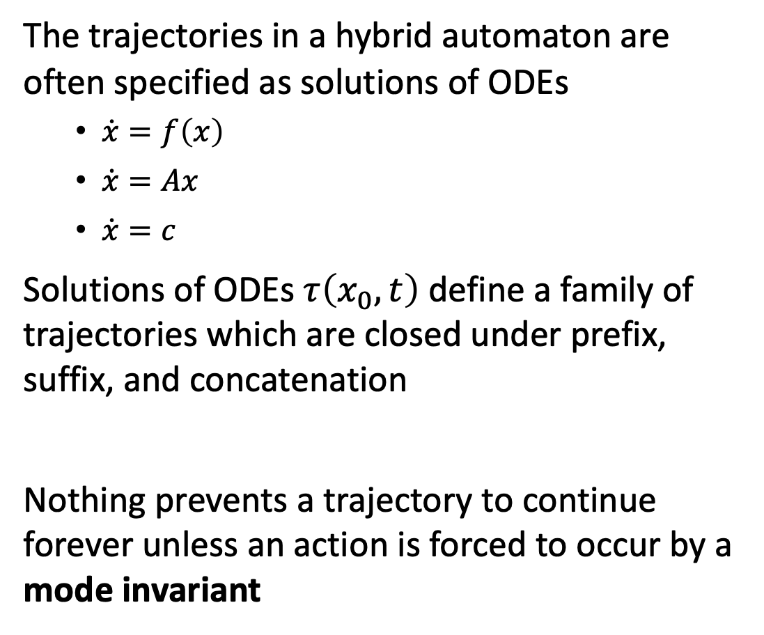
Mode invariants: Urgency in transitions
The trajectories in a hybrid automaton are often specified as solutions of ODEs
$\dot{x}=f\left(x\right)$
$\dot{x}=Ax$
$\dot{x}=c$
Solutions of ODEs $τ\left(x_{0},t\right)$ define a family of trajectories which are closed under prefix, suffix, and concatenation
Nothing prevents a trajectory to continue forever unless an action is forced to occur by a mode invariant
turnOff
turnOff
turnOn
turnOn
turnOn

Slide 10
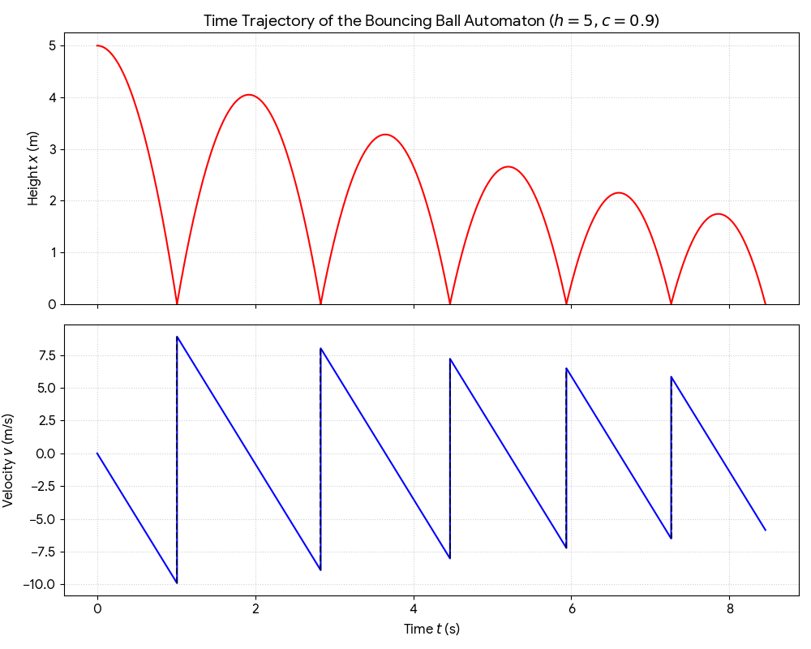
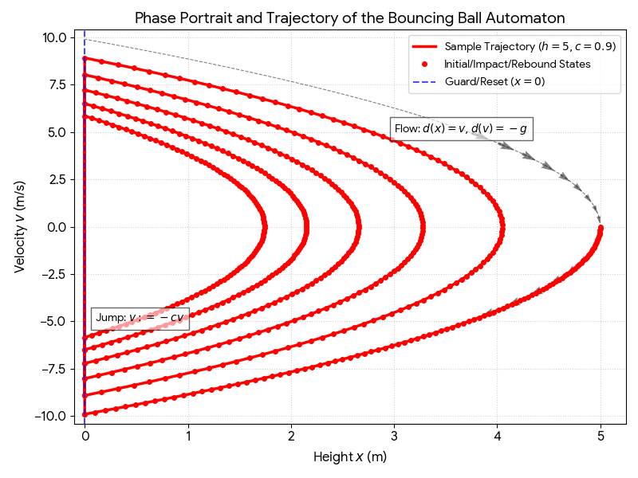
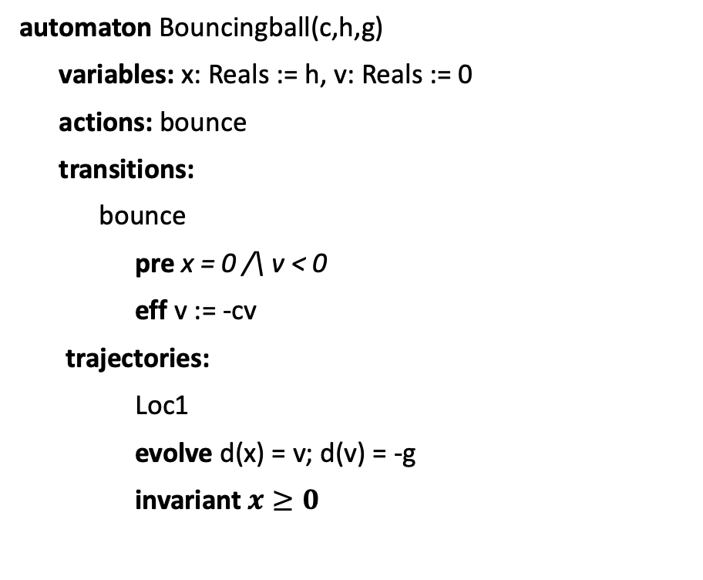
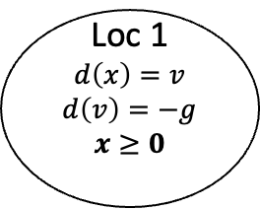
Example. Bouncing Ball
automaton Bouncingball(c,h,g)
variables: x: Reals := h, v: Reals := 0
actions: bounce
transitions:
bounce
pre x = 0 /\ v < 0
eff v := -cv
trajectories:
Loc1
evolve d(x) = v; d(v) = -g
invariant $x≥0$
bounce
x = 0 /\ v < 0
v’ := -cv
Loc 1
$$d\left(x\right)=v$$
$$d\left(v\right)=−g$$
$$x≥0$$
x:= h
mode invariant, not to be confused with invariants of the automaton
Graphical Representation used in many articles
Notes:
Guard, Precondition
Effect, Reset map
Invariance

Slide 11
Urgency: Must transitions
automaton Thermostat(u, l, K, h,d : Real) where u > l
type Status enumeration [on, off ] actions
turnOn; turnOff;
variables
x: Real := l loc: Status := on
transitions
turnOn
pre x≤l ∧ loc=off
eff loc := on
trajectories
modeOn
evolve d(x) = K(h − x)
invariant loc = on ∧ x ≤ u + d
turnOff
pre x≥u ∧ loc=on
eff loc := off
modeOff
evolve d(x) = −Kx
invariant loc = off ∧ x ≥ l - d
An urgent transition (or action) is an action that has to occur as soon as it is enabled
Introduce special syntax for creating urgent transitions, but we can use mode invariants to accomplish this

Slide 12
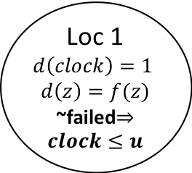
Another Example: Periodically Sending Process
Automaton PeriodicSend(u)
variables: analog
clock: Reals := 0, z:Reals, failed:Boolean := F
actions: send(m:Reals), fail
transitions:
send(m)
pre clock = u /\ m = z /\ ~failed
eff clock := 0
fail
pre true
eff failed := T
trajectories:
evolve d(clock) = 1, d(z) = f(z)
invariant failed \/ clock<=u
send(m)
clock = u /\ m = z /\ ~failed
clock := 0
Loc 1
$$d\left(clock\right)=1$$
$$d\left(z\right)=f(z)$$
~failed$⇒clock≤u$
clock:= 0
fail
true
failed := T

Slide 13


Zeno’s Paradox
Achilles, the fastest athlete, greatest warrior
Zeno, Greek philosopher
whatever!
You couldn’t even beat a turtle
Achilles runs 10 times faster than than the tortoise, but the turtle gets to start 1 second earlier. Can Achilles ever catch Turtle?
Lesson: Mixing discrete transitions with continuous motion can be tricky!
After 1/10th of a second, Achilles reaches where the Turtle (T) started, and T has a head start of 1/10th second.
After another 1/100th of a second, A catches up to where T was at t=1/10 sec, but T has a head start of 1/100th
…
T is always ahead …
Notes:
5 mins.

Slide 14



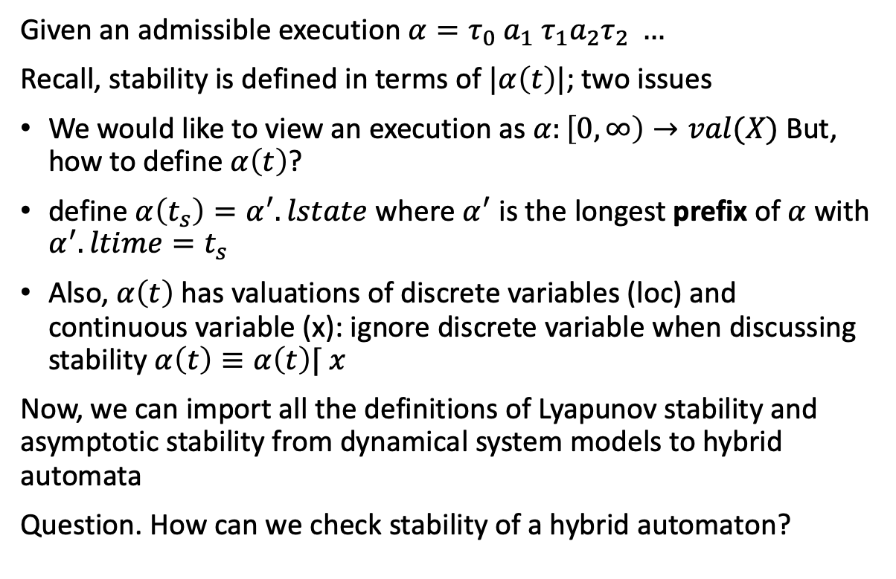





Defining stability of hybrid automata
$$α(t_{s})$$
$$τ_{3}$$
Given an admissible execution $α=τ_{0} a_{1} τ_{1}a_{2}τ_{2} …$
Recall, stability is defined in terms of $|α\left(t\right)|$; two issues
We would like to view an execution as $α:\left[0,∞\right)→val(X)$ But, how to define $α\left(t\right)$?
define $α\left(t_{s}\right)=α^{′}.lstate$ where $α^{′}$ is the longest prefix of $α$ with $α^{′}.ltime=t_{s}$
Also, $α\left(t\right)$ has valuations of discrete variables (loc) and continuous variable (x): ignore discrete variable when discussing stability $α\left(t\right)≡α\left(t\right)⌈ x$
Now, we can import all the definitions of Lyapunov stability and asymptotic stability from dynamical system models to hybrid automata
Question. How can we check stability of a hybrid automaton?
$$τ_{2}$$
$$τ_{1}$$
$$α(t)$$
$$τ_{0}$$
$t_{s}$
time

Slide 15
Stability of a hybrid automaton
Each of the modes of a walking robot are asymptotically stable
Is it possible to switch between them to make the system unstable?
Walk
Run

Slide 16
Yes! By switching between them the system becomes unstable
Walk
Run
Notes:
So, 300 years of mathematics developed for analyzing physics will not be enough for analyzing systems like self-driving cars where computers switch between different physics

Slide 17
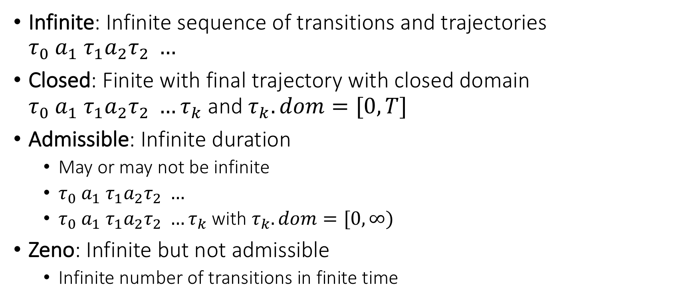
Special kinds of executions
Infinite: Infinite sequence of transitions and trajectories $τ_{0} a_{1} τ_{1}a_{2}τ_{2} …$
Closed: Finite with final trajectory with closed domain $τ_{0} a_{1} τ_{1}a_{2}τ_{2} …τ_{k}$ and $τ_{k}.dom=[0,T]$
Admissible: Infinite duration
May or may not be infinite
$τ_{0} a_{1} τ_{1}a_{2}τ_{2} …$
$τ_{0} a_{1} τ_{1}a_{2}τ_{2} …τ_{k}$ with $τ_{k}.dom=[0,∞)$
Zeno: Infinite but not admissible
Infinite number of transitions in finite time

Slide 18
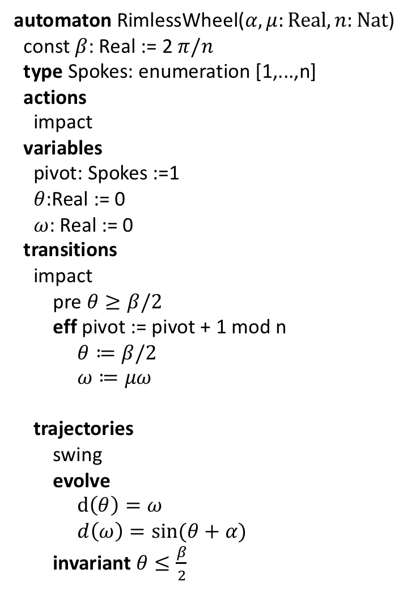
Rimless wheel
automaton RimlessWheel($α,μ:Real, n:Nat$)
const $β$: Real := 2 $π/n$
type Spokes: enumeration [1,...,n]
actions
impact
variables
pivot: Spokes :=1
$θ$:Real := 0
$ω$: Real := 0
transitions
impact
pre $θ≥β/2$
eff pivot := pivot + 1 mod n
$θ≔β/2$
$ω≔μω$
trajectories
swing
evolve
$d\left(θ\right)=ω$
$d\left(ω\right)=\sin{(θ+α)}$
invariant $θ≤\frac{β}{2}$

Slide 19
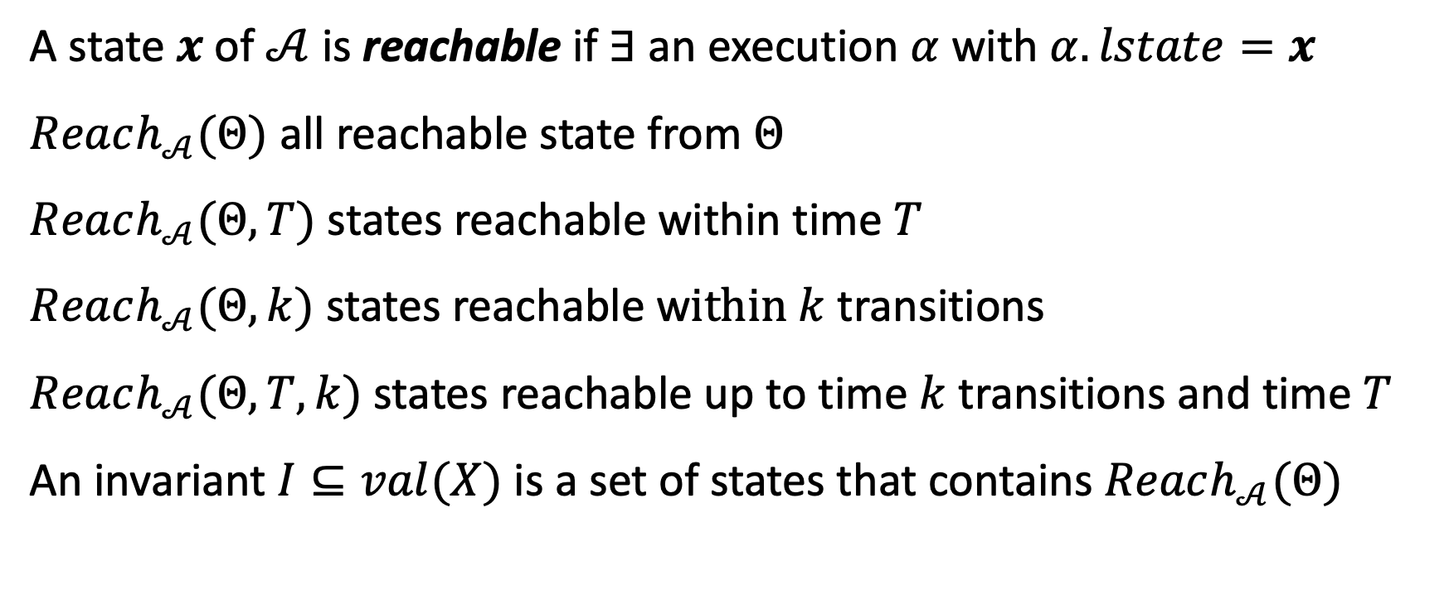
Invariants and reachability
A state $x$of $𝒜$ is reachable if $∃$ an execution $α$ with $α.lstate=x$
$Reach_{𝒜}(Θ)$ all reachable state from $Θ$
$Reach_{𝒜}(Θ,T)$ states reachable within time $T$
$Reach_{𝒜}(Θ,k)$ states reachable w$ithin k$ transitions
$Reach_{𝒜}(Θ,T,k)$ states reachable up to time $k$ transitions and time $T$
An invariant $I⊆val(X)$ is a set of states that contains $Reach_{𝒜}(Θ)$

Slide 20

How to prove invariants of hybrid automata
Recall the theorem we used for proving I is an invariant for automaton$𝒜=⟨X,Θ, A,D⟩$
Theorem 7.1. Given an automaton $𝒜=⟨X,Θ, A,D⟩$, if a set of states $I⊆val\left(X\right)$ satisfies the following:
(Start condition) For any starting state $x∈Θ, x∈I$ and
(Transition closure) For any action $a∈A$, if and $x→_{a}x^{′}$and $x∈I$ then $x^{′}∈I$, and
Then $I$ is an inductive invariant of $𝒜$.

Slide 21

How to prove invariants of hybrid automata
Theorem 7.1. Given an HIOA $𝒜=⟨X,Θ, A,D, T⟩$, if a set of states $I⊆val\left(X\right)$ satisfies the following:
(Start condition) For any starting state $x∈Θ, x∈I$ and
(Transition closure) For any action $a∈A$, if and $x→_{a}x^{′}$and $x∈I$ then $x^{′}∈I$, and
(Trajectory closure) For any trajectory $τ∈T$ if $τ.fstate∈I$ then $τ.lstate∈I$
Then $I$ is an inductive invariant of $𝒜$.

Slide 22
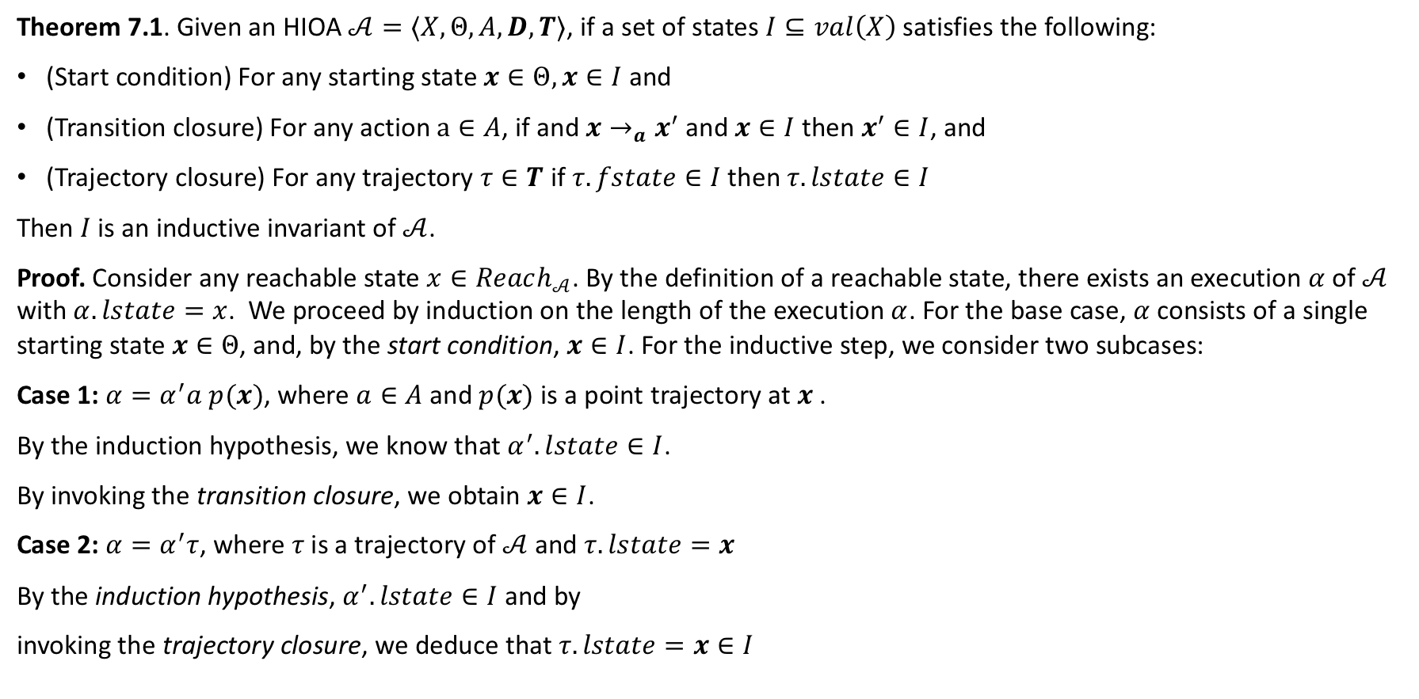
How to prove invariants of hybrid automata
Theorem 7.1. Given an HIOA $𝒜=⟨X,Θ, A,D, T⟩$, if a set of states $I⊆val\left(X\right)$ satisfies the following:
(Start condition) For any starting state $x∈Θ, x∈I$ and
(Transition closure) For any action $a∈A$, if and $x→_{a}x^{′}$and $x∈I$ then $x^{′}∈I$, and
(Trajectory closure) For any trajectory $τ∈T$ if $τ.fstate∈I$ then $τ.lstate∈I$
Then $I$ is an inductive invariant of $𝒜$.
Proof. Consider any reachable state $x∈Reach_{𝒜}$. By the definition of a reachable state, there exists an execution $α$ of $𝒜$ with $α.lstate=x$. We proceed by induction on the length of the execution $α$. For the base case, $α$consists of a single starting state $x∈Θ$, and, by the start condition, $x∈I$. For the inductive step, we consider two subcases:
Case 1: $α=α^{′}a p(x)$, where $a∈A$ and $p(x)$ is a point trajectory at $x$ .
By the induction hypothesis, we know that $α^{′}.lstate∈I$.
By invoking the transition closure, we obtain $x∈I$.
Case 2: $α=α^{′}τ$, where $τ$is a trajectory of $𝒜$ and $τ.lstate=x$
By the induction hypothesis, $α^{′}.lstate∈I$ and by
invoking the trajectory closure, we deduce that $τ.lstate=x∈I$

Slide 23
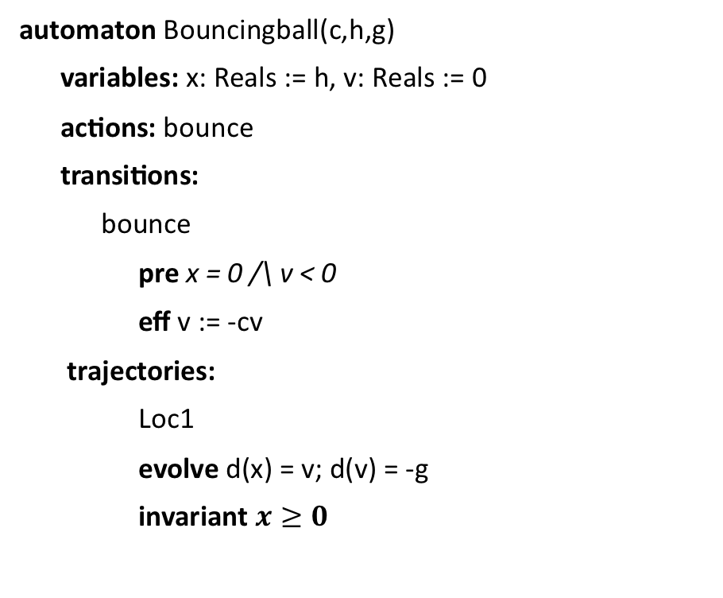
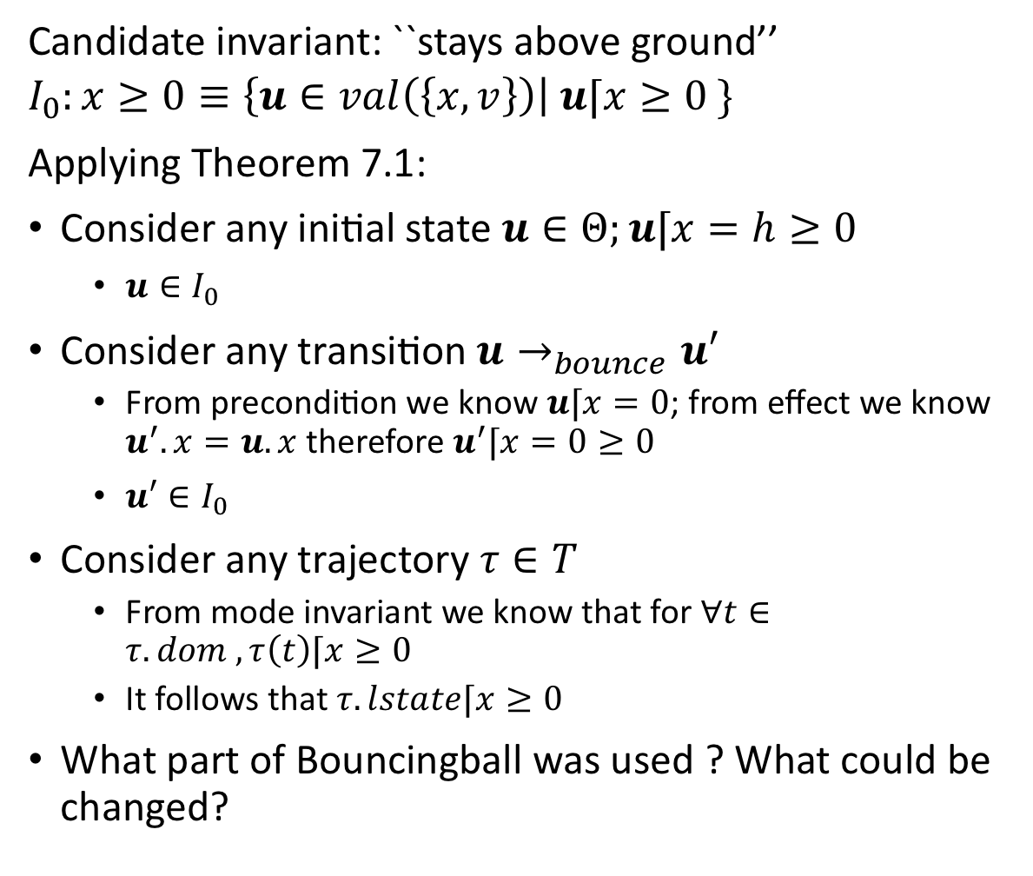
An application
Candidate invariant: ``stays above ground’’
$$I_{0}:x≥0≡\left\{u∈val\left(\left\{x,v\right\}\right)\right| u⌈x≥0 \}$$
Applying Theorem 7.1:
Consider any initial state $u∈Θ;u⌈x=h≥0$
$u∈I_{0}$
Consider any transition $u→_{bounce}u′$
From precondition we know $u⌈x=0$; from effect we know $u^{′}.x=u.x$ therefore $u^{′}⌈x=0≥0$
$u′∈I_{0}$
Consider any trajectory $τ∈T$
From mode invariant we know that for $∀t∈τ. dom , τ\left(t\right)⌈x≥0$
It follows that $τ.lstate⌈x≥0$
What part of Bouncingball was used ? What could be changed?
automaton Bouncingball(c,h,g)
variables: x: Reals := h, v: Reals := 0
actions: bounce
transitions:
bounce
pre x = 0 /\ v < 0
eff v := -cv
trajectories:
Loc1
evolve d(x) = v; d(v) = -g
invariant $x≥0$

Slide 24
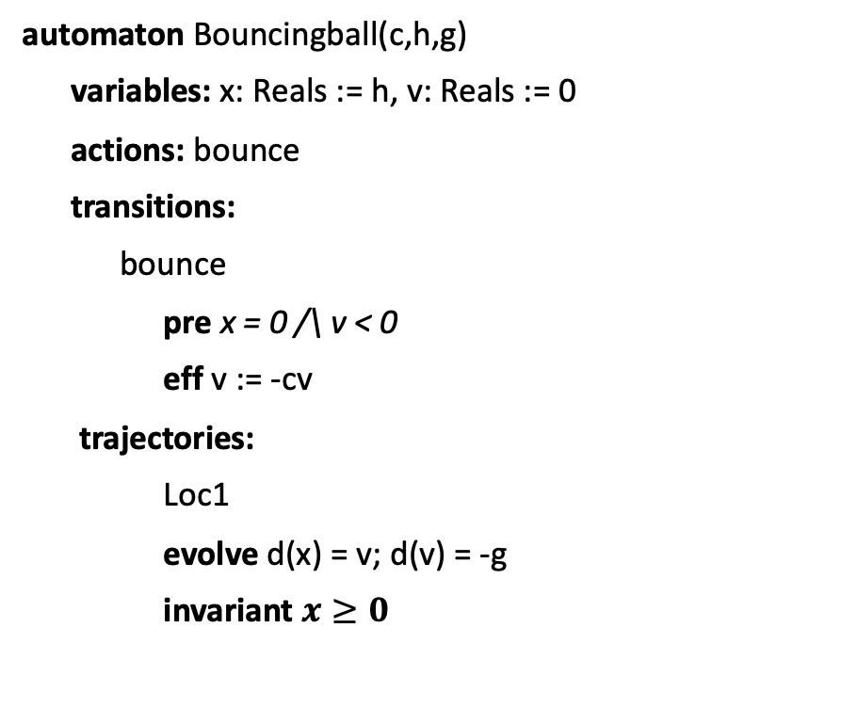
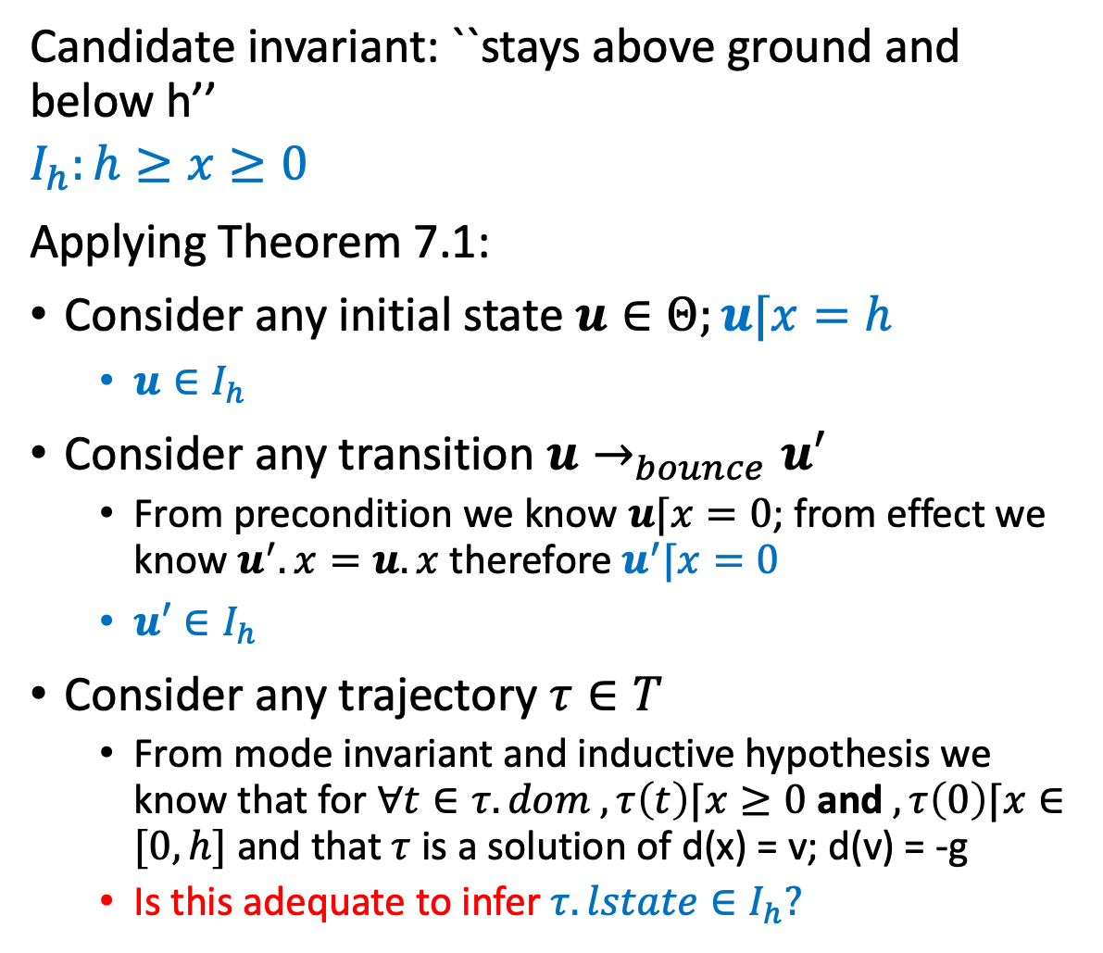
An application
Candidate invariant: ``stays above ground and below h’’
$$I_{h}:h≥x≥0$$
Applying Theorem 7.1:
Consider any initial state $u∈Θ;u⌈x=h$
$u∈I_{h}$
Consider any transition $u→_{bounce}u′$
From precondition we know $u⌈x=0$; from effect we know $u^{′}.x=u.x$ therefore $u^{′}⌈x=0$
$u′∈I_{h}$
Consider any trajectory $τ∈T$
From mode invariant and inductive hypothesis we know that for $∀t∈τ. dom , τ\left(t\right)⌈x≥0$ and $, τ\left(0\right)⌈x∈[0,h]$ and that $τ$ is a solution of d(x) = v; d(v) = -g
Is this adequate to infer $τ. lstate∈I_{h}?$
automaton Bouncingball(c,h,g)
variables: x: Reals := h, v: Reals := 0
actions: bounce
transitions:
bounce
pre x = 0 /\ v < 0
eff v := -cv
trajectories:
Loc1
evolve d(x) = v; d(v) = -g
invariant $x≥0$

Slide 25
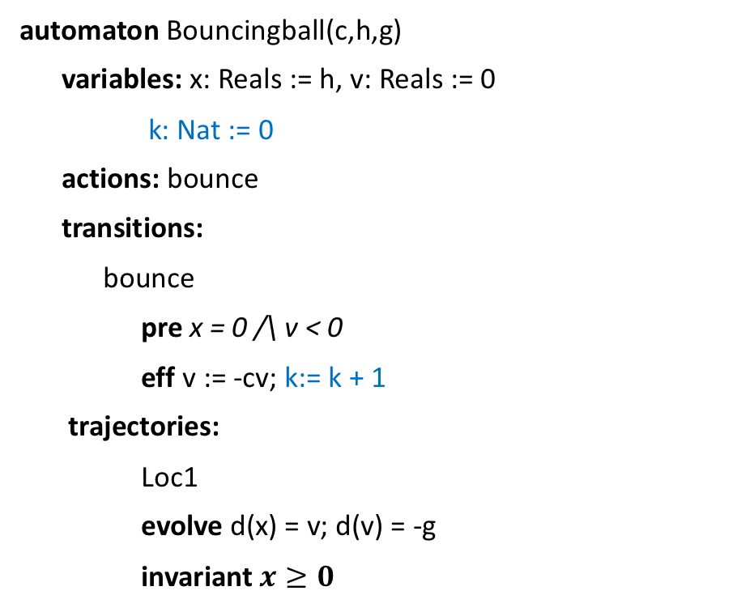

Strengthened invariant
Candidate invariant: ``stays above ground and below h’’
$$I_{v}:v^{2}−2g\left(hc^{2k}−x\right)=0$$
Applying Theorem 7.1:
Consider any initial state $u∈Θ;u⌈x=h$; $u⌈k=0$
$u∈I_{v}$
Exercise: Finish the rest
automaton Bouncingball(c,h,g)
variables: x: Reals := h, v: Reals := 0
k: Nat := 0
actions: bounce
transitions:
bounce
pre x = 0 /\ v < 0
eff v := -cv; k:= k + 1
trajectories:
Loc1
evolve d(x) = v; d(v) = -g
invariant $x≥0$

Slide 26
Summary
Theorem 7.1 gives a sufficient condition for proving inductive invariants
Not all invariants are inductive
We often have to strengthen invariants to make them inductive
Read examples in Chapter 7

Slide 27
Floyd-Hoare Proofs
The core idea of inductive invariants dates back to program analysis technique called Floyd-Hoare logic (1969) which gives a set of rules for deducing correctness of automata, programs
The logic is built on Hoare triples, which describes how the execution of a statement (or line of code) changes the state of the automaton:
P c Q where
P and Q are predicates on the program variables and are called the precondition and postcondition
c is a statement describing program variable change
The triple implies that when the precondition P is met, execution of c establishes the postcondition Q

Slide 28

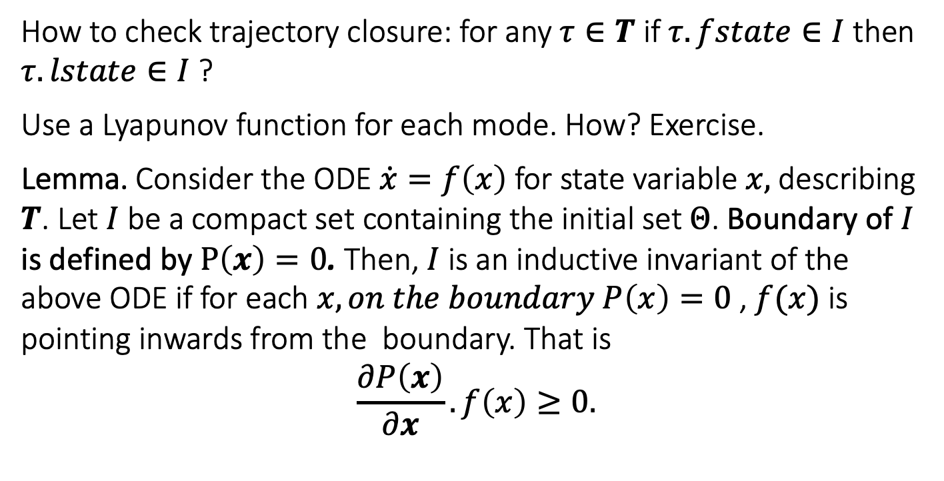


Sub-tangential conditions. Checking trajectory conditions without solving ODEs [Bhatia and Szegö 67]
How to check trajectory closure: for any $τ∈T$ if $τ.fstate∈I$ then $τ.lstate∈I$ ?
Use a Lyapunov function for each mode. How? Exercise.
Lemma. Consider the ODE $\dot{x}=f\left(x\right)$ for state variable $x,$ describing $T$. Let $I$ be a compact set containing the initial set $Θ$. Boundary of $I$ is defined by $P\left(x\right)=0$. Then, $I$ is an inductive invariant of the above ODE if for each $x,on the boundary P\left(x\right)=0$ , $f(x)$ is pointing inwards from the boundary. That is
$$\frac{∂P\left(x\right)}{∂x}.f\left(x\right)≥0.$$
$$f(x)$$
$$I$$
$$P\left(x\right)=0$$
Related to the notions of Barrier Certificates and more general Control Barrier Functions.

Slide 29
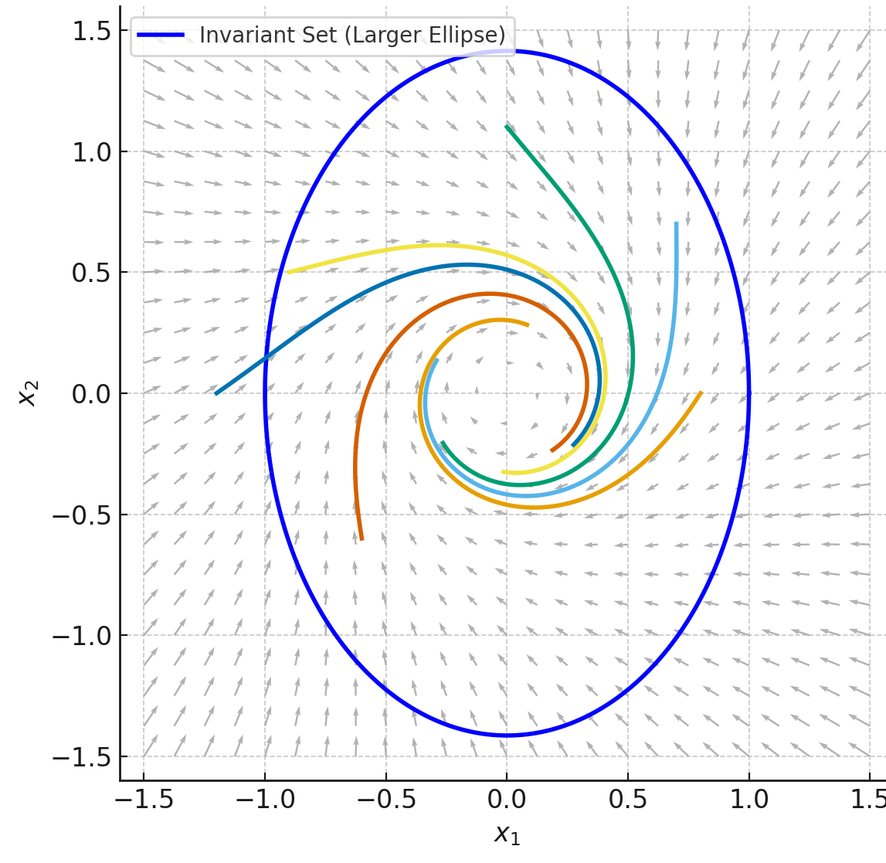
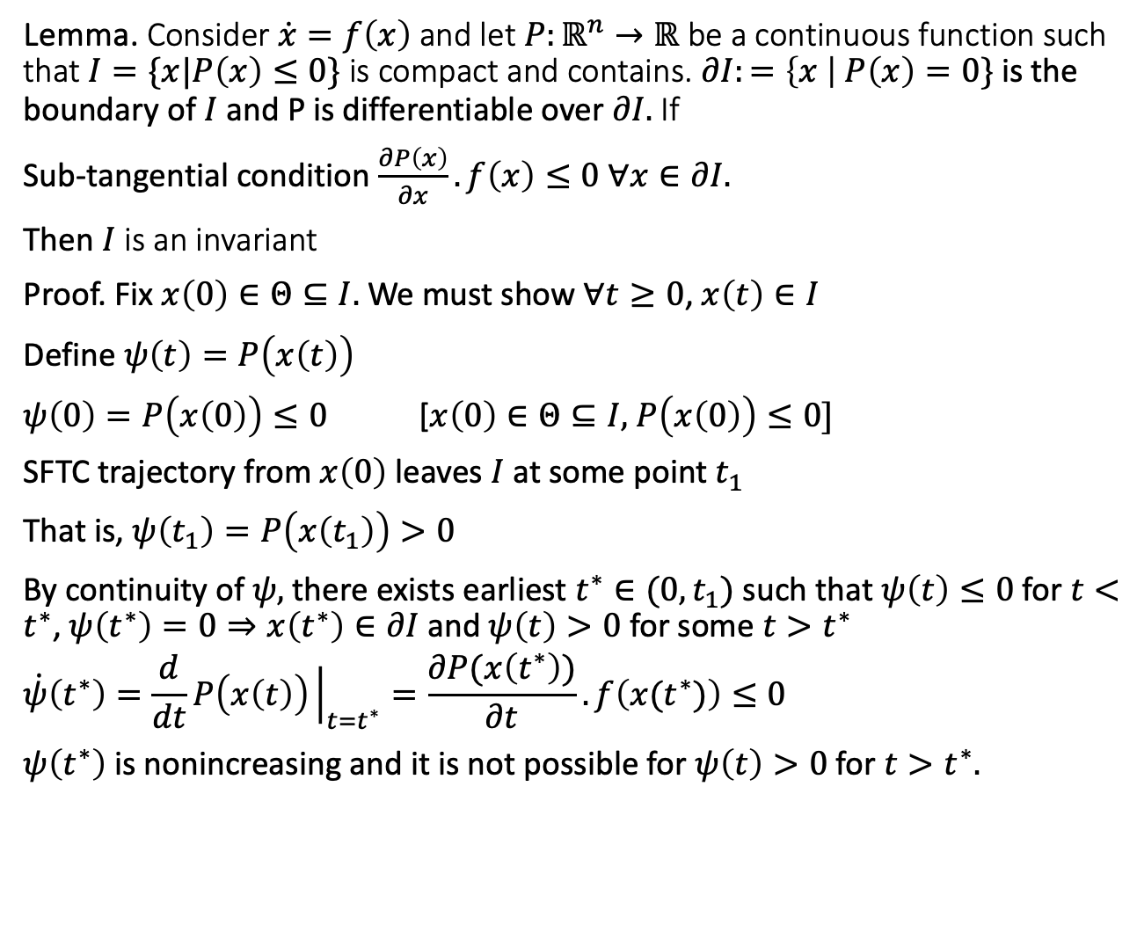
Proving invariance using subtangential condition
Lemma. Consider $\dot{x}=f\left(x\right)$ and let $P:ℝ^{n}→ℝ$ be a continuous function such that $I=\{x|P\left(x\right)≤0\}$ is compact and contains. $∂I:=\left\{x \right|$ $P\left(x\right)=0\}$ is the boundary of $I$ and P is differentiable over $∂I.$ If
Sub-tangential condition $\frac{∂P\left(x\right)}{∂x}.f\left(x\right)≤0 ∀x∈∂I.$
Then $I$ is an invariant
Proof. Fix $x\left(0\right)∈Θ⊆I.$ We must show $∀t≥0$, $x\left(t\right)∈I$
Define $ψ\left(t\right)=P\left(x\left(t\right)\right)$
$ψ\left(0\right)=P\left(x\left(0\right)\right)≤0$ [$x\left(0\right)∈Θ⊆I,$ $P\left(x\left(0\right)\right)≤0]$
SFTC trajectory from $x\left(0\right)$ leaves $I$ at some point $t_{1}$
That is, $ψ\left(t_{1}\right)=P\left(x\left(t_{1}\right)\right)>0$
By continuity of $ψ,$ there exists earliest $t^{∗}∈(0,t_{1})$ such that $ψ\left(t\right)≤0$ for $t<t^{∗}$, $ψ\left(t^{∗}\right)=0⇒x\left(t^{∗}\right)∈∂I$and $ψ\left(t\right)>0$ for some $t>t^{∗}$
$$\dot{ψ}\left(t^{∗}\right)=\frac{d}{dt}P\left(x\left(t\right)\right){\left.​\right|}_{t=t^{∗}}=\frac{∂P(x\left(t^{∗}\right))}{∂t}. f\left(x(t^{∗})\right)≤0$$
$ψ\left(t^{∗}\right)$ is nonincreasing and it is not possible for $ψ\left(t\right)>0$ for $t>t^{∗}.$

Slide 30
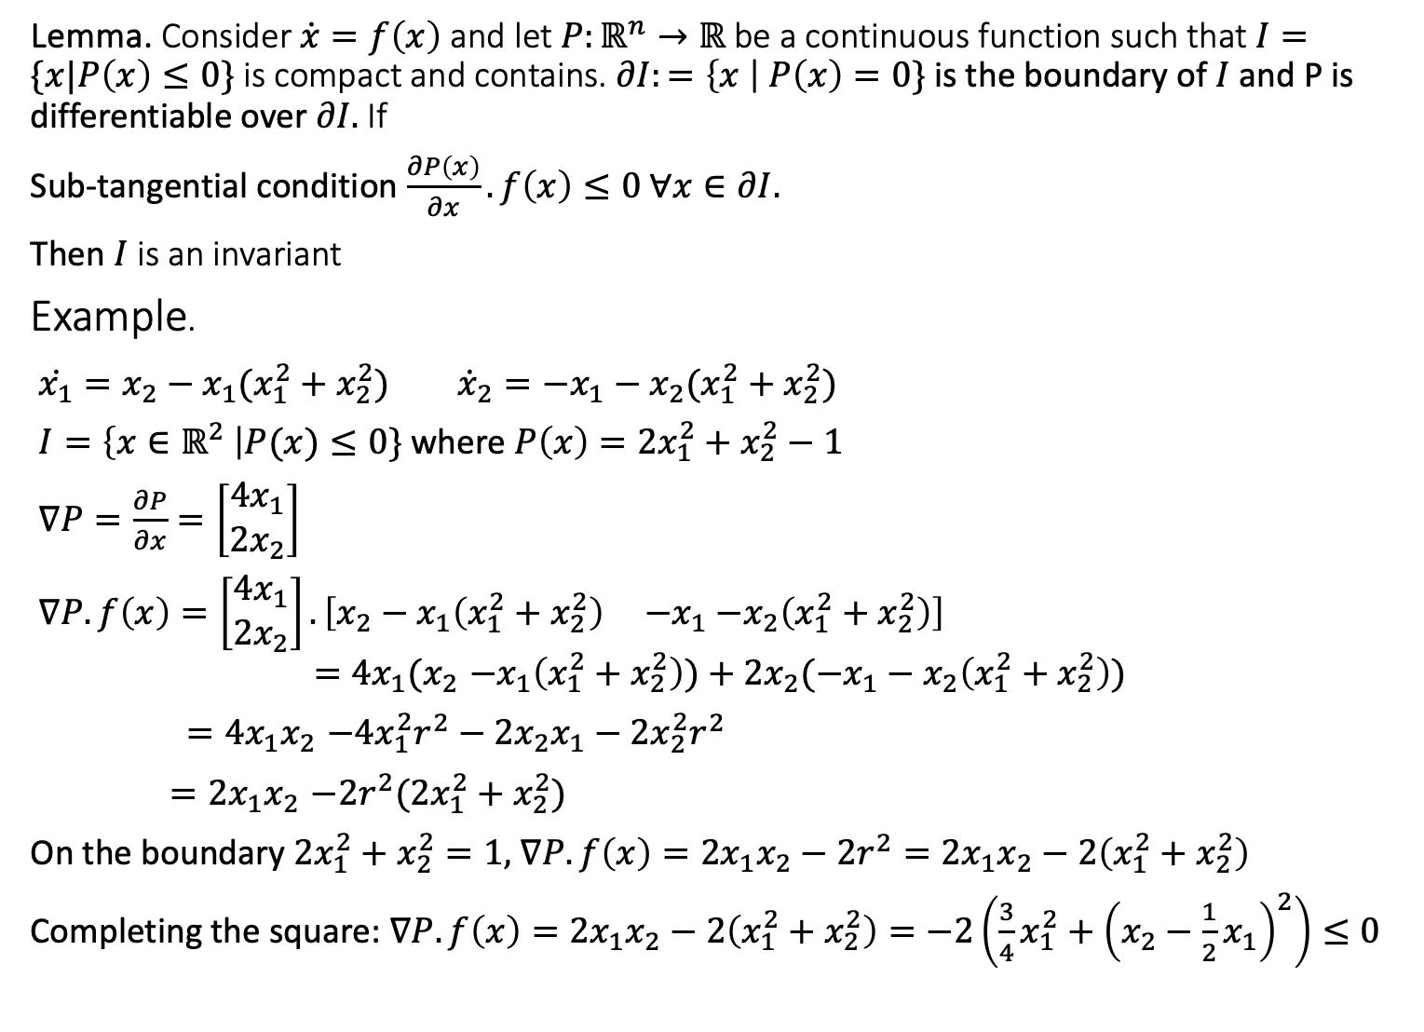
Lemma. Consider $\dot{x}=f\left(x\right)$ and let $P:ℝ^{n}→ℝ$ be a continuous function such that $I=\{x|P\left(x\right)≤0\}$ is compact and contains. $∂I:=\left\{x \right|$ $P\left(x\right)=0\}$ is the boundary of $I$ and P is differentiable over $∂I.$ If
Sub-tangential condition $\frac{∂P\left(x\right)}{∂x}.f\left(x\right)≤0 ∀x∈∂I.$
Then $I$ is an invariant
Example.
$\dot{x_{1}}=x_{2}−x_{1}(x_{1}^{2}+x_{2}^{2})$ ${\dot{x}}_{2}=−x_{1}−x_{2}(x_{1}^{2}+x_{2}^{2})$
$I=\left\{x∈ℝ^{2} \right|P(x)≤0\}$ where $P\left(x\right)=2x_{1}^{2}+x_{2}^{2}−1$
$∇P=\frac{∂P}{∂x}=\left[\begin{matrix}4x_{1} \\ 2x_{2}\end{matrix}\right]$
$∇P.f\left(x\right)=\left[\begin{matrix}4x_{1} \\ 2x_{2}\end{matrix}\right].\left[x_{2}−x_{1}\left(x_{1}^{2}+x_{2}^{2}\right) {−x}_{1}−x_{2}\left(x_{1}^{2}+x_{2}^{2}\right)\right]$
$${=4x_{1}(x}_{2}−x_{1}\left(x_{1}^{2}+x_{2}^{2}\right))+2x_{2}({−x}_{1}−x_{2}\left(x_{1}^{2}+x_{2}^{2}\right))$$
${=4x_{1}x}_{2}−{4x}_{1}^{2}r^{2}−2x_{2}x_{1}−{2x}_{2}^{2}r^{2}$
${=2x_{1}x}_{2}−2r^{2}({2x}_{1}^{2}+x_{2}^{2})$
On the boundary $2x_{1}^{2}+x_{2}^{2}=1,$ $∇P.f\left(x\right)={2x_{1}x}_{2}−2r^{2}={2x_{1}x}_{2}−2\left(x_{1}^{2}+x_{2}^{2}\right)$
Completing the square: $∇P.f\left(x\right)={2x_{1}x}_{2}−2\left(x_{1}^{2}+x_{2}^{2}\right)=−2\left(\frac{3}{4}x_{1}^{2}+{\left(x_{2}−\frac{1}{2}x_{1}\right)}^{2}\right)≤0$

Slide 31
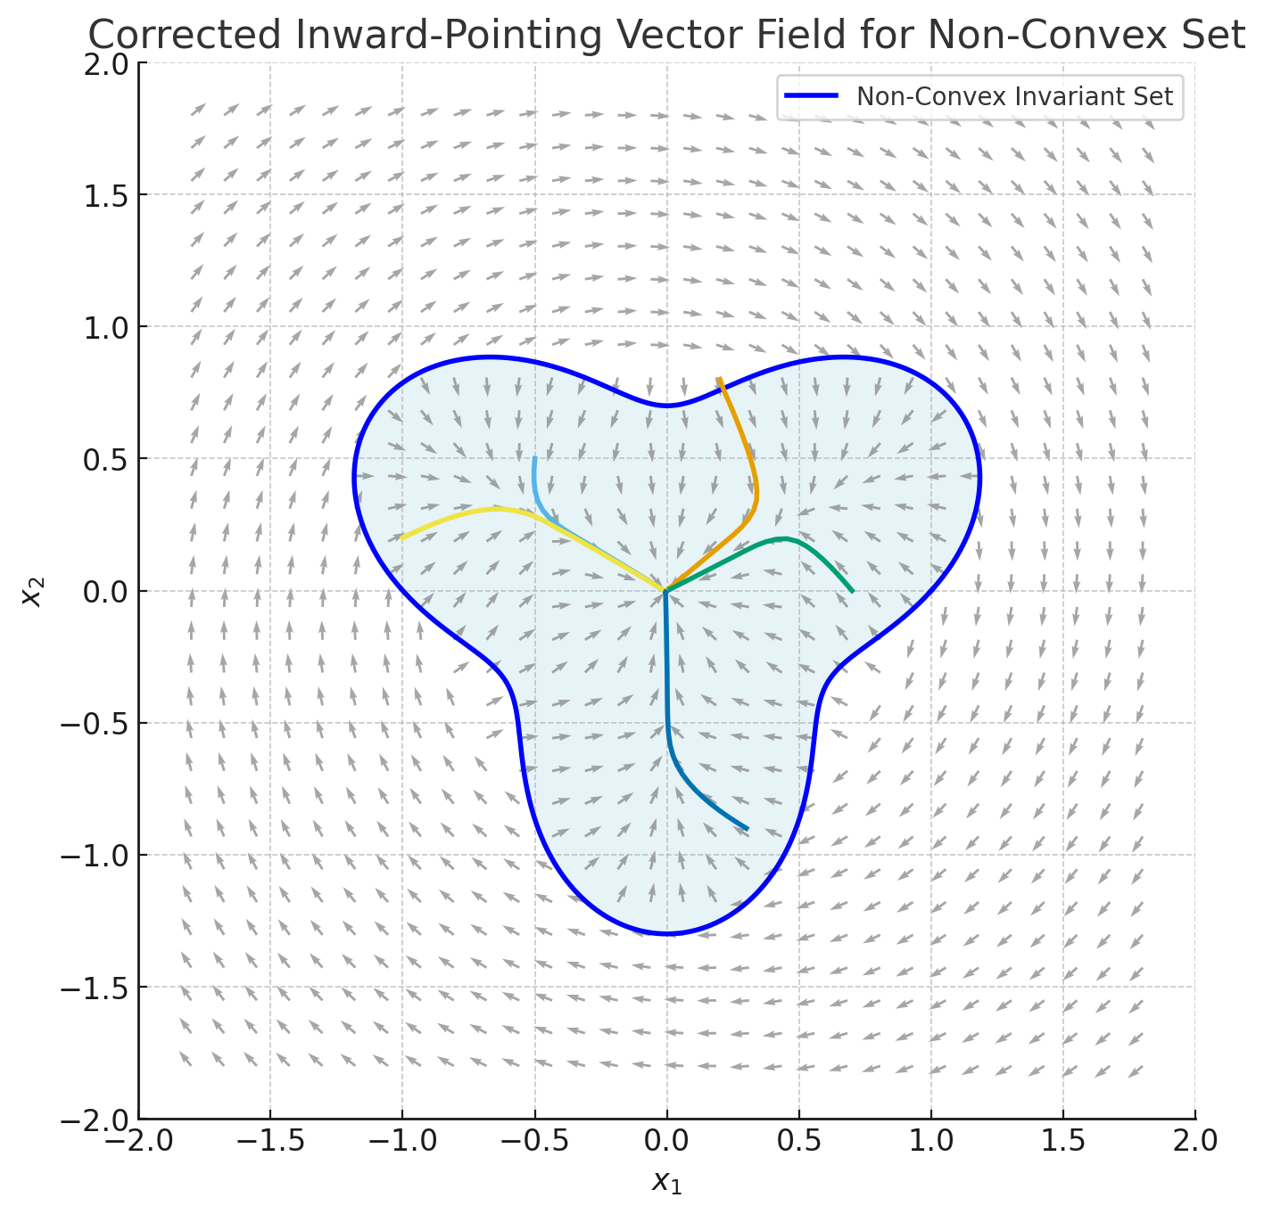
Another example

Slide 32
Checking sub-tangential condition in pieces
If the boundary is defined in pieces, for example, one fore each mode, then check the condition for each piece

Slide 33
Summary
Interesting features in hybrid models
Interaction between transitions, trajectories, and mode invariants can lead to extra sources of nondeterminism; transitions can be made urgent with mode invariants
Mode switches can make the system unstable
Zeno behavior
Inductive invariance proofs work with additional condition for trajectory closure
Trajectory closure can be checked with subtangential condition, Lyapunov functions, Barrier certificates

