Slide 1
Verifying Dynamical Systems: Stability Part 2
Sayan Mitra
Verifying cyberphysical systems
mitras@illinois.edu

Slide 2
Plan
Dynamical system models
Lyapunov method
Proofs
Examples
Stability of linear systems

Slide 3
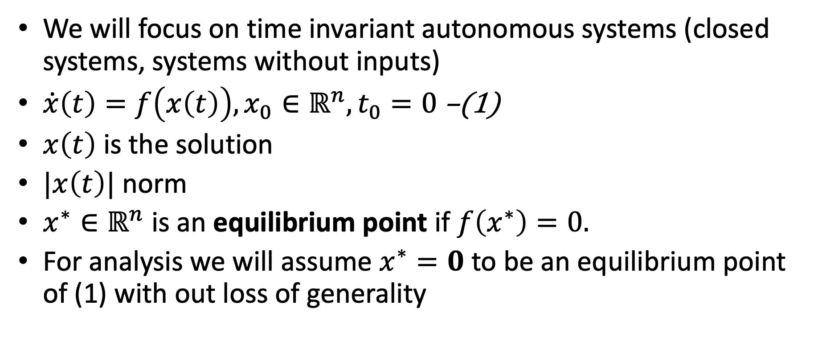
Requirements: Stability
We will focus on time invariant autonomous systems (closed systems, systems without inputs)
$\dot{x}\left(t\right)=f\left(x\left(t\right)\right), x_{0}∈ℝ^{n}, t_{0}=0$ –(1)
$x\left(t\right)$ is the solution
$|x\left(t\right)|$ norm
$x^{∗}∈ℝ^{n}$ is an equilibrium point if $f\left(x^{∗}\right)=0.$
For analysis we will assume $x^{∗}=0$ to be an equilibrium point of (1) with out loss of generality

Slide 4
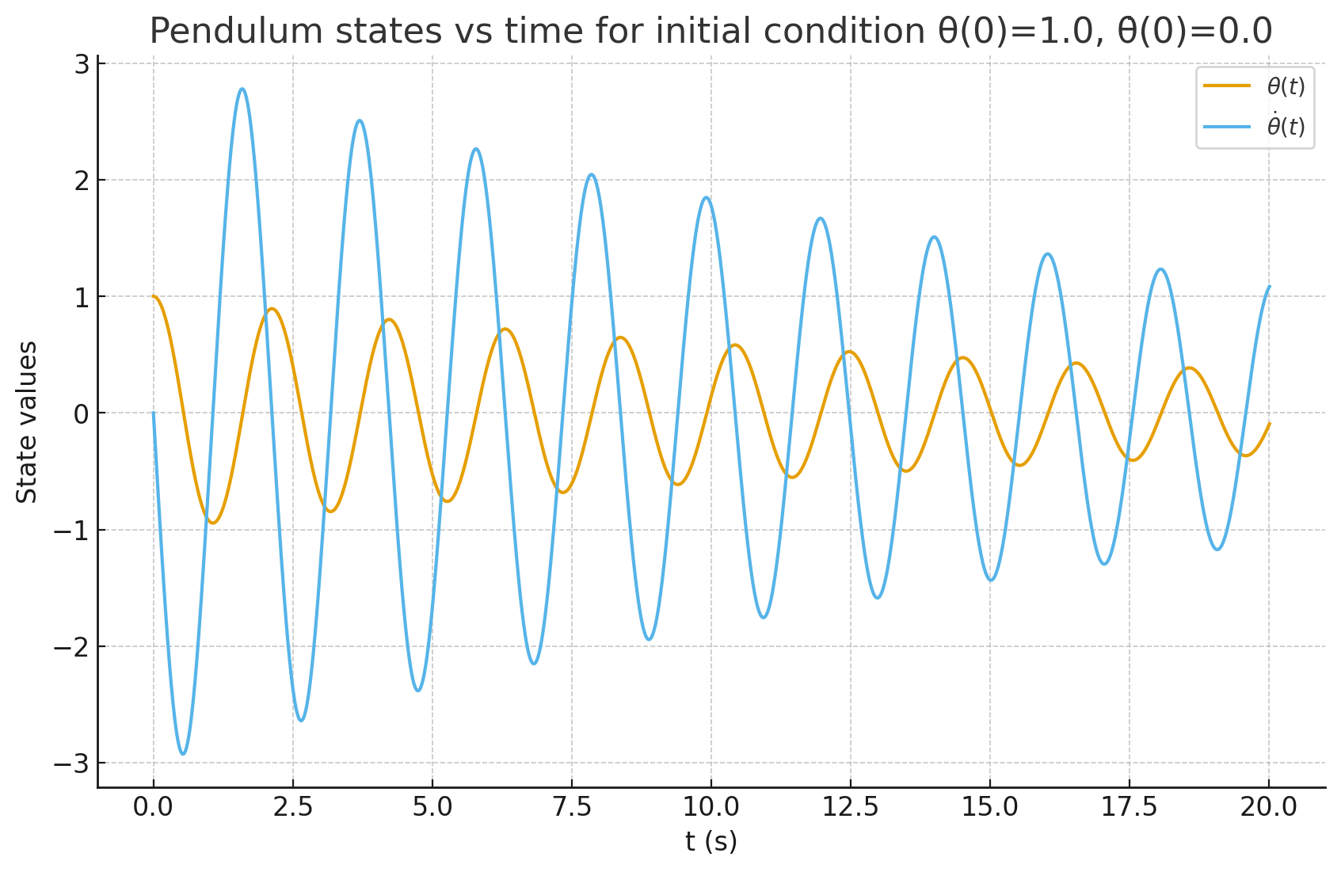

Example: Pendulum
Pendulum equation
$$x_{1}=θ x_{2}=\dot{θ}$$
$$x_{2}={\dot{x}}_{1}$$
$${\dot{x}}_{2}=−\frac{g}{l}\sin\left(x_{1}\right)−\frac{k}{m}x_{2}$$
$\left[\begin{matrix}\dot{x_{2}} \\ \dot{x_{1}}\end{matrix}\right]$= $\left[\begin{matrix}−\frac{g}{l}\sin\left(x_{1}\right)−\frac{k}{m}x_{2} \\ x_{2}\end{matrix}\right]$
$k:$ friction coefficient
Two equilibrium points: $\left(0,0\right), (π,0)$
upright
down

Slide 5
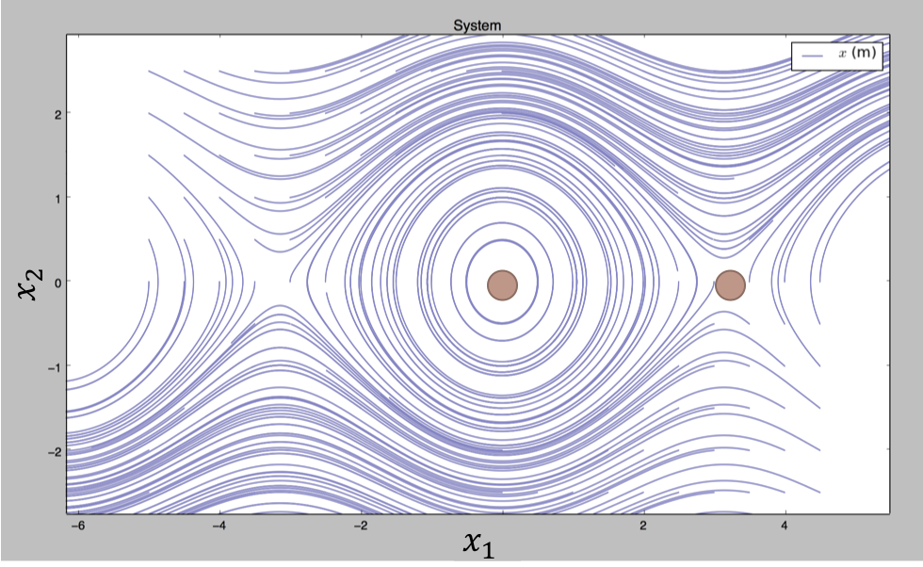
CW
stable
speed=0
unstable
upright
down
CCW
Notes:
left to right angle of the pendulum: line : hanging right at the bottom
up : higher speed CW, down higher speed CCW, on this line speed 0
Now as its hanging at the bottom I give the pen a slight tap.. give it some speed… and plot all the angles and the corresponding speeds… what would this look like?

Slide 6

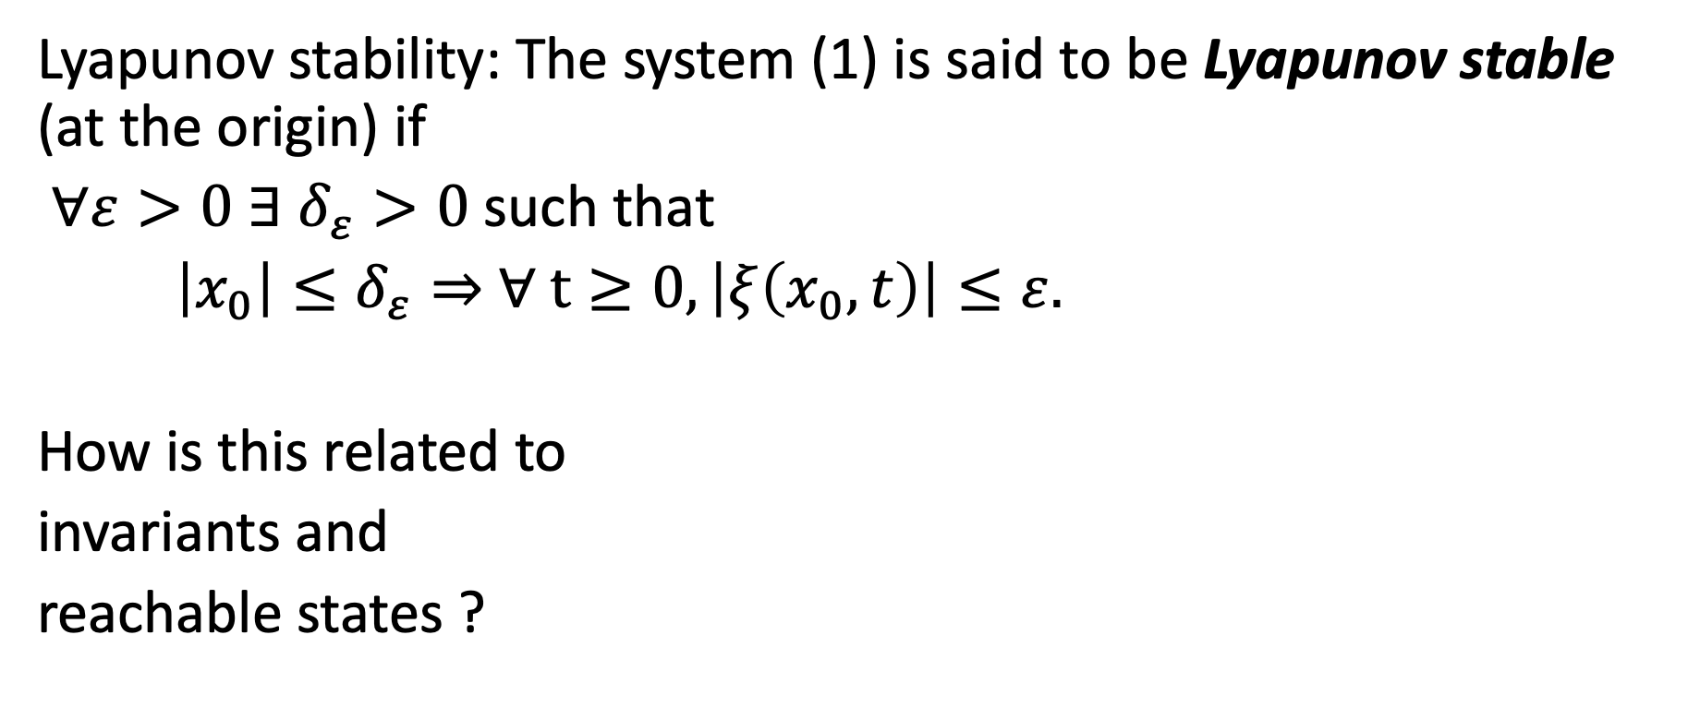


Lyapunov stability
Lyapunov stability: The system (1) is said to be Lyapunov stable (at the origin) if
$∀ε>0 ∃$ $δ_{ε}>0$such that
$\left|x_{0}\right|≤δ_{ε}⇒$ $∀ t≥0, \left|ξ\left(x_{0},t\right)\right|≤ε.$
How is this related to
invariants and
reachable states ?
$$δ_{ε}$$
$$ε$$
$$x_{0}$$

Slide 7

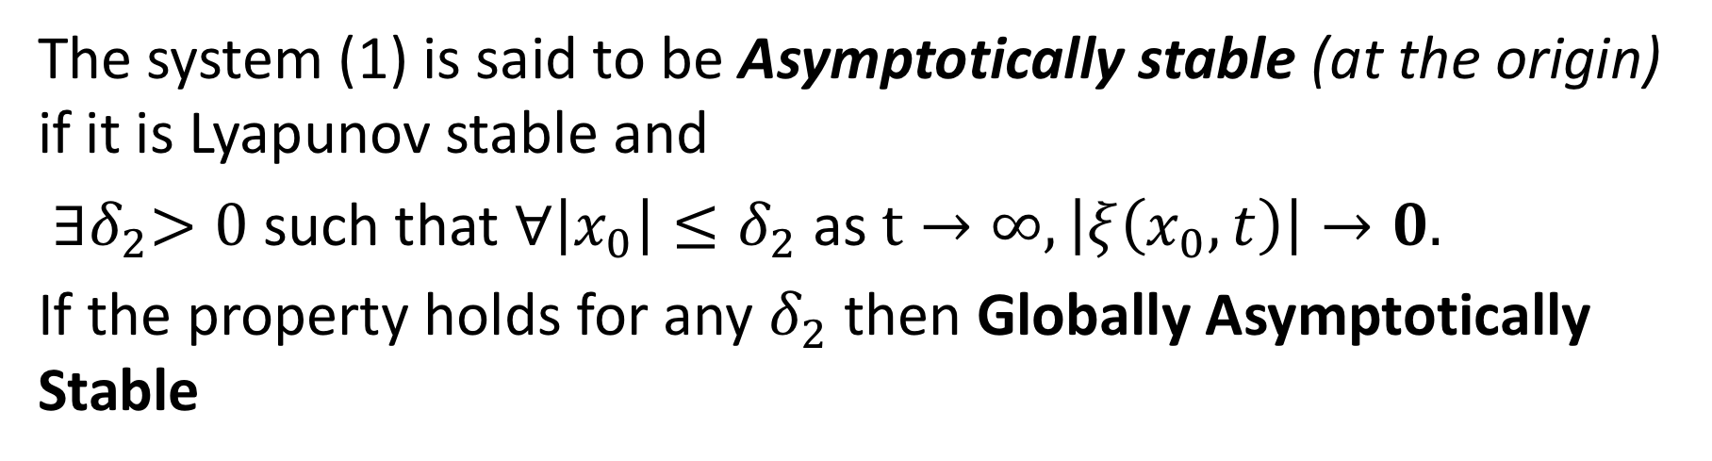

Asymptotically stability
The system (1) is said to be Asymptotically stable (at the origin) if it is Lyapunov stable and
${∃δ}_{2}>0$such that $∀\left|x_{0}\right|≤δ_{2}$ as $t→∞, \left|ξ\left(x_{0},t\right)\right|→0.$
If the property holds for any $δ_{2}$ then Globally Asymptotically Stable
$$δ_{2}$$
$$x_{0}$$

Slide 8
Phase portrait of pendulum with friction

Slide 9

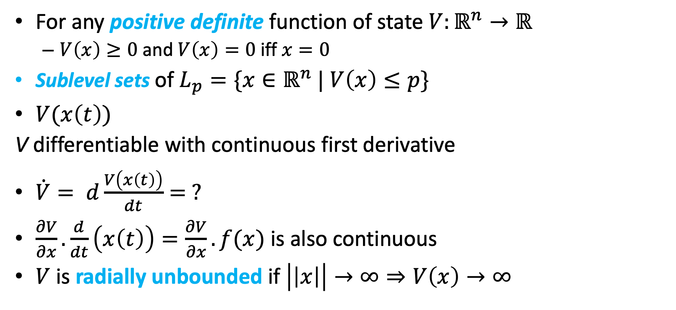



Stability of nonlinear systems
For any positive definite function of state $V:ℝ^{n}→ℝ$
$V\left(x\right)≥0$ and $V\left(x\right)=0$iff $x=0$
Sublevel sets of $L_{p}=\{x∈ℝ^{n}$ | $V\left(x\right)≤p\}$
$V(x\left(t\right))$
V differentiable with continuous first derivative
$\dot{V}= d\frac{V\left(x\left(t\right)\right)}{dt}= ?$
$\frac{∂V}{∂x}.\frac{d}{dt}\left(x\left(t\right)\right)=\frac{∂V}{∂x}.f(x)$ is also continuous
$V$ is radially unbounded if $\left|\left|x\right|\right|→∞⇒V\left(x\right)→∞$
$$q$$
$$p$$
$$L_{p}$$
$$L_{q}$$

Slide 10
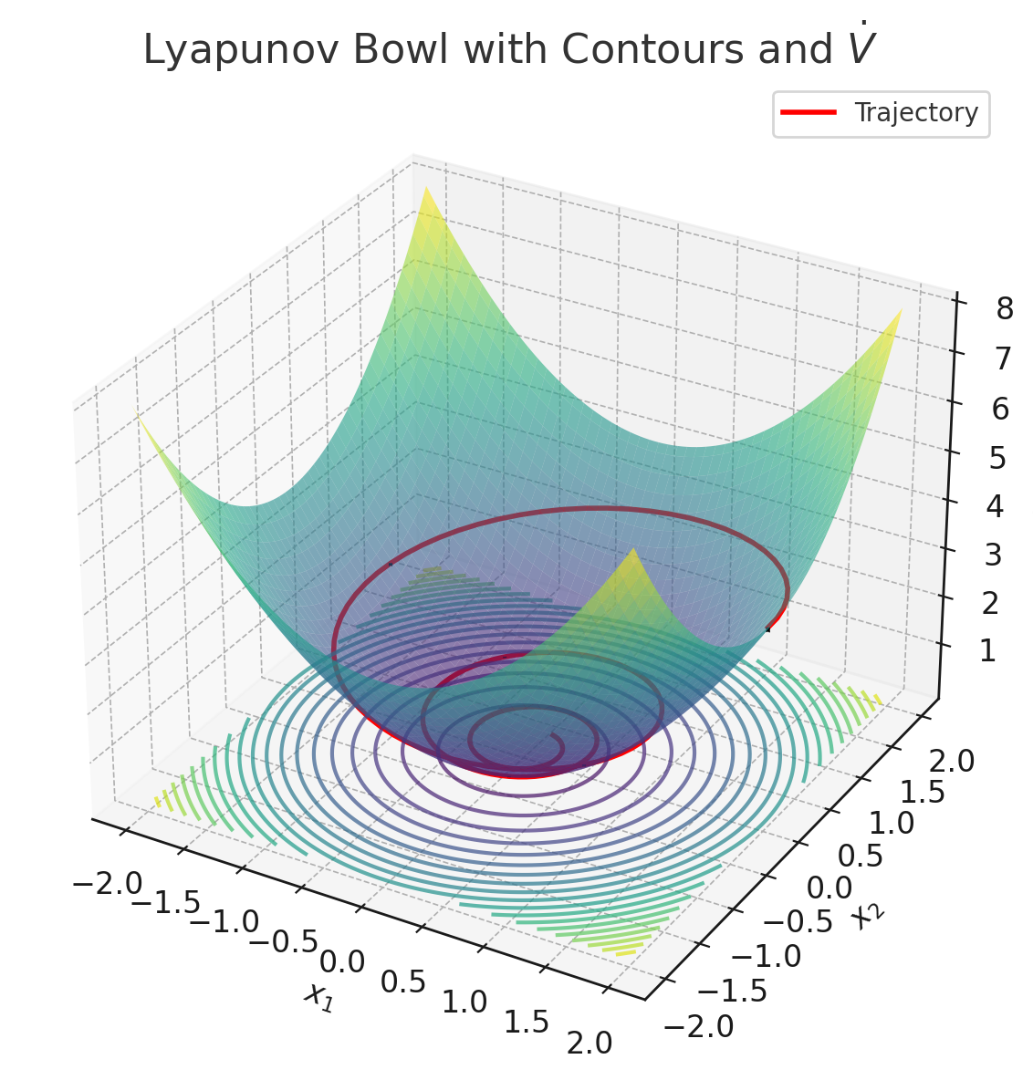
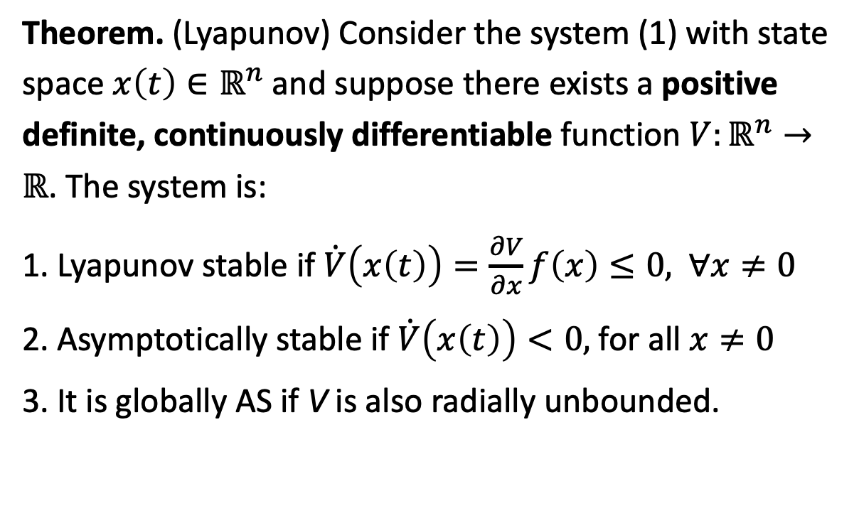

Verifying Stability
Theorem. (Lyapunov) Consider the system (1) with state space $x\left(t\right)∈ℝ^{n}$ and suppose there exists a positive definite, continuously differentiable function $V:ℝ^{n}→ℝ$. The system is:
1. Lyapunov stable if $\dot{V}\left(x\left(t\right)\right)=\frac{∂V}{∂x}f\left(x\right)≤0,$ $∀x≠0$
2. Asymptotically stable if $\dot{V}\left(x\left(t\right)\right)<0,$ for all $x≠0$
3. It is globally AS if V is also radially unbounded.
$$V\left(x_{1},x_{2}\right)=x_{1}^{2}+x_{2}^{2}$$

Slide 11
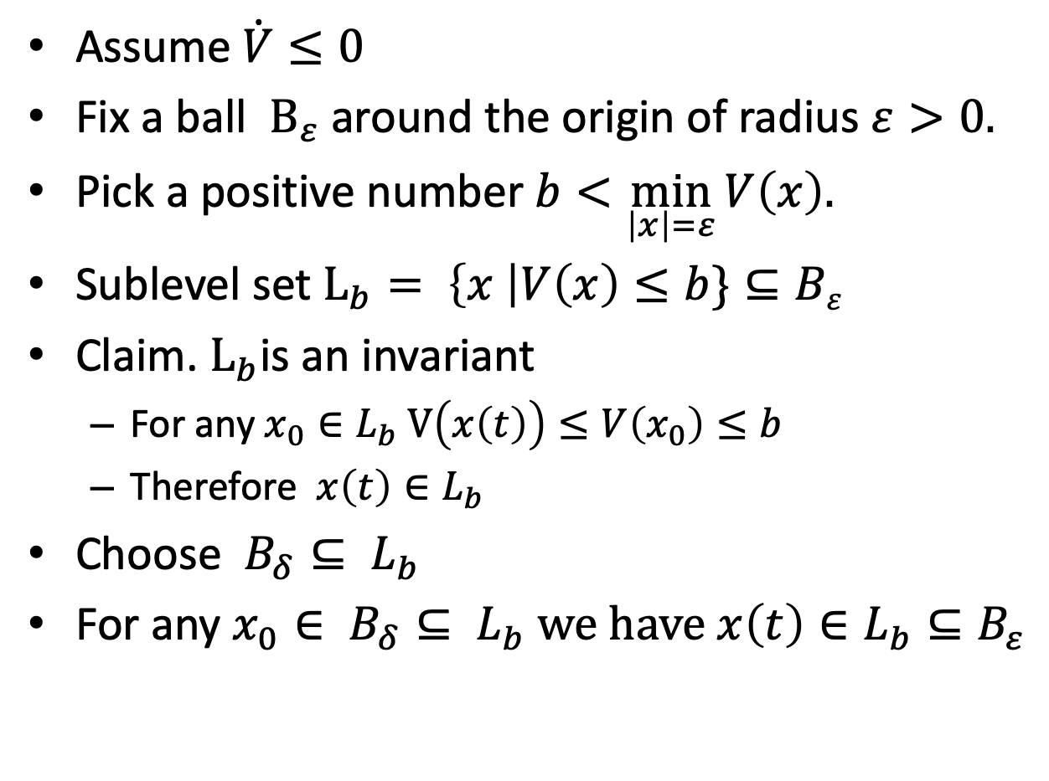




Proof : Lyapunov stable if $\dot{V}≤0$
Assume $\dot{V}≤0$
Fix a ball $B_{ε}$around the origin of radius $ε>0.$
Pick a positive number $b<\min_{\left|x\right|=ε}{V\left(x\right).}$
Sublevel set $L_{b}= \left\{x \right|V\left(x\right)≤b\}⊆Bε$
Claim. $L_{b}$is an invariant
For any $x_{0}∈L_{b}$ $V\left(x\left(t\right)\right)≤V\left(x_{0}\right)≤b$
Therefore $x\left(t\right)∈L_{b}$
Choose $B_{δ}⊆ L_{b}$
For any $x_{0}∈ B_{δ}⊆ L_{b}$ we have $x\left(t\right)∈L_{b}⊆B_{ε}$
$$B_{ε}$$
$$L_{b}$$
$$B_{δ}$$

Slide 12
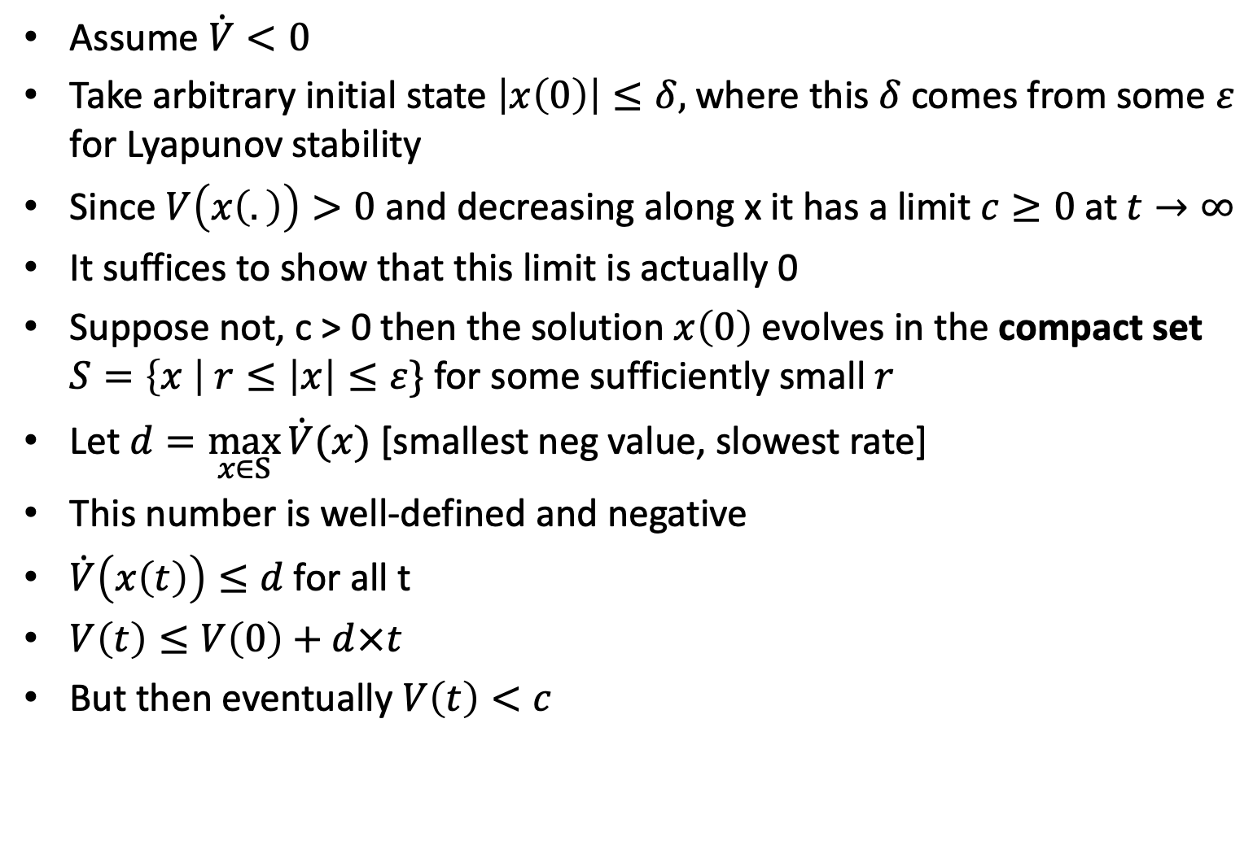




Proof sketch: Asymptotically stable if $\dot{V}\left(x\left(t\right)\right)<0$
Assume $\dot{V}<0$
Take arbitrary initial state $\left|x\left(0\right)\right|≤δ,$where this $δ$ comes from some $ε$ for Lyapunov stability
Since $V\left(x\left(.\right)\right)>0$ and decreasing along x it has a limit $c≥0$at $t→∞$
It suffices to show that this limit is actually 0
Suppose not, c > 0 then the solution $x\left(0\right)$evolves in the compact set $S=\left\{x \right| r≤\left|x\right|≤ε\}$ for some sufficiently small $r$
Let $d=\max_{x∈S}{\dot{V}(x)}$ [smallest neg value, slowest rate]
This number is well-defined and negative
$\dot{V}\left(x\left(t\right)\right)≤d$for all t
$V\left(t\right)≤V\left(0\right)+d×t$
But then eventually $V\left(t\right)<c$
$$B_{ε}$$
$$r$$
$$S$$

Slide 13
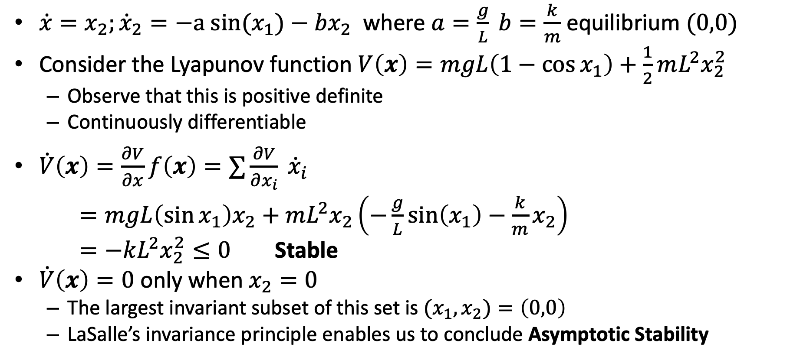
Example: Pendulum
$\dot{x}=x_{2}​;{\dot{x}}_{2}​​=−a sin⁡(x_{1}​)−bx_{2}​​$ where $a=\frac{g}{L} b=\frac{k}{m}$ equilibrium $(0,0)$
Consider the Lyapunov function $V\left(x\right)=mgL\left(1−\cos{x_{1}}\right)+\frac{1}{2}mL^{2}x_{2}^{2}$
Observe that this is positive definite
Continuously differentiable
$\dot{V}\left(x\right)=\frac{∂V}{∂x}f\left(x\right)=∑\frac{∂V}{∂x_{i}} {\dot{x}}_{i}$
$=mgL\left(\sin{x_{1}}\right)x_{2}+mL^{2}x_{2}\left(−\frac{g}{L}\sin\left(x_{1}\right)−\frac{k}{m}x_{2}\right)$
$=−kL^{2}x_{2}^{2}≤0$ Stable
$\dot{V}\left(x\right)=0$ only when $x_{2}=0$
The largest invariant subset of this set is ${(x_{1},x}_{2})=\left(0,0\right)$
LaSalle’s invariance principle enables us to conclude Asymptotic Stability

Slide 14

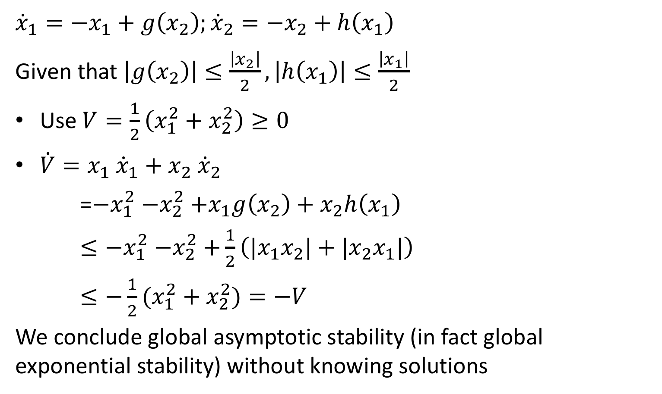


Example 2: Reasoning about stability without solving ODEs
$${\dot{x}}_{1}=−x_{1}+g(x_{2})$$
$${\dot{x}}_{1}=−x_{1}+g\left(x_{2}\right);{\dot{x}}_{2}=−x_{2}+h\left(x_{1}\right)$$
Given that $\left|g\left(x_{2}\right)\right|≤\frac{\left|x_{2}\right|}{2},\left|h\left(x_{1}\right)\right|≤\frac{\left|x_{1}\right|}{2}$
Use $V=\frac{1}{2}\left(x_{1}^{2}+x_{2}^{2}\right)≥0$
$\dot{V}=x_{1} {\dot{x}}_{1}+x_{2} {\dot{x}}_{2}$
=${−x}_{1}^{2}{−x}_{2}^{2}+x_{1}g\left(x_{2}\right)+x_{2}h\left(x_{1}\right)$
$≤{−x}_{1}^{2}{−x}_{2}^{2}+\frac{1}{2}\left({|x}_{1}x_{2}|+|x_{2}x_{1}|\right)$
$≤−{\frac{1}{2}(x}_{1}^{2}+x_{2}^{2})=−V$
We conclude global asymptotic stability (in fact global exponential stability) without knowing solutions
$${\dot{x}}_{2}=−x_{2}+h(x_{1})$$
$${\left(\left|x_{1}\right|−\left|x_{2}\right|\right)}^{2}≥0$$
$$x_{1}^{2}+x_{2}^{2}≥2\left|x_{1}x_{2}\right|$$
$$\left|x_{1}x_{2}\right|≤\frac{1}{2}(x_{1}^{2}+x_{2}^{2})$$

Slide 15
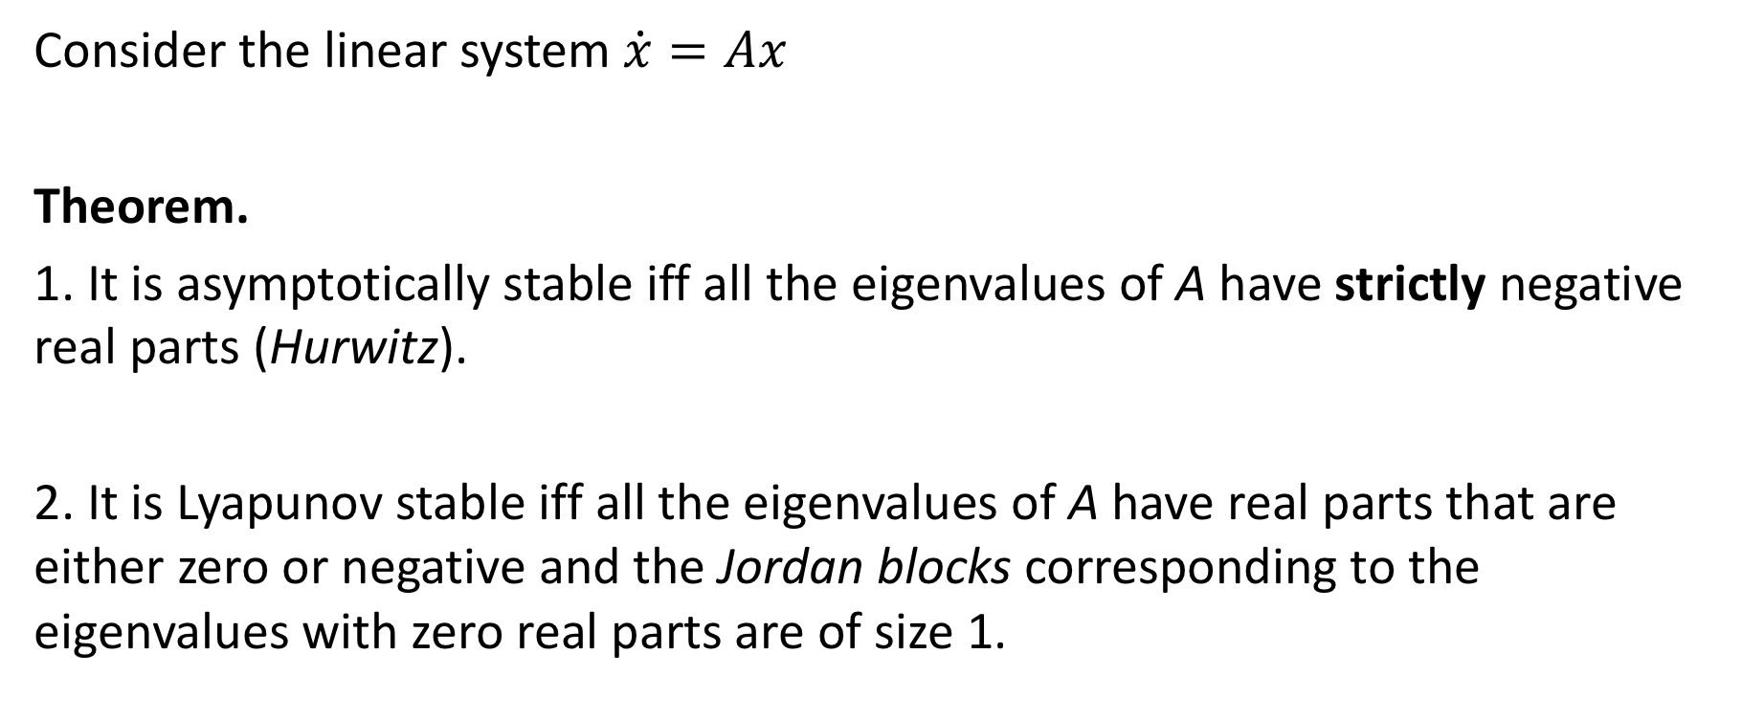
Verifying Stability for Linear Systems
Consider the linear system $\dot{x}=Ax$
Theorem.
1. It is asymptotically stable iff all the eigenvalues of A have strictly negative real parts (Hurwitz).
2. It is Lyapunov stable iff all the eigenvalues of A have real parts that are either zero or negative and the Jordan blocks corresponding to the eigenvalues with zero real parts are of size 1.

Slide 16
Jordan decomposition
For every n x n matrix A, there exists a nonsingular n x n matrix P such that
where each $J_{i}$ is a upper triangular matrix called a Jordan block

Slide 17
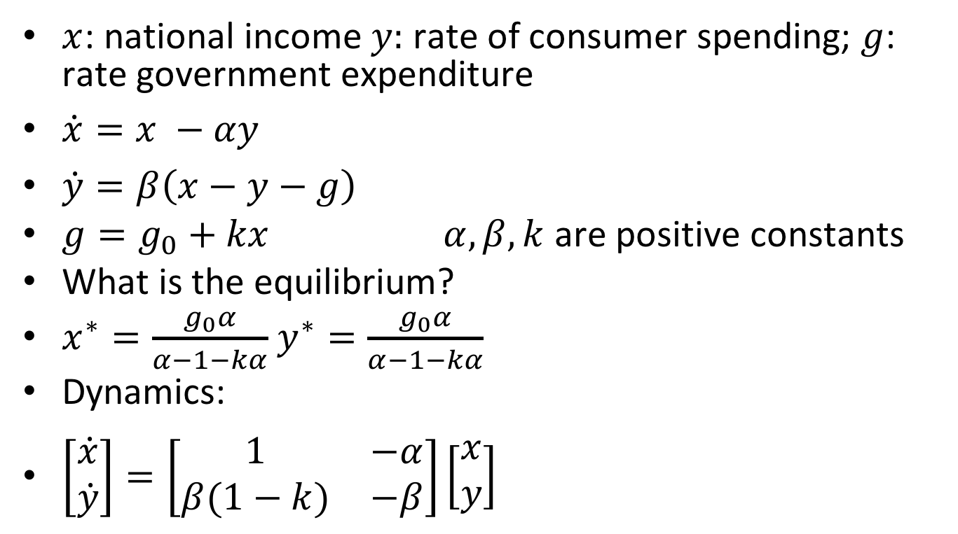
Example 1: Simple model of an economy
$x$: national income $y:$ rate of consumer spending; $g$: rate government expenditure
$\dot{x}=x −αy$
$\dot{y}=β\left(x−y−g\right)$
$g=g_{0}+kx$ $α, β, k$ are positive constants
What is the equilibrium?
$x^{∗}=\frac{g_{0}α}{α−1−kα}$ $y^{∗}=\frac{g_{0}α}{α−1−kα}$
Dynamics:
$\left[\begin{matrix}\dot{x} \\ \dot{y}\end{matrix}\right]=\left[\begin{matrix}1 & −α \\ β(1−k) & −β\end{matrix}\right]\left[\begin{matrix}x \\ y\end{matrix}\right]$

Slide 18
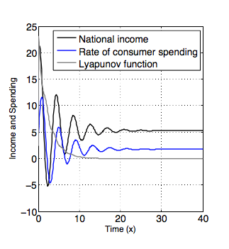
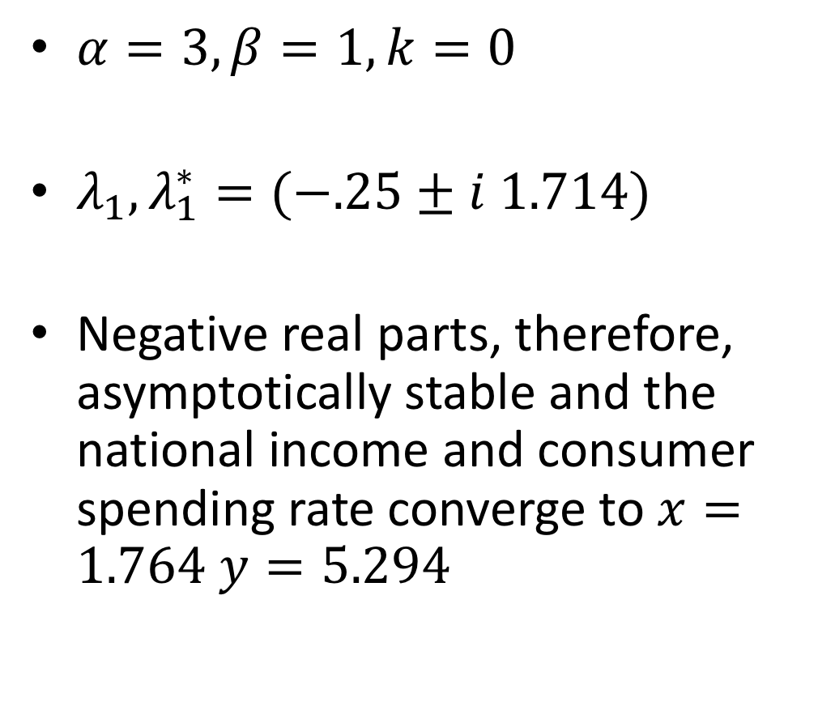
Example: Simple linear model of an economy
$α=3, β=1, k=0$
$λ_{1},λ_{1}^{∗}=(−.25±i 1.714)$
Negative real parts, therefore, asymptotically stable and the national income and consumer spending rate converge to $x=1.764$ $y=5.294$

Slide 19
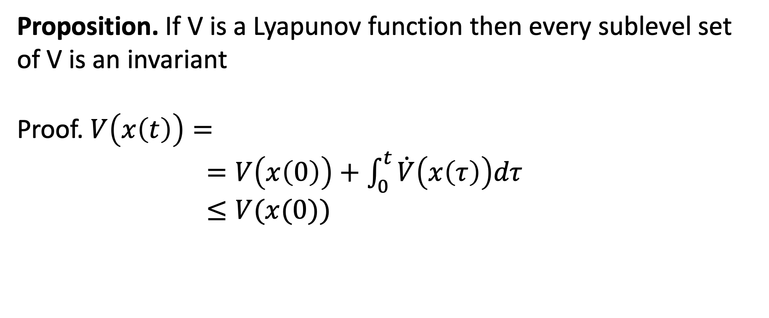
Proposition. If V is a Lyapunov function then every sublevel set of V is an invariant
Proof. $V\left(x\left(t\right)\right)=$
$=V\left(x\left(0\right)\right)+\int_{0}^{t}{\dot{V}\left(x\left(τ\right)\right)dτ}$
$≤V(x(0))$

Slide 20
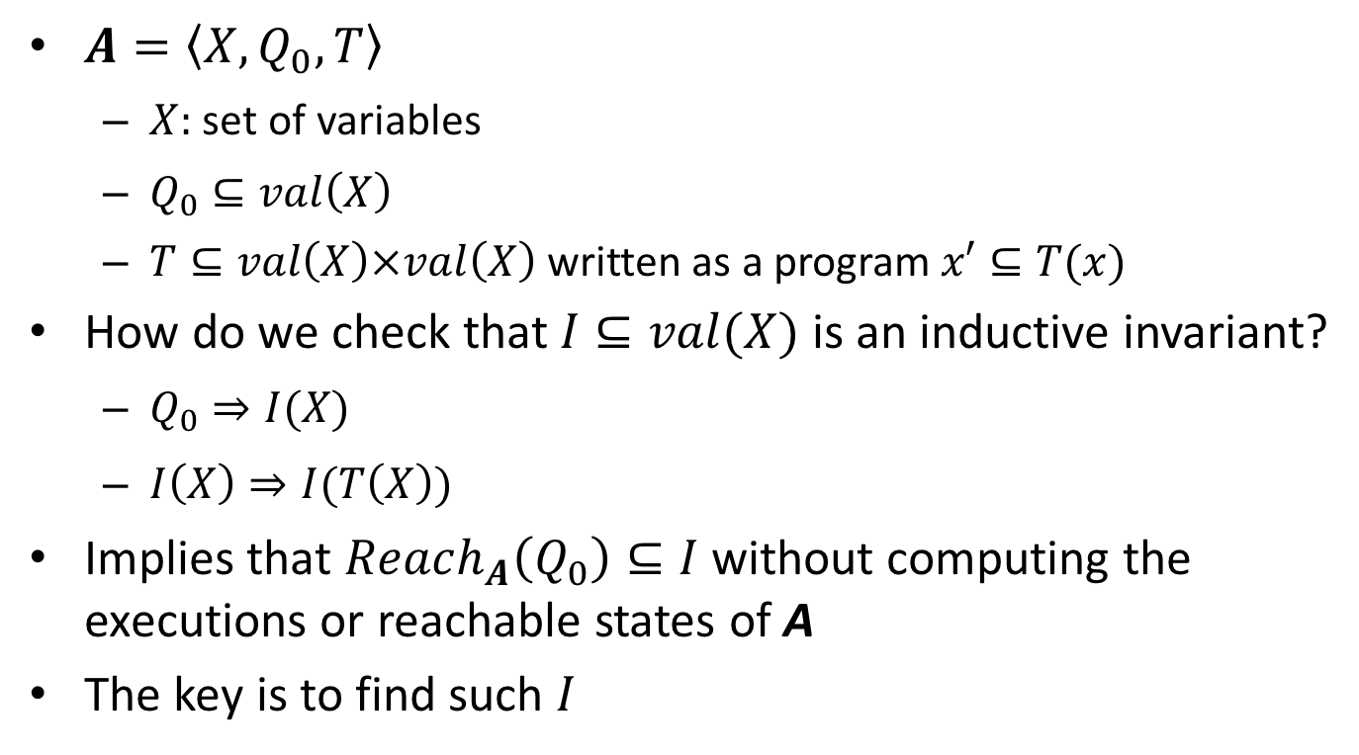
An aside: Checking inductive invariants
$A=\left\langle X,Q_{0},T\right\rangle$
$X:$ set of variables
$Q_{0}⊆val\left(X\right)$
$T⊆val\left(X\right)×val\left(X\right)$ written as a program $x′⊆T(x)$
How do we check that $I⊆val(X)$ is an inductive invariant?
$Q_{0}⇒I(X)$
$I\left(X\right)⇒I(T\left(X\right))$
Implies that $Reach_{A}\left(Q_{0}\right)⊆I$without computing the executions or reachable states of A
The key is to find such $I$

Slide 21
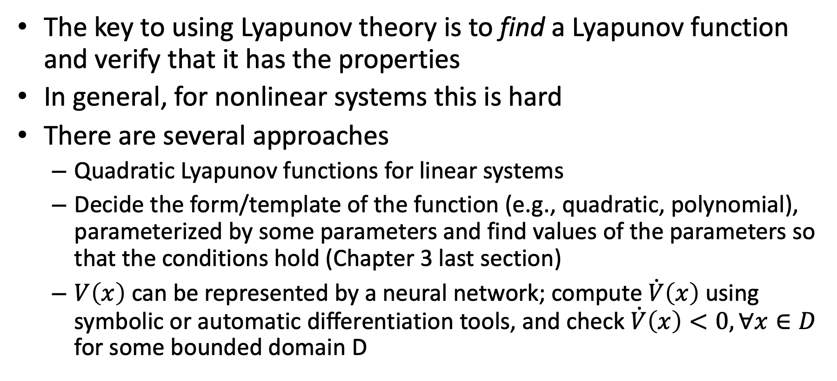
Finding Lyapunov Functions
The key to using Lyapunov theory is to find a Lyapunov function and verify that it has the properties
In general, for nonlinear systems this is hard
There are several approaches
Quadratic Lyapunov functions for linear systems
Decide the form/template of the function (e.g., quadratic, polynomial), parameterized by some parameters and find values of the parameters so that the conditions hold (Chapter 3 last section)
$V\left(x\right)$ can be represented by a neural network; compute $\dot{V}\left(x\right)$ using symbolic or automatic differentiation tools, and check $\dot{V}\left(x\right)<0, ∀x∈D$ for some bounded domain D

Slide 22
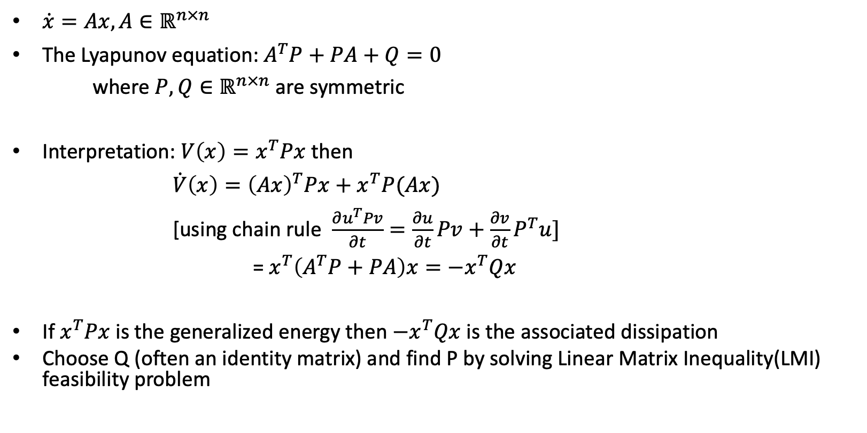
Linear autonomous systems
$\dot{x}=Ax, A∈ℝ^{n×n}$
The Lyapunov equation: $A^{T}P+PA+Q=0$
where $P,Q∈ℝ^{n×n}$ are symmetric
Interpretation: $V\left(x\right)=x^{T}Px$ then
$\dot{V}\left(x\right)={\left(Ax\right)}^{T}Px+x^{T}P(Ax)$
[using chain rule $\frac{∂u^{T}Pv}{∂t}=\frac{∂u}{∂t}Pv+\frac{∂v}{∂t}P^{T}u]$
=${ x}^{T}\left(A^{T}P+PA\right)x=−x^{T}Qx$
If $x^{T}Px$ is the generalized energy then $−x^{T}Qx$ is the associated dissipation
Choose Q (often an identity matrix) and find P by solving Linear Matrix Inequality(LMI) feasibility problem

Slide 23
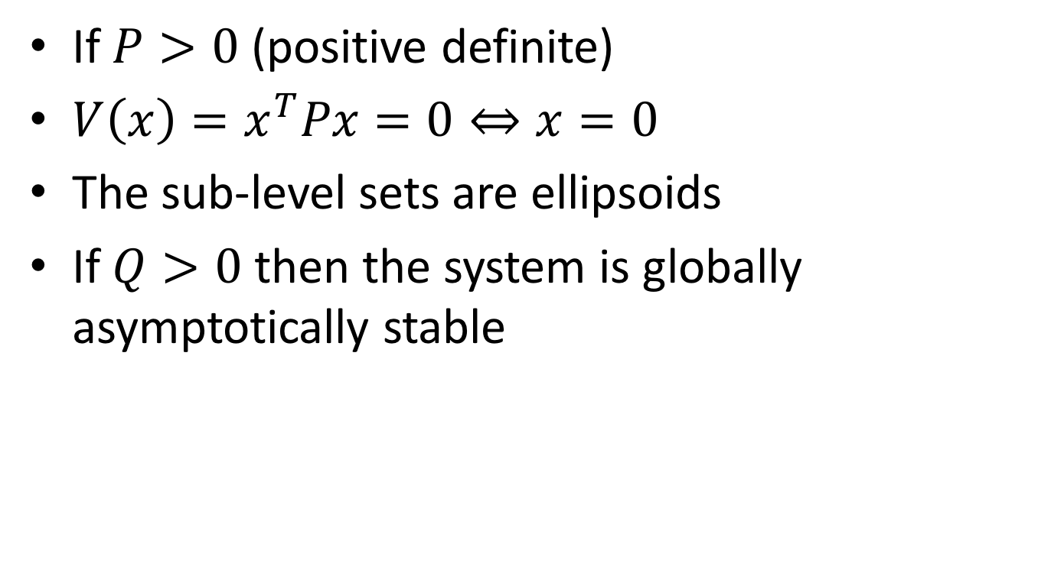
Quadratic Lyapunov Functions
If $P>0$ (positive definite)
$V\left(x\right)=x^{T}Px=0⇔x=0$
The sub-level sets are ellipsoids
If $Q>0$ then the system is globally asymptotically stable

Slide 24
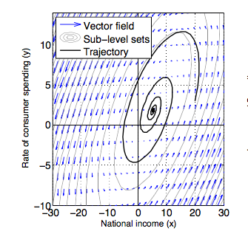
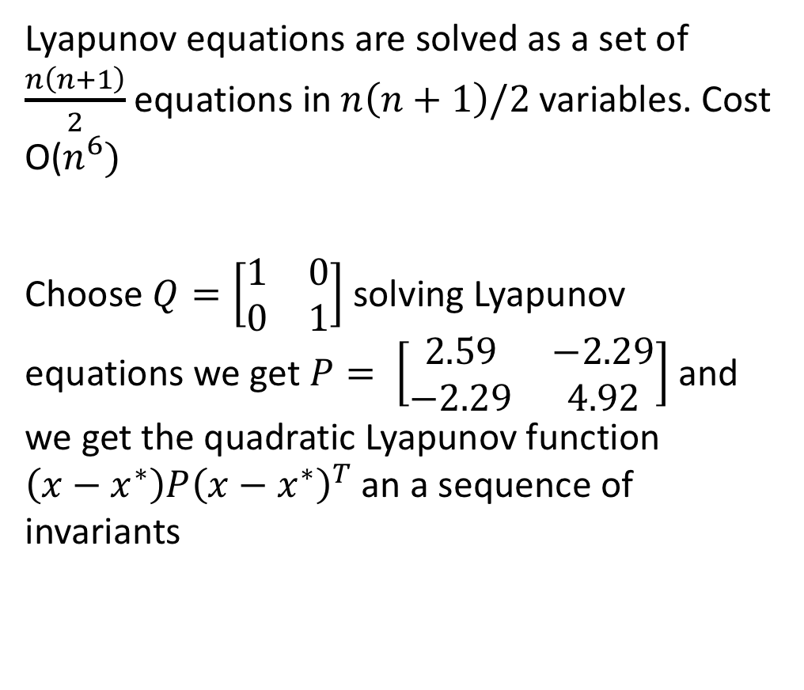
Same example
Lyapunov equations are solved as a set of $\frac{n\left(n+1\right)}{2}$ equations in $n\left(n+1\right)/2$ variables. Cost O($n^{6})$
Choose $Q=\left[\begin{matrix}1 & 0 \\ 0 & 1\end{matrix}\right]$ solving Lyapunov equations we get $P= \left[\begin{matrix}2.59 & −2.29 \\ −2.29 & 4.92\end{matrix}\right]$ and we get the quadratic Lyapunov function $\left(x−x^{∗}\right)P{\left(x−x^{∗}\right)}^{T}$ an a sequence of invariants

Slide 25
Summary
Key requirements for dynamical systems: stability, asymptotic stability
For linear systems, Hurwitz conditions or LMIs for verifying stability
For nonlinear systems, Lyapunov functions provide a general method and certificate for proving stability
Checking Lyapunov conditions does not involve finding solutions of the system
Finding Lyapunov functions involves solving optimization problems

