Slide 1
Capturing data from Pulse Heart Rate Sensor using Hyperterminal

Slide 2
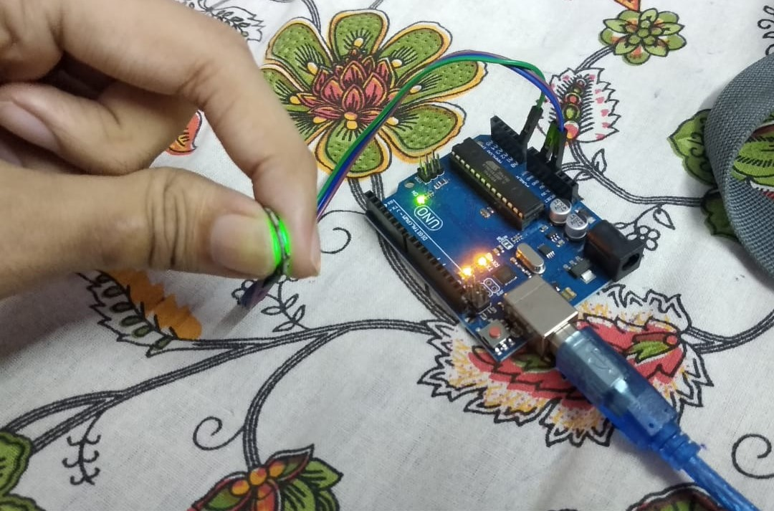
Connect the Sensor to Arduino and hold it as shown. “+” wire of sensor connected to 3.3 V, “-” wire connected to “GND” and the third wire is used for sending data, and here it’s connected to pin A0 :

Slide 3
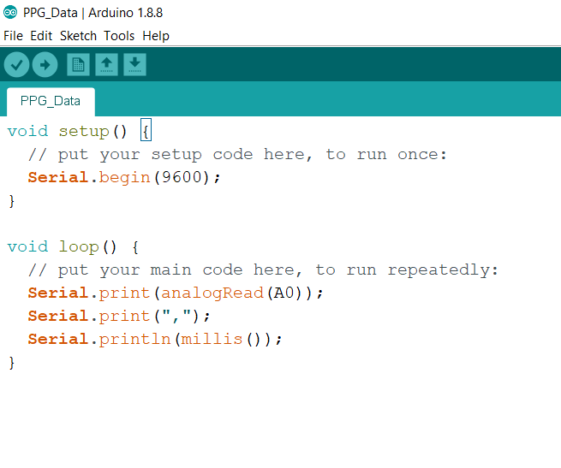
Upload the Arduino Code as given below:

Slide 4
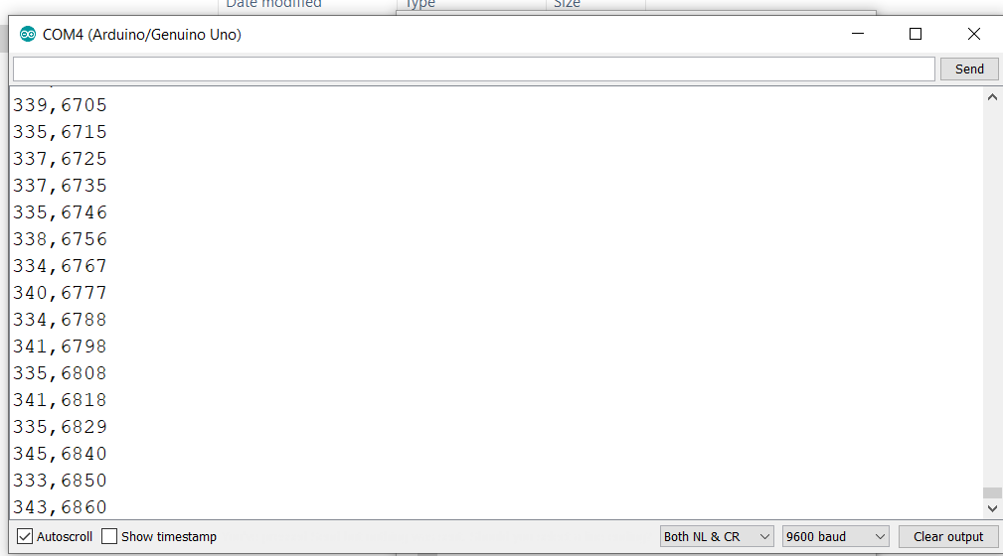
Open the Serial Monitor to check if data is being transmitted:

Slide 5
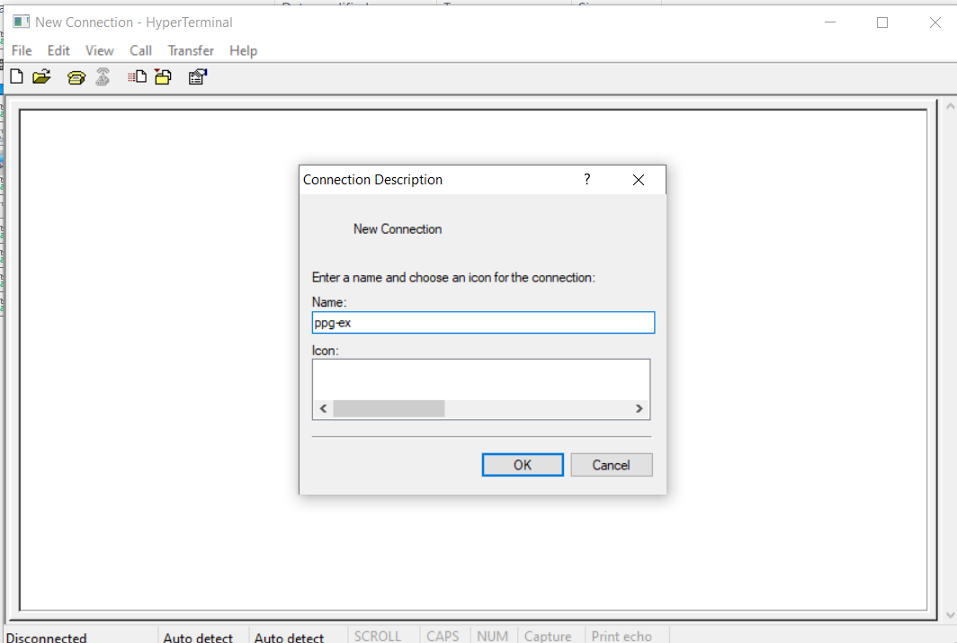
Open Hyperterminal Application, from the Hyperterminal zip file. You’ll get the below dialog box. Enter some name and press OK:

Slide 6
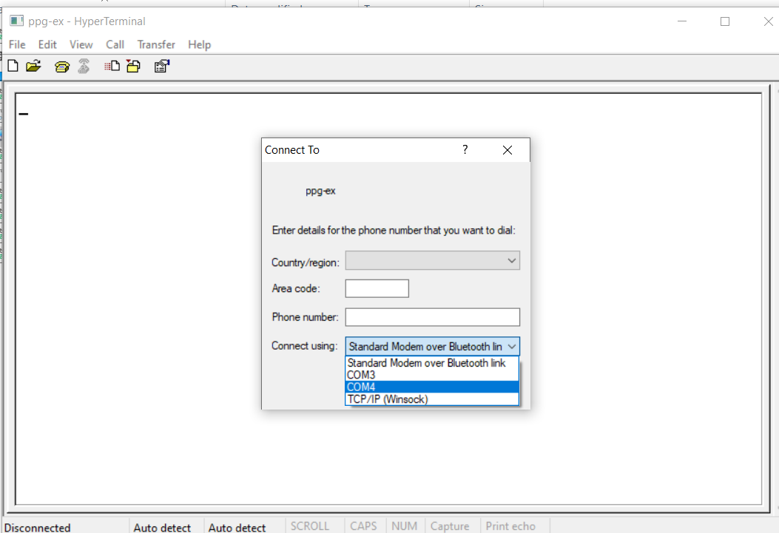
Select the option as shown below from the next dialog box (Select your Arduino port, that is):

Slide 7
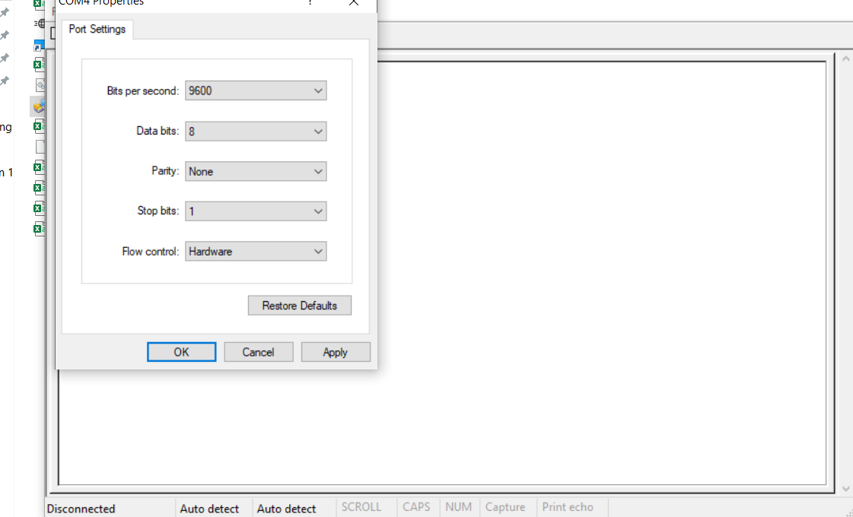
Set Baud Rate as 9600, as is needed for Arduino:

Slide 8
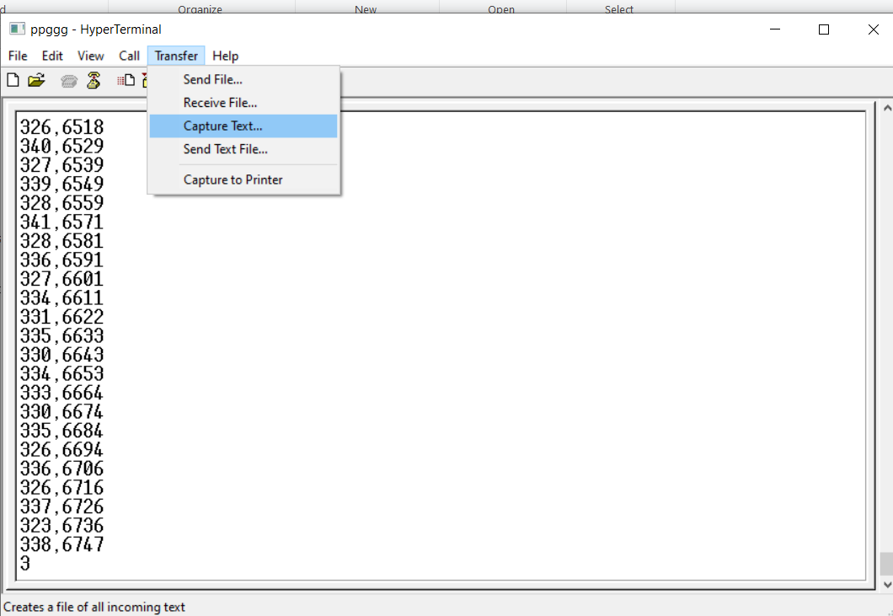
The screen below is expected to appear. Click on Transfer and select Capture Text:

Slide 9
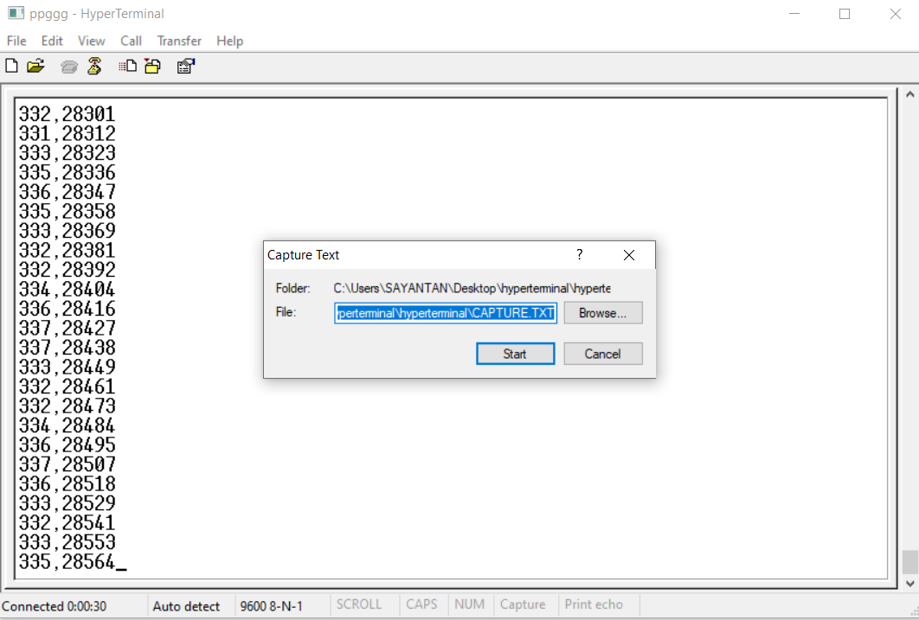
Select location where you want to save, and save it as a “.csv” file:

Slide 10
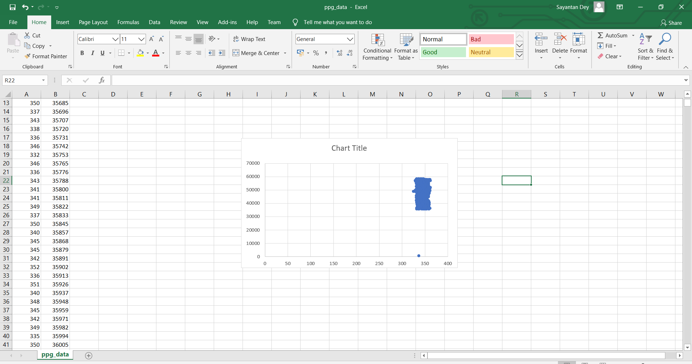
You can open the file and view the data in excel. A scatter plot has also been show. The data is in a certain range mostly. The left column represents the data from sensor, the right column represents the time in milliseconds.:

