Slide 1
A Neural Oscillator for Position Controlled Joints
Sayantan Auddy

Slide 2
Motivation
Legged robots can go places wheeled robots cannot
Efficiency of human movement
Stable bipedal motion – difficult to achieve
ZMP based approaches do not utilize dynamics of the robot
Alternative bio-inspired approach
Notes:
Video of baby taking first steps.
https://www.youtube.com/watch?v=1H_XqO5OwWM
https://www.youtube.com/watch?v=jOIgR4o9Iu8
https://www.youtube.com/watch?v=jIzuy9fcf1k
Why are walking robots useful
How do humans and other animals walk
The neural circuitry for rhythmic motion is already present
Practice needed for balancing and fine tuning walk

Slide 3
Outline

Slide 4
Bipedal Walking Approaches
ZMP
LIP
Passive Walkers
Neural Controllers and RL
Central Pattern Generators
Notes:
Current state of the art in bipedal walking
ZMP
LIP
Passive walkers
CPGs
Utilize dynamics

Slide 5
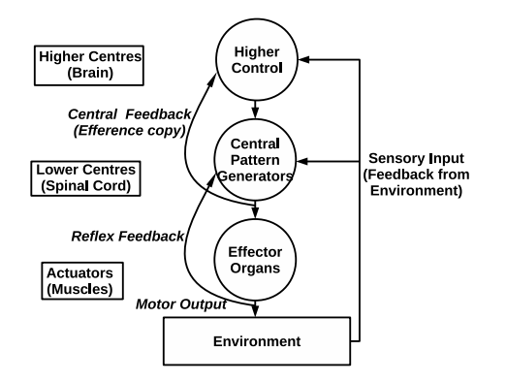
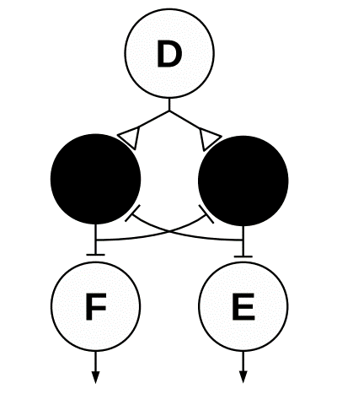
Biological Background
Neural Circuits (Central Pattern Generators) exist in the spinal cord
Produce rhythmic patterns without rhythmic input
Half-center model
Neural components of motor systems

Slide 6
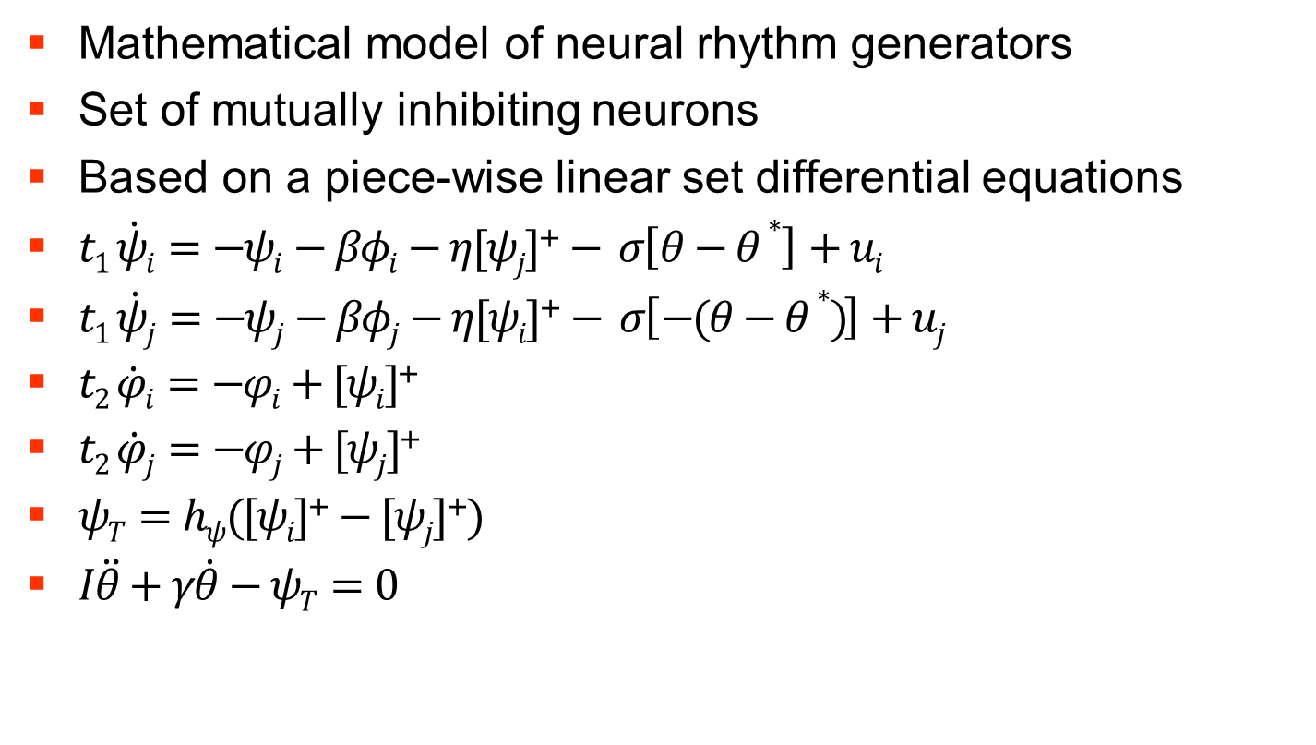
Matsuoka Oscillator
Mathematical model of neural rhythm generators
Set of mutually inhibiting neurons
Based on a piece-wise linear set differential equations
$t1 \dot{ψi}=−ψi−βφi−η[ψj]\text{+}− σ\left[θ−θ∗ \right]+ui$
$t1 \dot{ψj}=−ψj−βφj−η[ψi]\text{+}− σ\left[−(θ−θ∗ )\right]+uj$
$t2 \dot{φi}=−φi+[ψi]$⁺
$t2 \dot{φj}=−φj+[ψj]$⁺
$ψT=hψ([ψi]\text{+}−[ψj]\text{+})$
$I\ddot{θ}+γ\dot{θ}−ψT=0$

Slide 7
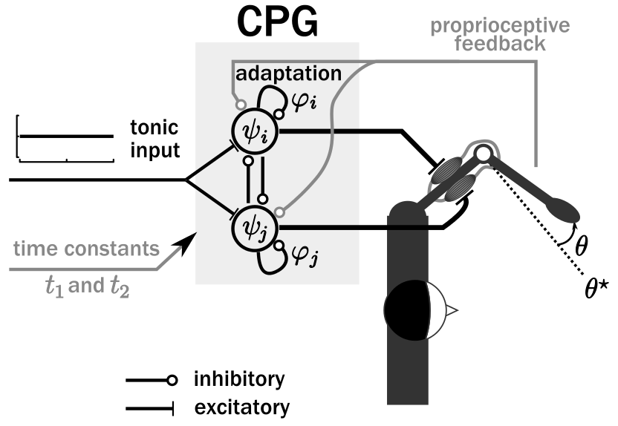

Slide 8
Pattern Modulation

Slide 9
Coupling of oscillators

Slide 10
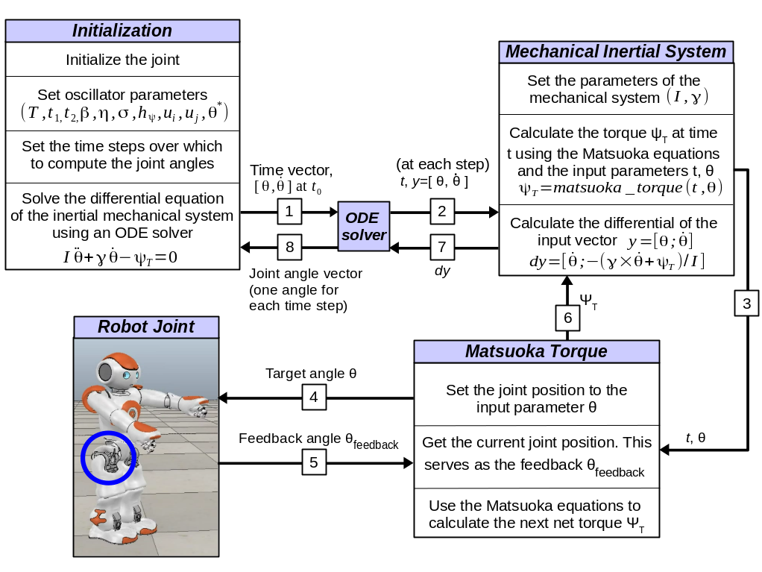
Robot Joint Control

Slide 11
Joint Control Demonstration

Slide 12
Joint Control Demonstration

Slide 13
Conclusion
Novelty and contribution of this work:
Sum up the approach
Sum op the results
...
Show that it solves the question
Open Questions:
Something
... is always missing

Slide 14
Future Work

Slide 15
Future Work

Slide 16
Future Work

Slide 17
The End
Thank you for your attention.
Any questions?
Literature:
Author , Author , Author, and Author. Name of the conference paper. In: Proceedings of the Conference Name, 2008
Author, Author, and Author. Name of the Article. Name of the Journal, 42:111-133, 2010
Author, and Author. Name of the Book. Publisher, 2009

