Slide 1
A Neural Oscillator for Position Controlled Joints
Sayantan Auddy

Slide 2
Motivation
Legged robots can go places wheeled robots cannot
Efficiency of human movement
Stable bipedal motion – difficult to achieve
ZMP based approaches do not utilize dynamics of the robot
Alternative bio-inspired approach
Talk a bit about alternative approaches
CPGs in position controlled robots
Notes:
Video of baby taking first steps.
https://www.youtube.com/watch?v=1H_XqO5OwWM
https://www.youtube.com/watch?v=jOIgR4o9Iu8
https://www.youtube.com/watch?v=jIzuy9fcf1k
Why are walking robots useful
How do humans and other animals walk
The neural circuitry for rhythmic motion is already present
Practice needed for balancing and fine tuning walk

Slide 3
Outline

Slide 4
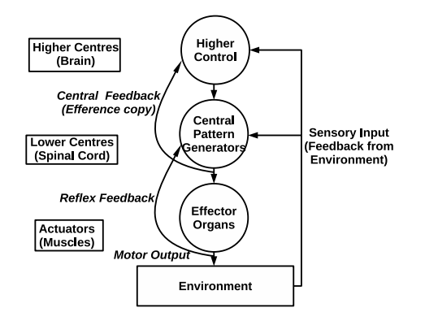
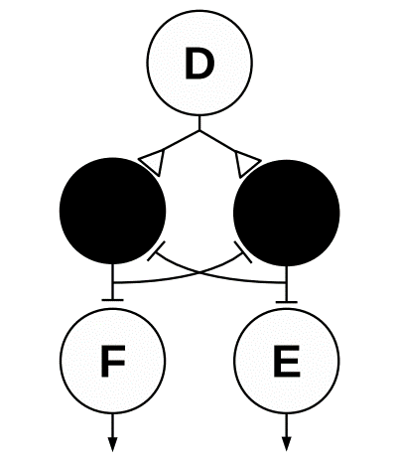
Biological Background
Neural Circuits (CPGs) exist in the spinal cord
Rhythmic patterns produced without rhythmic input
Sensory feedback used for modulation of the patterns
Half-center model
Neural components of motor systems

Slide 5
Benefits of CPGs
Stable limit cycle behavior
CPGs handle low level motor commands, higher controllers can focus on important tasks such as maintaining balance
Sensory feedback can be easily integrated
Can utilize the dynamics of the mechanical system

Slide 6
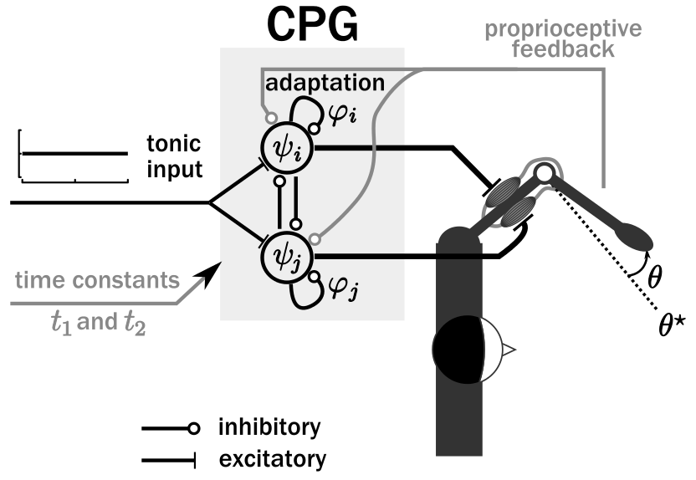
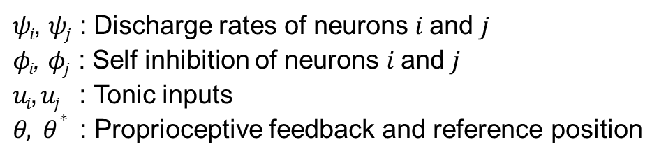



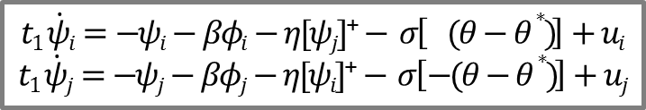

Matsuoka Oscillator
Mathematical model of neural rhythm generators
Based on a piece-wise linear set differential equations
$$t1 \dot{ψi}=−ψi−βφi−η[ψj]\text{+}− σ\left[ (θ−θ∗ )\right]+ui$$
$$t1 \dot{ψj}=−ψj−βφj−η[ψi]\text{+}− σ\left[−(θ−θ∗ )\right]+uj$$
$t2 \dot{φi}=−φi+[ψi]$⁺
$t2 \dot{φj}=−φj+[ψj]$⁺
$$ψT=hψ([ψi]\text{+}−[ψj]\text{+})$$
$$I\ddot{θ}+γ\dot{θ}−ψT=0$$
$ψi$, $ψj$ : Discharge rates of neurons $i$ and $j$
$φi$, $φj$ : Self inhibition of neurons $i$ and $j$
$ui$, $uj$ : Tonic inputs
$θ, θ∗$ : Proprioceptive feedback and reference position
$$\left[∙\right]\text{+}=max(0,∙)$$
Notes:
Mathematical model of neural rhythm generators
Set of mutually inhibiting neurons
Based on a piece-wise linear set differential equations

Slide 7



Pattern Modulation
Joint torques
Joint angles
-- joint angle
-- reference position
Reference angle $θ^{∗}$ varied
(0 to 1 to -1 radians)
Tonic inputs $u_{i},u_{j }$varied from 1.0 to 4.0
Time constant $t_{1}$varied (0.3 to 0.6 to 0.9s)

Slide 8
Coupling of oscillators
Two joints can be coupled at the level of: Mention pros & cons
Input variables
Internal state variables
Output variables
Modified coupled equations

Slide 9
In-phase / anti-phase oscillations
Diagram of in-phase
Diagram of anti-phase
Diagram of basins of attraction
Consequences

Slide 10
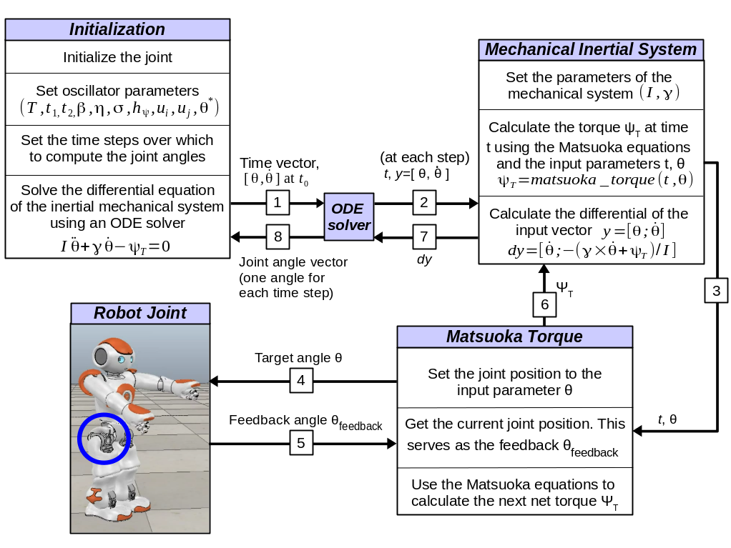
Robot Joint Control

Slide 11
Joint Control Demonstration

Slide 12
Conclusion
Novelty and contribution of this work:
Sum up the approach
Sum op the results
...
Show that it solves the question
Open Questions:
Something
... is always missing

Slide 13
Future Work

Slide 14
The End
Thank you for your attention.
Any questions?
Literature:
Author , Author , Author, and Author. Name of the conference paper. In: Proceedings of the Conference Name, 2008
Author, Author, and Author. Name of the Article. Name of the Journal, 42:111-133, 2010
Author, and Author. Name of the Book. Publisher, 2009

