Slide 1
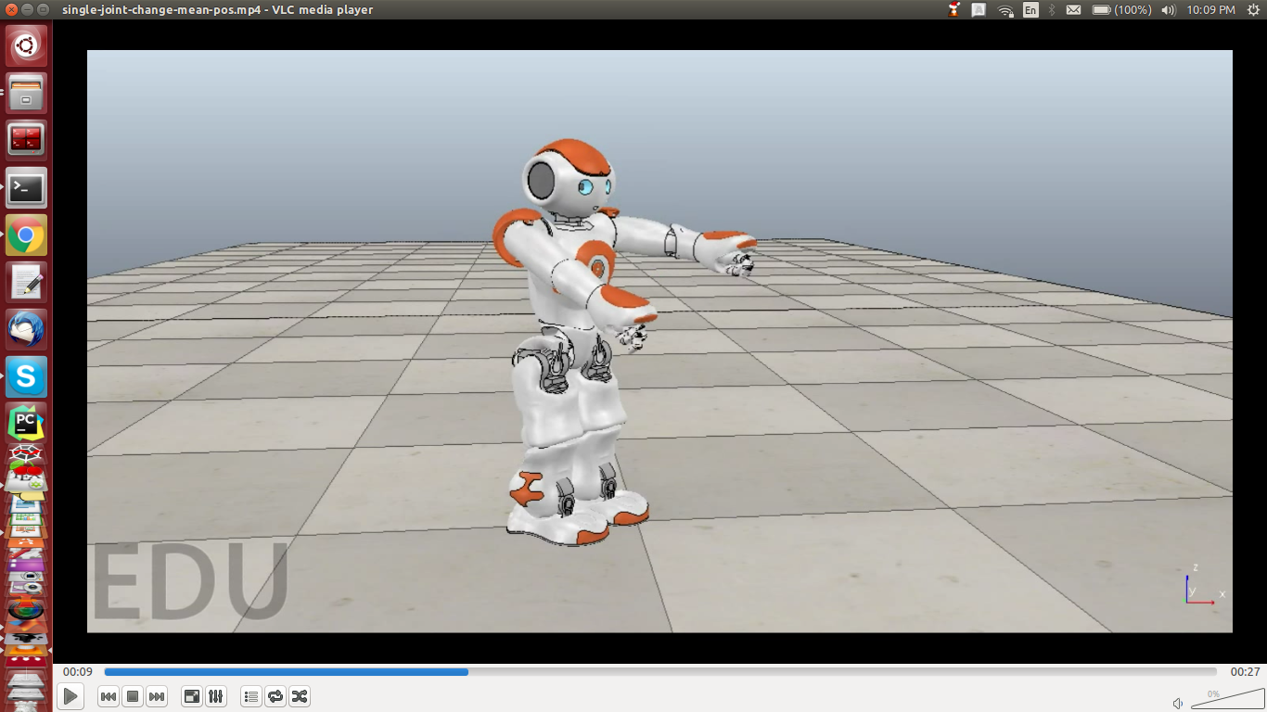
Initialization
Initialize the joint
Set oscillator parameters
Set the time steps over which
to compute the joint angles
Solve the differential equation
of the inertial mechanical system
using an ODE solver
Mechanical Inertial System
Set the parameters of the
mechanical system
Calculate the torque ψ_{T} at time
t using the Matsuoka equations
and the input parameters t, θ
Calculate the differential of the
input vector
Time vector,
(at each step)
t, y=[ θ, θ ]
.
ODE
solver
Joint angle
vector (one
angle for
each time step)
dy
Ψ_{T}
Robot Joint
Matsuoka Torque
Set the joint position to the
input parameter θ
Get the current joint position. This
serves as the feedback θ_{feedback}
Use the Matsuoka equations to
calculate the next net torque Ψ_{T}
Target angle θ
Feedback angle θ_{feedback}
t, θ

