Slide 1



Trip_card_cash_BI_report
View in Power BI
Last data refresh:
30-09-2022 05:42:10 UTC
Downloaded at:
30-09-2022 05:44:32 UTC

Slide 2
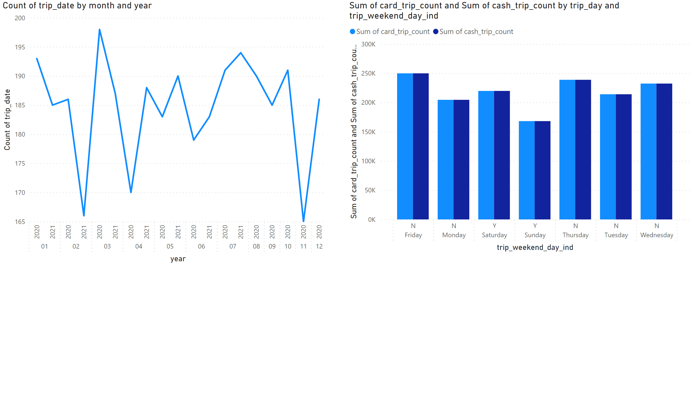
Página 1
Notes:
lineChart
No alt text provided
clusteredColumnChart
No alt text provided

