Slide 1
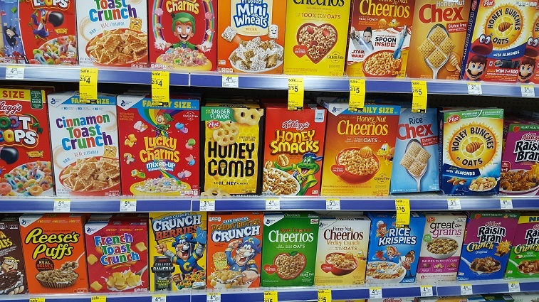
Data Exploratory Project
Prepared By: Sayantan Chakraborty
Mentor: Dr. Vinod

Slide 2
We have to prepare 10 questions around calories and create a model based on the observations and find meaningful insights from the cereal dataset.
So let’s begin !

Slide 3
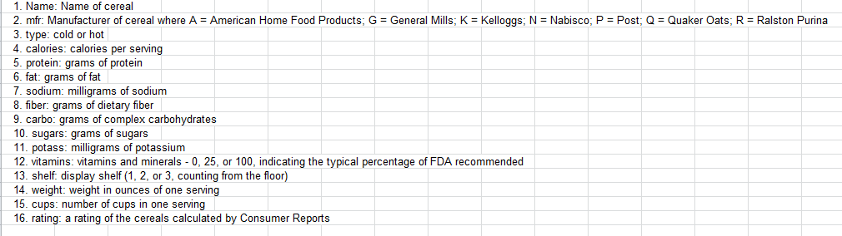
The cereal dataset with its nutritional breakup is as follows:
It has No of Observations as: 77
And No of Variables:16

Slide 4
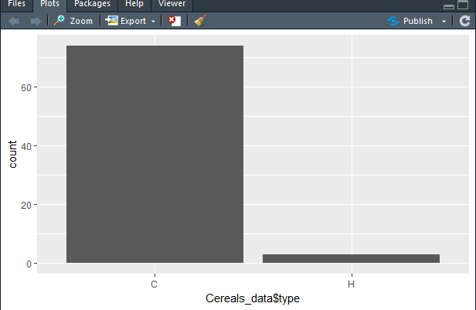
How many cereals are present in each type?
>ggplot(data.frame(Cereals_data), aes(x=Cereals_data$type)) + geom_bar()

Slide 5
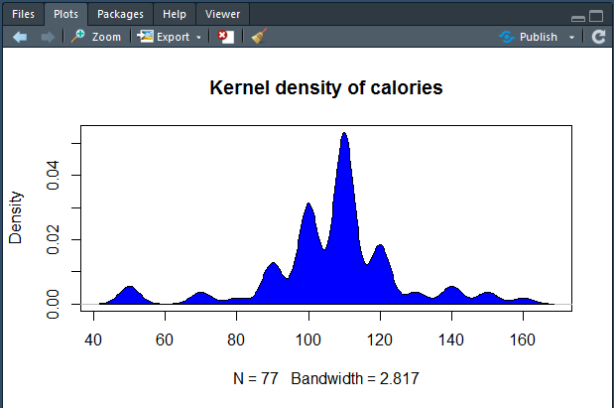
2. How Calories are distributed?
>d <- density(Cereals_data$calories)
>plot(d,main = "Kernel density of calories")
>polygon(d,col = "blue",border = "black")

Slide 6
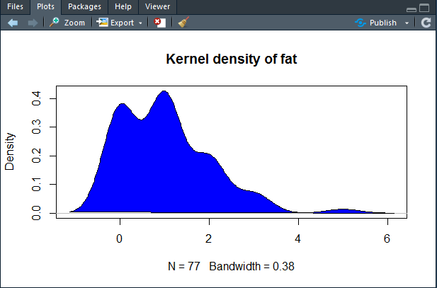
3. How fat is distributed?
>d1 <- density(Cereals_data$fat)
>plot(d1,main = "Kernel density of fat")
>polygon(d1,col = "blue",border = "black")

Slide 7
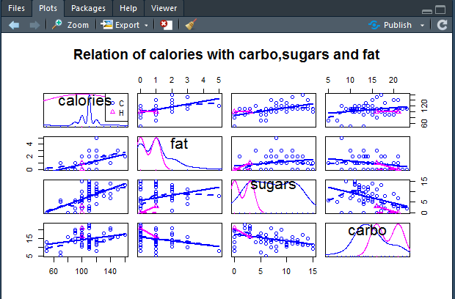
4. How calories are related to fat,sugars and carbohydrates?
>scatterplotMatrix(~calories+fat+sugars+carbo|type,data = Cereals_data,main = "Relation of calories with carbo,sugars and fat")

Slide 8
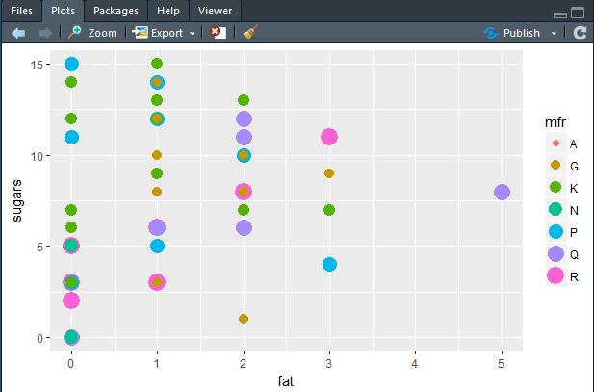
5. Which manufacturer has least amount of fat and sugar contents so that we can find out the healthiest among them?
>ggplot(data = Cereals_data)+geom_point(mapping = aes(x = fat,y = sugars,color = mfr,size = mfr))
A- American Home food products
G- General mills
K- kellogs
N- Nabisco
P- Post
Q- Quaker Oats
R- Ralston Purina

Slide 9
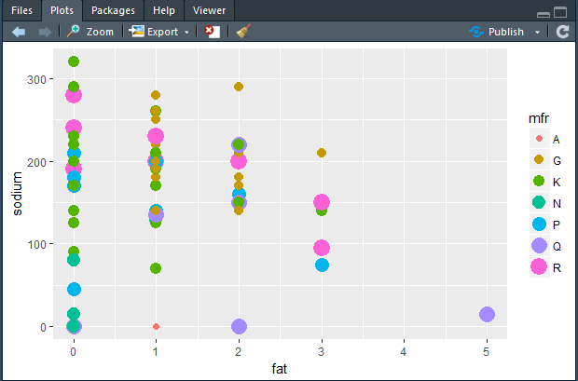
6. Manufacturers with least amount of fat and sodium?
>ggplot(data = Cereals_data)+geom_point(mapping = aes(x = fat,y = sodium,color = mfr,size = mfr))
A- American Home food products
G- General mills
K- kellogs
N- Nabisco
P- Post
Q- Quaker Oats
R- Ralston Purina

Slide 10
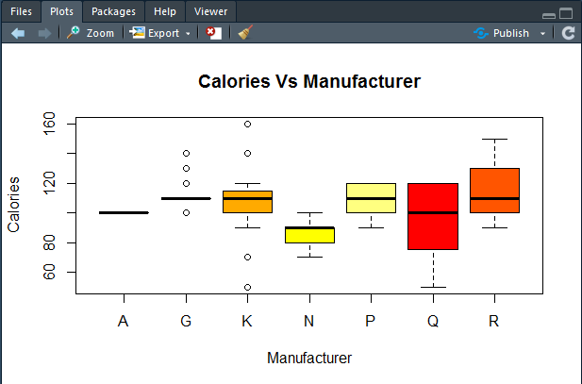
7. Which manufacturer sells cereals with high calories?
>Cereals_data$mfr = as.factor(Cereals_data$mfr)
>boxplot(calories~mfr,data = Cereals_data,main = "Calories Vs Manufacturer",xlab = "Manufacturer",ylab = "Calories",col = heat.colors(5))
A- American Home food products
G- General mills
K- kellogs
N- Nabisco
P- Post
Q- Quaker Oats
R- Ralston Purina

Slide 11
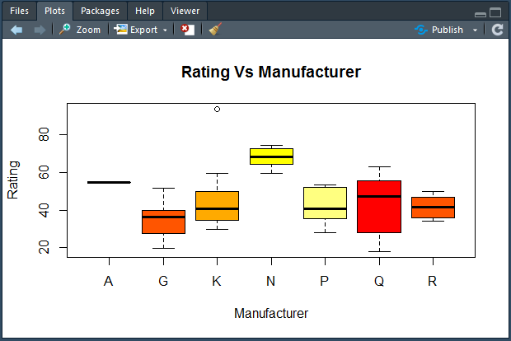
8. Which manufacturer sells cereals with highest rating?
>boxplot(rating~mfr,data = Cereals_data,main = "Rating Vs Manufacturer",xlab = "Manufacturer",ylab = "Rating",col = heat.colors(5))
A- American Home food products
G- General mills
K- kellogs
N- Nabisco
P- Post
Q- Quaker Oats
R- Ralston Purina

Slide 12
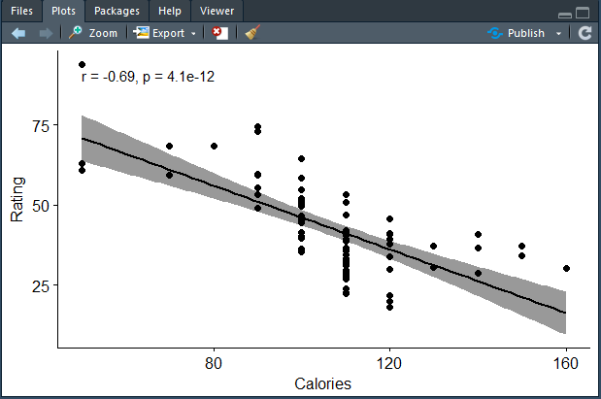
9. What relation rating has with calories?
>ggscatter(Cereals_data,x = "calories",y = "rating",add = "reg.line",conf.int = TRUE,cor.coef = TRUE,cor.method = "pearson",xlab = "Calories",ylab = "Rating")

Slide 13
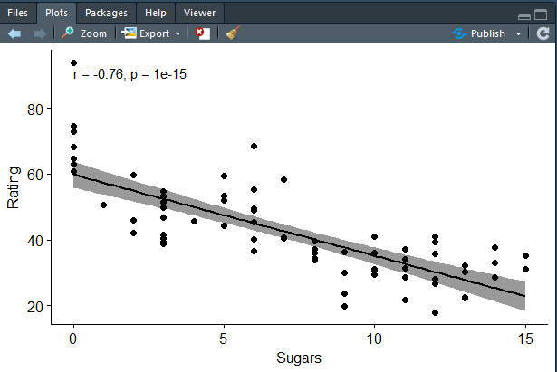
10. What relation sugar has with rating?
>ggscatter(Cereals_data,x = "sugars",y = "rating",add = "reg.line",conf.int = TRUE,cor.coef = TRUE,cor.method = "pearson",xlab = "Sugars",ylab = "Rating")

Slide 14


